Slide 1
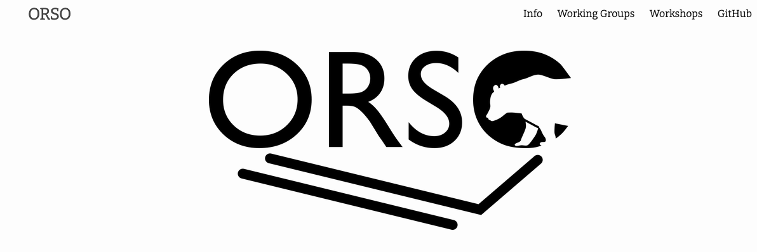
Open Reflectivity Standards Organisation
www.reflectometry.org
What is the problem with reflectometry?
inconsistent data formats & data reduction processes
incompatible & single point of failure analysis packages
inconsistency between x-rays vs neutrons
This creates real problems for open access data, reproducibility and making the most of future developments such as A.I.
ORSO formed in an effort to collaborate on these issues based on the approach used in the SAS community.

Slide 2
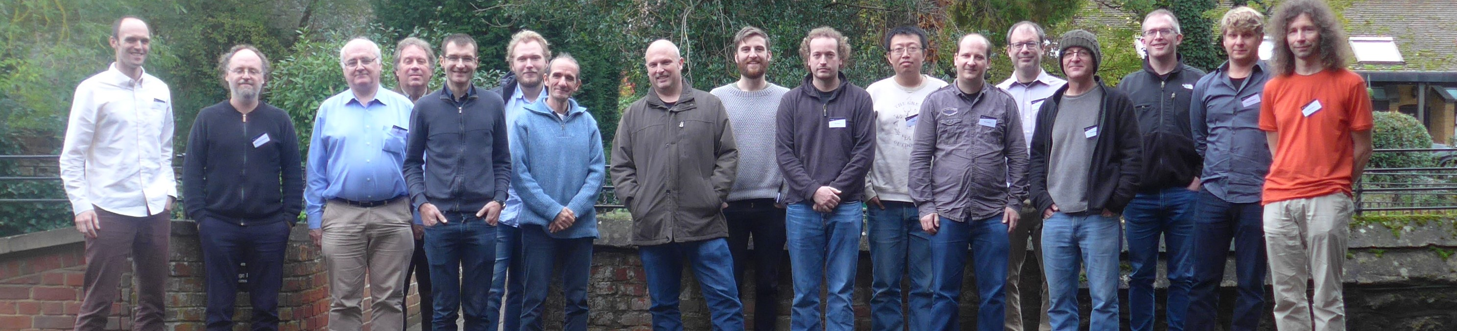
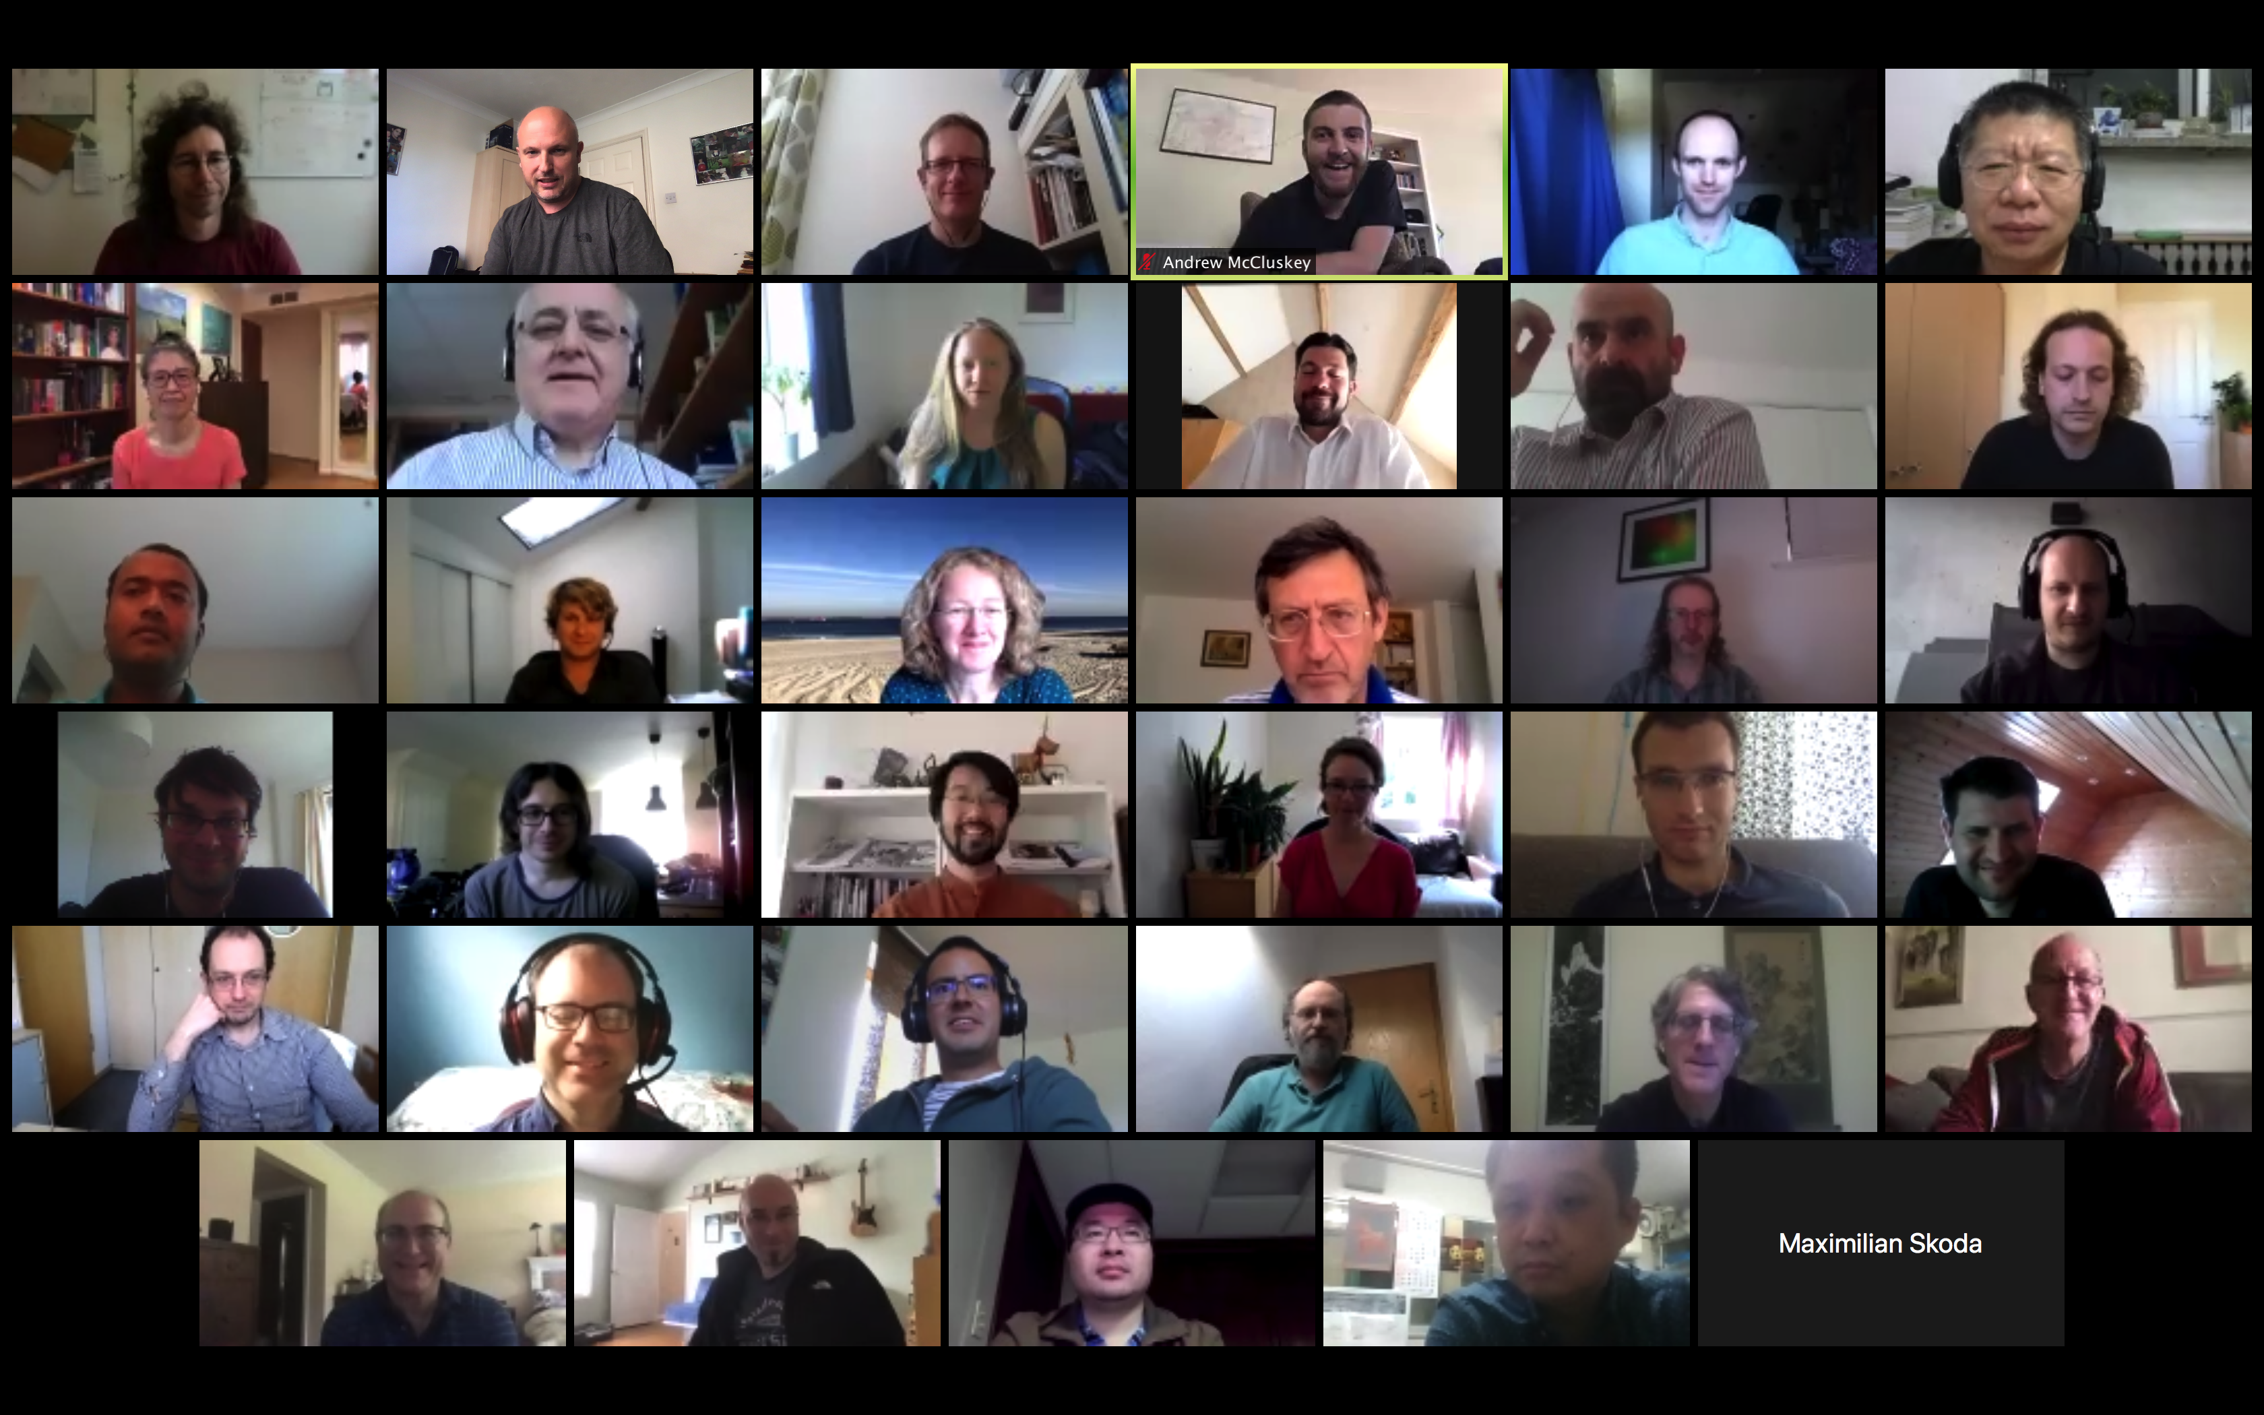
Open Reflectivity Standards Organisation
1st Meeting: in October 2019
2nd meeting, originally planned for SXNS, but moved online in May 2020: over 40 participants from x-ray and neutron facilities all over the world.
Plan to repeat at least annually

Slide 3

Open Reflectivity Standards Organisation
Working groups:
Education and outreach aims to develop understanding of reflectivity techniques and disseminate information about reflectivity analysis. Chairs: T. Arnold (ESS), B. Murphy (University of Kiel)
File formats aims to draft a spec for a standard file format to be used across X-ray and neutron reflectivity. This is an important goal to move towards interoperability across facilities. Chairs: J. Stahn (PSI), M. Skoda (ISIS)
Data Analysis is targeting a universal descriptive model language for reflectometry analysis. Additionally, they hope to develop test cases for reflectometry calculations to ensure robustness across analysis software. Chairs: B. Maranville (NIST) , A. Nelson (ANSTO)
Reproducibility is focused on creating guidelines to ensure reproducibility of data reduction and analysis of neutron and X-ray reflectivity measurements. Chairs: C. Kinane (ISIS), Andrew McCluskey (Diamond)

Slide 4
Data analysis working group
List of issues: https://github.com/reflectivity/analysis/issues
Shared model language
Shared kernel
Combining different data types (e.g. X-rays and neutrons)
Reflectometry calculation validation (credit: Andrew Nelson, ANSTO)
Automatic workflow
Refnx, Refl1D, BornAgain, GenX (to come)
Currently only unpolarized samples

Slide 5
Unpolarized data sets
Sample | Reference software
four layer system that has absorption | Refnx
four layer system that has an absorption (dQ/Q = 0.05 FWHM or 0.0212 1-sigma) | Refnx
Fresnel reflectivity from an air-water interface
Fresnel reflectivity from an air-water interface (slabs generated from slicing up an error function)
Ti-Ni multilayer | BornAgain
Ti-Ni multilayer (dQ/Q = 0.05 FWHM or 0.0212 1-sigma) | Refnx, BornAgain
three layer system that has an absorption dip in the critical edge | refl1D

Slide 6
From requirements to road map
Autumn
2019
Functionality list defined with instrument teams
Spring
2020
Functionality List sent to STAP
Joachim started working on the RoadMap
Autumn
2020
Feedback on the RoadMap
https://indico.esss.lu.se/event/1548/attachments/10309/17058/BornAgainRoadMap.pdf

Slide 7
RoadMap highlights
Data-centric entry
Data loader
Plot of multiple data sets
Sample model builder
Repeated layer editor
SLD(z) visualization
Structural roughness (magnetization)
Improved python interface and documentation (TOF)
Consolidated treatment of roughness
Connection to BornAgain core finalized
Fit interface designed
Decision taken on materials library
Co-refinement
Polarized reflectometry
Off-specular scattering
ToF fitting
Prototype off-specular viewer
+ Python API
+ Polarization (in progress)
Now
+1yr
+2yr

