Slide 1
SNS linac beam commissioning
By Michael Plum
Spallation Neutron Source
Oak Ridge National Laboratory
ESS
Workshop on beam commissioning
April 8-9, 2014

Slide 2
Outline
Introduction to SNS
How we commissioned the SNS linac
What we should have done differently
What worked well for us
Lessons learned

Slide 3
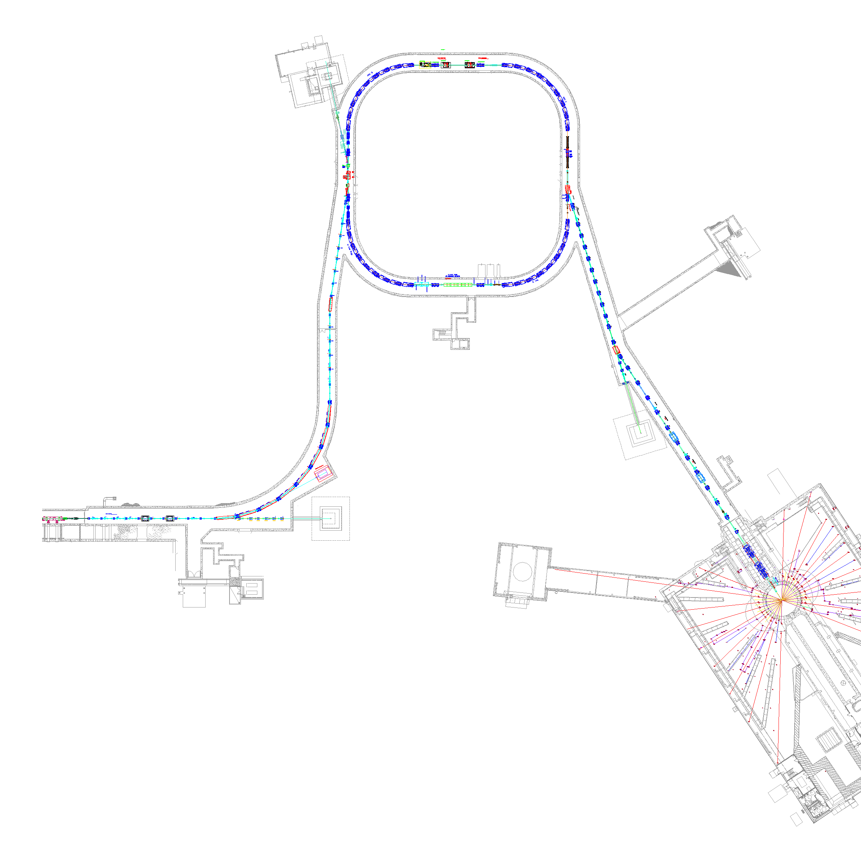
SNS Accelerator Complex
150 kW injection dump
1 GeV LINAC
Accumulator Ring: Compress 1 msec long pulse to 700 nsec
Collimators
Front-End:
Produce a 1-msec long, chopped,
H⁻ beam
Extraction
Injection
RF
2.5 MeV
87 MeV
186 MeV
387 MeV
1000 MeV
RTBT
Ion Source
7.5 kW beam dump
HEBT
RFQ
DTL
CCL
SRF, β=0.61
SRF, β=0.81
Design parameters
Kinetic Energy [GeV] | 1.0
Beam Power [MW] | 1.4
Repetition Rate [Hz] | 60
Peak Linac Current [mA] | 38
Linac pulse length [msec] | 1.0
SRF Cavities | 81
7.5 kW beam dump
Liquid Hg Target

Slide 4
Commissioning Timeline
2002
2003
2004
2005
2006
Front-End
DTL/CCL
DTL Tank 1
SCL
DTL Tanks 1-3
Ring
Target

Slide 5
How we did it
Staffed 24/7
Commissioned with beam in 7 stages (5 for linac, 2 for Ring and target) over 3.5 years
Front End through CCL-3 “control room” was a few computer stations in the Front End building, hard hats and safety shoes were required
Commissioned DTL-1 (7.5 MeV output energy) with a special diagnostics beam line (D-plate) that had a high-power beam stop. We used it to demonstrate 1.0 MW equivalent power (26 mA pk, 650 us, 60 Hz) in 2003. After that did not return to 1 MW beam parameters until 2009.

Slide 6
How we did it (cont.)
After initial low intensity commissioning, large fraction of accelerator physics time was spent developing low-loss tunes for the next step in beam power
We’re still improving our linac tuning algorithms (A. Shishlo)
  utilize beam phase measurements inside the same DTL tank whose set points are being determined
  utilize all beam phase measurements in SCL for every cavity scan for beam-based calibration of BPM positions to allow absolute beam energy measurements all along the linac

Slide 7
How long did it take (how much time did we spend)?
Section commissioned | days actual*
Front end | 33
DTL 1 | 47
DTL 2-3 | 12
DTL 4-6 and CCL 1-3 | 135 (incl. ~40 days of planned shutdown)
CCL 4 thru SCL | 63 (incl. ~13 days of planned shutdown)
*Some times could have been shorter. For example we spent a large amount of time studying the beam halo, and some of this work never bore fruit. On the other hand, this could be seen as time well spent gaining experience with the machine.

Slide 8
DTL and CCL warm linac commissioning
Temporary high-power (1.4 MW equivalent) beam dump for DTL-1
Temporary low-power (50 us, 1 Hz) dump for DTL 2-3
After that only internal / permanent dumps
For DTL we had two methods prepared to set cavity phases and amplitudes
  Delta-t method
  Energy degrader method
  Later developed phase scan signature method (PASTA), and this is the one we use today
For CCL we had one method prepared
  Delta-t method
  Today we use the phase scan signature method (PASTA)

Slide 9
SCL commissioning
Initially commissioned at 4.2 and 2.1 deg. K, but cryo-plant at
2.1 K was not stable at the time
Cavity amplitudes set to maximum stable gradients – much different than design gradients
Determining cavity phase set points was a lot easier than expected, partly due to the large acceptance of the SCL
  Had two methods prepared: Beam Induced Signal (Drifting Beam method) and Phase Scan. Phase Scan method worked great, no need to further develop Drifting Beam method.
Operated at 4.2 K from 2005 to 2007 to give time for cryoplant adjustments needed for stable 2.1 K operation, and also because 4.2 K met operations needs during that time

Slide 10
Design vs operation SCL gradients
HOM
HOM
Turned on
Conditioning
Tuner problem
Tuner
HOM+Conditioning
Design gradient
(from R. Campisi, June 2006)

Slide 11
Improvements to phase scan method
BPM 1
BPM 2
beam
When we first commissioned the SCL we turned off the RF to the cavities downstream of the cavity whose phase was being scanned. It took about 15 minutes to turn on the next cavity and move on.
Now we just blank the RF at 1 Hz (59 RF pulses on, 1 pulse off) and that can be turned on or off in about 1 second
We use low peak currents (~5 mA) and short pulses (~3 us) to minimize the cavity excitations and beam loading
In the first years of routine operations the SCL phase scans took about 12 hours. Today they are automated and take about 40 minutes.

Slide 12
What we should have done differently
During commissioning many system adjustments and modifications were needed to get everything working together. The rapid pace did not accommodate careful reviews of the modifications. Modifications to the Machine Protection System should have been more carefully reviewed.
Low pass filters were added to some MPS inputs to help with false trips due to noise. This ended up slowing down the response time of the MPS, which we didn’t realize at the time, and which caused some (temporary) performance degradation in the performance of the SCL cavities due to slow beam turn off during excess beam loss.

Slide 13
What worked well for us
Thorough magnet measurement program allowed “dialing-in” magnet currents and immediately transporting beam – first shot through HEBT hit view screen in ring injection section (didn’t do as well with first shot to neutron target)
Physics apps were integrated with the on-line model and the control system, and well developed before start of commissioning
Physics apps written by commissioning team members
Commissioning the machine in 7 stages
Good set of beam instrumentation (lots of beam position, beam profile, beam phase, and beam loss monitors)

Slide 14
Some lessons learned
Equipment checkout with beam takes a large fraction of the time
  Beam instrumentation
  RF & LLRF
  Control system
  Machine Protection System
Initial commissioning at low beam power was easy once the equipment was running properly
Be careful with modifications to critical systems (e.g. MPS system)
The high power ramp up was and still is our biggest challenge

Slide 15
Power ramp up (the commissioning after the initial commissioning)
Two schools of thought here:
  Keep the beam power low, get all the bugs worked out, don’t endanger beam availability, don’t activate beam line components until everything is working well
  Aggressively push beam power to identify weak components and to solve high-power problems before the users expect/demand high availability
At SNS we choose the latter, and we are glad we did
At 1 MW we paused to focus on beam availability. Budget and then target problems caused us to stay at 1 MW for longer than we had hoped.
We are now back on the trajectory to further increase the beam power

Slide 16
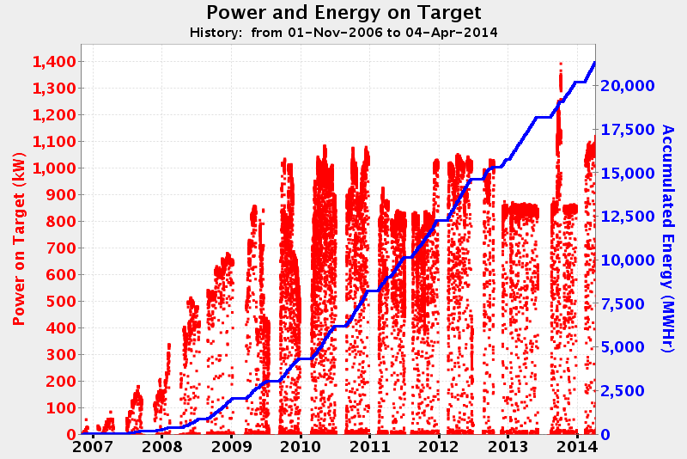
Beam power vs time
Typical beam power today is 1.1 MW
Save $$$
Target supply
issues
1 MW

Slide 17
Thank you for your attention!

Slide 18
Drifting beam method
This is the alternative method we developed to determine the SCL set points
Not used since the phase scan method worked well
Requires longer beam pulses (~30 us) which can create much more beam loss (compared to ~3 us for phase scan method) in downstream portion of SCL
Simulation for 466 MeV,
38 mA, 50 μs, rms size 3 deg
(Courtesy Y. Zhang)

Slide 19
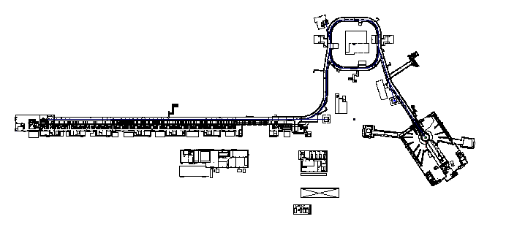
Evolution of PPS Enclosures with Commissioning
Injection Dump 150kW
HEBT-RTBT-Target
PPS 3.0
HEBT -Ring Gate
PPS 2.0
End of Linac - HEBT Gate PPS 1.0, 1.2
Extraction Dump 7.5KW
DTL Tank 1
And
DTL Tanks 1-3
PPS 0.4/0.5
Linac Dump 7.5 KW

