Slide 1
Control System Tools for Beam Commissioning
Timo Korhonen
Controls Division Chief Engineer
www.europeanspallationsource.se
April 8, 2014

Slide 2
Outline
Early preparations for machine commissioning
What is needed at the early stages
Tools outline – (partly) early ideas
EPICS
Databases
Application development

Slide 3
Early stage requirements
Component-level controls
EPICS infrastructure
Engineering GUIs
Timing infrastructure
Everything connected
Repetition rate control
Machine protection
Setting up machine modes
Where should the beam go
Beam modes
Pulse length, intensity

Slide 4
At start of commissioning...
Assume design model
Verify step by step
Tools have to be
Flexible : anticipate frequent changes
Robust
Avoid debugging several things at a time
Simple
Everybody is learning at this stage
Installation information should be available
Where to find systems and components
Machine design easily accessible
Lattice
Comparisons with model

Slide 5
Tools outline
Basic controls toolbox: EPICS
Version 3 provides good low-level control tools
Abstraction level is low, though
Version 4 is becoming mature
Introduced in machine operation at BNL, SLAC
More about EPICS V 4 in later slides
Design and infrastructure information
Databases in preparation
Lattice
Controls configuration
Cabling
Logbook
Electronic logbook from EPICS collaboration (oLog)

Slide 6
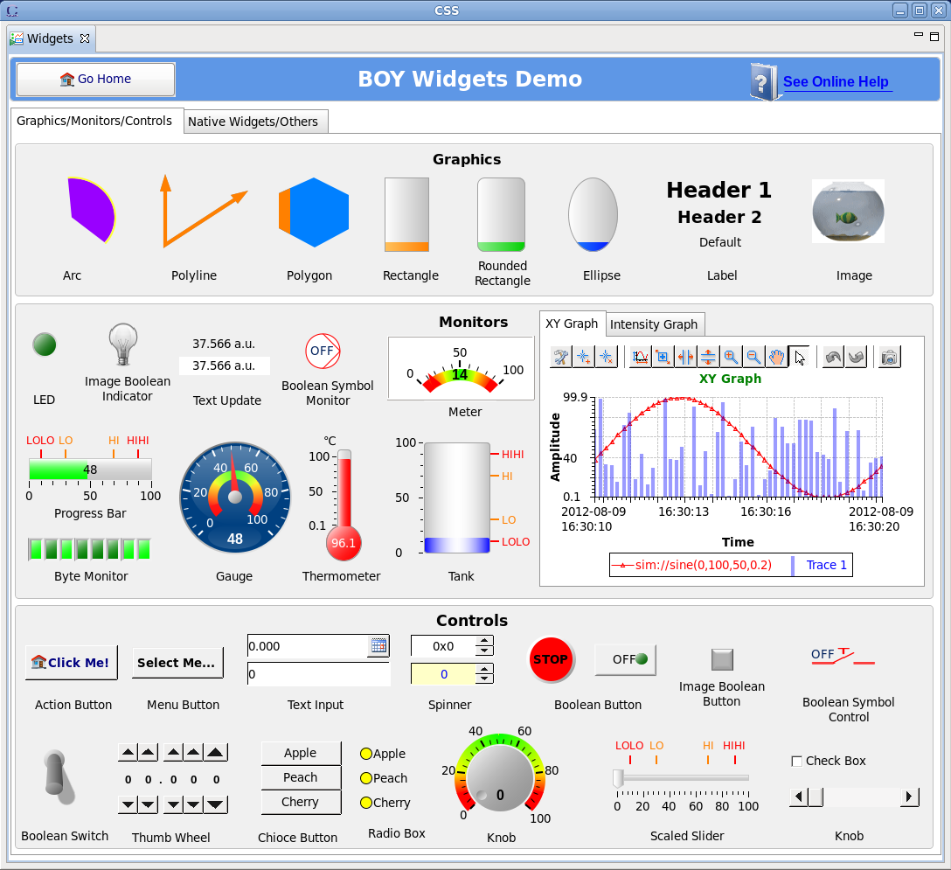
Basic tools
EPICS provides tools for device contol
CSS/BOY for writing device-level GUIs
CSS integrates many other tools
Alarm manager
Trend display, archive viewer, etc.
Can be extended with plugins
Archiving tool to be evaluated
CSS/BEAUTY
Not for high volume data
SLAC Archiver Appliance
High throughput, scalable
Targets “millions” of channels
Others? ...to be looked at

Slide 7
EPICS version 4
EPICS version 3 is control-oriented
Flat list of records
No standard easy way to build applications
Put together structures in a higher layer
No (easy) guarantees of synchronizity
EPICS version 4
Keep the low-level IOC (works well)
Add capability to handle structured data
New protocol supports some new access methods
Query with parameters,put-get
Plus the known put, get, monitor
High performance
Can also transport large datasets

Slide 8
Why EPICS 4?
EPICS 4 makes writing applications easier
With help of other infrastructure
Databases
Configuration, calibration, measurements
Synchronous data services
Pulse-to-pulse data
Work with high-level concepts
E.g. Orbit, Matrices (Twiss parameters, response matrix)
Transparent access to different data sources with one interface (pvAccess)
EPICS channels, databases, model services
Straightforward access from e.g. Matlab and Python

Slide 9
Databases for integration
Lattice database
Contains devices that “touch the beam”
Machine description for design
Design is evolving, version 2 in preparation
Source of lattice information for the online model
Controls Configuration Database
Device level information
What is connected to what, where it is located
Databases for calibration
RF, magnet field maps, etc.
Calibration data for instrumentation
To be looked at, no ready solutions yet.

Slide 10
System architecture with EPICS 4
Very generic application architecture diagram
Access all data with a single interface, regardless of data source
(CA: EPICS 3 protocol, PVA: EPICS 4 new protocol)

Slide 11
SUMMARY
Concentrate first on making basic infrastructure robust
Collect configuration information during planning and construction phase into databases
To be accessed online
Provide appropriate tools for the commissioning crew
Flexible, allow for rapid changes
Avoid complexity where not needed
Machine protection has to catch risky situations
Avoid costly mistakes
We are still in early phase
A lot of work to be done, but we still have time to think through the issues properly

Slide 12
Questions?

