Slide 1




experiences of Ion Source commissioning at CEA Saclay
CEA SACLAY DSM/Irfu/SACM/LEDA
Tuske Olivier
Workshop ESS (Lund) / 2014-04-08

Slide 2
Summary
Ion source design and assembly
  Principle of ECR
  Design and techniques
2. Dos and Don’ts for Ion source characterization
  Magnetic measurements
  Vacuum & Electrostatic “formation” of electrodes
  Pressure, Plasma ignition / Tunning
  Current measurement
  Fraction / Proportion measurement
  EMU at source exit
  Long time run

Slide 3
Ion source design
  Notion and Principle
  Design and technics

Slide 4
Principle ECR
2.45GHz
RF
Adap
RF Generator
Magnetic system
Insulator
Adapted extraction system
Pulsé ou continu
P_{crète}=2 kW
H₂
D₂
Wave guide
2,45GHz
High Voltage
Magnetic shield

Slide 5
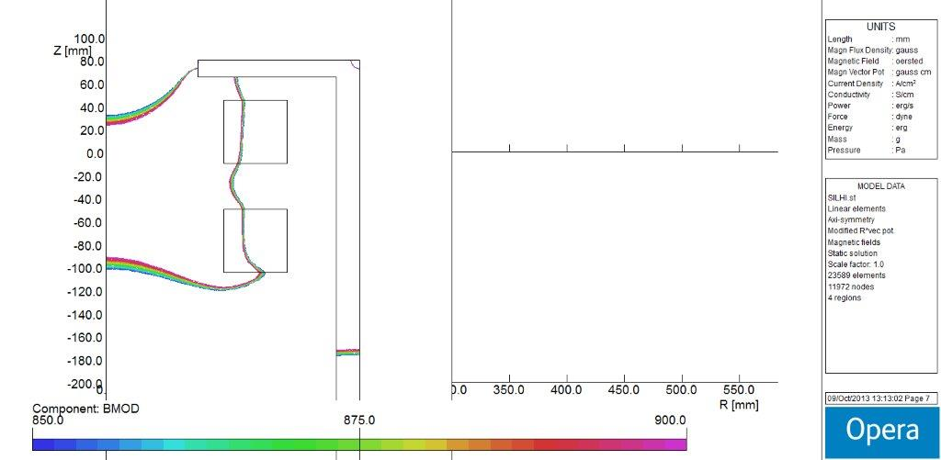
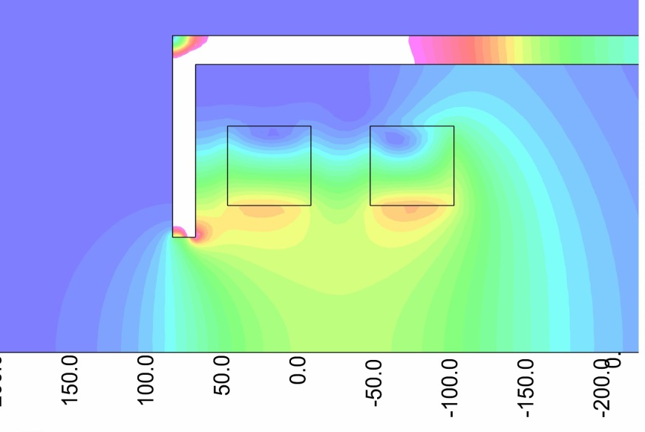
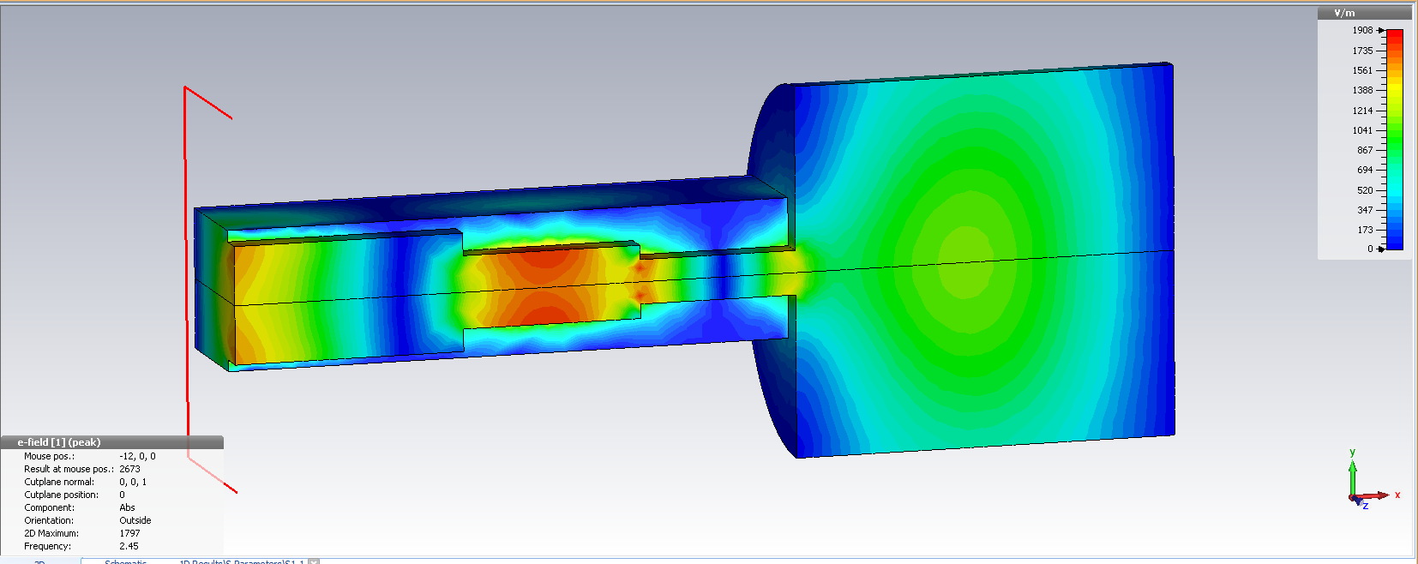
Simulations of heating zone
➔magnetism + RF
B1
B2
B1
B2
Opera code
BEAM
HF
BEAM
HF
Module Bz
Iso-Module Bz
2.45GHz
Magnetic simulation
RF simulation
➔ Design a geometry to concentrate energy at the « right » location.
HF
CST

Slide 6
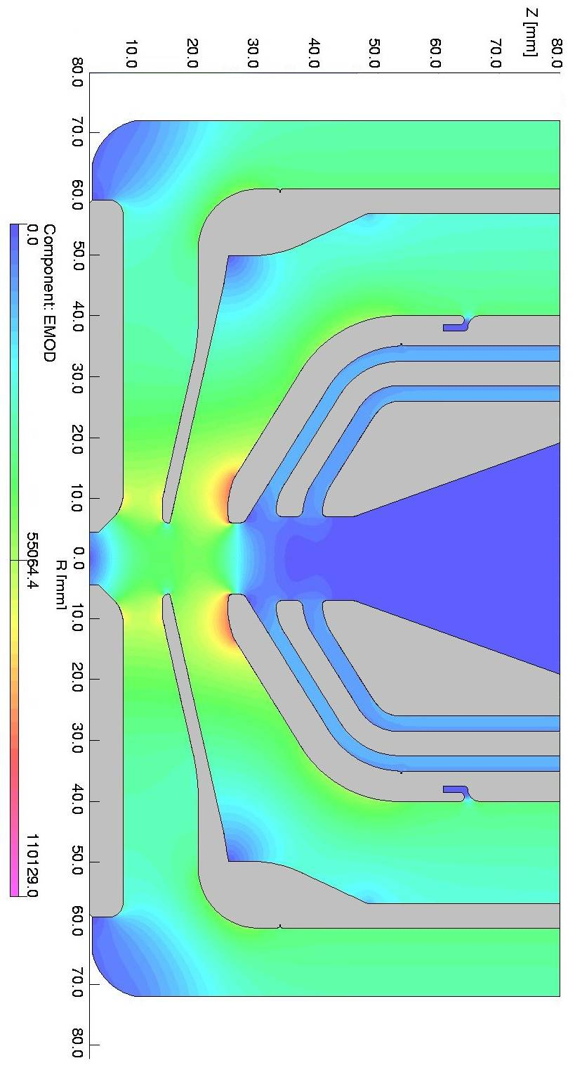
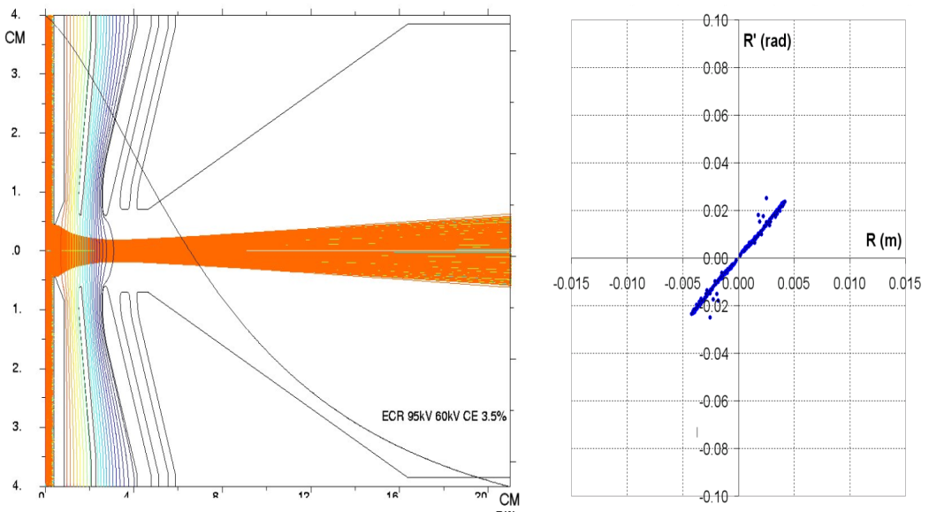
Ions extraction
➔ Potential + geometry + electrostatic
α≅25 mrad
r_{f}=10 mm
AXCEL code
Opera code

Slide 7
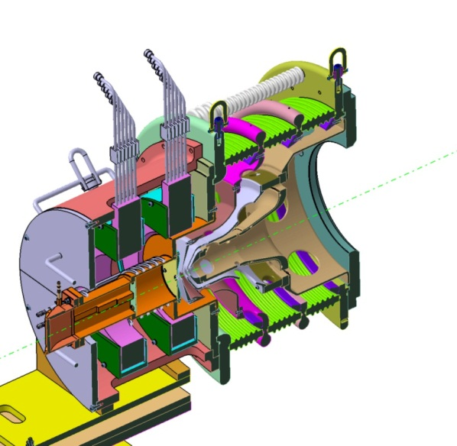
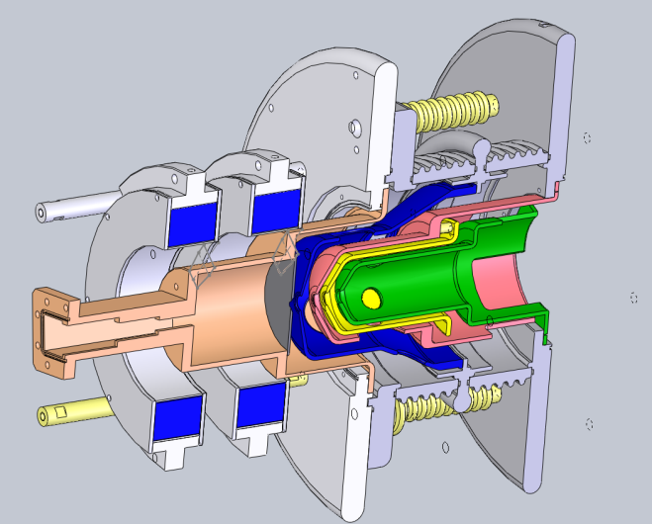
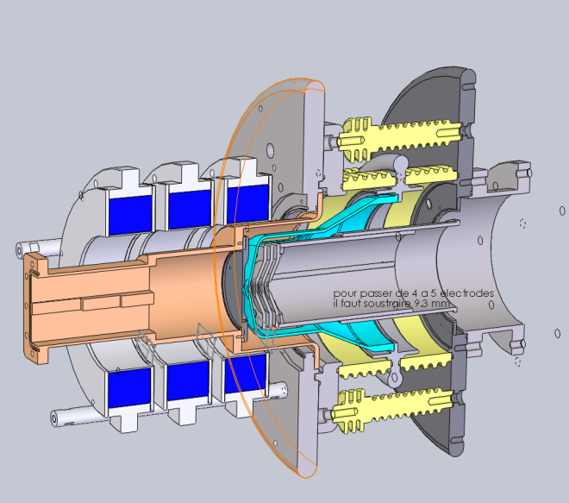
Ion Source developped at CEA Saclay
Projet /Source | High Voltage | Current | Magnetique Configuration
SILHI ➔ IPHI | 100kV | 100mA H+ | Coils
IFMIF EVEDA | 100kV | 140mA D+ | Coils
SPIRAL2 | 20kV 40kV | 5mA H+ 5mA D+ | Permanent Magnets
ALISES | 40kV 100kV | 15mA Not yet tested | Coils
SILAP-1 | 40kV | 30mA / 60mA | Permanent Magnets
SILHI2 | 50kV | 40mA | Permanent Magnets
SILAP-1
SP2
IFMIF-1

Slide 8
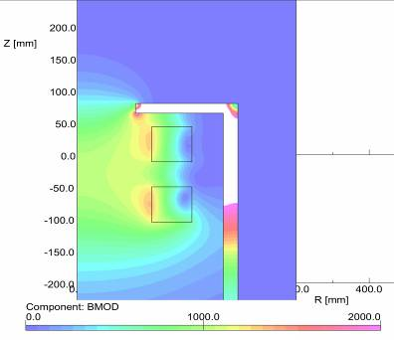
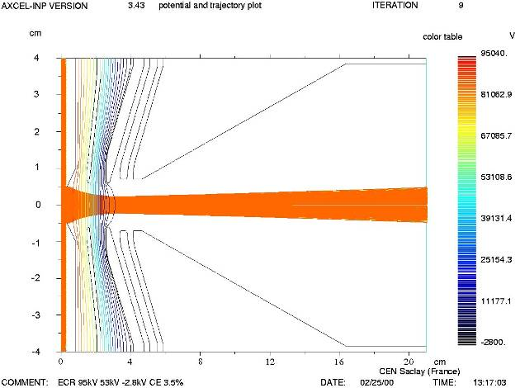
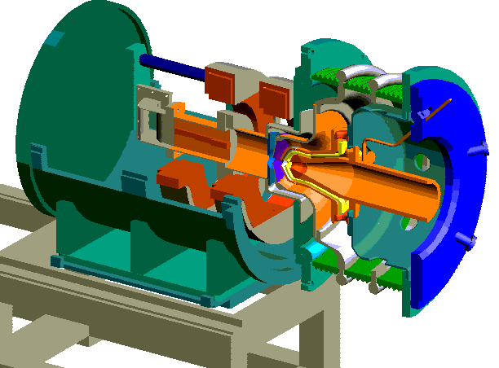
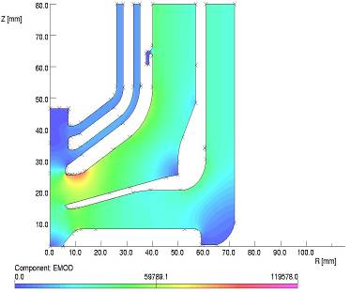
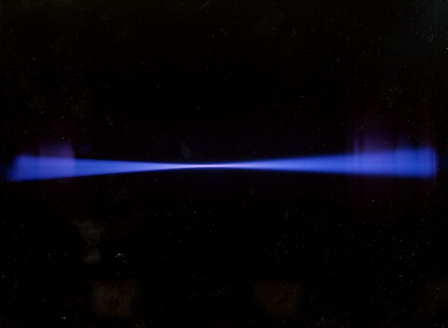
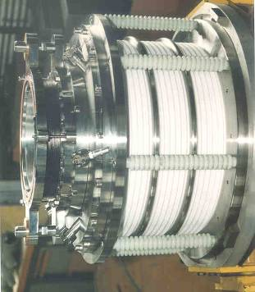
SILHI Source
Magnetic and electrostatic calculations
➢ Beam Extraction (10 kW)
AXCEL CODE
Opera CODE
Deuteron beam
Source working since years

Slide 9
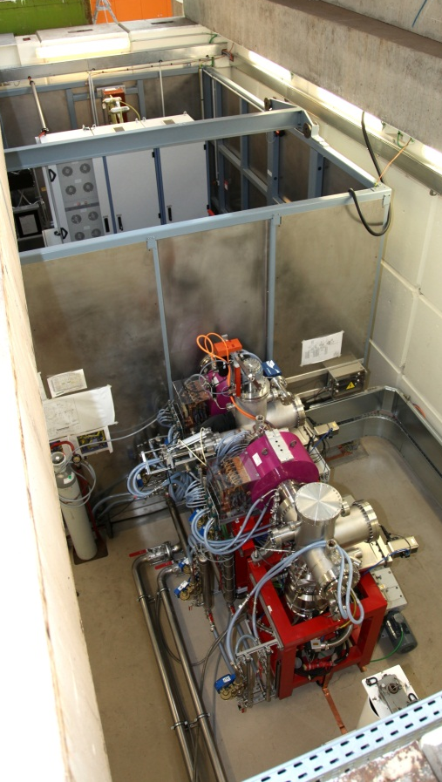
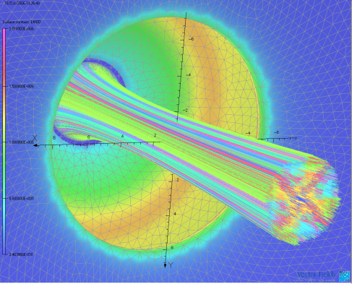
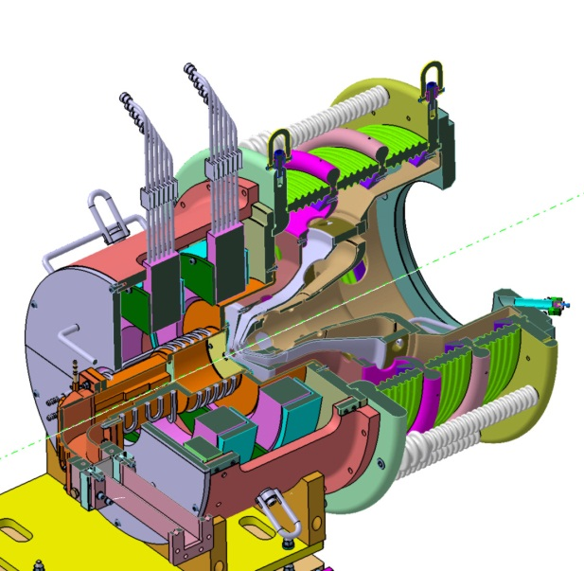
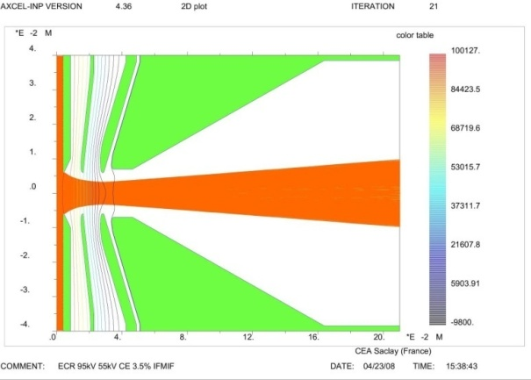
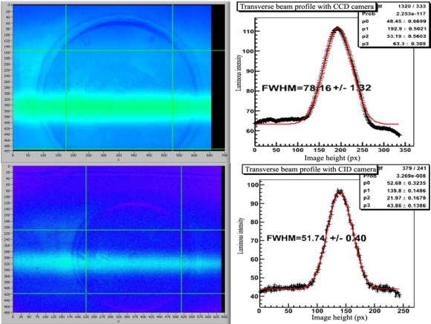
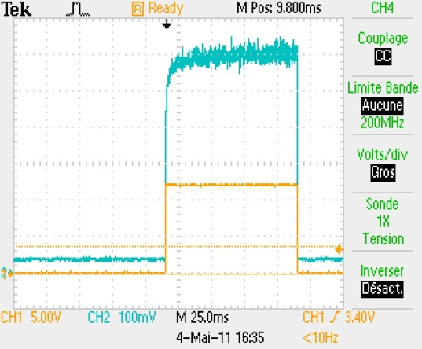
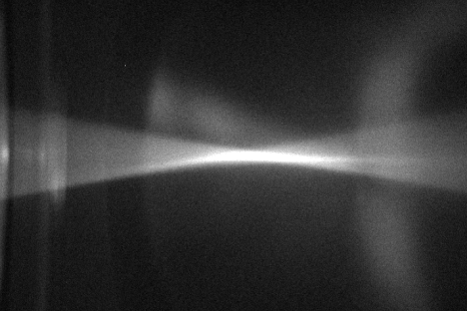
IFMIF Injector at Saclay
OPERA 3D CODE
AXCEL CODE
Source delivered in Rokkasho

Slide 10
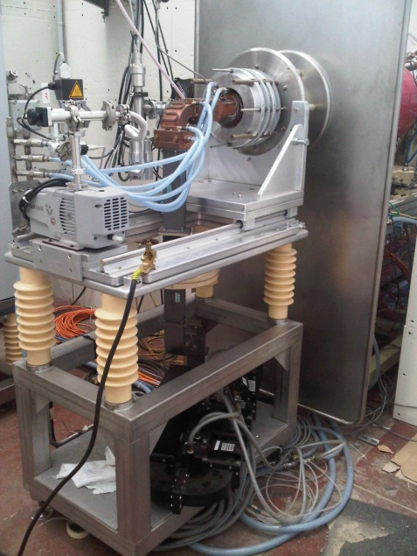
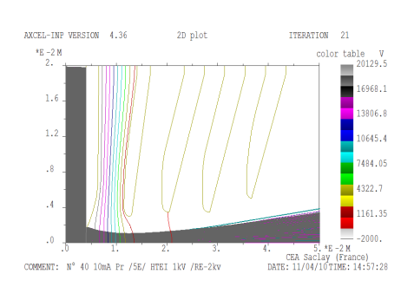
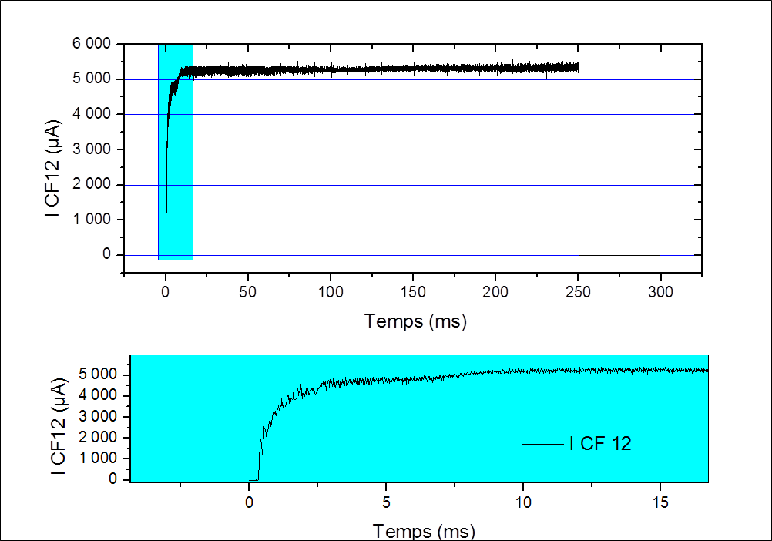
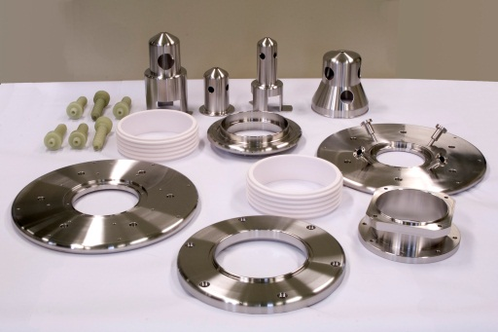
SPIRAL2 injector at Saclay
Source delivered at GANIL in Caen

Slide 11
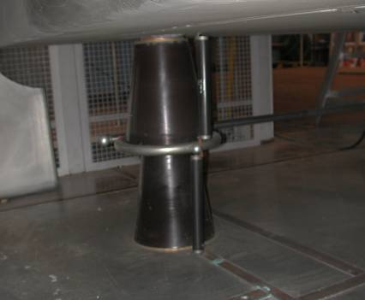
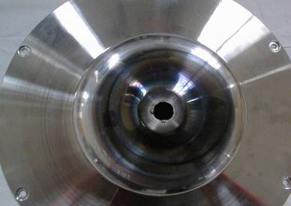
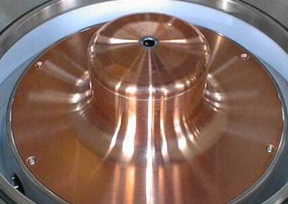
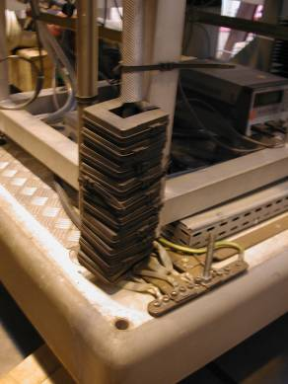
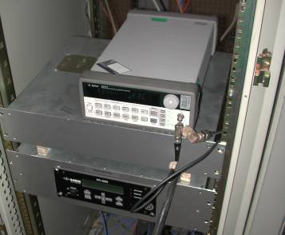
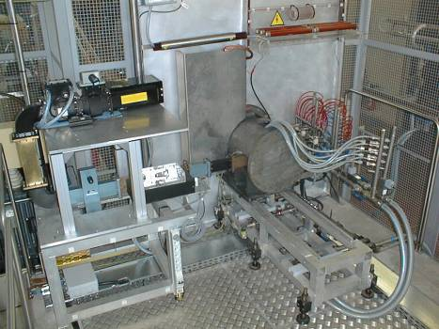
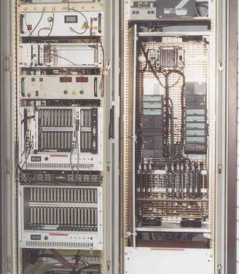
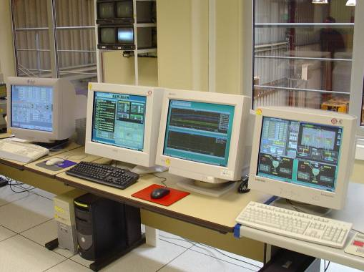
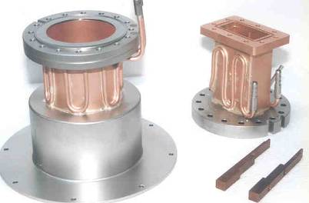
Technic to be mastered
➢ Magnetic, thermal and electrostatic calculations
➢ HV Technic
➢ EMC
➢ RF injection and coupling
➢ Materials
➢ Control system
➢ Beam Extraction

Slide 12
Ion source characterization during commissioning
  Magnetic measurements
  Vacuum & Electrostatic “formation” of electrodes
  Pressure, Plasma ignition / Tunning
  Current measurement
  Fraction / Proportion measurement
  EMU at source exit
  Reliability run

Slide 13
Setup up for source commissioning
→ Magnetic measurements
DIAG
Diag Chamber
Ion
source
Beam Stop
Pumping
BEAM
HF
Before vacuum,
generate the magnetic field with theoretical values obtained with Opera code
check the position of the 875 Gauss iso-surface with a gaussmeter inside the source at the RF injection point
For easy plasma ignition

Slide 14
Setup up for source commissioning
→ Vacuum & electrostatic formation of electrodes
DIAG
Diag Chamber
Ion
source
GAP1
Beam Stop
Pumping
GAP2
With the pumping system on, without and with gas injection :
Formation of GAP1: Puller electrode connect to ground potential
Formation of GAP2: Puller electrode connect to HV potential
Get rid of all the electrods surface imperfections for drastic reduction of sparks rate

Slide 15
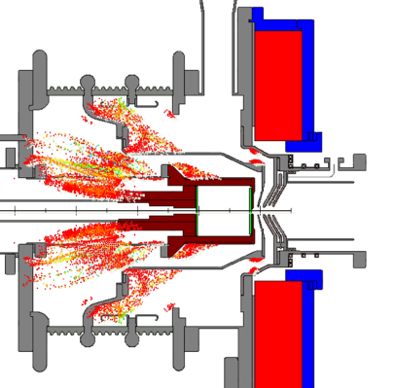
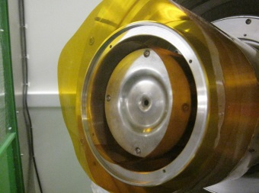
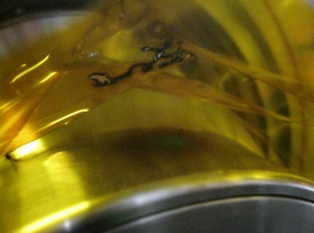
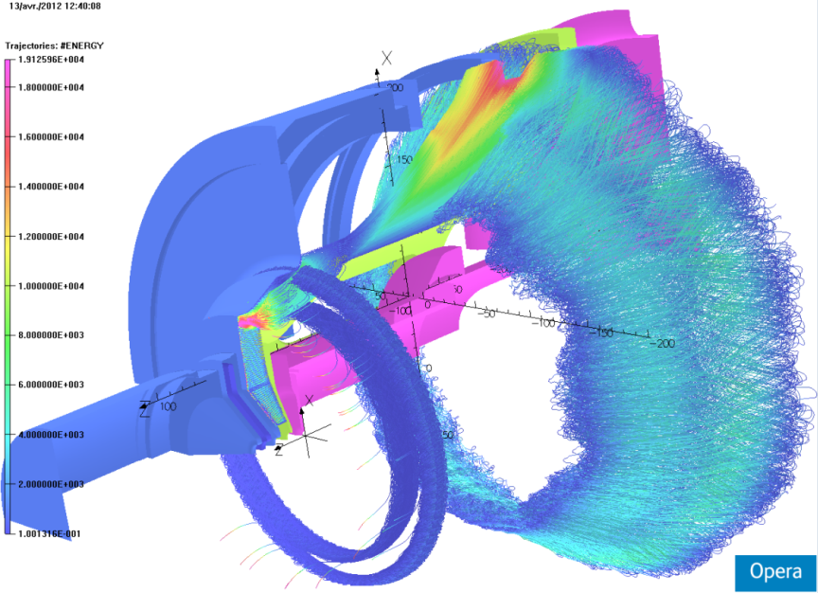


Setup up for source commissioning
→ Gas injection, Plasma Ignition & tunning (2)
Sometimes
Fringe field B and E field can be orthogonal !
On ALISES ion source Penning discharge forbade us to bias more than 17kV
Opera code has been used to simulate electron trapping in the accelerating column
Simulations
Experimental Test
➔ This simulation is now use where design is realized before realization
PhD thesis S. Nyckees
Simulation validation

Slide 16
Setup up for source commissioning
→ Gas injection, Plasma Ignition & tunning (1)
DIAG
First BEAM
Diag Chamber
Ion
source
OK
Not OK
Beam Stop
Pumping
boss
Gas injection, pressure in the Diag Chamber must around 1 or 2.10⁻⁵ mbar for one day before starting RF in order to “fill up” the BNi plates inside the source chamber.
RF in Pulse mode for plasma ignition 250 ms at 1 Hz
Shift to CW and put the Automatic tuning for the lowest RF reflected power
Tune the magnetic coil value at RF injection
Preparation of the plasma chamber

Slide 17
Setup up for source commissioning
→ current measurement
DIAG
Diag Chamber
Ion
source
Beam Stop
Pumping
Compare the HV power supply drain current vs the collected Beam Stop current
Tune the source for reducing
  the noise of the extracted current
  and the current rise time
by changing gas, magnetic values and RF adaptation
The sharper is the rise the more stable will be the source

Slide 18
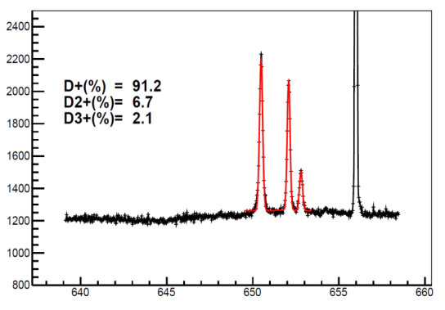
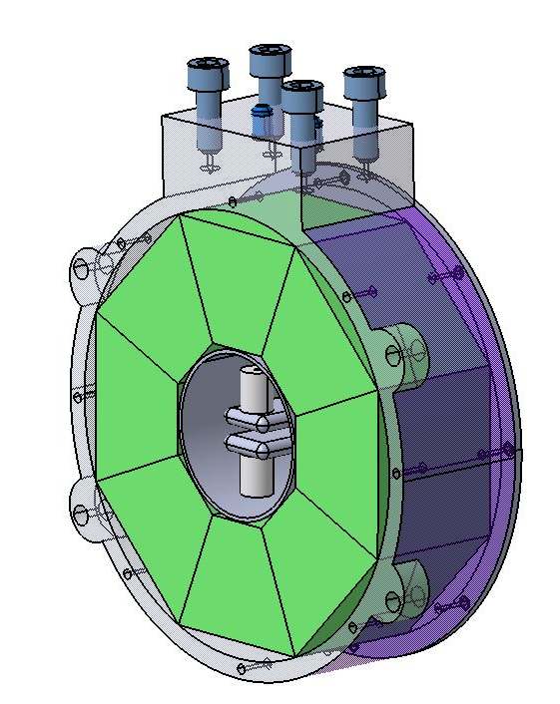
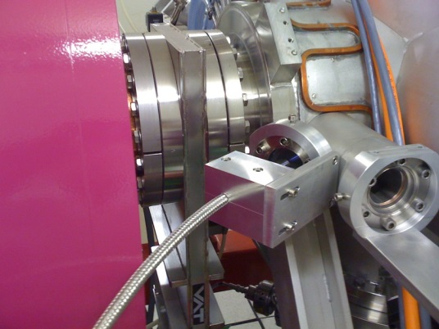
Setup up for source commissioning
→ proton and ion fraction
Wien Filter
Or
Doppler shift
Species fractions obtained with Doppler shift method for pulsed beam at 50% duty cycle
D_{α (D2+)}
Halbach magnetic structure
(FAIR project)
D_{α (D+)}
Diag Chamber
D_{α (res. gas)}
Ion
source
D_{α (D3+)}
Beam Stop
Wave-length (nm)
Pumping
θ
Measure the proportion of proton in the beam.
To increase proton fraction :
the gas, RF reflected power, magnetic field
Reduce the beam loss due to molecular ions

Slide 19
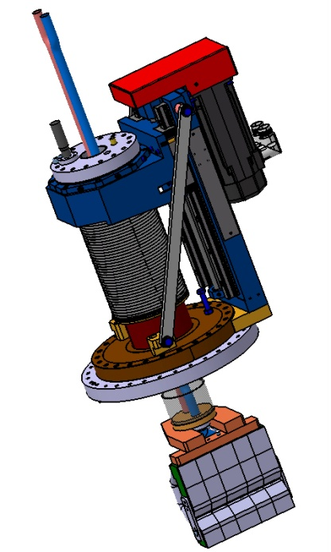
Setup up for source commissioning
→ emu
EMU
Diag Chamber
Ion
source
Beam stop
Pumping
Allison scanner
(IFMIF project)
Get the beam divergence, beam profile at source exit in horizontal and vertical
Real Twiss parameter for LEBT simulation

Slide 20
Setup up for source commissioning
→ Long time run
DIAG
Diag Chamber
Ion
source
Beam stop
Pumping
Estimate the spark rate and if the source stops when sparks occur
Also test specific high level program : feed-back on the extracted measured current intensity that change the RF power
Control the source stability with more accuracy to compensate the temperature drift and other long time effect

Slide 21
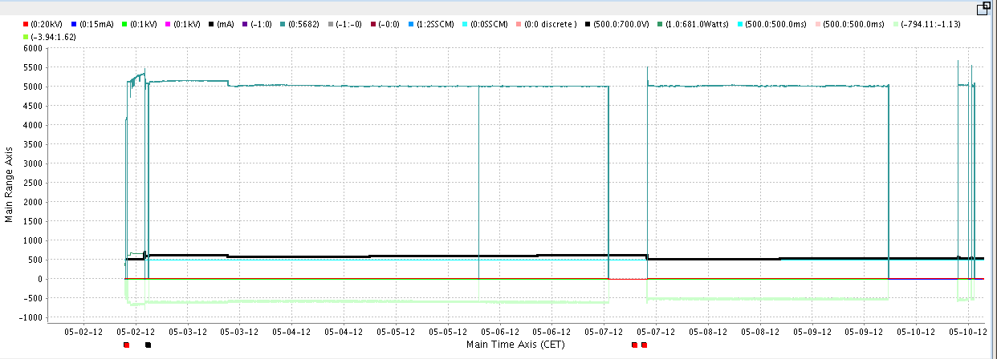
Setup up for source commissioning
→ Long time run (SPIRAL2)
D
F
G
B
C
E
A
H
A : 14h59 Start the long run 5.1mA and 0.2mA regulation
B : 9:11 regulation @ 5mA with delta 0.05mA ➔ regulation more drastic
C : 19:14 10ms short electrical distribution failure at CEA ➔ it stops the RF generator, the High level program restart the source
D : 00:59 100ms stops on the phase2 of electrical distribution ➔ it stops the current power supplies of the line
E : restart @9:51.
F : 17 :23 Q14 power supplies fails again (as usual!)
G : 11 :53 Q14 again
H : 13:17 Q14 again ➔ stop the long test run

Slide 22

ConclusionS
Source commissioning is an important step !
And it is usually made too quickly because of lack of time.
Start with Source + small diag chamber as B. Cheymol recommended it (24 Fev 2014)
Better to take some time for measurements to be able to confront them with early simulations and adjust next simulations for the LEBT start/commissioning.
Robust Diagnostic are NEEDED and already calibrated ! And not calibrate the diagnostic with the new ion source
Source must work as much as possible (pulsed “plasma mode” when not using it)
Vacuum break only with Nitrogen to avoid BNi pollution.
WHAT | W1 | W2 |  | W3 |  | W4 | W5++
Electrical field + vacuum
Current optimization
Doppler measurements
EMU measurements
Long run
Alice Wonderland
Schedule in
a ideal world

