Slide 1
Commissioning End Game:
Beam to Dump and Target
Tom Shea
www.europeanspallationsource.se
8 April, 2014

Slide 2
Layout
HEBT
A2T
1st dipole – Critical Device
For initial commissioning runs, High Beta section is simply part of transport line
Tuning Dump Line (straight on lower level)

Slide 3
Prerequisites
Beam to Tuning Dump
Readiness Review Complete
Linac tuned through the Spokes into insertable beam stop -> beam energy at about 200 MeV.
Beam To Target
Initial Readiness Review Complete
Target and Instruments out of Maintenance mode
Linac tuned through Medium Beta into tuning dump
Long pulse demonstrated at > 500 MeV
External readiness reviews certify that beam can be delivered to destination without violating license. Administrative holds may be required along the way to certain beam modes, particularly for increased power. Additional reviews may be needed for ~500 kW and for full duty factor.
MPS should restrict pulse length (a single pulse, particularly at low energy can break vacuum window in dump or target – bad day)

Slide 4
Goals
Beam To Tuning Dump
First beam to dump
Support medium beta tuning
Full pulse demonstration
Beam To Target
First beam on target
Tune Dogleg and A2T line
First Neutrons
Support Target Commissioning (few kW)
Power increase for first production run (~100 kW)
Agile planning: Activities may be reordered or skipped; tools and administrative procedures should support this.
Minimal beam: Anticipate human intervention and equipment rework, even in target station.

Slide 5
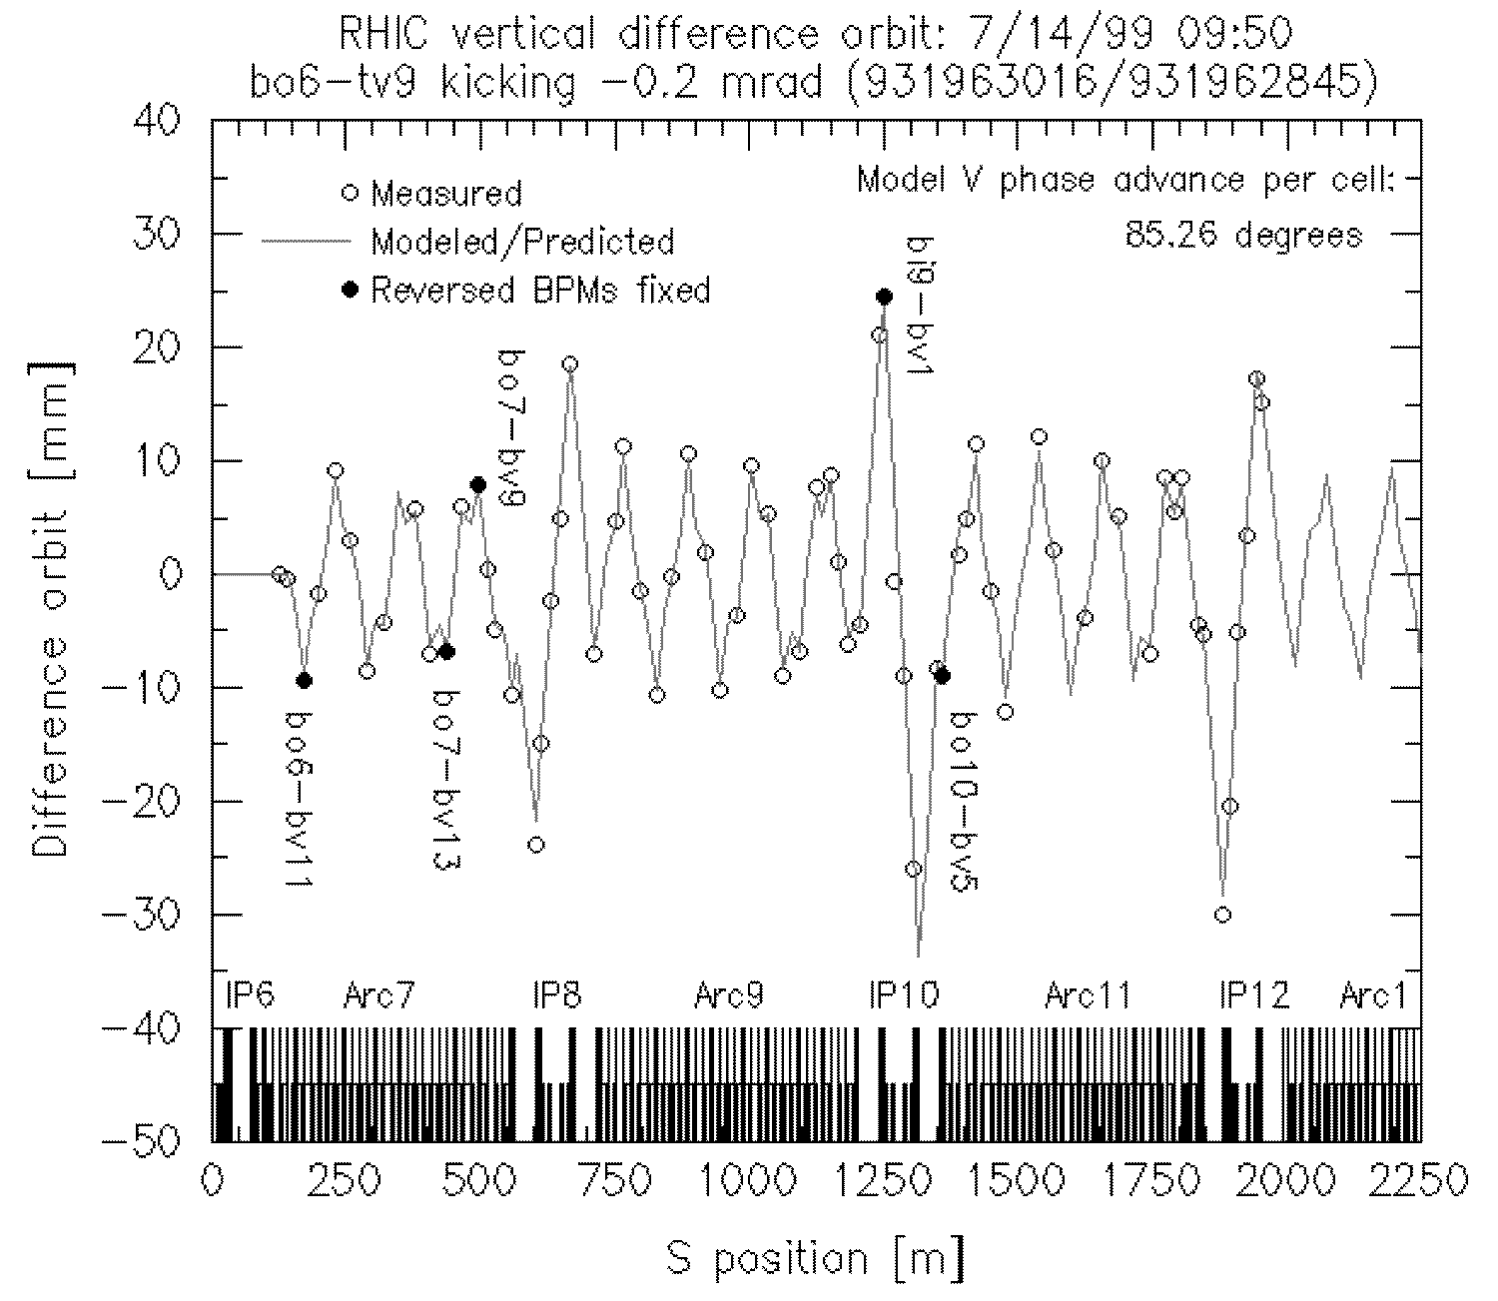
Goal: First Beam to Dump/Target Activity: Simple Check of BPMs, Optics Tools: Safe beam, Difference Orbit, BPMs…
Some requirements:
Safe Beam: MPS restricts beam parameters: i.e. 5µs, <1 Hz, tens of mA,…
Difference orbit: App uses online model, live and saved BPM readbacks, kick strength is free parameter, …
BPMs: ~mm precision in this mode, data on each pulse, self trigger within wide timing gate

Slide 6
Activity: Calibrate imaging/profile devices Tools: Safe Beam, DC scan, BPM, BCM…
With additional tools, extend to additional “safe beam” activities:
Calibrate BLMs with 100% loss of “safe beam”
Similarly, fault studies to verify shielding and Machine Protect System
Iteratively commission tools and use them to characterize and set beam properties.
4 Wire scanners to measure transverse emittance, BSM+Shishlo method to measure longitudinal, TOF for energy…
Finally, set beam density before long pulse to dump or target.

Slide 7
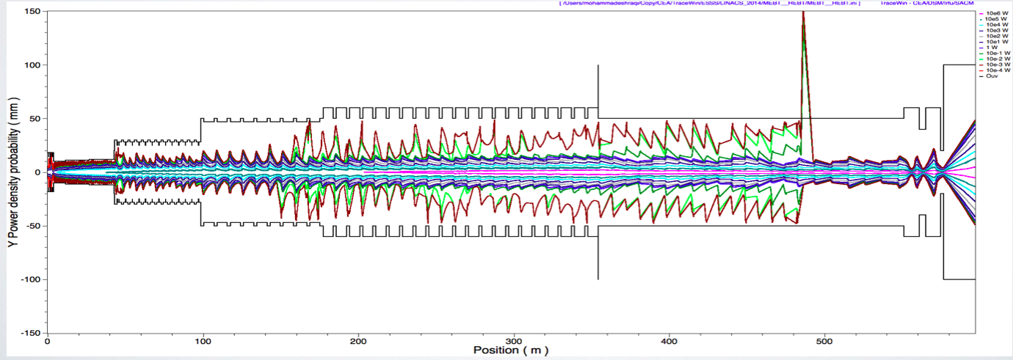
Goal: Power Increase for Production Activity: Halo Management
Halo Twiss parameters probably differ the those of the core, and ~ part in 10^5: Challenging to simulate or measure
Minimize halo in Warm Linac; transport remaining to target, or to collimators
Long Pulse feature: Production is at full pulse length (neutron instrument design). Power handling can be limited by elevated beam loss, target/moderator cooling, etc... Limit beam power by reducing peak current.

Slide 8
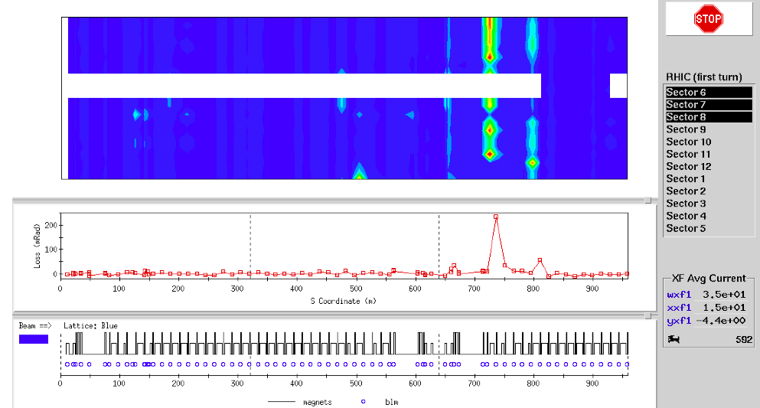
Activity: Halo Management Tools: Monkeys and Loss Monitors ☺
Other instrumentation for full pulses: Halo, BPM, BCM, NPM, in-monolith profile, and 4 flying wires in HEBT…
Loss Trend Display
history
System downtime ocurred here…
RHIC first turn display shown; similar tools at J-Parc, etc.

Slide 9
Goal: First Neutrons Activity: Demo Integrated Operation of ESS Tools: Commissioning Display, +…
Neutron monitors
Imaging Systems
Redundant BCMs provide beam accounting (monitor fluence, integrated dose,..)
Multi-wire grids for profile
In-monolith BPM to monitor rastering
Thermocouple halo for aperture protection
In monolith
Inst. Plug

Slide 10
Comparing to SNS Commissioning Timeline, ESS Plan is Aggressive
After 1st beam
on target,
70% power:
3 years
1
2
3
4
5
6
7
8
9
2002
2003
2004
2005
2006
Run #1: - RFQ at LBNL (2.5 MeV), Jan 25th through Feb 2002 - beam stop for design beam power
Run #2: - MEBT at LBNL (2.5 MeV), Apr 4 to May 31, 2002 - beam stop for design beam power
Run #3: - MEBT at ORNL (2.5 MeV), Nov 5, 2002 to Jan 31, 2003 - beam stop for design beam power
Run #4: - DTL tank 1, D-Plate (7.5 MeV), Aug 26 to Nov 17, 2003 - beam stop and radiation shield for design beam power
Run #5: - DTL tank 1,2,3 (39 MeV) Spring 2004 - Beam stop and radiation shield for reduced beam power (50us, 1Hz)
Run #6 : - DTL, CCL modules 1,2,3 (158 MeV) Fall 2004 - In-line beam stop and radiation shield for reduced beam power (50us, 1Hz)
Run #7 : - SCL (1 GeV), Linac Dump, Aug 2005
Run #8 : - Ring (1 GeV), Feb 2006
Run #9 : - Target (1 GeV), April 28, 2006
ESS: 2 years
ESS: Beam to Tuning Dump
ESS: “Raster commissioning”
ESS: Beam to Target

Slide 11
Thanks

