Slide 1
Commissioning of the A2T: DC and AC Magnet Systems
Heine Dølrath Thomsen, ISA, Aarhus University

Slide 2
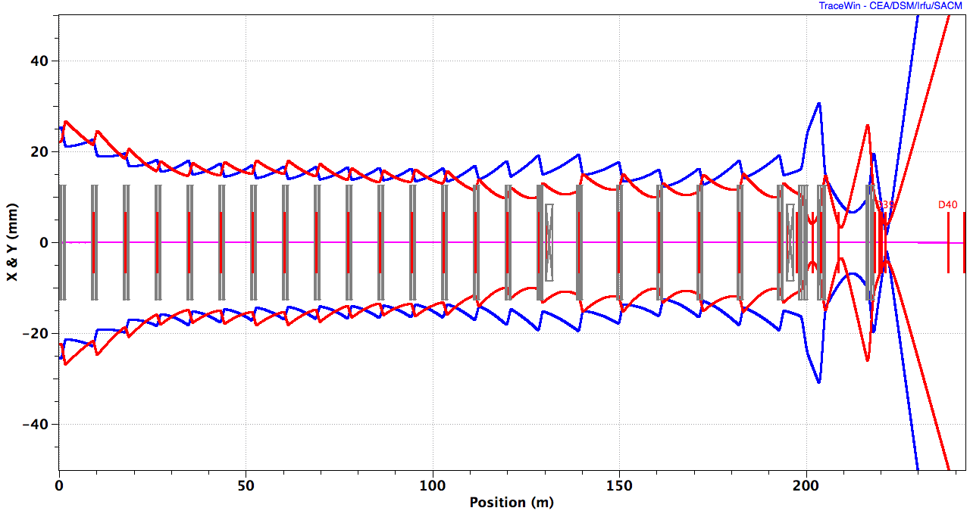
HEBT Layout (4 deg ACH)
ACH
A2T
128 m
UHB, 15 periods
DUMP
10 RMS, X, Y,
EWU with quadrupole doublet

Slide 3
Assumptions
MAGNETS:
All magnet polarities have been verified after installation in tunnel
Quadrupoles have auxillary coils to generate a dipole corrector field (1D).
Separate correctors in the A2T though…
BPMs in immediate vicinity of almost every quad
BEAM:
Low-power beam mode available, 1 Hz x < 10 microsec ~ kW avg. power
Beam-based alignment is applied to correct the beam centroid
Beam parameters at the SCL exit are roughly known (beam stops & dump).

Slide 4
Accelerator-to-Target (a2T)

Slide 5
Raster Pattern
f_{y} / f_{x} = 5:4
f_{w} ~ 40 kHz, T_{p-p} = 12.5 us (w = x,y)
x,y [arb. units]
Max(∆x) ~ 90 mm, max(∆y) = 16 mm,
RMS(x-∆x) = 12.6 mm, RMS(y-∆y) = 6.3 mm
One pattern cycle
Notes:
113/83

Slide 6
Beam Optics: LANL MTS Concept (B. Blind et al)
ACH
A2T
Matching Q’s
RMs
CO Q’s
AP
CO
Target

Slide 7
‘Raster25’
Centroid
10 x RMS beamlet
BEW
QP1-4
RMs
QP5,6
PBW
B_{y} B_{y} B_{x} B_{x} | B_{x} B_{x} B_{y} B_{y}
ACH
A2T
AP
CO
2.0 GeV: B_{x} = ±1.96 mT.m, B_{y} = ±2.28 mT.m, ±5 mT.m

Slide 8
A2T Commissioning: DC optics

Slide 9
How to Tune Your DC A2T: 1/3
Condition | Measure | Scan | Adjust | BI Resolution
R_{12,AP-CO} = 0 R_{34,AP-CO} = 0 | Apparent CO location; deduced from BPMs near CO + dedicated BPM near target | DC raster corrector pair | QP5-6 | CO: ~0.5 mm M: ~2 mm
AP
CO

Slide 10
How to Tune Your DC A2T: 2/3
Condition | Measure | Scan | Adjust | BI Resolution
Beam size @ CO | Wire scanner @ AP: + QP5-6 size magnification (0.22 & 1.1) | --- | QP1-4 | 0.1 mm
Beam size @ Target | Wire scanner @ PBW |  |  | TBD
AP
CO

Slide 11
How to Tune Your DC A2T: 3/3
Condition | Measure | Scan | Adjust | BI Resolution
Max. deflection at target | CO BPMs + Monolith BPM | DC raster corrector pair | --- | CO: ~0.5 mm M: ~2 mm
 |  |  |  | 1 mm, (3 mm accuracy)
 | Target imaging system
AP
CO

Slide 12
A2T Commissioning: AC optics

Slide 13
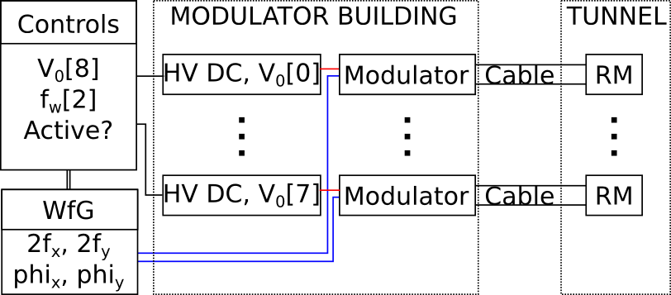
Modulator: DC supply (V_{0w}) + H-bridge
f_{w}: clock (memory array)
Slope: V_{0w}, (L/R)
a_{w}: slope / 4f_{w}
doi: 10.1016/j.nima.2004.09.034
Notes:
Switching times tabulated in 2D memory array

Slide 14
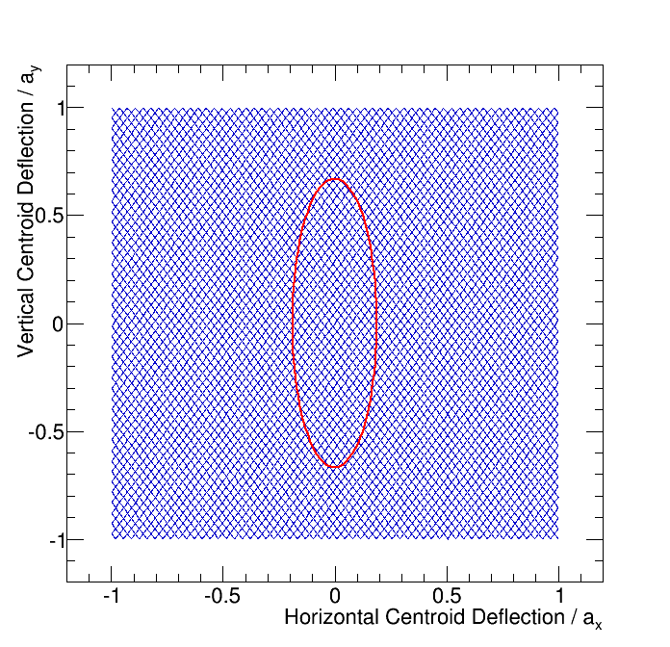
Checking the Raster Pattern
40 kHz: 0-a_{w} in 6.25 us
Magnification is verified with DC correctors
Raster pattern is cyclic:
Short beam pulses
RM deflection: dedicated BPM (1 us interval)
ϕ_{x} += δt, ϕ_{y} += δt
Shot-to-shot consistency
Increase pulse length and check intensity profiles
Notes:
Beam sweep waveform

Slide 15
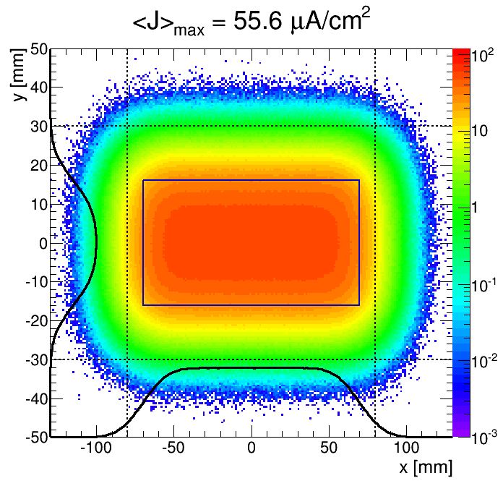
J_{max} @ Target (BEW)
Notes:
Coating: 2% amplitude resolution

Slide 16
Commissioning the A2T
DC Elements
AC Elements
2 x 2 (XY corrector + BPMs)
6 quadrupoles
2 x CO quads: R₁₂ + R₃₄, (BPMs)
4 x Matching quads: Beam sizes at CO (profile monitor, indirectly) and target (thermolum. coating)
Check angular magnification
8 x RMs (2 families)
DOFs: f_{w}[2], ϕ_{xw}[2], V_{0w}[8] (f_{x}, f_{y}, V_{0x}, V_{0y})
Beam sweep waveforms can be sampled with short bunches (dedicated BPMs)
Shot-to-shot reproducibility

Slide 17
Extra slides

Slide 18
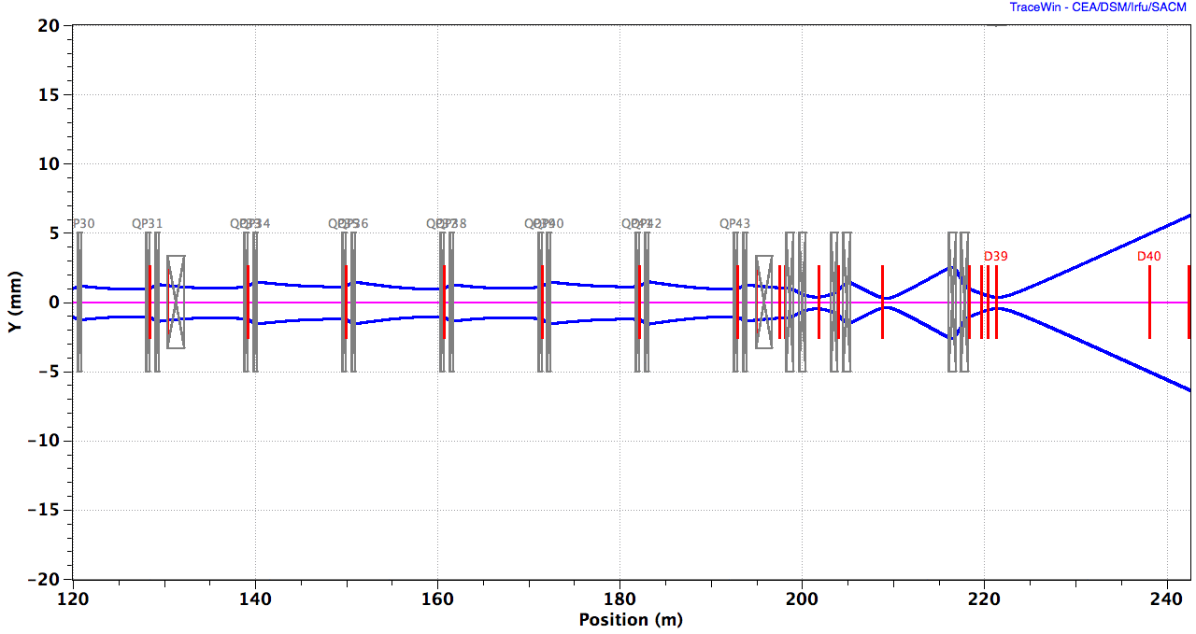
Commissioning An Achromat
Condition | Measurable quantity | Scan? | Adjust | BI Resolution
R_{26,ACH} = 0 ϕ_{y,ACH} = 2π | Δy = R_{26,ACH} x dp/p | Final SCL cavity, dp/p = 1.2% | Ach. quads | 0.5 mm (σ_{η}~50 mm)
 | Δy, R₃₄ = sqrt(β₁β₂)sin(ϕ_{y}) | Corrector kick
ACH
30 MeV detuning in 5 steps

Slide 19
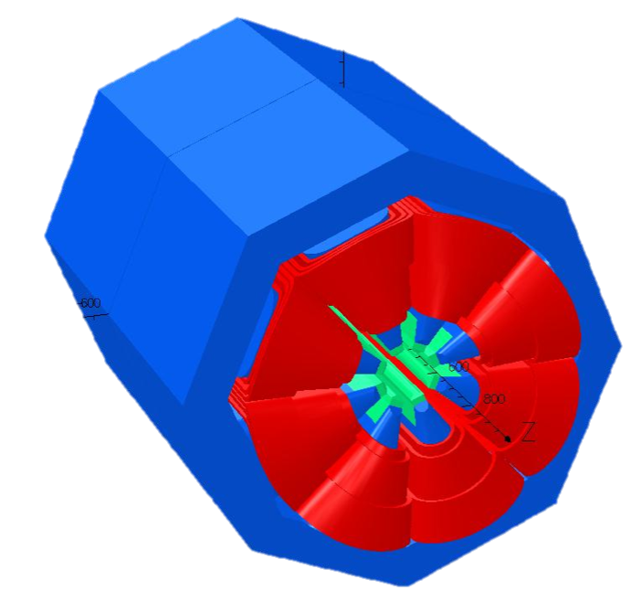
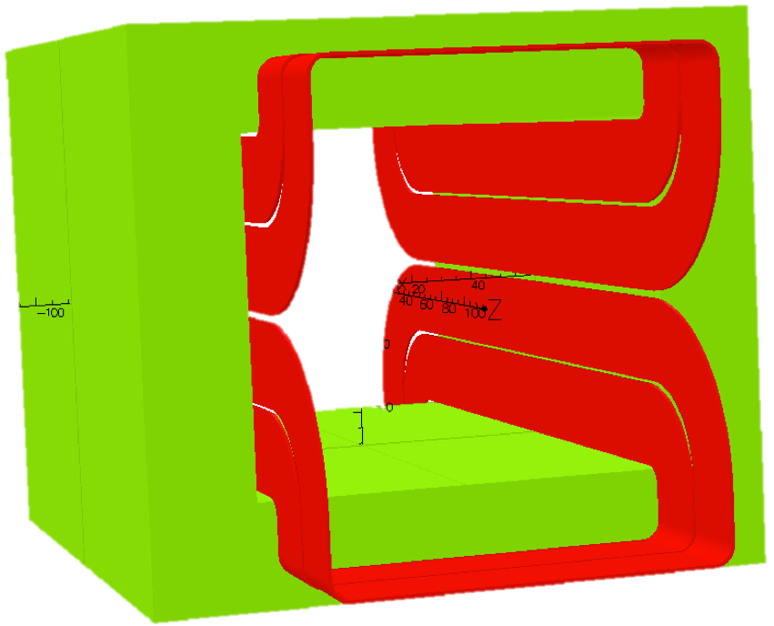
A History of Beam Expander Systems…
200 mm
160 mm
140 mm
B_{y}
B_{y}
B_{y}
f_{raster} ~40 kHz
x
x
x
Non-linear DC field distorts phase space and focuses tails
Complex tuning
Overfocusing of halo
Dodecapole comp.: overfocusing is neutralized
SFM: cheap magnet?
Suitable for CW or long-pulse machines
Linear focusing and pattern is decoupled

Slide 20
Hardware

Slide 21
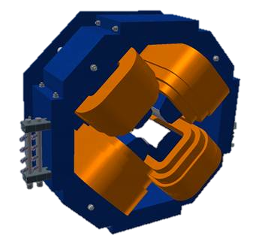
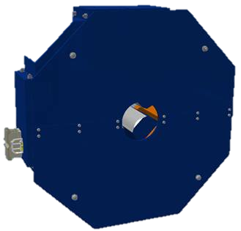
Magnets: EWU Quads
Laminated:
Scans & tuning less time consuming
Cheapest solution, given the quantities (N > 20)
Longer versions? Add laminates + change coils!
Magnetic shield
Technology study:
DC-powered:
Off the shelf power supplies
Limited resistive losses (low J)
Pulsed operation?
Expensive power supplies (10x) with limited benefit
Notes:
Longer versions?

Slide 22
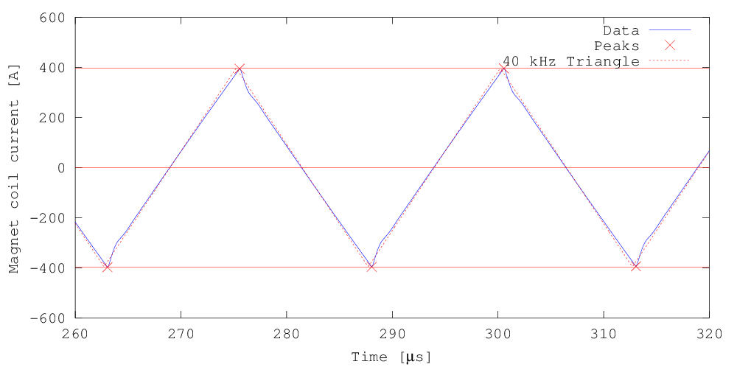
Raster System
200 mm
160 mm
Raster magnets:
Window frame ferrite yoke
Cu windings (air-cooled)
Ceramic pipe, Ø80 mm
NI = 4 x 340 A (peak)
± 5 mT.m peak field
IGBT-based H-bridge
140 mm

Slide 23
Hardware
Detailed studies: Impact of non-ideal waveforms

Slide 24
HEBT: 4 Principal Sections
Upgrade High Beta (UHB)
Contingency towards unexpectedly poor SC linac performance: extra HB cavities can be installed!
Transport section being mechanically identical to the MB+HB linac (apart from cryomodules, etc.)
Adjustable collimators (would be excluded by upgrade)
Achromat (ACH)
4.5 m vertical shift of the beam from linac to target level
Reduce dispersive effects
Accelerator to Target (A2T)
Reduce the beam peak intensity on the target (BEW) and proton beam window (PBW), cooling + radiation damage.
Strong requirements for the beam on PBW + BEW (several zones defined for each element)
Beam Dump Line (DMPL)
Dispose pilot beam during tuning of the linac.
Up to nominal beam energy x low duty cycle => 50 kW (7.5 kW avg. beam power, passively cooled)
Insensitive to energy fluctuations (in line of sight with linac)

Slide 25
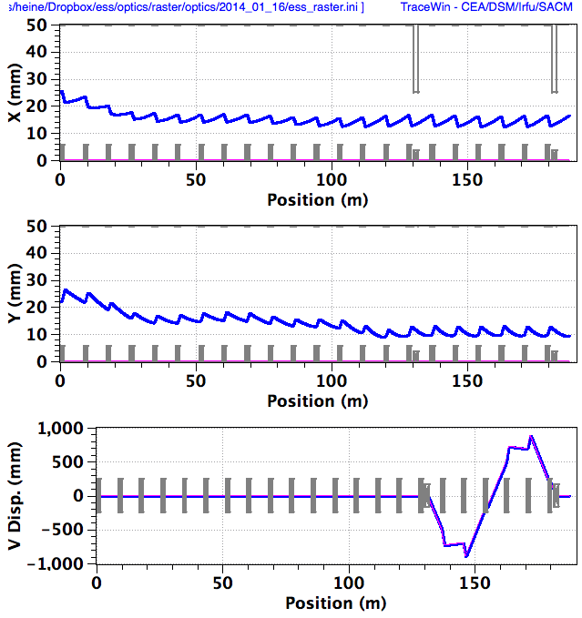
Contingency Region ~ HB Linac
M
C
R
ACH

