Slide 1
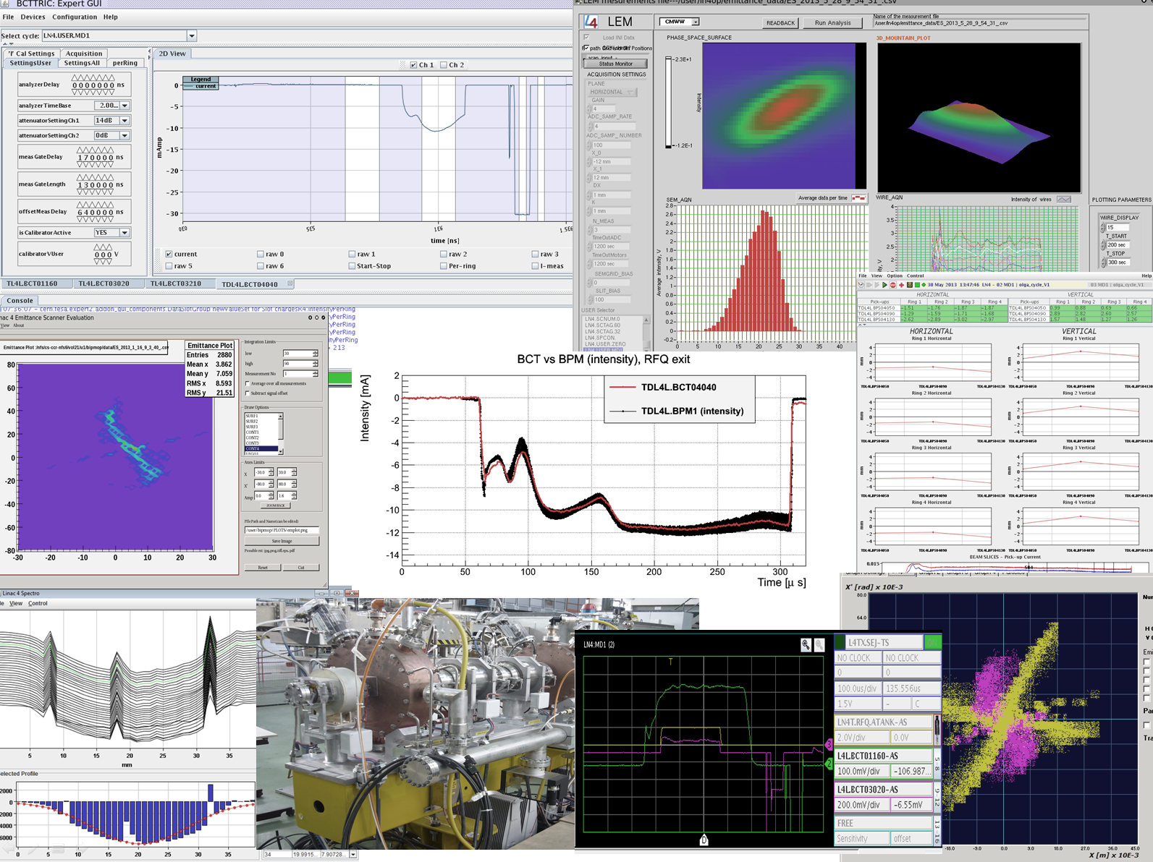


EuCARD2/ Proton Linacs beam commissioning workshop - ESS
Linac4 commissioning results
and lessons learnt
J.B. Lallement, for the L4 commissioning team.
9 April 2014

Slide 2
Linac4 : 160 MeV, H- accelerator
Design parameters : 65 mA, 352.2 MHz, 1.1 Hz, 400 µs.

Slide 3
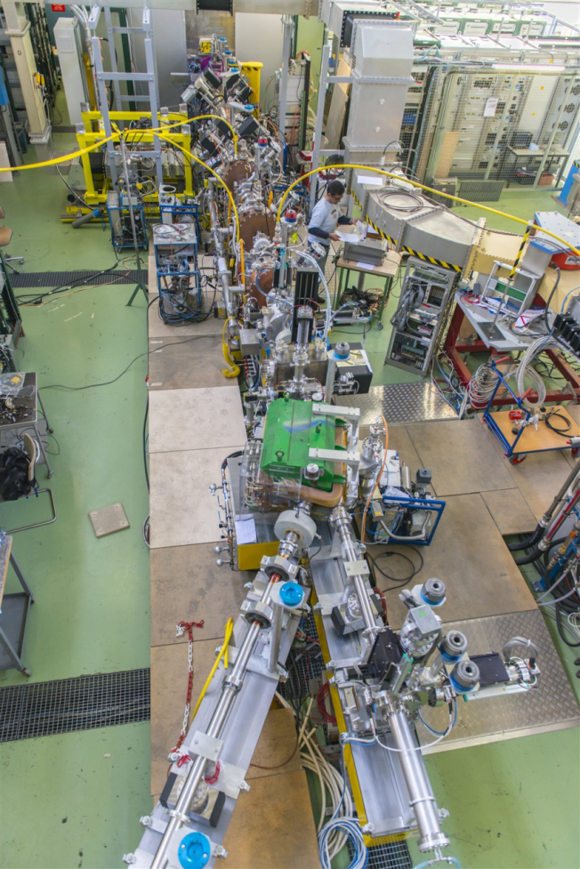
2 first commissioning stages completed
The 3 MeV test stand : First half of 2013
Temporary location on surface where the H- Source, LEBT, RFQ and MEBT were successively installed and commissioned.
3 MeV “Tunnel” commissioning : Nov-13 to Mar-14
Re-commissioning of the 3 MeV line in one go.
New power supplies, new electronics, LLRF …
To follow:
- DTL tank 1 at 12 MeV : May-Jun-14
- DTL tanks 2 &3 at 50 MeV : Sep-Oct-14
- CCDTL at 100 MeV : Dec-Mar-15
- PIMS at 160 MeV : Aug-Oct-15
- One year reliability run in 2016

Slide 4
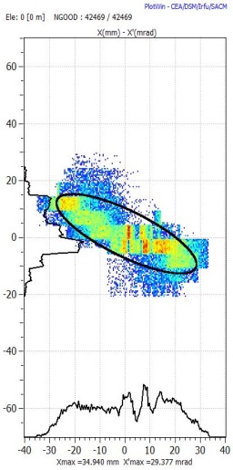
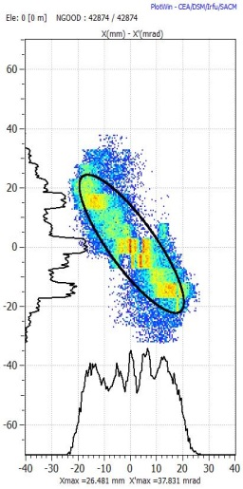
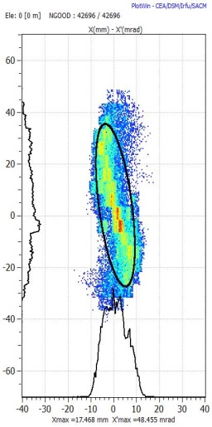
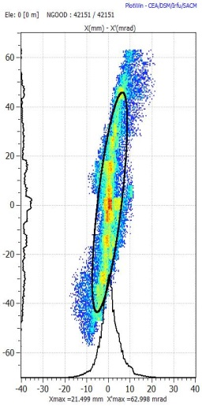
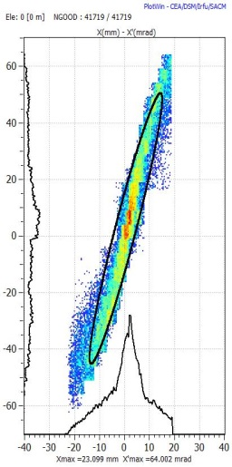
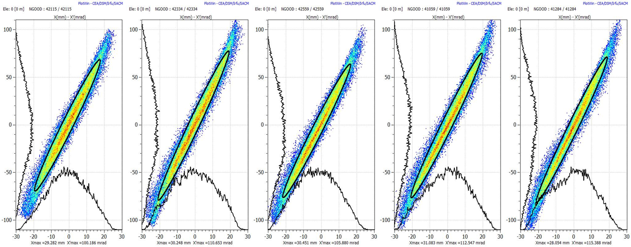
Transverse emittance from the source
Source
Sol
ε measurement
Sol
Preliminary version of the source :
15 mA – 0.7/0.8 mm.mrad.
( IS-02 – 50 mA extracted)
Transverse emittance measured for different solenoid settings.
Beam reconstructed at source output and effective space charge estimate.

Slide 5
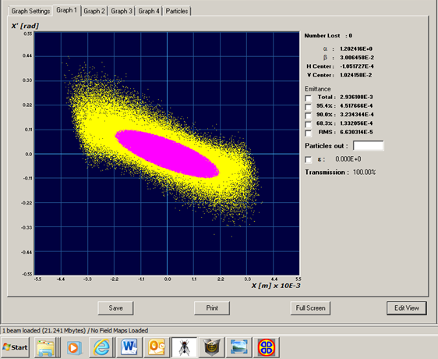
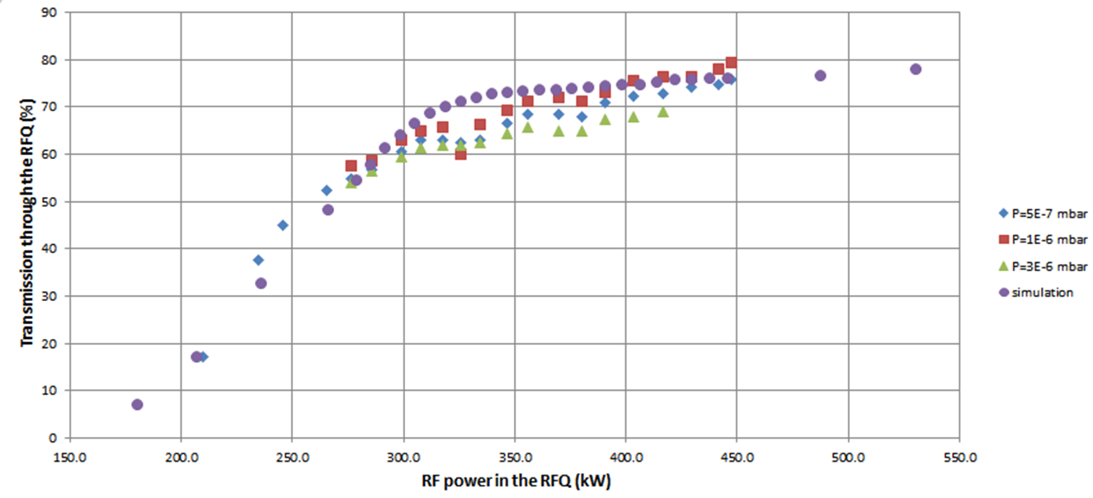
RFQ transmission: As expected
RFQ simulated with Parmteq (LANL) and Toutatis (CEA).
Input beam distribution from the LEBT measurements.
The acceptance is smaller than the beam emittance at the test stand!
Everything OK after it was moved to the tunnel !

Slide 6
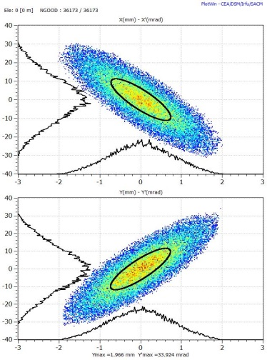
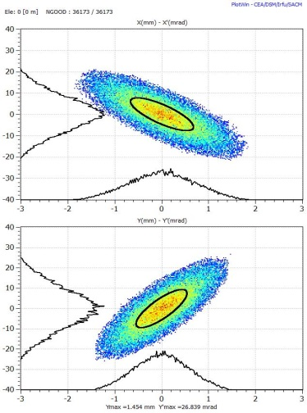
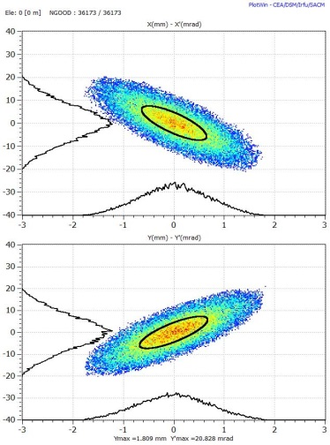
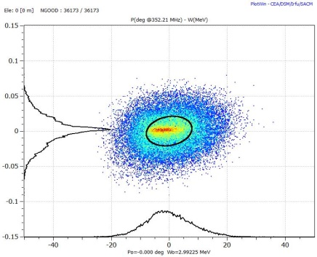
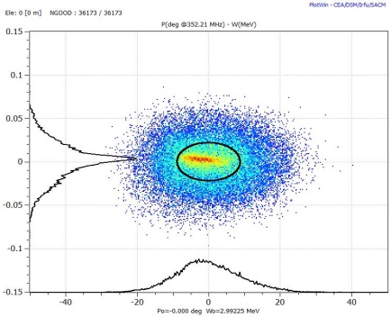
RFQ output beam is OK
Transverse and longitudinal emittance reconstruction
Simulations | 3 MeV test stand | Linac4 tunnel
 | Expected | Recons.
ΔE (keV) | 21 | 22
Δφ (°) | 7.8 | 8.8

Slide 7
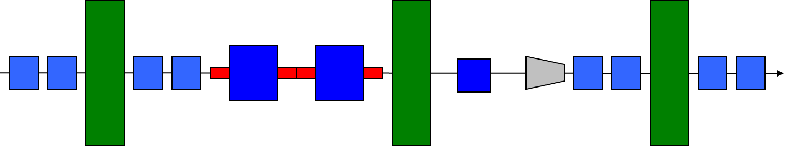
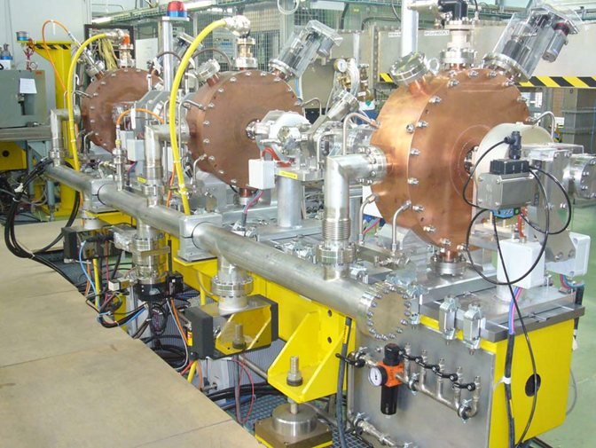
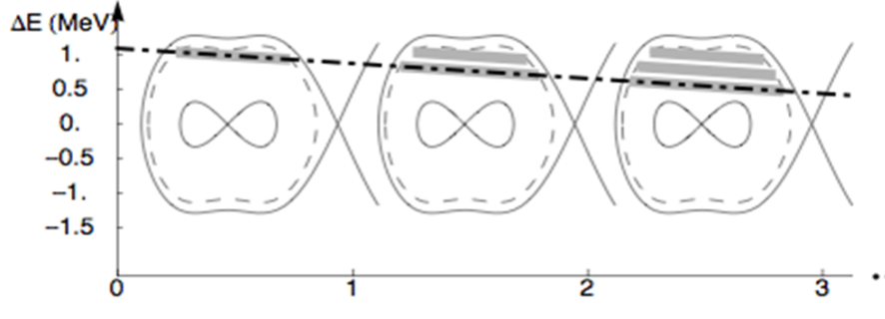
A fast chopper in the MEBT
GREEN=BUNCHER
BLUE = QUADS
RED = CHOPPER
GREY = DUMP
Linac4 at 352 MHz – PSB at 0.99 MHz
-> Remove 135 microbunches over 355
220
135
220
135
220

Slide 8
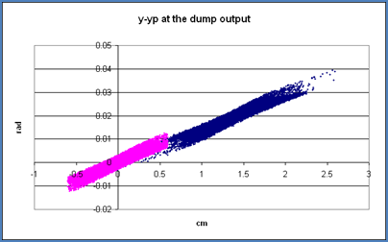
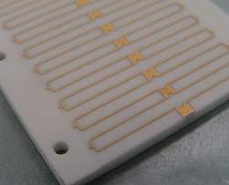
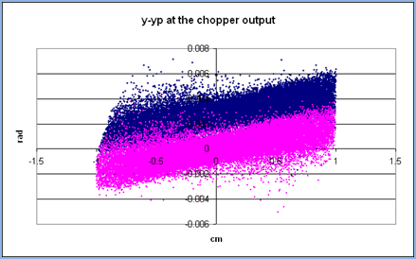
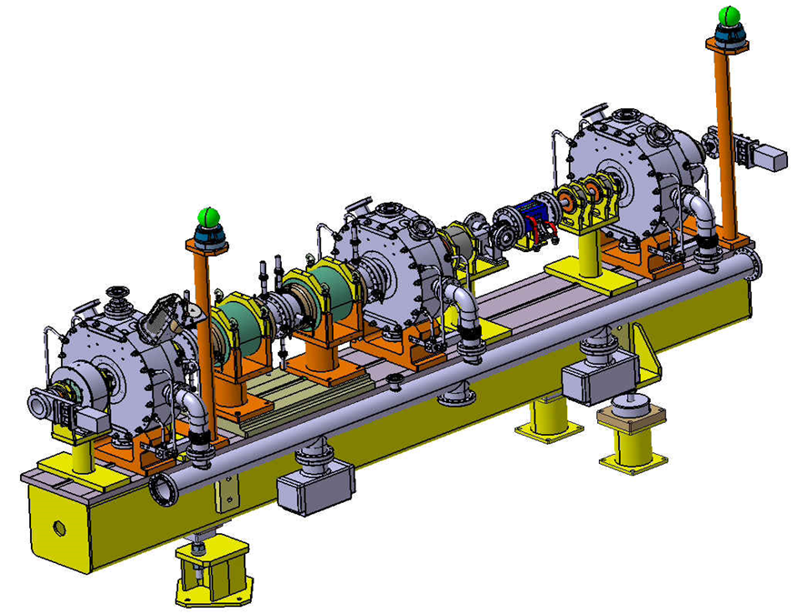
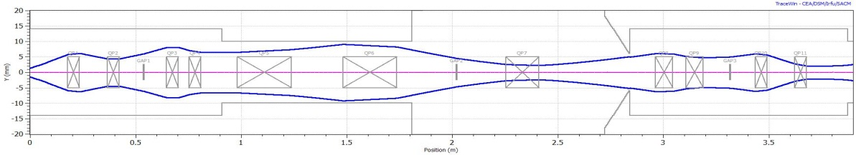
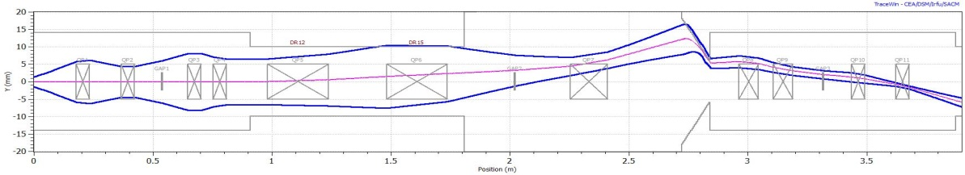
Chopper principle
Micro-bunches are shifted in the phase space by a voltage applied between two plates.
Relatively low voltage to allow for short rise/fall time.
Shift transferred in the real space at the dump – Appropriate phase advance.

Slide 9
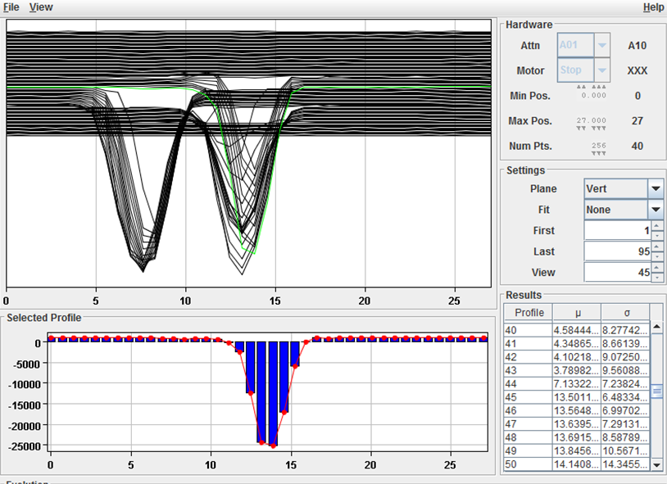
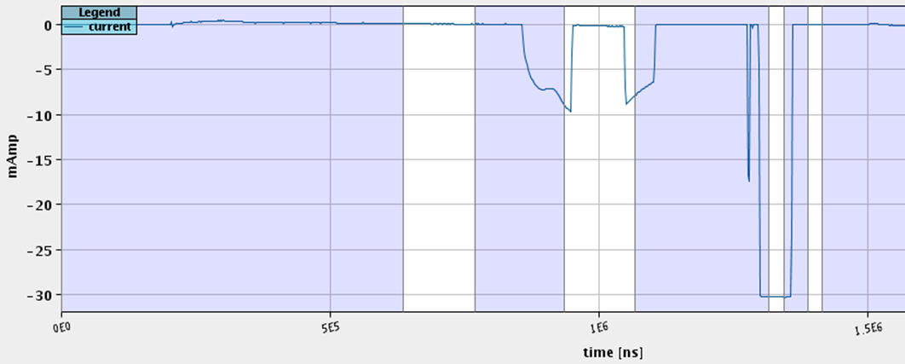
The chopper is working
The chopper line dynamics is validated !
Fall and rise time < 10 ns !

Slide 10
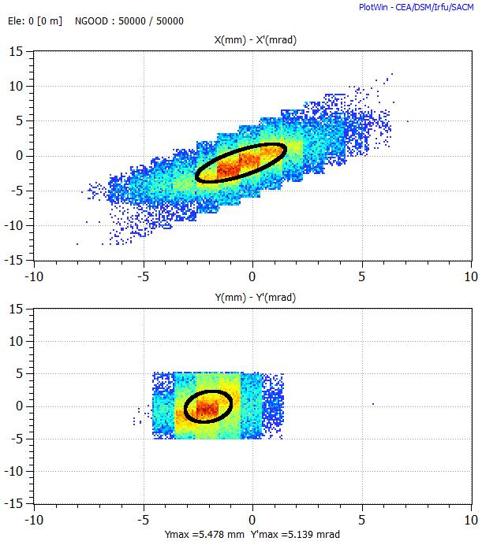
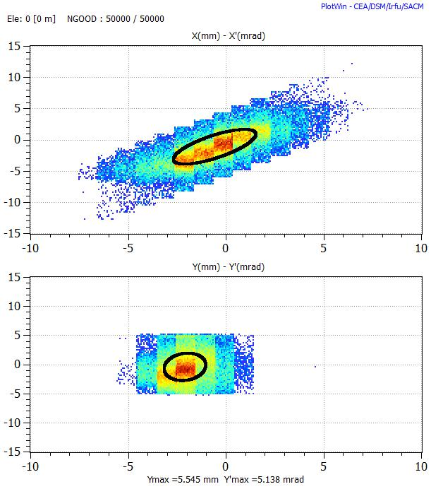
Transmitted beam not affected by the chopper
Emittance of un-chopped beam is similar to the emittance when the chopper is OFF !

Slide 11
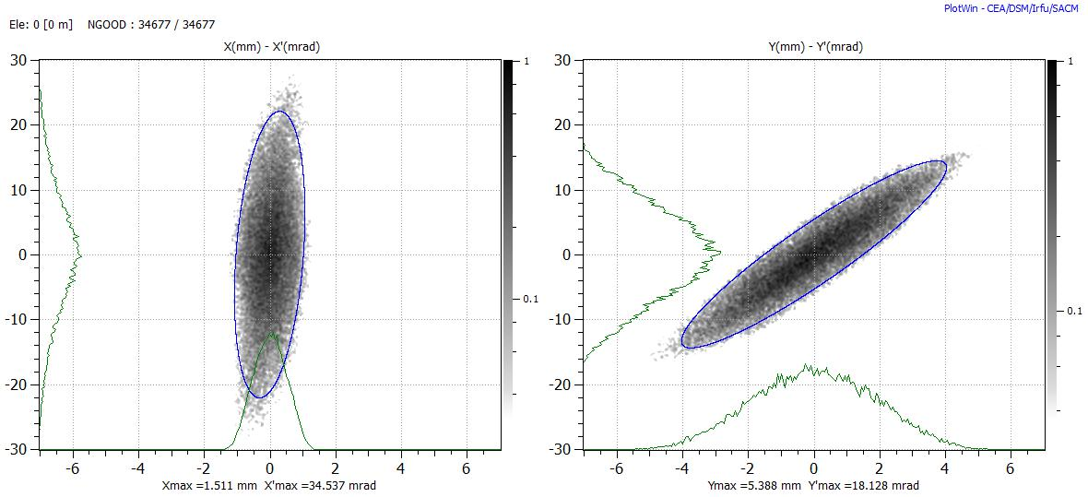
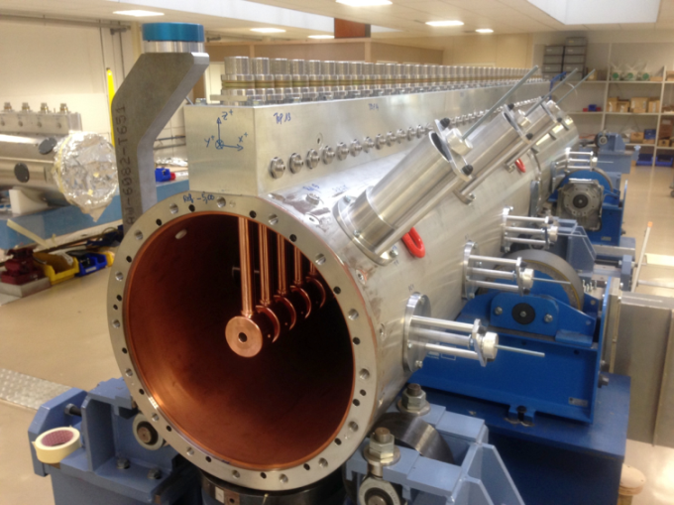
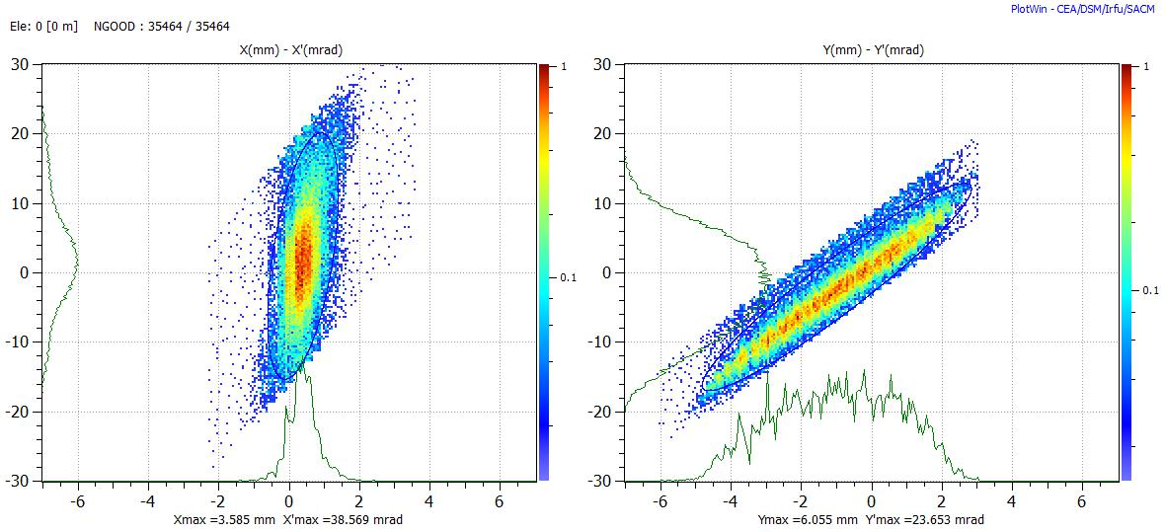
Beam matched to the DTL
Quads adjusted within +/- 5% wrt design values
Quads at design values
95% transmission.
As predicted by the simulation codes (TraceWin and Travel)
  And the fine tuning will be done in few weeks, once the DTL tank1 in place.

Slide 12
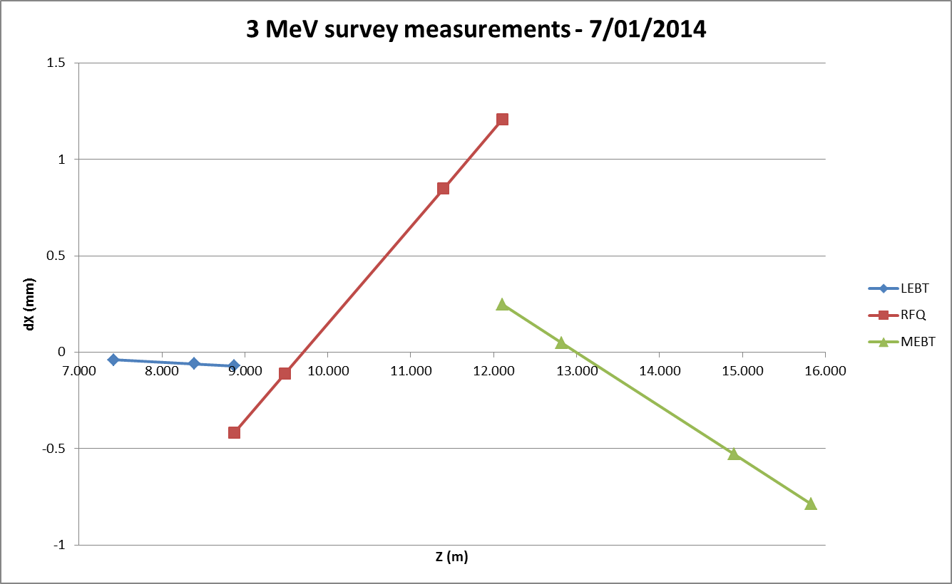
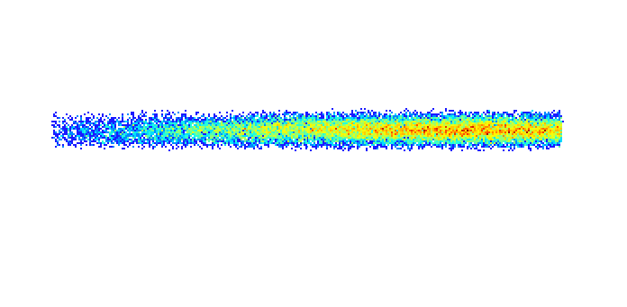
Lessons learnt – 1
Yes, a 10 mA – 3 MeV - 0.04 % duty cycle beam can damage the line !
A beam misalignment at the RFQ/MEBT interface combined with unlucky quadrupole settings entailed a vacuum leak on the bellow downstream the 1st buncher cavity.
1 mm
Thanks to the prompt reaction of the different WP involved, we were able to restart beam commissioning within 3 working weeks.
The bellow was replaced and the line realigned.
Such an event will not happen again with the watchdog deployed.
Bellows with inner diameter smaller than the beam pipe will be progressively replaced.

Slide 13
Lessons learnt - 2
LEBT :
  The extensive measurement campaign on the LEBT has been a very good investment : Input beam distributions, SC compensation etc…
  Measurements on IS02 in a dedicated test stand are going on.
RFQ : Went very smoothly thanks to the point mentioned above.
MEBT :
  Not only beam commissioning, but also diagnostics and different systems…
  Good agreement between simulations and measurements : Simulations were very useful in parallel of the commissioning . Ex.: Diagnostic and LLRF setting up.
  Redundancy in diagnostics and measurement methods. Ex. : Spectro vs TOF, SEM-Grids vs Wire-Scanners…
  3 and 12 MeV commissioning stages also used to validate the measurements techniques for 50, 100 and 160 MeV.

Slide 14

Thank you for your attention
Questions ?

Slide 16
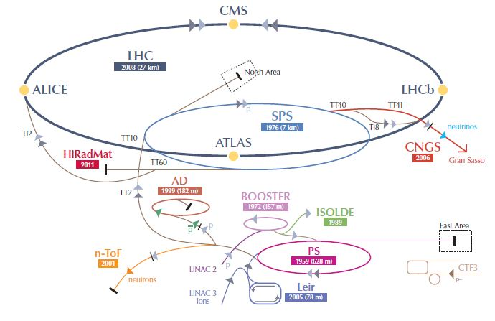
Linac4 : A new injector for the CERN proton complex
Replace the 50 MeV Proton Linac2 (1978)
160 MeV, H⁻ injection.

Slide 17

The 3 MeV test stand
Validate Source, LEBT, RFQ and Chopper-line
Source – 45 keV
LEBT
RFQ
MEBT
Diagnostic bench
The low energy section is the most difficult part to master in a Linac:
Space charge
Critical devices – RFQ and Chopper
The measurements at the test stand took place during the first half of 2013.

Slide 18
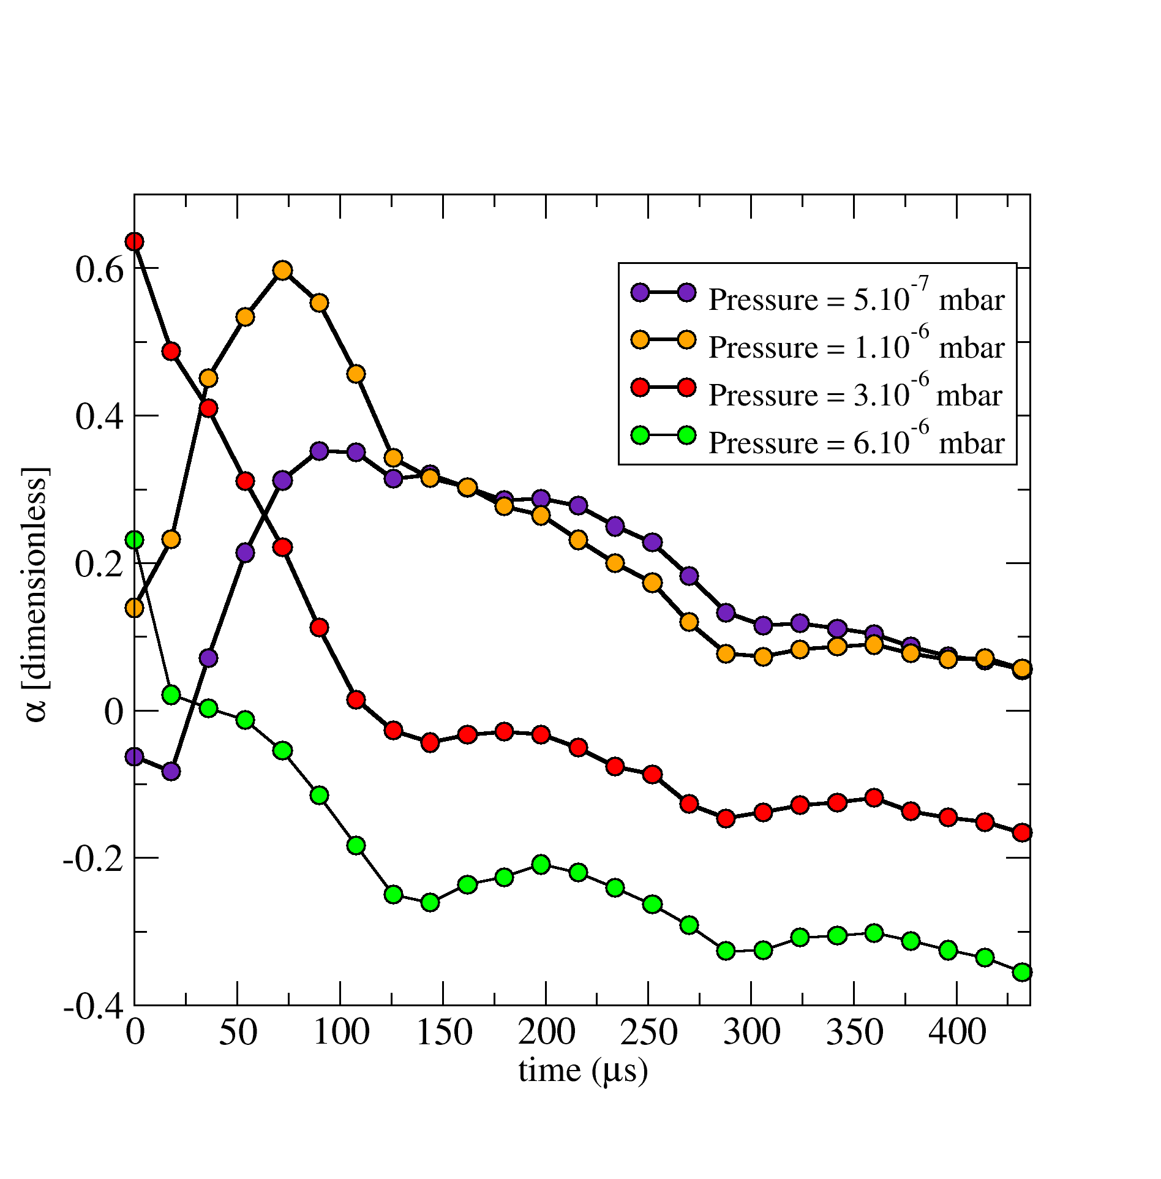
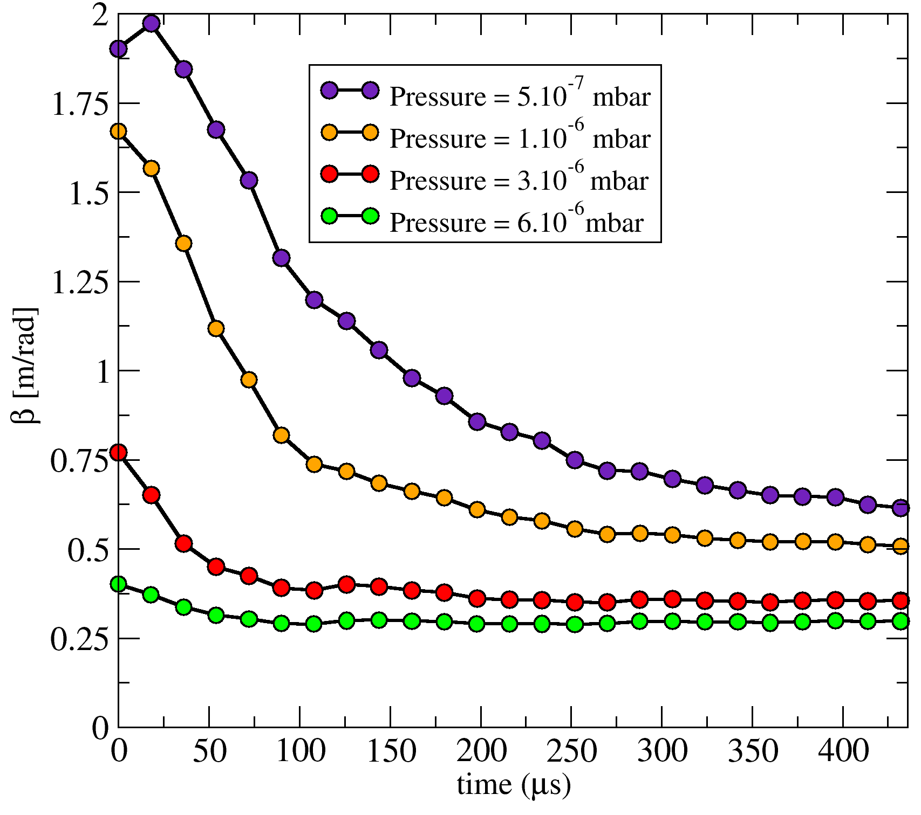
Space charge compensation in the LEBT
Space charge compensation : Effects of space charge can be reduced by secondary particles created from ionization of the residual gas.
Influence of the pre-chopper still need to be measured

Slide 19
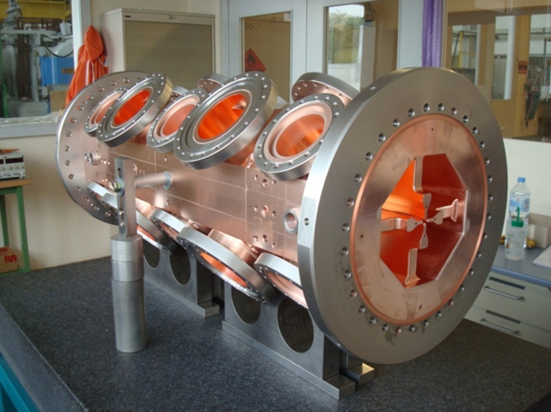
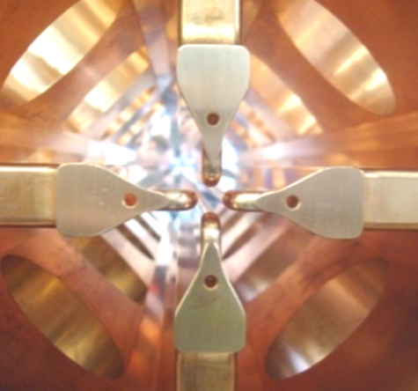
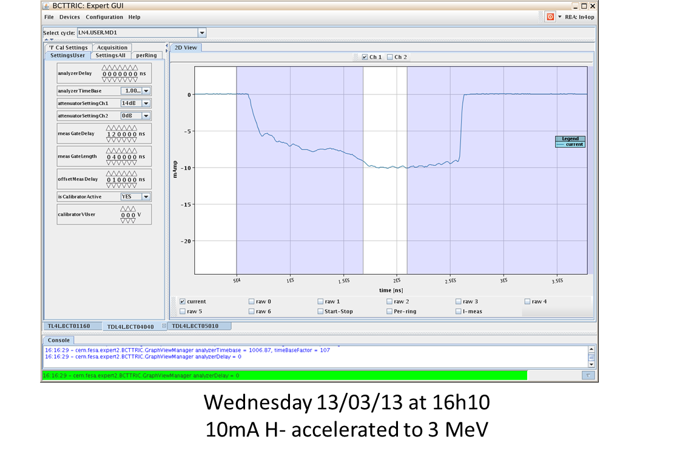
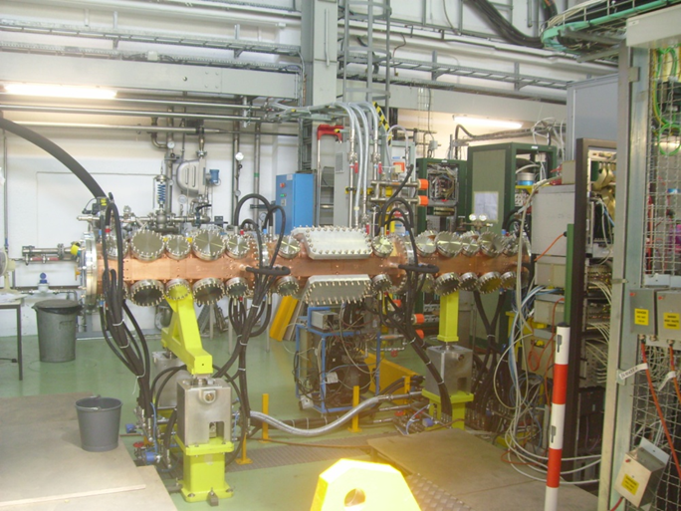
The Linac4 RFQ
4 vanes
352.2 MHz
3 m
Designed and manufactured at CERN

Slide 20
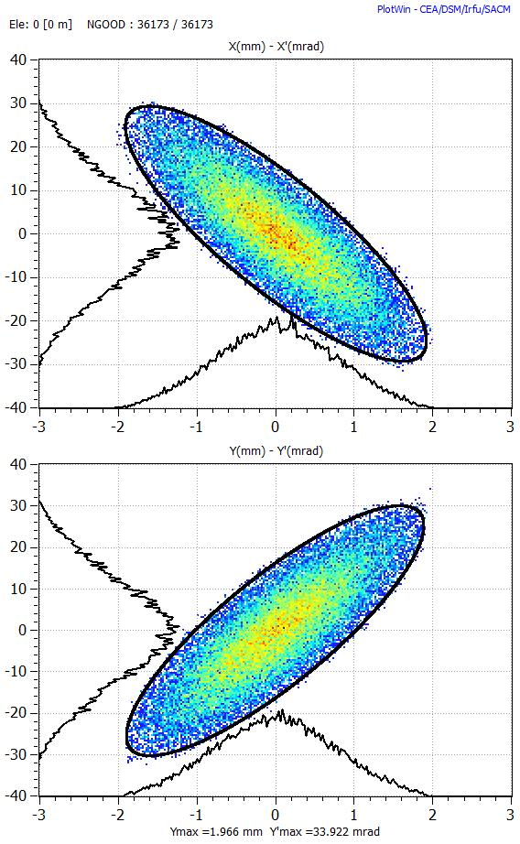
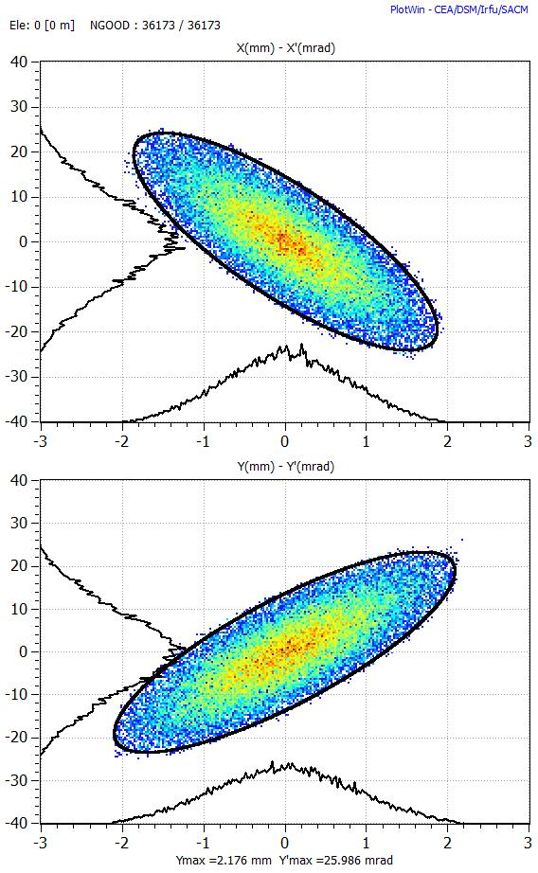
RFQ transverse emittance reconstruction
Transverse emittance was reconstructed using the 3 gradient method
Expected from simulations
Reconstructed
 | Expected | Recons.
α_{x} | 1.54 | 1.35
β_{x} (mm/mrad) | 0.12 | 0.13
ε_{x} (mm.mrad) | 0.36 | 0.31
α_{y} | -1.56 | -1.39
β_{y} (mm/mrad) | 0.12 | 0.15
ε_{y} (mm.mrad) | 0.37 | 0.34
Measurements are very close to our expectations !

Slide 21
A fast chopper in the MEBT
GREEN=BUNCHER
BLUE = QUADS
RED = CHOPPER
GREY = DUMP
Linac4 at 352 MHz – PSB at 0.99 MHz
-> Remove 135 microbunches over 355
220
135
220
135
220

Slide 22
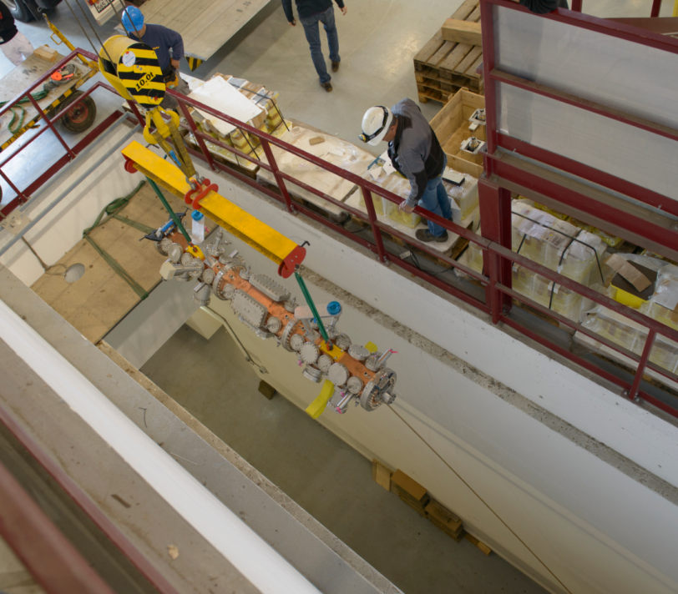
3 MeV test stand is a success
Better understanding of the LEBT dynamics
RFQ as expected
100% chopper efficiency – 10 ns
Beam dynamics models and tracking codes validated
Commissioning strategy and measurements techniques are OK

Slide 23
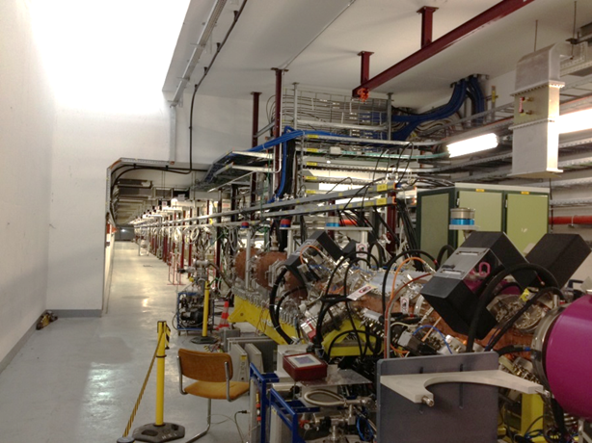
Still 157 MeV to go…
3 MeV commissioning in the tunnel starting in 2 weeks
Time resolved measurement of chopping on the ns scale
Spectrometry / Time Of Flight
Matching to DTL and 3rd buncher cavity
Beam commissioning interlaced with installation period until end 2015
Connection to PSB foreseen in 2017-18
Still a long …
… but quite straight way

Slide 24
Reserve slides

Slide 25
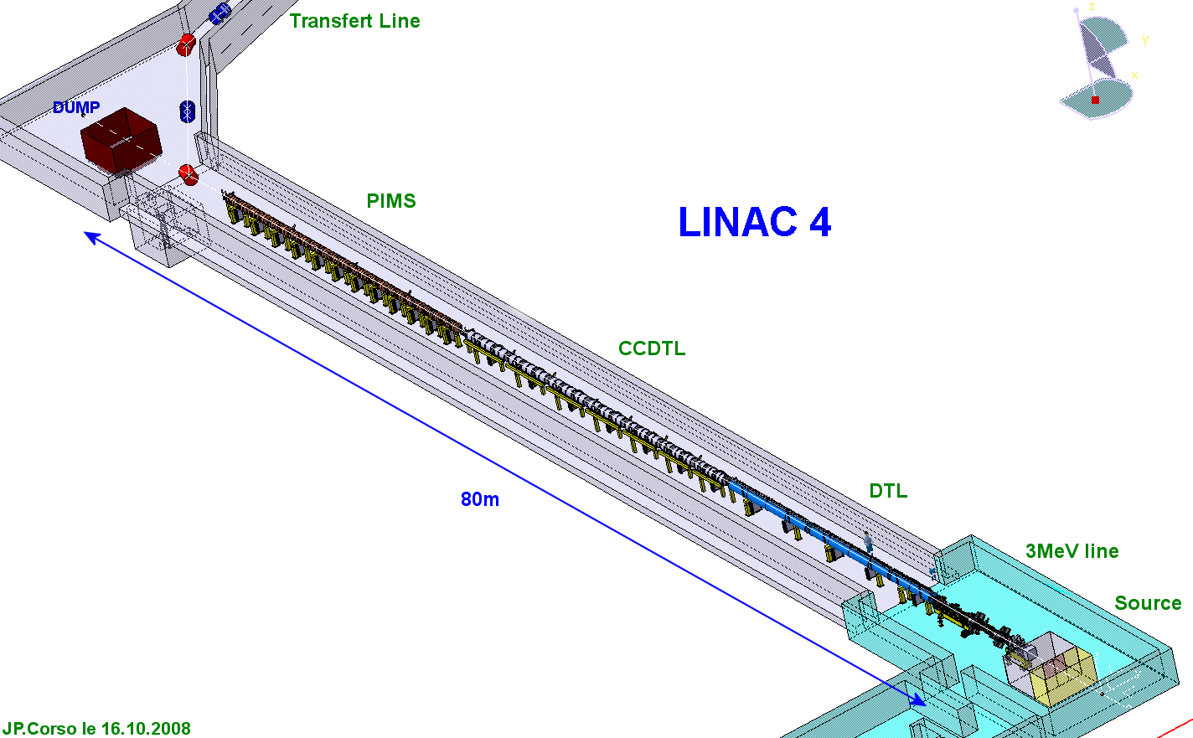
LINAC4 - layout
Drift Tube Linac
50 MeV
3 Tanks
3 Klystrons
1 EMQ
2 steerers
114 PMQ
19 m
Preinjector
3 MeV
Source(s)
2 solenoids
RFQ
11 EMQ
3 Cavities
2 Chopper units
dump
Π-mode Structure
160 MeV
12 Modules
8 Klystrons
12 EMQ
12 steerers
23 m
Cell-Coupled Drift Tube Linac
100 MeV
7 Modules
7 Klystrons
7 EMQ
7 steerers
14 PMQ
25 m

Slide 26
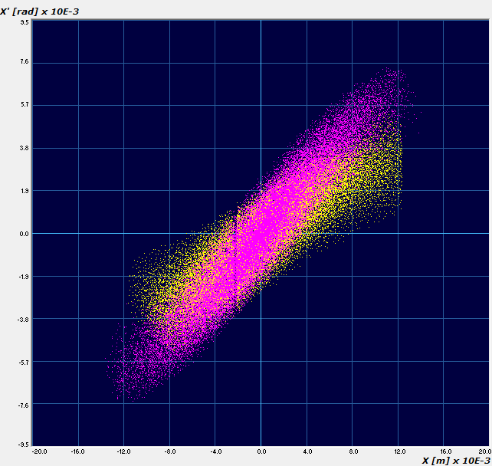
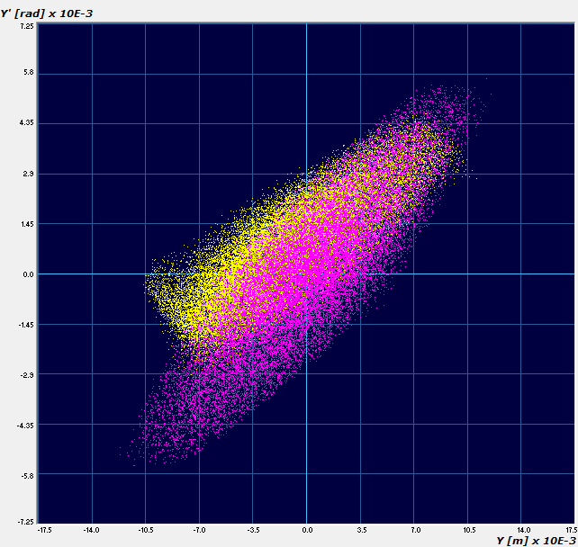
Transverse emittance-direct
Yellow = measured with protons , pink = simulations

Slide 27
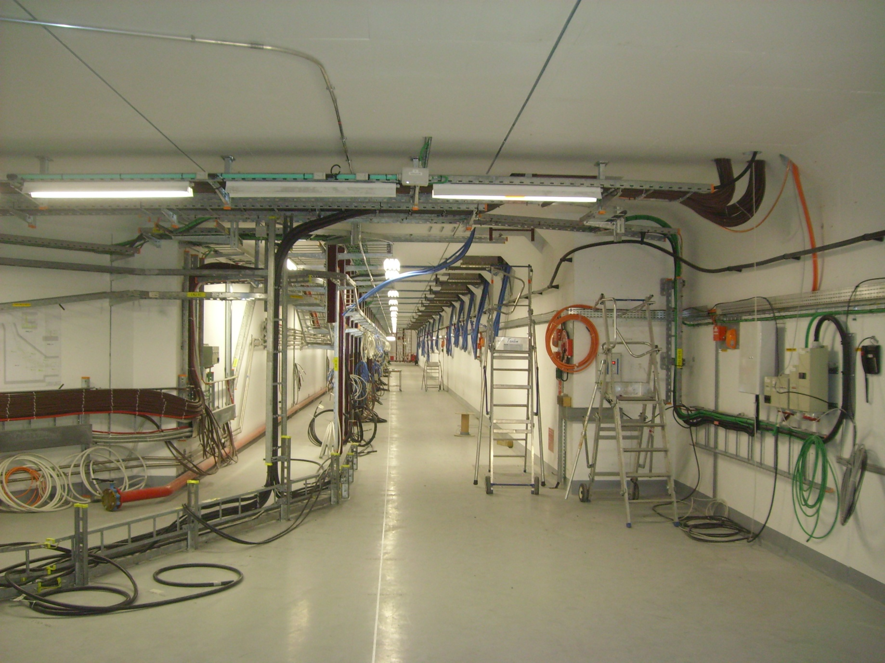
Tunnel – from high-energy side

Slide 28
TIME-RESOLVED MEASUREMENTS
Objective : Verify the correct functioning of the chopper line.
10⁴ ions
1.15×10⁹ ions
2.84 ns
Measure residual H- in (not completely) chopped buckets with a
sensitivity of ~10⁴ ions, in the vicinity of full bunches (10⁹ ions).
Detector must be turned ON/OFF within 1ns, gating ratio.
Suppress un-chopped buckets (1.15 x 10⁹ H⁻ ions).

Slide 29
The « Forward Method »
2nd step, Including space charge, iterative process with particle tracking code.
Generate a beam distribution file for a multiparticle tracking code, with parameters found at step 1.
Assume a longitudinal distribution (simulations and BSM).
Launch a series of statistical runs of the measurement line by varying the beam input transverse parameters (α, β, ϵ) at each run.
At each run, simulated beam size at the monitor locations is compared to measured values to get a convergence criteria.

Slide 31
