Slide 1
Beam Commissioning at ESS
Dave McGinnis
8 April 2014

Slide 2
Why Now?
The beam commissioning plan will feed requirements to:
Beam Instrumentation
What kind of Instruments?
How many?
Performance specifications
Controls
What type of applications? Save/Restore? Data logging?
Hardware interface
Machine Protection
Beam Permit
Beam Abort.

Slide 3
Beam Instrumentation Scope
There are over 500 separate beam instruments in the ESS Lattice
We would like to find the minimal set of beam instruments that can commission the linac in a cost effective and robust manner
There seems to be an overabundance of transverse phase space instruments even though ESS is a 5 MW linac.

Slide 4
Commissioning Plans
The ESS Accelerator Integration Group would like to have beam commissioning plan for each major subsection of the linac.
In the plan we would like to see:
Objectives
Machine State required
Procedures Outlined
Instrumentation required
Applications required
Hardware required

Slide 5
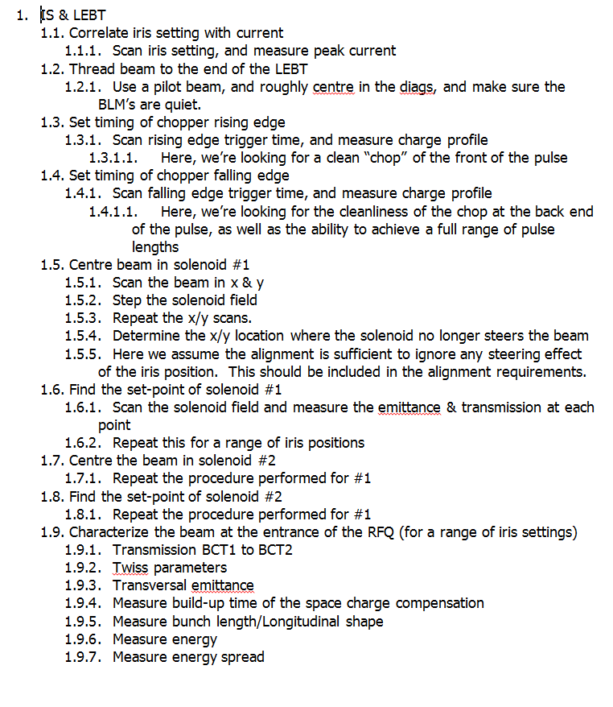
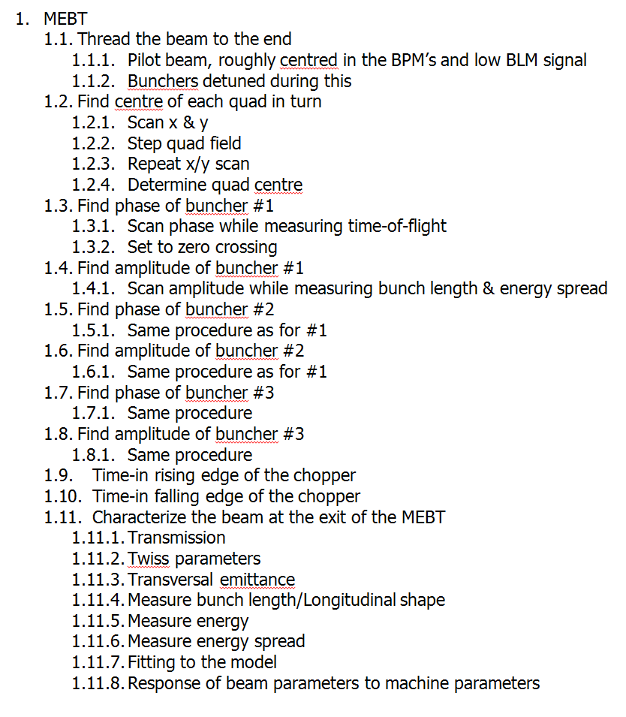
Example Procedures (S. Molloy)

