Slide 1
Paul Scherrer Institut
Design and performance of the copper collimator KHE2 in the 590 MeV beam line at PSI
Daniela Kiselev, Pedro Baumann, Daniel Laube,
Davide Reggiani, Raffaello Sobbia, Ake Strinning
PSI,
12. Mai 2014
Daniela Kiselev, Beam losses and collimators in transfer lines, 13-14.5.2014, Lund, ESS AB

Slide 2
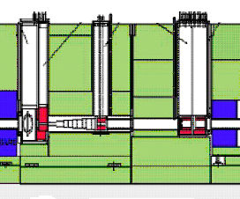
Proton beam line from Target E to KHE2&3
Target E
KHE0
KHE1
KHE2
KHE3
Target E:
purpose: meson production
4 cm graphite wheel
rotating with 1 Hz
additional beam spread:
~6 mrad
590 MeV
Protonen
Collimator system: OFHC-Cu
- protection of the beam line
reduction of beam losses
(activation)
large power deposition
@ 2.4 mA:
152 kW in KHE2
34 kW in KHE3
beam losses: 13% 16%
5m
Daniela Kiselev, Beam losses and collimators in transfer lines, 13-14.5.2014, Lund, ESS AB

Slide 3
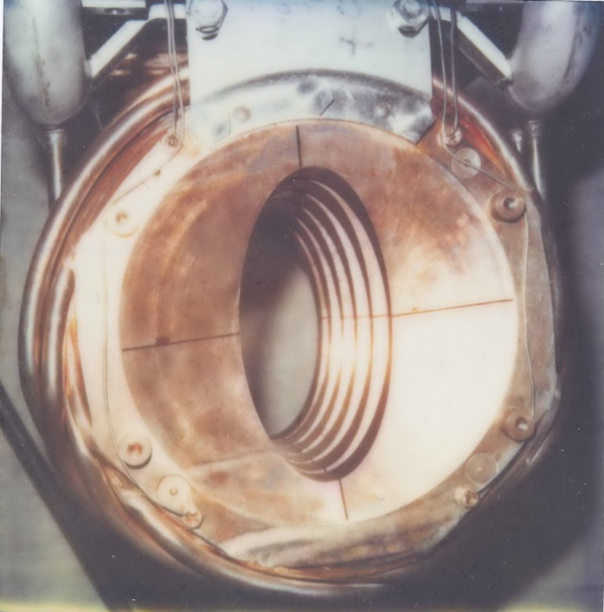
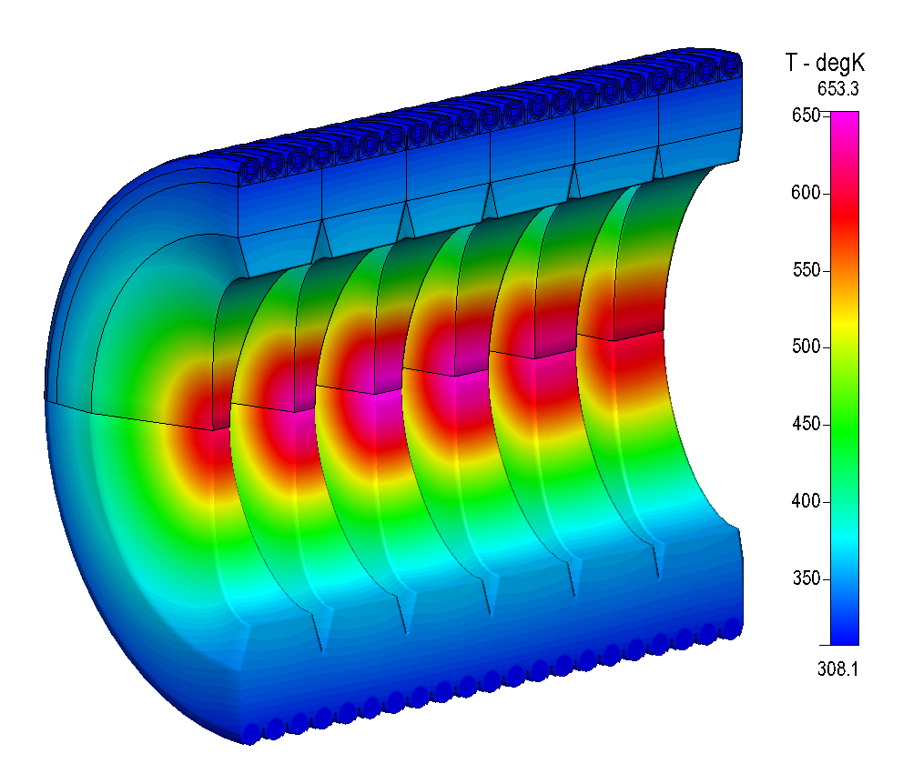
The collimator KHE2
Active cooling:
steel tubes (coated with Cu)
brazed with SCP1 at 850 ºC on Cu
5.3 m/s (limit for Cu-tubes would be 2-3 m/s)
4 Thermocouples (TC) for
temperature controlling
4 slits for thermal expansion
Temperature distribution: max: 380 ºC @ 2 mA
K
@ 2.4 mA: ~ 400 ºC
engineering limit:
homologeous temperature
= ½ of melting temperature in K
= 405 ºC
→ limit reached!
600
500
400
2mA
protons
Y.J. Lee
Daniela Kiselev, Beam losses and collimators in transfer lines, 13-14.5.2014, Lund, ESS AB
Notes:
Dimension: 26 cm Durchmesser, 16 cm vertikale Öffnung, 8 cm horizontal

Slide 4
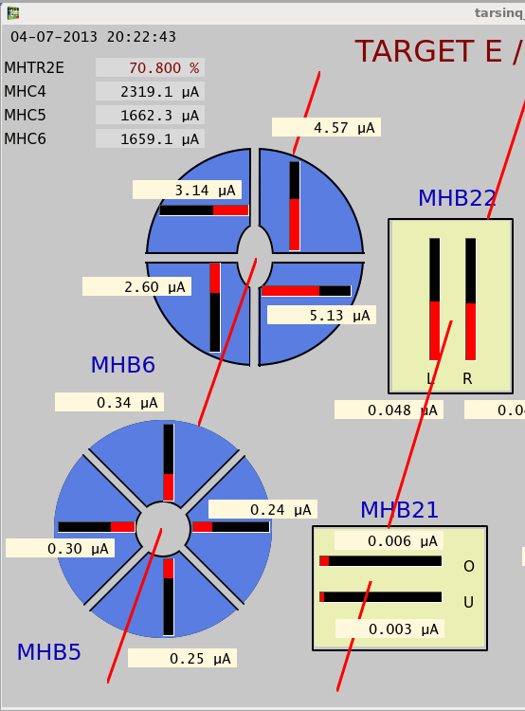
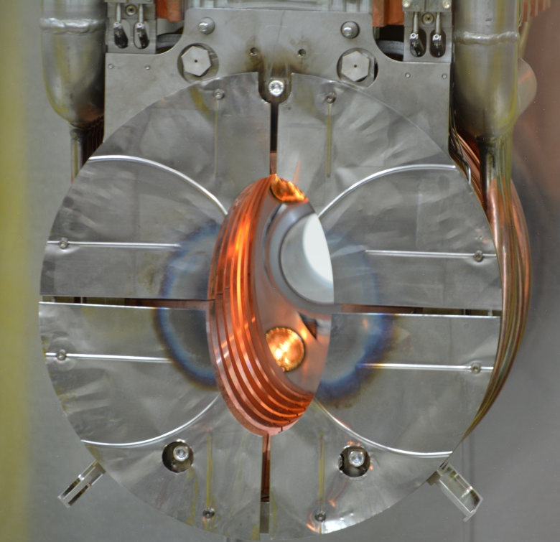
Diaphragm in front of KHE2
PIC
127 μm Ni- foil, isolated from KHE2:
production of secondary electrons
small current
measure of beam position
included in interlock system
online monitoring in control room
Daniela Kiselev, Beam losses and collimators in transfer lines, 13-14.5.2014, Lund, ESS AB

Slide 5
Shielding
Concrete shielding
Concrete shielding can be removed
by crane
4 m
inflatable
seals
Working platform
Target E
Collimators
Steel shielding: ~ 2.5 m
2.5 m
Local shielding:
10 cm Cu, water cooled
Inserts can be removed
by exchange flask & crane
5 m
Daniela Kiselev, Beam losses and collimators in transfer lines, 13-14.5.2014, Lund, ESS AB

Slide 6
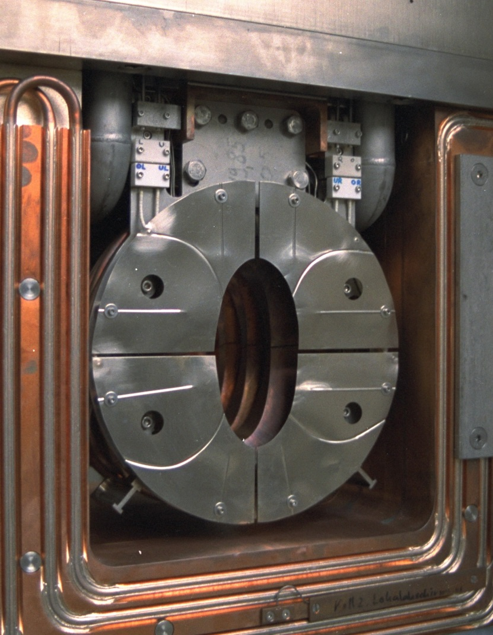
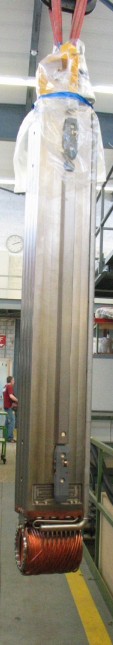
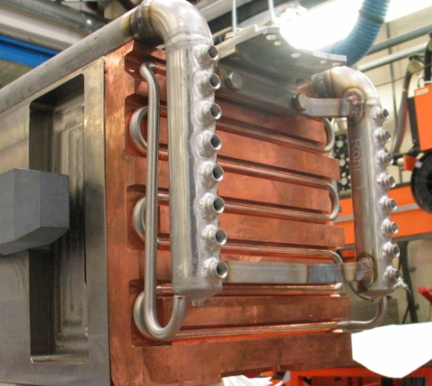
Shielding
cooling plate
main shielding
can be removed
remotely
Local shielding around the
collimator
Daniela Kiselev, Beam losses and collimators in transfer lines, 13-14.5.2014, Lund, ESS AB

Slide 7
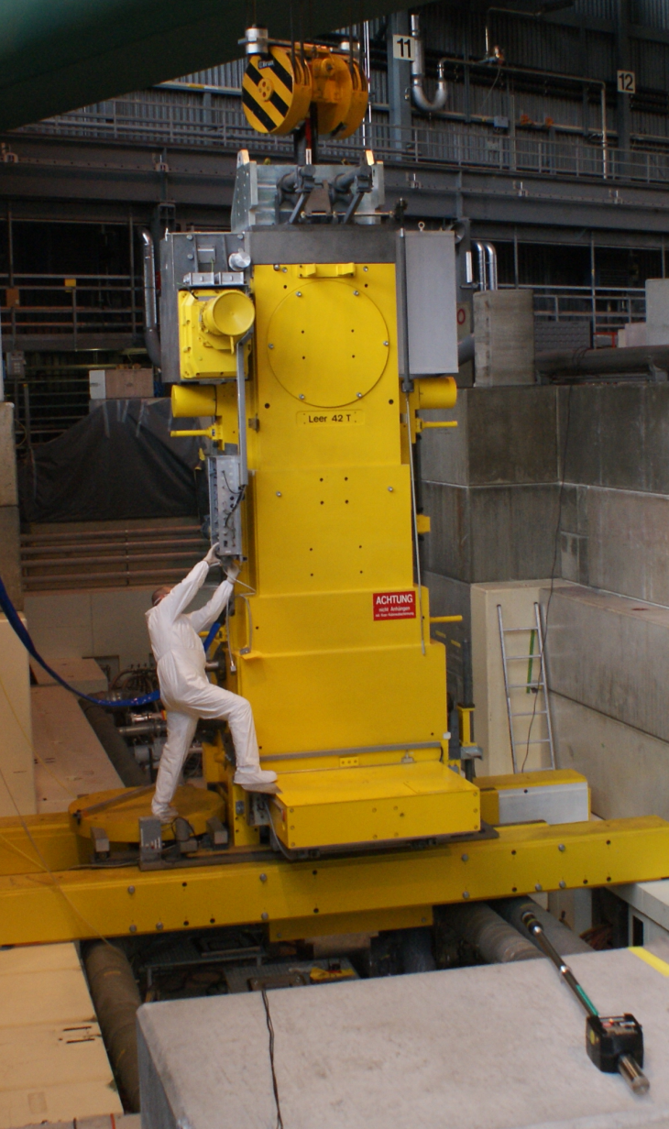
Remote control and measures for Radiological safety
Radiological control:
dose measured at several locations
Tritium monitor
Contamination protection: box around,
air is sucked out
dose rate at surface of the exchange flask:
< 2 mSv/h
box against contamination
air sucking
dosimeter: up to 45 Sv/h measured
door
bridge
Daniela Kiselev, Beam losses and collimators in transfer lines, 13-14.5.2014, Lund, ESS AB

Slide 8
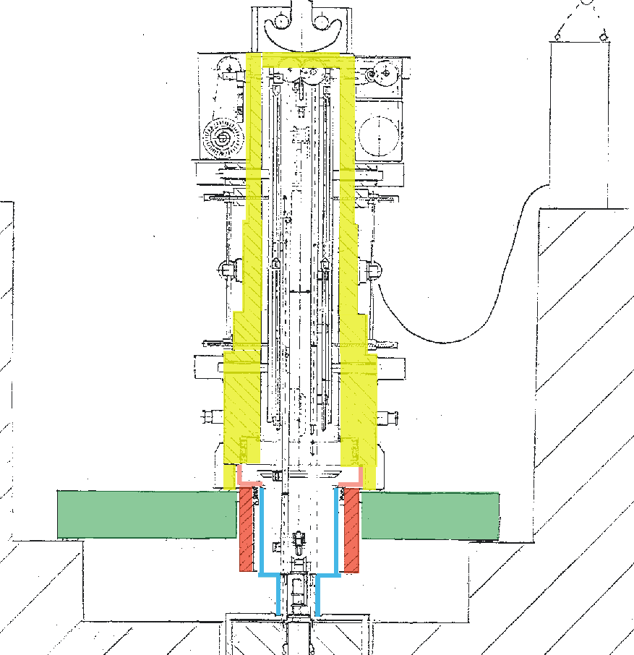
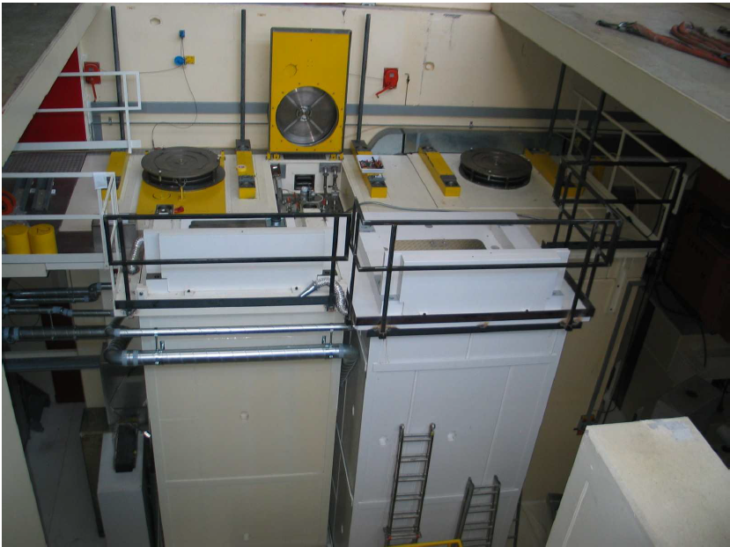
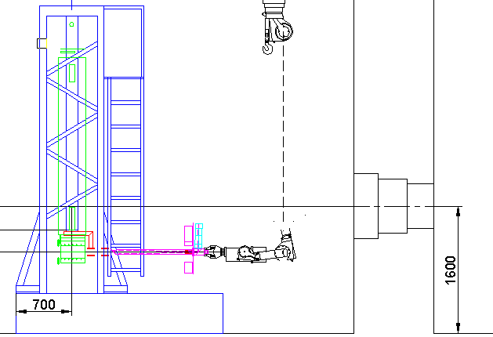
Transportation in parking slot or service cell
service cell
stand
sluice
control room
Pb-window
parking slot2
parking slot1
1 m
shielded with 50 cm heavy concrete
and 20 cm steel
remotely movable table
Daniela Kiselev, Beam losses and collimators in transfer lines, 13-14.5.2014, Lund, ESS AB

Slide 9

Dose rate of KHE2
after 19 years of operation and 3 months cooling (March 2009)
measured
calculated
MCNPX
+ Cinder’90
dose rate [Sv/h]
p
Ni aperture (127 micron)
upstream
downstream
KHE2
distance [cm]
highest dose ever measured at PSI West, limit of the dose meter: 500 Sv/h
in general: components after TargetE have dose rate between 1-10 Sv/h
Daniela Kiselev, Beam losses and collimators in transfer lines, 13-14.5.2014, Lund, ESS AB

Slide 10
Reasons for the inspection of KHE2 2009 (after 19 years)
1) Operation reliability:
after 19 years of operation: end of life time?
no replacement at hand: would take ~3/4 year
For the new KHE2&3 design:
Is OFHC-Cu a good choice ? (alternative Glidcop)
radiation damage?
change of mechanical properties:
cracks, embrittlement, therm. conductivity
high therm. load: ~150 kW at 2 mA, up to 380 ºC
→ assuming therm. conductivity unchanged
volume swelling?
There is a risk of failure after removal and reinstallation
→ good preparation, precautions and safety procedures necessary
Daniela Kiselev, Beam losses and collimators in transfer lines, 13-14.5.2014, Lund, ESS AB

Slide 11
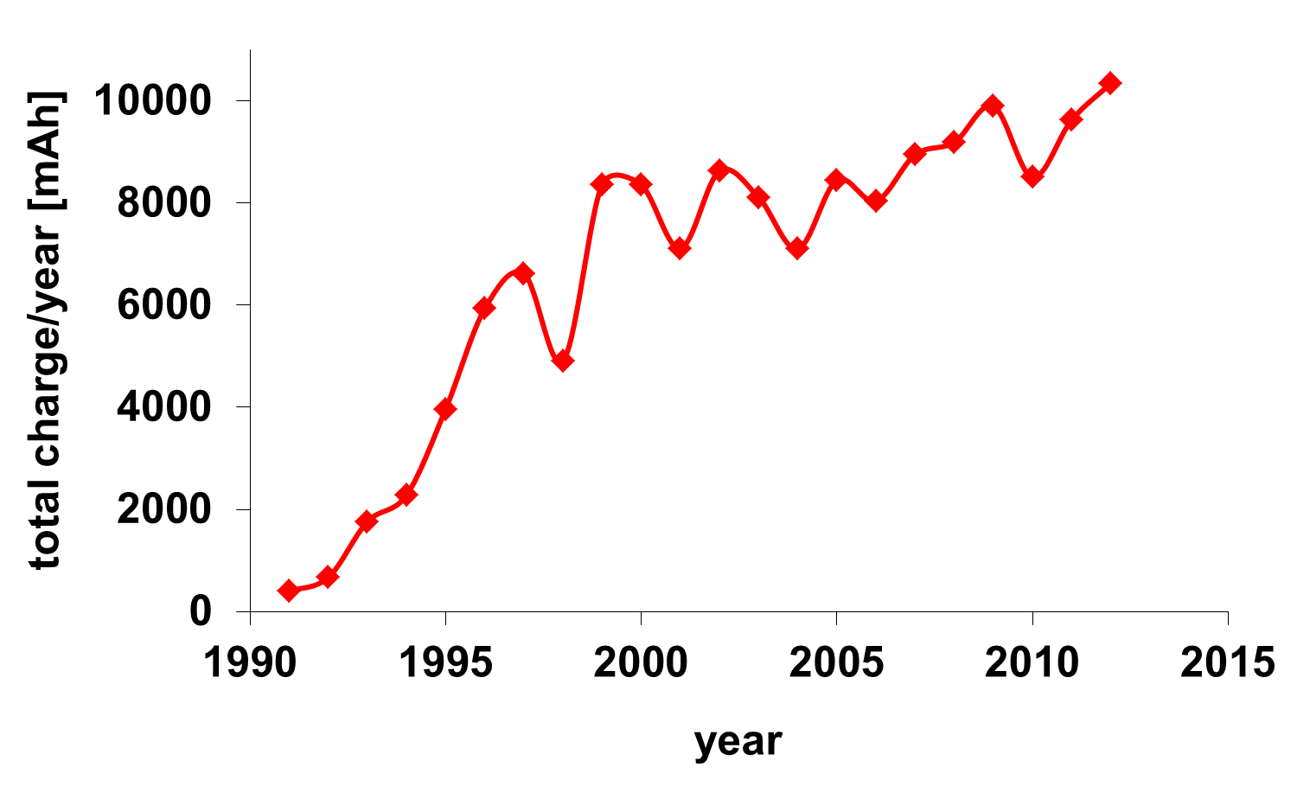
KHE2 in 2009
Current integral/year at HIPA
Current integral onto Target E:
1990-2009: 120.5 Ah
(1990-2012: 147.2 Ah)
absorbed: ~ 10%
DPA
0
10
MARS results:
1. tooth of KHE2:
31.2 DPA in average
inside: ~ 180 DPA
note: MCNPX result
~ half of this value
20
60
100
140
180
ring
4.2 DPA
Daniela Kiselev, Beam losses and collimators in transfer lines, 13-14.5.2014, Lund, ESS AB

Slide 12
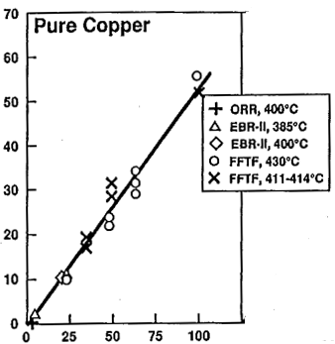
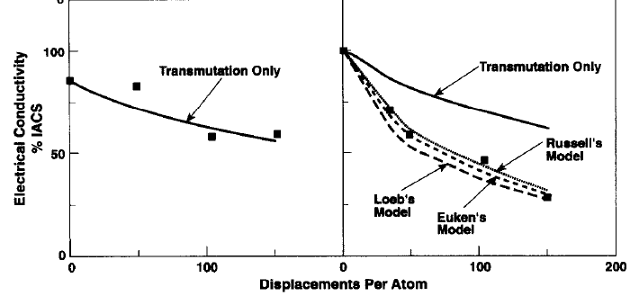
Change of properties with radiation (?)
for fast reactor neutrons
Swelling:
Thermal conductivity λ
Pure copper
0.5%/dpa
100
volume swelling %
thermal conductivity
% IACS
50
0
0 50 100 150 200
DPA
DPA
D.J. Edwards, J. Nuc. Materials 212 (1994), 404
S. Zinkle, Effects of Radiation
on Material, 15th Symposium 1992,p. 813
Transmutation products reduce λ:
here: < 10 % effect (mainly Ni)
Same effect for irradiation with reactor neutrons and high energetic protons?
Daniela Kiselev, Beam losses and collimators in transfer lines, 13-14.5.2014, Lund, ESS AB
Notes:
distribution might be not the same for dcs

Slide 13
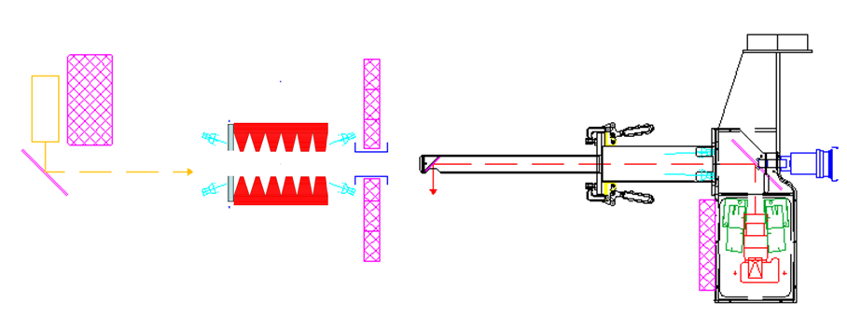
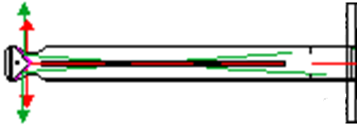
Inspection tool in the hot cell (fully remote controlled)
designed by A. Strinning
Power
Manipulator
Shielding (5cm Pb )
with support for
inspection tool
Filament
lamps
laser
Collimator
remote controlled mirror
Shielding (5cm Pb )
Tube1 with one deflection mirror
Camera
+ laser distance
meter
Tube2 with prism-like mirror
Daniela Kiselev, Beam losses and collimators in transfer lines, 13-14.5.2014, Lund, ESS AB

Slide 14
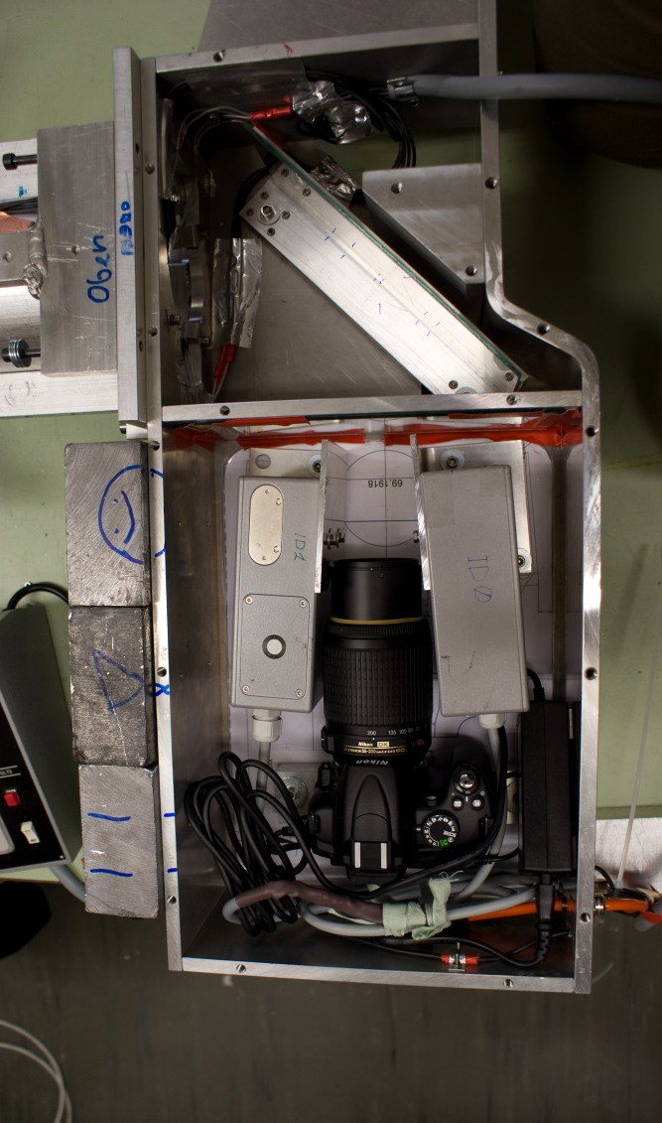
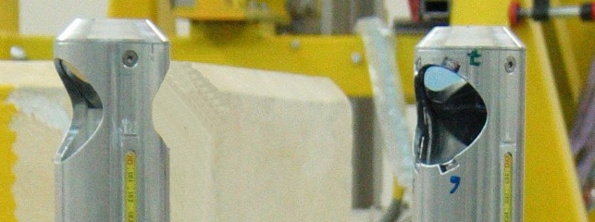
Examination with the inspection tool
mirror
constraint: contact-free!
fully remotely controlled in the hotcell
options:
- photos from inside and outside
via camera and mirror tube1
- opening of the aperture
with 2 laser distance meters
- surface roughness with a
tiltable laser beam
lead,
5 cm
Digital SLR
Camera
top part:
2 laser distance meter
Tube2 with 2 mirror
Tube1 with 1 mirror
Daniela Kiselev, Beam losses and collimators in transfer lines, 13-14.5.2014, Lund, ESS AB

Slide 15
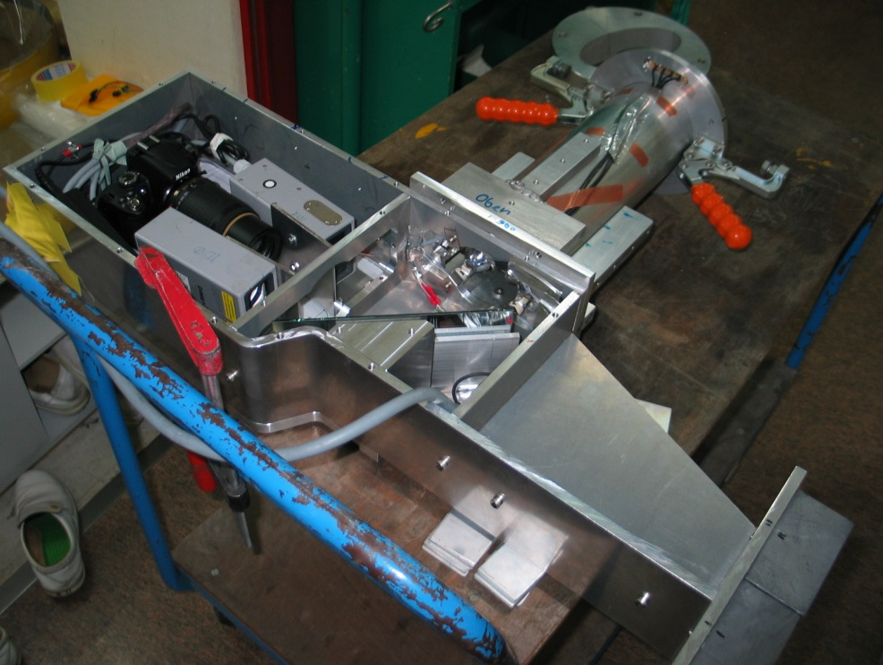
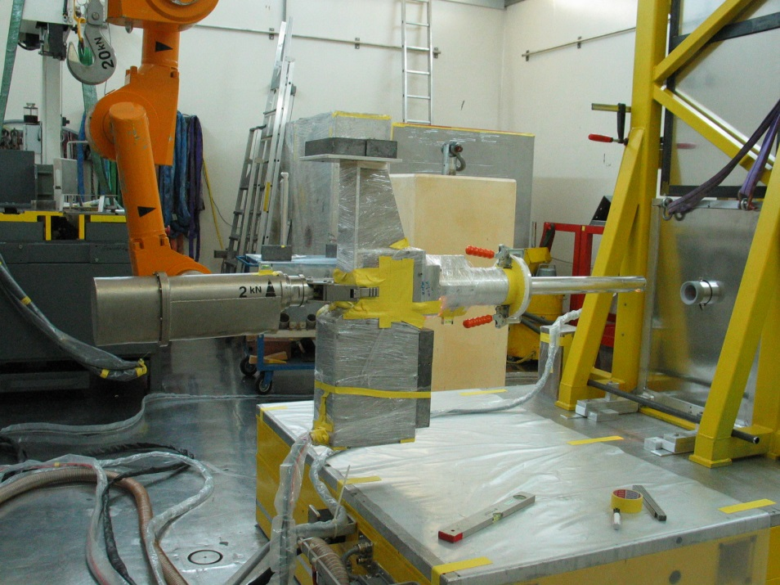
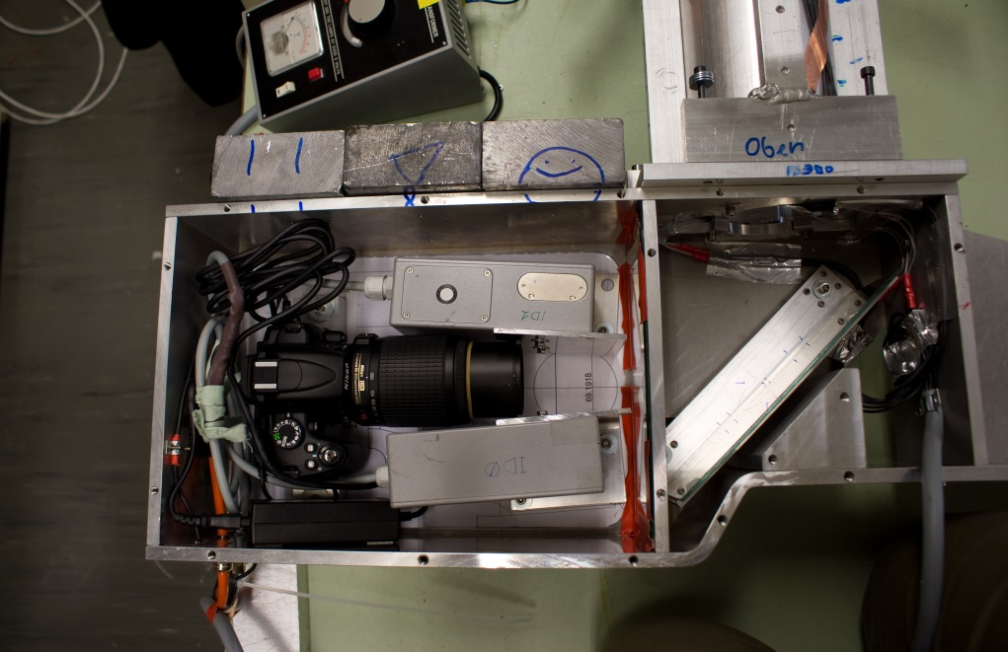
Preparation at the hotcell ATEC and tests
Against contamination:
all wrapped into plastic foil:
closed box with camera and
laser meters,
signal- and control cable in
Against damage:
guiding tube in front of collimator
Daniela Kiselev, Beam losses and collimators in transfer lines, 13-14.5.2014, Lund, ESS AB

Slide 16
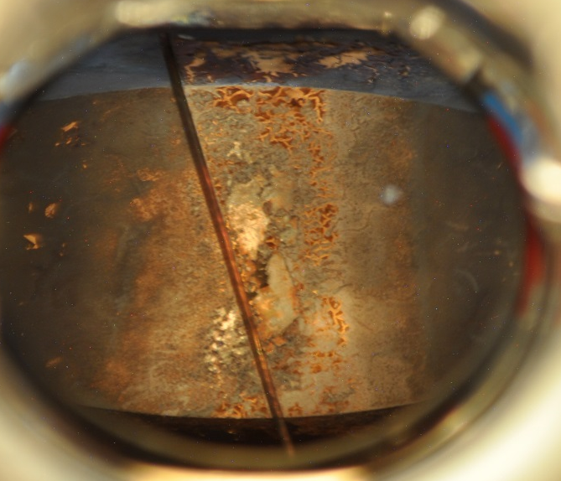
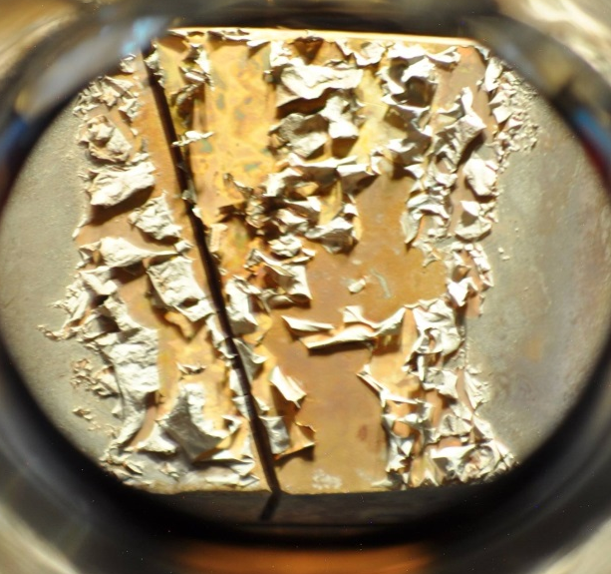
Results: KHE2 inside after 19 y. in operation
vertical: 80 - 100 ºC (2mA)
main damage at exit
→ low energetic particles produce
more damage
- some pieces (1-2 mm height)
seems to peel off
- grey surface
→ guess: errosion + dirt
K
600
500
400
2mA p
entry
exit
sample:
contains Be-7
Daniela Kiselev, Beam losses and collimators in transfer lines, 13-14.5.2014, Lund, ESS AB
Notes:
heisser durch Ni Blende

Slide 17
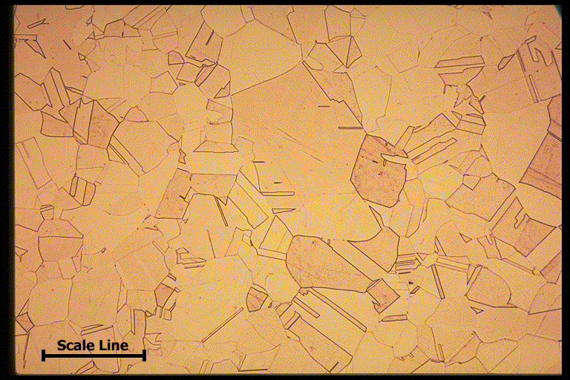
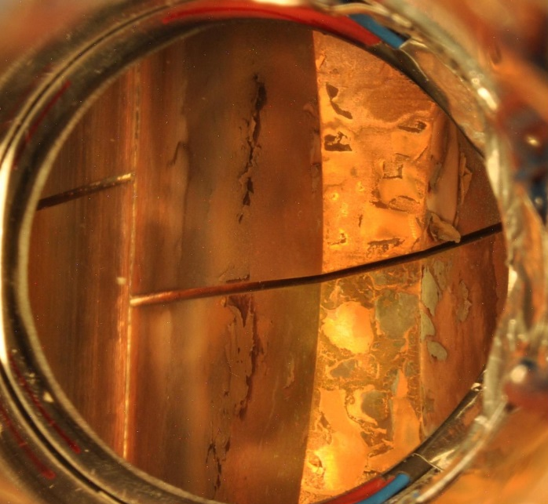
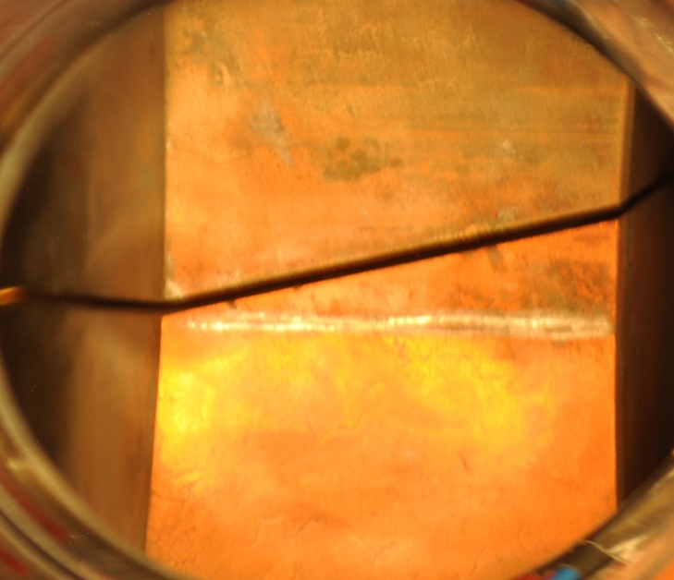
Results: KHE2 inside after 19 y. in operation
horizontal: 350 - 400 ºC (2 mA)
main damage at entry
→ higher temperature
- large grey pieces peeling off → dirt?
- seems to reveal grain boundaries
might be grown due to temperature
and irradiation
→ no swelling or deformation at slits
OFHC Cu
125 μm
slits
completely
intact !
entry
exit
Daniela Kiselev, Beam losses and collimators in transfer lines, 13-14.5.2014, Lund, ESS AB

Slide 18
Results: KHE2 inside after 19 y. in operation
Most astonishing:
no damage of the surface
between vertical & horizontal,
Possible explanation:
thermal expansion/movement close
to the slits, highest stress
Measurement of the horizontal opening
via 2 laser distance meters:
result: very close to original values
accuracy: 0.5 mm
→ no swelling observed
example: ΔV/V=0.5%/DPA
V=10x10x10mm³, 80 DPA
→ Δl = 2 x 1.2 mm
Daniela Kiselev, Beam losses and collimators in transfer lines, 13-14.5.2014, Lund, ESS AB

Slide 19
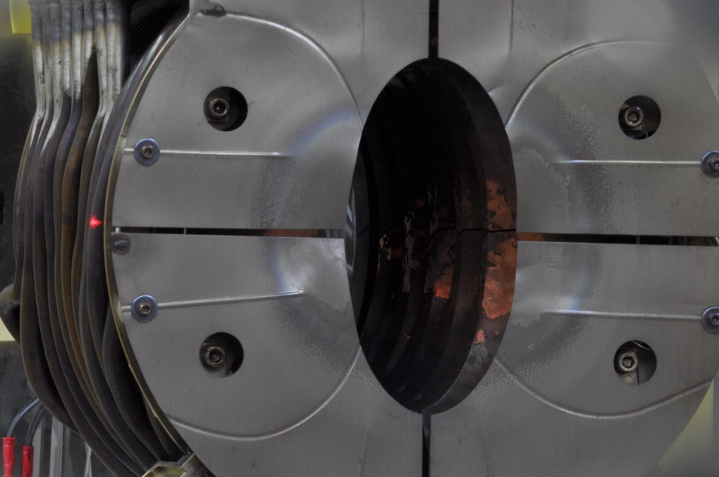
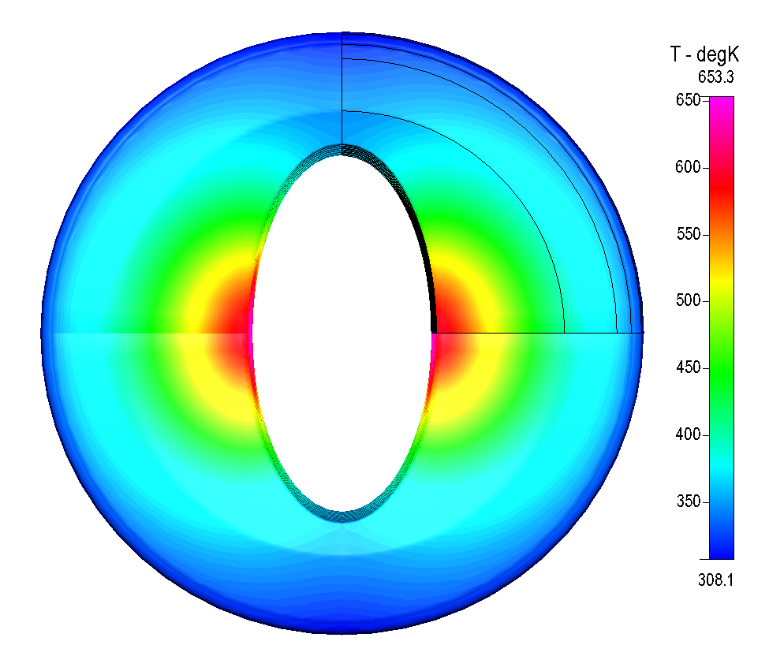
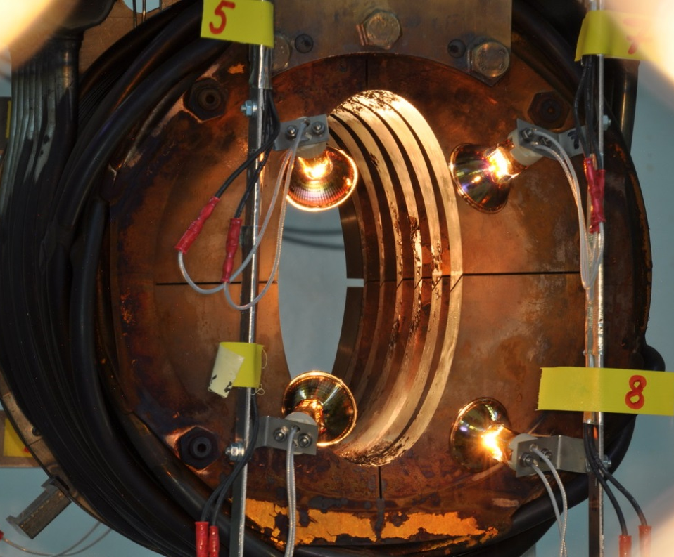
Results: KHE2 from outside
front:
- aperture in very good shape
- one can see beam profile
back:
more damage at top & bottom
K
600
500
400
some black pieces peel off
→ „golden“ surface below
sample:
no Be-7 but Ag-110m
Daniela Kiselev, Beam losses and collimators in transfer lines, 13-14.5.2014, Lund, ESS AB
Notes:
gold: looks not like Cu, some alloy of Ag, Cu etc?

Slide 20
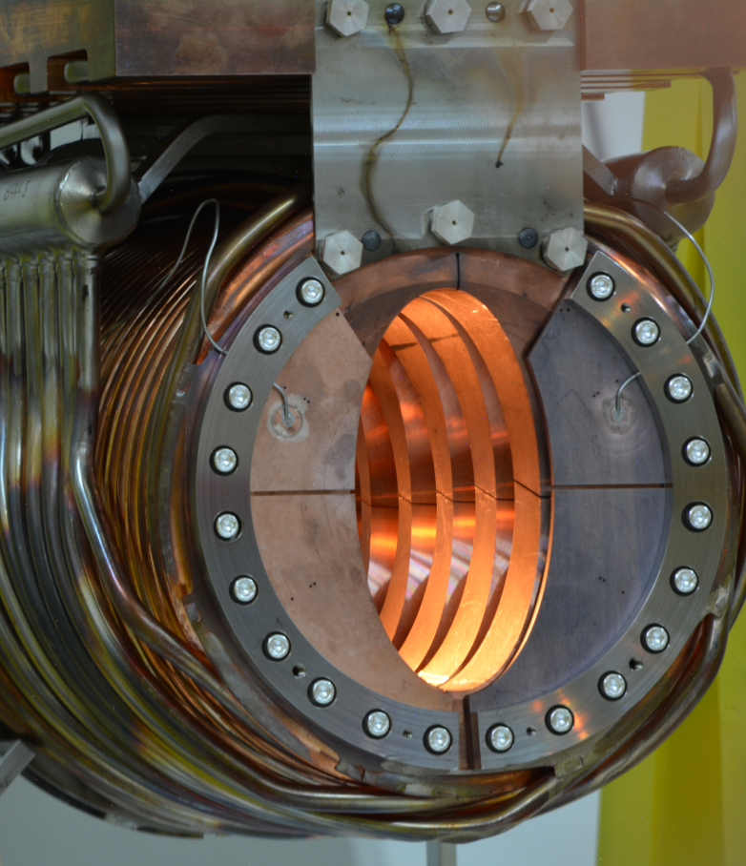
New KHE2 inserted in March 2013
Same geometrical design as present collimator
- except for sample plates out of OFHC-Cu and Glidcop (4 mm thick)
590 MeV p
Glidcop
Idea:
after irradiation cutting of samples
with electrical discharge machine (EDM) for
tensile test
electrical resistivity measurement
thermal conductivity measurement
OFHC-Cu
Plates controlled by TC
Daniela Kiselev, Beam losses and collimators in transfer lines, 13-14.5.2014, Lund, ESS AB
Notes:
Picture from the back side,
in front: 4 TC

Slide 21
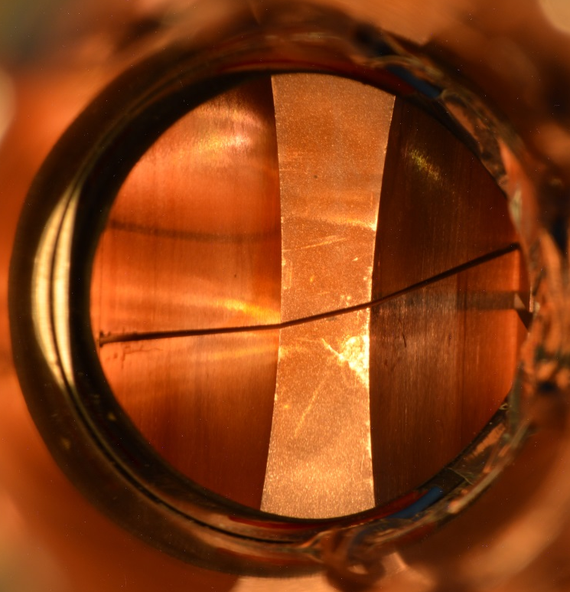
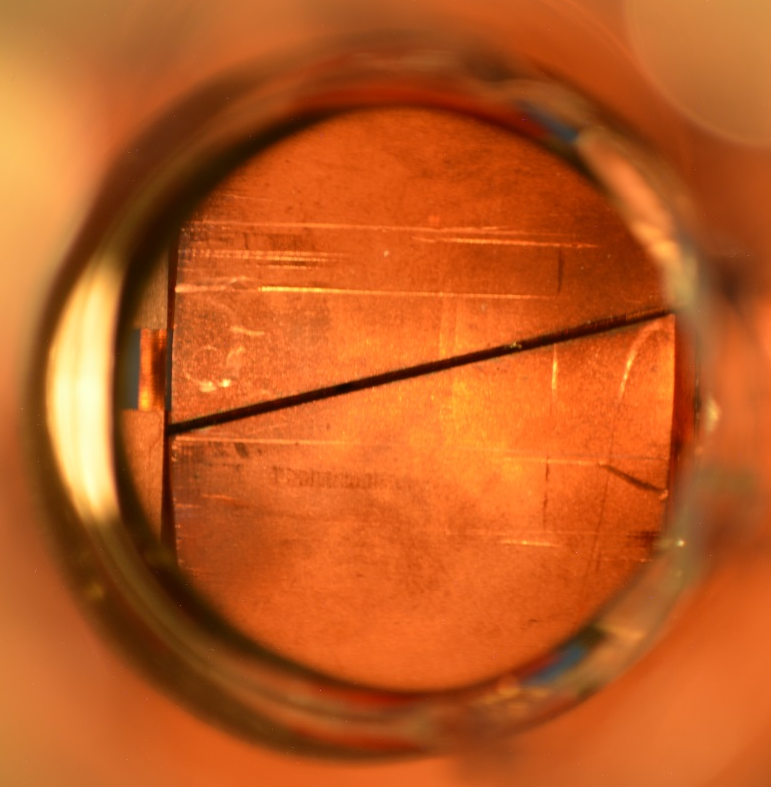
Inspection of new KHE2 in March 2014 (after 1 y)
Reason:
Check of sample plates
indirectly cooled via contact provided by screws
get quite hot inside: ~ 750 ºC
KHE2 is in good shape: clean (except for some carbon from Target E)
wipe test
contains Be-7
entry (vertical)
exit (vertical)
Daniela Kiselev, Beam losses and collimators in transfer lines, 13-14.5.2014, Lund, ESS AB

Slide 22
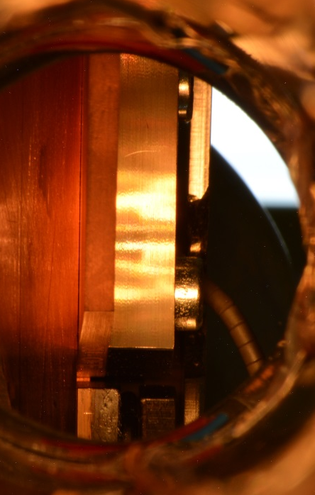
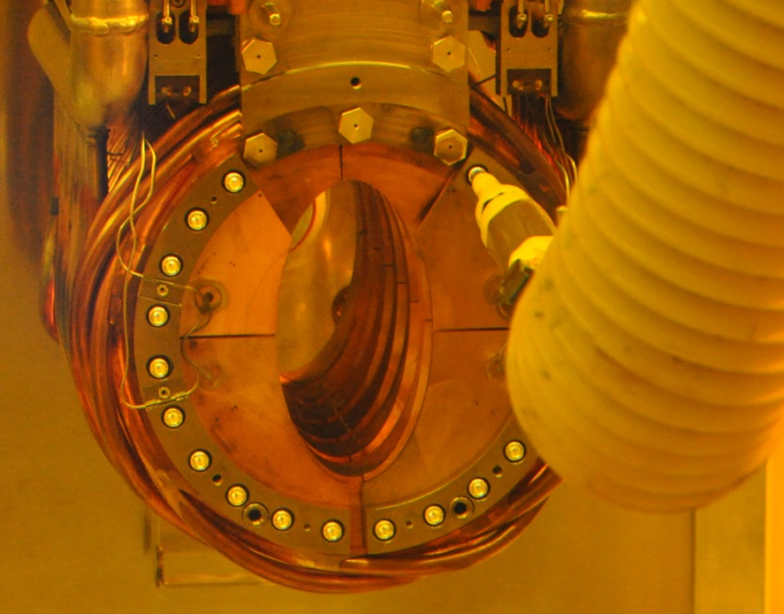
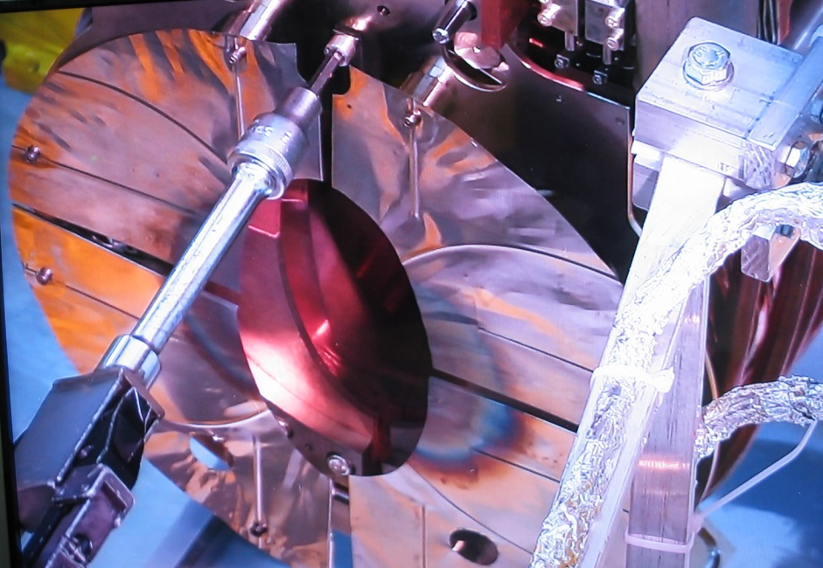
Unexpected observation
Problem: some screws from the front sample plates are loose!
one came 4 mm out → 4 full turns
Reason: probably vibration from the inlet water tube
Procedure:
- Diaphragm has to be removed by the manipulator
- Tighten with larger clamping momentum (5 instead 3 Nm)
→ all done with remote handling
Daniela Kiselev, Beam losses and collimators in transfer lines, 13-14.5.2014, Lund, ESS AB

Slide 23
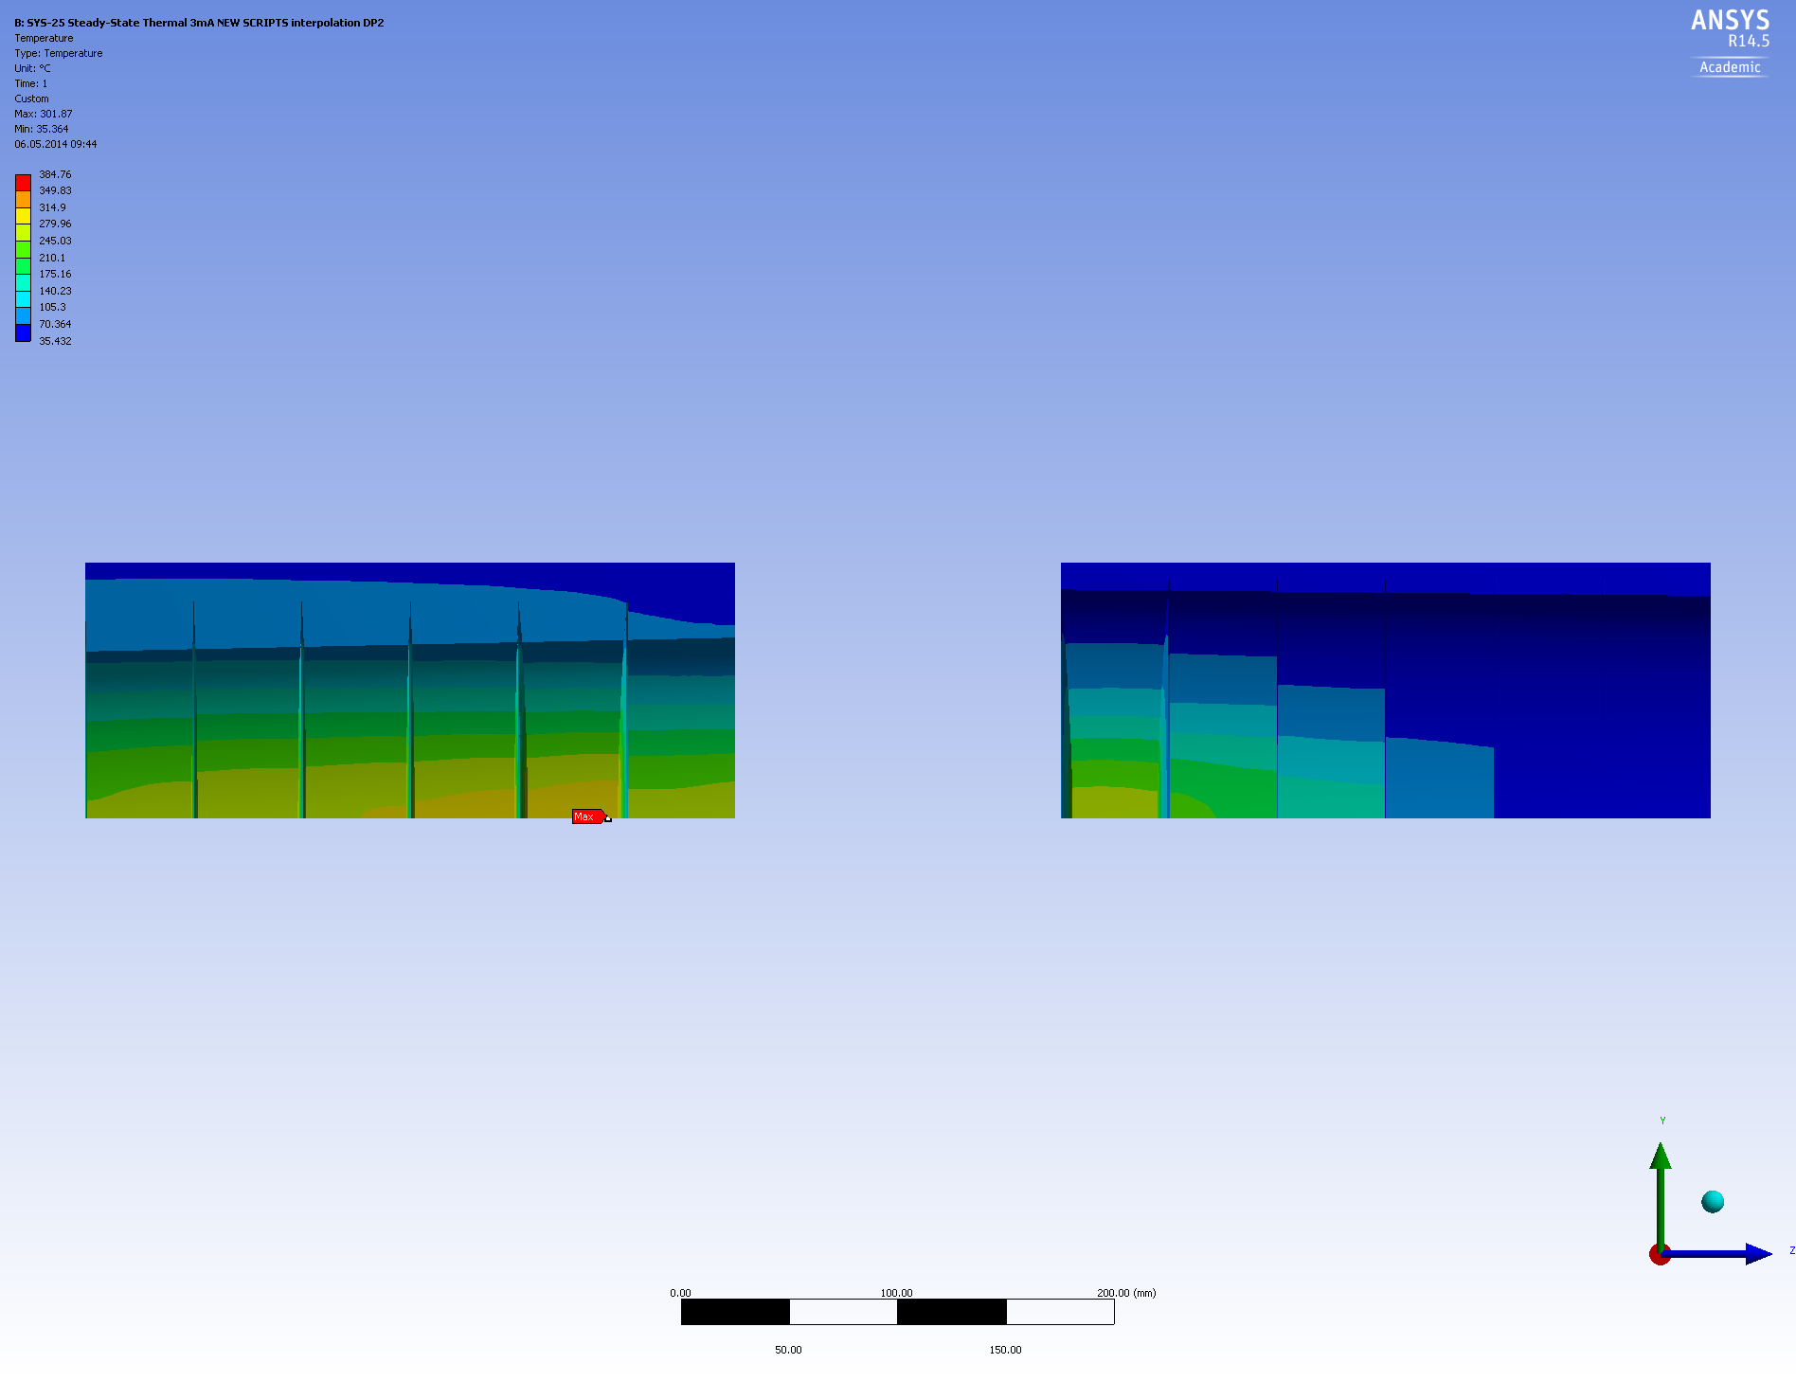
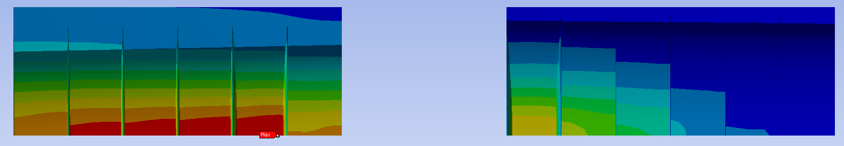
New design for KHE2&3
Larger opening allowed by beam transport calc. with TURTLE: + 25%
increase in transmission: 68 % → 71 %
less energy deposit on KHE2&3
New design proposed: DP2
less energy deposit than current design: max. T = 302 ºC
@ 3 mA
KHE2
KHE3
PIC
beam tilted by 1 mrad:
30 cm
max. T = 385 ºC < 405 ºC (temp. limit)
Daniela Kiselev, Beam losses and collimators in transfer lines, 13-14.5.2014, Lund, ESS AB
Notes:
2.5 GeV (ESS): 170 cm stopping range

Slide 24
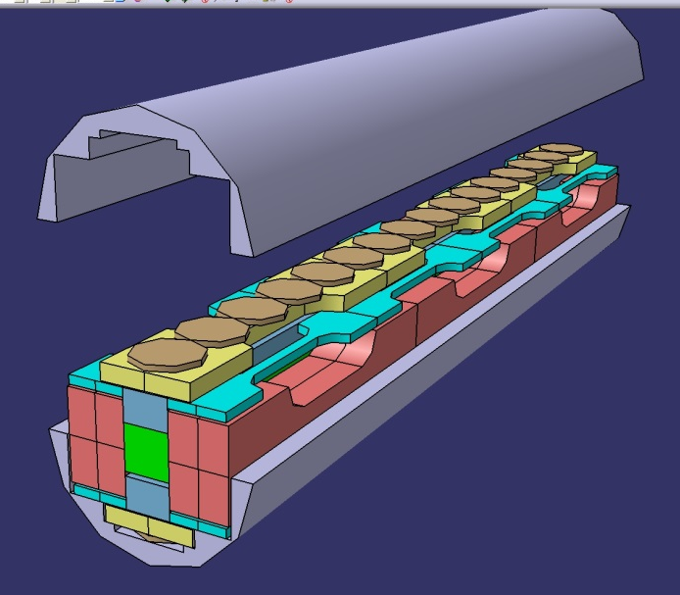
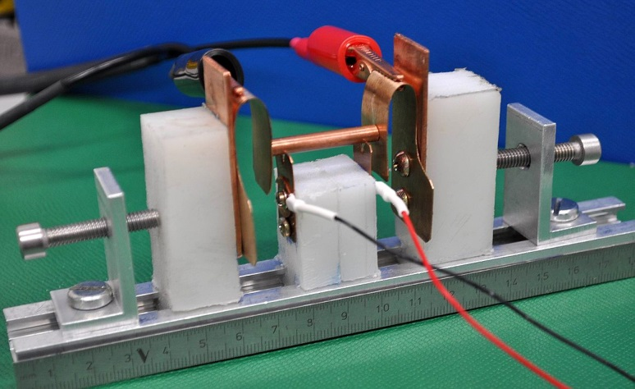
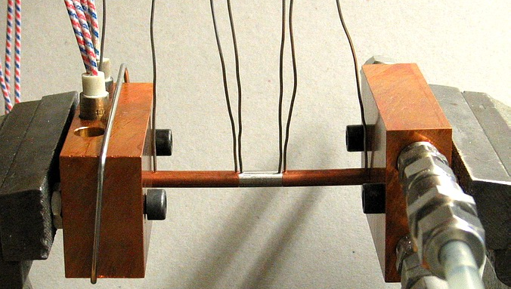
Samples?
a) Sample in SINQ-Target (STIPVI): 2011-2012
filled with Cu und Glidcop + 1 thermocouple
CAD Illustration (half tube)
Sample tubes will be taken out in June 2014
Cutting of tube in hot cell (when?)
If samples in tube survived
tensile test
electrical resistivity measurement
therm. conductivity measurement
electrical resistivity
therm. conductivity
Setup for remote handling not yet done!
b) Samples from old KHE2 ? → feasibility study
Daniela Kiselev, Beam losses and collimators in transfer lines, 13-14.5.2014, Lund, ESS AB
Notes:
STip samples: n+p: 10 to 50 DPA (with damage cross sections of Konobeeyev

Slide 25
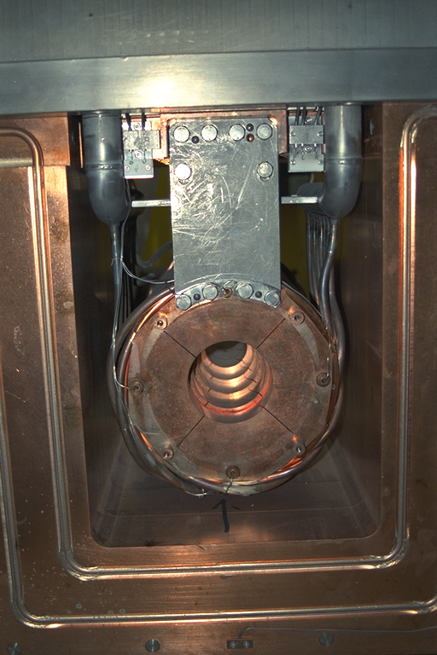
Summary
Cu- collimator KHE2 (+ 127 μm Ni diaphragm for beam diagnosis):
150 kW, water cooled, 20 years in operation, heavily irradiated (up to 180 dpa)
Remote handeled inspection: No serious damage but highly activated (up to 500 Sv/h)
Remote handling with exchange flask is routine operation (also for other components)
New KHE2 inserted in 2013, inspected in 2014: loose screws at sample plate
Samples from STIP tube, old KHE2, sample plates:
Behaviour of tensile strength, electr. resistivity and thermal
conductivity not known under high energetic protons
Beam dump:
similar design to KHE2
PSI,
12. Mai 2014
Daniela Kiselev, Beam losses and collimators in transfer lines, 13-14.5.2014, Lund, ESS AB

Slide 26
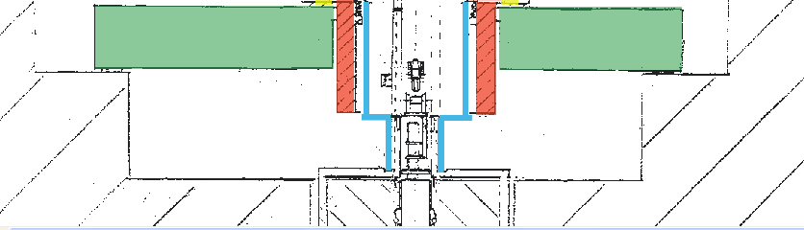
Exchange flask above beam line (p-channel)
Dose rate has to be < 2 mSv/h,
with KHE2 < 0.15 mSv/h (Tc = 90 d)
shielding plate
closed
Al-box against contamination
40 cm steel
movable
shielding plate
x
“bridge”: platform with positioning sticks
for exchange flask

Slide 27
Displacement cross section (dcs)
particle energy
damage cross section:
damage function (no. of displaced atoms):
modified Kinchin-Pease m.
= NRT model
(Norgett RobinsonTorrens)
w(E_{R}): recoil spectrum
needs nuclear reaction models
x: thickness of the sample
N_{V}: atomic density (atoms/cm³)
T_{dam} : damage energy
displacement efficiency κ = 0.8
some remarks on uncertainties:
E_{D} in Cu: 18 – 43 eV, choice: 30 eV (for MCNPX, dcs)
κ = 0.8: for hard sphere model (Rutherford formula)
compensates for the forward scattering

Slide 28
DPA calculation
φ(Ε): fluence (particles/cm²)
σ_{disp}: displacement cross section
Methods and codes:
Displacement cross section (dcs) from A. Konobeyev (Sept. 2010)
evaluated from several reaction c.s. codes,
accounting for defect efficiency η, η=1 for NRT
MCNPX2.5.0: CEM model and ENDF/B-VI (for n, < 20MeV)
for protons:
- displacement cross section for E = 590 MeV only
→ o.k. for 1. section of KHE2 (energy loss in 5 cm Cu: ~120 MeV)
for neutrons:
built-in damage cross sections (Monroe Wechsler and Marvin Barnett)
as flux multipliers
MARS15 (2010):
- energy dependent displacement efficiency: κ(E_{R}), in NRT: κ = 0.8
κ(0.1keV) = 1.4 to κ(100keV) = 0.3
- Coulomb interaction, formfactors, photons, muons, electrons
- nice feature of 2-dim. plots showing distributions of DPA (+other quantities)

Slide 29
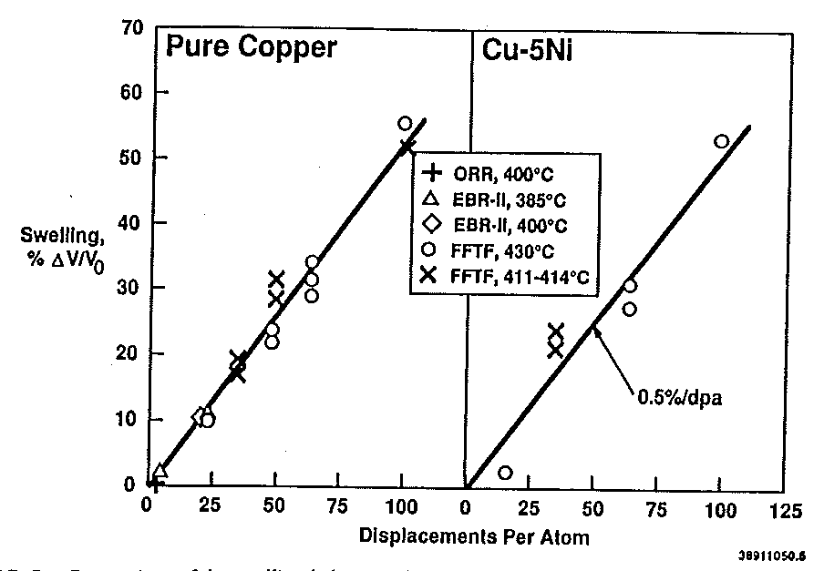
Swelling after irradiation with neutrons
0.5%/dpa
80 DPA → ~40 % swelling
S. Zinkle, Effects of Radiation
on Material, 15th Symposium 1992,
p. 813-834
no saturation up to 100 dpa
data are for neutrons only (thermal and fast reactors)
→ Not much is known for high energetic protons

Slide 30
Checks on the MCNPX calculation
Comparison of the dcs for 590 MeV p
MCNPX2.5.0 + CEM, A. Konobeyev:
6227 barn 4764 barn
→ fair agreement: 30 % deviation
Comparison of DPA:
- (Old) Experiment at Pirex (PSI): 590 MeV protons on 0.3 mm Cu
1 DPA = 1.5 10²⁰ protons/cm² (LAHET calculation)
(Singh,Horsewell, ASTM STP 1175, (1993), 1003)
- Calculation: MCNPX2.5.0 + CEM model
0.93 DPA due to protons
0.02 DPA due to neutrons
→ very good agreement!

Slide 31
Displacement cross sections (dcs)
A. Konobeyev:
- E > 150 MeV: average of Bertini, Isabel, INCL4
- 20 < E < 150 MeV: CEM, DISCA code
- E < 20 MeV: ENDF/B-VII (neutrons)
elastic c.s.: optical model + screened Coulomb potential (protons)
see U. Fischer‘s talk
for details
E < 28 keV: Molecular Dynamics (MD)
E > 28 keV: Binary Collision Approximation (BCA)
→ number of stable defects obtained with the IOTA code (ion-ion collisions)

Slide 32
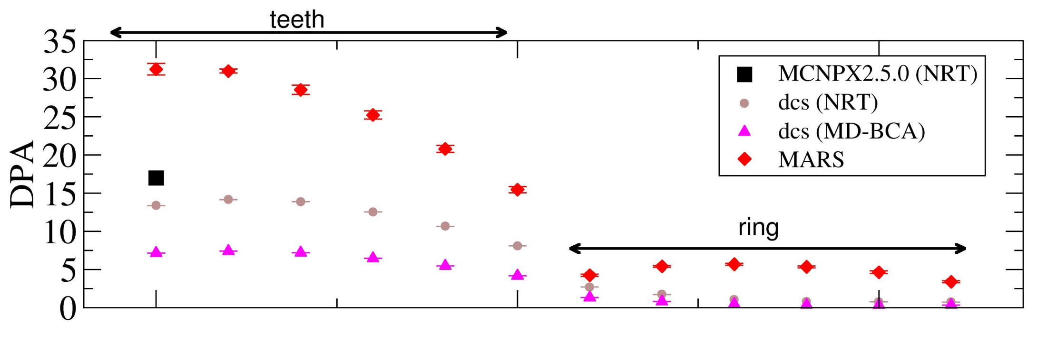
Comparison of results from MCNPX, dcs, MARS
DPA for 1. tooth: Comparison
NRT(MCNPX) NRT(dcs) MD(dcs) MARS
protons: 11.6 8.2 4.8
neutrons: 5.4 5.2 2.3
Total: 17.0 13.2 7.1 31.2
ring
tooth
1 2 3 4 5 6
p
irradiation from 1991 – 2009
Notes:
MARS/NRT(dcs) = 5 for 3. ring
NRT(dcs)/MD(dcs) = 2 for 3. ring

Slide 33
Impurities due to transmutation
(original) material composition for OFHC Cu: 28 ppm impurities
after irradiation: 0.16 w% = 0.015 g
contribution to electr. resistivity
Ni: 0.09 w%
Fe: 0.02 w%
Zn: 0.009 w%
others: ~10⁻³ w% or less
1.22 μΩ cm/w%
?
0.27 μΩ cm/w%
values from
Edwards et al.
valid for < 10 w%
→ Ni: 0.11 μΩ cm, Zn: 0.0025 μΩ cm
Cu: 1.68 μΩ cm → < 10 % increase of electr. resistance
This is only the effect due to impurities,
not due to defects in the Cu-matrix.

Slide 34
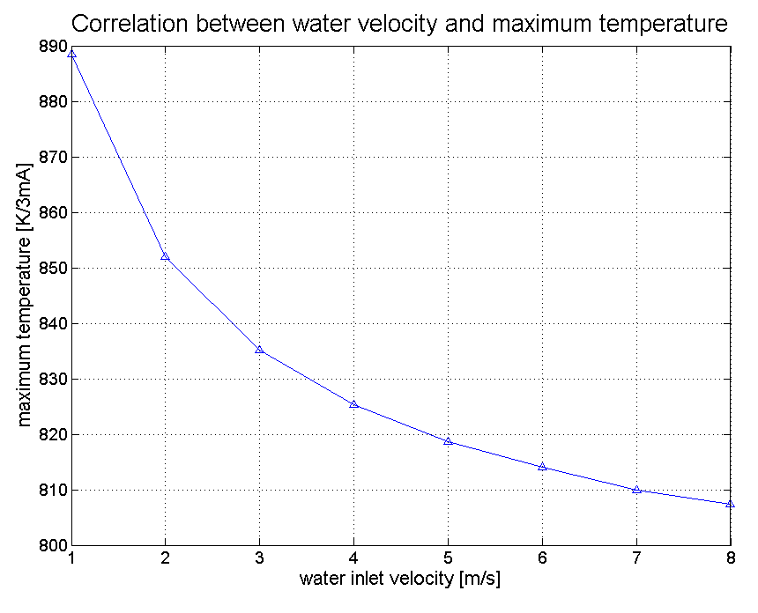
The correlation between maximum temperature and water speed becomes weak for velocities larger than 5 m/s, where turbulent flow is fully developed.
max. temperature [K]
1 2 3 4 5 6 7 8
water velocitv [m/s]

Slide 35
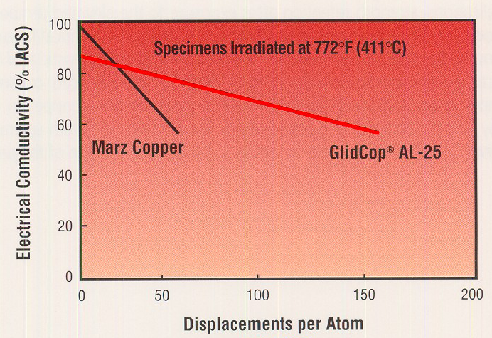
Degradation of phys. properties with radiation
Electrical conductivity σ
due to (therm.) neutron radiation
→ probably not comparable
Behavior at high energetic proton
irradiation not known
→ also thermal conductivity λ decreases
Franz-Wiedemann Law: λ = L T σ, L = 2.44 10⁻⁸ WΩ/K²
Notes:
L = Lorenz number

Slide 36
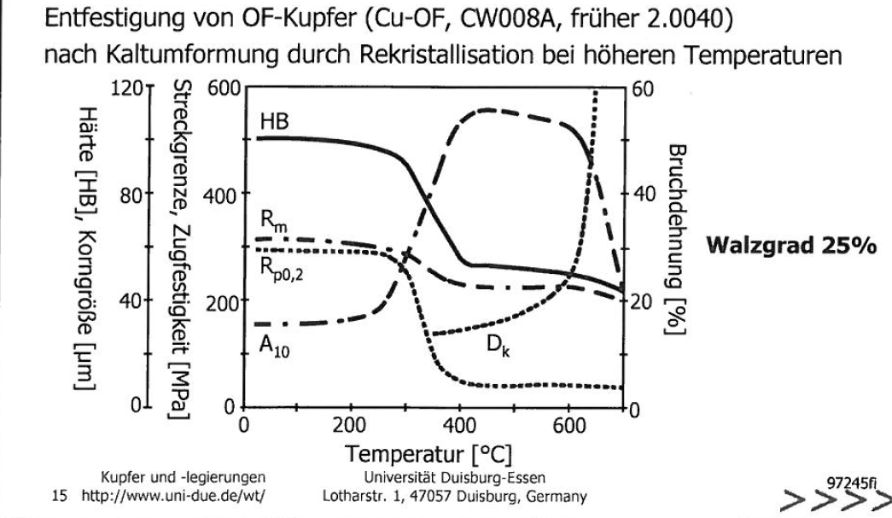
Was passiert bei hohen Temperaturen?
D_{K}: Korngrösse
H_{B}: Härte
A: Bruchdehnung
R_{m}: Zugfestigkeit
ab 600 ºC starkes Kornwachstum
→ diesen Bereich unbedingt vermeiden!
Notes:
Als Zeitdehngrenze (Formelzeichen: Rp) wird die Spannung bezeichnet, die bei einer vorher festgelegten Temperatur und Beanspruchungsdauer zu einer bestimmten plastischen Dehnung führt.

