Slide 1
Structure and Operation of the Collimator System in J-PARC 3-50BT Line
M. Shirakata
KEK(J-PARC), Japan
Lund, 13/05/2014
Including:
J-PARC and 3-50BT
Required specifications
Design and structure of collimators
Operation
Estimation of the residual radiation

Slide 2
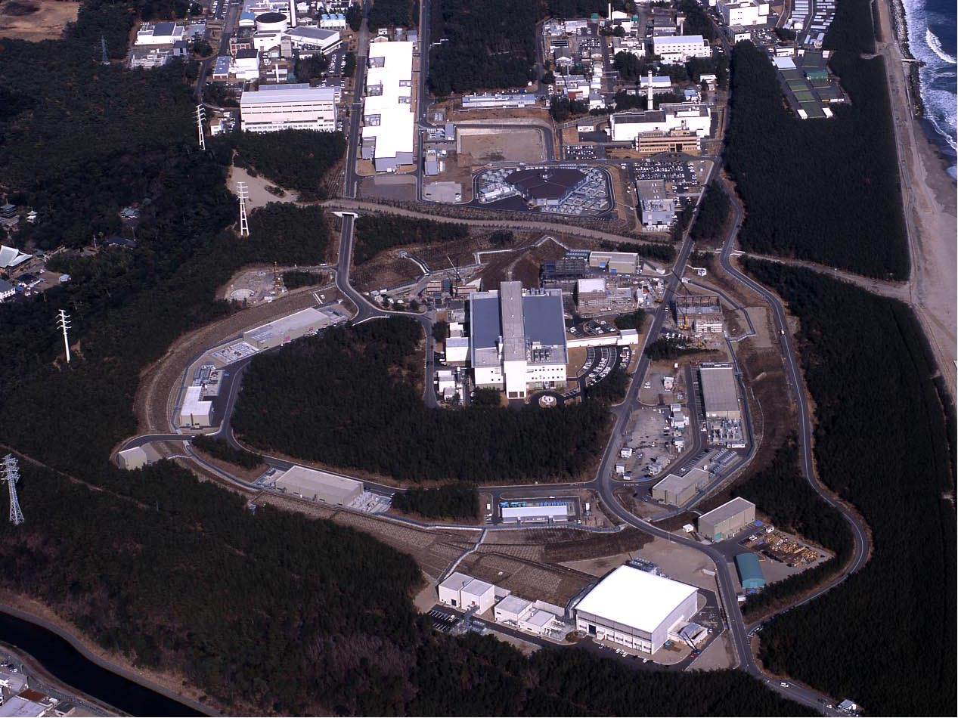
Japan Proton Accelerator Research Complex
Linac
J-PARC Site View
120km from Tokyo
3GeV RCS
3-50BT
Neutrino beams to SK
MLF
50GeV ＭＲ
JFY 2006 / 2007
JFY 2008
JFY 2009
Hadron experimental hall

Slide 3
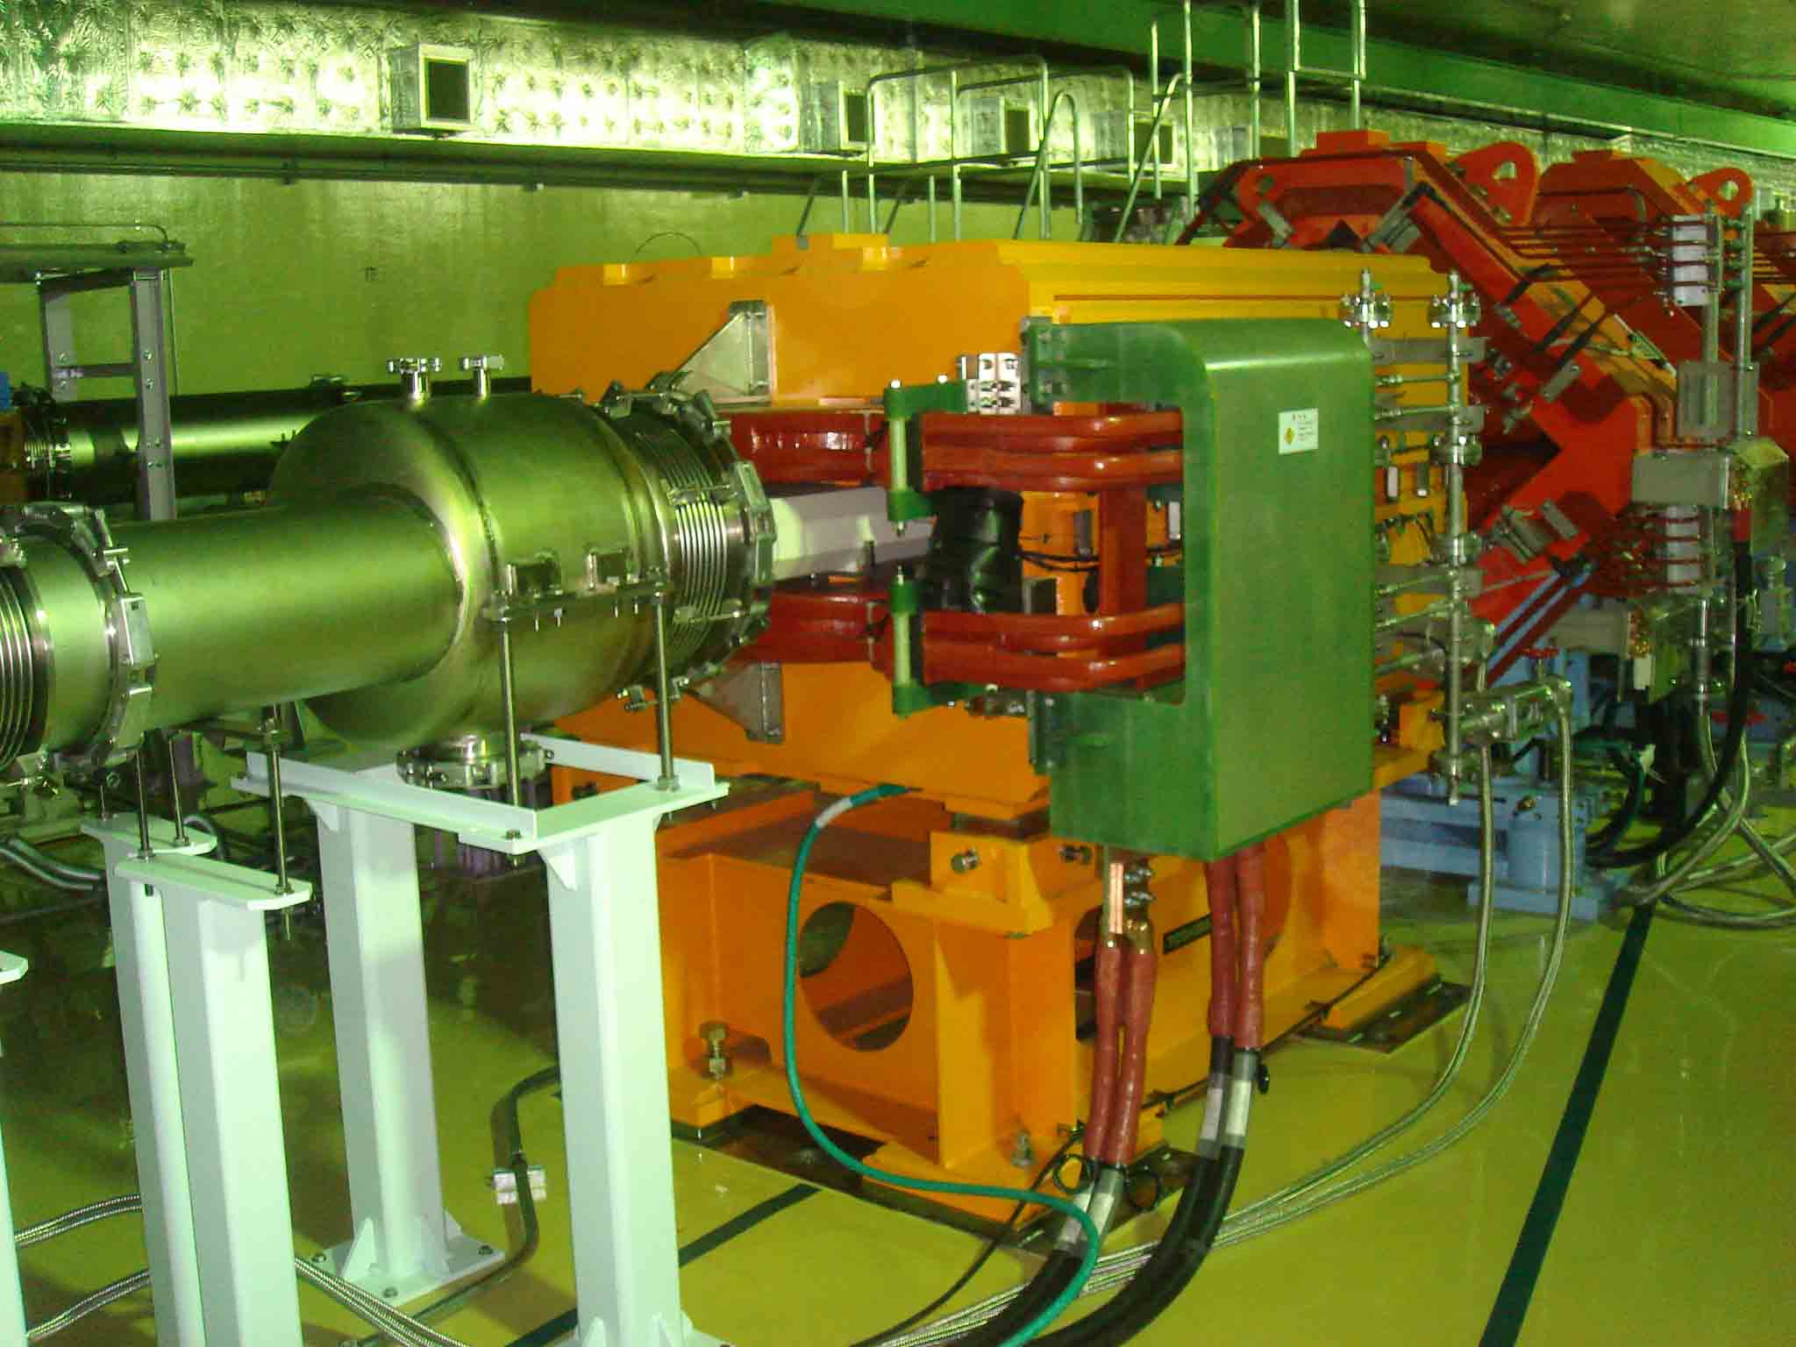
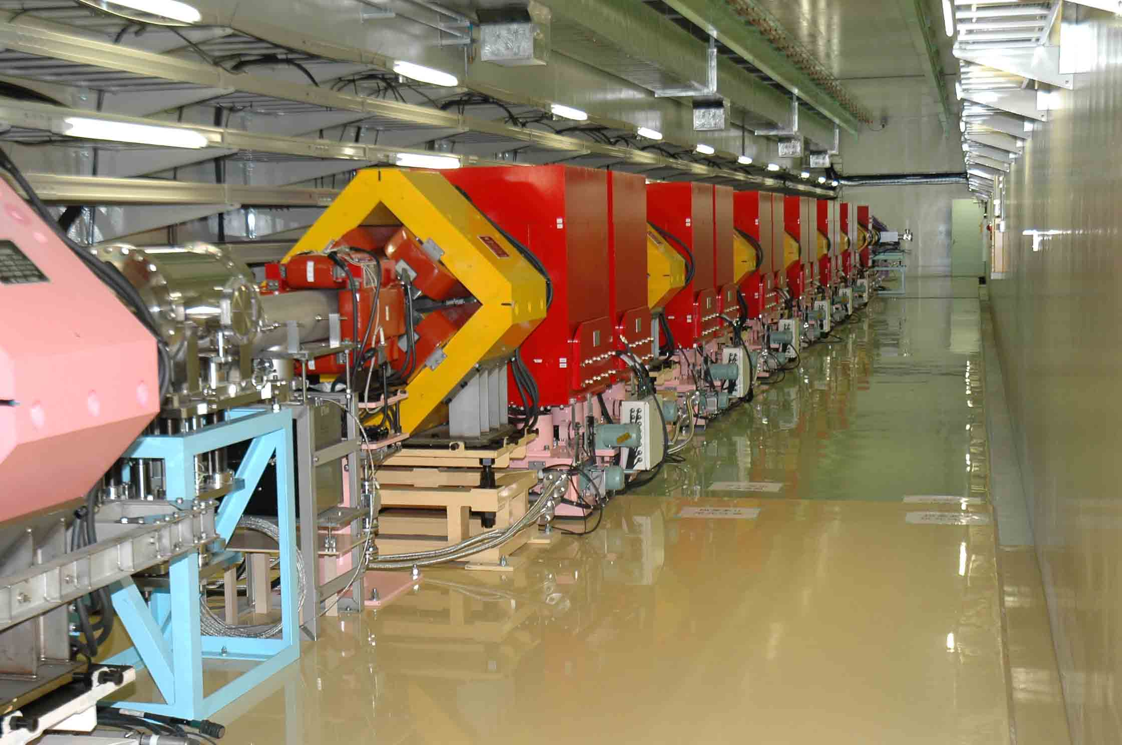
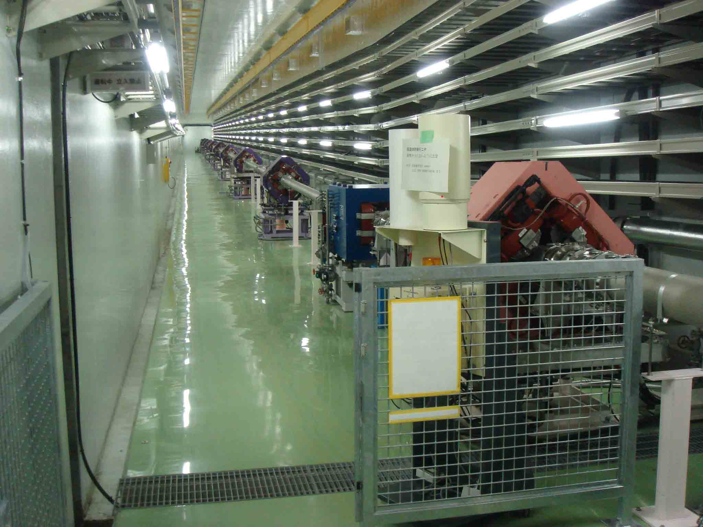
3-50 Beam Transport Line
Length 230 m
Dipole 1 (pb), 3 (h), 2 (v)
Quadrupole 38
Steering 14
Collimator 12 units (120 - 54 p mm mrad)
Monitor
BPM / MRPM / OTR 17 / 10 / 1
FCT / BLM 5 / 50
Pulsed bending magnet
3NBT
3-50BT
50mrad downwards
BT collimators
Slope section

Slide 4
Required Specifications
Purpose: MR protection
Particle: proton
Beam energy: 3 GeV
Allowed beam emittance: 216 π mm mrad
(full, before the collimator area)
Collimator range: 120 to 54 π mm mrad
                for transverse only
Allowed beam loss: 450W/unit and 2kW/12 units
Number of installable space: 6
Drift Length: 3,300 mm for two collimators
High availability (Do not be broken)
Maintenance ability (Accessibility)

Slide 5
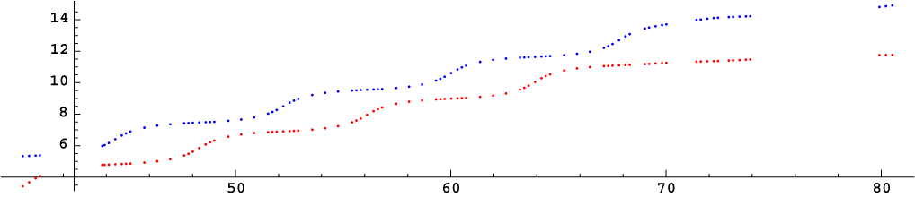
Optics of Collimator System
Layout of 3-50BT collimator units
Radiation
shield
QDS1
QFS1
QDS2
QFS2
QDS3
QFS3
QDB1
Collimator units (6 sets)
Phase advance [rad]
Vertical
Horizontal
A pair jaws in almost middle of drift space
QDS1 to QDS2 120 deg. (2.094 rad) phase advance both in horiz. and vert. planes
Distance in 3-50BT line [m]
Schematic view of the hexagonal halo rejection
One unit has a pair of jaws: single unit can collimate both H and V planes.
Unit 1 and 2 make one collimator set: The center and span are adjustable.
Two hexagonal halo rejection systems (set 1,3,5 and set 2,4,6)
Jaw
120 deg
rotation
120 deg
rotation
Peel the both sides in one collimator set
halo
beam core

Slide 6
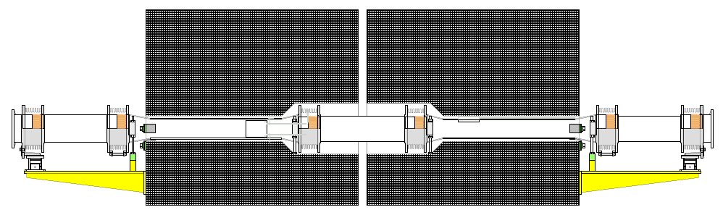
Structure of Collimator Duct
bellow-pipe-bellow joint structure
(used in the beam mask of KEK-B)
Horizontal jaw
Vertical jaw
Ti pipes
Fe shield
Range： ±10 mm
Technical choise
No machine in vacuum for high availability
Movable block style of jaws, beam duct and radiation shield (The weight of moving block is up to 10 t)
All drive mechanism is put out of the radiation shield for protection
One duct goes through two units.
Bellow-pipe-bellow joint allows large duct shift over 10 mm.
Gear jack and linear motion(LM) guide are used in order to make the precise adjust system of heavy blocks.

Slide 7
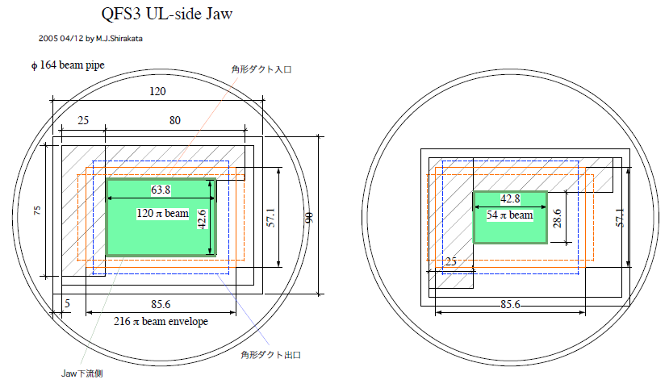
Example of beam collimation
In case of collimator unit-11
Layout of the jaw locations of the required apertures
In order to achieve them, the beam duct including the jaws should be moved ±10 mm.

Slide 8
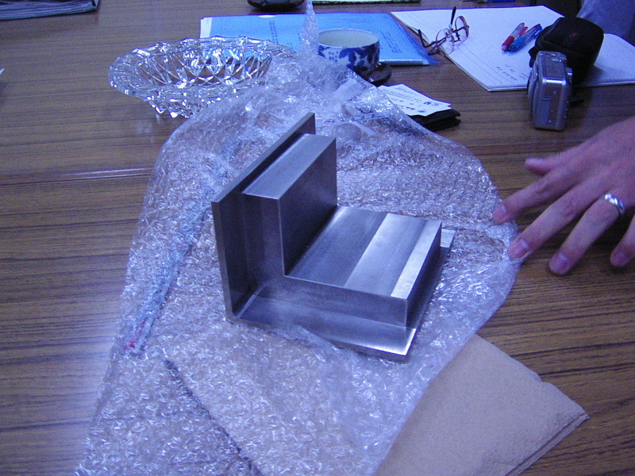
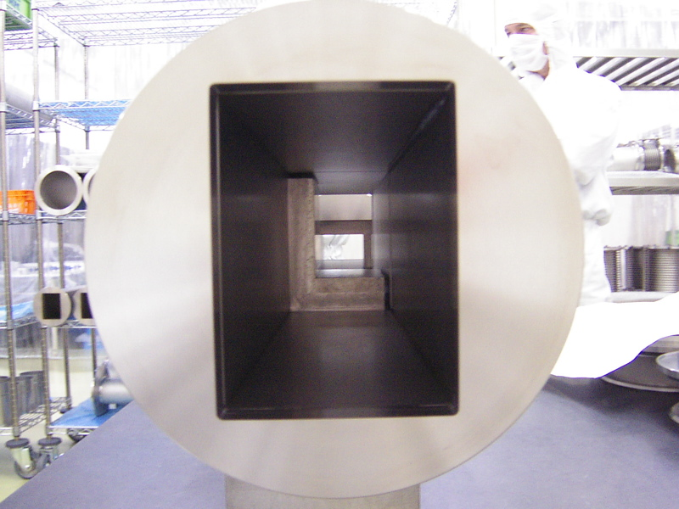
Collimator Jaw
Notice:
We also used tungsten in MR collimators
Collimator jaws are made of Tantalum. The jaw is bonded by hot isostatic pressing method (HIP)
Collimator duct
Jaw-2 behind jaw-1
Ti
Ta
Jaw-1
Jaw block piece

Slide 9
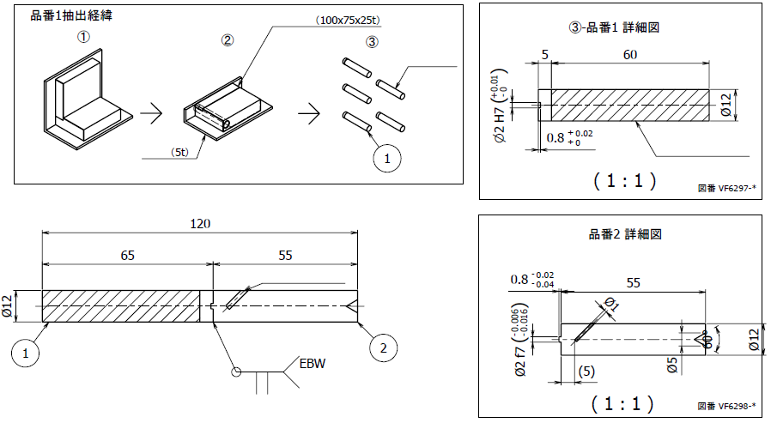
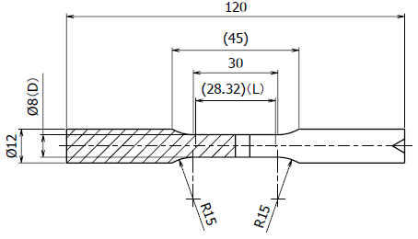
Tensile Strength of HIP between Ti and Ta
Tantalum
Titanium
Titanium
Thermo couple
405℃
Higher than TIG welding at the duct making
Test pieces are made of the jaw sample.
test piece
cut to the specified diameter

Slide 10
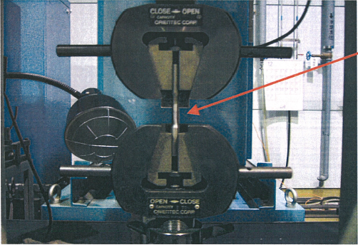
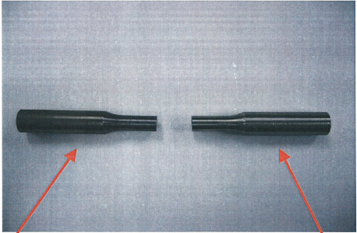
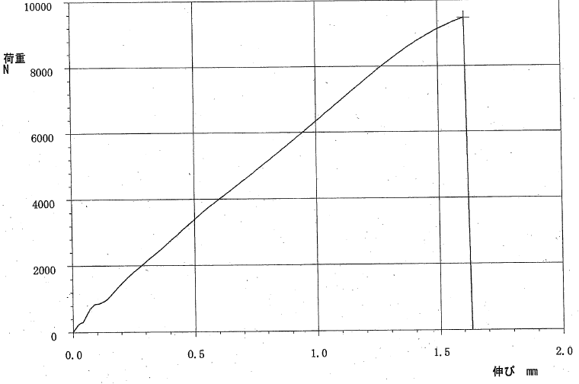
Ta
Ti-2
Yamanashi Industrial
Technology Center
Test piece： Ti-Ta HIP
Env. temp： 22℃
Env. humidity： 20%RH
Test type： tensile
Full load cell： 5000 kgf
Full extension： 10 mm
velocity： 2 mm/min
Load [N]
Break at 965 kgf
Strength = 19.2 kg/mm^2
Extension [mm]

Slide 11
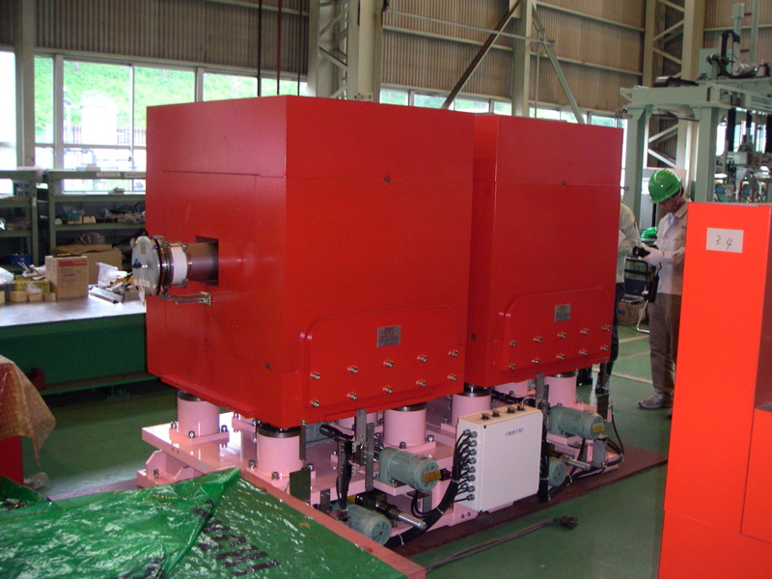
The collimator set
50 cm
Unit-1
Unit-2
For example:
When the first unit has jaws at up and right, the second unit has ones at down and left.

Slide 12
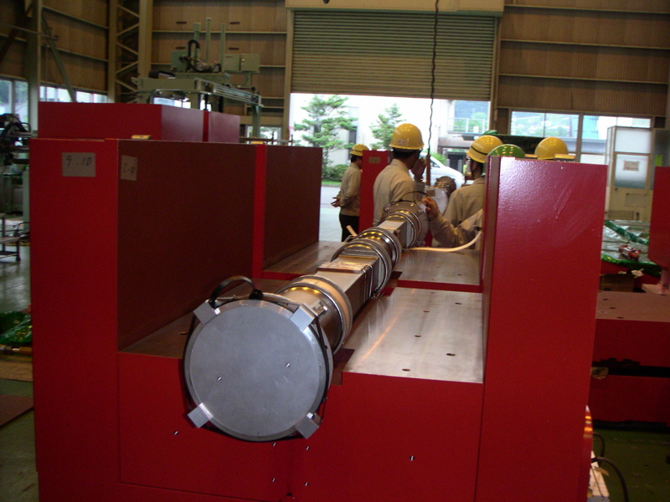
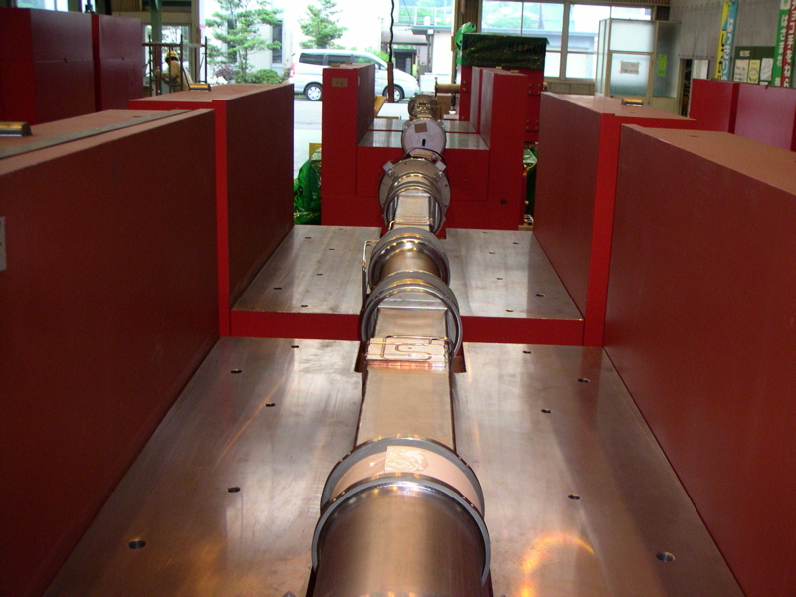
Collimator duct is 3,300 mm long.
It is located through two collimator units.

Slide 13
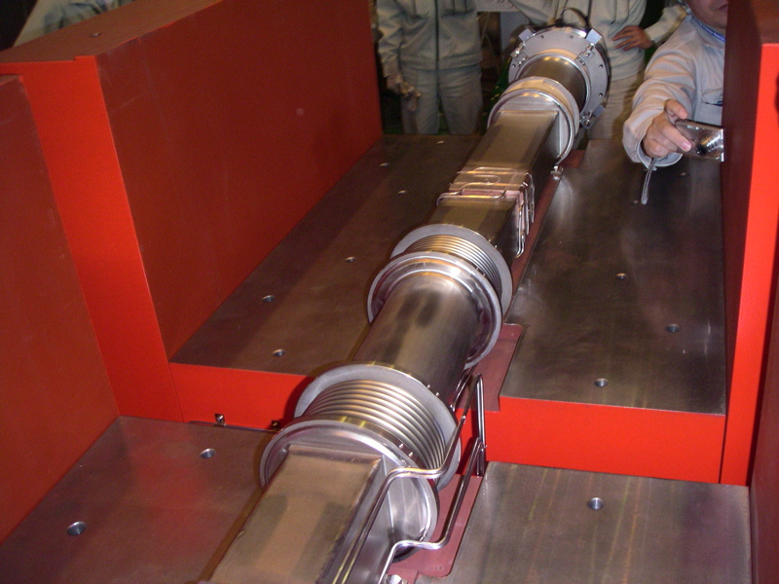
Heat sink (Cu) at jaw position
Jaws are cooled from outside of beam duct by water.

Slide 14
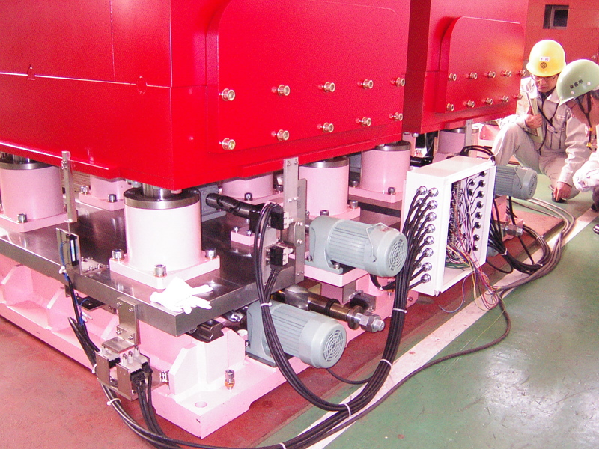
Jaw Position Shifter
Gear jack for
Vertical motion
The grease was exchanged for what has strong tolerance for radiation.
LM guide for
horizontal motion
Span: ±12 mm (14 mm)

Slide 15
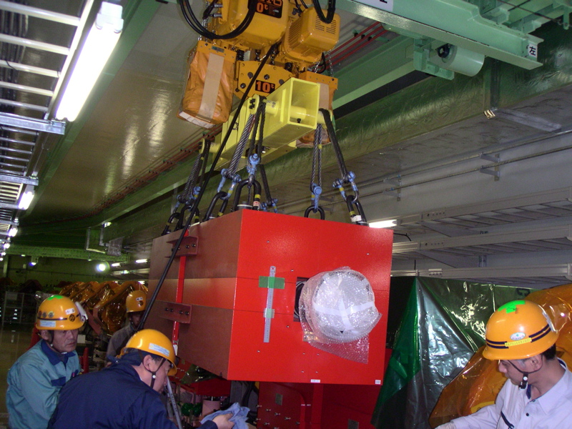
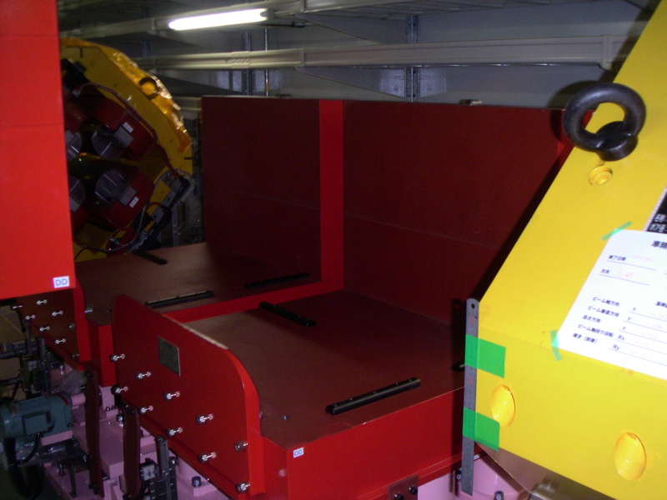
Installation of Collimators
The central blocks of two units are joined and carried as one part by 10 t crane.
It is removable when something became wrong.

Slide 16
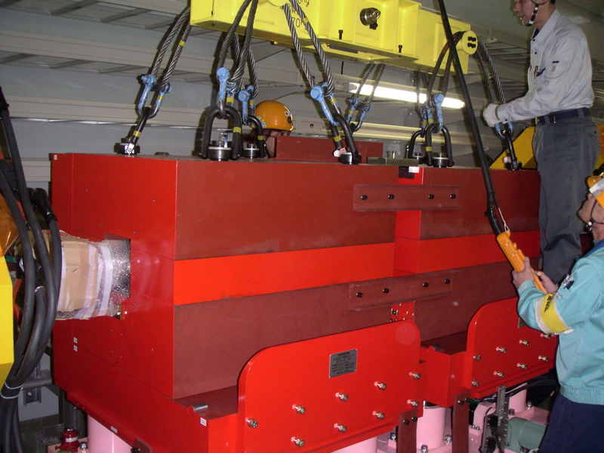
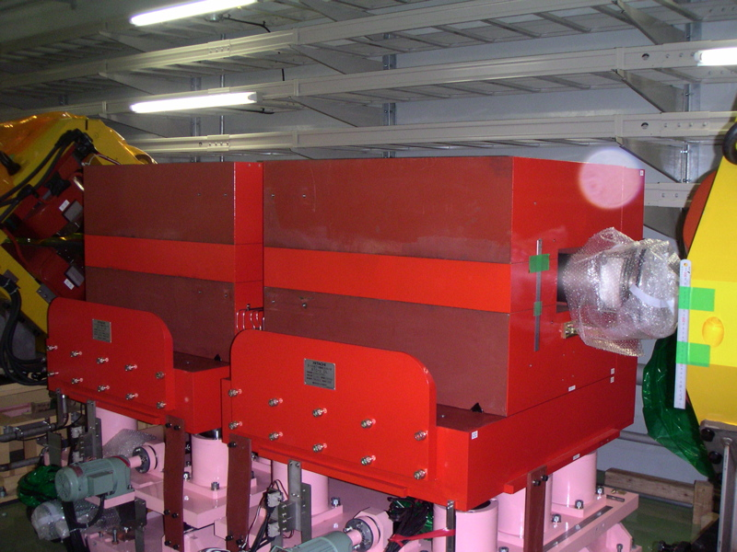
Continued
Additional shields are installed at the front and top positions.
The weight is limited by the crane. The thickness of the shield of central block become 30 cm.

Slide 17
Calibration of Collimator Position by AIC Monitor
misalignment?
Vertical plane
The AIC (Air Ionization Chamber) monitor covers the collimator area. Beam loss measured by long AIC monitor is plotted , inserting collimators. The beam size is not large. Some units are used in the edge of the range.
The balanced unit positions are calculated based on these data.
Jaw position [x0.001 mm]

Slide 18
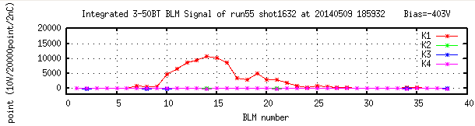
Beam Losses by Collimator Jaws
Measured beam loss with 2.8 x 10^13 protons/batch beam
(equivalent to 213kW in Main ring)
Six collimator sets
are located here!
09/05/2014
Loss monitor signal with the typical operation

Slide 19
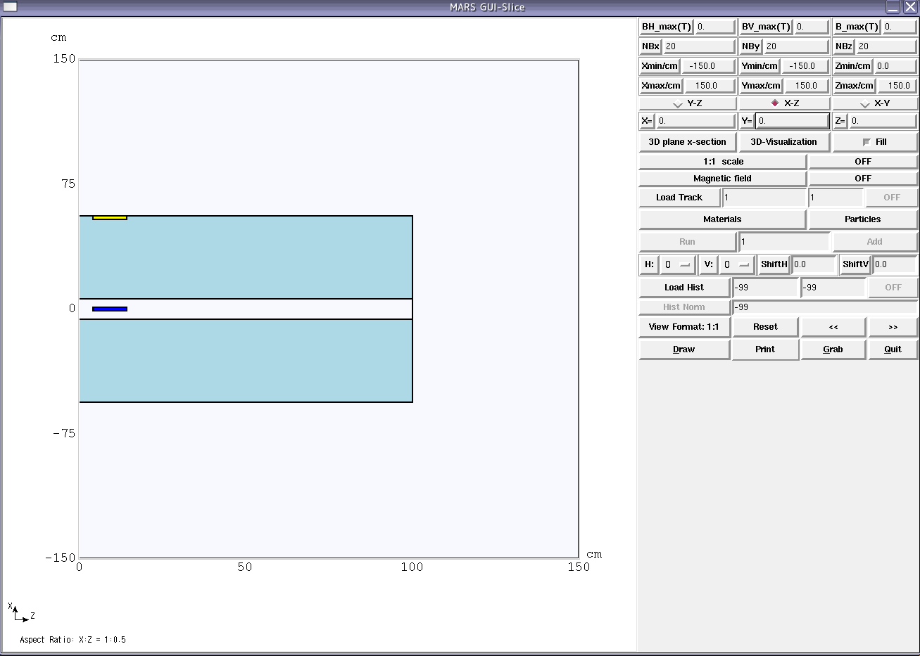
Residual Radiation Estimation for the Hands-on-maintenance
ZX-plane cross section
Fe
Ta
Assuming 500 W loss
2009 5/25
M. Hagiwara

Slide 20
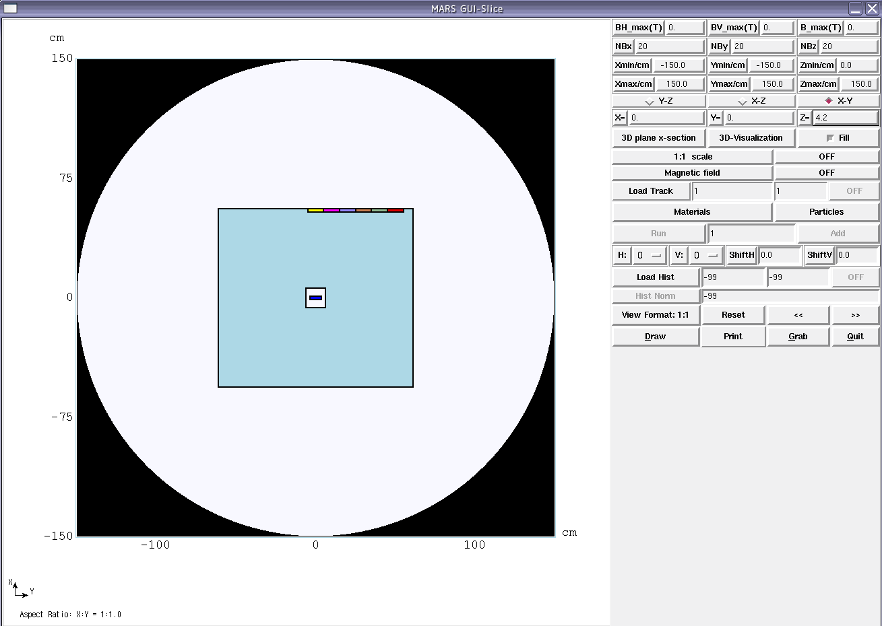
Evaluation point 3 to 8
50 cm
EP-1
Ta
Fe
EP-9
YX-plane cross section

Slide 21
Residual Radiation of Jaws
RESIDUAL DOSE RATE (mSv/hr) IN A TISSUE-EQUIVALENT BODY ON CONTACT WITH MATERIAL IM = 1 VOLUME= 1.75000E+02 CM^3
AT AINT = 1.000E+12 P/SEC
**********************************************************************************************
IRRADIATION TIME = 1/2d 1day 5days 30days 100days 1yr 20yr
Tcool Tcool (sec)
1sec 1.000E+00 5.252E+04 6.311E+04 7.194E+04 8.379E+04 8.587E+04 8.817E+04 9.163E+04
1min 6.000E+01 4.971E+04 6.029E+04 6.910E+04 8.096E+04 8.304E+04 8.534E+04 8.881E+04
10min 6.000E+02 4.009E+04 5.057E+04 5.926E+04 7.115E+04 7.322E+04 7.553E+04 7.899E+04
0.5hr 1.800E+03 3.222E+04 4.251E+04 5.103E+04 6.288E+04 6.494E+04 6.725E+04 7.072E+04
1hr 3.600E+03 2.700E+04 3.701E+04 4.533E+04 5.708E+04 5.913E+04 6.145E+04 6.491E+04
2hr 7.200E+03 2.209E+04 3.154E+04 3.955E+04 5.105E+04 5.309E+04 5.541E+04 5.888E+04
4hr 1.440E+04 1.768E+04 2.604E+04 3.349E+04 4.440E+04 4.644E+04 4.877E+04 5.225E+04
6hr 2.160E+04 1.537E+04 2.298E+04 3.001E+04 4.045E+04 4.247E+04 4.480E+04 4.828E+04
12hr 4.320E+04 1.059E+04 1.625E+04 2.215E+04 3.129E+04 3.329E+04 3.565E+04 3.911E+04
1day 8.640E+04 5.661E+03 9.092E+03 1.341E+04 2.072E+04 2.266E+04 2.506E+04 2.852E+04
2days 1.728E+05 2.297E+03 3.947E+03 6.516E+03 1.167E+04 1.352E+04 1.597E+04 1.943E+04
7days 6.048E+05 2.356E+02 4.368E+02 1.049E+03 2.862E+03 4.397E+03 7.005E+03 1.043E+04
30days 2.592E+06 2.086E+01 4.144E+01 1.820E+02 9.459E+02 2.013E+03 4.534E+03 7.843E+03
0.5yr 1.577E+07 5.603E+00 1.119E+01 5.423E+01 3.141E+02 8.059E+02 2.220E+03 4.914E+03
1yr 3.154E+07 2.755E+00 5.505E+00 2.695E+01 1.580E+02 4.390E+02 1.318E+03 3.501E+03
2yr 6.307E+07 1.240E+00 2.478E+00 1.226E+01 7.275E+01 2.192E+02 7.176E+02 2.210E+03
5yr 1.577E+08 3.694E-01 7.386E-01 3.668E+00 2.184E+01 6.731E+01 2.259E+02 7.361E+02
10yr 3.154E+08 6.182E-02 1.236E-01 6.141E-01 3.658E+00 1.134E+01 3.825E+01 1.417E+02
20yr 6.307E+08 5.110E-03 1.022E-02 5.098E-02 3.051E-01 9.923E-01 3.527E+00 2.713E+01
30yr 9.461E+08 2.934E-03 5.867E-03 2.932E-02 1.759E-01 5.826E-01 2.112E+00 1.934E+01

Slide 22
Residual Radiation on the surface of 50 cm Iron
RESIDUAL DOSE RATE (mSv/hr) IN A TISSUE-EQUIVALENT BODY ON CONTACT WITH MATERIAL IM = 3 VOLUME= 2.00000E+02 CM^3
AT AINT = 1.000E+12 P/SEC
**********************************************************************************************
IRRADIATION TIME = 1/2d 1day 5days 30days 100days 1yr 20yr
Tcool Tcool (sec)
1sec 1.000E+00 4.038E+00 4.274E+00 5.053E+00 6.150E+00 6.962E+00 7.957E+00 9.117E+00
1min 6.000E+01 3.747E+00 3.983E+00 4.753E+00 5.859E+00 6.668E+00 7.666E+00 8.825E+00
10min 6.000E+02 3.108E+00 3.340E+00 4.086E+00 5.215E+00 6.016E+00 7.021E+00 8.180E+00
0.5hr 1.800E+03 2.494E+00 2.719E+00 3.433E+00 4.590E+00 5.382E+00 6.395E+00 7.554E+00
1hr 3.600E+03 1.979E+00 2.192E+00 2.872E+00 4.058E+00 4.843E+00 5.864E+00 7.021E+00
2hr 7.200E+03 1.419E+00 1.615E+00 2.246E+00 3.469E+00 4.244E+00 5.275E+00 6.432E+00
4hr 1.440E+04 8.340E-01 1.004E+00 1.579E+00 2.847E+00 3.611E+00 4.663E+00 5.825E+00
6hr 2.160E+04 5.745E-01 7.268E-01 1.261E+00 2.542E+00 3.290E+00 4.344E+00 5.501E+00
12hr 4.320E+04 2.363E-01 3.607E-01 8.217E-01 2.124E+00 2.839E+00 3.920E+00 5.077E+00
1day 8.640E+04 1.244E-01 2.262E-01 6.185E-01 1.898E+00 2.586E+00 3.686E+00 4.841E+00
2days 1.728E+05 8.900E-02 1.690E-01 5.017E-01 1.692E+00 2.363E+00 3.462E+00 4.615E+00
7days 6.048E+05 4.524E-02 8.835E-02 2.964E-01 1.146E+00 1.754E+00 2.836E+00 3.976E+00
30days 2.592E+06 1.074E-02 2.128E-02 8.815E-02 4.300E-01 8.716E-01 1.883E+00 2.964E+00
0.5yr 1.577E+07 2.221E-03 4.439E-03 2.171E-02 1.271E-01 3.457E-01 1.015E+00 1.783E+00
1yr 3.154E+07 1.322E-03 2.641E-03 1.298E-02 7.641E-02 2.133E-01 6.435E-01 1.158E+00
2yr 6.307E+07 5.623E-04 1.124E-03 5.534E-03 3.264E-02 9.210E-02 2.810E-01 5.143E-01
5yr 1.577E+08 5.024E-05 1.004E-04 4.948E-04 2.920E-03 8.278E-03 2.538E-02 5.172E-02
10yr 3.154E+08 1.721E-06 3.440E-06 1.707E-05 1.016E-04 3.127E-04 1.049E-03 6.575E-03
20yr 6.307E+08 6.897E-07 1.380E-06 6.897E-06 4.137E-05 1.374E-04 4.995E-04 4.862E-03
30yr 9.461E+08 5.937E-07 1.187E-06 5.936E-06 3.560E-05 1.183E-04 4.303E-04 4.209E-03
Equivalent to the EP1 extraction BL of KEK-PS: 800 μSv/h with 400W loss

Slide 23
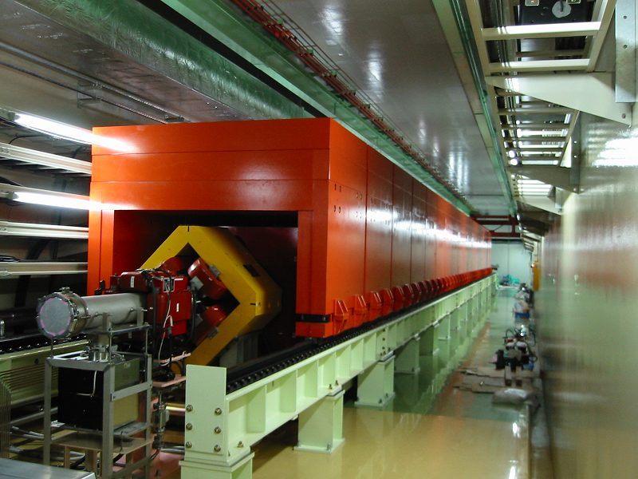
Residual Radiation after the Installation of Gate-type Shield in 2010
In 2010, the radiation shield was upgraded according to the increase of total loss:
450W → 2kW, because there is a public road above the collimator area.
The gate-type shield was installed in order to protect the above public road. The shield consists of 19 shield blocks which can be moved along the LM railway. The shield can be opened for the maintenance of quadrupole magnets, collimator units, beam monitors, and so on.
After the installation of the shield, the residual radiation over 500μSv/h was observed 4 hours later from the beam stop though the total beam loss at the collimator was about only 80W. The radiation is highest on the wall of the tunnel. On the other hand, the radiations were almost same inside and outside of the shield??? That’s under investigation.
Mystery?
Same level
Highest

