Slide 1
Overview of Present and Upgraded SPS-to-LHC Collimation System
A. Mereghetti, C. Bracco, V. Kain, G.E. Steele, F.M. Velotti
Acknowledgements:
O. Aberle, F. Cerutti, L. Drosdal, E. Gianfelice-Wendt, B. Goddard, F.L. Maciariello, M. Meddahi

Slide 2
Outline
Design of the Present System
  Overview of the system;
  Phase space coverage;
  First tracking results;
Operational aspects of the Present System
  Alignment procedure
  Setup validation
  Interlocks
Design of the Upgraded System
  Collimator design
  Local and global protection

Slide 3
Design of the Present System

Slide 4
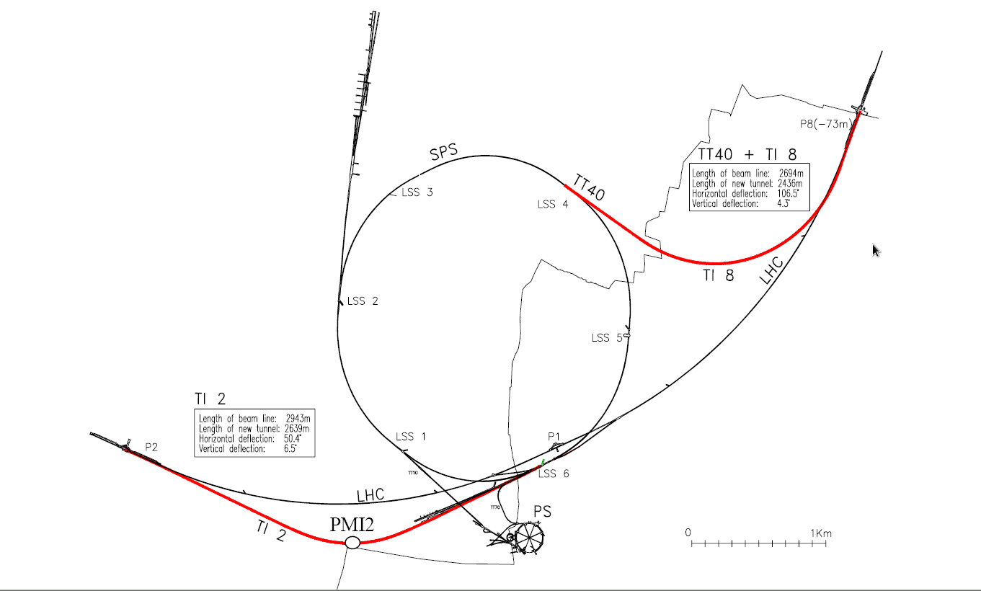
SPS-to-LHC Collimation System
Full SPS nominal batch at extraction (450 GeV): 3.3 10¹³ p⁺;
→ more than one order of magnitude above assumed damage level;
Aperture to be protected:
  LHC arc: 7σ @ injection energy;
  Injection septa MSI;
Robust system of collimators:
TCDI: SPS-to-LHC Transfer Lines;
TDI: LHC injection region;
to protect against any failure from SPS extraction or transfer

Slide 5
SPS-to-LHC Collimation System
Composed of 7 collimators:
  Jaw: 1.2 m of Graphite R4550 @ 1.83 g cm⁻³;
  3 vertical and horizontal collimators at 0º, 60º and 120º upstream of the MSI, respectively;
  a momentum collimator at the first available location with large dispersion (v for TI2 and h for TI8).
TCDI_MOM
TCDIH/V
SPS
TT40/60
TI 8/2
LHC
MKE
TED
TED
MKI
TDI

Slide 6
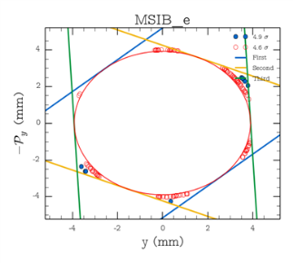
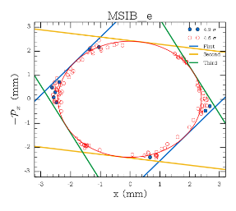
Phase-Space Coverage
“three-phase” collimation system at n_{nominal} = 4.5σ;
→ theoretical n_{max} = 5.2σ;
The total estimated error is 1.4σ;
→ Max particle amplitude permitted: n_{max} = 6.8σ;
Goal: to protect the LHC 7σ aperture in both planes;
5.2σ
4.5σ

Slide 7
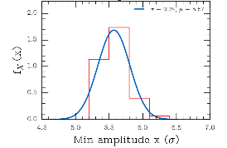
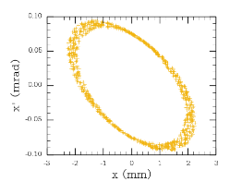
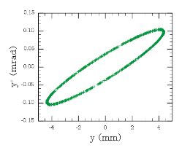
Phase-Space Coverage
tracking simulations run to check the actual coverage ensured:
  PTC code;
  Whole beam line, from SPS extraction to MSI entrance;
  Jaws: 4.5σ nominal aperture + 0.53σ misalignment error;
  Halo distribution:
    HL-LHC Beam;
    MC with 300 different seeds;
    Between 4.6σ and 7.0σ, with 0.1σ step;
Collimators: black-hole absorbers, i.e. protons killed at interaction;
More imperfections and also scattering inside the jaws to be considered;

Slide 8
Simulation Tools for TL Loss Maps
For a realistic loss map:
Important to take into account also scattered primary particles after traversing the whole, or part, of the collimator jaws
SixTrack extended for collimation would need some modifications in order to be used with non-circular machines
A new scattering routine, written in Python and interfaced with PTC, is in development

Slide 9
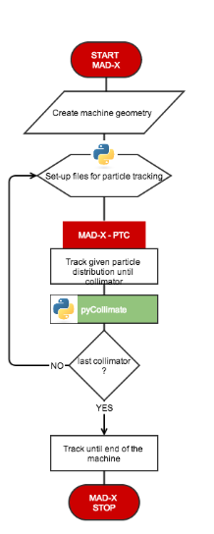
Simulation Tools for TL Loss Maps
The integration of the new scattering routine and PTC is done exploiting the MAD-X - PTC interface
Use of physical model implemented in K2* (SixTrack) and collimate.cc** (cross sections, edge effects, etc…)
Complete flexibility on the position, errors, material characteristics, initial distribution, and also it is completely modular
* K2: A Software Package evaluating Collimation System in Circular Colliders, T. Trenkler and J.B. Jeanneret
**Scattering routine of Orbit, S. Cousineau, J. Holmes

Slide 10
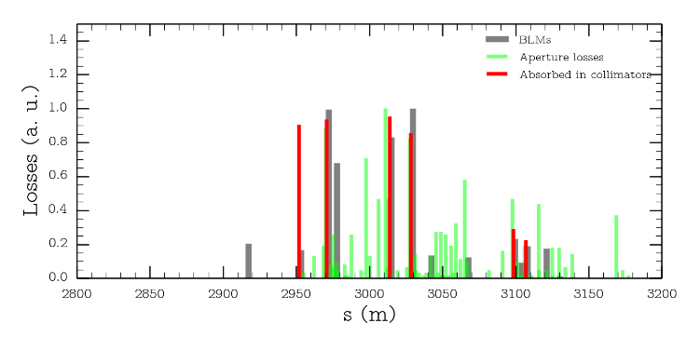
Simulation Tools for TL Loss Maps
Loss map of TI2 tracking 5 σ beam halo
VERY PRELIMIRAY
RESULTS!!

Slide 11
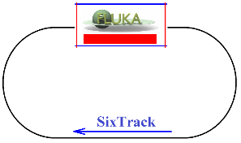
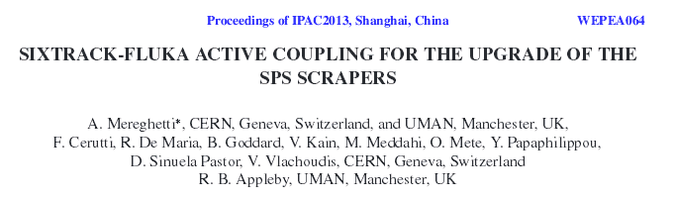
SixTrack-Fluka Coupling
Fluka and SixTrack run independently at the same time, communicating with each other;
One or more portions of the accelerator lattice are covered by Fluka, the rest by SixTrack:
  Fluka: interaction of the beam with the material;
  SixTrack: tracking beam particles through the accelerator lattice;
The two codes exchange particles at run-time through a network port, by means of a dedicated communication protocol (C/C++);
Assets:
More accurate predictions, relying on the best of the two codes (development, benchmarking…);
self-consistency: limited human intervention, less error prone method, automatic change of reference systems…
Successfully used for studying the SPS scraper system and its possible upgrade;
Development / validation for LHC and ions on-going (collaboration between the Fluka Team and the LHC Collimation Team);

Slide 12
Operational aspects of the Present System

Slide 13
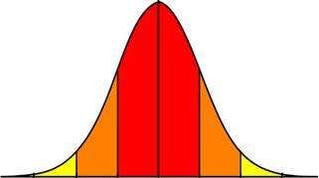
TCDI Alignment Procedure
BLM
4.5σ
Reference trajectory
4.5σ
Set up TCDI jaws at ± 4.5σ around reference trajectory
Pilot beam (5E9 ➔ 1E10) in Inject&Dump

Slide 14
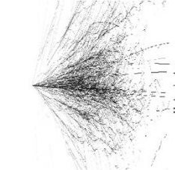
TCDI Alignment Procedure
BLM
BLM
4.5σ
Reference trajectory
4.5σ
4.5σ
4.5σ
Set up TCDI jaws at ± 4.5σ around reference trajectory
Pilot beam (5E9 ➔ 1E10) in Inject&Dump
Move one TCDI jaw, keeping gap fixed, into the beam with 0.5σ steps ➔ beam ➔ BLM losses ➔ next step

Slide 15
TCDI Alignment Procedure
BLM
4.5σ
BLM
4.5σ
Reference trajectory
4.5σ
4.5σ
Set up TCDI jaws at ± 4.5σ around reference trajectory
Pilot beam (5E9 ➔ 1E10) in Inject&Dump
Move one TCDI jaw, keeping gap fixed, into the beam with 0.5σ steps ➔ beam ➔ BLM losses ➔ next step
Repeat with other jaw

Slide 16
TCDI Alignment Procedure
BLM
4.5σ
BLM
4.5σ
Reference trajectory
4.5σ
4.5σ
Set up TCDI jaws at ± 4.5σ around reference trajectory
Pilot beam (5E9 ➔ 1E10) in Inject&Dump
Move one TCDI jaw, keeping gap fixed, into the beam with 0.5σ steps ➔ beam ➔ BLM losses ➔ next step
Repeat with other jaw
Beam Centre = -0.243σ

Slide 17
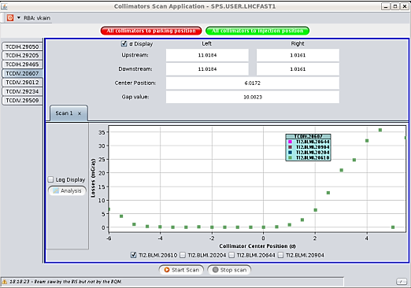
TCDI Alignment Procedure
Automatic JAVA-tool:
Send command to move collimator jaws
Check beam extraction from SPS into TL
Record BLM signal
If no beam extracted ➔ wait for next shot before moving collimator
Y. Le Borgne

Slide 18
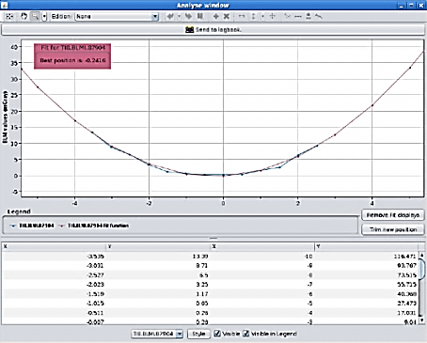
TCDI Alignment Procedure
Automatic JAVA-tool:
Send command to move collimator jaws
Check beam extraction from SPS into TL
Record BLM signal
If no beam extracted ➔ wait for next shot before moving collimator
Perform the data analysis: beam centre!
Possible sending beam centre position to LHC “TRIM” application (operational settings)
Y. Le Borgne

Slide 19
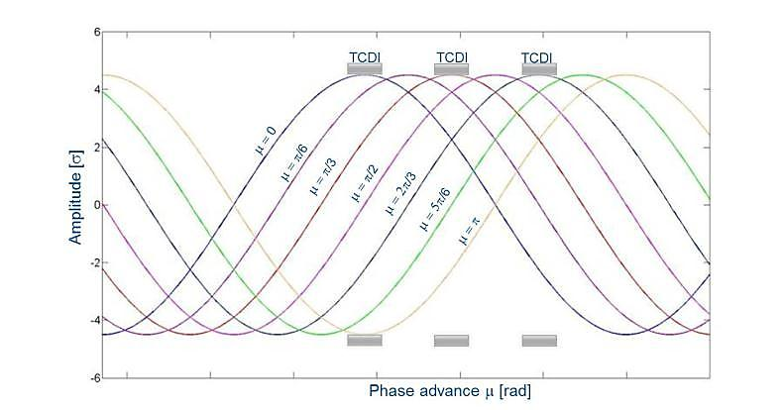
TCDI Setup Validation
All collimators at 4.5σ (σ calculated for nominal emittance and β function)
Knob: oscillations with varying phase and amplitude (using correctors in TL)
  Phase from 0 ➔ 2π
  Amplitude from 4σ ➔ 5σ (0.5σ step)
  Repeat in H and V plane

Slide 20
TCDI Setup Validation
All collimators at 4.5σ (σ calculated for nominal emittance and β function)
Knob: oscillations with varying phase and amplitude (using correctors in TL)
  Phase from 0 ➔ 2π
  Amplitude from 4σ ➔ 5σ (0.5σ step)
  Repeat in H and V plane
What is the real “cut” nσ_{r}?
(tolerances: alignment, flatness, β errors, real emittance, dispersion)

Slide 21
TCDI Setup Validation
Calibration procedure:
Measure emittance ε_{r} and Δp/p in SPS
Define σ_{r} using ε_{r} and taking into account the dispersion
TCDI Collimator set @ 1σ (other TCDIs open) ➔ convert into nσ_{r} ➔ nσ_{r} = xx% beam intercepted (from theory for a perfect Gaussian distribution)
Extract beam on TCDI ➔ K = BLM signal normalised wrt beam intensity (FBCT) ➔ reference value K for xx% intercepted beam
Calibration
TCDI
BLM
1σ_{r}
1σ

Slide 22
TCDI Setup Validation
Calibration procedure:
Measure emittance ε_{r} and Δp/p in SPS
Define σ_{r} using ε_{r} and taking into account the dispersion
TCDI Collimator set @ 1σ (other TCDIs open) ➔ convert into nσ_{r} ➔ nσ_{r} = xx% beam intercepted (from theory for a perfect Gaussian distribution)
Extract beam on TCDI ➔ K = BLM signal normalised wrt beam intensity (FBCT) ➔ reference value K for xx% intercepted beam
Validation:
All TCDIs at 4.5σ
Oscillations with increasing amplitude ➔ BLM signal normalised wrt beam intensity ➔ xx% intercepted beam (normalising wrt K) ➔ nσ_{r} (from theory for perfect Gaussian)
Calibration
TCDI
BLM
1σ_{r}
1σ
Validation
TCDI
BLM
4.5σ
4.5σ_{r}

Slide 23
TCDI Setup Validation
Real Measurement

Slide 24
TCDI Setup Validation
Real Measurement
Limits:
Still nominal β and dispersion (very close to nominal)
Perfect Gaussian beam (see next slide)
Post LS1 operation: use reference loss maps for validation!

Slide 25
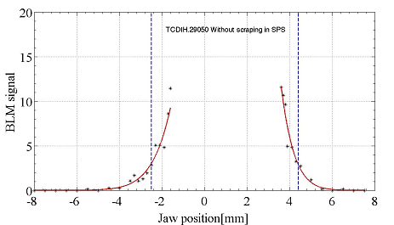
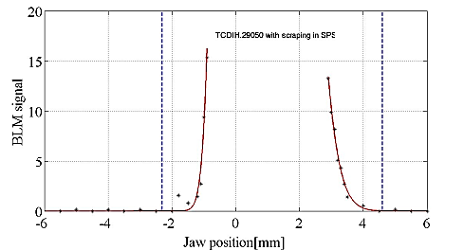
Gaussian Beam?
Beam not Gaussian unless scraping in the SPS
TL measurements: TCDI jaw scan, 0.5 σ steps into the beam
Nominal TCDI settings = 4.5σ
Nominal TCDI settings = 4.5σ
No scraping
Scraping
Double Gaussian (highly populated tails)
Gaussian Beam

Slide 26
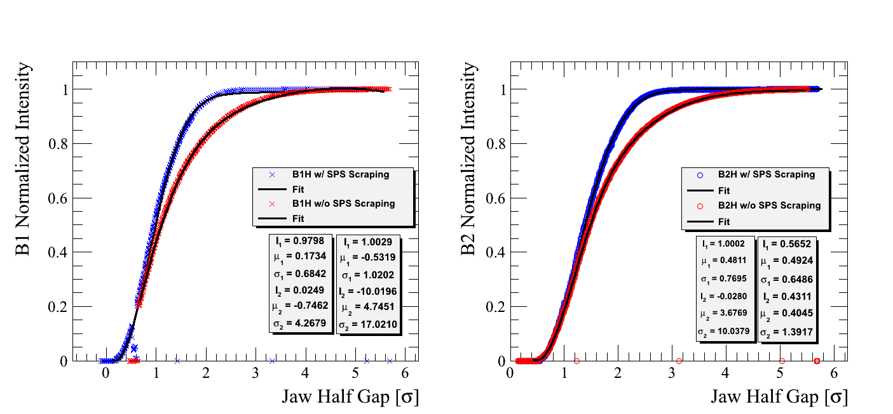
Gaussian Beam?
Beam not Gaussian unless scraping in the SPS
LHC measurements: full beam scraping with a primary collimator
Courtesy of collimation team

Slide 27
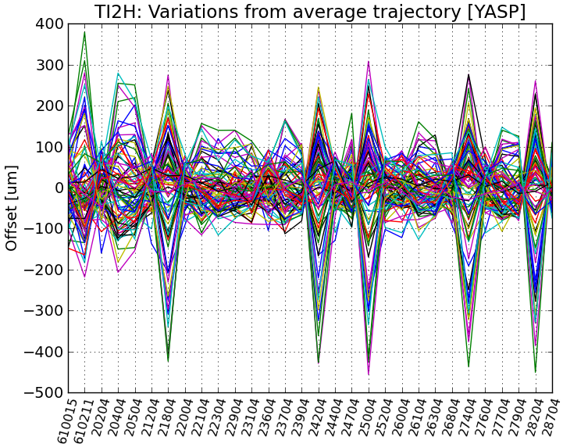
Shot-by-Shot Stability Studies
L. Drøsdal, Evian 2011
Dedicated periods of repeated extractions on TEDs at the end of TI2 and TI8 with 12 bunches for study of shot-by-shot variations
TI 2: 82 Shots, 19 June
Horizontal plane: max 760 μm
Vertical plane: max 260 μm
TI 8: 117 Shots, 2 November
Horizontal plane: max 770 μm
Vertical plane: max 260 μm
760 μm
→ used data in Model Independent Analysis to find strongest Eigenmodes of oscillations ➔ MSE (SPS extraction Septum)

Slide 28


Interlock Logics
A system of redundant interlocks is implemented to check the collimator position
Out threshold
Jaw position
In threshold
Position interlock: ±1/4 σ around actual position;
Beam
LHC injection
Allowed!
Jaw position
Out threshold
In threshold
Beam
Out threshold
In threshold
LHC injection
Inhibit!
Jaw position
Beam

Slide 29
Interlock Logics
A system of redundant interlocks is implemented to check the collimator position
Position interlock: ±1/4 σ around actual position;
Energy interlock: actual gap ±1/2 σ;
Maximum gap
Beam
LHC injection
Allowed!
Maximum gap
Beam
LHC injection
Inhibit!

Slide 30
Interlock Logics
A system of redundant interlocks is implemented to check the collimator position
Position interlock: ±1/4 σ around actual position;
Energy interlock: actual gap ±1/2 σ;
Optics interlock: actual gap ±1/2 σ (quads current associated to a given β*);
Minimum gap
Maximum gap
Beam
LHC injection
Allowed!
Minimum gap
Maximum gap
Beam
LHC injection
Inhibit!

Slide 31
Interlock Logics
A system of redundant interlocks is implemented to check the collimator position
Position interlock: ±1/4 σ around actual position;
Energy interlock: actual gap ±1/2 σ;
Optics interlock: actual gap ±1/2 σ (quads current associated to a given β*);
Magnet powering check (SPS/TL/LHC)!
Minimum gap
Maximum gap
Beam
LHC injection
Allowed!
Minimum gap
Maximum gap
Beam
LHC injection
Inhibit!

Slide 32
Operational Impact
TCDI setup and validation have to be performed:
During commissioning time following long technical stops (Xmas break, long shutdown)
In case of optics and/or HW (TCDIs or magnetic elements in the TL) change
In case of significant TL trajectory drifts (not possible to steer back to reference trajectory)
On average 1-2 setups and validations per year
Time: about one shift (8 hours) per beam line

Slide 33
Design of the Upgraded System

Slide 34
Beam Parameters
 | Structure | N_{p} [10¹¹] | ε^{N}_{x,y} [μm] | Δp/p [10⁻³] | (N_{p}/ε^{N})/ (N_{p}/ε^{N})_{Ult} | Att Fact | Stored Energy [MJ]
Nominal LHC | 288b (25ns) | 1.15 | 3.5 |  | 0.68 | 14 | 2.38
Ultimate LHC | 288b (25ns) | 1.7 | 3.5 |  | 1.0 | 20 | 3.53
Run I | 144b (50ns) | 1.8 | 1.5 | 0.1 | 1.24 | 25 | 1.87
HL-LHC req. | 288b (25ns) | 2.3 | 2.1 | 0.2 | 2.3 | 45 | 4.77
BCMS LIU | 288b (25ns) | 2.0 | 1.3 | 0.3 | 3.2 | 63 | 4.15
Challenging new beam parameters for the LIU era (linear scaling with N_{p} and ε_{N}):
damage to jaw (‘sacrificial’ design?);
attenuation requirements;
Not achievable with present collimation system, especially in case of BCMS LIU (→ really required?)

Slide 35
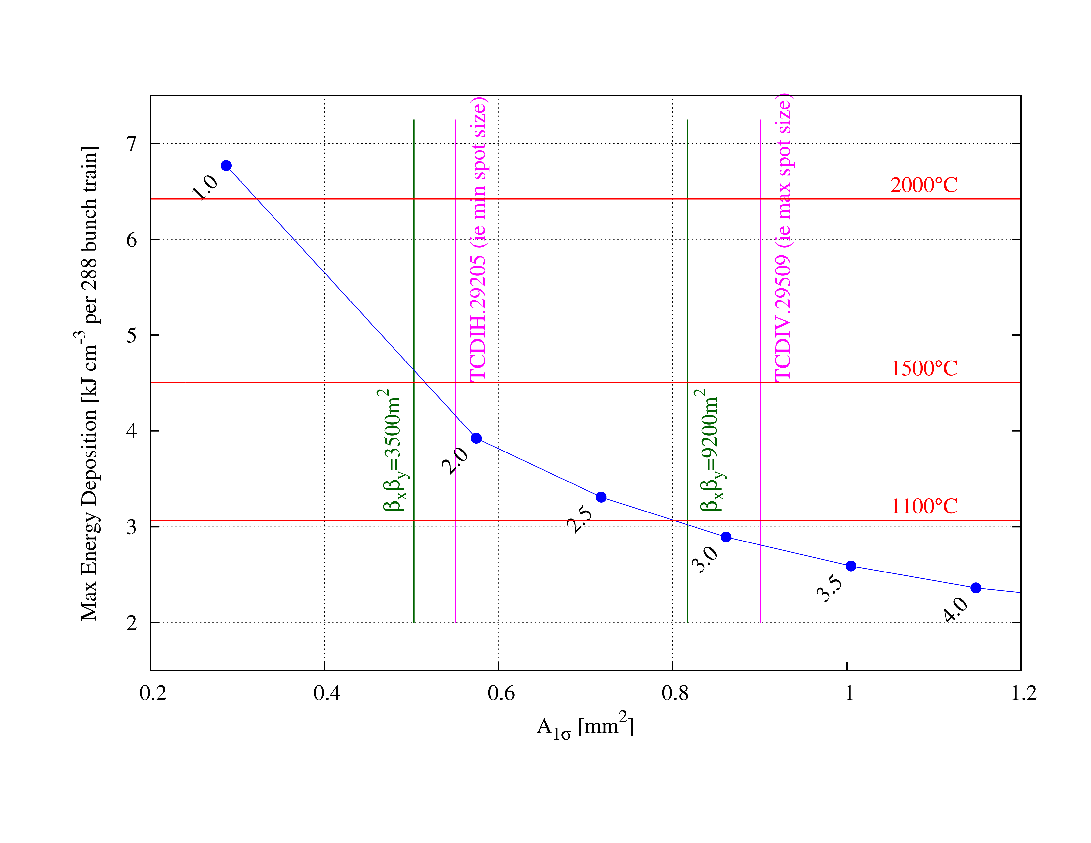
Constraining the Optics
Graphite R4550 @ 1.83 g cm⁻³, with optics constrained to fulfill the a-priori case
A-priori case: ΔT_{max}<1500°C
→ For BCMS LIU:
β_{x} β_{y} > 3500 m²
Conditions can be met!
…but:
tensile stresses above limit (F.L. Maciariello):
32 MPa / 29 Mpa;
Power supplies + integration problems;
Safe conditions (same spot size):
ΔT_{max}<1100°C (F.L. Maciariello) → β_{x} β_{y} > 9200 m² (BCMS LIU); → hard to achieve!
ΔT_{max}<1200°C (F.L. Maciariello) → β_{x} β_{y} > 3600 m² (HL-LHC req); → no sacrificial design!

Slide 36
Materials
F.L. Maciariello
Low ρ / Z materials:
  Lower endep values;
  More suitable for RP;
  Longer jaws (attenuation);
  → Is there enough space?
Material | Density [g/cm³] | Mohr-Coulomb S.F. | Max T [°C] | Tensile strength /Max Tensile Stress [MPa] | Compressive strength /Max Compressive Stress [MPa]
BN5000 | 1.9 | 0.46 | 1311 | 3/11 | 104/59
Graphite R4550 | 1.8 | 0.9 | 1400 | 29/32 | 118/81
CFC | 1.7 | _ | 1370 | 12.8/20 | 132/38
F.L. Maciariello

Slide 37
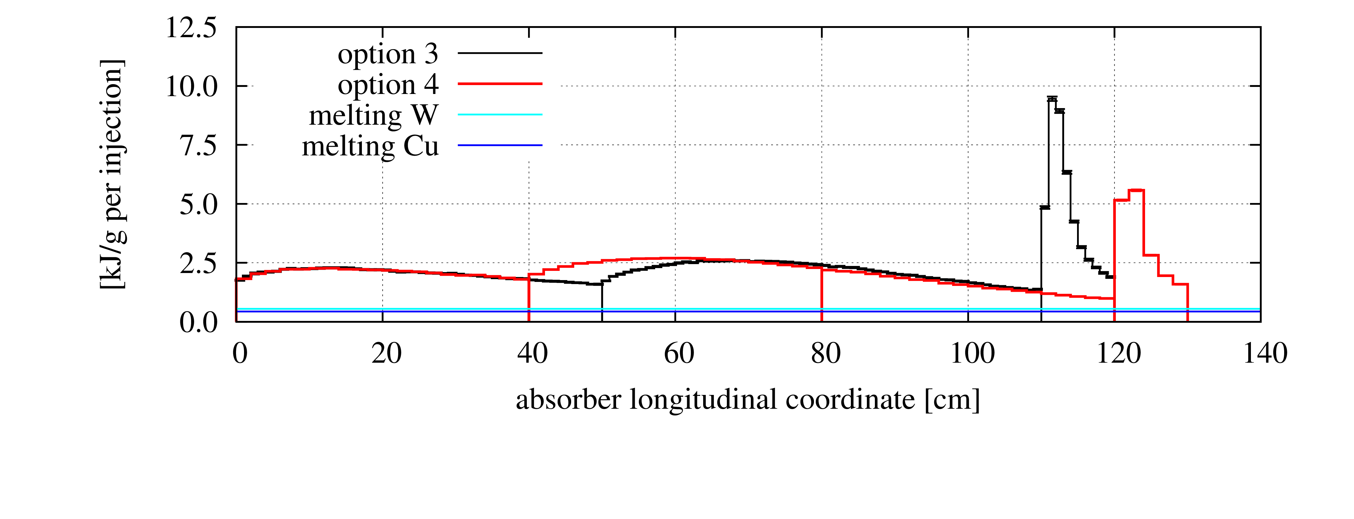
Materials
Sandwich structure with high ρ / Z materials
  Keep present locations, optics and lengths;
  Sacrificial design; → quick plug-in (RP!) systems needed;
  Material break: pollution? No proven solution…
Sandwich structures investigated used graphite as initial material, SiC or Al300 and then Cu or W;
In all cases, final metal would melt;

Slide 38
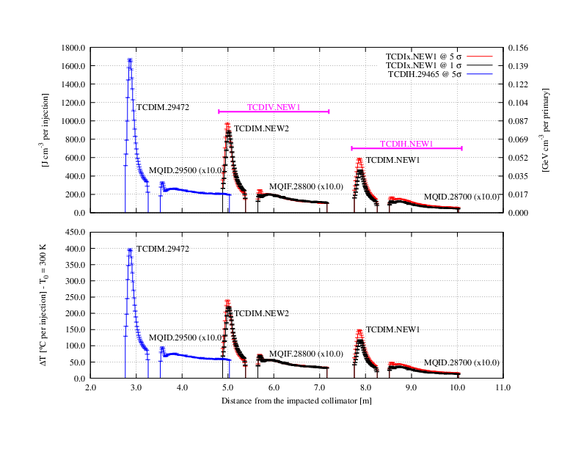
Local Protection of Warm Magnets
endep in warm magnets just downstream of TCDIs (e.g. deformation of Cu coils, overpressure in cooling circuits…);
→ use of masks;
Collimator–magnet distance is the key factor!

Slide 39
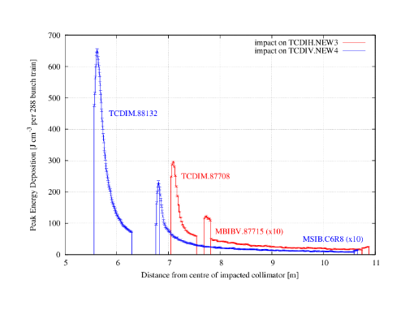
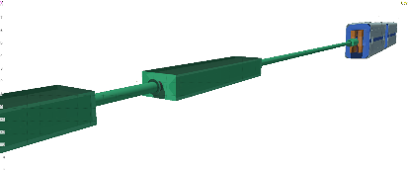

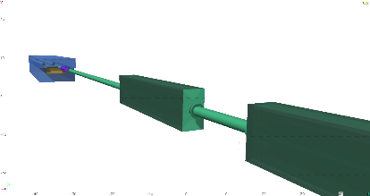
Local Protection of Warm Magnets
TCDIH.NEW3
TCDIM.87708 + MBIBV.877*
p⁺
TCDIM.88132 + MSIB.*
p⁺
TCDIV.NEW4

Slide 40
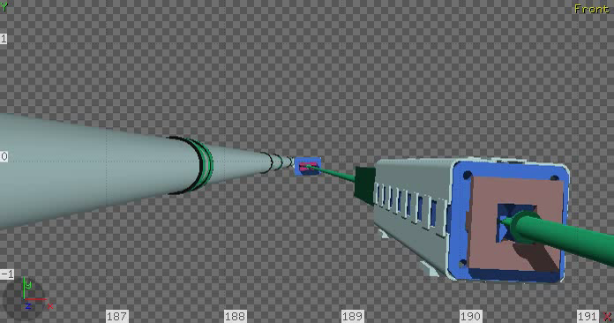
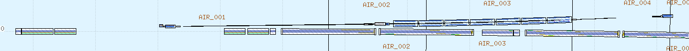
Cross-Talk on LHC Magnets
TCDI collimators close to LHC → possible effects:
  Heat load on SC magnets: quench, totals…
  BLM signals: un-wanted beam dumps…
Example: heat load on LHC SC magnets in case of beam loss at TCDIH.87904:
3σ impact;
10σ impact;
Two TCDI modules;
Fluka geometry built with fedb (Fluka Element DataBase) and LineBuilder;

Slide 41
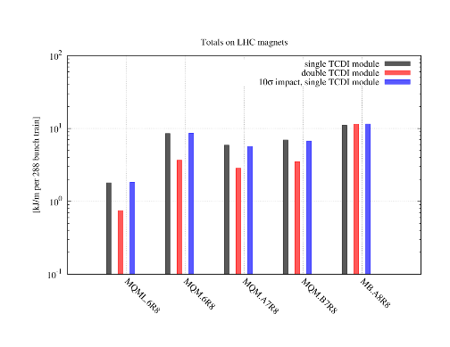
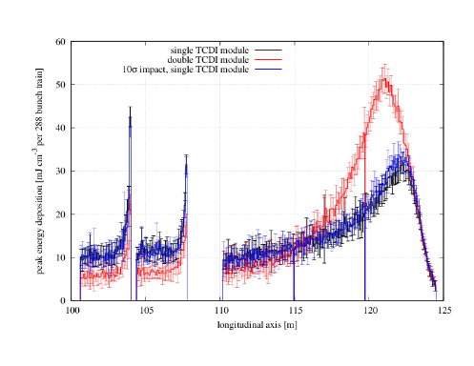
Cross-Talk on LHC Magnets
Totals:
3σ vs 10σ: little difference. 1σ needed for final word on role of impact parameter;
2 modules: reduced effects downstream;
MQM.A7R8
MQM.B7R8
Peaks:
Higher peak in MB.A8R8 with two modules;
→ Play off: more local showering for better protection downstream;
MB.A8R8

Slide 42
How can our experience be of help for you?

Slide 43
Spare Slides

Slide 44
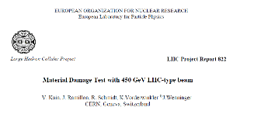

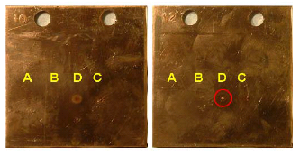
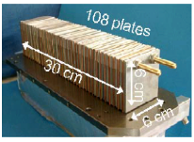
Requirements for TCDIs
TCDI collimators are diluters:
Protection downstream:
stringent requirements on attenuating beam below a ‘safe’ level;
Device integrity:
less stringent requirements on jaw integrity after hit (‘sacrificial’ design);
How to define a ‘safe’ level?
Experiment in TT40 @ CERN: check beam intensity needed for actually melting Cu (σ=0.5 – 1 mm, ε_{N}=3.5 μm);
2.3 10¹² p⁺;

