Slide 1

Beam Losses and Collimators
in Transfer Lines
ESS Workshop
May 13-14 2014

Slide 2
Purpose of Workshop?
~10 facilities
Uncontrolled losses
1 W/m ~ 200 PPB/m at 5 MW
Collimation strategies?
ESS has undergone major revisions
Notes:
- May be differences in machines, but...
- Major challenge: today's and future high intensity machines are
limited by uncontrolled losses
ESS: 1 W / m ~ 200 PPB / m, hands on maintenance
- A process of revising top level parameters, linac and beam
optics. Revise collimator strategy? Hope you will help
- Motivation: learn how present and future facilities approach the
collimator vs. beam loss challenge.
'Open discussion' = buffers, hope for discussions after each talk.

Slide 3
Beam Physics & Losses?
DTL
Spoke
Med-beta
High-beta
Notes:
Only protons: H- loss mechanisms!
Space charge drives halo production

Slide 4
Collimation Systems: Process
Machine type
  Beam physics
  Problems?
Purpose
Strategy
  Location
  1-stage, 2-stage, etc.
  NPS coverage
Solutions:
  Materials
  Cooling
Ct
Collimantium
Atomic mass
ZZ

Slide 5
Approach
Condition | Nominal Beam | Off-Nominal Beam
Purpose | Induce controlled, localized losses (Destructive halo monitor?) | Mask sensitive components
Conditions | Halo: sparse tails Modest relative power intercepted Phase coverage | Beam core: ~Gaussian Infrequent, energetic pulses n x π, n = 0,1,…
Challenges | Anticipating beam quality (codes!) | Covering all scenarios?
Notes:
activation, aperture contingency

Slide 6
(Courtesy of Chris Prior)
Notes:
Collimators offer contingency

Slide 7
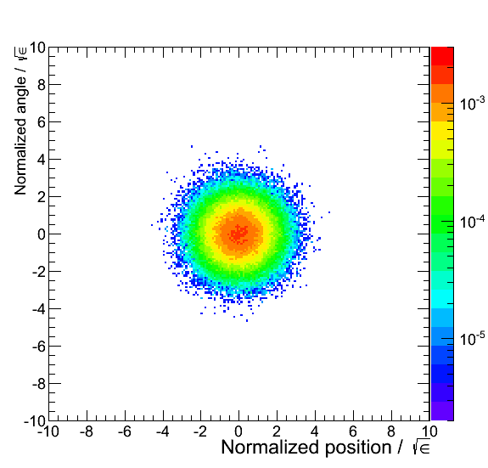
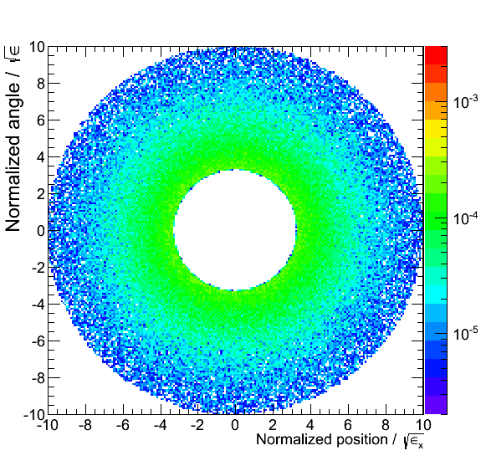
Input Beam?
Core: 2D Gaussian
Halo: Core-Less Exponential

Slide 8
Thanks already!
  You: for participating
  ESS: for hospitality & dinner tonight
19:00 Glorias, Sankt Petri Kyrkogata 9
  Please confirm attendance
  Special diet!
Notes:
Mention wifi

