Slide 1
The ESS HEBT Beam Physics:
Collimator Opportunities & Requirements
Heine Dølrath Thomsen, ISA, Aarhus University

Slide 2
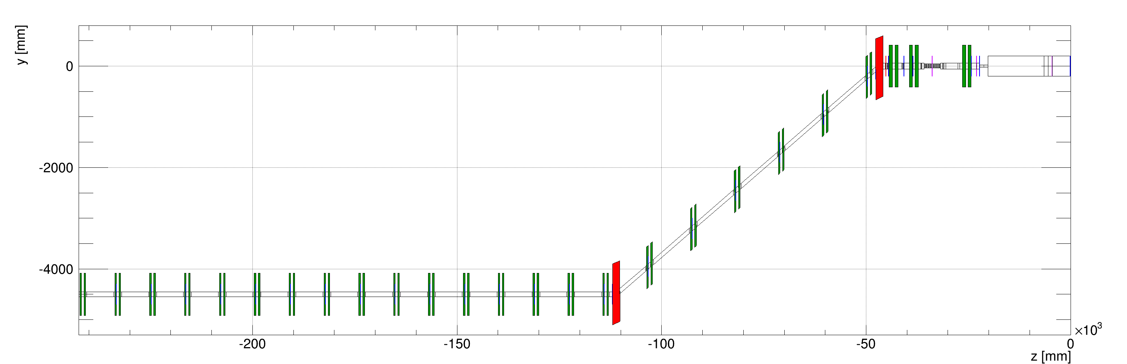
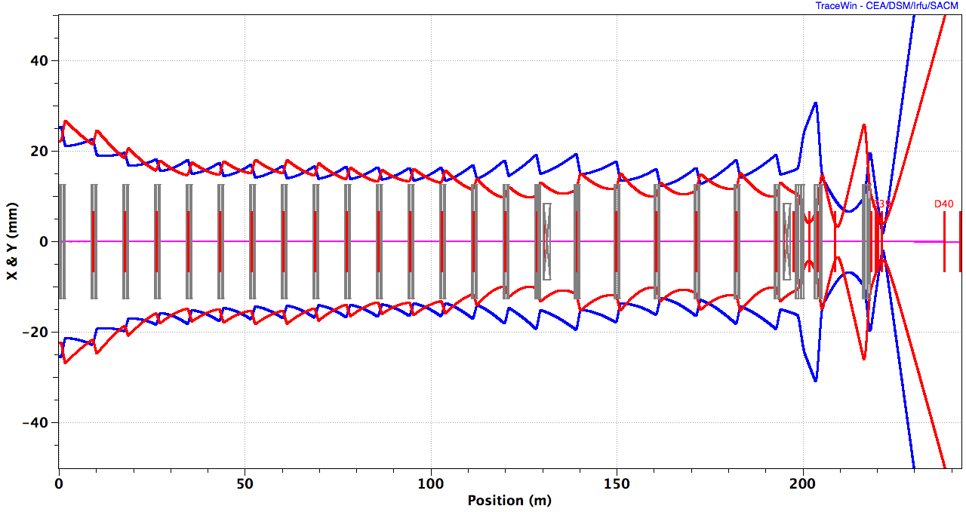
HEBT Layout
Quadrupole
Dipole
4º ACH
A2T
128 m
UHB, 15 periods
DUMP
10 RMS, X, Y,
EWU with quadrupole doublet
Notes:
Normalized aperture > 10
Bends: momentum collimation
Change in ACH

Slide 3
ESS HEBT Collimators: Strategy?
No ring, straight to target
  No build-up of errors
  Collimation efficiency
  Phase coverage?
  Single-stage
Only 2 bends (V)
  D_{y} < 0.9 m
Movable collimators:
βcollimation
  No p collimation
Fixed collimator
Mask target, etc.
Many recent changes…
Notes:
To be designed by NCBJ, Świerk, Poland
Requirements outdated?

Slide 4
Movable Collimator System

Slide 5
HEBT Layout
Quadrupole
Dipole
4º DgLg
A2T
128 m
UHB, 15 periods
DUMP
10 RMS, X, Y,
EWU with quadrupole doublet
Notes:
Bends: momentum collimation
Normalized aperture > 10
Change in DgLg

Slide 6
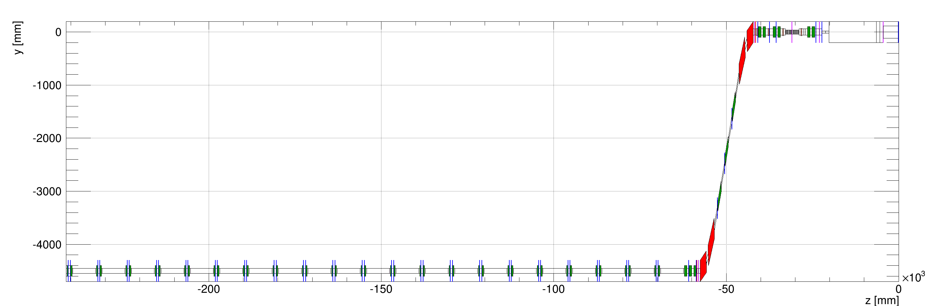
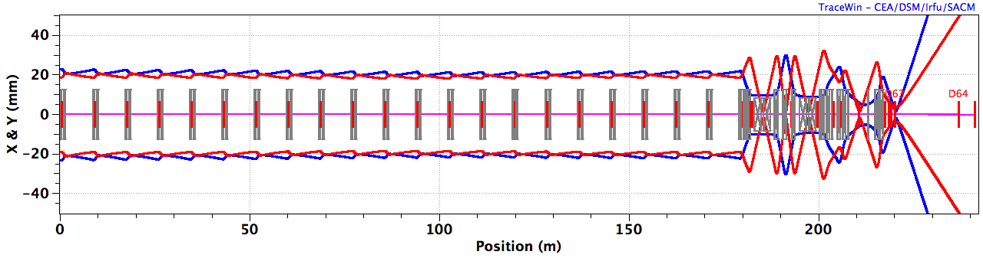
HEBT Layout – Ultimo 2013 (22 deg DgLg)
Quadrupole
Dipole
DgLg
180 m
UHB, 21 periods
A2T
10 RMS, X, Y,
EWU with quadrupole doublet

Slide 7
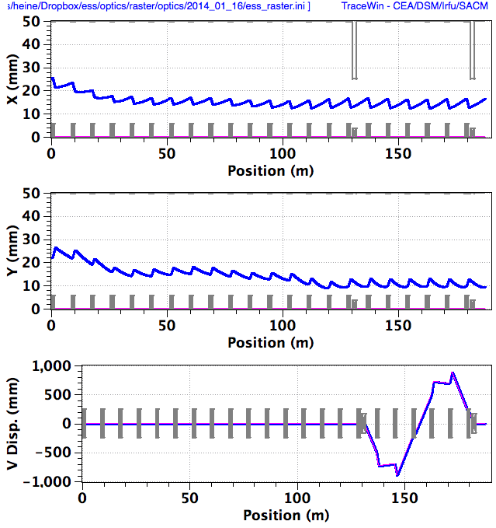
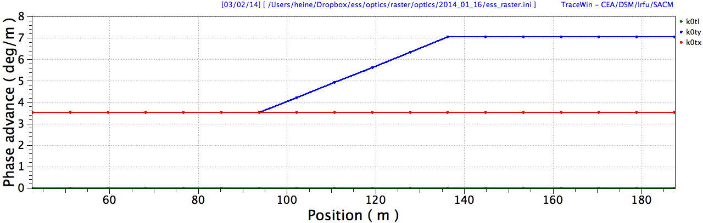
Contingency Region ~ HB Linac
M
C
R
DgLg

Slide 8
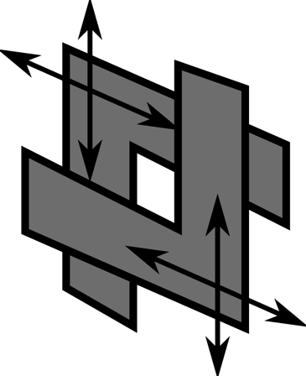
Elliptical LWU in Contingency Section
LINAC + HEDP
1932.4
6587.6
Collimators: (U+L) + (D+R)
Before linac extension:
~6.6 m dummy cryomodule (spool pipe)
Suitable location for collimators: Repeated structure of 4 jaws
After linac extension:
All periods fully occupied by cryomodules
Movable collimators will have to go out

Slide 9
Normalized Phase Space Coverage
4 jaws / plane
6 jaws / plane
Notes:
Proper halo reduction requires a transverse phase advance (or zero!)

Slide 10
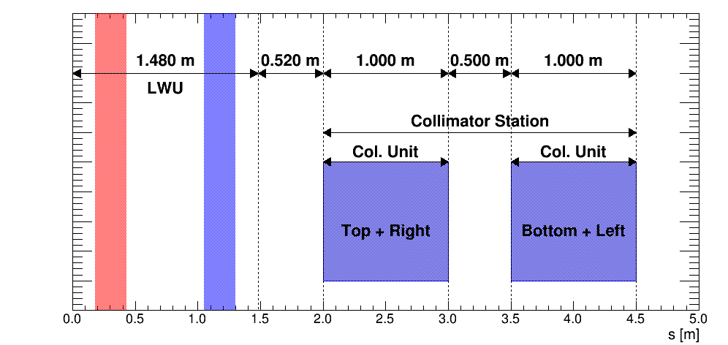
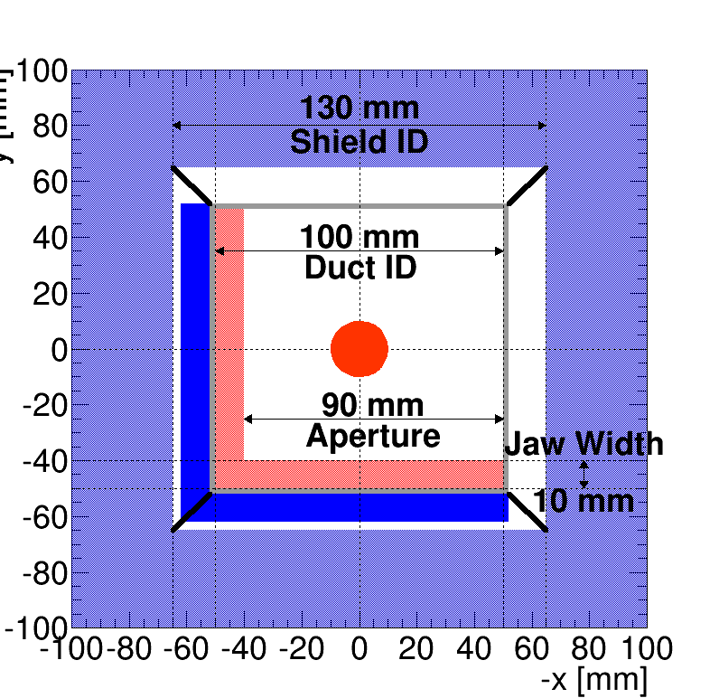
Movable Collimators
μ_{x,y} = 60°
μ_{x,y} = 60°
Uncontrollable losses in HEBT -> controllable losses
Protect downstream aperture restrictions
Handle and measure unforeseen halo?
Notes:
Difficult to evaluate need – contingency!

Slide 12
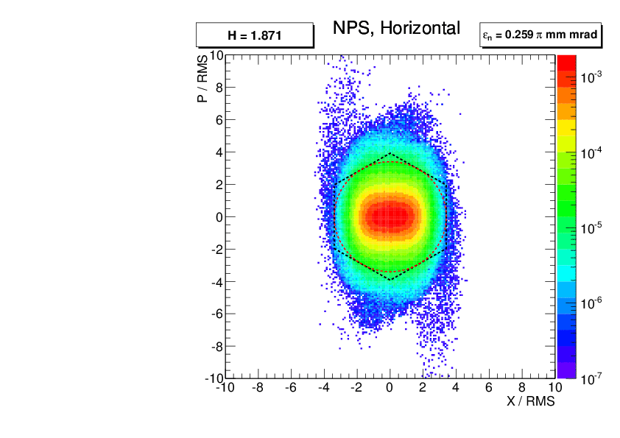
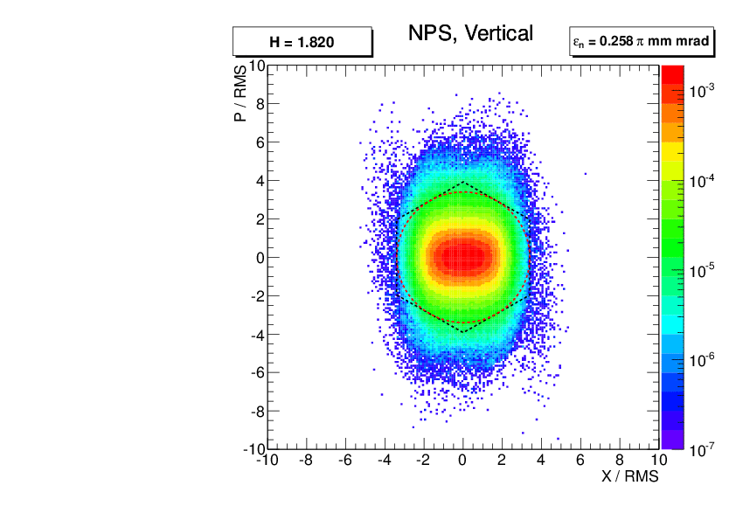
Black Body Absorbers
1
3
5
2
4
6

Slide 13
Emittance Conservation?
Horizontal
Vertical

Slide 14
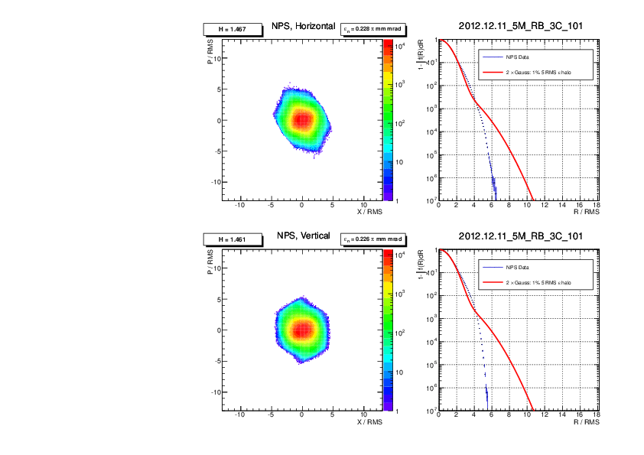
Element no

Slide 15
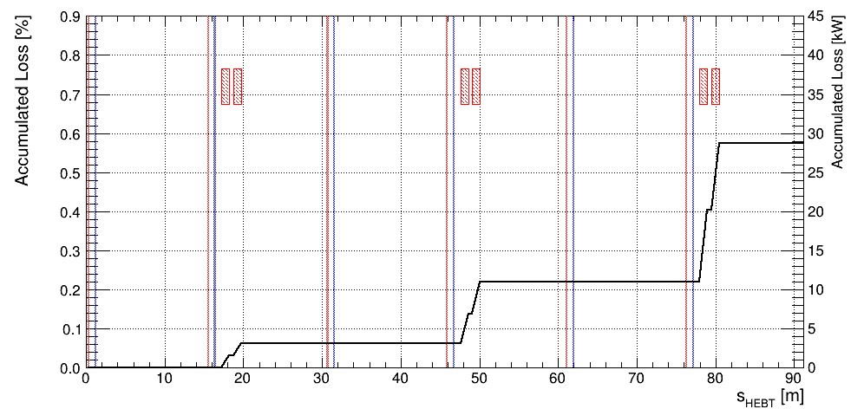
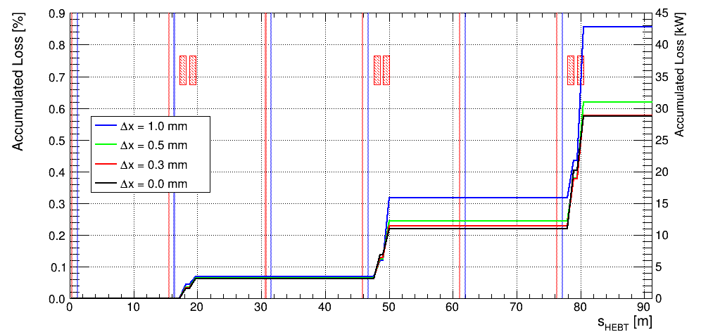

Slide 16
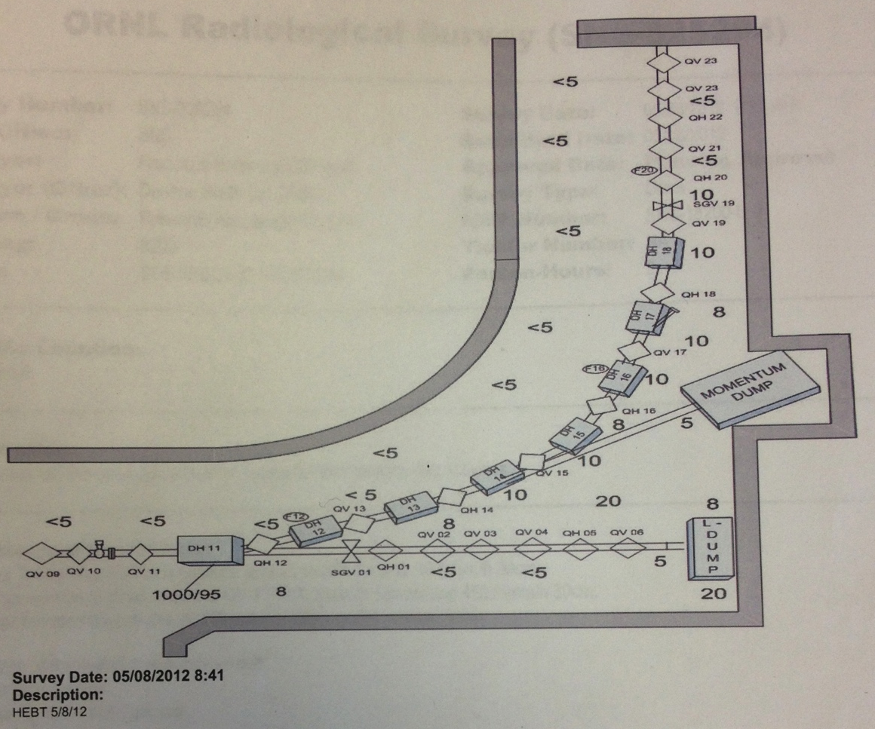
SNS Achromat to Ring
mrem / hr
10 mSv/h

Slide 18
Accelerator-to-Target (a2T)

Slide 19
HEBT Layout
Quadrupole
Dipole
4º DgLg
A2T
128 m
UHB, 15 periods
DUMP
10 RMS, X, Y,
EWU with quadrupole doublet
Notes:
Bends: momentum collimation
Normalized aperture > 10
Change in ACH

Slide 20
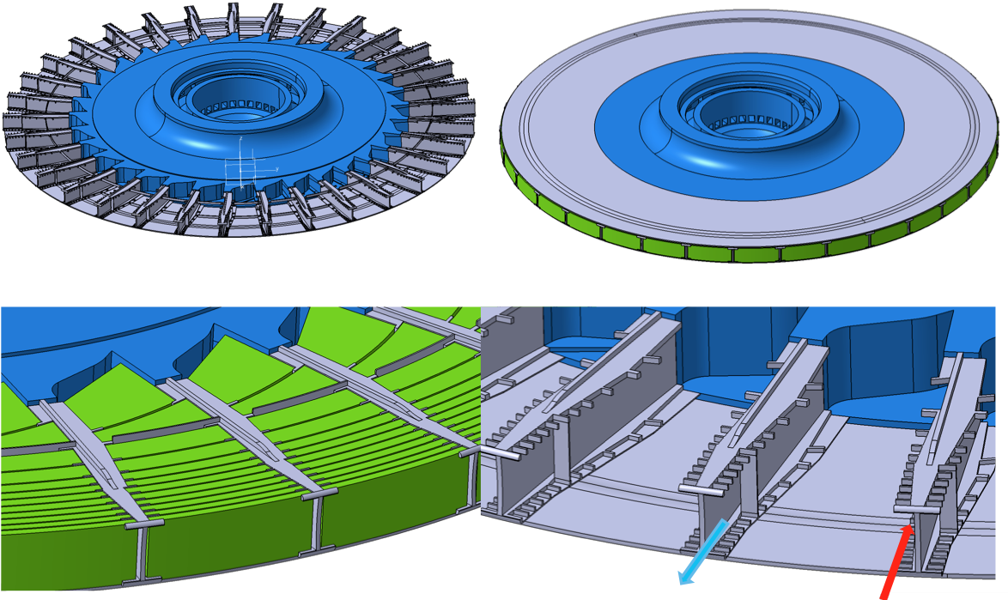
Target Wheel Design
Rotating seal for He gas
W pieces
Proton Beam
He flow
Notes:
30 rpm, 7t
He cooled
Green: W

Slide 21
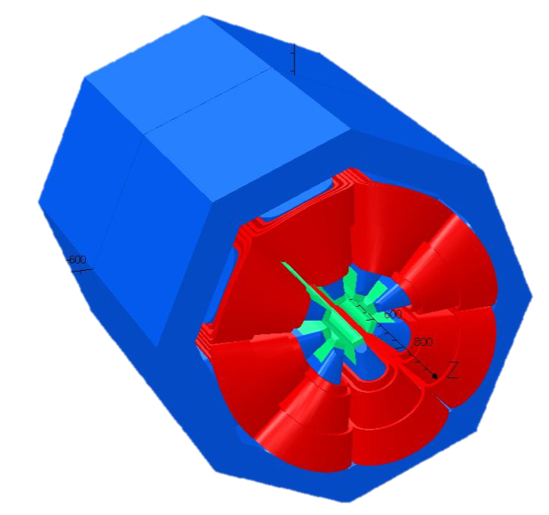
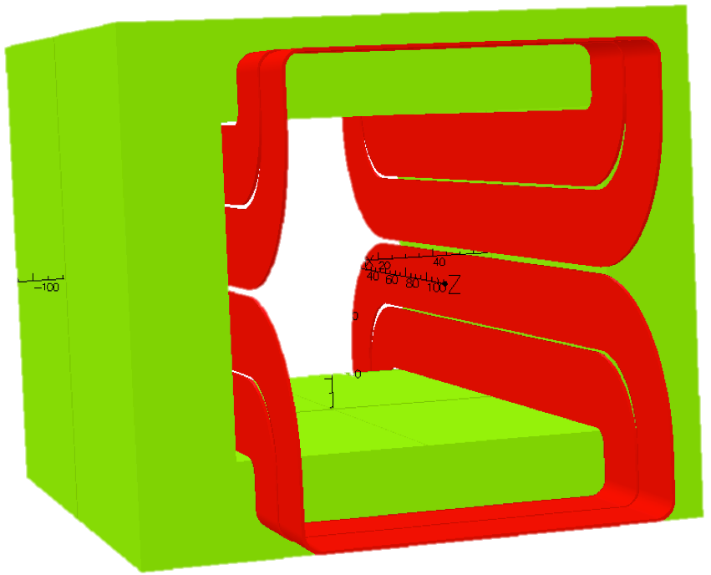
A History of Beam Expander Systems…
200 mm
160 mm
140 mm
B_{y}
B_{y}
B_{y}
f_{raster} ~40 kHz
x
x
x
Non-linear DC field distorts phase space and focuses tails
Complex tuning
Overfocusing of halo
Dodecapole comp.: overfocusing is neutralized
SFM: cheap magnet?
Suitable for CW or long-pulse machines
Linear focusing and pattern is decoupled

Slide 22
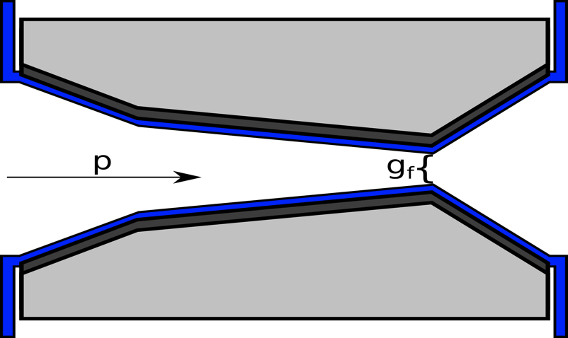
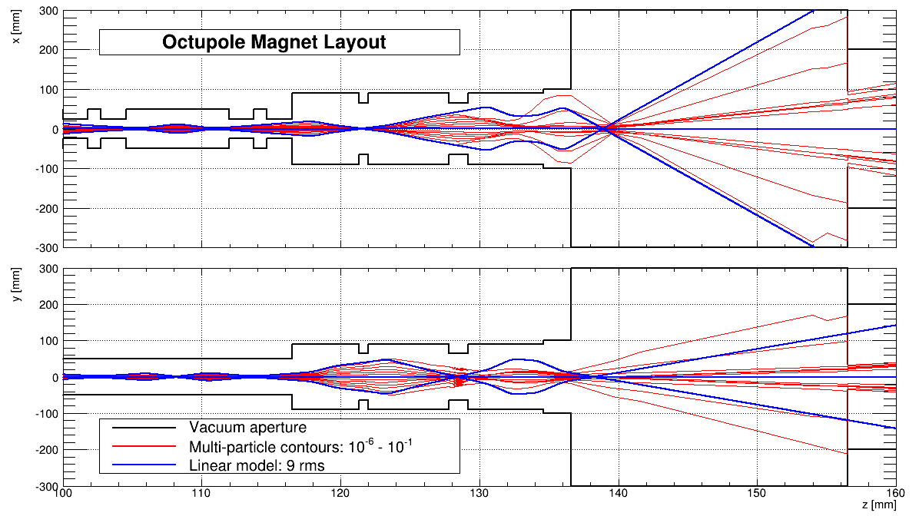
Over-Focusing of Halo
PBW
Focusing = (Lin. – non-lin)
Notes:
Balance losses vs Jmax
Primary beam power ~5-25 kW

Slide 23
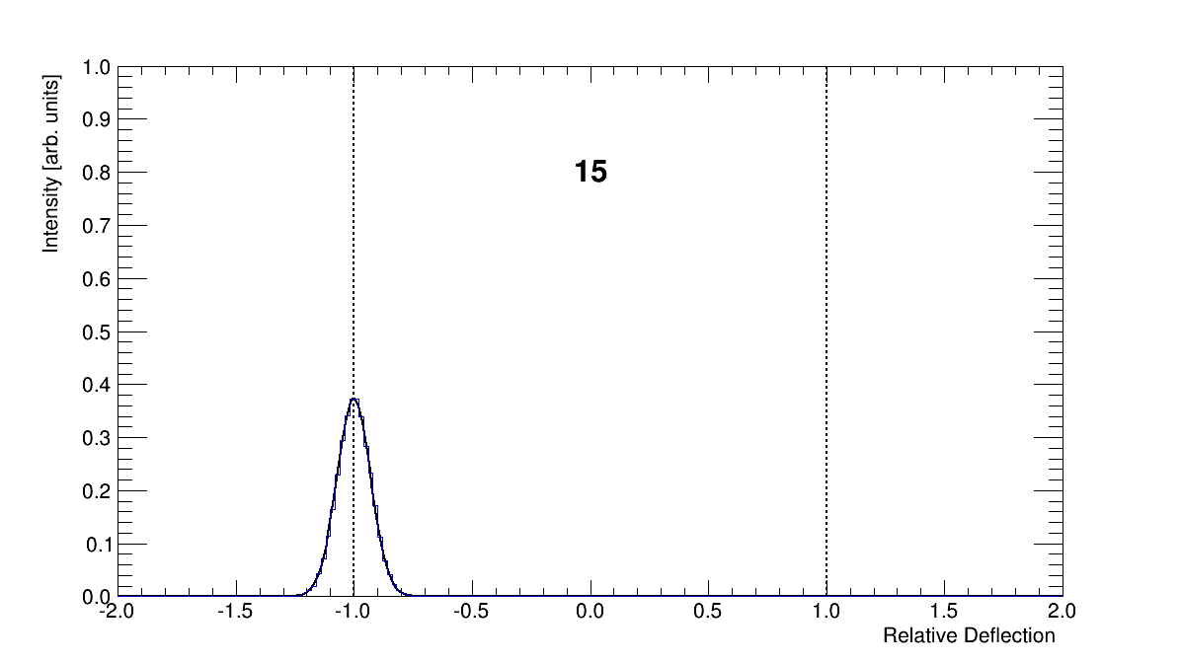
Beam Expander Systems: 1D Rastering
Magnification
Deflection

Slide 24
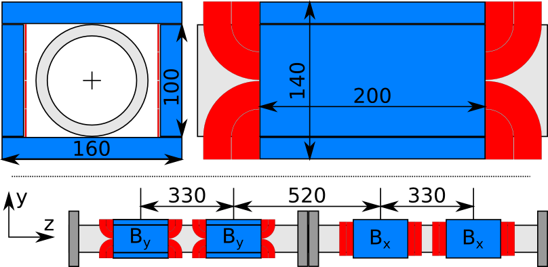
Beam Optics: LANL MTS Concept (B. Blind et al)
ACH
A2T
Matching Q’s
RMs
CO Q’s
AP
CO
Target

Slide 25
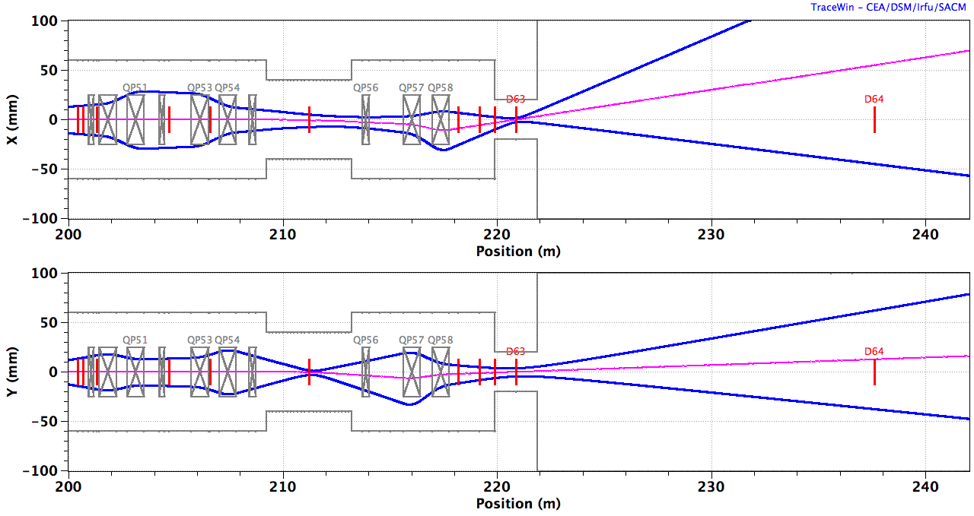
‘Raster25’
Centroid
10 x RMS beamlet
BEW
QP1-4
RMs
QP5,6
PBW
B_{y} B_{y} B_{x} B_{x} | B_{x} B_{x} B_{y} B_{y}
ACH
A2T
AP
CO
2.0 GeV: B_{x} = ±1.96 mT.m, B_{y} = ±2.28 mT.m, ±5 mT.m
Notes:
NSW
location of fixed collimator

Slide 26
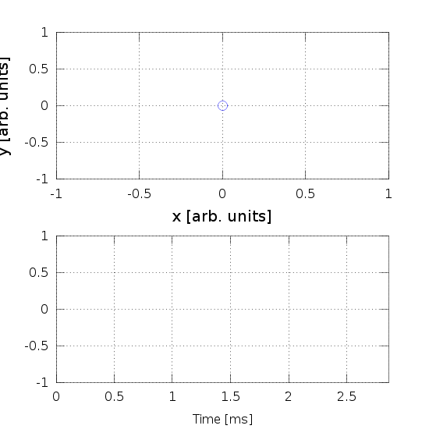
Raster Pattern
f_{y} / f_{x} = 5:4
f_{w} ~ 40 kHz, T_{p-p} = 12.5 us (w = x,y)
x,y [arb. units]
Max(∆x) ~ 90 mm, max(∆y) = 16 mm,
RMS(x-∆x) = 12.6 mm, RMS(y-∆y) = 6.3 mm
One pattern cycle
Notes:
113/83

Slide 27
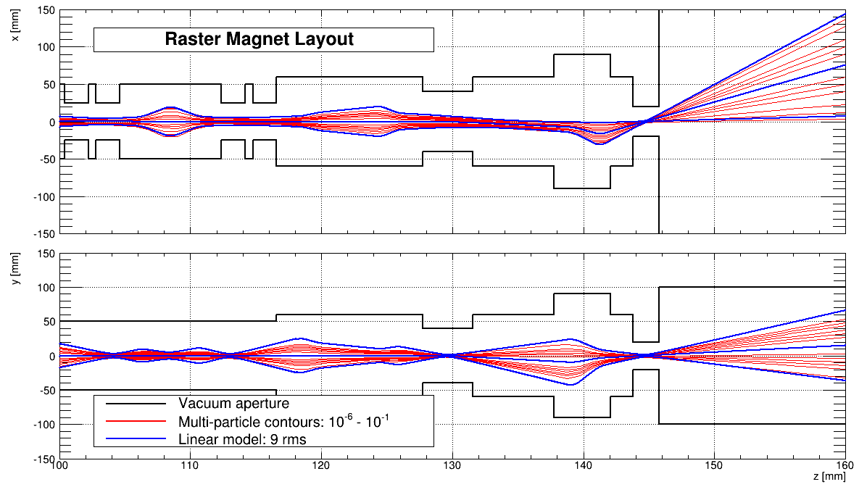
Waist
Outdated optics!

Slide 28
Waist
Focusing = (Lin. – non-lin)

Slide 29
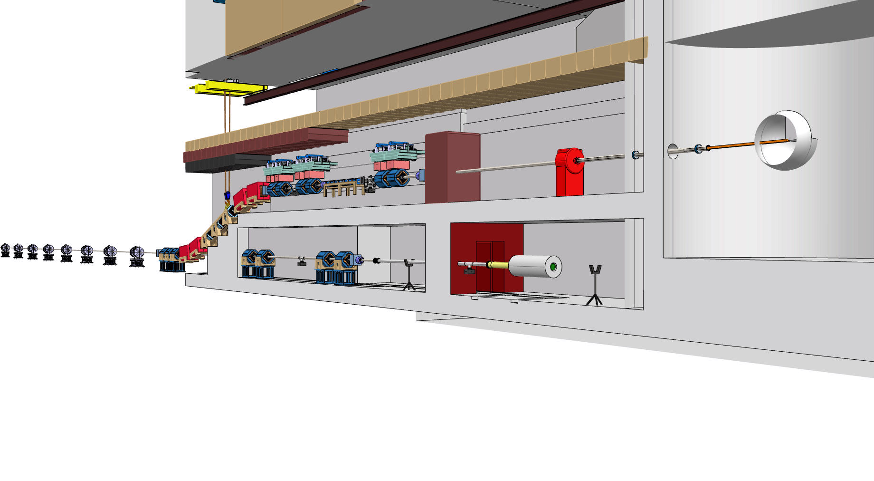
Fixed Collimator
Extreme halo & errant beams (larger gap)?
Location: Upstream of PBW, target, etc.?
Errant beams now even more interesting to study

Slide 30
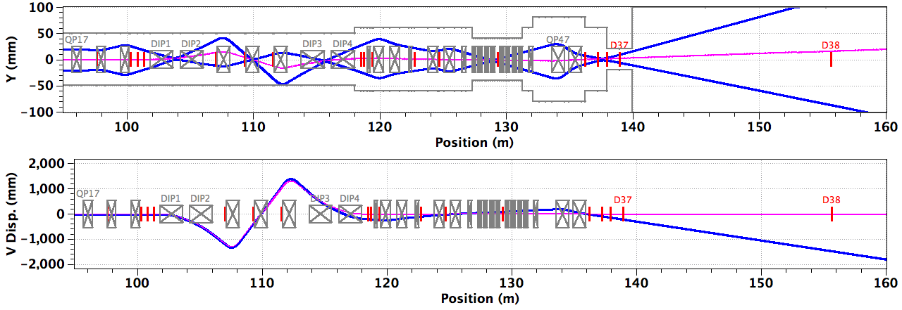
HEBT Errors & Acceptance?
ACH

Slide 31
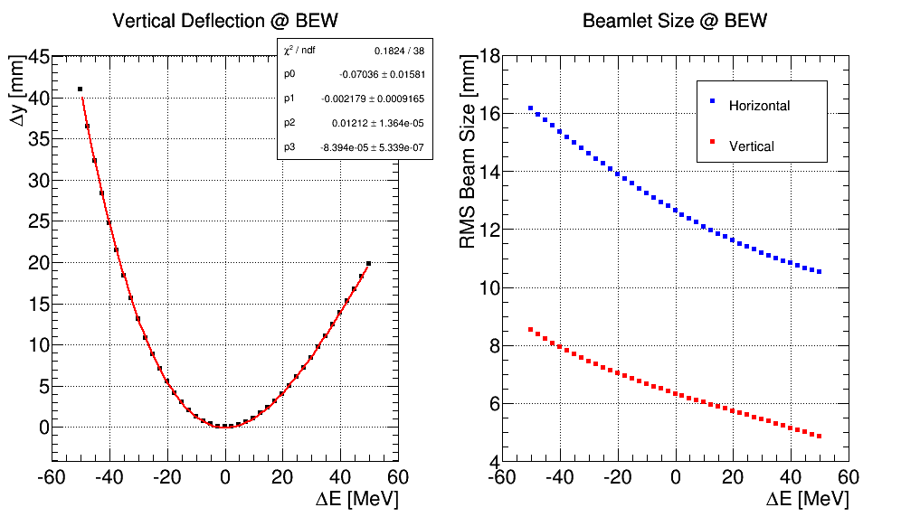
Raster25

Slide 32
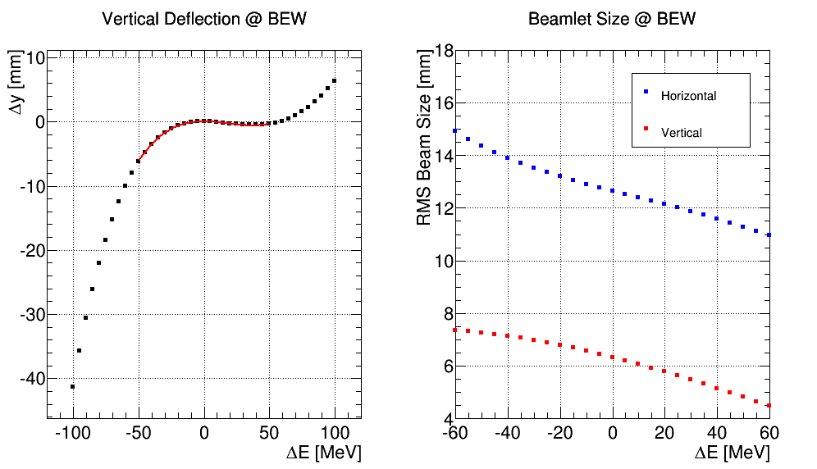
Raster26

Slide 33
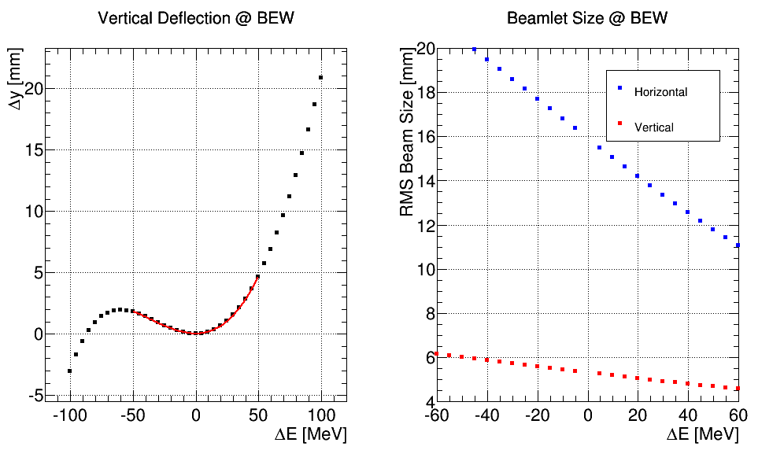
Raster27

Slide 34
Conclusion
μ_{x,y} = 60°
Fixed Target Collimator:
Movable Collimators:
Halo & over-focused particles
Errant beams?
Location: Upstream of PBW, target, etc.
Uncontrollable losses in HEBT, 12 kW / 12 jaws?
Protect downstream aperture restrictions
Handle and measure unforeseen halo?
Location: UHB (DgLg)?
Notes:
Karol & Piotr

Slide 35
Extra Slides

Slide 36
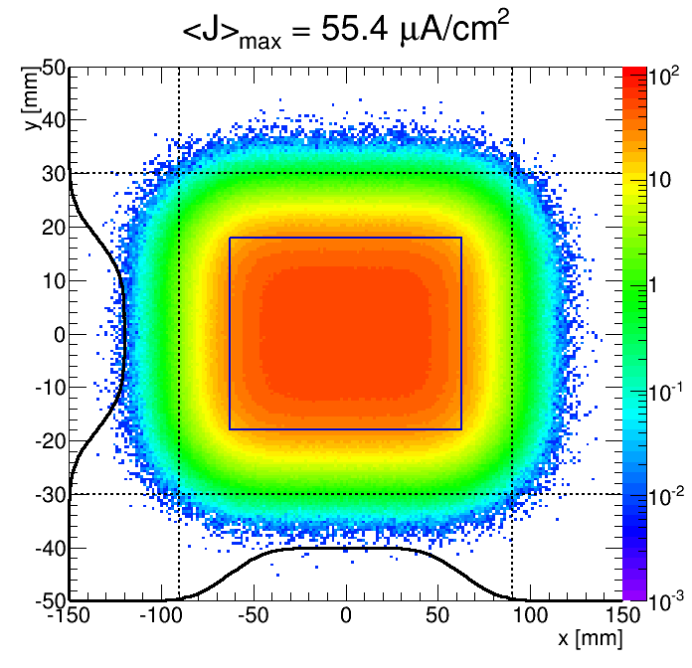
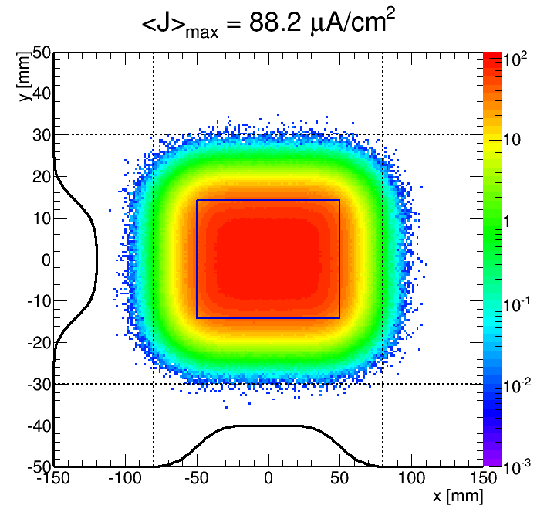
J_{max} @ BEW vs. PBW
 | Unit \ Location | PBW | BEW
amp. x | mm | 55.42 | 70.00
amp. y | mm | 12.67 | 16.00
rms (x) | mm | 10.00 | 12.64
rms (y) | mm | 5.00 | 6.32
rms(x)*rms(y) | mm^2 | 50.0 | 79.9
Jmax | uA/cm^2 | 88.2 | 55.6
Outside 160x60 | % | 0.04 | 2.40
Outside 180x64 | % |  | 0.07
Outside 180x62 | % | 0.00
Geometry: |CO <-> BEW| / |CO <-> PBW| = 1.263

Slide 37
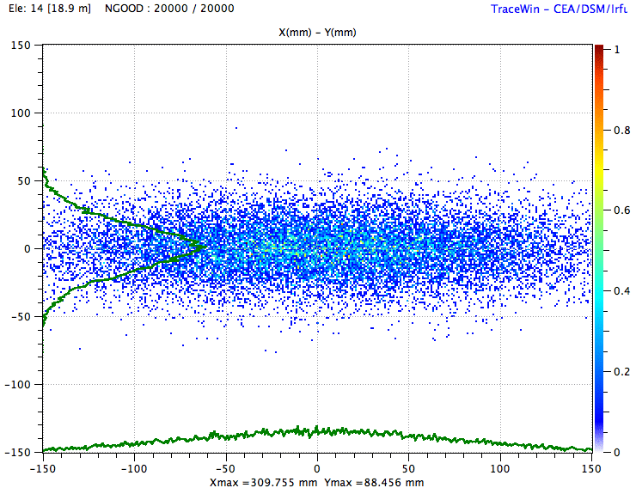
Y
Dummy footprint
X
Notes:
Sensitive towards halo
Truncated distributions

Slide 38
Results – black absorbers
Notes:
Rhombic

Slide 39
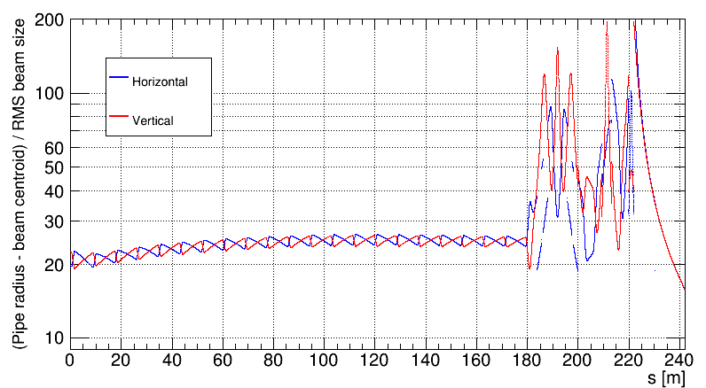
Normalized Aperture – RMs OFF
Final drift -
400 x 200 mm²?
Raster magnets:
Ø80 mm
Dipoles:
H x V = 50 x 100 mm²
Ø100 mm
Ø120 mm
To be followed up by error studies

Slide 40
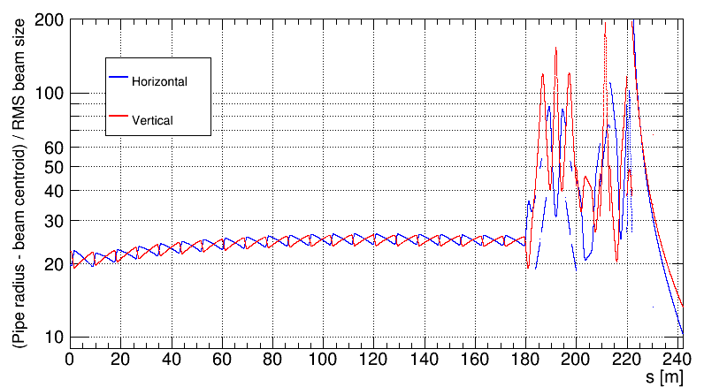
Normalized Aperture – RMs @ MAX
Final drift -
400 x 200 mm²?
Raster magnets:
Ø80 mm
Dipoles:
H x V = 50 x 100 mm²
Ø100 mm
Ø120 mm
To be followed up by error studies

Slide 41
1D: Phasing
n₂/n₁ = 1.41

Slide 42
Timeline (to be detailed)
2013: Conceptual design of the collimators
2014: Detailed technical design of the collimators
2015: Prototype of movable collimator finished and tested.
2017: All collimator system ready for installation

Slide 43
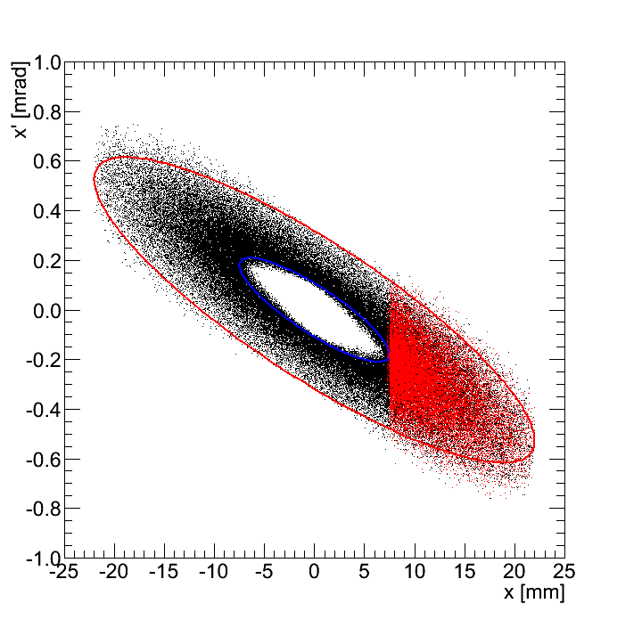
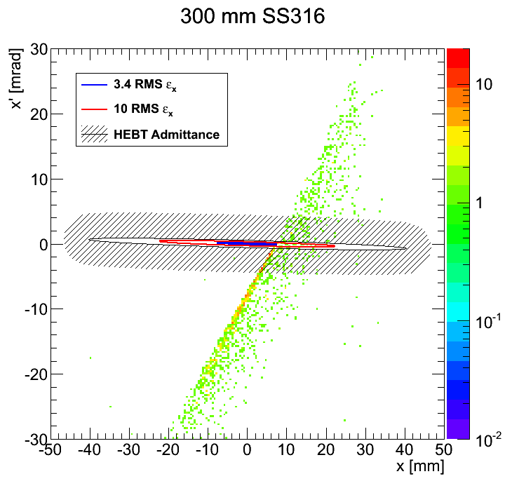
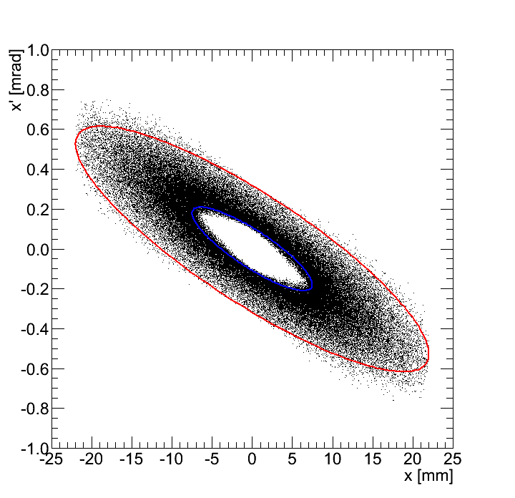
1st Jaw
H Phase space before 1st Jaw
H Phase space density after 1st Jaw
10 RMS
Transmission
3.3 RMS
Outscattering
(~6% @ 800 mm) ➔ masks & absorbers

Slide 44
Particles on Collimator
Proton Fluence @ 3.4 σ Coll.
Further Work
  Materials and dim.
  Masks? Activation?
  Repeat optimized col. system after μ_{x,y} = 90°
  Effects of beam offsets for
    Collimators
    Beam on target

Slide 45
Extra slides

Slide 46
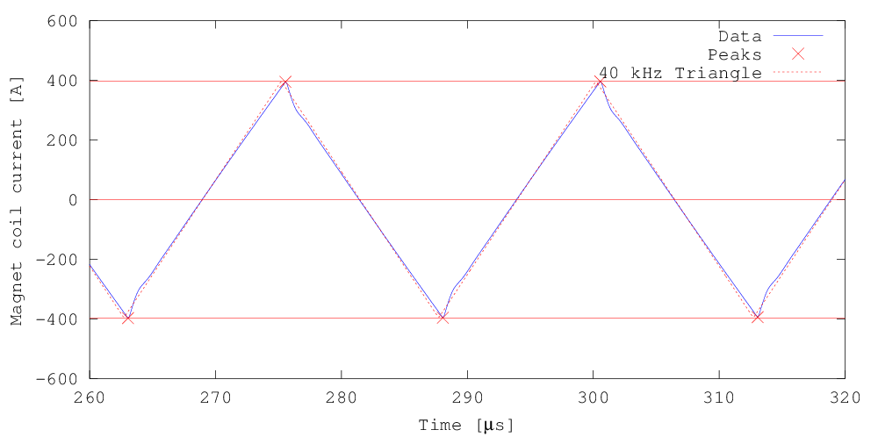
Raster System
200 mm
160 mm
Raster magnets:
  Window frame ferrite yoke
  Cu windings (air-cooled)
  Ceramic pipe, Ø80 mm
  NI = 4 x 340 A (peak)
  ± 5 mT.m peak field
IGBT-based H-bridge
140 mm

Slide 47
Hardware
Detailed studies: Impact of non-ideal waveforms

Slide 48
HEBT: 4 Principal Sections
Upgrade High Beta (UHB)
  Contingency towards unexpectedly poor SC linac performance: extra HB cavities can be installed!
  Transport section being mechanically identical to the MB+HB linac (apart from cryomodules, etc.)
  Adjustable collimators (would be excluded by upgrade)
Achromat (ACH)
  4.5 m vertical shift of the beam from linac to target level
  Reduce dispersive effects
Accelerator to Target (A2T)
  Reduce the beam peak intensity on the target (BEW) and proton beam window (PBW), cooling + radiation damage.
  Strong requirements for the beam on PBW + BEW (several zones defined for each element)
Beam Dump Line (DMPL)
  Dispose pilot beam during tuning of the linac.
  Up to nominal beam energy x low duty cycle => 50 kW (7.5 kW avg. beam power, passively cooled)
  Insensitive to energy fluctuations (in line of sight with linac)

