Slide 1
Status Report ACCSYS
Mats Lindroos
Head of Accelerator
www.europeanspallationsource.se
April, 2014

Slide 2
Overview
Good progress in all WPs !
Creation of an integration group lead by the Chief engineer consisting of lead engineers, ACCSYS system engineers, installation WP leader and associated staff. Close links to beam physics WP.
Review of CF preliminary design for ACCSYS tunnel buildings (solutions proposed for FE and Dog-leg regions and all approved in February CCB)
Review of CF preliminary design for ACCSYS RF gallery. Approved and in detailed design from March CCB
Level 3 requirements reviewed and “steady state” for level 4 requirements. Technical specifications in progress (level 5). Implementation of DOORS repository in good progress.
Risk register transferred to Exonaut and risks assigned to ACCSYS staff with treatments in progress
Good progress with In-kind discussions with several partners (e.g. Fr, Po, Es, It, UK, D, CH), planning of in-kind and drafts for technical appendices.
Audit of electrical and cooling support WP, HEBT WP and Vacuum WP

Slide 3
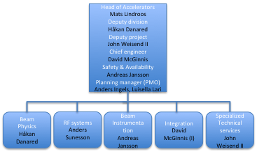
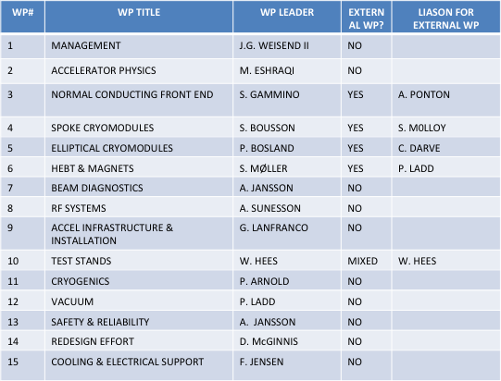
Organization and Work package leaders
Division and project aligned at high level
“WP as a group” would make for too big fragmentation
Four WPs have external leaders
Weekly or bi-weekly meetings at ESS Accelerator Division
Management board of project and division
WP leaders
Lead engineers
Safety
Regular meetings for ACCSYS project
Technical board (all WP leaders and reps of labs/uni. with contract) as governance and CCB on project level (6 meetings per year)
Collaboration board with reps of director of of labs/uni. with contracts as oversight committee
Audits yearly of every WP
Reviews (Conceptual, design, ready to build) as required mostly co-organized with audits

Slide 4
M Lindroos
Head of Division
H Danared – Deputy Head of Division
J Weisend II – Deputy Head of Acc Projects
D McGinnis – Chief Engineer
S Peggs (C)
A Jansson – Safety & Reliability Manager
BEAM PHYSICS
H Danared – GL
R de Prisco
M Eshraqi
R Miyamoto
M Munoz
E Sargsyan
C Darve
SPECIALIZED TECHNICAL SERVICES
J Weisend II – GL
P Arnold
J Fydrych
W Hees
G Hulla
F Jensen
J Jurns
P Ladd
H Spoelstra
X Wang
M Ferreira
RF
A Sunesson – GL
C de Almeida Martins
M Jensen
R Yogi
R Zeng
R Montano
C Prabert - Personal Assistant
G Jacobsson - Team Assistant
Solveig Aas– Team Assistant
BEAM INSTRUMENTATION
A Jansson – GL
C Böhme
B Cheymol
I Dolenc Kittelmann
H Hassanzadegan
M Jarosz
E Lundh
C Roose
T Shea
L Tchelidze
C Thomas
E Bargallo
H Kocevar
INTEGRATION
D McGinnis - GL (I)
A Ponton – Lead Eng
S Molloy – Lead Eng
G Lanfranco
E Tanke
N Gazis
M Conlon (C)
50 people +
1 not started yet
C Prabert, 2014-02-19

Slide 5
Staff plan and in-kind
Leveling required: i) move non critical activities, ii) temporary staff movements within division and iii) look for in-kind partners who can contribute with staff on site
110 in operation
Probable in-kind ->

Slide 6
Plan for staff levels and recruitment at AD
Present planning of staff from Primavera is available
Information on planned staff in in-kind work packages must be entered manually
Resulting staff to be recruited in Lund to be compared to available budget in 2014 and leveled to assure feasibility of recruitments needs
Long term needs at ESS AD to be analyzed:
Base needs for operation
Training now but operation later
Results to be presented to management and governance of project before May review

Slide 7
THE ESS LINAC
352.21 MHz
704.42 MHz
2.4 m
4.6 m
3.8 m
39 m
56 m
77 m
179 m
Target
Source
LEBT
RFQ
MEBT
DTL
Spokes
Medium β
High β
HEBT & Contingency
75 keV
3.6 MeV
90 MeV
216 MeV
571 MeV
2000 MeV
 | Length (m) | W_in (MeV) | F (MHz) | β Geometric | No. Sections | T (K)
LEBT | 2.38 | 0.075 | -- | -- | 1 | ~300
RFQ | 4.6 | 0.075 | 352.21 | -- | 1 | ~300
MEBT | 3.81 | 3.62 | 352.21 | -- | 1 | ~300
DTL | 38.9 | 3.62 | 352.21 | -- | 5 | ~300
LEDP + Spoke | 55.9 | 89.8 | 352.21 | 0.50 (Optimum) | 13 | ~2
Medium Beta | 76.7 | 216.3 | 704.42 | 0.67 | 9 | ~2
High Beta | 178.9 | 571.5 | 704.42 | 0.86 | 21 | ~2
Contingency | 119.3 | 2000 | 704.42 | (0.86) | 14 | ~300 / ~2
Upgrade | 59.6 | 2000 | 704.42 | (0.86) | 7 | ~300 / ~2
M. Eshraqi
April 2-3

Slide 8
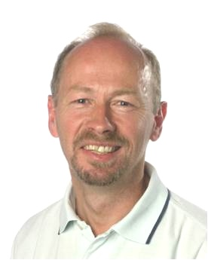
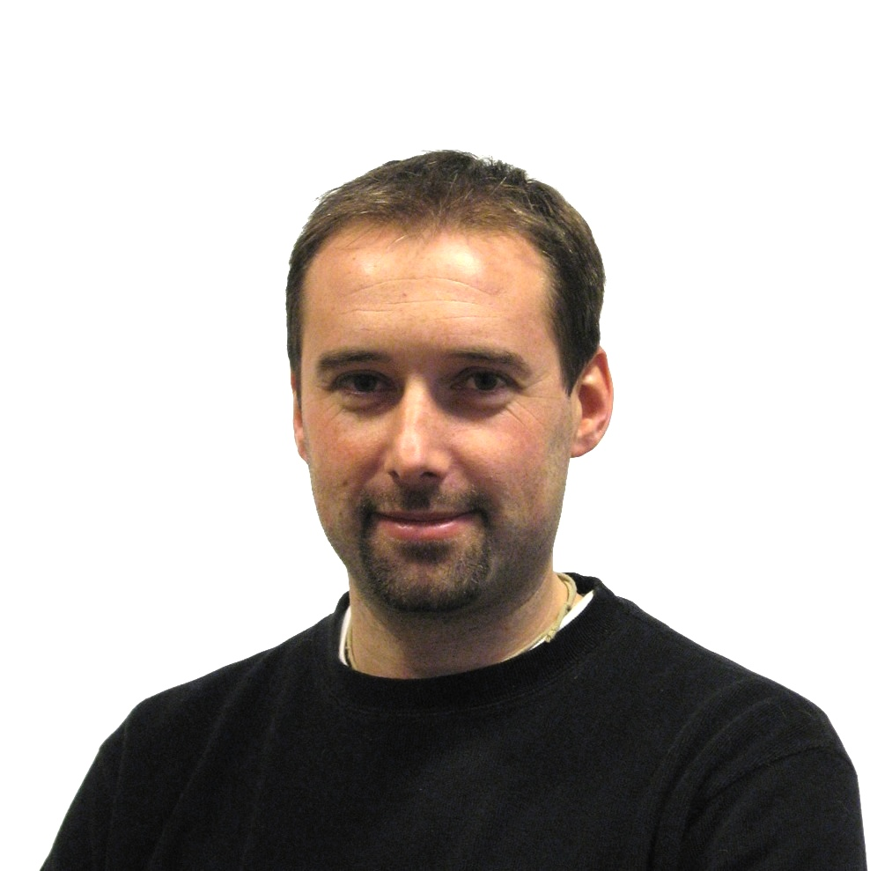
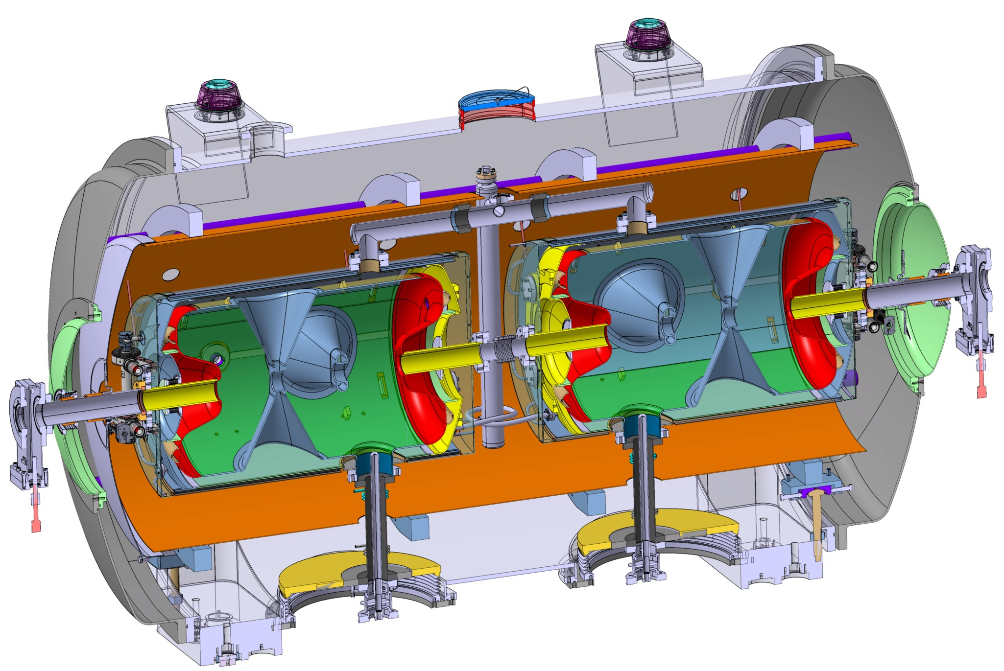
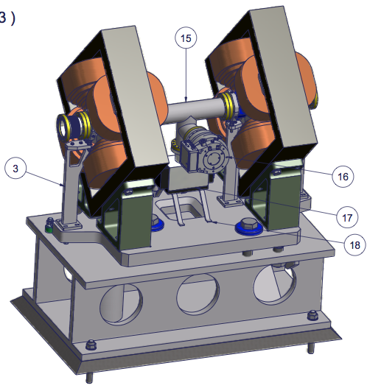
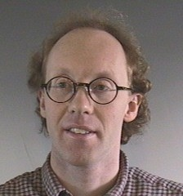
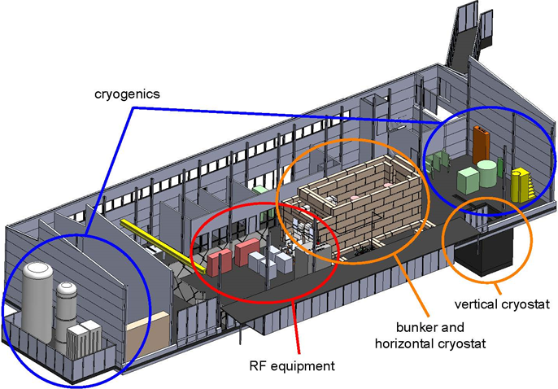
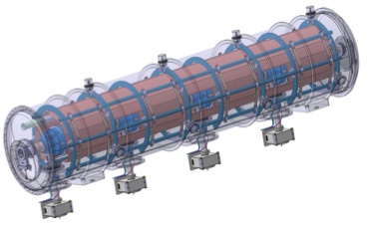
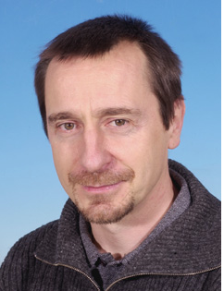
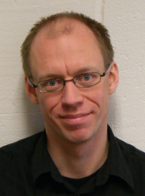
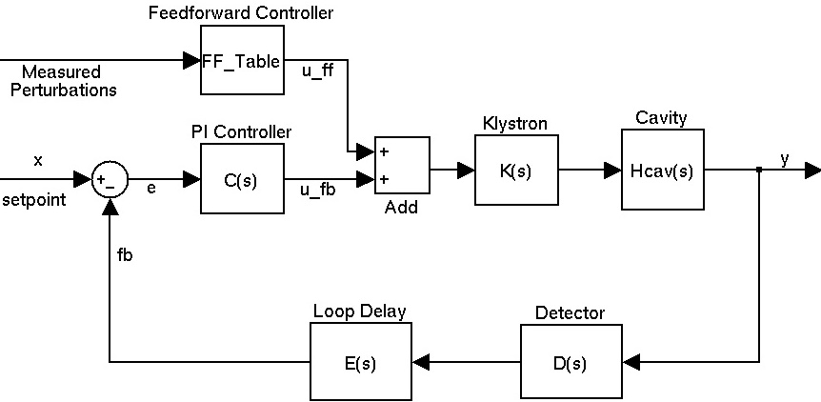
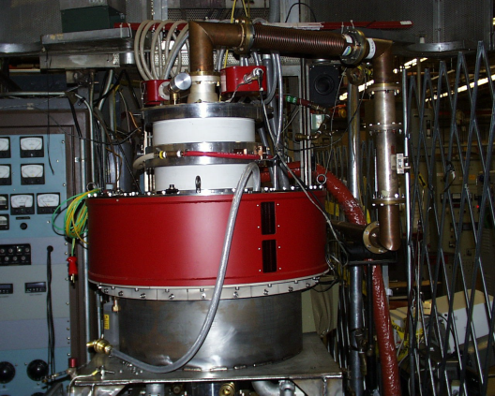
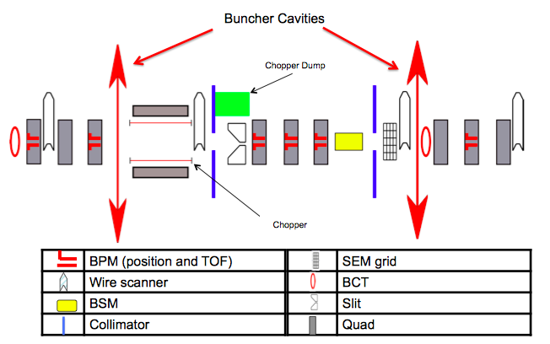
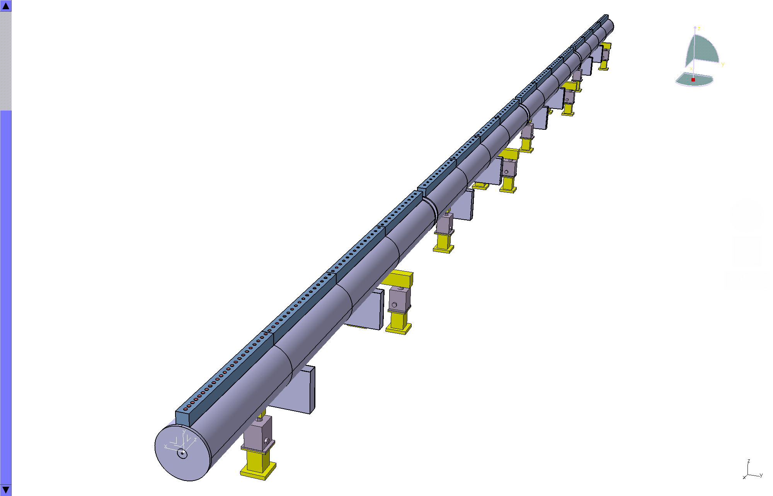
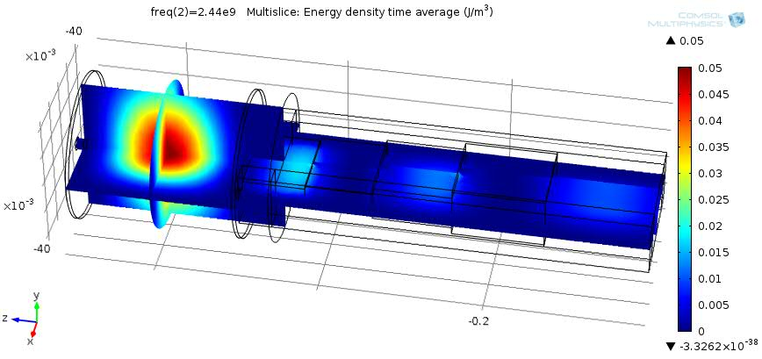
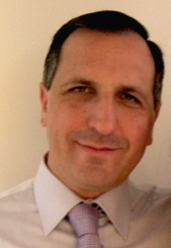
Prototyping the ESS accelerator
Søren Pape Møller
Sebastien Bousson
Roger Ruber
Pierre Bosland
Anders J Johansson
CERN
The National Center for Nuclear Research, Swierk
Roger Barlow
Ibon Bustinduy
Santo Gammino

Slide 9
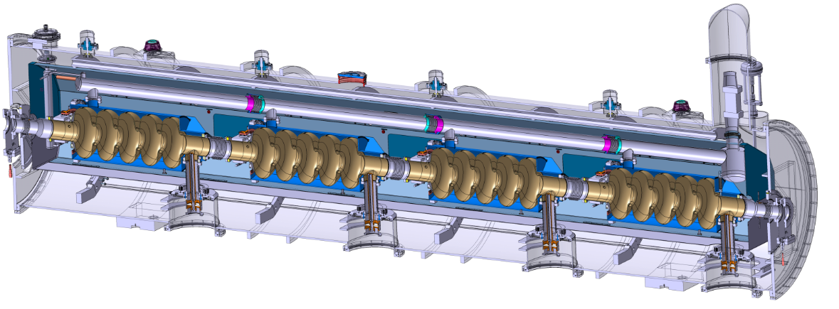
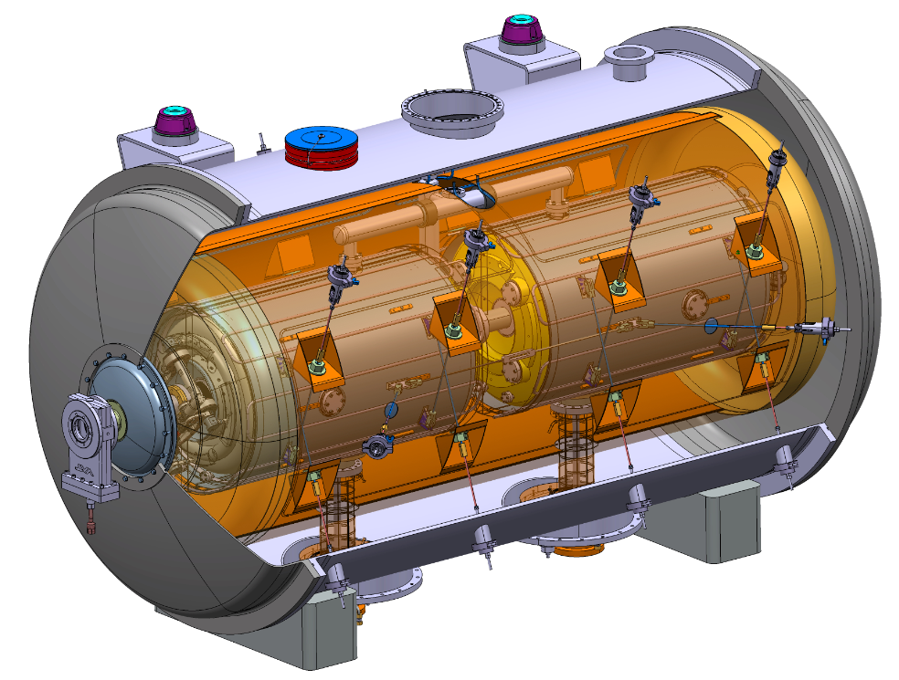
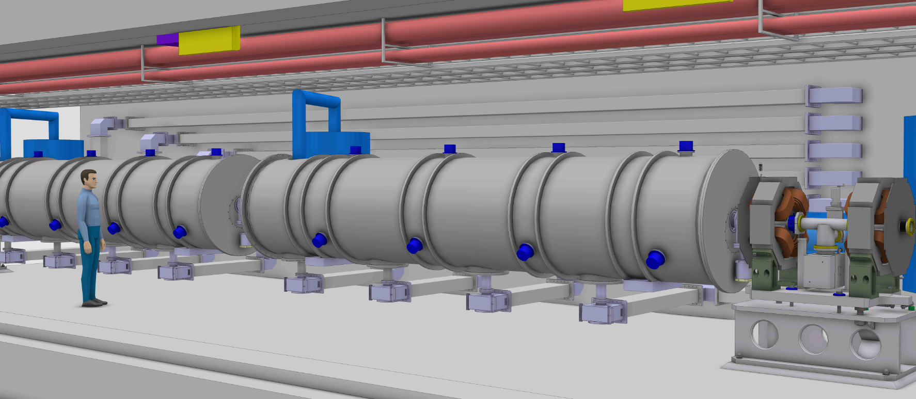
The Cavity Cryomodule Technology Demonstrators
Helium tank
Cold tuning System
5-cell elliptical cavity
Power coupler
Space frame
→ Cavities Cryomodule Technology Demonstrator results by 2016
Notes:
Accelerateur principe avec proton
Technologie de pointe supraconductice
Spoke – insatalle

Slide 10
(Some of the) Achievements past month
RF (WP8): Decision on a vendor for the modulator prototype
RF (WP8): Received offers for prototype IOTs, order in April
Cryogenics (WP11): Arrival of final industry study reports for the Accelerator Cryoplant and specification of accelerator cyoplant finished
NC front-end (WP3): Start of production of DTL prototype components at INFN Turin
SCRF (WP4 and 5): Continued work on SRF Cavity and coupler prototypes e.g. spoke cavity prototype elements fabricated and cavities to be delivered in July from both vendors
Beam diagnostics (WP7): Start of re-planning of the Beam diagnostics to respond to new accelerator design and desire for additional in kind contributions
Vacuum workshop held to agree on standards and hand book (WP12)
Safety&Reliability (WP13): Completion of Report on Accelerator Shielding design requirements
Infrastructure and Installation (WP99): Continued detailing of RF Cell layouts and cabling requirements. Requirements for CF.
Significant progress on cabling and rack requirements (WP14)

Slide 11
Next month’s major activities
In-kind discussions with Spain, Poland, Italy, Denmark, Sweden, Germany, Switzerland, Norway and France to prepare in-kind contracts and HOAs
Tracking of actions on annual review recommendations, 6 of 8 to be completed for end of May (talk by J. Weisend for TAC)
Completion of review of requirements at level 3 and completion of level 4 requirements and migration to DOORS
Continue commissioning and operation planning
Decision on IOT prototype contract
Continued WP activities according to plan

Slide 12
Project wide issues and other higher project level issues
Delays will be incurred if in-kind contracts aren't agreed or intermediate solution for in-kind crediting found, e.g. LEBT diagnostics, RFQ, MEBT and Raster scanning prototypes.
Need to find workable solution for earned value reporting for (in-kind) contracted activities
Need of a real-time integration of CF and ACCSYS configuration data and decision on E-CAD software for ESS
Delay in cavity prototype manufacturing for 2(3) spoke cavities and 1(2) elliptical cavity
Need to discuss accelerator MPS design philosophy at ESS level, possibly hold an independent review
Preparation of technical appendices for all in-kind contracts

Slide 13
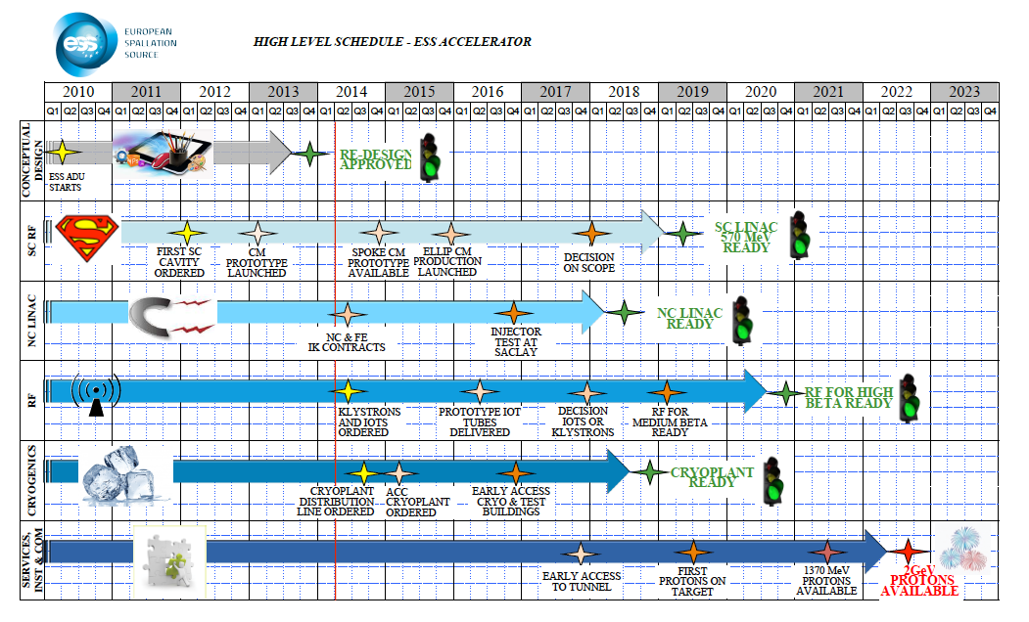
Very high level Schedule

Slide 14
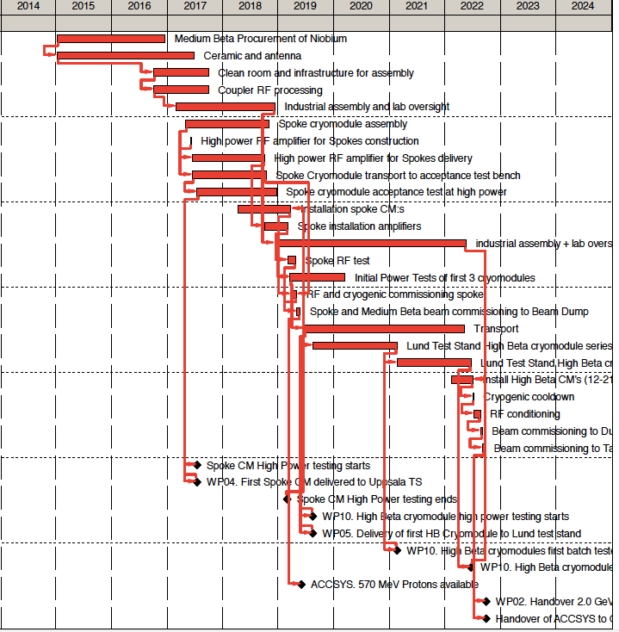
Schedule Critical Path
For first protons to target:
CP is mainly set by cryomodule production
For final milestone for 2 GeV:
CP is mainly set by elliptical cryomodule production
Interplay between activities at different labs critical:
Interface documents
Transport
“on the same schedule”
Many “near critical paths”

Slide 15
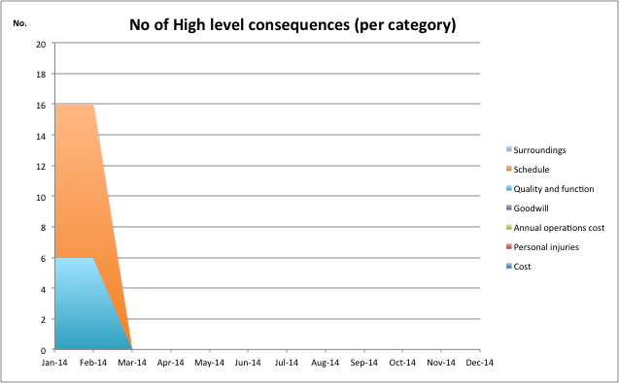
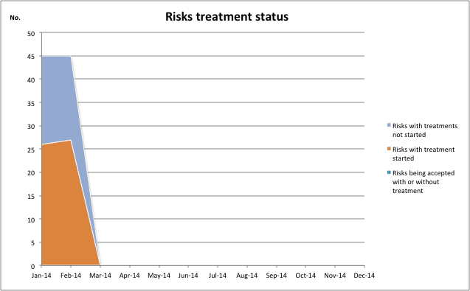
Risk and treatment status
Top 5 risk Cost:
political and financial considerations overrule technical considerations for IKC assigments
In-kind contributors do not meet scope and schedule requirements
Both funding and costing have uncertainties. The uncertainties are still present very late in the process. Changes will impact scope and schedule but these are fixed! E.g. the cost uncertainty is +30% - 0%, our contingency is apporx 15%, i.e. not aligned.
Unidentified design faults are not prototyped and fail in production
Suppliers do not deliver on time with right quality/quantity, e.g. klystrons, modulators, CMs, cavities
Top 5 risk Schedule:
Integration failure and/or interfaces don't match.
Suppliers do not deliver on time with right quality/quantity, e.g. klystrons, modulators, CMs, cavities
Cryomodule production is late
In-kind contributors do not meet scope and schedule requirements
Delay in issuing major contracts, both in-kind and others.

Slide 16
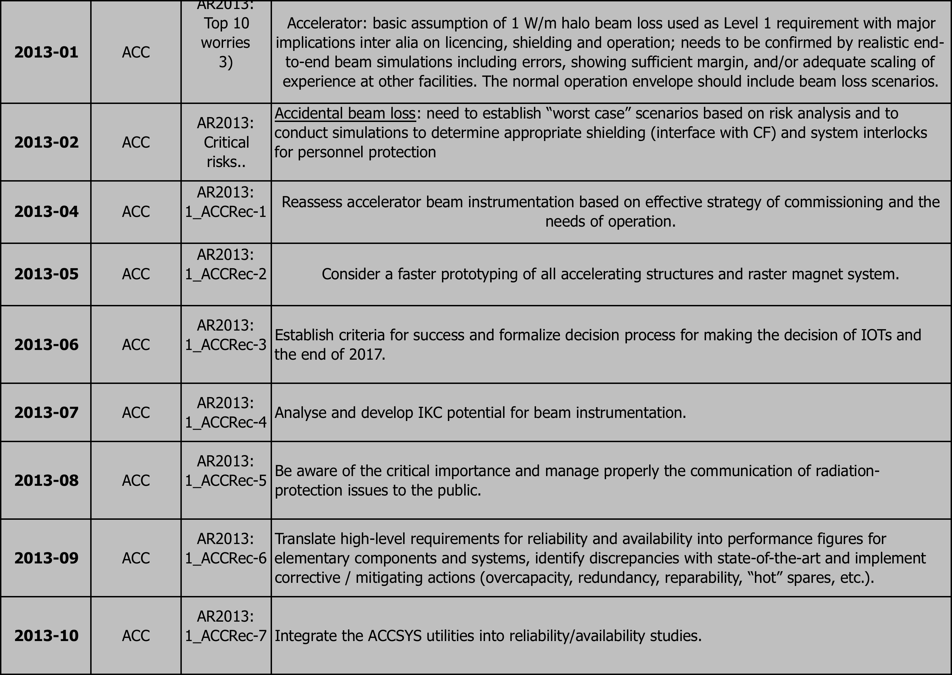
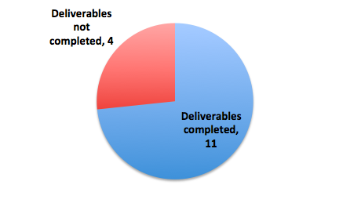
Annual review

Slide 17
Additional Annual Recommendation
Original Recommendation : “Recommend to continue to develop/refine the estimates to reflect benchmarks, parametric, industry inputs, 3rd party inputs and to ensure that the basis is properly structured, and consolidated in a formalized approach.”
Interpretation: The quality of the cost estimates should be improved. Focus should be on estimates (excluding labor) with Basis of Estimates in the category "Engineering, experienced or professional judgment (ENI)" but preferably all estimates should be updated if possible
Status: In Progress. This will be an ongoing process with the BOEs being improved as we further develop designs and acquire either vendor quotes or budgetary estimates from vendors. Since November we have gathered better information on several large procurements representing almost 70 MEuros of cost. These are:
RF Modulator – Vendor quotes for prototype work matches cost predictions
Accelerator Cryoplant – Budgetary estimates from two separate vendors are within or near to cost predictions
Cryogenic Distribution Line – Budgetary estimates from 2 separate vendors are within or near to cost predictions

Slide 18
A-TAC: Accelerator Project Status
Observations
Staffing numbers show growing discrepancy with resource-loaded plan, casting doubt on credibility of schedule
The Committee has concern about lack of practical technical activities at ESS Lund until test stations get operational, thus missing opportunity to early train technical staff
Likely IKCs identified for 48% of ACCSYS, well below target of 75% which is unprecedently high
Staff numbers and competencies should be tailored to handle high level of IKCs
Delays already building up on spoke and elliptical cavity prototypes
Schedule allocation of 1.5 year between first access to tunnel and first beams appears very short
Co-activity of “initial operation” for users and completion of construction in period 2020-2025 needs to be clarified (competing schedule and resources)
A table of R&D tasks was presented with expected completion dates. For this committee to make sense of the list, it would be good to add a column on how much is completed to date. It is our understanding the monthly reports are provided by all collaborators.
In the very near future, a significant amount of procurement will begin. Is the ESS business office prepared for this increase? When hardware starts being delivered, where will it be received and stored?

Slide 19
A-TAC: Accelerator Project Status
Recommendations
Revise planning as soon as situation of IKCs gets better defined
Allocate sufficient time and resources in schedule for 1)individual system tests (= commissioning without beam) and 2)commissioning with beam. Consider early access to tunnel front-end for staged installation & commissioning
Consider possibility of practical training of newly recruited technical staff at existing experimental facilities in partner institutes
Strive to secure IKCs identified as likely, and estimate from the results the likelihood of achieving full 75% target; revise ACCSYS IKC plans accordingly
Plan combined& intertwined operation/construction activities in 2020-2025 in terms of schedule and resources
Report qualitatively and quantitatively on progress of the different tasks

Slide 20
Annual review 26-27 May
Monday, May 26, 2014 – Location: Tänkar Tanken
8:30 Committee Executive Session Review Committee Chair
9:15 Welcome and ESS Overview and Status (15+15) J. Yeck
Project Update and Plans
Response to Recommendations from the November 2013 Review
Assessment of Construction Readiness
9:45 Neutron Scattering Systems (20+10) D.Argyriou
NSS System Update and Plans
Response to Recommendations from the November 2013 Review
Assessment of Construction Readiness
10.15 Break
10.30 Accelerator (20+10) M.Lindroos
11.00 Target Station (20+10) J.Haines
11.30 Integrated Control System (20+10) G.Trahern
12.00 Lunch
13.00 Infrastructure (20+10) Ö.Larsson
13.30 Cost and Schedule & Planning for Initial Operations (20+10) J.Brisfors
14.00 Management (20+10) M. Tiirakari
14.30 Break
14.45 Parallel Subcommittee Presentations/Discussions (see below for schedule)
16.00 Committee Executive Session Tänkar Tanken
19.00 Reception and Dinner
Tuesday, May 27, 2014 - Conference rooms according to detailed schedule, ESS
8:30 Parallel Subcommittee Presentations/Discussions (see below for schedule)
10:00 Review Committee Executive Session/Lunch Location Tänkar Tanken
13:00 Closeout Briefing with ESS Management Location Tänkar Tanken

Slide 21
Summary
In-kind partners identified for contracts for more than 48% of ACCSYS project budget
ACCSYS buildings in detailed design
ACCSYS continuous to track progress on annual review recomendations
The AD organization is being further aligned with the project with a focus on the challenges ahead of technical coordination and integration
TAC recommendations are being addressed
Staffing and recruitment needs in Lund are being re-analysed and a credible plan which supports planned work and in-kind work to be adopted

