Slide 1
European Spallation Source Update
Jim Yeck
ESS CEO and Director General
ESS Accelerator Collaboration Board Meeting
14 April, Kastrup Hilton
www.europeanspallationsource.se

Slide 2
2013 in review
Key approvals by ESS Steering Committee (STC)
  Technical Design Report, Construction Cost, and Annual Operations Cost Target
ESS organization clarified for project delivery
Strengthened support for construction decisions by STC Members
  Cost Book, Call for Expressions of Interest, Partner Days, ILOs
  Maturing In-kind plans
Regular advisory committee meetings (AFC, IKRC, SAC, TAC, CFAC)
Completed the 1st Annual Project Review in November 2013
Focus shifted to project execution plans

Slide 3
2014 plans
Selected conventional facilities partner company and started final design for the accelerator buildings in Feb 2014
Secure environmental permit and funding commitments for facility construction by May 2014
Letters of Intent or Agreements with Member countries
Demonstrate accelerator and target station technology readiness for the civil construction start – ensure key interfaces resolved
Increase engagement of the scientific user community and continue selection of instruments for engineering development - develop in-kind model
Partner days to promote opportunities to participate in ESS construction
Start facility construction!

Slide 4
ESS construction funding picture
Current members preparing their construction commitments
  Sweden, Denmark, and Norway (~50% total)
  France, Germany, and the United Kingdom (~30% total)
  Italy, Spain, Switzerland, Netherlands (~>15% total)
  Czech Republic, Hungary, Poland, Baltic countries (~>5% total)
Discussions with countries that would join after construction start
  Belgium, Finland, Israel, Portugal, Russia, Singapore…..?

Slide 5
ESS transition from ESS AB to an ERIC
Member countries will submit a formal application to establish a European Research Infrastructure Consortium (ERIC) for ESS. The ESS ERIC will be in place in early 2015.

Slide 6
2014 top level milestones
ID | Name | Proj | Planned | Forecast | Actual
G1500 | Start of Concept Design for instrument 1-3 | NSS | 7 Jan | 7 Jan | 7 Jan
G5220 | Start of Detail Design Accelerator Building | Convf | 7 Jan | 18 Feb
G5180 | Contract C101 Signed | Convf | 18 Feb | 18 Feb
 | First in-kind contracts presented to IKRC | Accsys | 7 Mar | 7 Mar
G8000 | Establish the ES&H Advisory Committee | Admin | 31 Mar | 31 Mar
G28900 | SSM Permit | Licens | 30 Apr | 31 July
G63640 | Moderator Concept Finalized | Target | 30 Apr | 30 Apr
G5040 | Environmental Court Verdict | Licens | 14 May | 30 May
G8010 | Annual Review update | Admin | 26 May | 26 May
G5060 | Ground Break | Convf | 2 Jun | 2 Jun
G1665 | Decision on 2013 Instrument proposals (instr. 4 plus ) | NSS | 1 Oct* | 1 Oct
G36450 | Lattice database version 2 available | ICS | 30 Jun | 30 Jun
G63720 | Preliminary design review of beam extraction | Target & NSS | 10 Jul | 10 Jul
G36460 | ICS Hardware Platform freeze | ICS | 30 Sep | 30 Sep
G36470 | Audit on MPS technical design specification finished | ICS | 1 Oct | 28 Nov
G31210 | Cryogenic transfer line ordered | Accsys | 8 Oct | 8 Oct
G31250 | Spoke Cavity Prototype available For Uppsala test stand | Accsys | 3 Nov | 3 Nov
G148900 | Start construction of Tunnel G01 | Convf | 18 Nov | 18 Nov
G1460 | Define and implement the In-kind collaboration model for the construction of the neutron instruments | NSS | 19 Dec | 19 Dec
*) The decision on 2013 instrument proposals will be taken at the September STC meeting

Slide 7
Review Charge
∗ A Performance Measurement Baseline (PMB) is an integrated work plan made up of a sequence of activities which cover the complete scope, cost and schedule of a project. Once the PMB established and approved, the PMB can be used to evaluate actual cost and schedule performance to determine whether the project is meeting its planned scope, cost and schedule objectives.

Slide 8
Review Charge
1
2
3
4
5
6
7
11. Will ESS be ready to establish the project performance baseline∗ in early 2014 and start conventional construction in mid-2014?
Yes, if environmental permits and regulatory licence are available, the possible interfaces with the various systems is mastered and the mitigation of possible late changes is taken into account in the CF contract.
In addition, CF funding and overall 85% of commitments to the project secured.
The follow-up to the 1st Annual Project Review is scheduled for 26-27 May to assess general progress and plans, response to the recommendations from Nov 2013, and the status of plans for the initial operations and ramp-up phase.

Slide 9
Licensing – on track!
2014
Jan | Feb | Mar | Apr | May | Jun | Jul | Aug | Sep | Oct | Nov | Dec
Environmental Court
SSM Opinion to Court
Main Hearing April 25th
Court ruling and permit
Ground break June 2nd
Radiation Safety Authority (SSM)
Public announcement: Info from ESS complete for construction permit
Reviews and reports
Assessment
Issue of permit to construct
Start of concrete works
EU Notification, Euratom art 37
~6 month process
Opinion needed before permit for
test ops
Swedish Environmental Court required EU Opinion before main hearing. ESS, with support of SSM and EU, appealed as EU Opinion is an operations requirement. Resolved in ESS favor.

Slide 10
Conventional facilities contract
The Collaboration contract and Option 1, Special conditions for Phase 1, signed on February 18 with Skanska
Skanska provides project management staff to assist ESS in planning the start of civil construction
Initial contract commitment is 10-15 people for 6-9 months
Joint development of detailed facility designs, target cost including detailed estimate and schedule, procurement plan for sub contractors, and performance plan for phase 2
Critical path activity
Civil construction schedule needs push the project decision-making process

Slide 11
Critical Path
Licencing
Accelerator Buildings
Licensing
ConvF
Spoke & Medium Beta CM
(Prod&Inst&Comm)
AccSys
NSS
High Beta CM
(Prod&Inst&Comm)
Instrument Construction
Ground break
First installations
on-site (ACCSYS)
First Beam
on Target (570 MeV)
Machine installed
for 2.0 GeV
Last of Instr Const
Instr HO to Op

Slide 12
ESS is a collaborative project
ESS is an emerging research laboratory at a “green field” site limited capacity in-house (although staffing just passed 200!)
Essential to work in a collaboration where the scope of the project can benefit from the distributed capabilities and capacity of the partners
Good start with the accelerator community which has a strong tradition of open collaboration (e.g. E-XFEL, FAIR, LHC, framework programs and design studies)
Delivery of scope “In-kind” or in partnership with collaborating institutions is the foundation of the project execution plans
Notes:
User driven innovation – external actor to be collective ownership
Limit risk by reusing and improving an existing technology

Slide 13
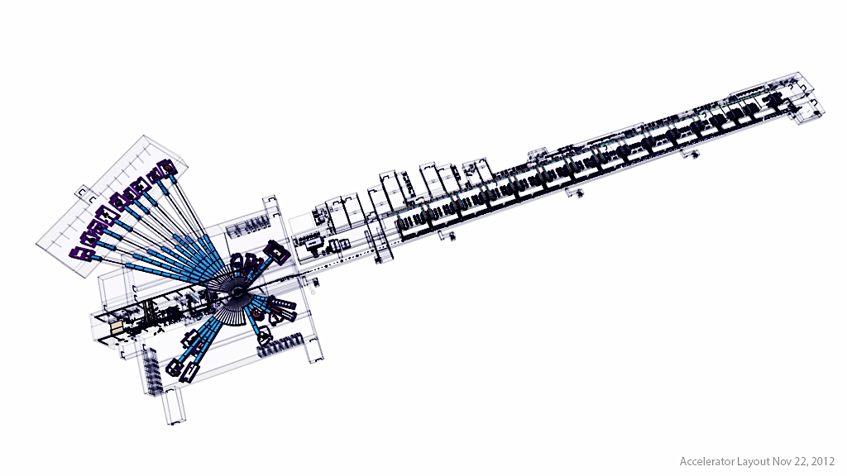
ESS In-kind goals €900 million
Integrated Control System €71 Million
Neutron Scattering Systems
€350 Million
Target €155 Million
Accelerator €509 Million

Slide 14
Annual rounds of instrument proposals
2012-13: 4 proposals submitted, 3 accepted:
  ODIN multi-purpose imaging
  LOKI broadband SANS
  NMX macromolecular crystallography
2013-14: 16 proposals submitted, 14 currently under evaluation
  see next slide
2014-15: 5+ proposals expected
  Magnetism single-crystal diffractometer
  Miracles backscattering spectrometer
  Vibrational spectroscopy
  Resonant spin-echo
  General-purpose fundamental physics beamline
  + resubmissions from current round

Slide 15

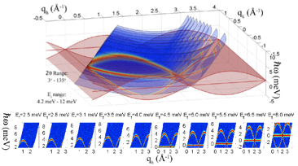
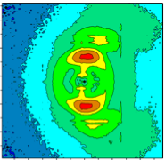
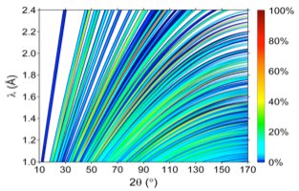



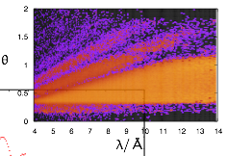
14 Instrument Concepts currently being evaluated
Spectroscopy
VOR Wide Bandwidth Spectrometer
T-REX Bi-Spectral Spectrometer
C-SPEC Cold Chopper Spectrometer
CAMEA Indirect Geometry Spectrometer
ESSENSE Spin Echo Spectrometer
SKADI High Intensity SANS
Compact-SANS SANS Biology & Materials Science
BEER Engineering Diffractometer
HEIMDAL Thermal Powder Diffractometer
DREAM Bi-Spectral Powder Diffractometer
FREIA Reflectometer for liquid interfaces
THOR Horizontal Reflectometer
VERITAS Polarised Reflectometer
ESTIA Focusing Reflectometer
SANS
Diffraction
Reflectometry
Notes:
The community is ready to go, and the pressure is on – we will use the first 3 proposals to streamline processes & interfaces for the next batches.

Slide 16
From Idea to Construction via an Open Process
Example: Small-Angle Neutron Scattering
Partners
Scientists from ESS or Partner Institutes
STAP
Scientific & Technical Advisory Panel
SAC
Scientific Advisory Committee
STC
ESS Steering Committee
SKADI
Review
Recommendation
STC decides
Compact-SANS
ESS assessment

Slide 17
The Community Advises ESS on Instruments
through the STAPs and SAC
STAP: Scientific and Technical Advisory Panel. One for each instrument class.
Imaging
Chair: Muhammad Arif,
NIST, USA
5 members.
Powder Diffraction
Chair: Bo Brummerstedt Iversen, Aarhus University, DK.
10 members.
Small-Angle Neutron Scattering
Chair: Richard Heenan,
ISIS, UK
11 members.
Scientific Advisory Committee (SAC)
Chair: Aleksandar Matic, Chalmers University of Technology, SE.
Co-chair:
Peter Böni, Technische Universität München, DE.
23 members.
Direct-Geometry Spectroscopy
Chair: Tobias Unruh,
University of Erlangen, DE
7 members.
Single-Crystal Diffraction
Chair: Oleg Petrenko,
University of Warwick, UK
7 members.
Macromolecular Diffraction
Chair: John Helliwell,
University of Manchester, UK
5 members.
Europe’s Spallation Source
Indirect-Geometry Spectroscopy
Chair: Bernhard Frick,
ILL, FR
6 members.
Materials and Engineering Diffraction
Chair: Michael Preuss, University of Manchester, UK
7 members.
Reflectometry
Chair: Robert Dalgliesh,
ISIS, UK
11 members.
Neutron Spin-Echo Spectroscopy
Chair: Bela Farago,
ILL, FR
8 members.
STAPs consist of 77 expert-scientists from the international community
STAPs advise ESS management and inform SAC.
SAC advises ESS management, who proposes to STC.

Slide 18
Initial operations and ramp-up phase and commitment to 22 instruments
Decision Outlook and Scenario for Construction of 22 Instruments
Start of Instrument Construction
1st Neutrons
Start of User Program
Construction Budget
2013 | 2014 | 2015 | 2016 | 2017 | 2018 | 2019 | 2020 | 2021 | 2022 | 2023 | 2024 | 2025 | 2026 | 2027 | 2028
STC Decision on
Instruments
Initial Operations and Ramp-up
Steady-Sate Budget
3
12
16
17
22
Plans for
Instruments 17 to 22
Engineering Design
Construction of instrument 17 to 22
Expected Instruments in hot commissioning
3
6
9
12
15
18
20
22
Expected Instruments in user programme
6
9
12
16
20
22

Slide 19
Preparing the construction project
Deliver on the Technical Design Report performance and Steering Committee commitments
  5 MW accelerator capability
  Construction cost of 1,843 B€
  Operations cost target of 140 M€
  22 “public” instruments
Start w/ unconstrained resources (technically limited schedule) and develop credible project execution plans ☑
Comprehensive review of project baseline and execution plans ☑
Secure funding and resources and align schedules with the available resources ☐

Slide 20
ESS is ready for a construction commitment
STC member countries committed to share in support of ESS project phases: construction, initial operations and ramp-up, and steady state operations
STC commitment to start construction anticipated at the next meeting (6-7 May in Oslo)
  Each member’s share of total construction investment defined in Letter of Intent
  Developing comprehensive cash flow assessment and financing plans

