Slide 1
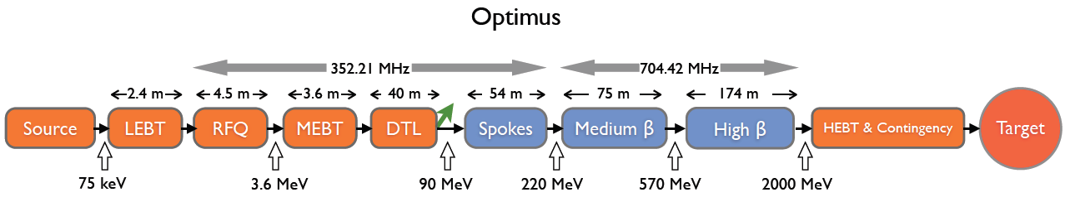
Collaboration Board
Status of the French activities
under the responsibility of CEA
Philippe CHOMAZ

Slide 2
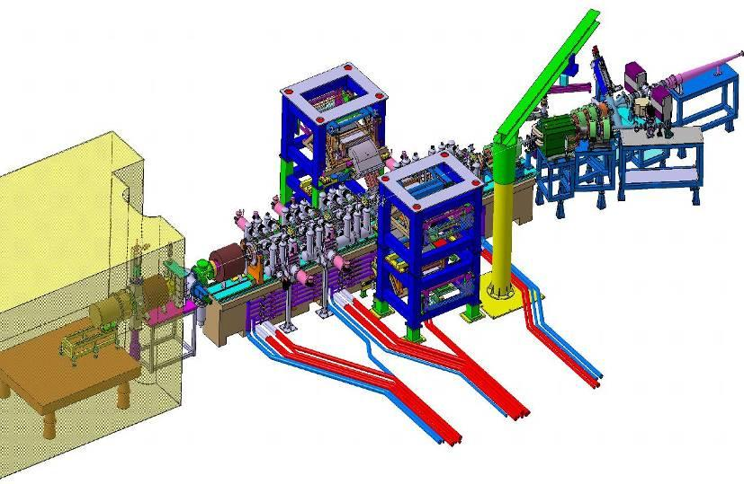
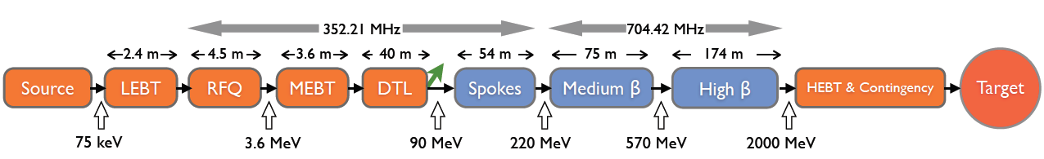
Project #1: Beam tests with IPHI

Slide 3
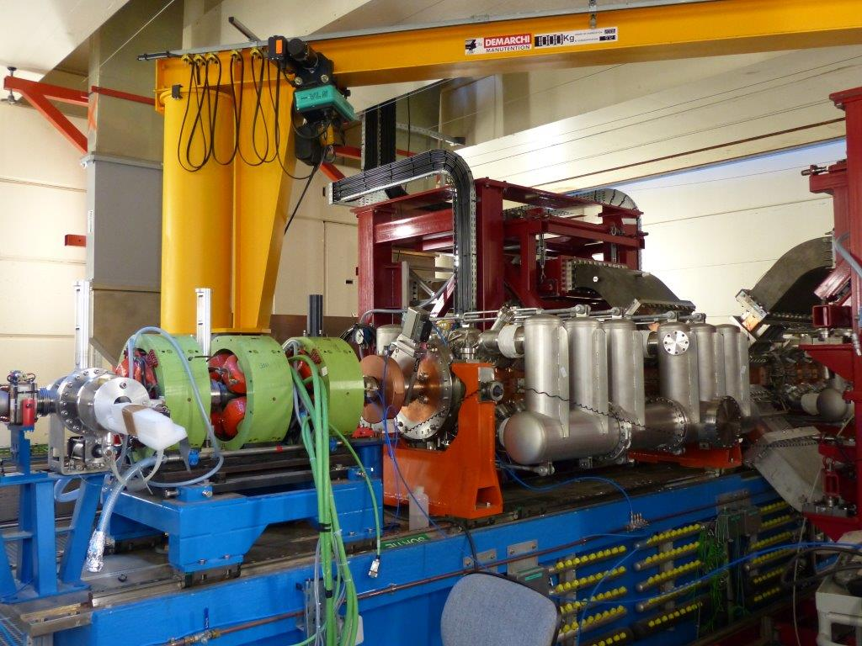
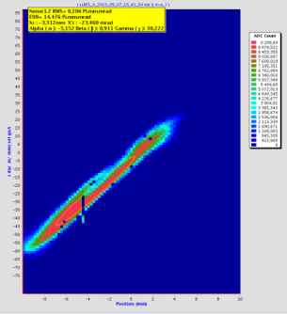

The assembling of the RFQ is almost completed !
All manifolds are mounted except one that needs to be repaired (leak on a weld)
All wave guides mounted
The last operations to be performed before the tests:
Water cooling circuit (700 flexible pipes, 1 km, skid).
Cabling of the pumping groups with the C/C system
The SILHI source is ready
Sept 2013: I=65 mA with ESS parameters
Start of the RF conditioning: Q3 2014
Three talks by D. Uriot, O. Tusk and F. Peauger at the EUCARD2/ESS workshop on beam commissioning on the proton source, the injector beam commissioning and on the IPHI commissioning plan (April the 8th & 9th).

Slide 4
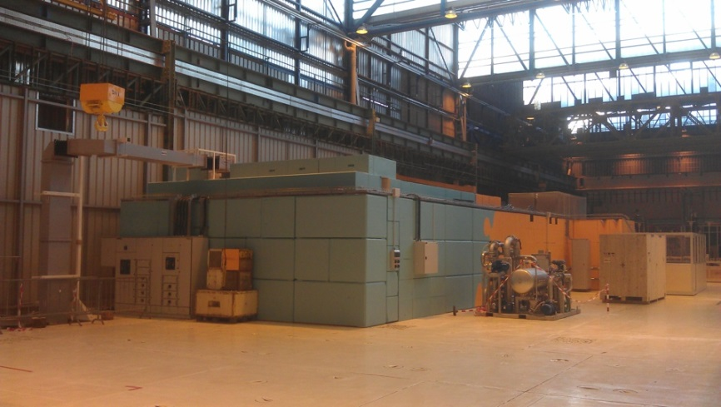
Project #2: 352 MHz RF test stand

Slide 5
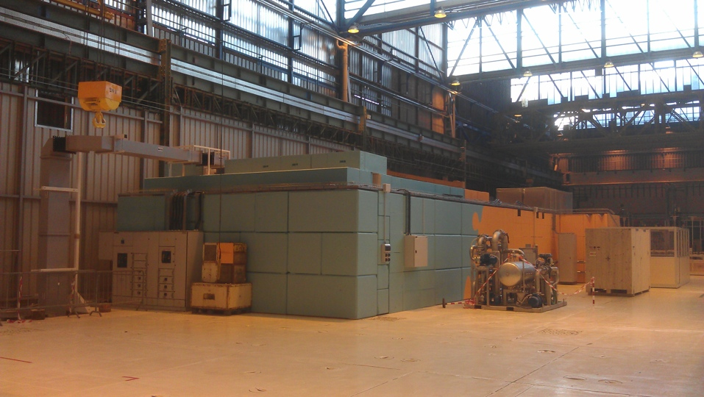
Status
The tests stand is ready to host the IPNO bench for the RF power processing of the 2 couplers pairs (4 couplers)

Slide 6



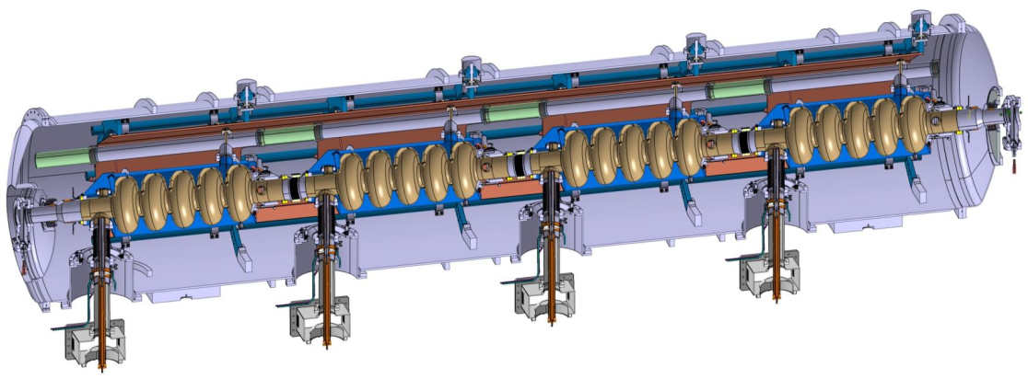
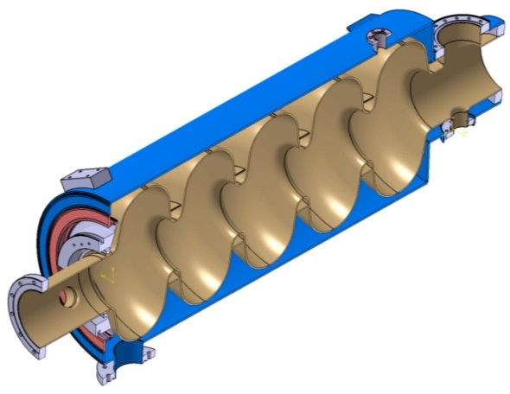
Projects #3, #5, # 8:
High beta prototypes
Medium beta ECCTD

Slide 7
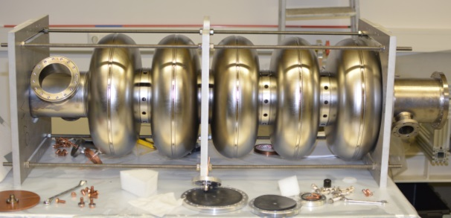
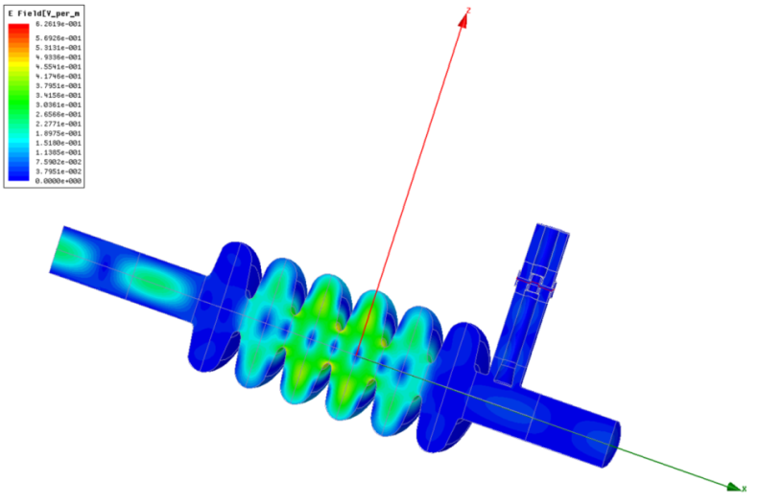
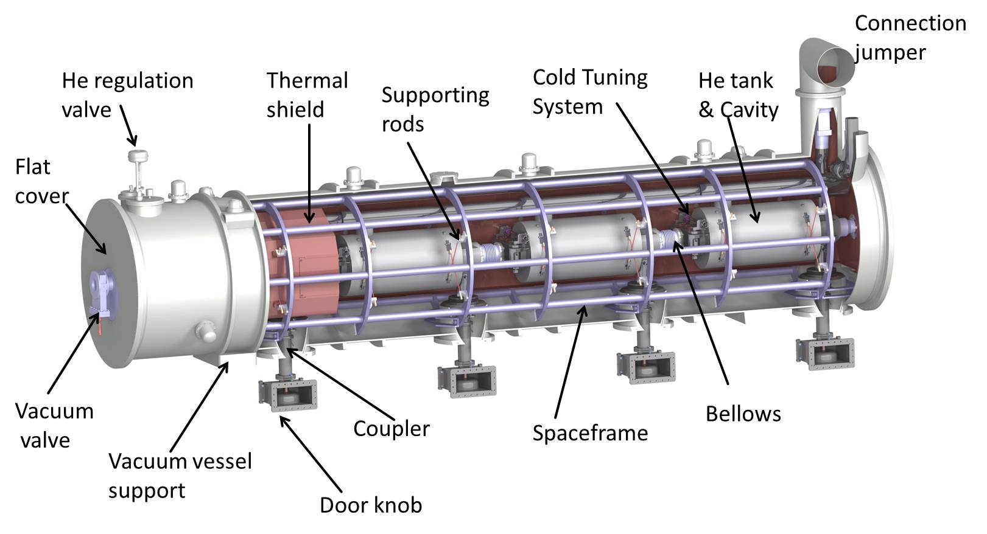
Main achievements for the period
First chemical treatments on the high β prototype cavity (ZANON)
Second high β prototype cavity welded (RI)
Redesign of the medium β cavity – dangerous HOM suppressed
Call for tender finalized
ECCTD design study: completion of the cryogenic pipes and first analysis for compliance with PED

Slide 8
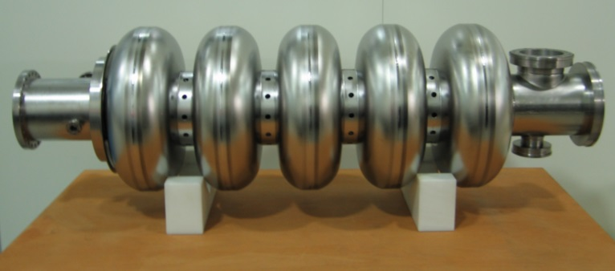
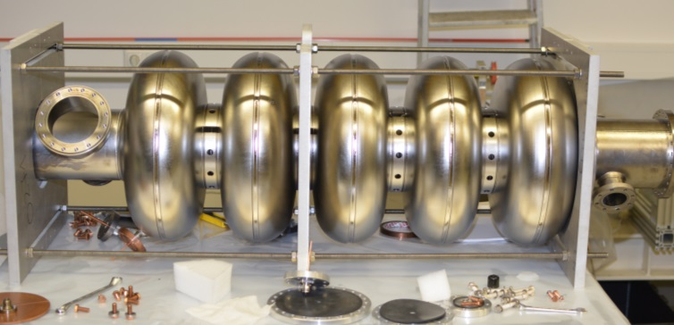
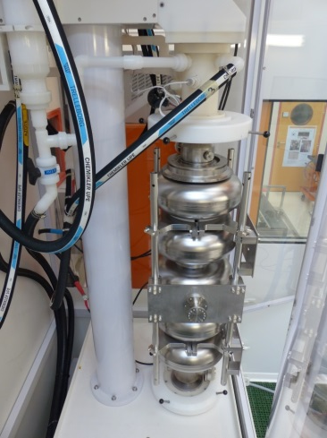
    2 prototype high beta cavities manufactured
    ZANON cavity: * 2 BCP (80µm in total)
    * tests in VC in April
    RI cavity welded, and delivered soon
    No HOM coupler on the high beta cavities of the series
    (Prototypes are equipped with HOM coupler ports)
    EUCARD2 SPL β=1 cavity
        cavity delivered to Saclay a few weeks before the first ESS cavity
        2 Electropolishing treatments performed
        Heat treatment for H₂ release performed
        Tests in CV in 2 weeks (Pb with He delivery)
SPL cavity electropolishing at Saclay
| PAGE 8

Slide 9
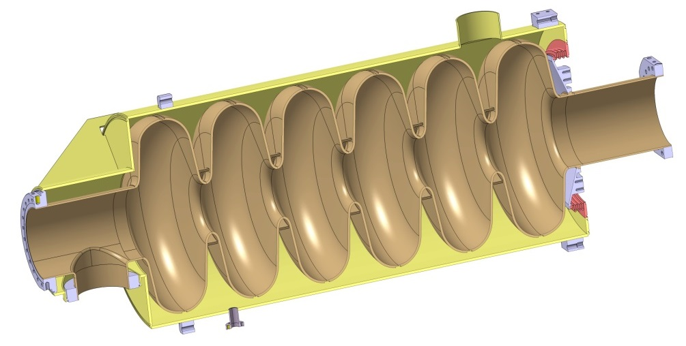
Status of the medium β cavities
    no HOM coupler needed
    Call for tender in progress for 6 medium beta cavities. Order to be launched soon (~ 1 or 2 weeks)
    Last checks before completion of the drawings needed before the Kick-off meeting (once the contract is awarded)
    The general planning of the M-ECCTD ( October 2013) should not be delayed by this modification of the cavity design.

Slide 10

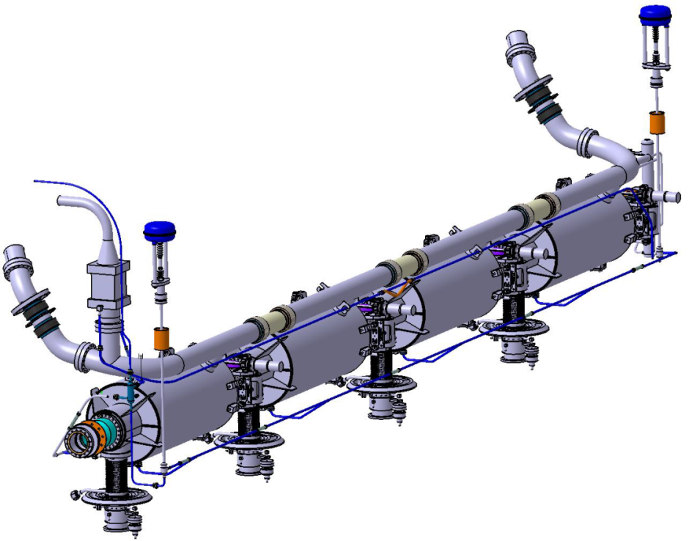
    Compliance with European
    PED 97/23/EC
    First meeting with APAVE last February confirmed our first analysis
    Article 3.3 of PED
    To be confirmed
    Volumes of the helium circuits and vessels < 50 l
    1,431 bars< Working pressure
    Ps can be < 2 bars
    Meeting at Lund for PED compliance in April

Slide 11
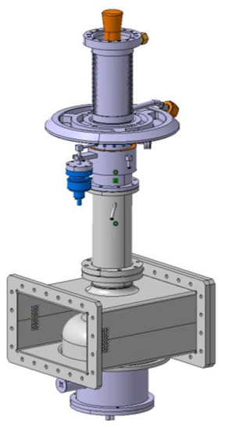
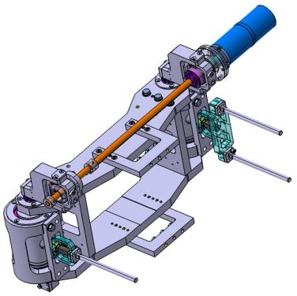
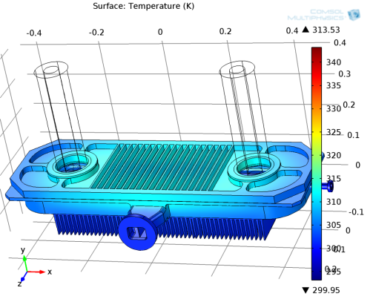
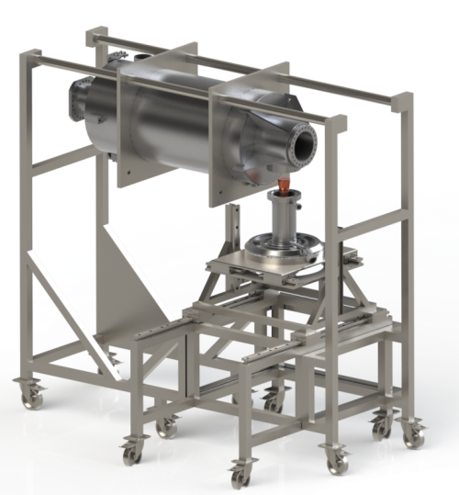
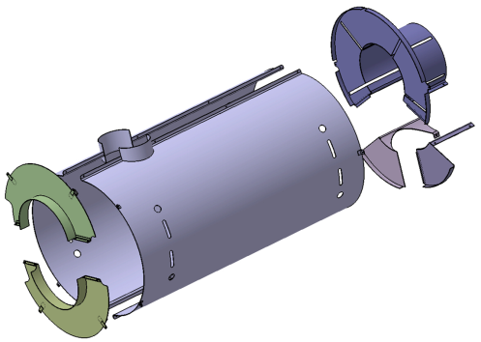
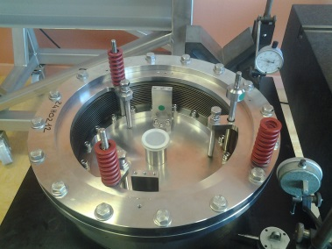
Status on other components and toolings

Slide 12

Fundamental power coupler
    Call for tender for the ceramic windows and antennas closed. Offers analysed. The order should be launched in few weeks
    Drawings for the outer conductors completed. Preparation of the call for tender in the comming months
    Door-knob: design almost completed. A seal design to be tested before.

Slide 13
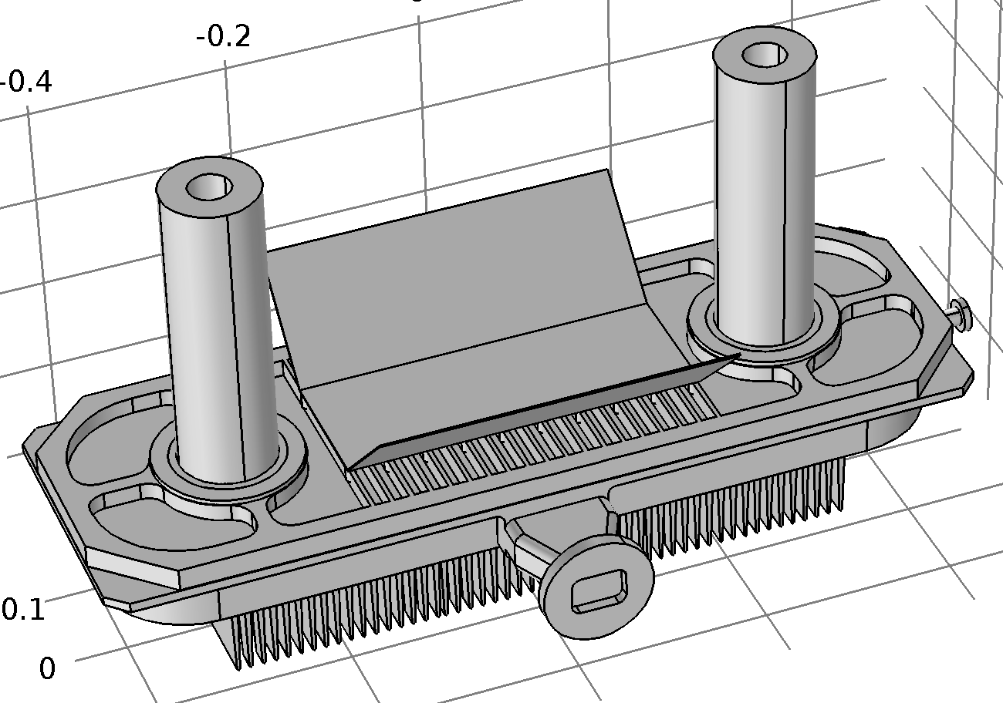

Test bench for the pressure compensation system of the power coupler
    Coupling box design finalized
    First tests performed.
    Modifications in progress (Stronger sping needed, sliding guids, …)
    Preparation of the call for tender in the comming months

Slide 14


Procurement of all main other components will be preprared before summer and launched before the end of 2014

Slide 15
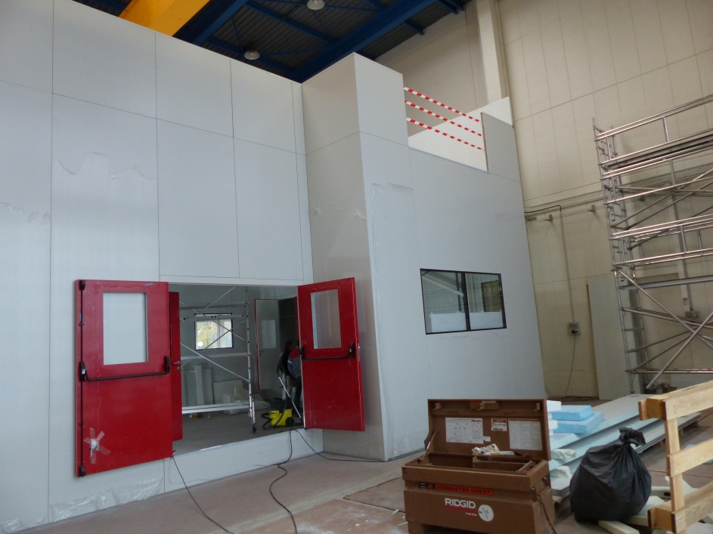
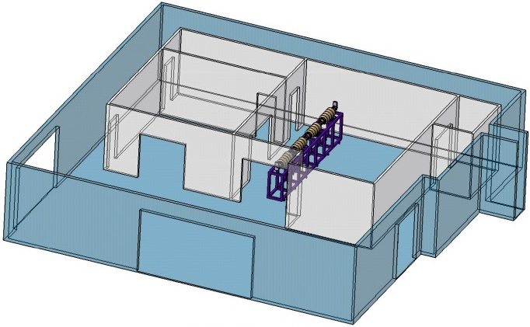
The new clean room ISO5 at Saclay
  2 rooms: ISO7 & ISO5.
    Picture of the clean room last November
High Pressure Rinsing HPR
IS0 7
27,5 m²
Water cleaning
IS0 5
52,69 m²
    The clean room will be ready for operation in April 2014

Slide 16
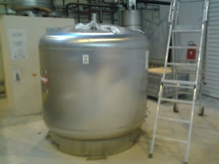
Preparation of the stand for the RF power tests at 2 K
2000l Dewar delivered. Tests in the coming weeks
Cryogenic line (L > 50 m) delivered in the coming weeks
C/C system: Geobrick system chosen by ESS
The modification of the klystron modulator to increase the pulse length up to the ESS requirements (2ms => 3ms) will start in June (after the 2 SPL coupler processing)
Test stand for the M-ECCTD

Slide 17
Project #4: TDR contributions

Slide 18

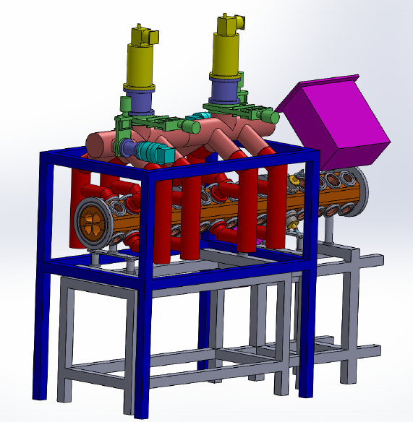
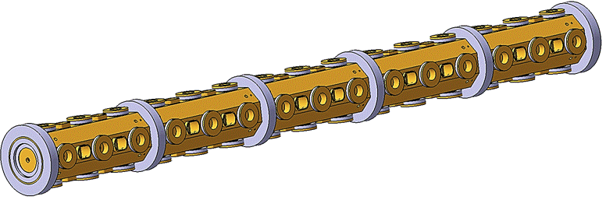
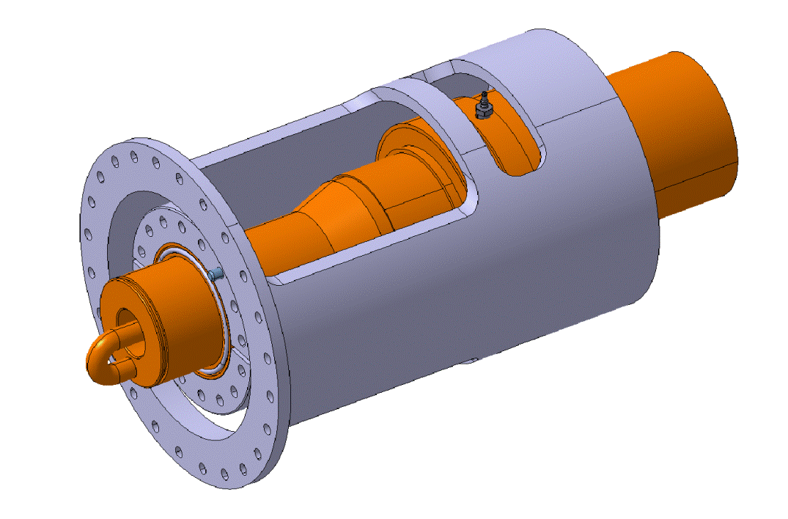
RF design completed
Thermomechanical calculation almost completed
Achievements
Conceptual design review to be organized in June
Objective: launch the procurement of the copper

Slide 19
Thank you for your attention

