Slide 1
Status of In-Kind Contributions to Accelerator
Kastrup, 14 April 2014
Håkan Danared

Slide 2
Introduction
EoIs for ACCSYS have been received from 18 organizations and 52 companies in 16 countries, and counting.
Detailed discussions going on with 13 organizations.
Possible in-kind partners to Accelerator have been identified in Denmark, France, Germany, Italy, Norway, Poland, Spain, Sweden, Switzerland, UK.
Value of items discussed with these partners is 48% of accelerator budget.
Next step with many partners is to write Statements of Work and to get firm confirmations of their interest to give specific contributions.

Slide 3
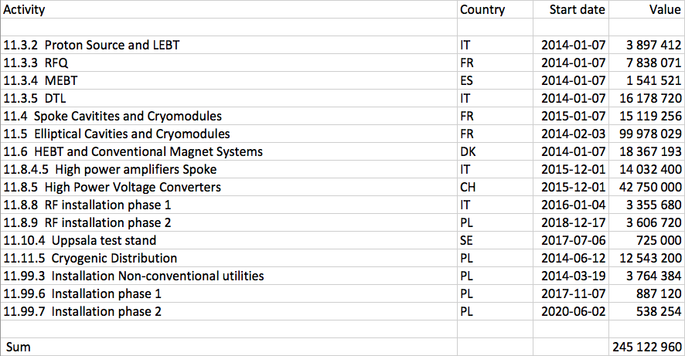
Planned In-Kind from Primavera
Summary of activities (work packages or work units) where at least one specific partner has been identified and discussions with this partner has started

Slide 4
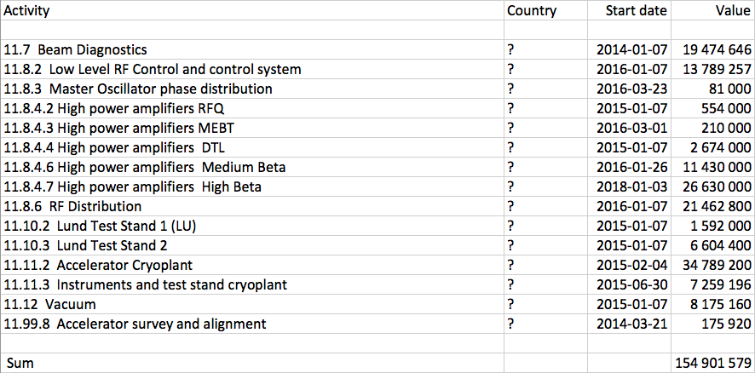
Potential In-Kind from Primavera
Summary of activities where no specific partner has been identified or, in the case of beam instrumentation, where the WP is being re-organized such that start dates and values cannot be assigned at the moment

Slide 5
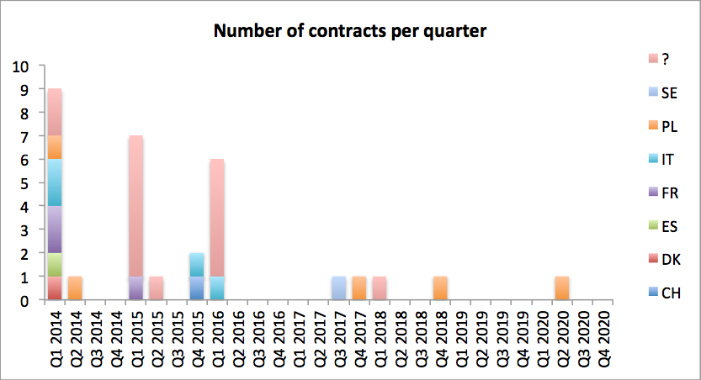
Number of Contracts per Quarter
Many activities start Q1 2014, reflecting the importance of reaching agreements soon

Slide 6
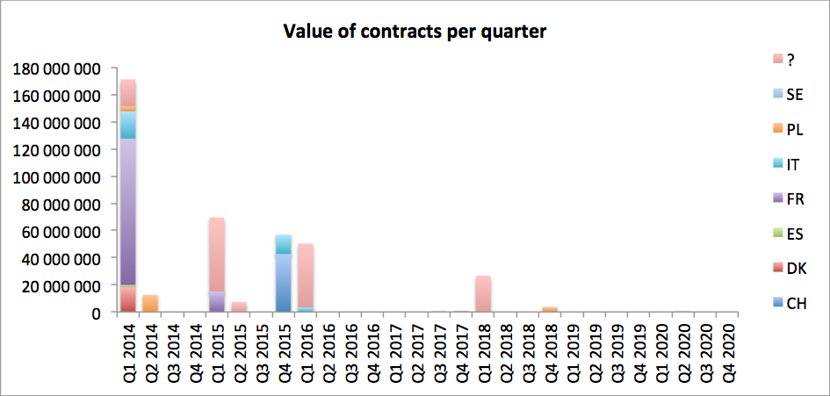
Value of Contracts per Quarter
Activities starting Q1 2014 also represent large value, plot clearly does not give true picture of cash flow

Slide 7
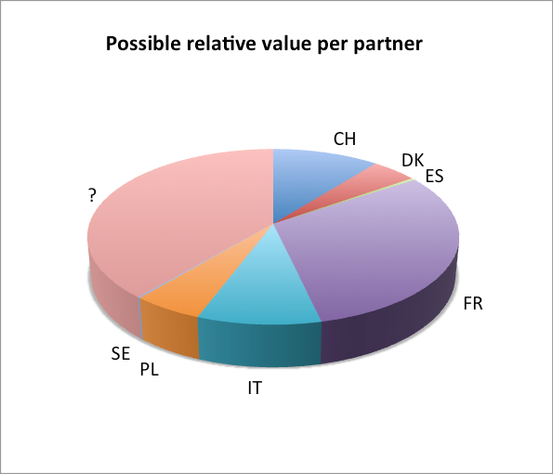
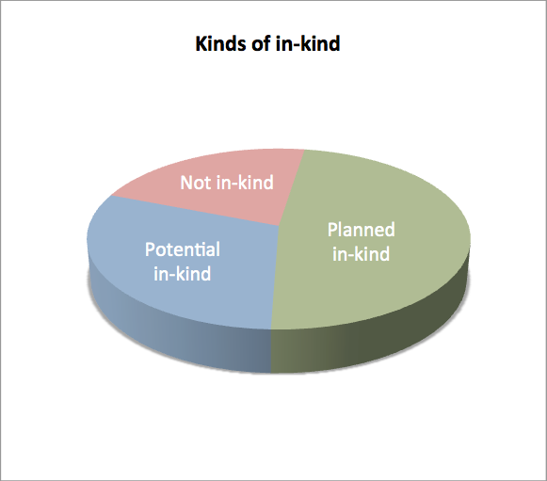
In-Kind Proportions
Planned and potential in-kind contributions represent 78% of accelerator budget
Potential partners identified for 61% of this value, i.e. 48% of accelerator budget

Slide 8
Country by Country: Denmark
Denmark, being a host country, can according to current understanding not give true in-kind contributions.
Within the accelerator collaboration, they are nevertheless working like in-kind contributors.
S. Pape Møller, Århus, is WP6 Leader, coordinating HEBT and warm magnets.
Århus contribution likely to be design and raster magnet prototypes.
Contract to fund work in Århus is being prepared.

Slide 9
Country by Country: France
During pre-construction France has contributed design and some prototyping of RFQ and superconducting cavities and cryomodules.
Work package leader for spoke cavities and cryomodules is Sébastien Bousson, and for elliptical cavities and cryomodules Pierre Bosland.
Per-construction has been funded through a bilateral contract between ESS and IPN Orsay / CEA Saclay. The contract runs until 2016, but far from all activities planned until then are covered by it.
In order to proceed into construction, in-kind agreements need to be signed, possibly with technical appendices in several stages.
Most urgent items concern RFQ, LEBT diagnostics and high-beta ECCTD. Heads of agreement are foreseen for these items.

Slide 10
Country by Country: Germany
No expressions of interest have been submitted from German labs on the accelerator.
An ESS ”wish list” has been sent to DESY after technical discussions on areas of collaboration. No written reply yet.
Wish list mentions cavity procurement and testing, LLRF, beam instrumentation, test stand and cryogenics. And additional topics may include the phase reference line. These items can be shared with UK, Poland and perhaps other countries depending on German interests.
Discussions with GSI/FAIR on common procurements as a way to get better prices on commercial items. Could apply to vacuum, beam instrumentation and cryogenics, including one cryoplant.

Slide 11
Country by Country: Italy
During pre-construction INFN has contributed design and prototyping of proton source (Catania), LEBT (Catania) and DTL (Legnaro). Also, an activity on high-beta elliptical cavities is starting (Milan).
Leader of WP3 on normal-conducting linac is Santo Gammino, Catania.
The pre-construction in-kind contract runs until end of 2014. Work on a final in-kind agreement needs to start.
Discussions have been initiated with Elettra on several items: Spoke amplifiers, HEBT, controls, diagnostics and installations.

Slide 12
Country by Country: Norway
Discussions with a group at University of Oslo on beam instrumentation and PhD student in beam physics.
Possibility for manufacturing of electronics for beam instrumentation.

Slide 13
Country by Country: Poland
Four institutes have submitted EoIs: NCBJ (Swierk, Warsaw), Wroclaw University of Technology, IFJ PAN (Krakow), Warsaw University of Technology.
Design and manufacturing of cryo-distribution line by WUT is being discussed. HoA on design in preparation.
NCBJ is collaborating on collimators in HEBT, as ”subcontractors” to WP6. Also 3-4 students working for ESS since severaly years. A role in manufacturing of mechanical component expected.
IFJ PAN has expressed interest in providing all manpower that we need in the installations work package plus in RF installations as well as for cryomodule tests.
Warszaw University of Technology interested in delivering phase reference line and those LLRF components that are not intellectual property of DESY.

Slide 14
Country by Country: Spain
ESS-Bilbao leading MEBT WU since several years. Expected to deliver MEBT as complete package.
Additional contributions from ESS-Bilbao to Accelerator under discussion: RFQ and DTL RF, HEBT magnets from the dogleg and onwards, installations.
Heads of agreement being developed for ESS-Bilbao.

Slide 15
Country by Country: Sweden
Contract exists with Lund University for LLRF work unit and modulator prototyping 2012-2016. RF test stand is being prepared.
Contract also exists with Uppsala University for testing of spoke cavity prototypes 2012-2016.
Also acceptance tests after series production of spoke cryomodules foreseen for Uppsala. Gap in activity and funding 2016-2017 needs to be filled.
Tests of beam instrumentation devices performed at Stockholm University, so far without cost to ESS.

Slide 16
Country by Country: Switzerland
Discussions since several months about development and delivery of klystron modulators at PSI together with industry.
Modulators for medium-beta section and possibly for RFQ and DTL would fit inside the Swiss contribution.

Slide 17
Country by Country: United Kingdom
Discussion restarting after UK’s decision to join ESS
Testing of medium-beta cavities proposed to Daresbury as well as beam diagnostics and vacuum
Huddersfield interested in RF contributions
All to be discussed at a meeting in Daresbury 6 May

Slide 18
Next Steps
Denmark: Distribute HEBT WP among partners. Write HEBT SoWs. Prepare contract with Århus for design to start with.
France: Write SoWs for CEA and CNRS. Prepare HoAs if in-kind contracts take too long.
Germany: DESY must declare how they want to contribute. Get concrete proposals for FAIR contributions.
Italy: Prepare SoWs and in-kind agreements for INFN. Decide about tasks and prepare SoWs for Elettra.
Poland: Decide about tasks for NCJB. Write SoWs for all proposed contributions. Prioritize depending on available funding at a later stage.
Spain: Get declarations of interest from ESS-Bilbao concerning tasks in addition to MEBT package.
Sweden: Find out if LWU integration would be possible in FREIA hall, to fill gap between prototype spoke cavity tests and production cryomodule tests.
Switzerland: Get firm confirmation from PSI on modulators. Medium-beta modulators would fit within Swiss contribution.
UK: Meet in Daresbury 6 May about cavity testing, vacuum and diagnostics. Find role for Huddersfield concerning RF.
Other countries with accelerator-related discussions or considerations: Estonia, Greece, India, Netherlands, Romania.

