Slide 1
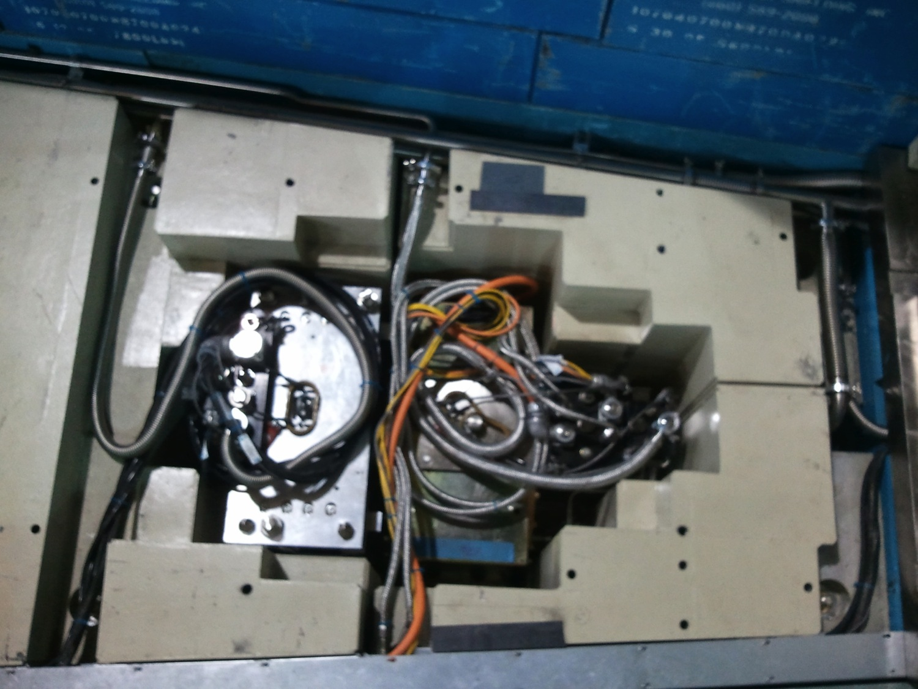
A vision of supporting Neutron Chopper systems @ ESS Pt 1 - BUNKER SYSTEMS
Discussion Document

Slide 2
Chopper installation in the common shielding
Notes:
One vision of the common casemate
Chopper cavities at 6-8 m and 10-11.

Slide 3
T - 48h: Anomaly detection
Resources: Chopper Group
Installed diagnostic systems detect that a chopper system is operating outside of normal parameters.
The diagnostic data permit the evaluation of the progression of the anomaly and indicate that the system should be shut down within 24hs to avoid damage.
Instrument responsible is notified – decision to intervene is taken jointly
Intervention is signaled to Operations

Slide 4
T -24H: Intervention planning
Resources: Operations, Technical groups, Instrument.
The operations & technical groups evaluate the scope of the intervention.
Crane
Group resources
Radiation team
Tooling
Duration
The intervention is scheduled for a ‘beam off’ period with instrument and technical staff.

Slide 5
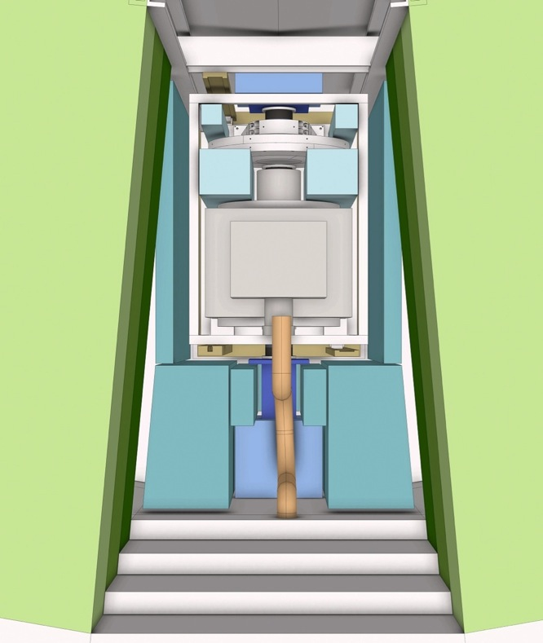
T = 0h Chopper Shutdown
TARGET MONOLITH
Resources: Chopper group, Instrument resp, Operation group.
A controlled shut down of installed chopper unit.
Chopper group use data from diagnostics sensors to evaluate failure and repair strategy.
When possible the chopper is parked ‘OPEN’ to permit continued operation of the instrument.
INSTRUMENT 02
INSTRUMENT 01
INSTRUMENT 03
< 5 degree >
<-------------- 15 degree ------------- >

Slide 6
T = 0h Shutter closure
Resources: Operations group, Instrument, H&S
H&S authorizes the intervention.
The Op’s group releases it’s resources preparation of the intervention
Crane
Heavy crew
The beam line shutter upstream of components is closed to commence cool down period.
The Shutter is ‘locked down’.

Slide 7
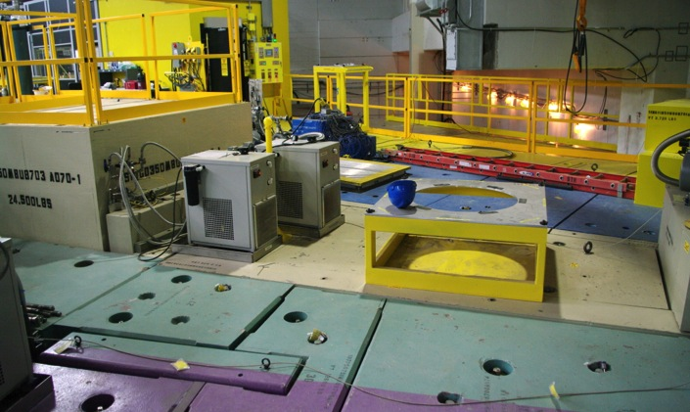
T +12-24h Cool down
Resources: Operations, Instrument, H&S, Technical Groups
The activation of components obliges a delay before access is permitted (cool down period)
All services in the area of the intervention are made safe.
Power
Fluids
Vacuum
A site safety perimeter is established within which and shielding locks are removed.
Use of remote handling equipment may permit a reduced cool down period.

Slide 8
T +25-28h Shielding removal
HAND-OFF
AREA
Required: Hall Crane(s) and or local cranes, Heavy Gang, HS&E
The outer layers of shielding are removed (Not activated)
The Inner layers of (activated) shielding are subject to cool down period.
Removed shielding block moved to the temporary storage area.
The chopper extraction tooling (pit lift) is brought to intervention site.
HALL CRANE 30t
BUNKER CRANE 20t
SHEILDING

Slide 9
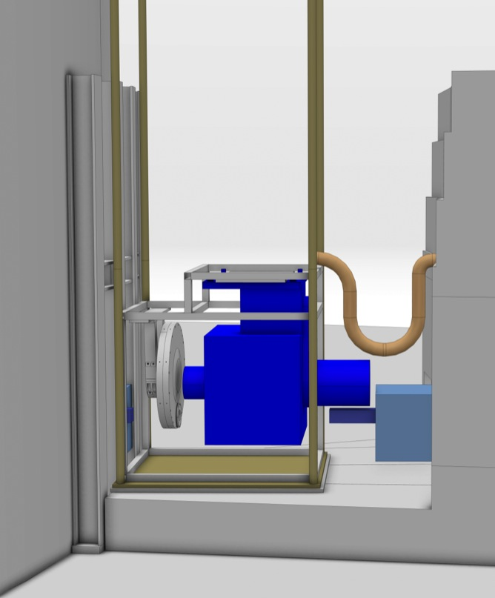
T +30h: Equipment release
Required: Local crane, Pit lift, Technical groups.
Cranes are used to install the ‘Pit lift’ within the cavity.
Local shielding for personnel is installed if required
Cameras lowered into the pit
Due to exposure to gamma radiation from activated components human access to the pit is not authorized.
From the roof the shielding
Equipment upstream and downstream (guides) are decoupled - remotely
The fixations to base plates & supports are released - remotely.

Slide 10
T +34h Extraction
The motorised ‘Pit lift’ is used to perform the critical initial lift of equipment clear of neighbors (guides)
The Pit lift raises equipment level with the top of the pit for disconnection of services ‘umbilical’
Pit lift raises equipment above the shielding permitting full access and is locked into position
Additional local shielding may be installed if required.
TRANSPORT CASK (?)

Slide 11
T +36h Inspection
The equipment is inspected to confirm the origin of anomalies and extent of work required.
Equipment may be connected and test run ‘in local’ for diagnostics
The repair / replacement strategy is confirmed and parts are brought to site.

Slide 12
T +40h Hot Swap
The Defective assemblies are decoupled (remotely)
The defective assemblies(s) are removed using the local crane and casked if required.
Activated components are removed to a ‘cool down’ pen.
Additional normal maintenance operations may be conducted.
Direct replacement assemblies are installed and coupled.

Slide 13
T +48h Reconnection & Test
The pit lift is unlocked
The pit lift lowers equipment to an intermediate level for connection of services umbilical
Connectivity tested
Low speed equipment tests are conducted in local.
Connectivity from remote is tested.

Slide 14
T +50h: Run down - Lock down
The Pit lift lowers equipment to near final position
The lift cage engages with alignment pins for guidance on critical initial approach
Cameras are used to oversee operations.
The lift cage touches down on precision locating pins
Equipment is Locked down

Slide 15
T +52h Alignment & Test
The alignment is checked from above.
Realignment should not be required (but could be conducted remotely)
Equipment pumped down and cooled/heated.
Equipment is run to conduct functional & vibrational tests.
Lock down is confirmed
A 12hr equipment test cycle is started
The Cameras and pit lift are removed.

Slide 16
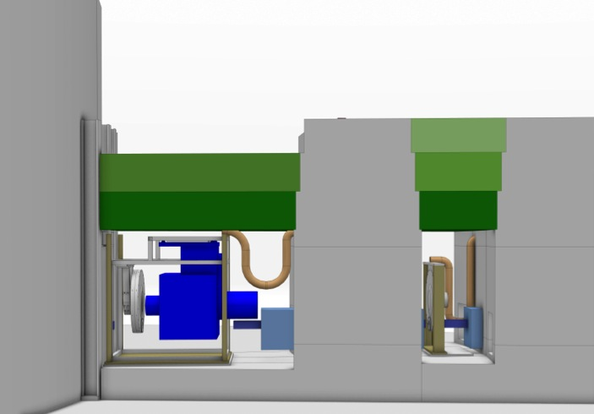
T +60h Shielding replacement
Required: Hall Crane and local cranes
Extraction tooling is removed from site.
All shielding is brought to site by the hall crane.
The Inner layers of activated shielding are reinstalled.
The Outer layers of shielding are reinstalled.

Slide 17
T +64h Chopper Tests
At the end of the Test cycle Choppers are cleared for use and released to instrument control.
MPS system is reactivated.
Control of the chopper systems is transferred to remote.

Slide 18
T +66h Evacuate Perimeter
Required: Health physics, Technical teams
The services on the instrument are reestablished.
Power
Fluids
Vacuum
All locks are reinstalled.
Beam line is declared secure for access.
The safety perimeter is removed.

Slide 19
T +72h Shutter release
The Beam line shutter upstream of the components is opened for radiological tests.
Neutrons are used to test and commission choppers.
Radiation levels are controlled
The beam line is declared radiologicaly safe for operation.

Slide 20
CONCLUSIONS
Notes:
So was it worth it ?
Are simple configerational studies and operational modelisation worth the effort ?

Slide 21
Important assumptions
Hall crane 25t
Bunker crane 10t
Upstream shutters
Remote tooling/shielding is available.
Full spares are available on site.
Sufficient NCG and Op’s staff for 24/7 call out.
Choppers & bunker is designed for Serviceability
Facility is in Steady state running
Front end components will be Activated
There is no or little exposure to activated shielding / neighbors
No neighboring equipment requires removal .

Slide 22
THE END

