Slide 1
Neutron Chopper Technologies Work Package
Iain Sutton
Neutron Chopper Group Leader
www.europeanspallationsource.se
Notes:
Good morning
My name is Iain Sutton
I am currently the Group leader for Neutron choppers
And In the following 10mn I will attempt to present the Status and strategy of NG Tech work package

Slide 2
Agenda
Scope
Schedule
Budget
Organisation
In-kind & procurement
Risk
Next six months
Summary
Notes:
Quick breakdown of what you can expect
As I am sure that at this point you have already seen a number of presentations along these lines from my colleges
and I would like to have time for your questions
I will not linger
We will start with the WHY and the WHEN
And then move quickly on to the HOW & WHAT
And the WHAT to watch out for.
So moving right along to WHY

Slide 3
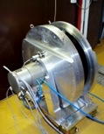
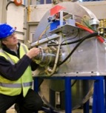
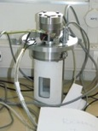
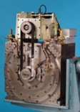
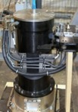
Scope - Mission
Mission statement
This work package concerns the study, selection and develop of chopper systems’ and associated supporting technologies, required for the scientific operation of the neutron instrument suite at ESS.
Principal objectives
Reducing the risk (budget/ schedule/performance) to instrument projects
To raise performance and quality of installations across the instrument suite
Reduce the overall cost of installations to the facility both in construction and operation
Ensure instrument availability through reliability and serviceability
Build up infra-structure, internal human resources, and competence.
Deliverables
‘Implementation ready’ Technologies & Design concepts
Equipment standards
Instrument technologies Infra-structure
In-house competence
Deliverables
Equipment standards and guidelines
- for instrument design & procurement
‘Implementation ready’ Technologies & design concepts
- for integration into instruments
In-house competence & technologies Infra-structure
- to support instrument construction activities and instrument operation.
?
Notes:
WHY are we here ?
WHAT are we trying to achieve
Well like all of the tech groups we are here initially to support instrument construction and then to support their operation
Bridging the gap from ‘concepts to construction’
In common with a number of other large project which depend on technological innovation
a strategic decision was made decouple the development of core technologies from the development of the instruments themselves
Number of benefits
Reduced risk
Reduce NRE
Raise performance and quality through developing solutions coherent across whole suite
address facility conserns
Availability
address cost issues in Construction & Operations
Build up infra structure to support operation

Slide 4
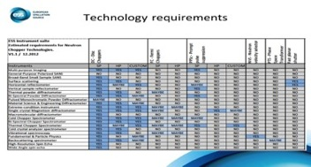
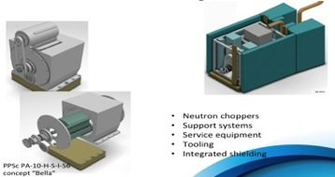
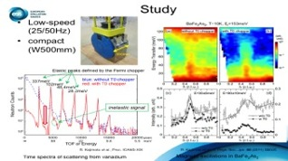
Scope - from Concepts to Construction
TRL 2
TRL 3
TRL 4
TRL 5
TRL 6
TRL 7 - 9
Exploration of Requirements
Theoretical studies
Engineering studies
Engineering Specification
Instrument Construction
|---------NEUTRON CHOPPER TECHNOLOGIES WP------------------------------|
|--CONSTRUCTION >
Exploration of Requirements
Theoretical studies
Engineering studies
Engineering Specification
Procurement
Notes:
quick look at the activities we are involved with
All starts with Requirements
Engineering studies
Computer
and Physical prototypes

Slide 5
Scope -WBS
Neutron Chopper
Technologies WP
PPS Chopper Technologies (PPSc)
Disc Chopper Technologies (DC)
Small Rotor
(DC-SR)
Large Rotor
(DC-LR)
Management
Conventional
Low Maintenance
Fermi Chopper Technologies
Facilities
Support Systems
Serviceability
Methods & Technologies
Service Tooling
Radiation hardness
Operations
1 & 2
Chopper Lab
Equipment standards
Pit systems
Vacuum
Cooling
Design standards
Rep Rate Multiplication
Reliability
Availability
Serviceability
Imperative for use of straight guides
Wave frame Multiplication
Infra-structure
Instrument performance issues
Reducing facility operating costs
Facility performance Issues
Notes:
Chopper development work package is composed on a number of work unit each intended to address the principal issues in the field
On the left
Units related to Instrument performance
Development of technology which is vital to instruments and which is not available commercially
Long pulse requires a number of specific techniques to be employed
These in turn require specific solutions to be developed
RRM
WFM
Long pulse PPS systems
All these techniques are critical to harnessing the power of the long pulse and making instruments possible.
On the right
Units relating to facility issues
Measures to reduce operating costs
Ensure reliability and instrument availability
Infra-structure

Slide 6
Instrument projects overview
 | 2014 | 2015 | 2016 | 2017 | 2018 | 2019 | 2020 | 2021 | 2022 | 2023 | 2024 | 2025 | 2026 | 2027 | 2028
Operations Schedule
#1
#2
#3
#4
#5
#6
#7
#8
#9
#10
#11
#12
#13
#14
#15
#16
1st Neutrons
Initial Design | Final Design | Procurement & Fabrication | Construction | Installation | Cold Commissioning | Hot Commissioning

Slide 7
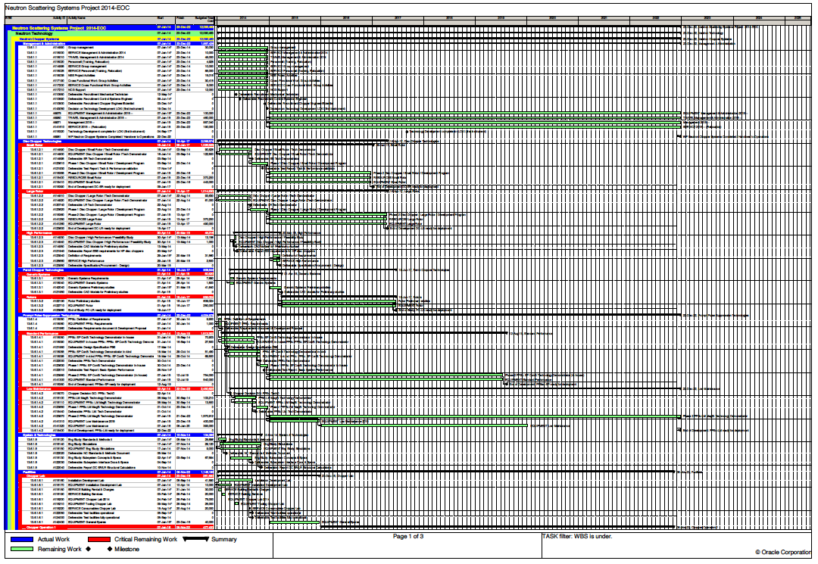
Schedule
2014 2015 2016 2017 2018 2019 2020 2021 2022 2023 2024 2025
Management
Disc Chopper Tech
ESS Disc Chopper: Design/Procurement specification
ESS Disc chopper: Validated components (TRL5)
ESS Disc Chopper: Large Rotor Prototype
ESS Disc chopper: Large rotor: Install ready (TRL6)
Fermi Chopper
ESS Fermi Chopper: Design/Proc Specification
Prompt pulse suppression
ESS PPSc: Design specification
ESS PPSc: Prototype
ESS PPSc: V1.0 Install ready (TRL6)
ESS PPSc: V2.0 (high reliability) Install ready (TRL6)
Methods
ESS Chopper design Standards & Methods
ESS Chopper support systems Specification
Facilities
ESS Chopper Lab
ESS Chopper operations facility
Notes:
A few words about the schedule
This is development & capacity building activities - front weighted
The deliverables are potentially on the critical path of many all instruments
Schedule is constrained by ensuring deployment ready for day 1.
For this reason so many activities are launched in parallel
Most systems will be available for implementation in 2018
Some may be in All be some in a preliminary form
Element of risk in new technologies
Considerable effort in testing and refinement is expected
Ensure performance of ESS unique solution have to be demonstrated as early as possible.
running paralell to this is the build up of the team and the facilities to support these activities

Slide 8
Organization -work units / resource affectation
SUMMARY
ENGINEER BLUE 5
TECHNICIAN GREEN 4
CONTRACTS GREY 3
WP Team
Engineer
Mech
Technician
(Mech)
Engineer
Mech
Technician
E&E (0.25)
Engineer
Control (0.5)
Engineer
SW 0.5
Technician (Mech)
Standards / Methods
Management
Technician (Mech)
Disc chopper technologies
Prompt Pulse Suppression
Support Systems
Snr Engineer
Engineer
Mech
Designer
(0.5)
Engineer
Control (0.25)
Designer
Fermi Chopper Technologies
Technician
E&E (0.5)
Technician
E&E (0.25)
Engineer Control (0.25)
Designer
(0.5)
Designer
(0.5)
End 2014
End 2015
Notes:
As one would expect the organisation of the group reflects that of the activities
Two principal poles
Engineering
Operation
The permanent group will compose 9 full time staff in addition to my self
The Engineering function will compose 4.

Slide 9
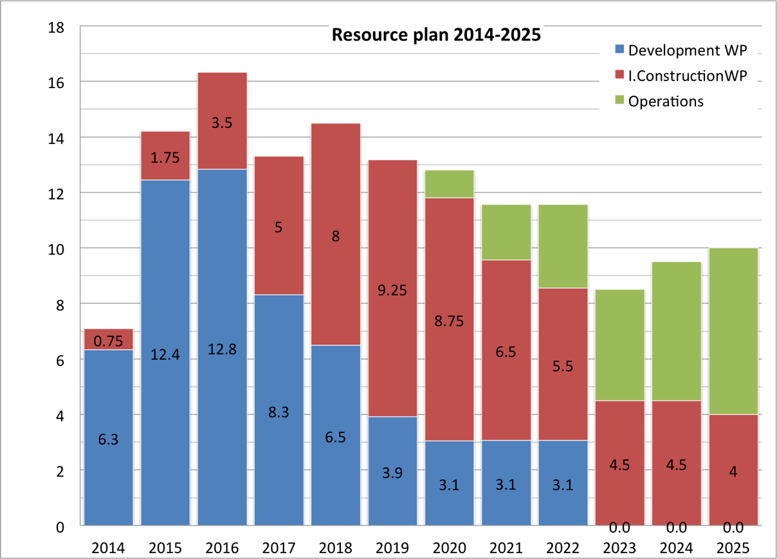
Resource requirements 2014 - 2025
OPERATIONS
STAFF LEVEL
Notes:
Human resources
Human Resource build up follows the spend profile
Heavily front loaded
Peaking around 2016 and then tailing off
I believe very strongly in building a core team in-house to ensure knowledge retention and continuity – and you can see that here
However looking forward to how many people we will need in operation it’s clear that there is a mis match - so I am proposing to cover the peak load with contracted staff.
Note that from 2017 onwards many of these people will be workong on instrument construction and will not disappear

Slide 10
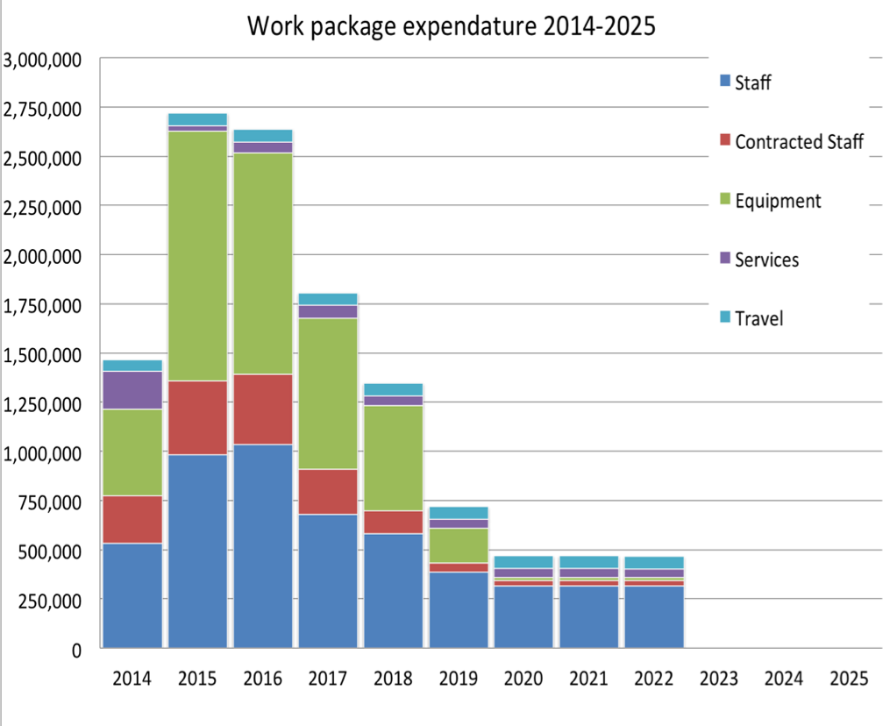
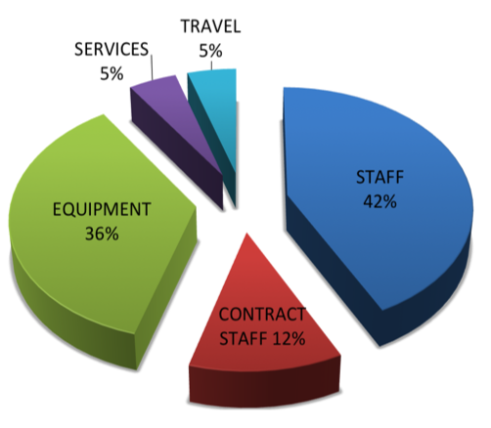
Budget
Breakdown by Class
Notes:
Overall yearly expendature – cash flow
As one might expect there is a very rapid early build up
And peak as capacity is built and development programs get underway
This is followed by a reduction as programs terminate and technology are progressively made available
Tails off – with the longer development programs and endurance testing activities which inherently take time
Early years are dominated by spends staffing – both permanent and contracted required to get the ball rolling
Equipment both on programmes and to set up facilities – this is a green field site

Slide 11
Organization - External interfaces
TECHNICAL ADVISORY PANEL
INSTRUMENT PROJECTS
Collaboration
Equipment Standards
& Technologies
ESS / SNS / ISIS
COMMERCIAL SYSTEM SUPPLIERS
In-kind procurement
Potential
REQUIREMENTS
Collaboration
on equipment
development
ESS / SNS / ISIS
DISCUSSION
STANDARDS
EQUIPMENT
CENTERS OF COMPETENCE
TECHNOLOGY SUPPLIERS
Tech Collaboration
Potential
EXPERIENCE
EQUIPMENT
INDUSTRIAL
STANDARDS
In-kind Instrument
Collaboration Potential
Consultation
on equipment standardisation
Notes:
We are not going to be able to pull this off alone
We need the support of the community
And by this I mean the engineering community
We need their knowledge
Their experience
Guidance
We crrently have a TAC panel to

Slide 12
Risk & Mitigation
Risk | Consequence | Probability / Impact | Mitigation
Development effort fails. ESS specific equipment can not achieve required performance levels. | The functionality or performance of instruments are degraded. Instrument concept is no longer viable. | Moderate / High | Manage expectations Prioritize critical aspects of development Start early with staged deliverables Design in stretch
Development activities are slowed due to resource bleed to construction projects | The delivery of technologies is delayed. The construction of instruments is delayed. | High / Moderate | Separate development and construction activities & personnel
Difficulties arising from in-kind arrangements delay or disrupt in-house activities. | The delivery of technologies is delayed. The construction of instruments is delayed. | High / Moderate | Reduce exposure of critical projects to risks of in-kind. Devote effort to well define contracts & Start early
The serviceability requirements of the facility are not achieved | Instrument breakdown frequency increases reducing availability. The operating cost of suite increases | High / Low (High during op’s) | Prioritize issues during development of equipment Prioritize issues during design of instrument Start early & stage targets
Prioritize critical issues, start early and stage deliverables
Ring fence development activities
Organization for in-kind activities
must be settled early on
Consider facility objectives from
start of development
ESS Instrument Neutron Chopper systems
Standard
Systems
Standardised Components
Standardised design
Custom
Systems
One - Off or
Very High Performance
ESS Instrument Neutron Chopper systems
Standard
Systems
Standardised Components
Standardised design
Custom
Systems
One - Off or
Very High Performance
ESS Instrument Neutron Chopper systems
Standard
Systems
Standardised Components
Standardised design
Custom
Systems
One - Off or
Very High Performance

