Slide 1
ESS STRATEGY for supply of chopper systems to NSS project
Science directorate
Instrument technologies division
Neutron chopper group leader
--- DRAFT ----
“ Strategy, the human attempt to get to desirable ends with available means".
Max McKeown
V 4.1

Slide 2
Objectives
The strategies objectives are aligned those of the NSS project, the ESS project and the facilities operating requirements.
The primary goals of can briefly be stated as;
To supply of chopper systems, which enables the world leading performance of instruments in neutronic terms at acceptable cost and within schedule.
To supply and support of chopper systems, which enable the achievement of the facilities objectives in terms of quality service to the scientific community
  (ie: high instrument availability and low operating costs)

Slide 3

Drivers
Raising Performance
  Neutronic performance
  Availability
Reducing Costs
  Procurement
  Operations
In-kind
  Harness experience
  Maximise in-kind potential
  Equitable distribution

Slide 4
ESS Instrument suite
Notes:
Baseline dimensions for target monolith, R6m
Baseline design of instrument halls
Reference suite of instrument from TDR
Operation considered during normal operation
225 Scheduled days at nominal power (5MW)
Beam lines were operationally independent when separated by 1.4m of lateral shielding
The reference suite represents a vision of a suite of instruments designed to meet the communities needs.
It is a working assumption of the types and balance of instruments which the community will themselves choose and is used for engineering studies preparing for construction.

Slide 5
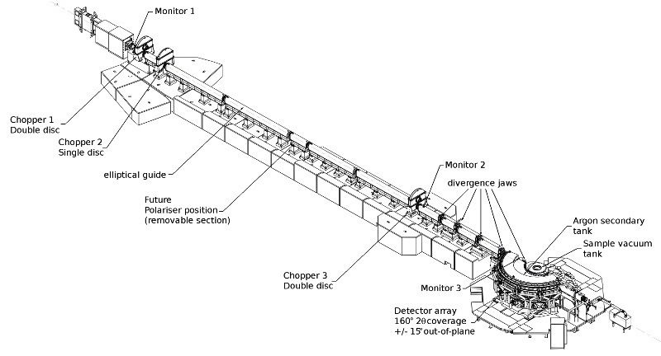
Spallation source instruments
BEAM SHUTTER
-HEAVY
DETECTOR
-BEAM MONITOR
NEUTRON OPTICS
- IN MONOLITH GUIDE
BEAM LINE SHIELDING
PHOTO ISIS Instrument
- overlay schematic components
CHOPPER 1
CHOPPER 2
DETECTOR
-BEAM MONITOR
BEAM SHUTTER
-LIGHT
NEUTRON OPTICS
- GUIDE
NEUTRON OPTICS
- COLLIMATION
NEUTRON OPTICS
- POLARIZER
FLIGHT TANK
SAMPLE
ENVIRONMENT
Instrument
Shielding
Choppers
Sample area
Detectors
Control systems
Optics
CHOPPER 3
DETECTOR
-BEAM MONITOR
DETECTOR
-ARRAY

Slide 6


An new approach to the engineering of instruments …
The Facility as a whole does not benefit from a purely ‘case by case’ approach to designing or building instruments.
  Potential for commonality and synergies are lost
  Procurement advantages of scale are lost
  Scientific and engineering effort is duplicated redesigning a solution the same requirements again and again
Cake - traditional approach
The facilities goals of performance, cost and quality and maximizing in-kind potential are more successful addressed by ensuring a degree of standardization of approach and equipment on an ‘Instrument suite wide basis’.
  Though the establishment of Equipment standards, and design guidelines
  The coordination of technology development & procurement through technical groups
  Though ensuring an optimal match to build partners and a maximal use of in-kind potential.
Cake - Cross cut approach

Slide 7
CROSS CUT APPROACH
‘5 tools’
Systems thinking, modular design.
Targeted development
Component standardization & interchangeability
Full cost & full cycle
Coordinated procurement

Slide 8
The ‘cross cut’ Benefits
Benefits
Maximize instrument performance by considering the needs of the instrument suite and that of the facility globally and not case by case.
Increase the effectiveness of collaborations by matching partner competence and capacity to equipment needs.
Reduce development costs by avoiding duplication of effort and sharing equipment across several instruments
Ensure high serviceability to achieve highest standard of support to instruments in operation.

Slide 9
Chopper Interfaces & Stake holders
DMSC
ICS
Detectors
Instrument
control Software
Control Network
HW / SW
Time stamping
Data acquisition
Software
Chopper
Hi level Control algorithms
Communication
protocols
Timing
signals
Data Veto
Instrument #1
Chopper
Control
HW/SW
Control
Box
Instrument specific control parameters
Control box
Software
(device driver)
E &E Group
Chopper Integrated Slow motion
Control
Electronic
Hardware &
Middleware
Instrument specific installations
Neutron Chopper Systems
Instrument #2
Servo Control
Electronics & Parameters
Motion control
Software
Instrument specific components
Instrument availability
Sample
Environment
Instrument # 22
Chopper
Mechanic
systems
Chopper
Support
Systems
Guide-Chopper Interface
Crane access & capacity
Alignment
Personnel Safety
Systems
Integrated
Beamline
shielding
Vacuum systems
Neutron optics
Machine Protection Systems
Operating schedule
Cooling /
heat recovery
Containment
Optics &
Shielding
Electrical Power & UPS
Facility
Target
Contamination
Safe working
practices
Ventilation
Health &
Safety
Monolith / instrument interface
Building Services
Notes:
In fact if you just try to identify the primary stakeholders and proximate issues concerning choppers you come up with something like this
I think you will agree it’s quiet a bundle
Establishing interfaces and tying up the loose end is currently proving quiet a challenge
But it’s a vital building block to enable the design and operation of instruments
Lets look at just one of these interfaces …

Slide 10
THINK ‘SUITE’
Identify the common requirements
Explore solutions which can meet ‘sub sets’ of requirements.
Exploit Synergy across instruments.
Consider global issues – crane access, shutter placement …
Consider facilities requirements of Serviceability, maintainability, instrument availability, and life cycle cost effectiveness…
Handle ‘boundary issues’
Handle interfaces between systems generically (across the board)

Slide 11
DESIGN
Coordinated design
Avoid duplication of effort
Common interfaces facilitating integration
Promote standardization where beneficial
Mitigate technical risk & development costs
Modular design
Component platforms
Reduces the cost of optimization
Increases serviceability (reliability
Reduces procurement costs
Reduced spares costs

Slide 12
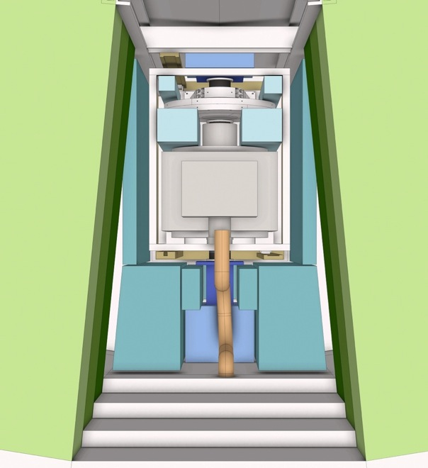
Coherent Equipment placement & packaging
TARGET MONOLITH
F : Curved guide
& Light shutter
INSTRUMENT 01
INSTRUMENT 03
INSTRUMENT 02
< 5 degree >
<-------------- 15 degree ------------- >

Slide 13
Coherent policies on common issues
Access , Interfaces , RAS
  ABOVE ONLY!
  CHOPPERs ABOVE GUIDE
  CHOPPERS DECOUPLED FROM GUIDES
  ADVANTAGES
  Does not requires side access for removal
  Chopper Extraction from TOP
  Fastest intervention time
  Small sideways footprint
  DISADVANTAGES
  Long support path for choppers
  Large vertical footprint
    More complicated shielding?
ACCESS & REMOVAL
> ICDs & GUIDELINES for Instruments
Notes:
What ever measures are made to improve equipment reliability
one issue that we must take concrete action on is to ensure the best access to it possible.

Slide 14
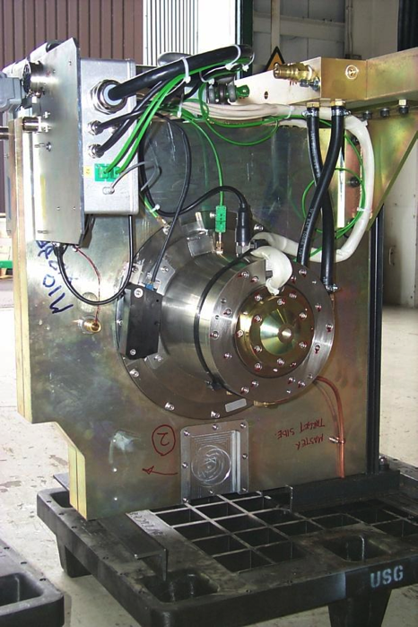
STANDARDS & COMMONALITY
Common approach
  Standardise where it makes sense …
  else facilitate optimisation
High level
  Component platforms
Standardised interfaces
  Mechanical
  Electrical
  Control

Slide 15
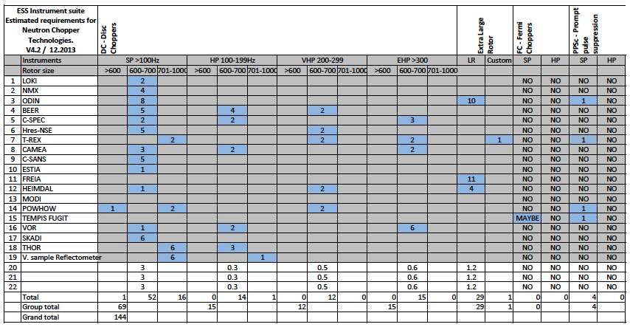
Common component platforms
LOW
SPEED
INTERMEDIATE
SPEED
HIGH
SPEED
LARGE
ROTOR
FAN
PPSc
2PA-02 (FTF)
2PA-02 (UO)
PA-02 (-M-14)
PA-02 (-M-14)
PA-10 (PPSc)
6 ‘platforms’
Notes:
Average choppers 7.5
Which 22 inst 150 -160 axis
By configuration, performance and requirements can be sub divided into 6 broad families
Small rotored disc chopper
Low / intermediate / high speed
Large rotored choppers

Slide 16
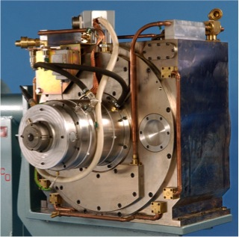
Platform
Within each platform….
A common mechanical & control architecture.
Motor & Drive
Rotor fixation
Support structures
Support systems
Control commands (?)
Monitoring system
MPS & PPS functions

Slide 17
CONTROL SYSTEM
NCG / E&E / DMSC
NCG / E & E Group
NCG / E& E / Integrated Control Systems
NCG & SUPPLIER

Slide 18
ELECTRICAL

Slide 19
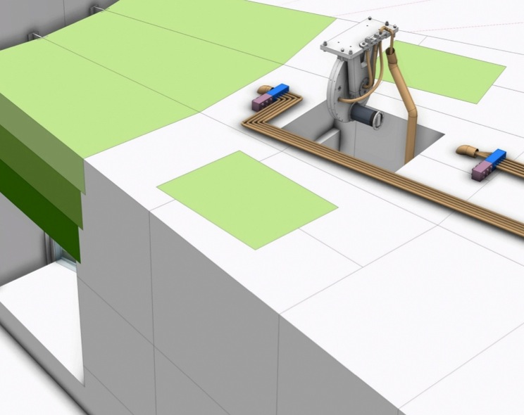
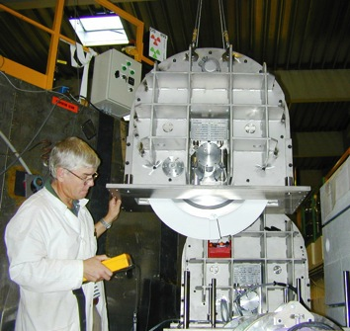
Interfaces: Chopper-Optics-Shielding
Key Objectives
  Highest neutronic performance for instruments
  Low back ground @ Detector
  Highest instruments availability
  Lowest lifetime costs
Input to instrument construction projects
  Interface definitions
    Chopper-Optics
  Guidelines for design
    Installation
    Access / Serviceability
    Integration of shielding
  Policies
    Alignment /Vacuum /Access /Activation
  Equipment standards for procurement
Common housing strategies
Vertical split
Guide removed with Choppers
Horizontal split
Guide remains in lower housing
Notes:
Very obvious and real interface Choppers / Guides
With the increased complexity of ESS choppers systems the number of these interfaces is increased
Intergration
with guides
with shielding
Ensuring serviceability within shielding…
The list goes on…
The result of this effort will be condensed into a number of documents – many in the form of guidelines for instruments
Its important to the design of each instrument
But equally to the operation of the instrument as a whole
We do …. so you do not have to.

Slide 20
Full cost & Full cycle
Procurement costs
  ‘Per unit cost’ is reduced through ‘economies of scale’ (-25%)
  Procurement process streamlined with grouped purchases of standardized equipment (-2%)
Design & Integration costs
  Reduces duplications of engineering effort developing solutions case by case for each instrument across the suite.(-5%)
  Reduces effort require to customize due to common Interfaces
Development cost
  Avoidance of duplication of engineering effort across suite of instruments (-5%)
  Common development shares effort / costs / risks across the suite of instruments and promotes formation of in-kind partnerships
Operational Costs
  Parts/ systems commonality Increases reliability, serviceability and availability (-2%)
  Reduced cost of parts stock and support personnel throughout the life of the facility

Slide 21
TARGETED DEVELOPMENT
Neutron Chopper
Technologies WP
PPS Chopper Technologies (PPSc)
Disc Chopper Technologies (DC)
Small Rotor
(DC-SR)
Large Rotor
(DC-LR)
Management
Conventional
Low Maintenance
Fermi Chopper Technologies
Facilities
Support Systems
Serviceability
Methods & Technologies
Service Tooling
Radiation hardness
Operations
1 & 2
Chopper Lab
Equipment standards
Pit systems
Vacuum
Cooling
Design standards
Rep Rate Multiplication
Reliability
Availability
Serviceability
Imperative for use of straight guides
Wave frame Multiplication
Infra-structure
Instrument performance issues
Reducing facility operating costs
Facility performance Issues
Notes:
Chopper development work package is composed on a number of work unit each intended to address the principal issues in the field
On the left
Units related to Instrument performance
Development of technology which is vital to instruments and which is not available commercially
Long pulse requires a number of specific techniques to be employed
These in turn require specific solutions to be developed
RRM
WFM
Long pulse PPS systems
All these techniques are critical to harnessing the power of the long pulse and making instruments possible.
On the right
Units relating to facility issues
Measures to reduce operating costs
Ensure reliability and instrument availability
Infra-structure

Slide 22
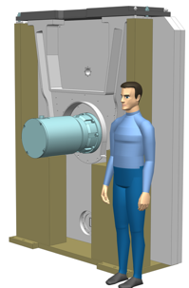
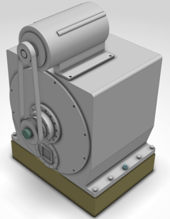
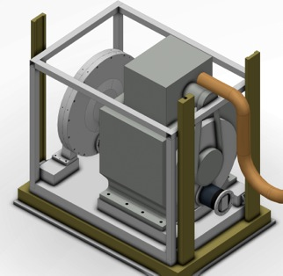
TARGETED DEVELOPMENT
- PRIORITIES
Enable instruments requiring new tech
  DC-LR (Large rotor)
  PPSc ‘Long pulse’
Project driven
  DC-SR Low Speed (cost effective/enabling inkind)
  Handling systems (Access – Remote handling)
Notes:
The facilities goals of performance, cost and quality are attained by the retaining of high level control over design and procurement parameters and the selection of equipment on and ‘Instrument suite wide basis’.
Establish Standards, Guidelines
Manage development & procurement through technical groups via the delegation of instrument work units.
An optimal match to build partners and a maximal use of in-kind potential.
Facility does not benefit from the ‘Fruit cake’ model of building instruments.
Commonality is lost
Cost advantages of scale are lost
Duplication of effort

Slide 23
Rotors (Disc Choppers)
Type 1 & 2
  Diameters 500 – 1000mm & 1000-2000m
  Collaborate with ISIS to develop a ‘simple & flexible’ cost effective solution (Aluminum) for low risk applications based on existing design.
  Identify partner for development for complex large diameter rotors if required
Type 3 (high performance)
  Use proprietary designs where possible. (Astrium / Mirrotron / Julich)
  Explore Partnership with TUM for development of CFRP rotor if/as required

Slide 24
Support systems
Pit systems / Vacuum / Cooling / etc
  Highly Standardised systems with strong integration to facility systems & instruments
  In-house design is required to ensure good integration compliance with standards and commonality to reduce costs and ensure quality.
The potential for grouped equipment procurement through in-kind partners.

Slide 25
Potential partners for development identified to date…
Chopper Type | Supply Quantity | Potential Partners ? | Development required
(P1) Low speed Disc chopper | 50 -70 | ESS – ISIS – SKF Spain Mirrotron | ***
(P2) Intermediate speed Disc chopper | 15 -35 | SKF / Mirrotron / Astrium / FZJ | *
(P3) High speed Disc chopper | 25 - 30 | FZJ / TUM / Astrium | **
(P4) Large rotor Disc chopper | 30 | ESS – ISIS collaboration | ****
(P5) Fan chopper | 3 - 5 | FZJ / JCNS + ESS ? | ***
(P6) Prompt pulse Suppression chopper | 4 - 10 | ESS – ISIS - SKF collaboration | *****

Slide 26
SUPPLYING THE NEED …
Preliminary estimations

Slide 27
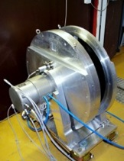
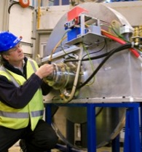
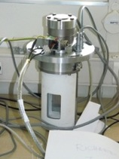
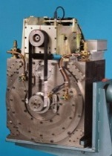
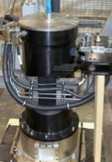





Procurement
- Some options : for ‘standard’ systems
SYSTEMS
SYSTEMS INTERGRATORS
TECHNOLOGY PROVIDERS
Notes:
Despite the fact that ESS unique many of the systems may be constructed for existing industry standard or ‘near standard’ components
Typical disc choppers / fermi
Commercial suppliers

Slide 28




Procurement options
- some ideas for ‘long pulse specific’ systems ?
SYSTEMS INTERGRATORS
Notes:
ESS unique requirements
Unique Long pulse will require some equally unique solutions
Special PPSc choppers adapted to the long pulse and higher energies
Completely unique large rotor choppers
Diameters 2 or more meters
Critical to employing the WFM and (RRM ?) techniques an harnessing the potential of the long pulse
No european commercial suppliers for complete systems
Current spallation sources design own
Suppliers of critical subsystems are known and we propose to work with them in much the same manner

Slide 29
COORDINATED PROCUREMENT
Harness the existing technical competences and capacities of in-kind build partners
Increase efficiency and quality through matching work packages to partners with requisite competences. (Harnessing partner strengths)
Maximize in-kind though commonality and procurement flexibility via ownership of IP rights (Layer cake model)
Share development risk equitably with build partners through co-development with experienced in-house groups.
Prefer partners with which IP generated can be shared and an agreement to share with the community.
Employ own IP to generate additional ‘flexible’ in-kind potential through the manufacture of ‘co-developed choppers’ with other partner countries to increase engagement.

Slide 30

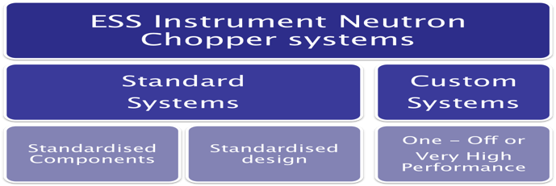

Procurement process
- for ‘Long pulse specific’ systems
DC-LR
PPSc
REQUIREMENTS
SPECIFICATION
& STANDARDS
DESIGN
PROTOTYPING
SUPPLY
INTEGRATION
Instruments projects
ESS Led ‘Inter-facility’ collaboration
Commercial
Expertise
ESS Led ‘Inter-facility’ collaboration
ESS
IN-KIND Potential ?
Commercial
Components
ESS
IN-KIND Potential ?
ESS
ESS Instrument Neutron Chopper systems
Standard
Systems
Standardised Components
Standardised design
Custom
Systems
One - Off or
Very High Performance
ESS Instrument Neutron Chopper systems
Standard
Systems
Standardised Components
Standardised design
Custom
Systems
One - Off or
Very High Performance
ESS Instrument Neutron Chopper systems
Standard
Systems
Standardised Components
Standardised design
Custom
Systems
One - Off or
Very High Performance

Slide 31




Development & Build partners
the discussion is open …
LOW
SPEED
INTERMEDIATE
SPEED
HIGH
SPEED
LARGE
ROTOR
FAN
PPSc
BUILD PARTNER ‘D’
BUILD PARTNER ‘E’
BUILD PARTNER ‘B’
BUILD PARTNER ‘F’
BUILD PARTNERS ‘A+H’
BUILD PARTNER ‘C+G’
POSSIBLE BUILD PARTNERS ?

Slide 32
Chopper system breakdown
Procurement value ~70 % of total
Procurement value ~20%
Predominantly Instrument specific
Neutron Chopper System
Mechanical systems
Control systems
Support systems
Pit systems
Chopper 1-2 Low speed
Chopper 3-4 Low speed
Rack & Cabling
Control Hardware
Software
Vacuum
Power supply
Cooling
Monitoring
Pit 1 module
Pit 2 module
Extraction tooling
Service pack
Tooling
Critical Spares
Chopper 5 PPsc
Chopper 6–7 Hi-Speed
Procurement value ~10%
Predominantly generic systems
Notes:
The facilities goals of performance, cost and quality are attained by the retaining of high level control over design and procurement parameters and the selection of equipment on and ‘Instrument suite wide basis’.
Establish Standards, Guidelines
Manage development & procurement through technical groups via the delegation of instrument work units.
An optimal match to build partners and a maximal use of in-kind potential.
Facility does not benefit from the ‘Fruit cake’ model of building instruments.
Commonality is lost
Cost advantages of scale are lost
Duplication of effort

Slide 33
Instrument projects overview
 | 2014 | 2015 | 2016 | 2017 | 2018 | 2019 | 2020 | 2021 | 2022 | 2023 | 2024 | 2025 | 2026 | 2027 | 2028
Operations Schedule
#1
#2
#3
#4
#5
#6
#7
#8
#9
#10
#11
#12
#13
#14
#15
#16
1st Neutrons
Initial Design | Final Design | Procurement & Fabrication | Construction | Installation | Cold Commissioning | Hot Commissioning

Slide 34
Chopper & Instruments
The ‘first 3’
Target Operations Schedule
T-60m T-48m T-36m T-24m T-12m T0
#1
#2
#3
Development
Delivery, Integration & Test
1st Neutrons
On site Installation
Commissioning Interventions
Procurement
Initial Design | Final Design | Procurement & Fabrication | Construction | Installation | Cold Commissioning | Hot Commissioning

Slide 35
THE END
Thank you for you attention

