Slide 1
Science Directorate Instrument Technologies division Neutron Chopper Group Update IKON6
Iain Sutton
Neutron Chopper Group Leader
www.europeanspallationsource.se
February 26, 2014
Notes:
Good morning
My name is Iain Sutton
I am currently the Group leader for Neutron choppers
And In the following 10mn I will attempt to present the Status and strategy of NG Tech work package

Slide 2
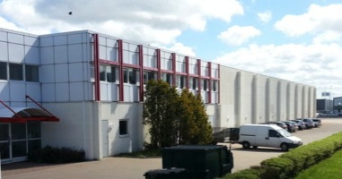
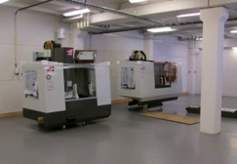
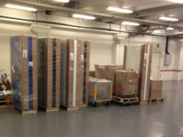
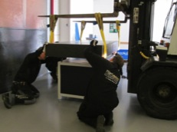
Science directorate / Neutron technologies division - Interim mechanical workshops -
CURRENT STATUS
Skiffervagen 26, 224 78 ,Lund
Tools
Equipment
Space
Building ESS’s capacity to innovate….

Slide 3
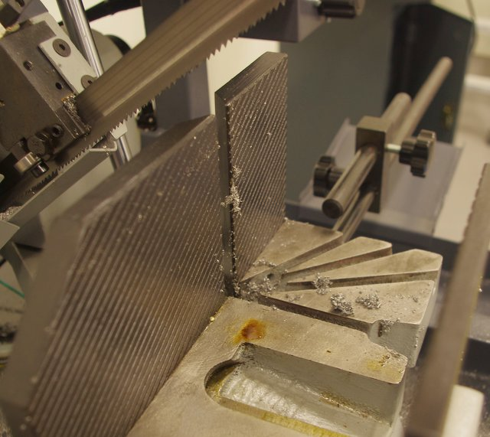
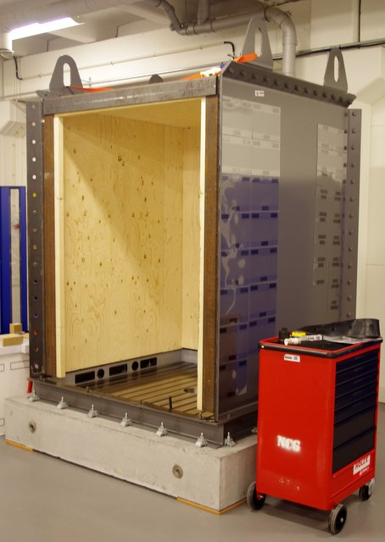
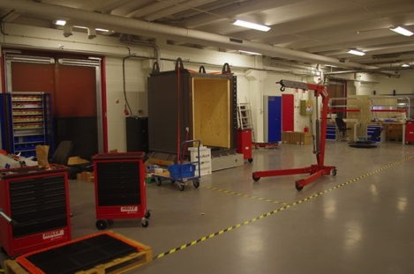
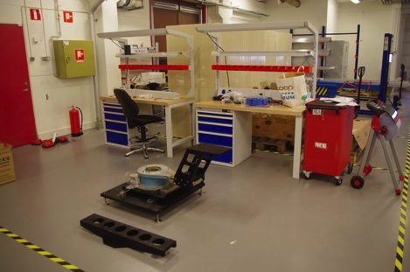
Neutron technologies workshops
Real work is commencing!
Basic machine shop
Optics group test station
Chopper test cell
Electronic assembly area
Prototype assembly area

Slide 4
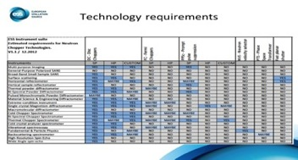
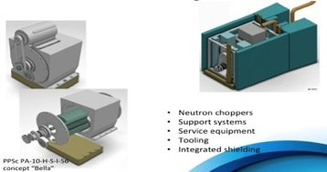
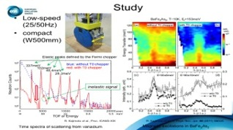
Scope - from Concepts to Construction
TRL 2
TRL 3
TRL 4
TRL 5
TRL 6
TRL 7 - 9
Exploration of Requirements
Theoretical studies
Engineering studies
Engineering Specification
Instrument Construction
|---------NEUTRON CHOPPER TECHNOLOGIES WP------------------------------|
|--CONSTRUCTION >
Exploration of Requirements
Theoretical studies
Engineering studies
Engineering Specification
Procurement
Notes:
quick look at the activities we are involved with
All starts with Requirements
Engineering studies
Computer
and Physical prototypes

Slide 5
DISC CHOPPER – TECH DEMONSTRATOR SMALL ROTOR

Slide 6
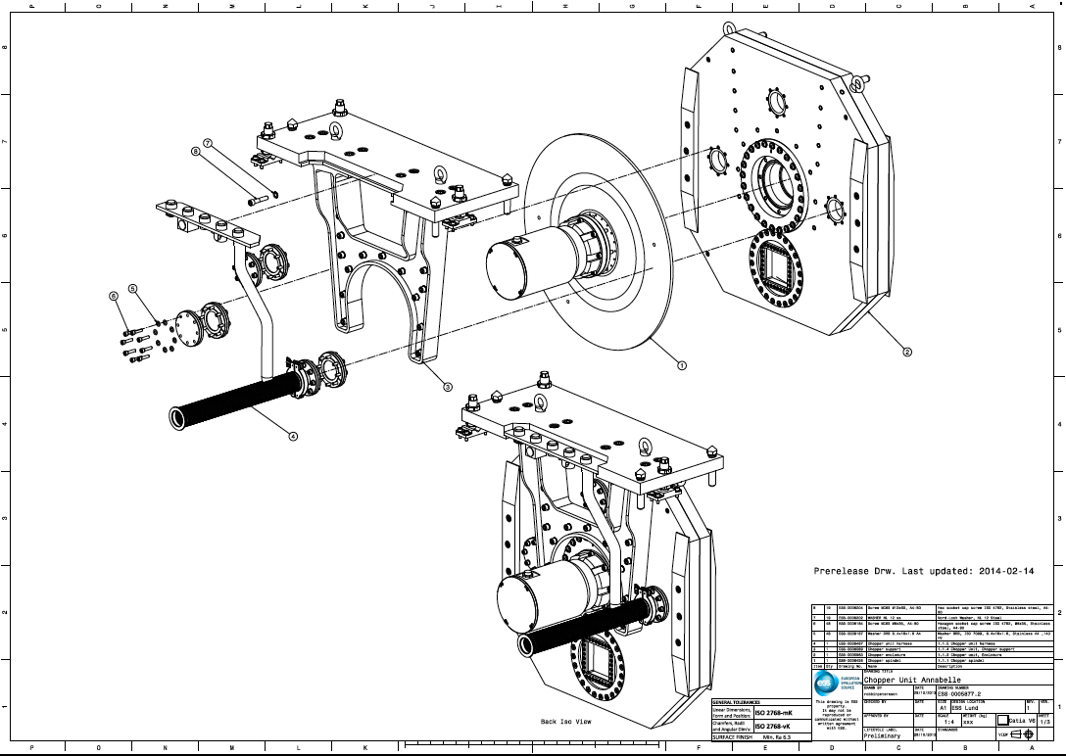
DC-SR
STATUS PROJECT LEADER: Erik Nilsson > Markus Olsson
Current TRL 2 (Design complete)
Current phase 2 Procurement
All principal components on order
Spindle + Control system SKF
Delivery June
Housing & Dummy rotor CECOM
Integration starts in September
Commisioning in November

Slide 7
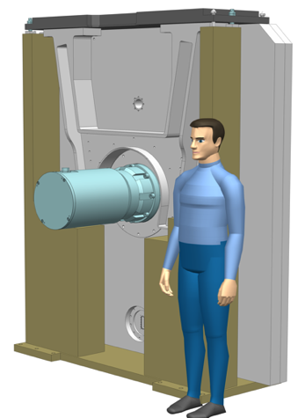
DC-LR
STATUS PROJECT LEADER: Erik Nilsson
Current TRL 1 (Requirements & concept)
Current phase 0 Preliminary Design
Requirements collected
Preliminary specification in progress
Design concepts under study
Looking for development partner
Design starts in August
Preliminary Design complete by December

Slide 8
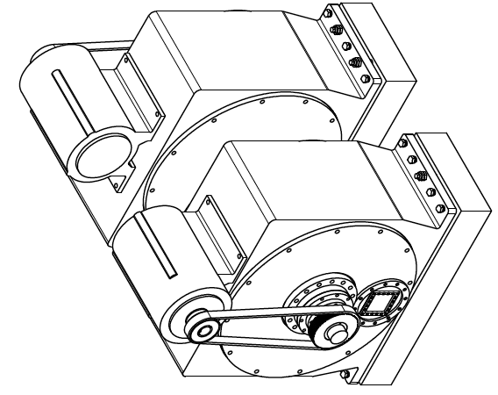
PPSc
STATUS PROJECT LEADER: Darek
Current TRL 1 (Requirements & concept)
Current phase 0 Preliminary Design
Requirements collection in progress
Preliminary specification in progress
Design concepts under study
Looking for development partner
Design starts in August
Preliminary Design complete by December

Slide 9
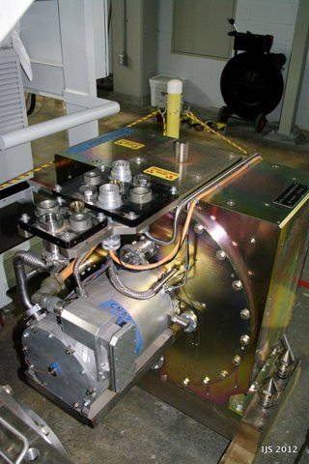
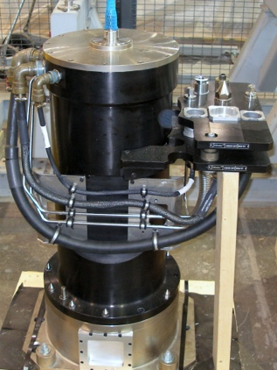
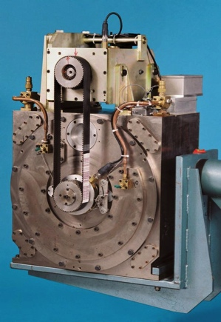
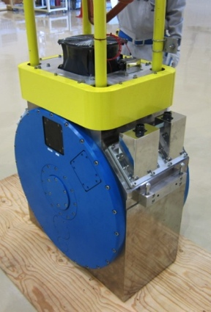
Prompt pulse suppression choppers ‘PPSc’
PPSc
SNS
ISIS
J-Parc
CNCS
?
500mm
PA-5-H-S
PE-5-V-C
PA-5-H-S-10
PA-5-H-S -25/50

Slide 10
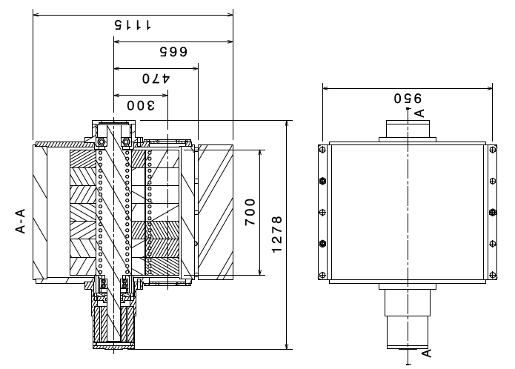
PPSc PA-10-H-S-D-56 concept “Dora”
Performance
Rotational speeds 7 > 56Hz
Beam size <= 100x100mm
Attenuation 10e6 ?
NFR
Design life 20 years
MTBF >500k hrs
Remote handling
Extreme radiation resistance
Features
Modular design
ESS systems compatible
Operation under vacuum
Water cooling
Metallic rotors (Inconel?)
Magnetic or Contact bearings
Notes:
Rotors d600mm
Material Inconel
Mass 600kg ?

Slide 11
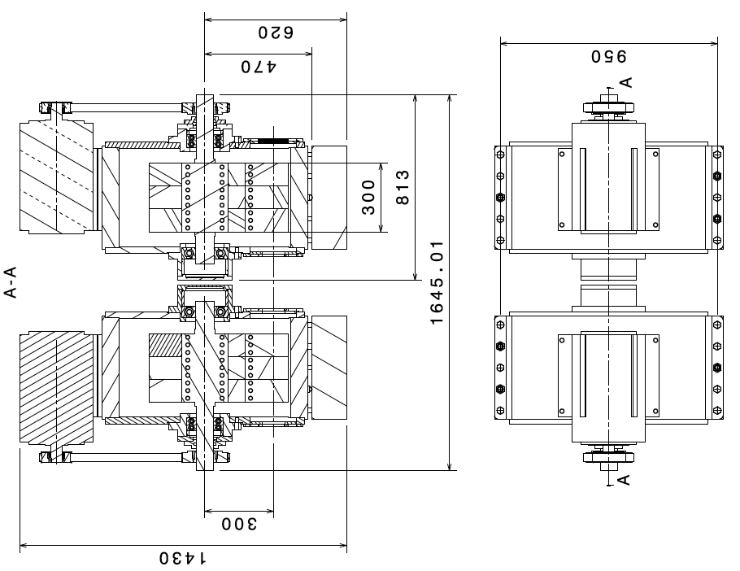
PPSc 2.PA-5-H-S-I-56 concept “Carla”
Back to back In-direct drive variant
2 x 300mm Hammers

Slide 12
A chopper extraction concept

