Slide 1




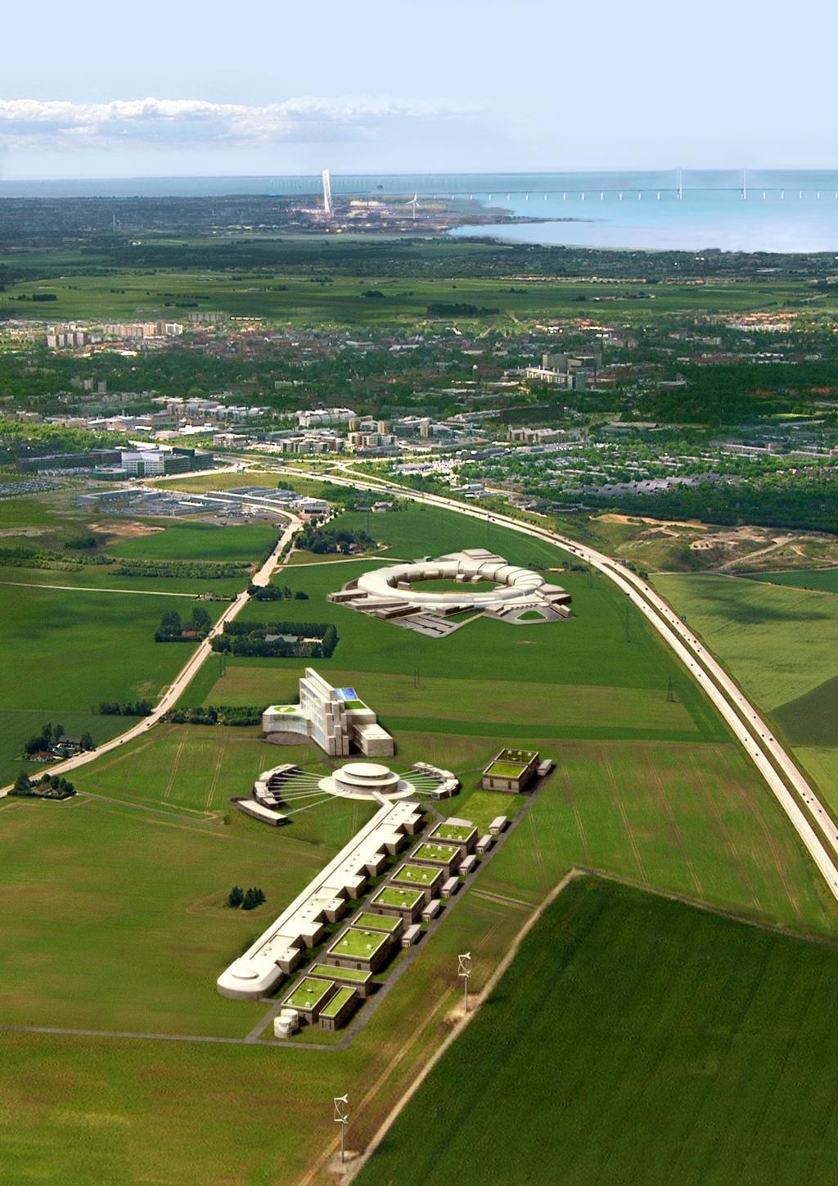
ESS Beam Diagnostics
Overview
Andreas Jansson / BI Group
Beam Diagnostics Mini-workshop
2012-3-20

Slide 2
Diagnostics Group
Current group members:
  Andreas Jansson (GL)
  Lali Tchelidze (BLM, currently on maternity leave)
  Hooman Hassanzadegan (BPM, BCM, Electronics, HW coordination)
  Christian Boehme (Noninvasive profile, SW coordination)
  Benjamin Cheymol (Frontend specific diagnostics)
  Tom Shea (target spot size & costing, ~one year visit)
Open positions:
  1 Postdoc (Focus on longitudinal diagnostics)
  2 Marie Curie Fellows (EU funded through oPAC network, ad closed)
Remaining posts 2012:
  Engineer (EE)
Expect we will need around 30FTEs at the peak
  Need to continue hiring during possible hiatus before construction.
  Plan for the long term (some collaborations, in-kind and contractors)

Slide 3
Responsibility matrix
 | Beam Loss Monitor | Beam Current Monitor | Beam Position and Phase | Faracay Cup | Slit Scanner | SEM Harp | Wire Scanner | Non-invasive transverse profile | Longitudinal Profile
Overall responsible | LT | HH | HH | BC | BC | BC | BC | CB | TBD
Detector Design |  |  | AJ
Cabling
Electronics Design | HH | HH | HH
Timing | HH | HH | HH
Controls Integration
Assembly
Installation
Commissioning
 | Software integration w controls |  |  |  |  |  |  |  | CB
 | Hardware Integration w controls |  |  |  |  |  |  |  | HH
Front end

Slide 4
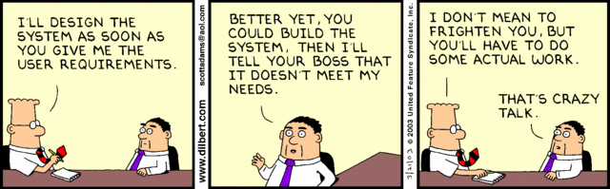
The Requirements Dilemma

Slide 5
Prel. ESS Diagnostics Specs
The beam loss monitoring system needs sufficient sensitivity to keep average losses below 1W/m, and enough time resolution/dynamic range to protect the machine from damage in case of fast beam loss.
The beam position needs to be measured with an accuracy of a couple per cent of the beam size, or about 0.1 mm. The measurement should have a response time to changes of the order of 1 μs or better.
The time of arrival (phase) should be measured to a fraction of a degree of RF phase, or about 2-4 ps. A fast response to changes is not needed to phase the cavities, but may be useful for e.g. LLRF studies.
The beam size needs to be measured with an accuracy of 10% or better. The beam size is about 2-3 mm at the available locations. The measurement can be an average over the LINAC pulse.
The bunch length needs to be measured with an accuracy of 10% or better. The measurement can be taken as an average over the pulse, or on a single bunch in the train. There is no need to measure the bunch length of all bunches individually.
Need to measure halo at the level of 10-5 or less of total beam.
The beam density distribution on target needs to be measured with an accuracy of 10%.

Slide 6
Diagnostics pulse
For some measurements, we plan to use a “special diagnostics beam” with low rep rate (perhaps 1Hz or less) and short pulse (perhaps 100us or less), but nominal bunch intensity.
  Lowering beam current changes the optics of the machine, making measurement results less useful
  Means nominal bunch charge is unchanged for diagnostics pulse
Exception: BPM data from low current beam might be useful for early commissioning (beam threading).

Slide 7
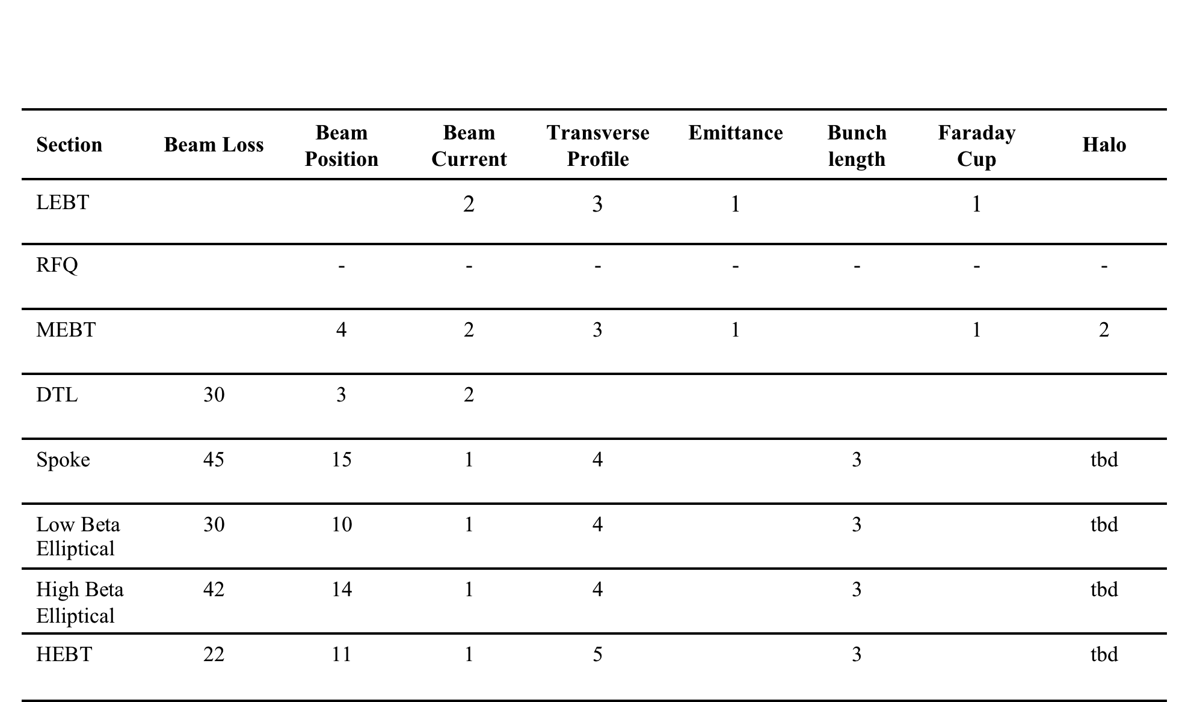
ESS Preliminary System Count
2
-
1
tbd
(?)
8
3
3
1
30
20
28
22

Slide 8
For LEBT & MEBT & DTL, see Benjamins talk tomorrow.

Slide 9
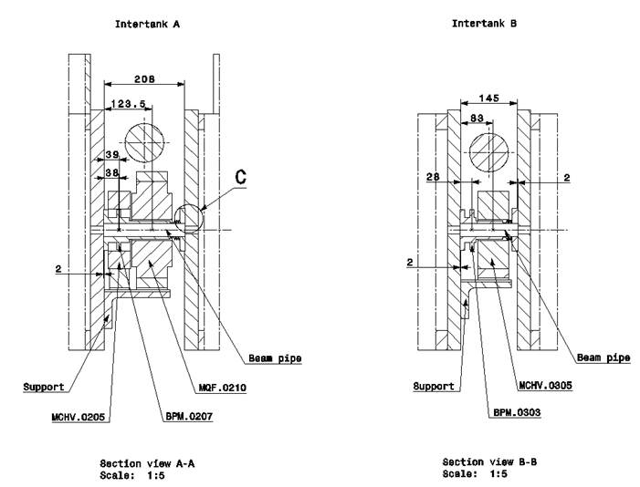
DTL
DTL design concept has moved from Linac4 style to SNS style.
Inter-tank diagnostics box
In-tank BPMs

Slide 10
DTL Layout
NEED TO BE UPDATES FOR ESS PARAMETERS!
Tank 1
Beam
QH
QV
QV
QH
QH
QV
QV
QH
QH
QV
QV
QH
QH
10
0
QV
QV
QH
QH
QV
QV
DH
QH
QH
DV
QV
QV
DH
QH
QH
DV
QV
QV
QH
20
30
40
WS
QH
QH
QH
DV
QH
QH
DV
QH
QH
FC
QT
QV
QT
QV
DH
QV
QV
DH
QV
QV
50
60
Tank 2
BPM
BPM
BLM
VS
QH
QH
QH
QH
QH
QH
QV
QV
QV
QV
QV
QV
DH
DV
QV
QV
10
20
0

Slide 11
DTL Layout cont.
NEED TO BE UPDATES FOR ESS PARAMETERS!
QH
QH
DV
QH
QH
QH
QH
DV
QH
QH
DH
QV
QV
QT
QV
QV
QT
DH
QV
QV
30
40
Tank 3
BLM
BPM
BPM
WS
DH
QV
QV
DV
QH
QH
FC
QV
QV
QH
QH
QV
QV
48
0
QH
QH
QV
QV
QH
QH
QV
QV
QH
QH
QV
QV
DV
QH
QH
DH
QT
QT
DH
10
20
Tank 4
BLM
BPM
BPM
WS
QV
QV
DV
QH
QH
FC
QV
QV
QH
QH
QV
QV
QH
QH
30
10
34
0

Slide 12
DTL Layout cont.
NEED TO BE UPDATES FOR ESS PARAMETERS!
WS
QT
QV
QV
QH
QH
DH
QV
QV
DV
QH
QH
DH
QV
QV
DV
QH
FC
QT
20
28
Tank 5
BLM
BPM
BPM
QH
QV
QT
QH
QH
QT
QH
QH
DV
QH
QH
DH
QV
QV
QV
DH
QV
QV
QV
10
20
0
Tank 6
WS
BLM
BPM
BPM
DV
QH
QH
FC
QH
QH
QH
QH
QV
QV
QV
QT
QV
QV
10
24
0
Spoke Module #1
DH
QV
QV
DV
QH
QH
QV
DV
NEG
NEG
DH
QV
20
22

Slide 13
DTL Legend
Symbol
Number of units
Name
Number of units
Name
Symbol
DTL Tank
x
BPM / Phase detector in DT
x
Quadrupole, Horizontal
x
Current Monitor (Toroid)
x
QV
QH
Quadrupole, Vertical
x
Faraday cup (Beam stop)
x
FC
QT
Quadrupole, Trim
x
WS
Wire Scanner
x
Dipole, Horizontal
x
Beam Loss Monitor
DH
BLM
x
DV
Dipole, Vertical
x
Energy degrader
x
Drift tube
x
VS
View Screen
x
Half drift tube
x
Quadrupole
x
Harp
x
Gate Valve
x

Slide 14
Spoke Outline
Spoke Linac
BLM
BLM
BLM
BLM
BLM
BLM
NIP
NIP
Beam direction
DTL
WS
WS
FC
BPM
BPM
BPM
BPM
CM
BLM
BLM
BLM
BLM
BLM
BLM
BLM
BSM
BLM
BLM
NIP
NIP
WS
WS
BPM
BPM
BPM
BPM
BPM
BPM
BLM
BSM
BLM
BLM
BLM
BLM
BLM
BLM
BLM
BLM
BPM
BPM
BPM
BPM
BPM
BPM

Slide 15
Spoke Outline
BLM
BLM
BLM
BLM
BLM
BLM
BLM
BLM
BLM
BPM
BPM
BPM
BPM
BPM
BPM
BLM
BLM
BLM
BLM
BLM
BLM
BPM
BPM
BPM
BPM

Slide 16
Spoke Legend
Symbol
Name
Number of units
Symbol
Name
Number of units
Spoke Cryomodule
BPM / Phase detector
x
x
BPM
NIP
Non-invasive profile
Current Monitor (CM)
x
x
CM
BSM
Bunch length monitor
FC
Faraday cup
x
x
WS
Wire Scanner
x
Quadrupole
x
Beam Box
x
Energy Degrader
x
Beam Loss Monitor
x
ED
BLM
Gate Valve
x
x
Note: Number of units include the beam diagnostic devices located in CCL/SCL transition region.

Slide 17
Medium Beta Elliptical Outline
Medium Beta Linac
BLM
BLM
BLM
BLM
BLM
BLM
NIP
WS
BPM
CM
BPM
BPM
BPM
BLM
BLM
BLM
BLM
BLM
BLM
NIP
NIP
WS
WS
BPM
BPM
BPM
BPM
BLM
BLM
BLM
BLM
BSM
BLM
BLM
NIP
WS
BPM
BPM
BPM
BPM
BLM
BSM
BLM
BLM
BLM
BLM
BLM
BPM
BPM
BPM
BPM

Slide 18
Medium Beta Elliptical Outline II
BLM
BLM
BLM
BLM
BLM
BLM
BPM
BPM
BPM
BPM
BLM
BLM
BLM
BLM
BLM
BLM
BPM
BPM
BPM
BPM
BLM
BLM
BLM
BLM
BLM
BLM
BPM
BPM
BPM
BPM
BLM
BLM
BLM
BLM
BLM
BLM
BPM
BPM
BPM
BPM

Slide 19
High Beta Elliptical Outline
Medium Beta Linac
BLM
BLM
BLM
BLM
BLM
BLM
NIP
WS
BPM
CM
BPM
BPM
BPM
BLM
BLM
BLM
BLM
BLM
BLM
NIP
NIP
WS
WS
BPM
BPM
BPM
BPM
BLM
BLM
BLM
BLM
BSM
BLM
BLM
NIP
WS
BPM
BPM
BPM
BPM
BLM
BSM
BLM
BLM
BLM
BLM
BLM
BPM
BPM
BPM
BPM
BLM
BLM
BLM
BLM
BLM
BLM
BPM
BPM
BPM
BPM

Slide 20
High Beta Elliptical Outline II
BLM
BLM
BLM
BLM
BLM
BLM
BPM
BPM
BPM
BPM
BLM
BLM
BLM
BLM
BLM
BLM
BPM
BPM
BPM
BPM
BLM
BLM
BLM
BLM
BLM
BLM
BPM
BPM
BPM
BPM
BLM
BLM
BLM
BLM
BLM
BLM
BPM
BPM
BPM
BPM

Slide 21
Elliptical Legend
Symbol
Name
Number of units
Symbol
Name
Number of units
Quadrupole
x
BPM / Phase detector
x
BPM
Gate Valve
x
Current Monitor (CM)
x
CM
F
Fast Valve
x
Beam Box
x
Cryomodules,
Beta = 0.61
WS
Wire Scanner
x
x
BLM
Beam Loss Monitor
x
Cryomodules,
Beta = 0.81
x
EP
Electrostatic Precipitator
x
Note: Only the number of quadrupole units includes the ones in CCL/SRF transition region.

Slide 22
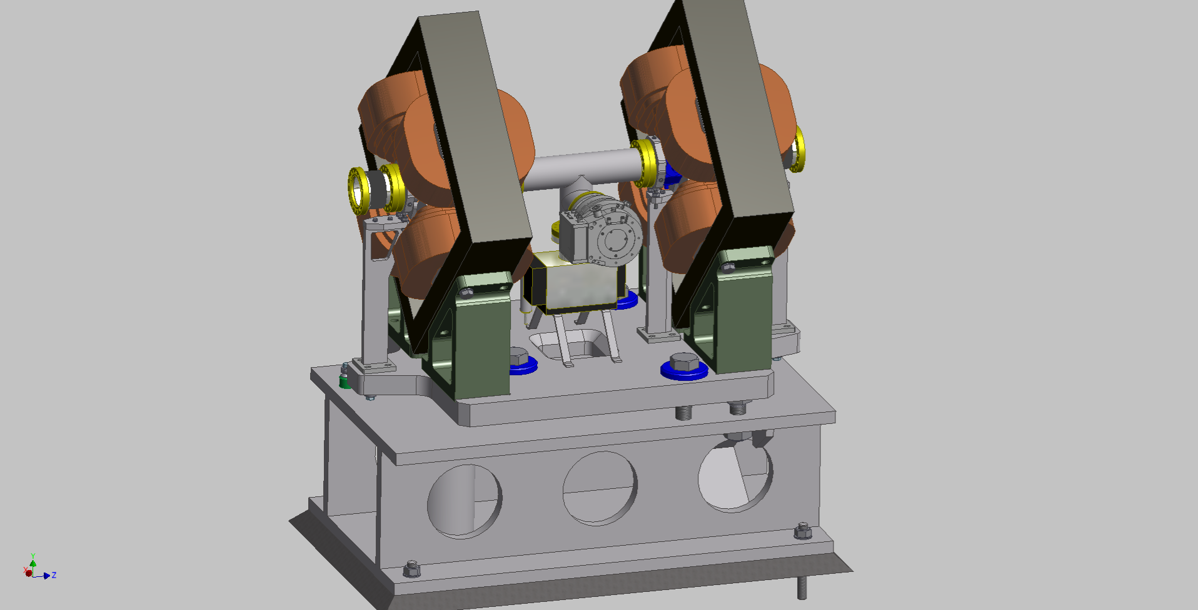
SCL Warm Sections
Have agreement to use tungsten wires, but will try to develop noninvasive method!

Slide 23
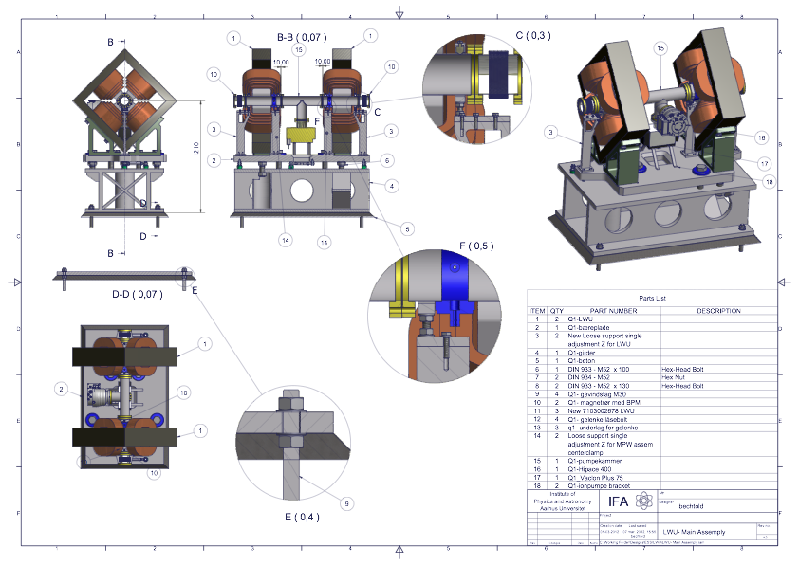

Slide 24
HEBT Outline
BLM
BLM
BLM
WS
NEG
NEG
EP
WS
WS
BPM
BPM
BPM
CM
28
27
29
BLM
BLM
HEBT QV1
WS
WS
WS
BPM
BPM
Beam Direction
30
31
32

Slide 25
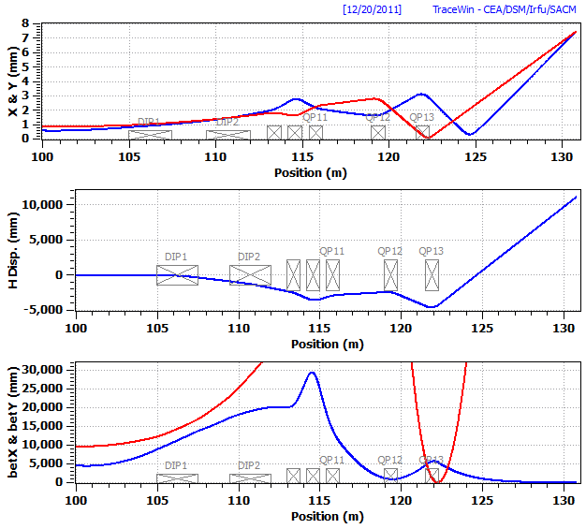
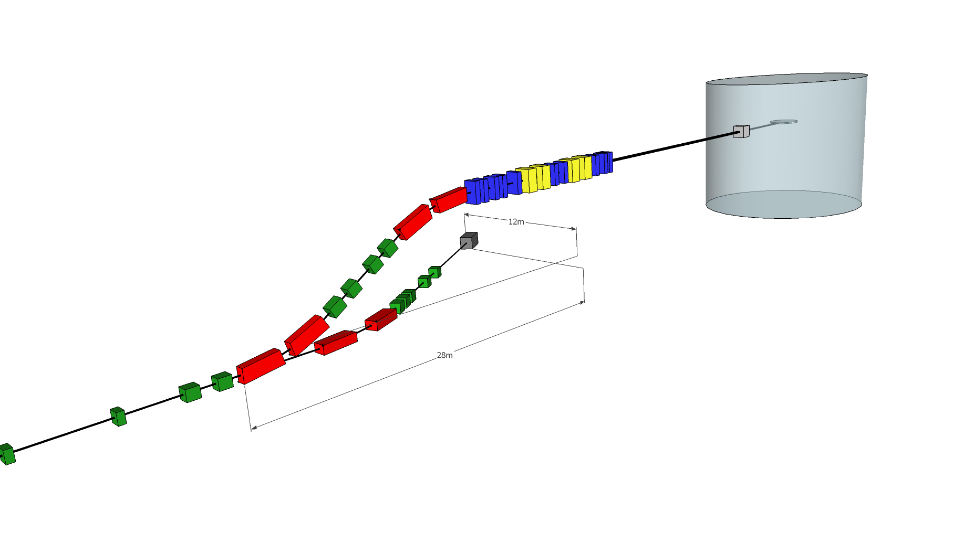
Beam Delivery Outline

Slide 26
Summary
This talk just gave an general outline of the distribution of diagnostics
More detail to follow in the coming presentations.

