Slide 1
Beam Instrumentation mini-workshop Conclusions from the Hardware, Timing and MPS mini-workshop Lund, 2012-03-20
Miha Reščič
Deputy Head of ICS @ European Spallation Source
Cosylab

Slide 2
Introduction
Integrated Control System
Control Box
HW Platform Discussion
Timing Discussion
MPS Discussion
Summary

Slide 3
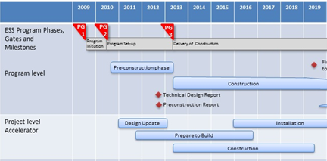
Integrated Control System
Construction -> Integrated Control System
-> Accelerator
-> Target
-> Instruments
…
Design Update -> Accelerator -> Accelerator Science -> Controls
Preparation To Build -> ICS XFunctional task force
@ Accelerator, Target & Instruments level

Slide 4
Control Box, purpose
1. Allow independent but standardized subsystem controls development
2. Encourage and enforce consistency between sub-systems
3. Facilitate new component testing (e.g. EPICS drivers)
4. Allow factory acceptance testing of subsystems through the control system
5. Validate technology decisions
6. Mediate early risk reduction, to prevent unexpected surprises at project integration time
7. Force the controls group to make and document early decisions

Slide 5
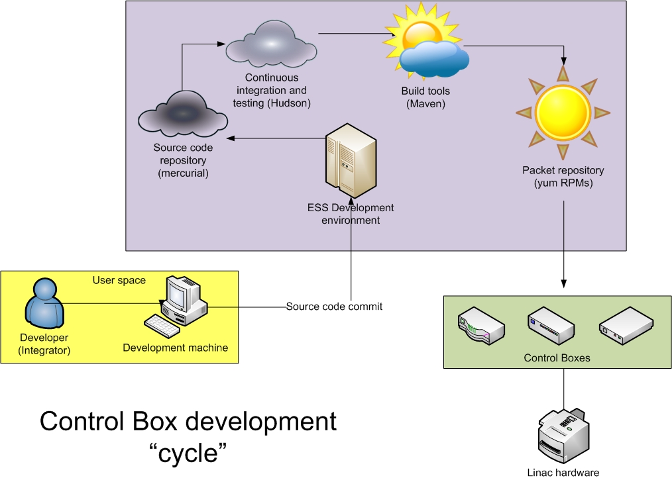
Control Box, schematic

Slide 6
Hardware Platform Decisions
cPCIe is the prototyping platform for applications that do not require extensive synchronization over the backplane
uTCA "for physics" (MTCA.4) is the prototyping platform for applications that do require the above.
cPCIe is the PRIMARY platform choice, uTCA is the platform for solutions that CANNOT run in cPCIe
The OS running on both crates is Linux
ICS is responsible to provide and support Control Boxes running Linux, EPICS and the Timing system for both crates
The platform provides remote firmware update possibilities

Slide 7
HW Decision support
Standardization
Definition of the backplane (e.g. ATCA having multiple substandards)
Vendor support and availability (e.g. low number of vendors for PXI (excluding cPCI(!) solutions))
EPICS integration
Driver availability for Linux
Backplane limitations
maximum number of available slots
synchronization and inter-communication
bandwidth (supports the 'express' choice)
Robustness of mechanical deployment
RTM (rear transition module), no 'front panel brick'o'lage'
RTM analog support (shielding of the signals)
[more info in Hooman's presentation]

Slide 8
Hardware Action Items
Look into the possible solutions of HW interfaces between EPICS and other OS/CS solutions (LabView)
The ICS should make a "shopping" list (ITER CODAC model) of supported crates, cards, cpu units, etc ...
Research the (DESY, SLAC ...) uTCA drivers and Linux support for the various cards and other HW
Research on the redundancy front (PS, fans, online health-checks, hot-swaps, MTBF, 'predictability‘ of failures, failure identification and time to repair
Get more information on the DESY uTCA possible in-kind contribution

Slide 9
Timing System Decisions
Primary prototyping transport layer is MRF
Primary prototyping HW platform is cPCIe (secondary is uTCA)
Current required accuracy is 1 ns (precision of the timestamp, jitter of the clock)
Currently there is no need for a BI-directional Timing transport layer
Instruments use the same timing transport layer as Accelerator and Target
The timing master generates '14Hz' phase locked to the clock signal from MO
Timing system prototype architecture allows change of transport layer in the future
Decision support
Availability and performance of the transport layer (WR, NI1588, custom)
HW platform discussion and decisions

Slide 10
Timing Action Items
Find correlation between 14Hz and 352.21MHz in the scope of the event table (event granularity; n*RF, n=?)
Research the possibility of timestamping with pulse sequential number (RF counts, ticks from princess visiting)
Look into supercycles concepts, pulse structure and commissioning pulse ramping
Look into the different modes of operation (e.g. running the machine with insertion devices)
Write requirements document for ESS Timing (based on SNS requirements (strip down SNS requirements to match ESS))
Start defining event table (and iterate with stakeholders), static and dynamic
Look into the integration between the post-mortem data acquisition (and analysis) and MPS, Timing and CS
Integration of Control Boxes with Timing receivers and the neutron guide choppers (infrastructure)
Build a functioning timing system prototype
Research the local mode operation in case of master timing link failure, loss-of-link, loss-of-signal

Slide 11
MPS System Decisions
Two MPS requests defined: Fast Abort (intra-pulse), Beam Permit (inter-pulse)
Currently, Fast Abort pulls the Beam Permit
Currently, the interface to MPS system is binary (e.g. 1/0, ok/nok) and fail(2)safe
MPS response time is a function of energy
Beam Fast Abort should use redundant mitigation devices
The MPS system timestamps all MPS input changes and all the nodes need to be synchronized with the same precision as the Timing system
MPS supports different modes of operation (e.g. commissioning stages)
Target upon failure pulls the Beam Permit (no Fast Abort)
Target can take a hit from one pulse after pulling the Beam Permit Inhibit
Instruments never provide any input into MPS

Slide 12
MPS Action Items
Identify possible mitigation devices and their speeds and redundancy (LEBT / MEBT chopper, dephase RFQ, source; listed in decreasing order of speed)
MPS post-mortem support (implication for device integration (e.g. interfaces))
Find the number and types of inputs to MPS or MPS nodes (order of magnitude) and their actions (FA, BP)
Define responsibilities for tresholds for devices that trigger (input) MPS

Slide 13
Summary
cPCIe is the primary and uTCA is the secondary prototyping platform.
The OS running on both crates is Linux and ICS is responsible to provide EPICS and the Timing system for both crates
Primary prototyping transport layer is MRF and current required accuracy is 1 ns
Timing system architecture allows the change of transport layer in the future
Fast Abort and Beam permit MPS requests and a binary interface
MPS supports different modes of operation

Slide 14
Thank you!

