Slide 1



¹⁰B-based MultiGrid detectors as an alternative to ³He:
Achievements and construction of a large area demonstrator
ESS Detector Group seminar
Mathieu FERRATON
ILL, Neutron Detector Group

Slide 2
Outline
Basic principles and design of MultiGrid detectors
Achievements with previous prototypes
The IN5 demonstrator

Slide 3
³He crisis and need for alternatives
³He gas detector
  demonstrated performance
  relatively simple use
³He is a byproduct of nuclear industry and nuclear weapons
  Product of tritium beta-decay (T_{1/2} ~ 12 years)
  available quantity is limited
Around 2008, USA government began to keep their ³He stock for Homeland Security Department
-> ³He shortage for scientific applications
-> cost of ³He increased by a factor ~40 (from ~100€/L to ~4000€/L)
-> a new IN5 detector (the largest at ILL) would cost about 10M€ just for the gas itself
ESS and other neutron scattering science facilities need hundreds (thousands) of square meters active area detectors
-> ³He is not an option anymore for the largest detectors
-> alternative technologies are needed shortly!!
We have a solution!!!!

Slide 4
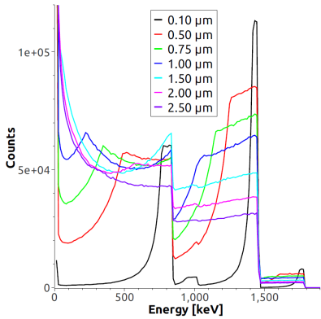
Basic principles of MultiGrid detectors
Gas neutron detectors based on solid 10B converters
Solid ¹⁰B₄C layers are used as neutron converters, coupled with a gas amplification system
Unlike ³He gas detectors, the neutron converter is not the amplification medium
~40 µm of ¹⁰B₄C is required to convert 90% of thermal neutrons
Ranges of fragments between 1.7 and 3.3 µm
Amplification gas
¹⁰B₄C layer
substrate
⁴He
⁴He
neutron
⁷Li
⁷Li
Fragments need to reach the gas to produce a signal
  thinner layers (~1µm) increase the probability for the fragments to reach the gas
  At least 30 layers (1 µm thick) to reach a good efficiency
⁷Li
α (⁴He)

Slide 5
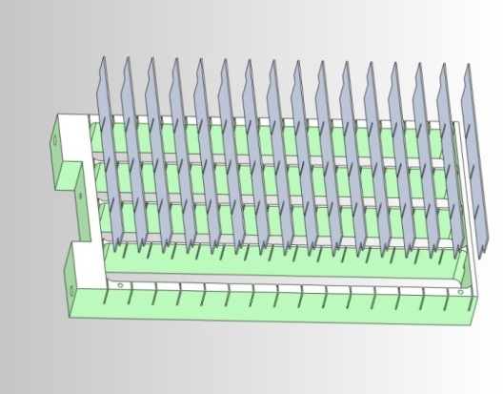
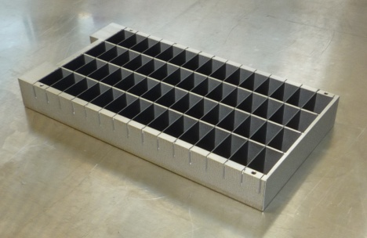
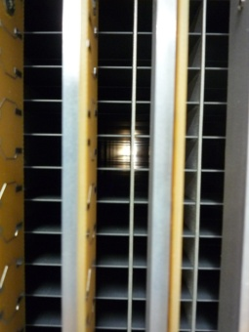
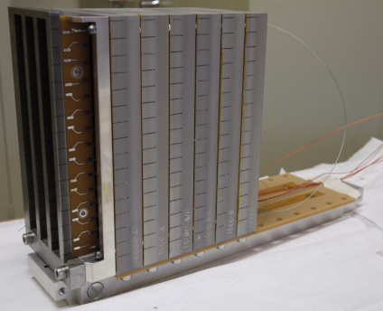
Basic principles of MultiGrid detectors
The MultiGrid concept
aluminum samples (blades) are coated on both sides with ¹⁰B-enriched B₄C layers (~1 µm thick)
15 blades (or more) are mounted on a frame, orthogonally to the incident neutron direction -> grid
1 grid is made of ~60 voxels (2 x 2 x 1 cm3)
-> active area = size of one blade (~10x2 cm²)
neutrons
Grids are stacked in column to increase the sensitive area (and kept insulated from each other)
Superimposed unit cells from different grids form rectangular tubes, mounted with anode wires (20 µm diameter)
-> proportional counters (gas amplification in 1 bar Ar/CO2)
Position sensitive detector:
-> coincidences between wire and grid signals
(position resolution = size of a voxel)
Stack of grids
Rectangular tubes (mounted with 20 µm diameter wires)

Slide 6
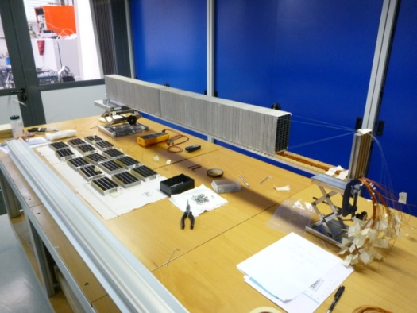
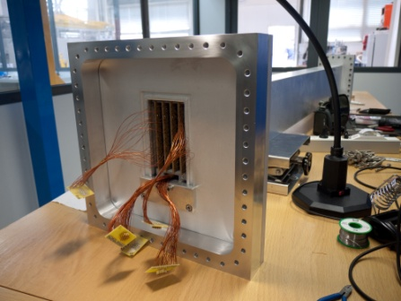
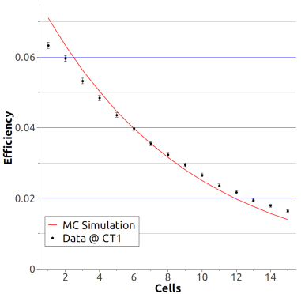
¹⁰B MultiGrid prototypes
Previous versions of MultiGrid prototypes
Several prototypes were tested to show that performances are compatible with ³He standards
12-grids prototype (2010):
  8x24 cm² active area
  60 anode wires
  optimized for the 2.5 Å neutrons from the CT1 test beam-line at ILL:
  -> 30 layers, 1 µm of ¹⁰B₄C each
96-grids prototype (2011)
  Stack of 96 grids
  8x200 cm² active area
Neutron efficiency measurement @2.5 Å
  Neutron efficiency @2.5 Å well predicted by MC calculation:
    Calculation: 53.5%
    Measurement: 53.1 %
Proved the feasibility of larger detectors with the MultiGrid technique
-> first step toward up-scaling the Multi-Grid concept

Slide 7
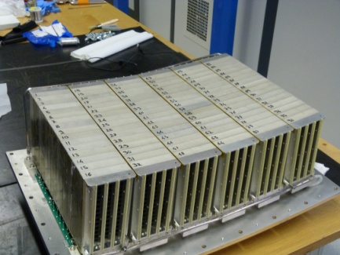
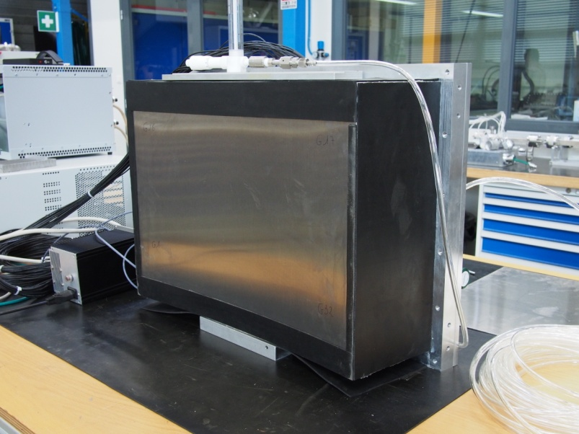
¹⁰B MultiGrid prototypes
Previous versions of MultiGrid prototypes
The IN6 prototype (2012-2013):
Designed to be mounted on the IN6 time-of-flight spectrometer at ILL (replacing part of the regular ³He tubes)
96 frames arranged as 6 stacks of 16 frames (sensitive area 32 x 48 cm²)
60 anode wires per stack (total 360 wires)
Gas (1 bar Ar/CO₂) flushed in the vessel to avoid contamination due to outgasing (detector is not
456 channels to read out the detector
-> a strategy had to be found to reduce this large number of channels
neutrons

Slide 8
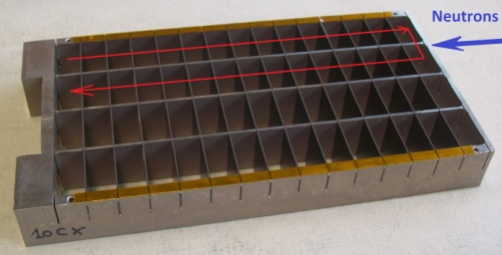
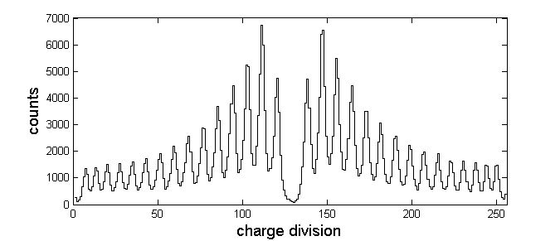
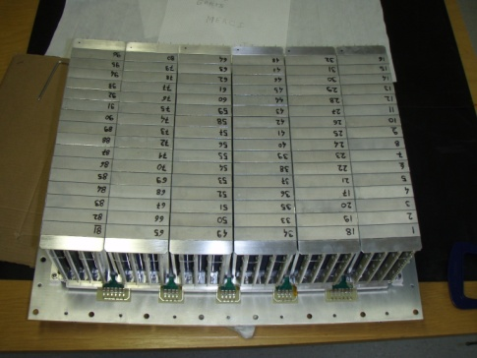
¹⁰B MultiGrid prototypes
Toward the reduction of channel number
Reduction of channel number :
  30 wires connected together via resistive networks
  -> charge division allows determination of the targeted wire
    12 resistive networks × 2 ends = 24 readout channels
  3 frames connected together horizontally
    96 / 3 = 32 readout channels
R
R
R
Charge division card
2R
anode wires
R
R
R
Charge Preamplifier
-> 56 readout channels to determine position and depth (reduction by a factor 8)

Slide 9
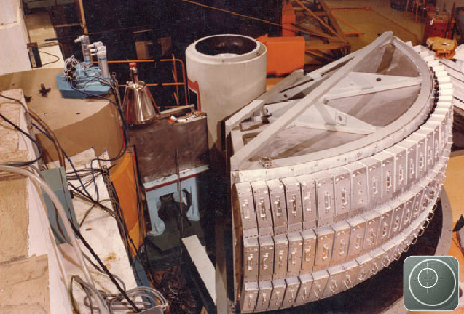
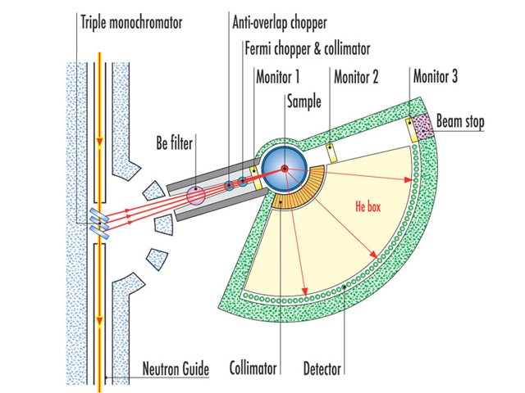
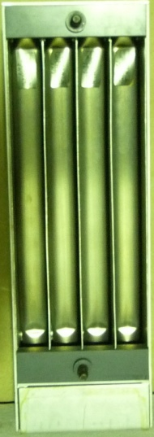
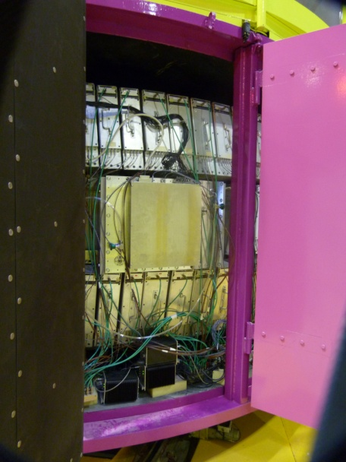
The IN6 measurement campaign
The IN6 time-of-flight spectrometer
ToF spectrometer in the range of thermal/cold neutrons (incident wavelengths : 4.1, 4.6, 5.1, 5.6 Å)
Detection system : 337 ³He tubes (sensitive area 4 m²)
³He tubes (3 bar, diameter 3.2 cm, length 30 cm)
Measurement
  3 weeks measurement with users’ samples
  24 h dedicated beam time
Side by side comparison of performances
Timing information from the IN6 chopper -> much more observables

Slide 10
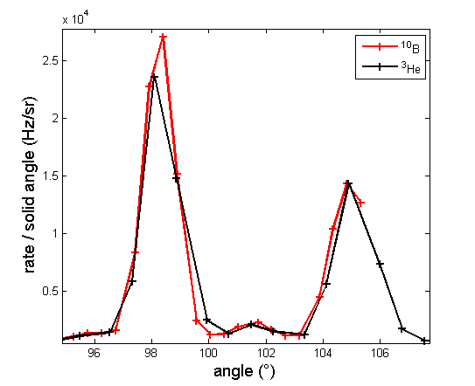
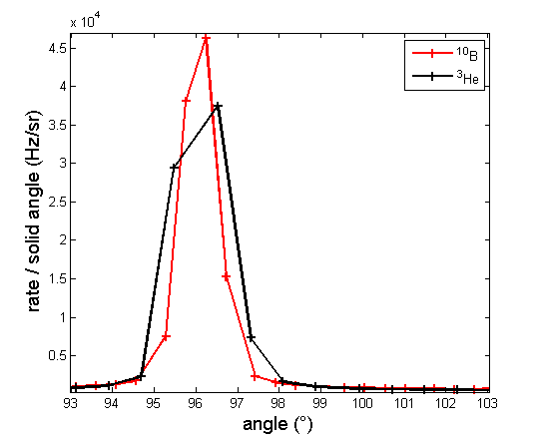
The IN6 measurement campaign
Efficiency comparison with IN6 tubes
Bragg peaks in the detector -> well defined wavelength
YGarnet @4.1 Å
Si @4.6 Å
rate(¹⁰B) / rate(³He) = 1.08
rate(¹⁰B) / rate(³He) = 0.97
³He tubes have higher intrinsic efficiency
¹⁰B Multi-Grid have less dead spaces thanks to optimized geometry
  -> optimized design of the MultiGrid (square tubes, minimized dead space) lead to an efficiency acceptable from the point of view of users

Slide 11
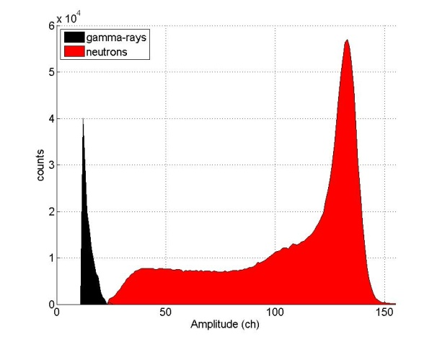
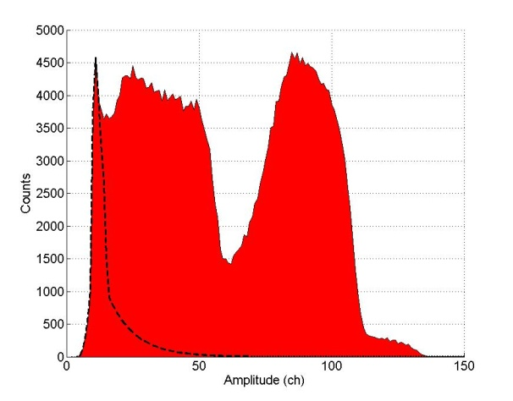
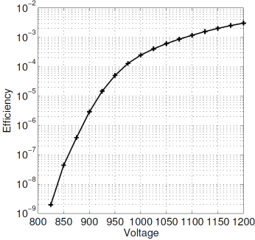
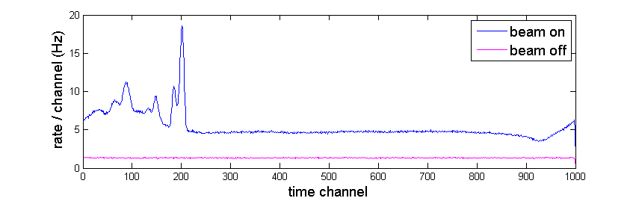
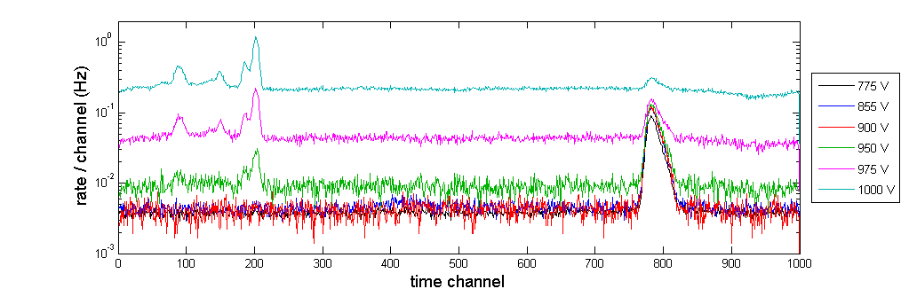
The IN6 measurement campaign
Gamma sensitivity
³He (gas converter)
¹⁰B (solid converter)
Gamma efficiency below 10⁻⁷ at normal operating voltage was measured (compatible with 3He standards)
gamma and fission fragment spectra widely overlapping
gammas and fission fragments well separated
⁷Li
α
Gamma efficiency measurement
(662 keV 137Cs source)
Time spectrum NaI
NaI scintillator:
  -> Strong gamma background from IN6 (see spectrum)
  -> well defined time structure
Time spectrum multigrid
Multi-Grid detector:
  -> a similar time structure is observed for large values of the high voltage (above 900 V)
  -> no sign of this structure down from 900V

Slide 12
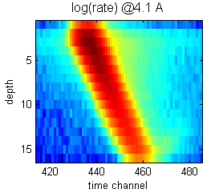
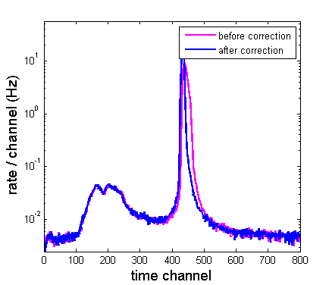
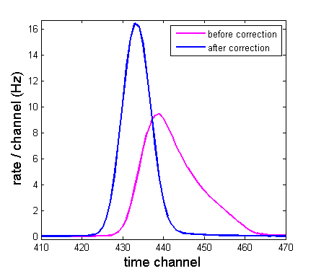
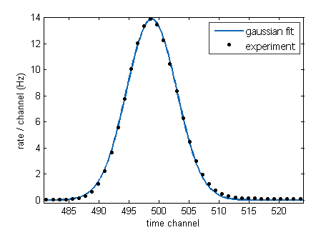
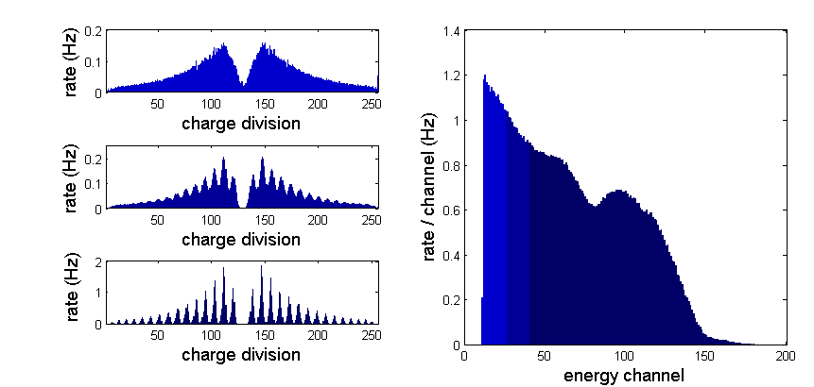
The IN6 measurement campaign
Time resolution
Measured ToF depends on the interaction depth in the detector
ToF value of interest is at the entrance window of the detector
  -> ToF value has to be corrected for depth
Elastic neutrons
¹⁰B@4.6 Å
Wavelength (Å) | FWHM (µs) |  | (¹⁰B -³He) / ³He
 | ³He | ¹⁰B
4,1 | 45,3 | 50,7 | 12,0%
4,6 | 45,9 | 53,0 | 15,5%
5,1 | 57,3 | 65,2 | 13,7%
δdepth = 1cm → δToF = 8.6 µs (@4.6 Å)

Slide 13
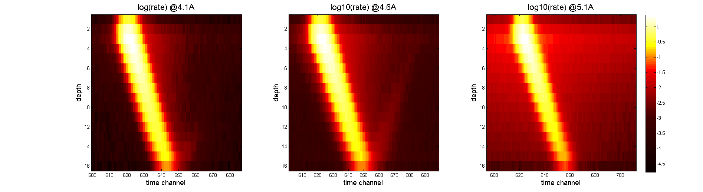
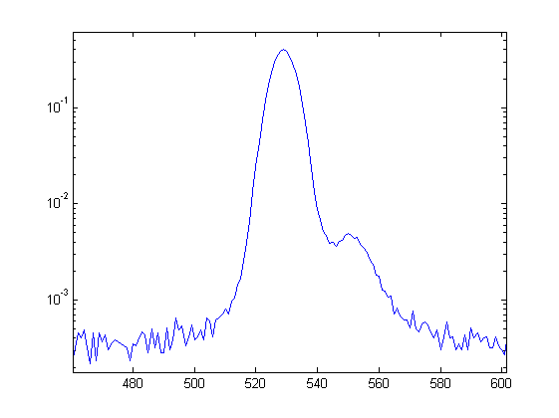
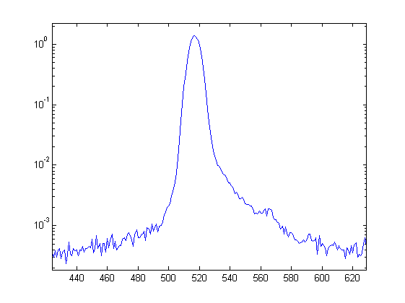
The IN6 measurement campaign
Scattering in aluminum
  24 h dedicated beam time
  Bragg peaks in the detector, well defined wavelength
  2 wavelengths and 2 samples (YGarnet@4.1 Å, Si@4.6 Å)
  Bragg scattering angles :
    4.1 Å : θ = 122°
    4.6 Å : θ = 160°
Cd shielding
θ
4.6 Å
z = 12
4.6 Å
z = 6
  -> Shielding the back of the detector will suppress the bump we observed in time-of-flight spectra

Slide 14
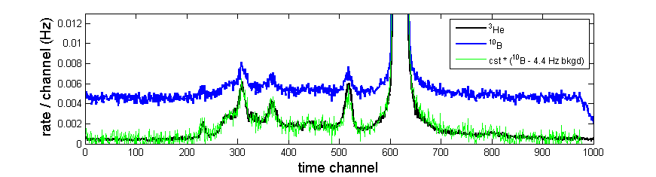
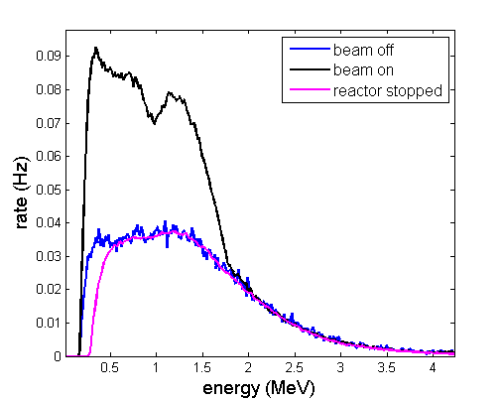
The IN6 measurement campaign
Background
4.4 Hz flat background (30 times higher than IN6’s) was observed (no time structure)
  -> independent of the IN6 instrument
ToF Spectrum (ZnO@5.1 Å)
Energy structure of the background (Pulse Height Spectrum measured on wires) :
  significant rate up to more than 3 MeV (excluding neutrons and gammas)
  background energy spectrum overlaps fission fragments spectrum (no threshold discrimination possible)
PHS measured on wires
What is the source of this background?

Slide 15
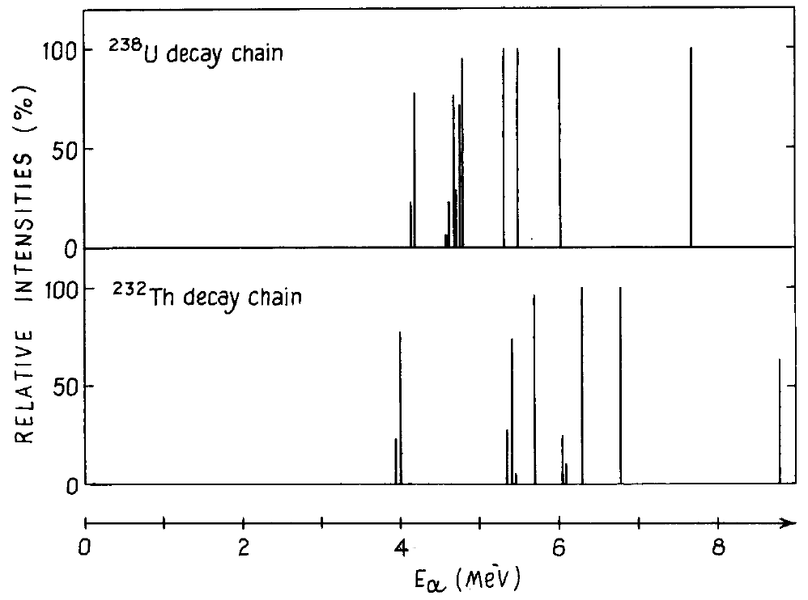
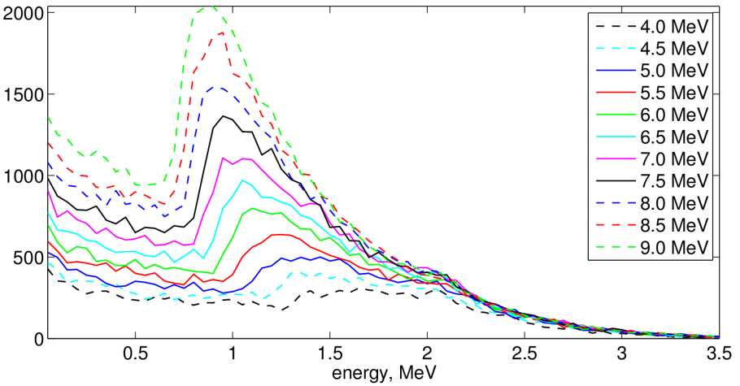
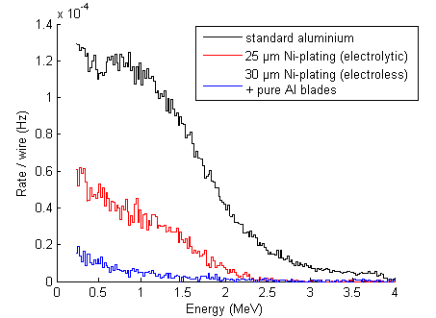
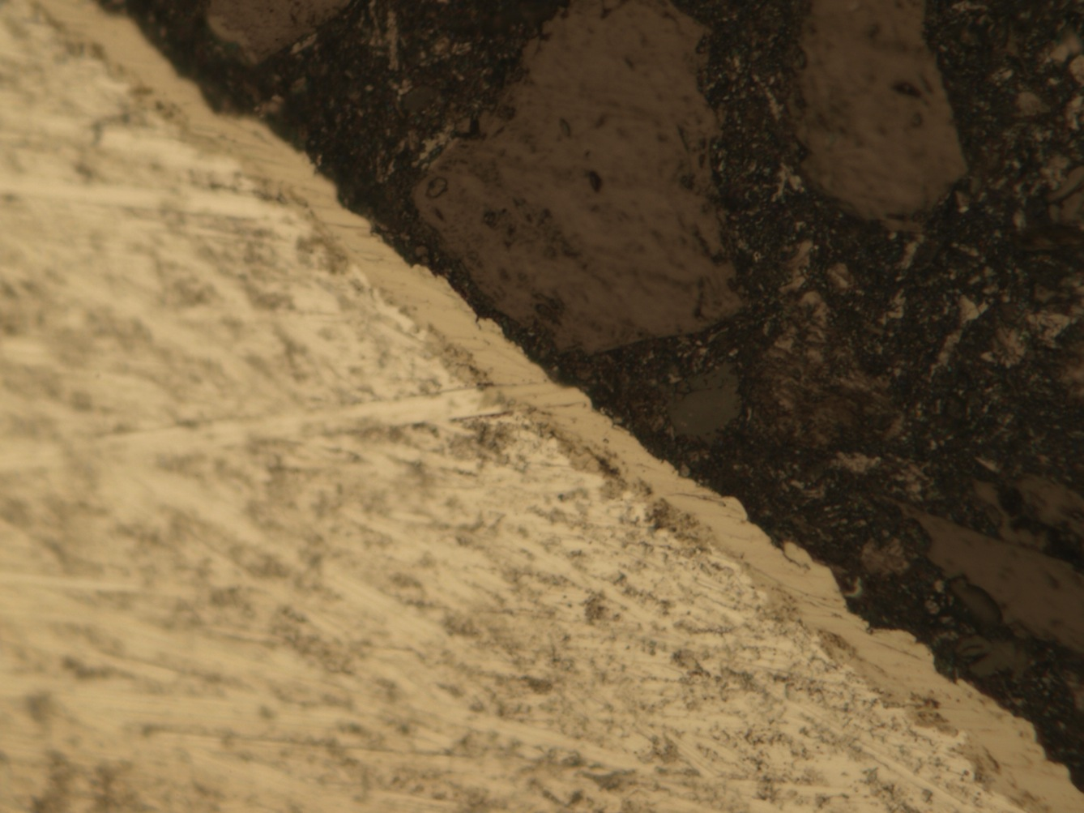
¹⁰B MultiGrid detectors
Background
Aluminum is known to be contaminated by alpha emitters (²³⁸U, ²³²Th and daughters)
  Emission rate at the surface: 0.05 to 0.25 cm⁻².h⁻¹
  our detector is made of 360 tubes, 192 cm² each
  -> expected total rate between 0.96 Hz and 4.8 Hz (whole detector)
  -> the measured 4.4 Hz background rate is coherent with these values
alpha energy
(from MC simulation)
Two solutions have been investigated with the 12-grid prototype:
  - Ni layer (thickness > 23 µm) deposited at the Al surface
  - ultra-pure Al (U,Th concentration < 1 ppb)
Background PHS on wires
(no B₄C coating)
10 μm
  -> Background reduced by a factor of 20

Slide 16
Toward large area MultiGrid detectors
Good performances of MultiGrid detectors are now well established
Our capacity to up-scale the technology still needs to be demonstrated
-> a large area detector is now under fabrication

Slide 17
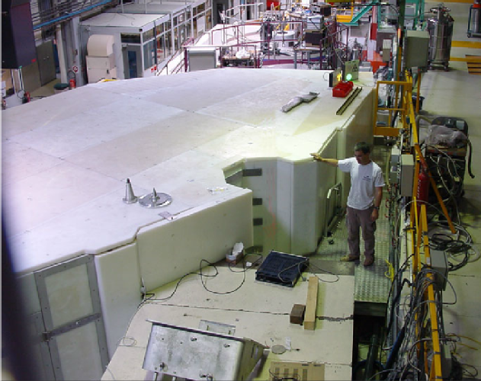
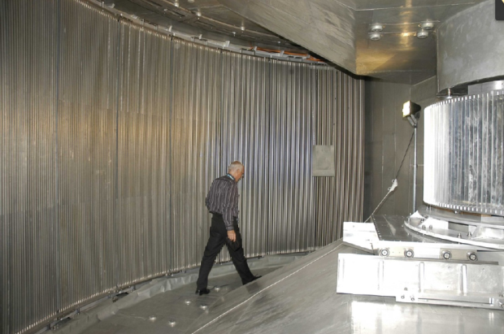
The IN5 demonstrator
IN5 chosen as a benchmark for the construction of a large area demonstrator (largest detector @ILL)
-> same dimensions as an IN5 module (1/12 of the instrument detector) : 3 x 0.8 m²
Challenges :
  Up-scaling means much more grids, blades, B4C coating, readout channels,… (an order of magnitude larger than the largest prototypes ever built)
    Mass production of the parts (grids, blades, inner mechanics,…)
    Optimized design to facilitate mounting
  Operation inside a vacuum chamber: outer pressure variation from vacuum to atmospheric pressure should not affect the detector
    strong pressure vessel required to stand these mechanical constraints

Slide 18
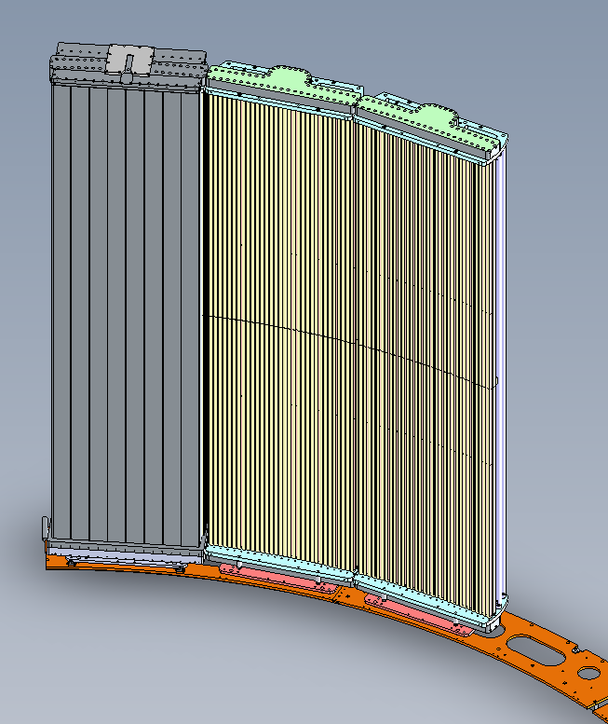
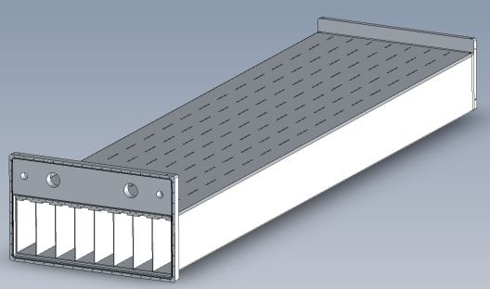
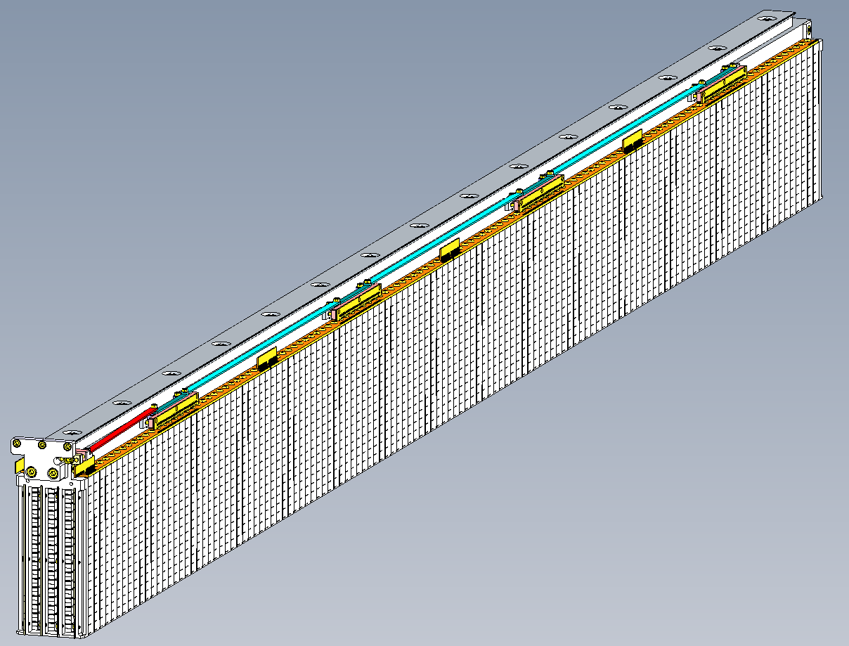
The IN5 demonstrator
Pressure vessel as large as an IN5 module
8 columns, 128 grids each (1024 grids)with new design (thinner walls)
  less scattering/absorption
34 B₄C layers in depth
  More efficiency
544 anode wires, 3m long (~ 1.6 km of 20 µm diameter wire)
1500 readout channels

Slide 19
Resolution of IN6’s problems
Scattering
Backscattering
  2 possible solutions
    Cadmium: blades after (of instead of) the last blade
    Gadolinium: epoxy/Gd2O3 painting
    Cd is heavy, expensive, and toxic -> Gd painting was chosen
    Test measurement at LLB (Saclay)
    -> efficiency of Gd painting as a neutron shielding
    -> determination of the optimum amount of Gd2O3
Scattering in the walls of the vessel (IN6 was shielded with Cd foils)
  large surface -> Gd2O3 painting is more convenient
  Wall painting -> 0.5 mm thick layer successfully tested in a 3m long tube (not in the IN5 vessel…)
    insertion could be forbidden by this additional thickness
  Side of the multi-part grid will be painted directly
Background:
  Combination of Ni-plating and pure Al
    Ni-plating on one part frames (Al is far to expensive)
    Blades: ½ Ni plated, ½ made of pure Al (cost effective solution?)

Slide 20
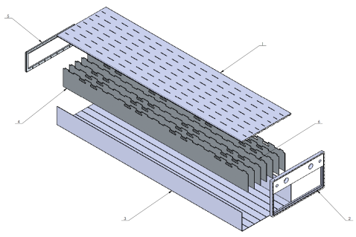
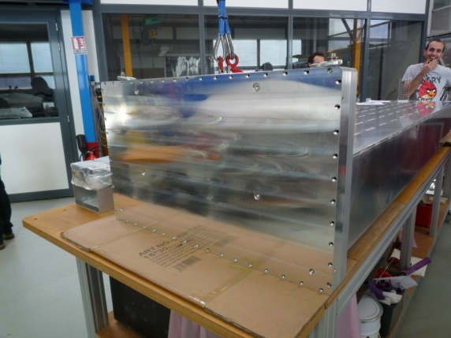
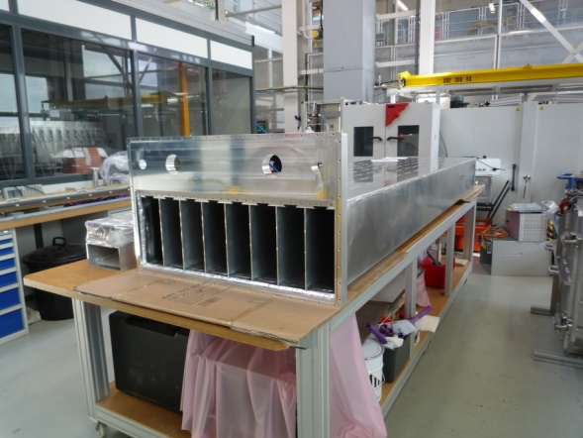
The IN5 demonstrator
Pressure vessel
Requirements:
  Small dead spaces (strong constraints on mechanical tolerances)
  Thin entrance window for transparency
  Strength against pressure constraints
  -> the last 2 pull in opposite directions!!
Design:
  4 mm thick entrance window
  4 mm thick walls between columns to help standing the pressure constraints
  25 mm thick backplate to hold the grids
  Electron beam welding -> minimum deformation of the parts due to heat
  total weight of the vessel: 350 kg
-> long awaited but now we have it!!

Slide 21
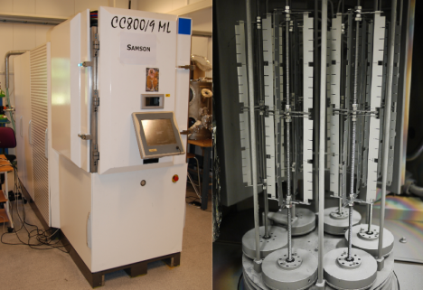
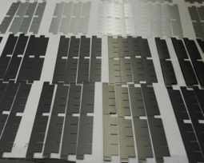
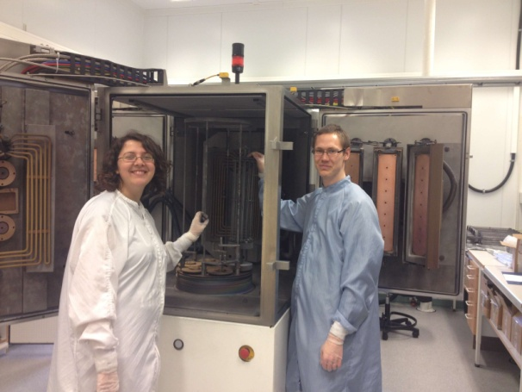
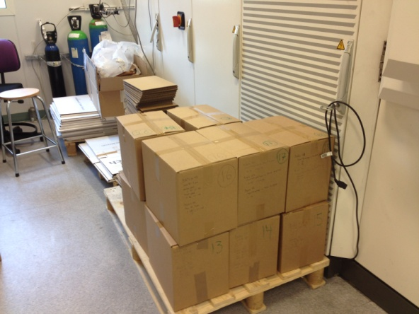
The IN5 demonstrator
Production of the blades @Linköping University
  More than 17000 blades have to be produced
Blades:
  0.5 mm thick aluminum blades
    1/2 from purified Al alloy
    1/2 from standard Al plated with 25 µm Ni
B4C layer coated in the “Samson” PVD reactor at Linköping University :
  3 different coating thicknesses (0.75 µm, 1 µm and 1.5 µm)
  8 week fulltime operation of the Samson deposition machine @Linkoping University
People working hard in Linköping at changing/ packing samples, sandblasting,…

Slide 22



The IN5 demonstrator
Production of the grids @ESS
1024 frames to machine/assemble and mount with blades
Frames:
  512 frames machined from standard aluminum alloy (spark erosion)
  512 frames assembled from several standard parts (good mechanical properties
  Chemical Ni-plating (25 µm Ni layer)
  Gd2O3/epoxy painting to prevent from scattering
    back of the frames
    Side of the multipart frames
Mounting of the grids
  Blades mounted in Lund
  128 grids delivered so far @ILL, 128 more next week

Slide 23





The IN5 demonstrator
Readout
More than 1500 channels for the whole detector, 64 for an IN5 3He module (factor of 25)
Same principles as for the IN6 prototype are applied
  Wires: Charge division readout, 34 channel connected together
  -> only 32 channel (instead of 544)
  Grids: connected 4 by 4 horizontally
  -> “only” 256 channels (instead of 1024)
grids have to be connected across the inner walls of the vessel -> mechanism mounted on backbones pushing some mobile PCBs through slits
32 x 4 grids

Slide 24





The IN5 demonstrator
Mounting procedure of the grid columns
Grids
  128 grids/column
  gap between two grids: 0.5 mm
  -> Spacers between grids to keep them insulated

Slide 25


The IN5 demonstrator
Wire mounting
3 m long, 20 µm diameter W/Th, 80 g tension
544 wires will be inserted in the tubes (1.6 km)
We will probably break some (we bought 5 km)

Slide 26







The IN5 demonstrator
Insertion of a column
First insertion test in the IN5 vessel

Slide 27
The IN5 demonstrator
Mechanical precision: vessel
Mechanical precision is a key parameter
  proper mounting
  good detection performances (gain homogeneity)
Mechanical precision of the vessel guarantee the possibility to insert the column:
    Flatness of the back plate
    Dimension of the tube (only 1.25 mm space between grids an wall)
-> deformation was measured along the columns direction maximum deformation 0.8 mm (over 3m long!!)
Tubes globally respect the specified tolerances (+/- 0.5 mm) except for the edge ones
-> Some simple tools will help guiding the insertion
2.5 mm
1.25 mm

Slide 28


The IN5 demonstrator
Mechanical precision: backbones
Some backbones show bending beyond tolerances (>1mm)
y
Two cases
  Bending in the y direction-> not a problem (thinner -> more flexible). We can unbend them at ILL.
  Bending in the x direction -> no proper insertion possible
  -> at the moment, we only have 2 “good” backbones
  -> discussion ongoing with the supplier to solve this problem
x
5 mm
Expected shape
Actual bended shape

Slide 29


The IN5 demonstrator
The flaking problem
Flaking of the Ni-plating on blades
  Probably due to heating during deposition process (it was never observed on frames)
  Flaking triggered when the blade is inserted in the frame (friction)?
  Possible consequences:
    Efficiency reduced
    Short-circuits between grids
    Discharges in the detector
  Pure Al blades do not flake!!!
  -> they might be used for most of the detector (the coating team is working on it)

Slide 30





The IN5 demonstrator
First tests
Single-column vessel
Mounting of the vessel last Friday (only a few wires)
Gas flushed from Monday
Detector successfully biased up to 1400V (standard operating voltage is only 900-1000V)
-> First neutrons detected 2 day ago!!!!!!!

Slide 31
The IN5 demonstrator
Test campaign at ILL
An IN5 measurement appears to be impossible:
  weight
    Our detector will weigh almost 900 kg
    The mounting rail of IN5 is designed for the 350 kg of its 3He modules
  Gas flow system
    IN5 is not equipped with flanges
  Strength of the vessel under vacuum constraints still to be demonstrated
CT2 beamline (2.5A only)
  3 different thicknesses -> further check reliability of calculations
Other measurements
  Background with the 2 uncoated columns (no need of a neutron shielding)
  Gamma sensitivity
  homogeneity
When we are done, we need to test the vessel strength

Slide 32
The IN5 demonstrator
And more tests
The IN6 measurement highlighted the interest of a pulsed monochromatic beam for characterization
  Scattering
  Time resolution
We need to find such a beam line in a NSS facility

Slide 33
The IN5 demonstrator
Where are we now?
Production phase still going on
  Coating is almost done @Linköping University
  Production of frames and mounting of blades will last for another few months @ESS
Mounting of the detector going on at ILL
  The bending problem need solution soon
We still have a few problems to solve
Our detector can detect neutrons
Many tests will be carried out

Slide 34
Conclusion
Construction of this large area demonstrator is the final phase of a huge research and engineering program that lasted for more than 5 years
Many and more people have been involved at all stages of its development
  Theoretical studies
  Mechanical design
  Development of the coating process
  Prototyping
  Test campaigns
This last phase requires a strong collaboration between the 3 labs involved, and huge efforts from everybody
  Coating is almost done @Linköping University
  Production of frames and mounting of blades will last for another few months @ESS
  Mounting is going in at ILL as soon as grids are available
The success of this project will show the Neutron Scattering Science community that we have a reliable and performing alternative to 3He, and that we can build it in a large scale
We will make it work!!

Slide 35
Thank you for attention!!!

