Slide 1
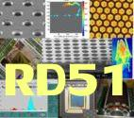


ESS-Cern work on MPGDs for NMX instruments
20.05.2014
Dorothea Pfeiffer

Slide 2
Content
Lab for neutron detector R&D
Detectors for thermal neutrons
Boron-GEM
Gd-GEM
uTPC
Geant4/Garfield interface
Schedule

Slide 3
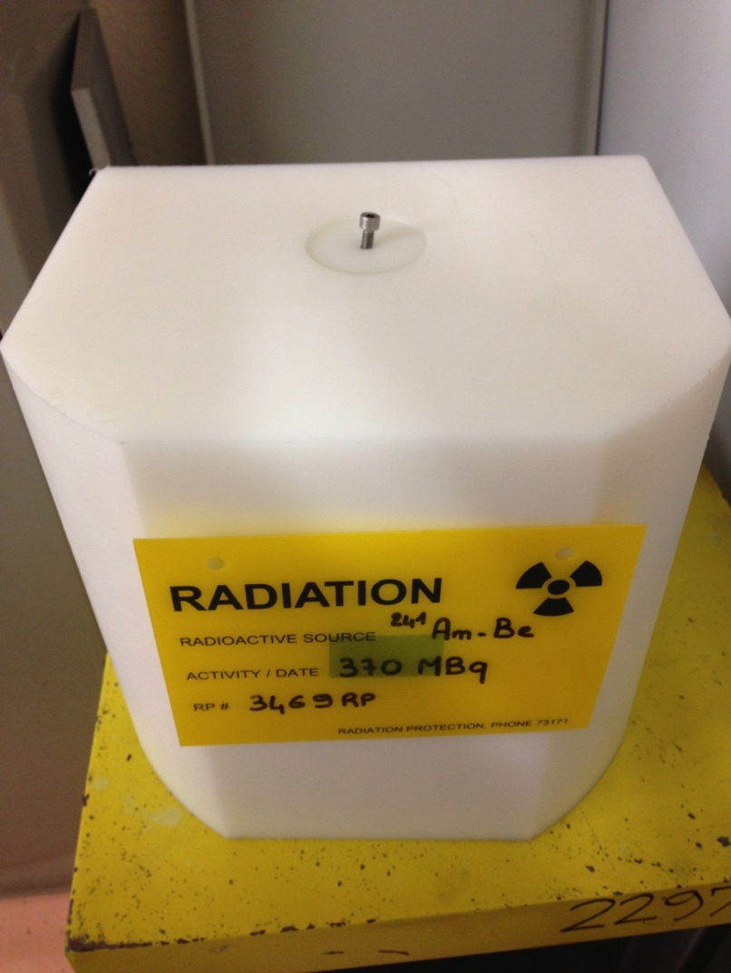
Procurement of neutron source
Investigation of different types of source (252 Cf or 241 AmBe)
Due to high price of 252 Cf decision to buy a 370 MBq 241 AmBe source
Cost is about 4000 CHF for the source, plus cost for PE moderator. Delivery of source (combined order for several sources by CERN RP) in June 2014
ETH Zuerich group at CERN lent us their 370 MBq 241 AmBe source (March/April 2014)

Slide 4
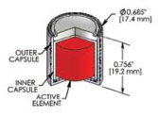

241 AmBe 370 MBq source
370 MBq = 0.01 Curie [Ci]
241 Am Be sources emit 2.28E+06 neutrons per second per Ci
Remainder of activity is due to gamma emission
Our source emits hence ca. 22800 neutrons per second
Source is shielded by 5 cm – 10 cm of PE
5 cm
10 cm
10 cm

Slide 5
Geant4 simulation of source
Physics list QGSP_BERT_HP
QGSP: quark gluon string model for high energy interactions of protons, neutrons, pions, and Kaons and nuclei
BERT: Bertini cascade for primary protons, neutrons, pions and Kaons below ~10GeV
HP: data driven high precision neutron package (NeutronHP) to transport neutrons below 20 MeV down to thermal energies
10⁶ primaries (neutrons) simulated, spectrum from ISO-DIS-8529 http://dpnc.unige.ch/~rapin/AmBe/Neutron-ISO-DIS-8529-1.pdf
Assumption: Source is a cylindrical volume source that emits isotropic radiation
PE thermalizes the higher energetic neutrons by elastic scattering

Slide 6
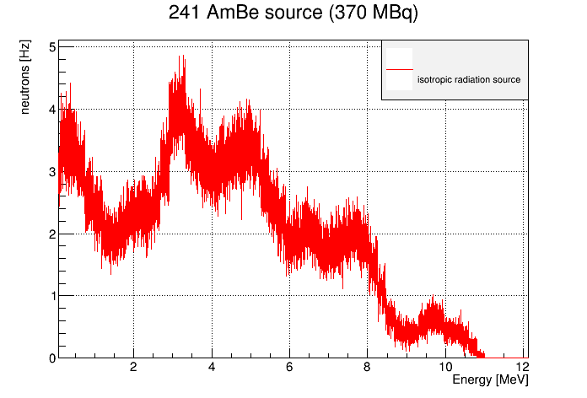
Neutron emission of 241 AmBe source
Neutrons [Hz/keV]

Slide 7
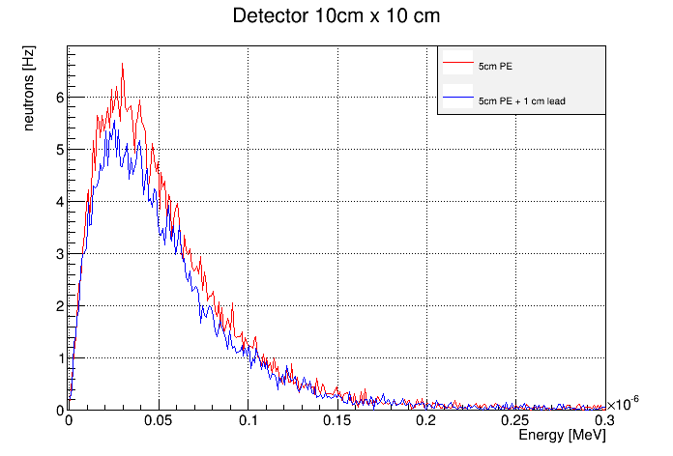
Thermal neutron flux at detector
Neutrons [Hz/eV]
Flux of neutrons with E <= 25 meV: 85 Hz
Flux of neutrons with E <= 50 meV: 200 Hz
25 meV

Slide 8
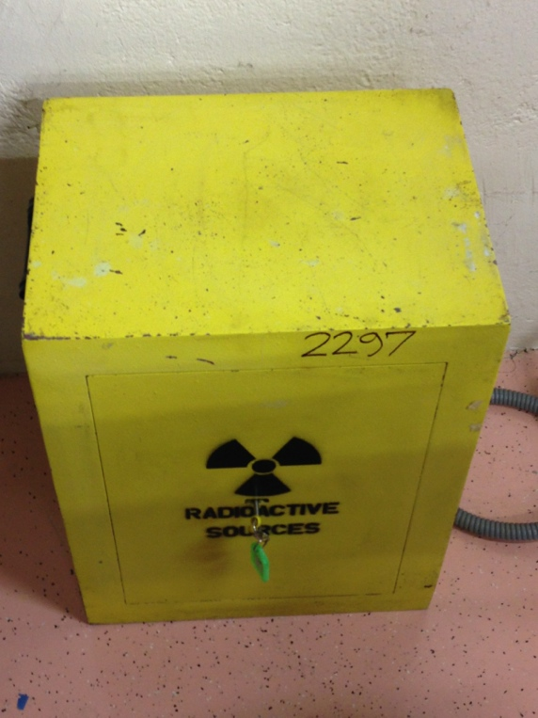
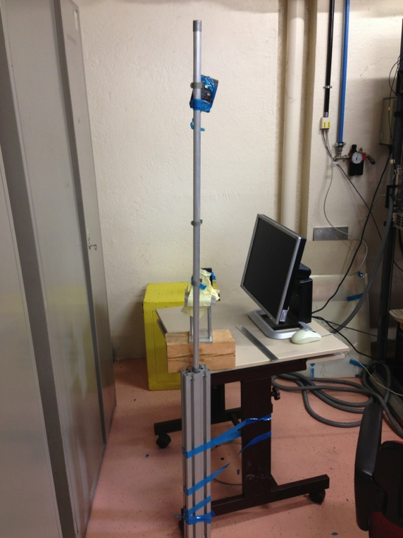
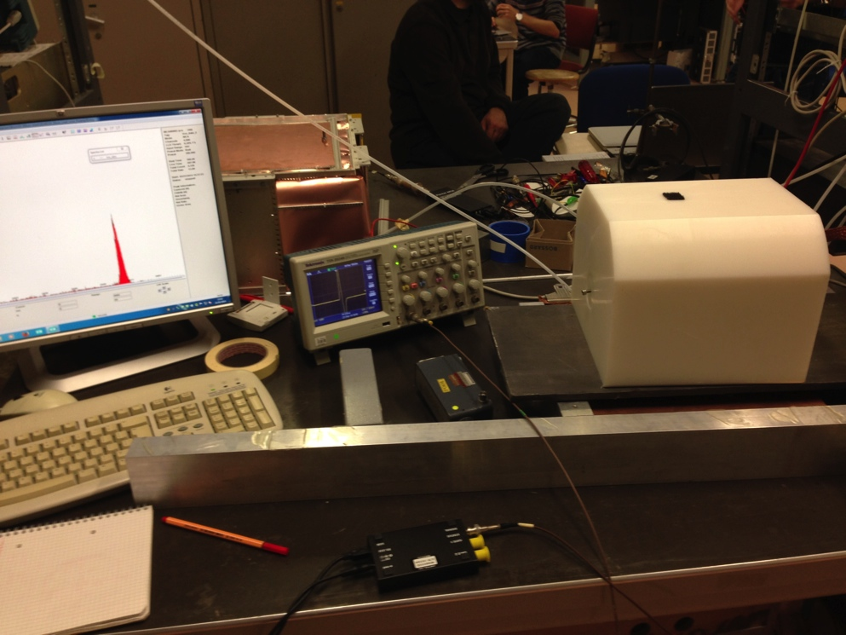
Our lab
Gamma: 0.5 uSv/h
Neutron: 4 uSv/h
Gamma: 0.1 uSv/h
Neutron: 1 uSv/h
Gamma: 3 uSv/h
Neutron: 8 uSv/h
Substantial dose rates measured
Shielding and relocation efforts were needed
Now shielded with flexible boronated PE

Slide 9
Detectors for thermal neutrons
Isotope | Crosssection [barns] | Reaction | Range
³He | 5333 | n + ³He -> ³H (191 keV) + ¹H (573 keV) Q= 0.76MeV | R_{p} = 5.7 bar cm
⁶Li | 940 | n + ⁶Li -> α (2.06 MeV) + ³H (2.73 MeV) Q = 4.79 MeV | R_{t}=130 μm
¹⁰B | 3835 | n + ¹⁰B -> ⁷Li*(0.84 MeV) + α (1.47 MeV) + γ (0.48 MeV) (93%) Q=2.3 MeV -> ⁷Li (1.16 MeV) + α (1.78 MeV) (7%) Q=2.79 MeV | R_{α} = 3.14 μm
¹⁵⁷Gd | 259000 | n + ¹⁵⁷Gd -> ¹⁵⁸Gd + γ (79, 181, 944 keV) + conversion electron spectrum (29-182 keV) Q=7.94 MeV | λ_{ce} = 11.6 μm
Conversion efficiency of 1um of 10B4C: about 1-2% at E_{n} = 25 meV => using the simulated rates of 85-200Hz thermal neutrons, the rate of charged particles from neutron conversion should be between 1 Hz and 4 Hz

Slide 10
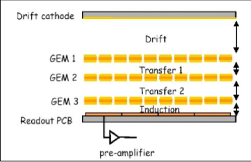
Triple GEM with Boron-10 converter (variant 1)
Drift cathode:
300 um Al coated with 1 um10B4C on both sides
3 mm
2 mm
2 mm
2 mm

Slide 11
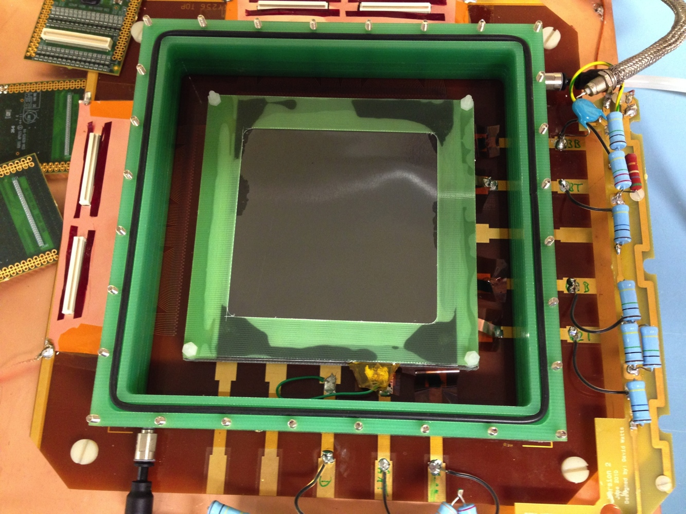
Boron GEM3: detector and support
Readout x direction
Readout for integrated signal induced at
bottom of third GEM
Readout y direction
Gas flow (in)
Drift with10B4C
Support with
O-ring
Voltage divider for HV for drift and 3 GEM foils
Gas flow (out)

Slide 12
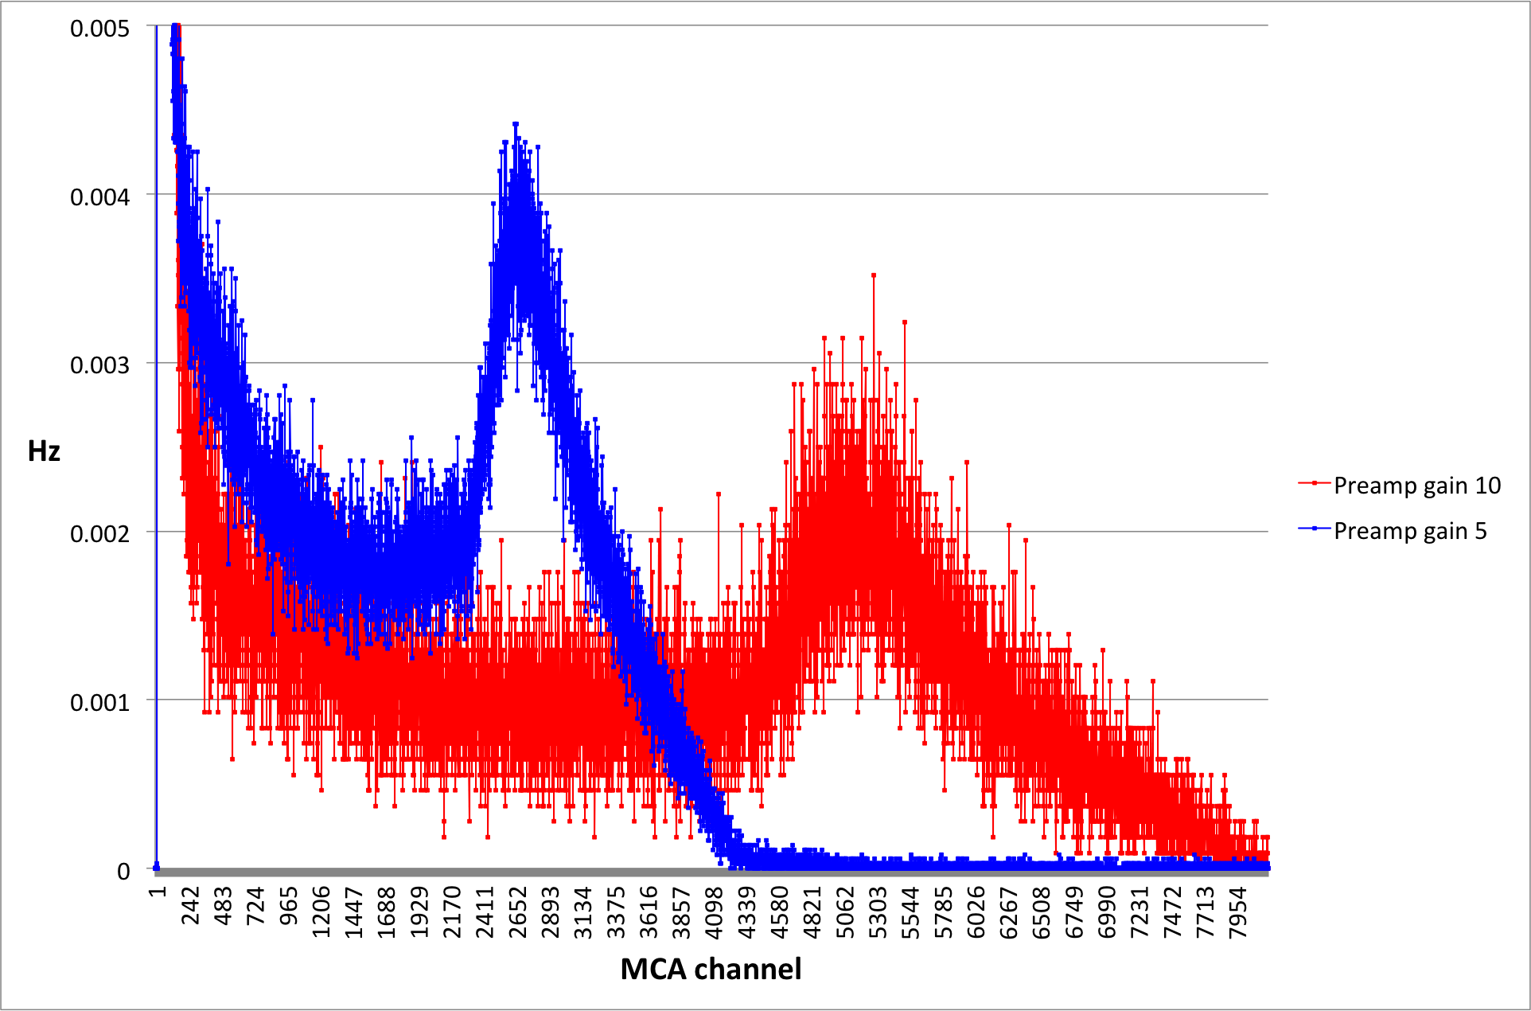
Spectrum 241Am Be source: 1 cm lead, gain ~200
Peak position: 2650 Rate in peak: 3.9 Hz
Peak position: 5200 Rate in peak: 4.1 Hz

Slide 13
Triple GEM with Boron-10 converter (variant 2)
Drift cathode:
18 um Al foil coated with 1.3 um10B4C one side
8 mm
2 mm
2 mm
2 mm

Slide 14
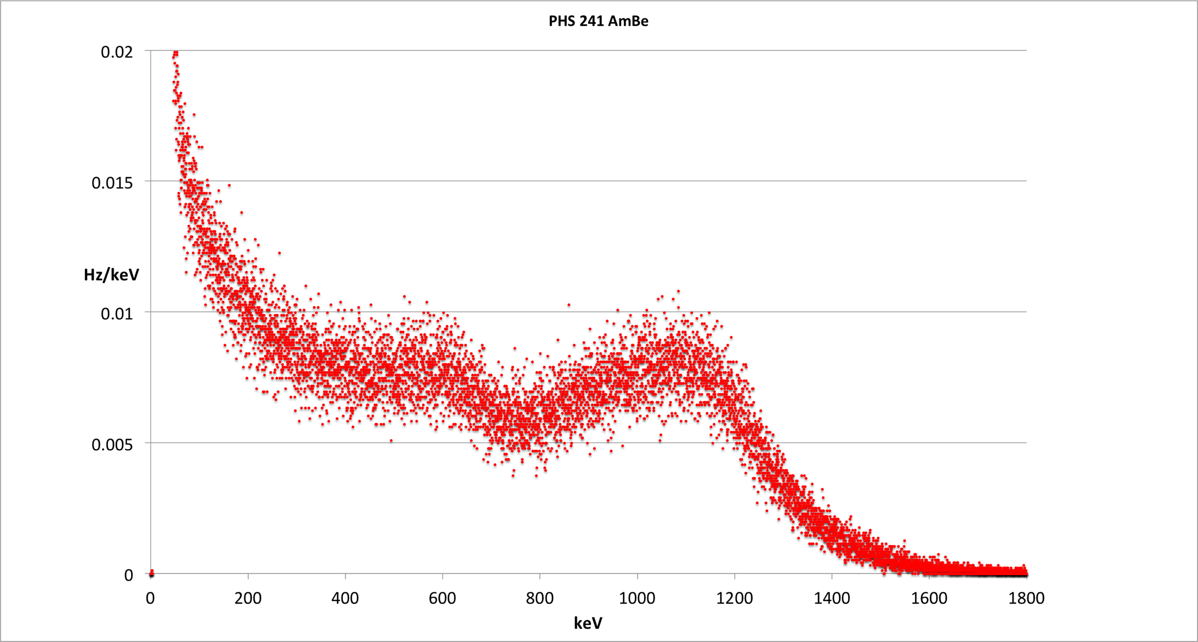
241 AmBe spectrum, drift gap 8 mm, gain ~ 200
Capture of thermal neutrons in Boron-10:
n + ¹⁰B ⁷Li* (0.84 MeV) + α (1.47 MeV) + γ (0.48 MeV)
⁷Li
α

Slide 15
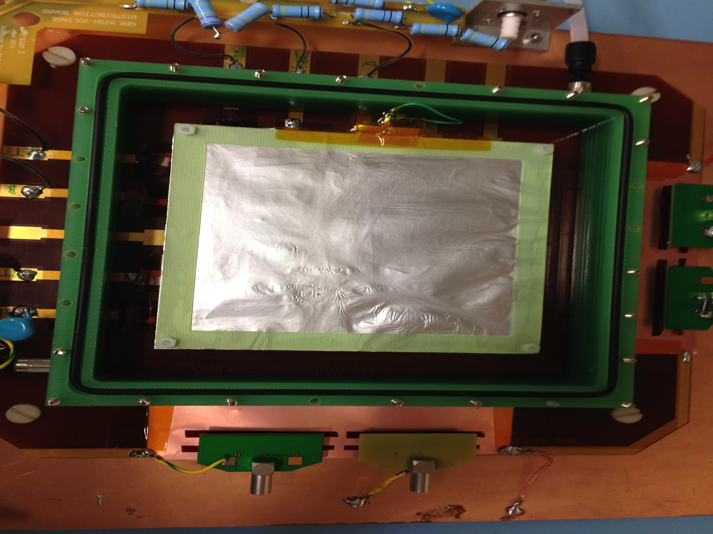
Boron GEM3: Four sectors
Sector 1: free (normal GEM)
Sector 2: 1 cm lead
Sector 3: 10B4C converter
1 cm of lead
Sector 4: 10B4C converter and 1 cm lead
y
x

Slide 16
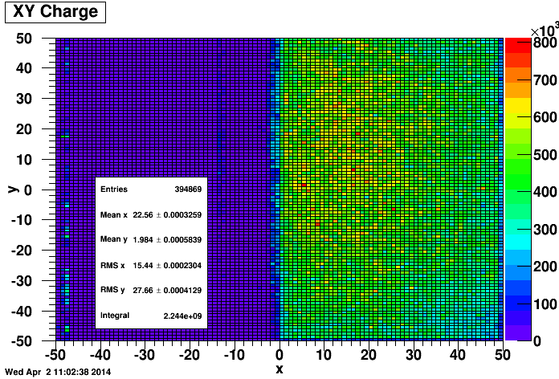
Boron GEM3: four sectors – 241AmBe source
Looks similar to our spectrum, also only one peak (not two peaks for alpha and Li ion)
lead
Boron

Slide 17
Boron GEMs
It is quite straightforward to create a neutron detector with a 10B4C coated cathode that has an efficiency of about 2%
The bGEM of the Milano group has already been used at a neutron scattering experiment at ISIS and was able to reconstruct the TOF spectrum in similar quality as the He3 tubes (G. Croci et al.: GEM-based thermal neutron beam monitors for spallation sources, NIM A, Volume 732, 21 December 2013, Pages 217–22, http://dx.doi.org/10.1016/j.nima.2013.05.111)
For higher efficiencies, different geometries are required, just putting a large stack of 10B4C coated GEM foils in the detector is not a efficient solution (CASCADE approach)
A promising approach is the “lamella detector” of the Milano group. Detector uses inclined 10B4C coated lamellas and will have 50% efficiency and a spatial resolution in the mm range
Visit in Milano in April helped to align efforts for neutron GEM R&D and make sure they are complimentary

Slide 18
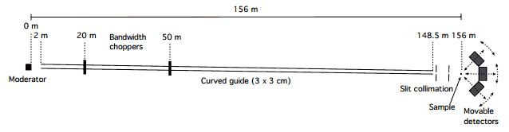
Gd-GEM
For ESS macromolecular crystallography instrument (NMX) at least three movable detectors of 60 cm x 60 cm with100 um spatial resolution and ~50 % detection efficiency required
Parameters difficult to achieve with 10B4C assuming normal neutron incidence
Started investigating Gd GEM option

Slide 19
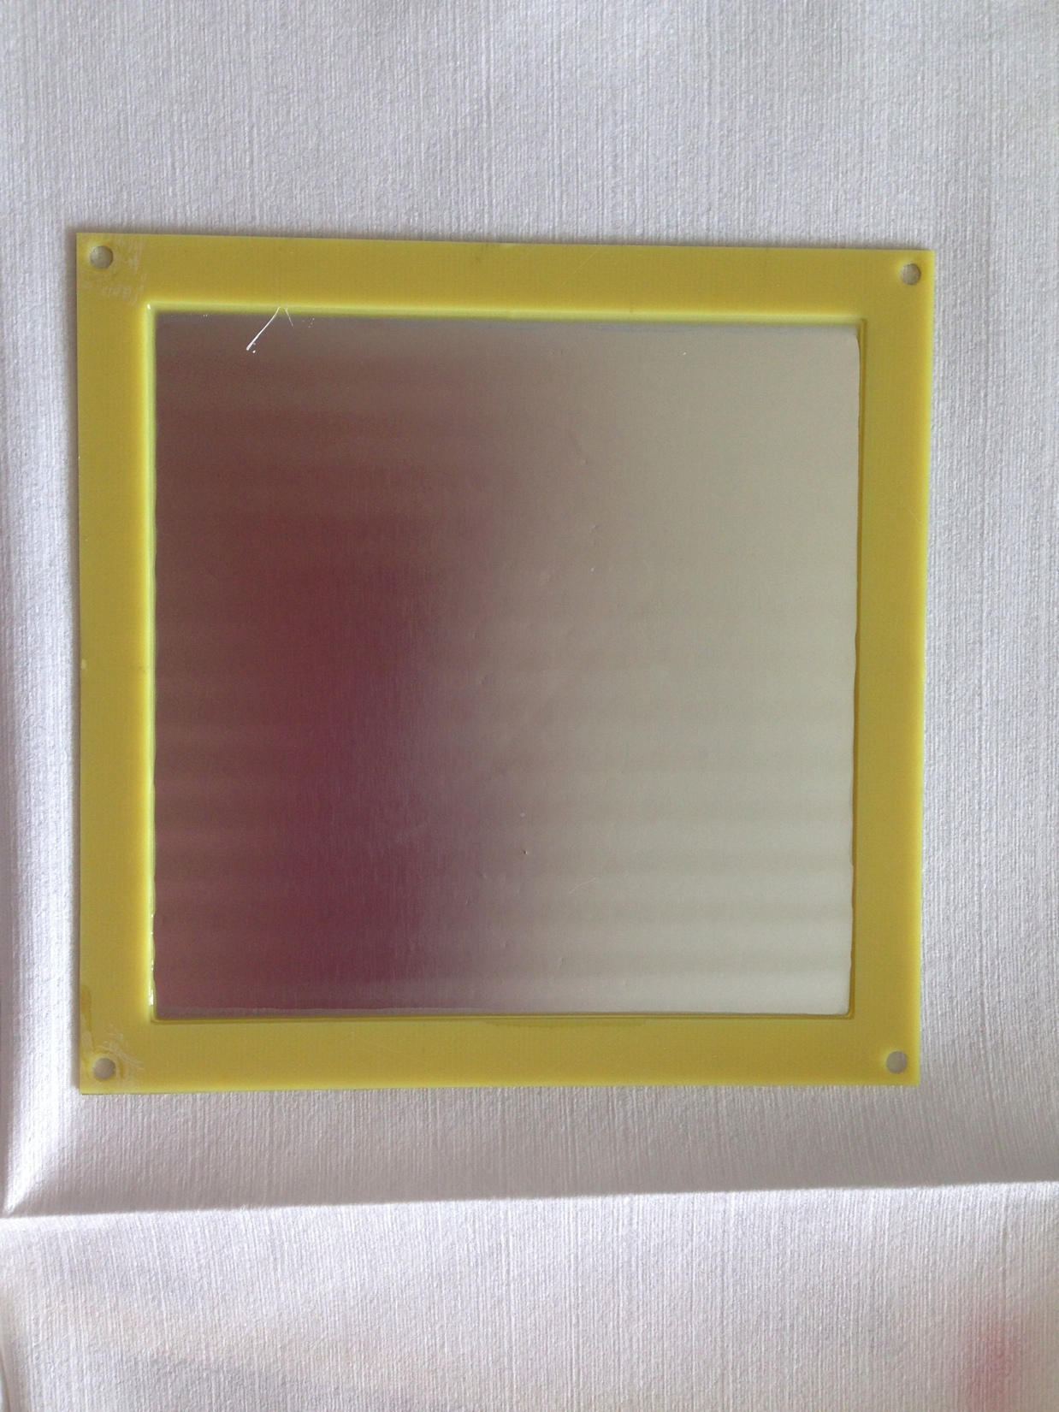

Gd-GEM
Received order of 5 13 cm x 13 cm large 25um Aluminium foils coated on one side with 12.5um Gd2O3 from Euro Collimator
Why are companies unable to wrap up their products in a proper way?
Possibility to add CsI coating at CERN
Since CsI is very hygroscopic, an enclosed and controlled testing environment is advantageous
Started Geant4 simulations of Gd-GEM

Slide 20
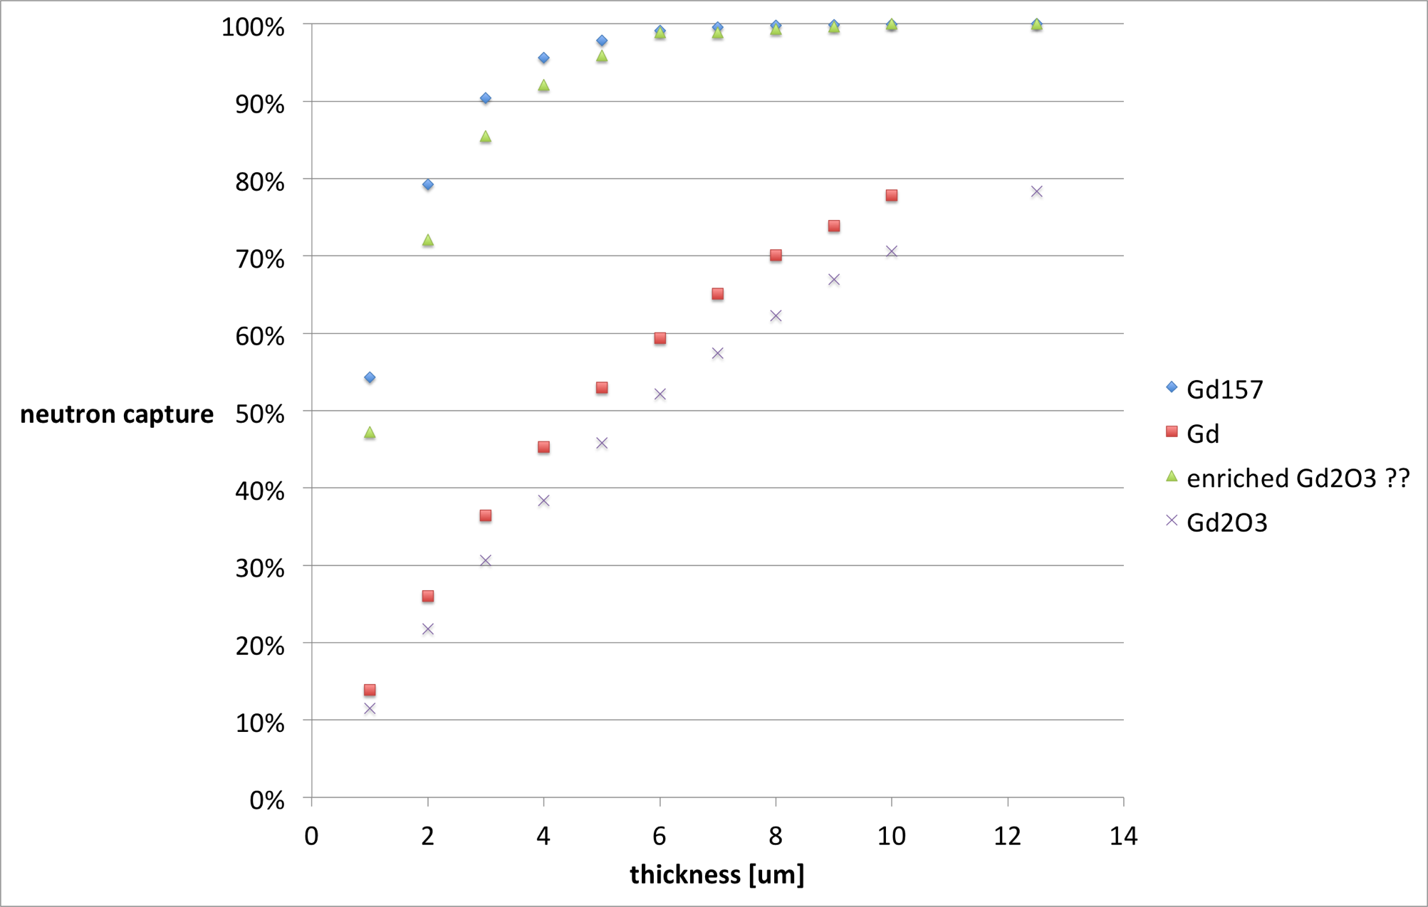
Gadolinium neutron capture 25 meV

Slide 21
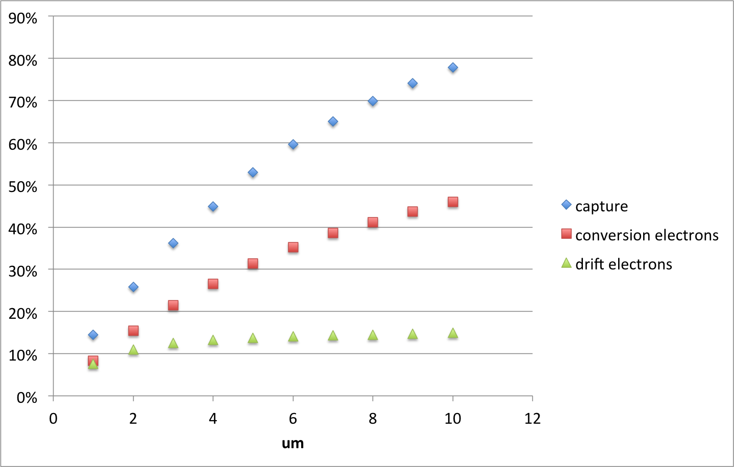
Natural Gd - conversion electrons

Slide 22
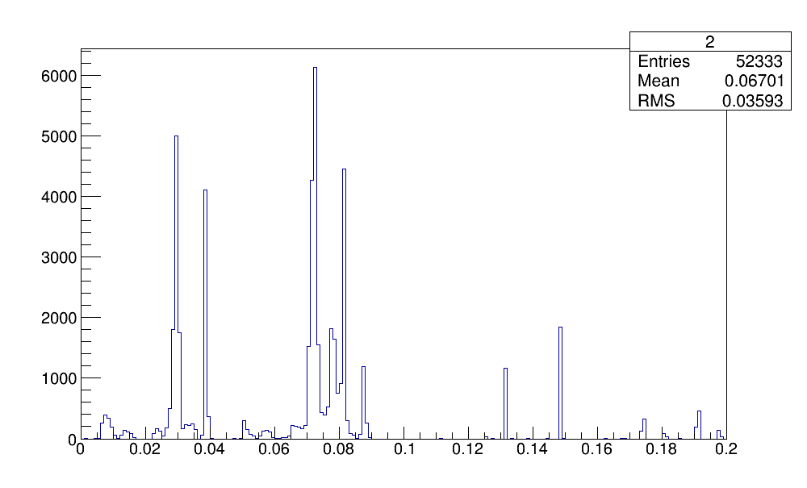
Natural Gd – spectrum conversion electrons
Electrons created in converter
n
MeV

Slide 23
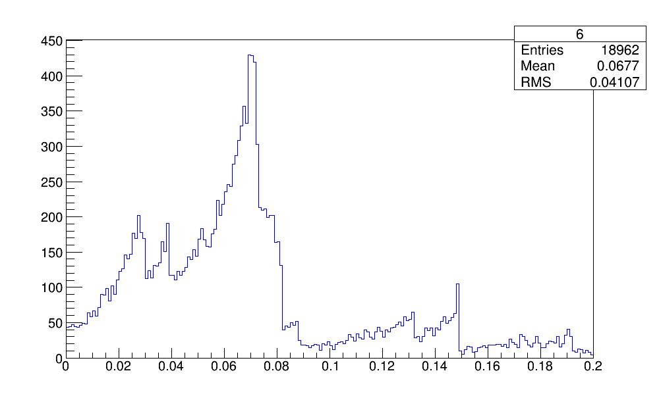
Natural Gd – spectrum conversion electrons
Electrons arrived in drift
n
MeV

Slide 24
Gd GEM – next steps
Look at other materials (157Gd, Gd2O3, Gd2O2S)
Simulate additional layer of CsI or other SEE
Modify drift field (so far 1000 V/cm)
Determination of optimal thickness of converter to extract conversion electrons and optimum thickness of CsI to create largest possible number of electrons per neutron.
Compare with simulations from Berlin?
Build Gd GEM with the 5 foils from Euro Collimator
Test without and with CsI

Slide 25
uTPC
SRS, the readout and data acquisition system for MPGDs, stores the raw data on disk
Raw data contains timing information. Granularity depends on the read-out chip: APV25 (25 ns), VMM (1 ns)
ATLAS team among George Iakovidis developed uTPC type analysis using this timing information and fitting algorithms to determine start, center and end of track
So far this analysis if offline, but an online implementation in the FPGA of the SRS FEC card should be possible
A quick analysis of the data of the Boron-GEM shows the potential of this method. First time such type of analysis has been done for neutrons

Slide 26
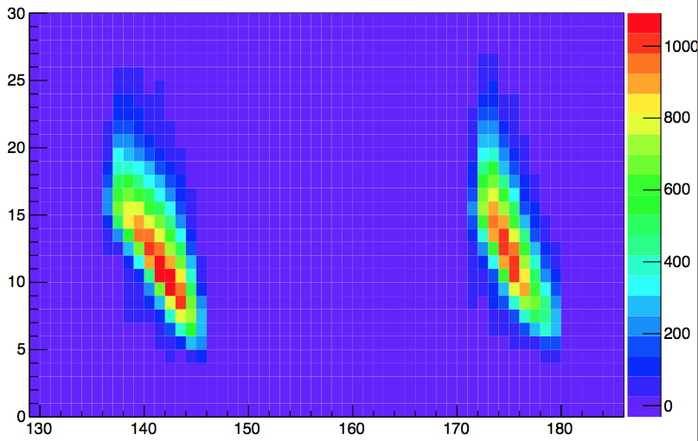
uTPC – alpha particle
Drift time
[25 ns bin]
Channel number

Slide 27
uTPC – alpha and gamma
Drift time
[25 ns bin]
Channel number

Slide 28
uTPC – 3D reconstruction
Drift time
[25 ns bin]
Channel number

Slide 29
uTPC – large potential
As we have seen, this method has a large potential to increase the spatial resolution compared to a centroid approach
Method offers potentially both pattern discrimination and enhancement of position resolution
With the Boron data it was also easy to distinguish between tracks created by gammas and alphas (amplitude AND shape)
Real test case will be the Gd data and the discrimination between gammas and electrons

Slide 30
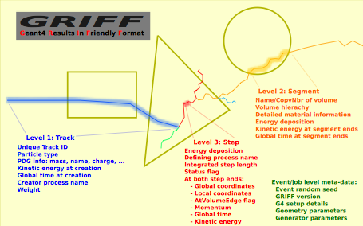
Geant4 simulation framework
Thomas Kittelmann et al., http://arxiv.org/abs/1311.1009

Slide 31
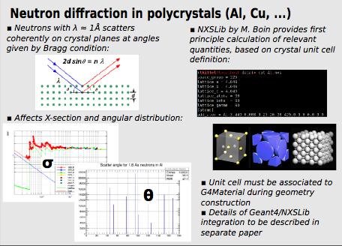
Geant4 simulation framework
Includes description of neutron diffraction in polychristals
For simulations of neutron gas detectors it is desirable to use Geant4 and Garfield in the same simulation
Discussions with Heinrich Schindler and Rob Veenhof resulted in a strategy to achieve a Geant4/Garfield++ interface

Slide 32
Geant4/Garfield++ interface
The idea is to use Geant4 for the neutron capture and the creation of the prompt gammas and conversion electrons in Gadolinium and for the secondary electron creation in CsI
The secondary electrons that arrive in the gas are then treated with Garfield/Heed. First Heed is used to create ionization clusters, then subsequently Garfield for the avalanches and the signal in the read-out
With Gd and conversion electrons > 50 keV this approach should work well, but for Boron10 and the resulting alpha particles it is not so easy
The alpha particles from the neutron capture have an energy < 1.47 MeV and are thus not relativistic. Heed works only for relativistic charged particles, the PAI is not applicable for slower particles. Geant4 is also not able to simulate the ionization of the gas by alpha particles
Solution: Get the deposited energy in each step in Geant4, then create delta electrons in Heed

Slide 33
Geant4/Garfield++ interface
Technical implementation:
Create region or parallel world with region in Geant4. In our case the region is the GEM detector below the cathode with the neutron converter
Create Garfield model class derived from G4VFastSimulationModel. The Garfield model is applicable for e.g. conversion electrons, kills the Geant4 primary track and uses the position, momentum and momentum direction to create a heed track (ionisation clusters). Subsequent steps are like in normal Garfield++ simulation
Attach the Garfield Model to the region
Add parametrisation to physics list. Create G4FastSimulationManagerProcess for the G4VFastSimulationModel
Update CMakeLists.txt to include Garfield++ sources and includes and link against library

Slide 34
Schedule
Next two weeks: Improve Boron-GEM (test with one GEM foil, as ionization chamber)
3 to 7 weeks: Build first Gd GEM with foils from Euro Collimator, experiment with CsI, Simulate optimum geometry, thickness, FIRST SIGNALS WITH SOURCE CHARACTERISE SIGNALS.
After summer: refine Gd GEM by applying the simulation results to get a prototype that can go to a test beam, together with the Boron GEM (problem is the procurement of Gd foils etc)
Late fall/winter: Have 2 prototypes and readout crate: Boron GEM and Gd Gem. Ready to take to testbeam. a) IFE or Berlin - definitely. b) Los Alamos if possible? NMX line would be very helpful.
Q1 2015: Determine in which ways the prototye has to be improved, decide whether Gd is feasible; what path to proceed down.

Slide 35


