Slide 1


A new irradiation facility FOR the test of large-area particle detectors
Thanks to:
Martin Jaekel, Federico Ravotti and Adrian Fabich for pictures and other material
Detector Seminar
19.06.2014
Dorothea Pfeiffer

Slide 2
Overview
Motivation for the new GIF++
Layout of the facility
  Fixed Infrastructure: Irradiator, Controls, Attenuators, Gas Systems
  Monitoring Infrastructure: Contributions by AIDA collaboration
Project planning and responsibilities
Conclusion

Slide 3
Motivation for the GIF++ facility

Slide 4
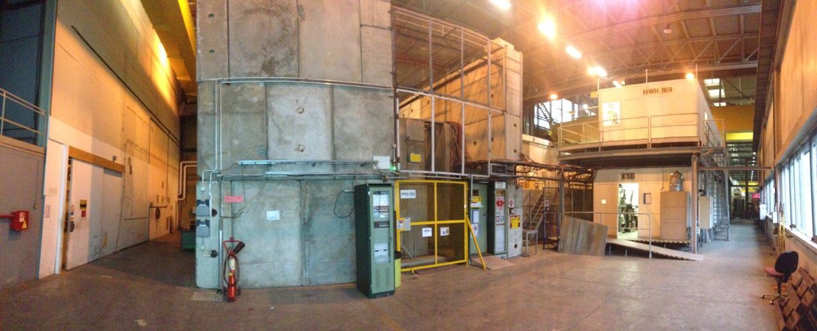
The old GIF in the SPS West Area
GIF has been intensively used to simultaneously expose detectors to the photons from a 740 MBq¹³⁷Cesium source and high energy particles from the X5 beam line (until 2004)
Most LHC gas detector technologies have been validated at the GIF: CMS: RPC, CSC; ATLAS: MDT, RPC, TGC, CSC
Facility still fully booked all around the year up to now!

Slide 5
Motivation for GIF++
The high-luminosity LHC (HL-LHC) upgrade is setting a new challenge for particle detector technologies
Increase in luminosity will produce a 10 x higher particle background with respect to present conditions
Detailed knowledge of performance of detectors under high particle fluxes and precise understanding of possible ageing of detector materials under permanent particle bombardment crucial for optimized design and efficient operation mode

Slide 6
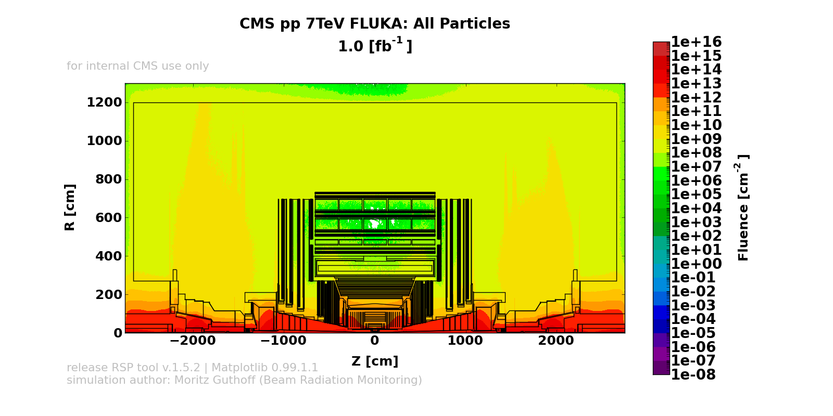
Particle Fluxes at CMS

Slide 7
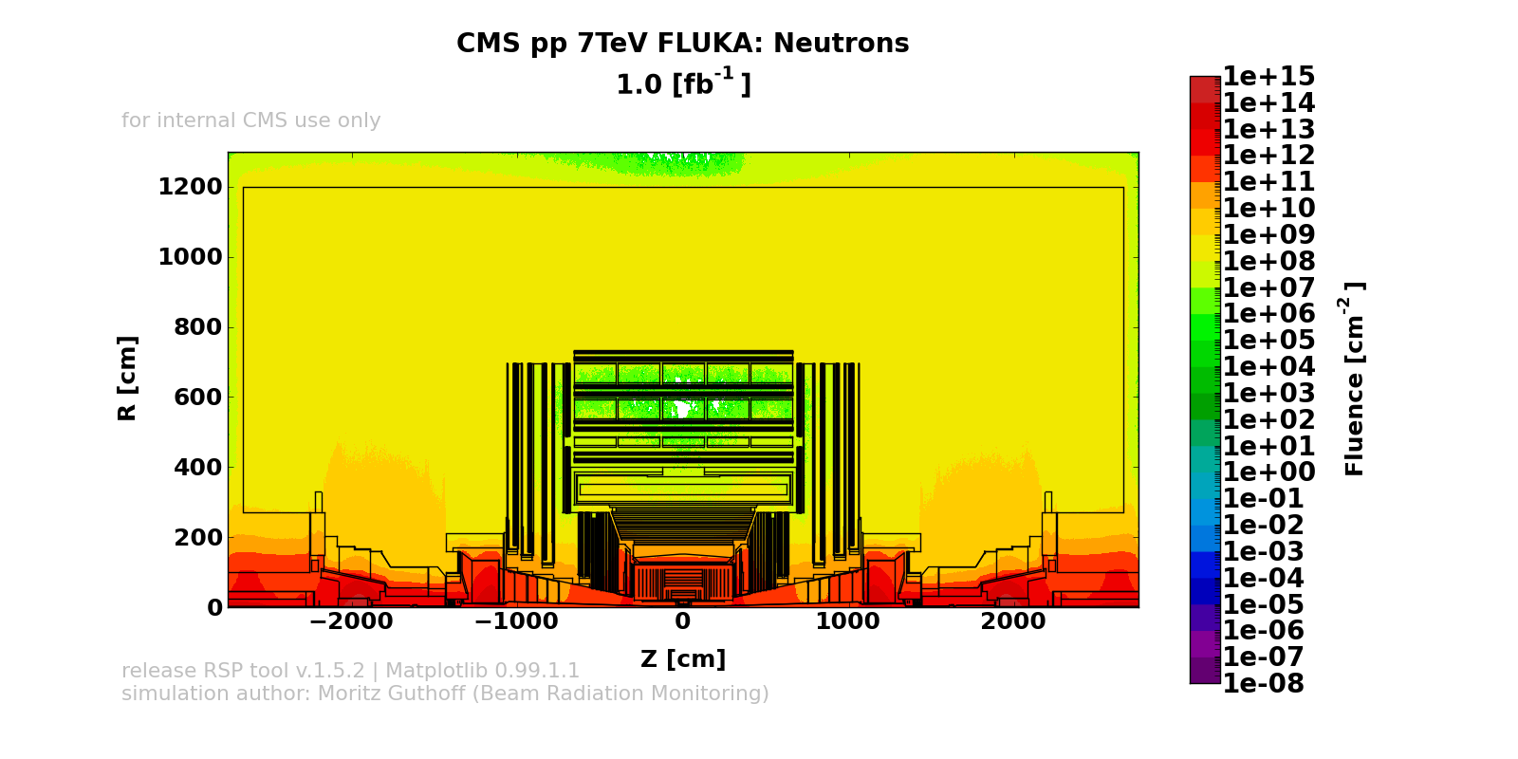
Neutron Fluxes at CMS

Slide 8
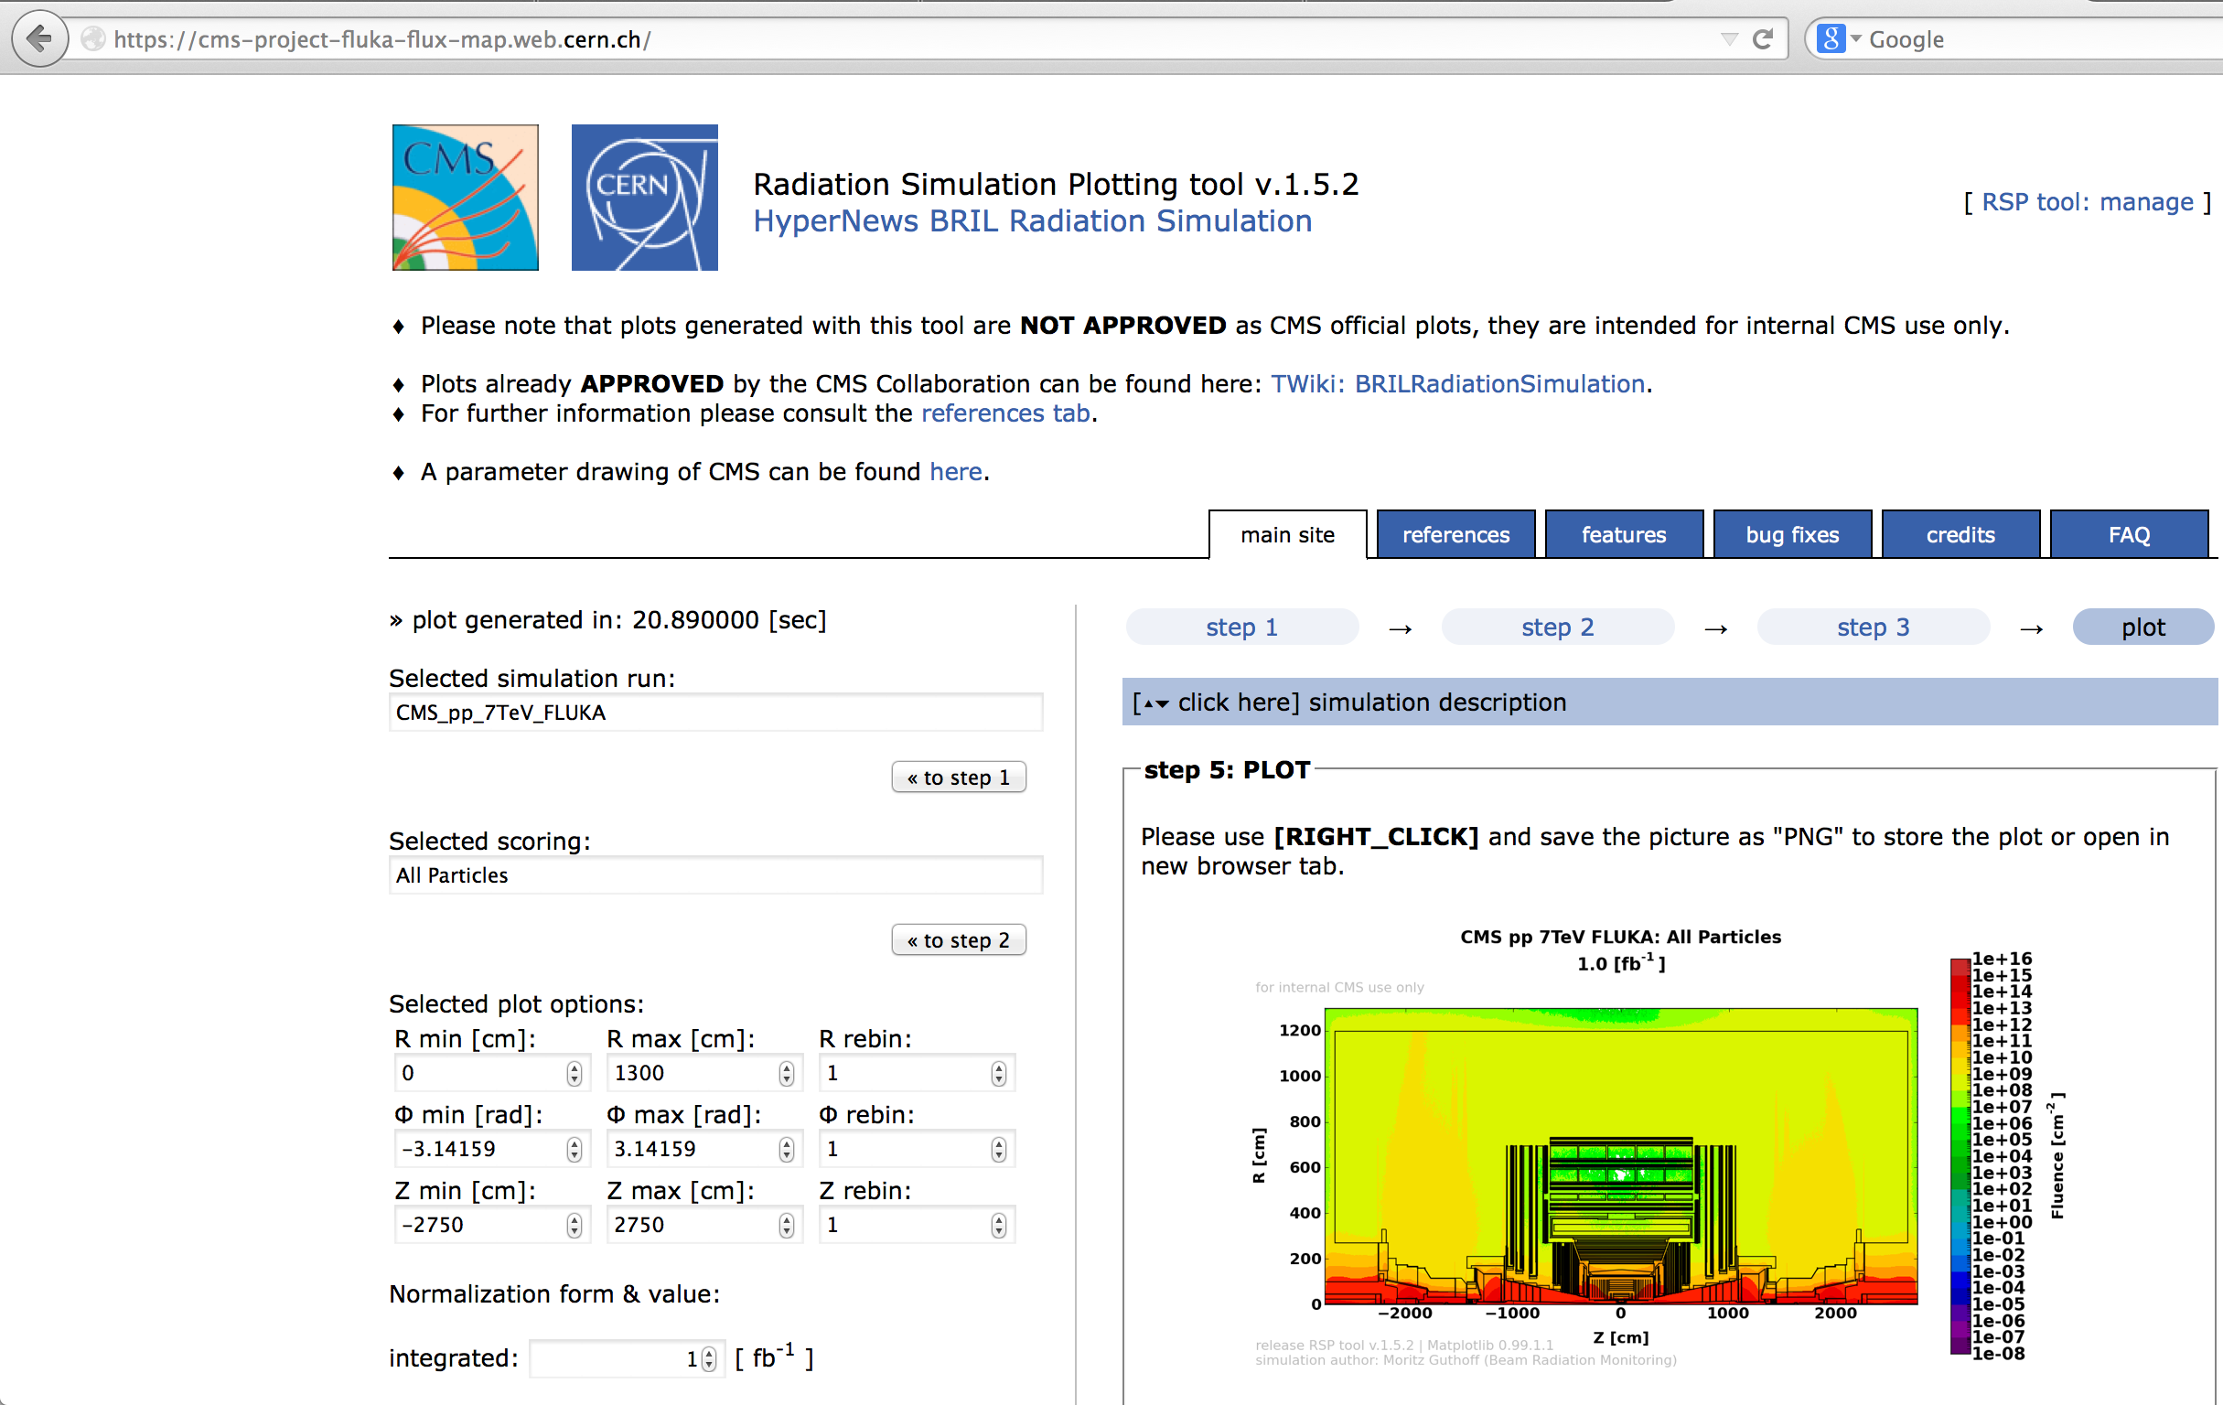

Slide 9
Radiation tests – why and how?
Aim of the detector tests: Characterization and understanding of long-term behavior of large particle detectors
Using the secondary beam from SPS (e.g. 100 GeV muons, 10⁴ particles per spill traversing 10x10 cm²) as detector signal and the gammas from the 14 TBq 137 Cs source as background, the detector reliability is tested under harsh background conditions
Setup allows to accumulate doses equivalent to HL-LHC experimental conditions in a reasonable time

Slide 10
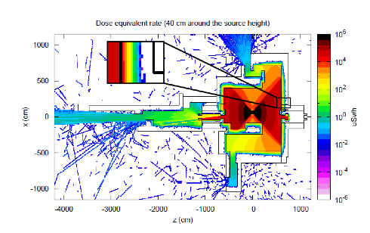
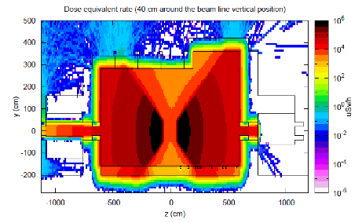
GIF++ Dose Simulation
Max. expected doses at sLHC | Equivalent time at GIF++ (~ 50 cm from source)
Si-trackers: ~ MGy/y | >> years
Calorimeters: ~ 20 kGy/y | < 1 year
Muon systems: ~ 0.1 Gy/y | ~ minutes

Slide 11
Layout of the facility

Slide 12
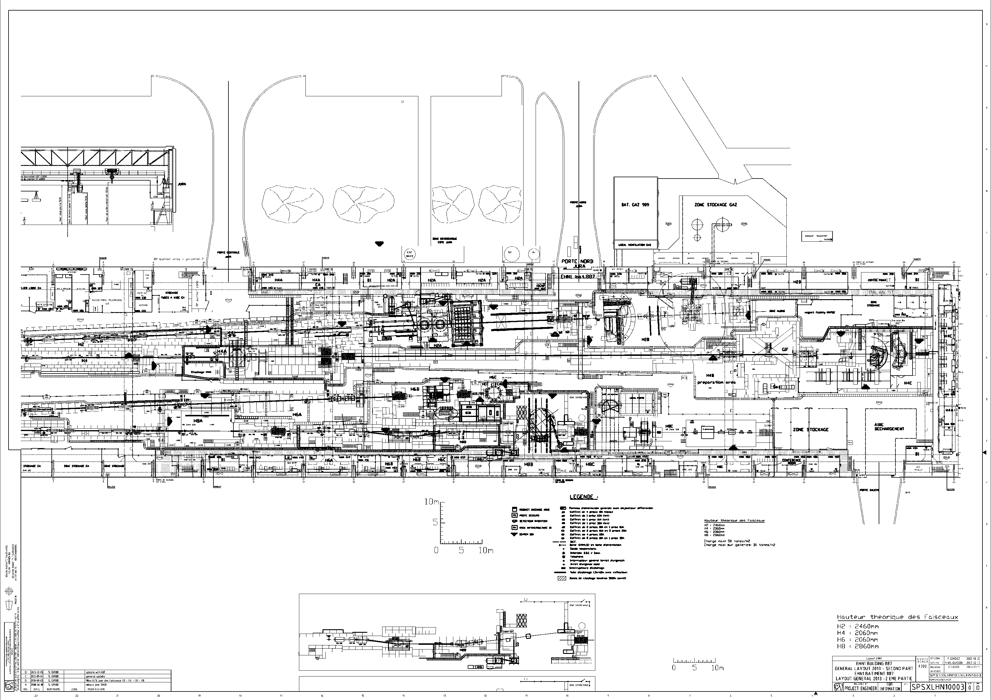
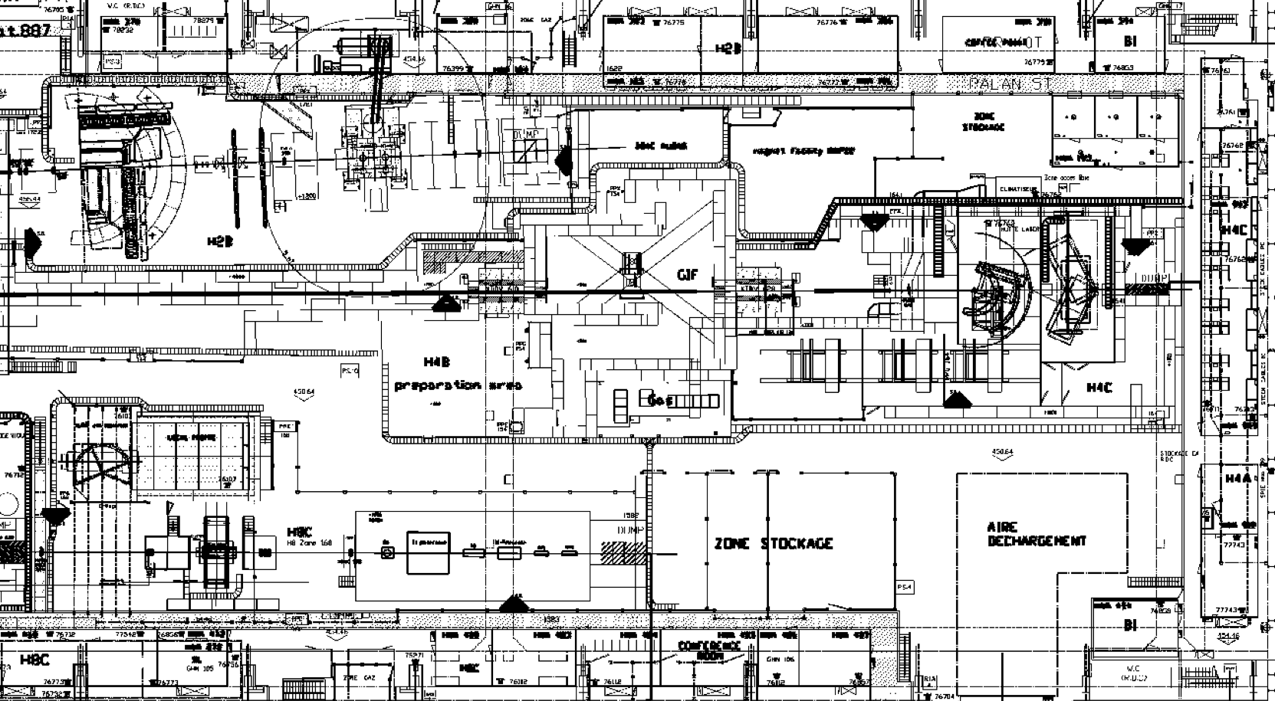
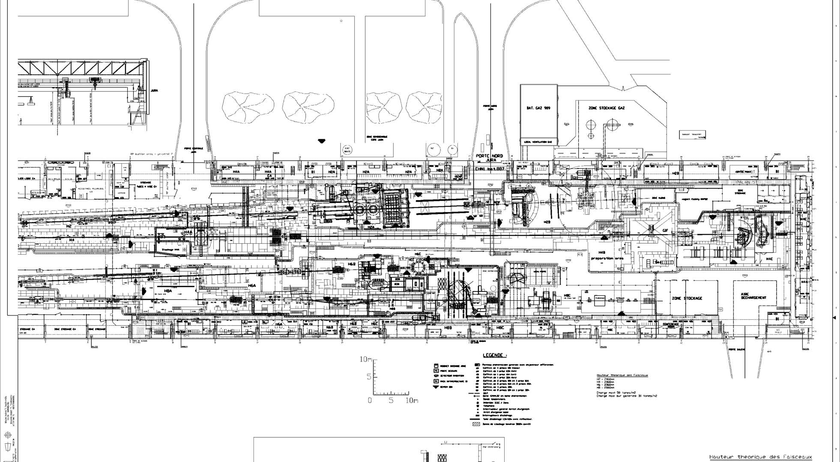
SPS North Area: EHN1
GIF++
CMS / ECAL
H4 beam line
GIF++ control room
GIF Control Room
GIF Control Room
GIF Control Room
GIF Control Room
GIF Control Room

Slide 13
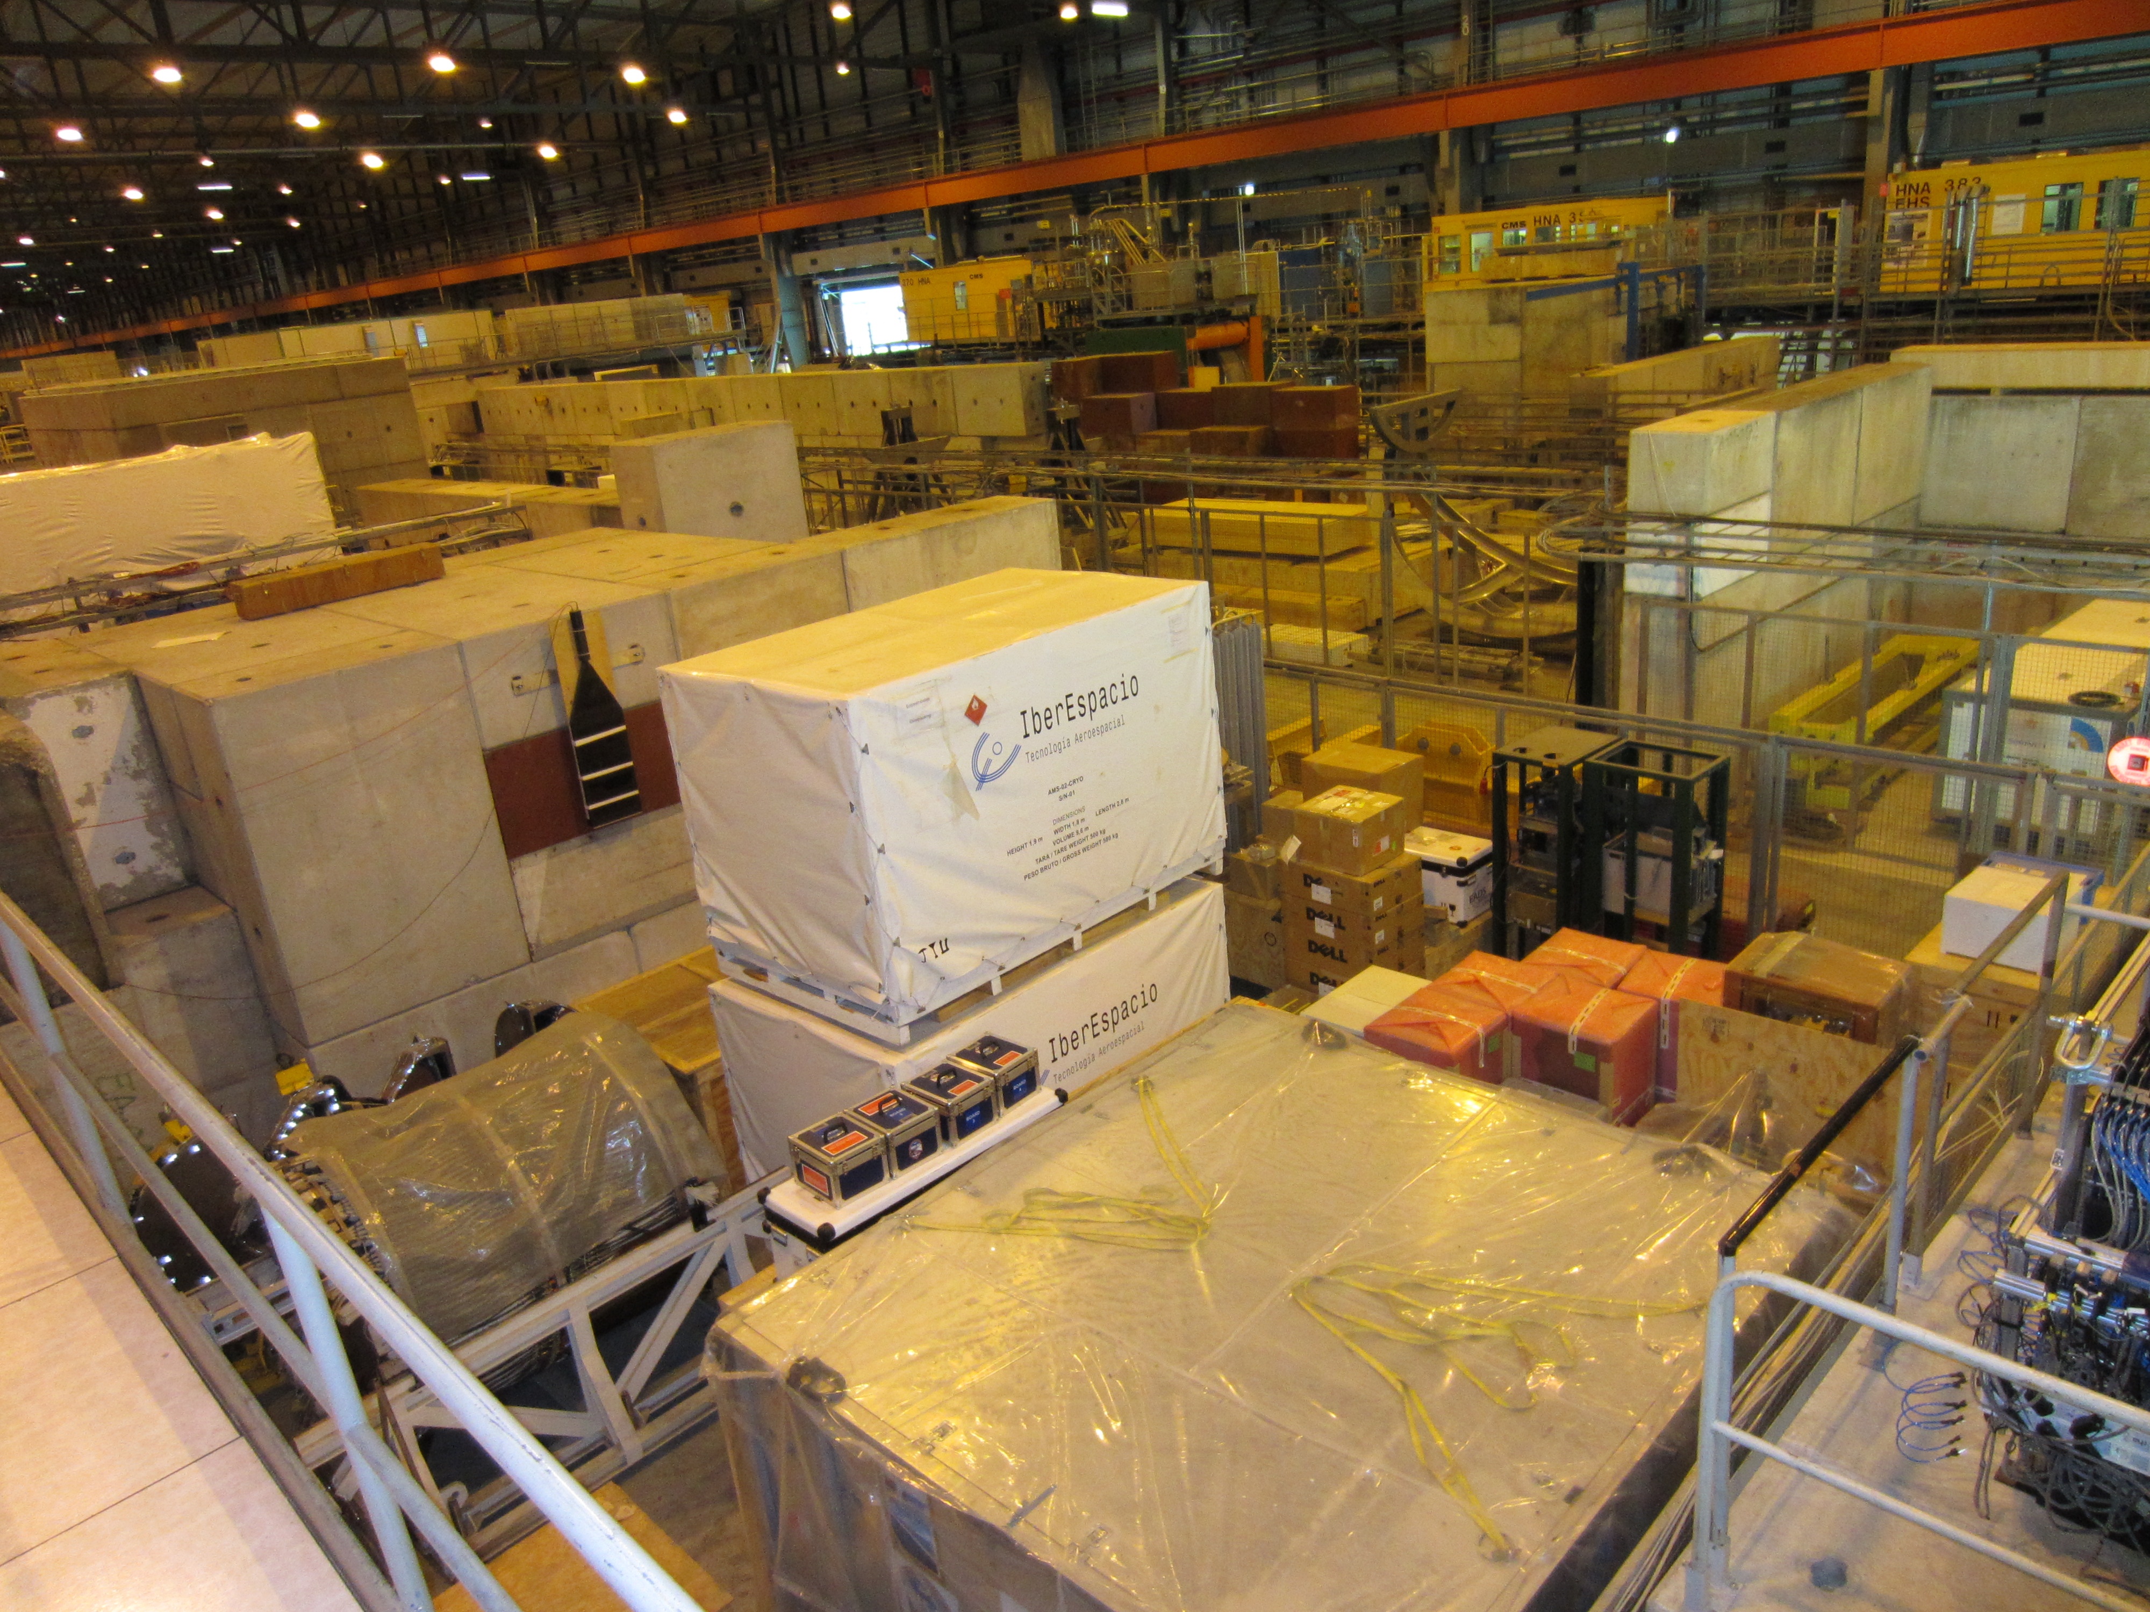
GIF++ - Before construction
EHN1: June 2012
Services area: June 2014

Slide 14
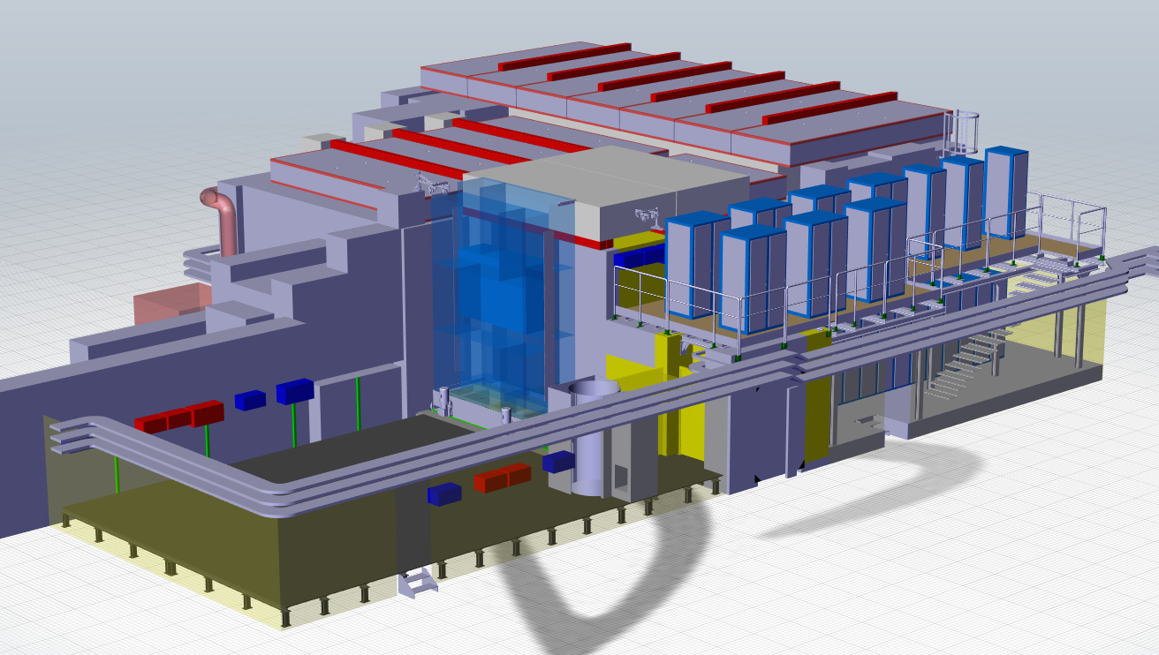
GIF++ Facility Layout
Removable Roof
Irradiation Area
Service Area
(Gas)
Material Access
Service Area
(Electronics)
SAS (Single person access system)
Small Material Access
Preparation Area
raised floor
throughout the facility
(pipes, cable trays)

Slide 15
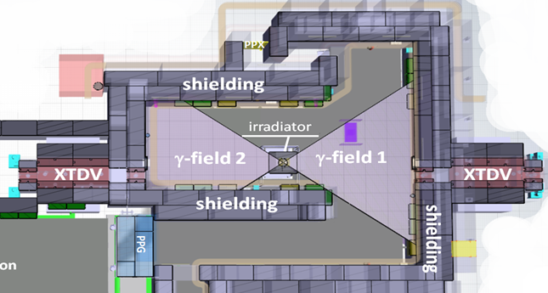
GIF++ Irradiation Zone
Irradiator can be moved by 150 cm
Material Access
Beam pipe (159 mm) for CMS ECAL

Slide 16
Fixed infrastructure

Slide 17
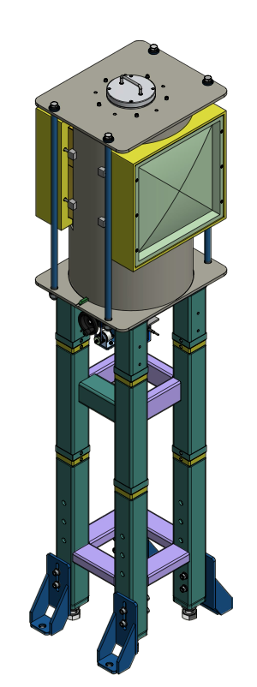
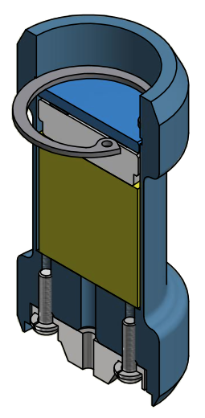
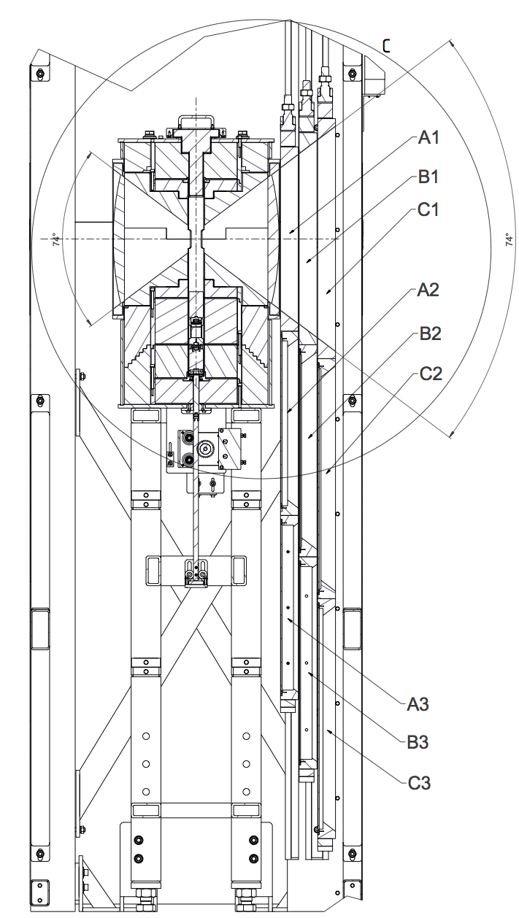

GIF++ Irradiator
Attenuator
3 planes of Pb/Fe plates
flexible, provide up attenuation up to 46400
14 TBq Cs¹³⁷
1.Nov.2011 = 14.91 TBq
260 µGy/s or 1 mSv/h
at 1 meter
Source available in Prague
hot-cell, certificate received.
Angular
correction filter (Fe)

Slide 18
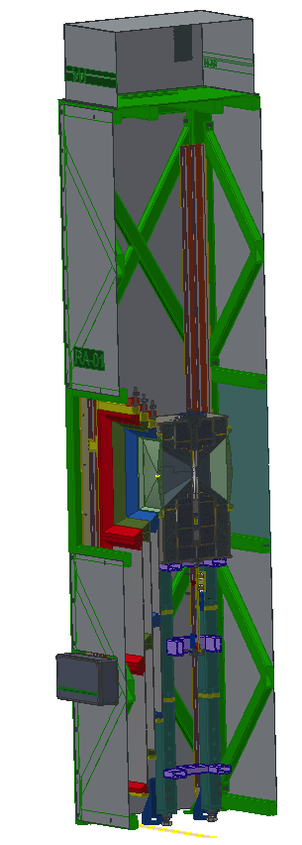
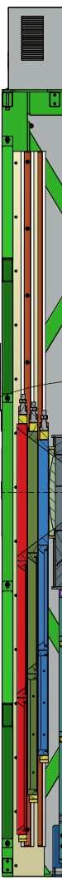
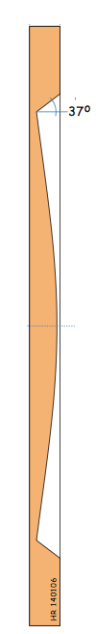
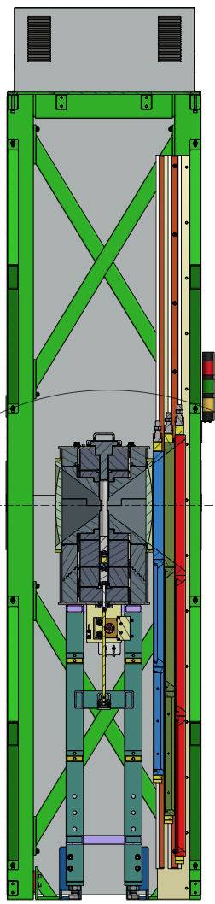
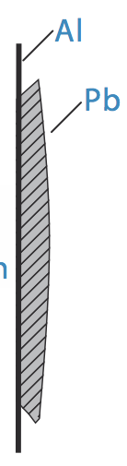

GIF++ Irradiator Filter System
Angular correction filter provides uniform gamma distribution for large area detectors in plane normal to irradiation direction
Two identical attenuation systems each consisting of one angular correction filter (Fe) and 6 absorption filters allow attenuation between 1 and 46400
A B C
Filter System :
Absorption factor
0
0
0
10
1.47
2.15
100
100
4.64
H. Reithler

Slide 19
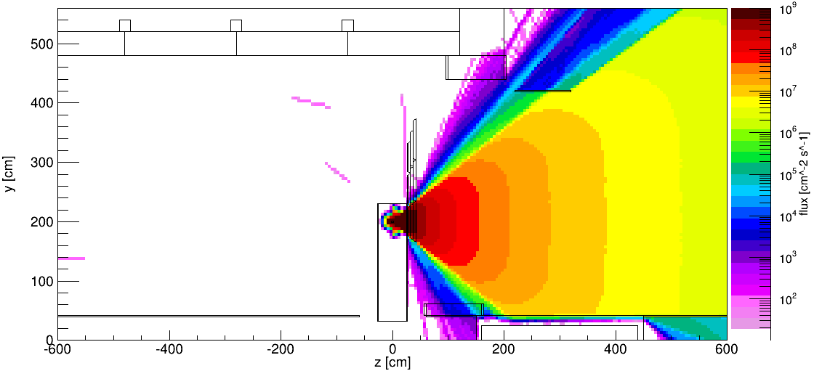
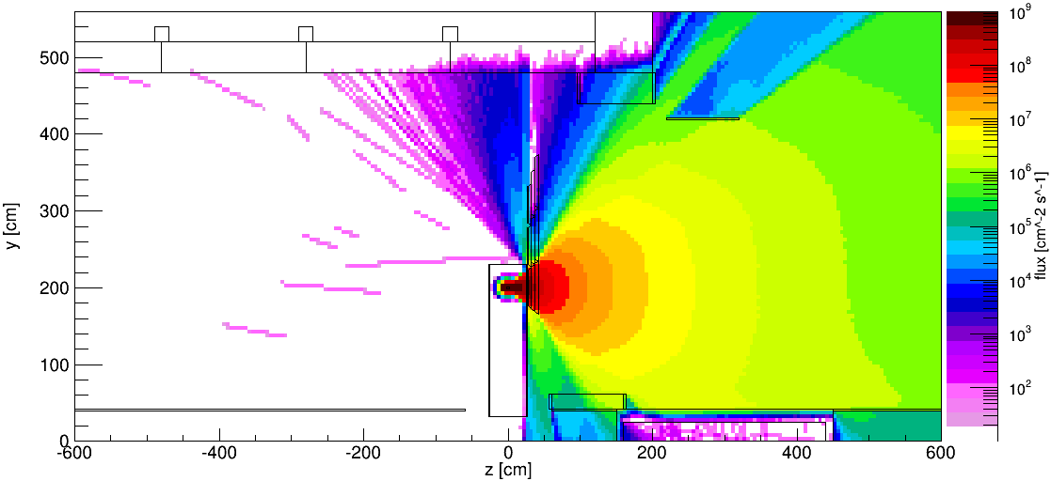
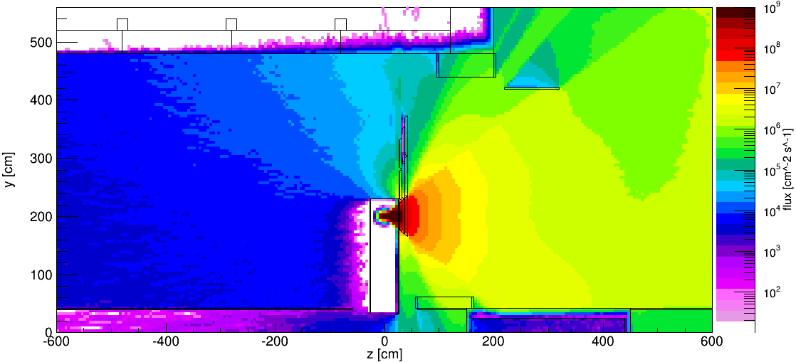
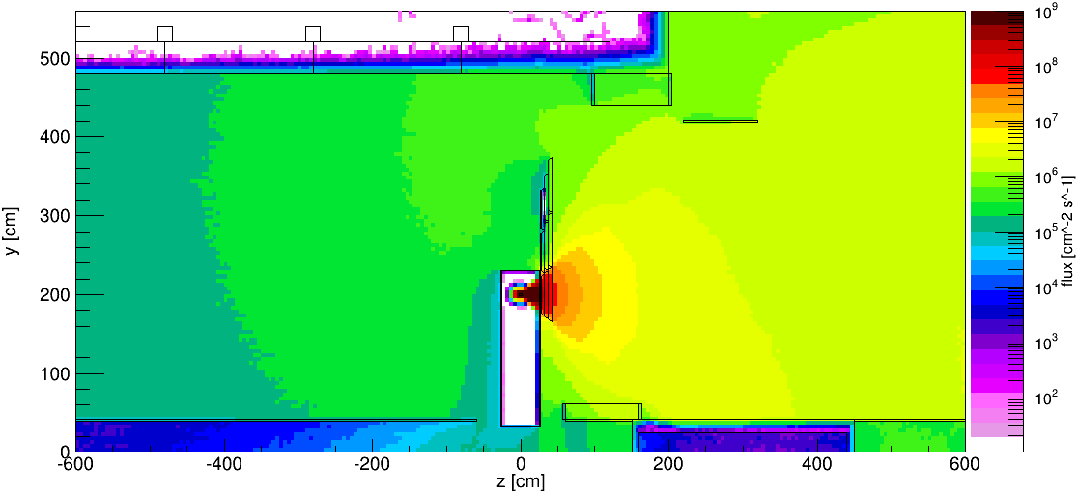
Unattenuated γ- flux at source height
E >= 600 keV
400 keV <= E < 600 keV
200 keV <= E < 400 keV
E < 200 keV

Slide 20
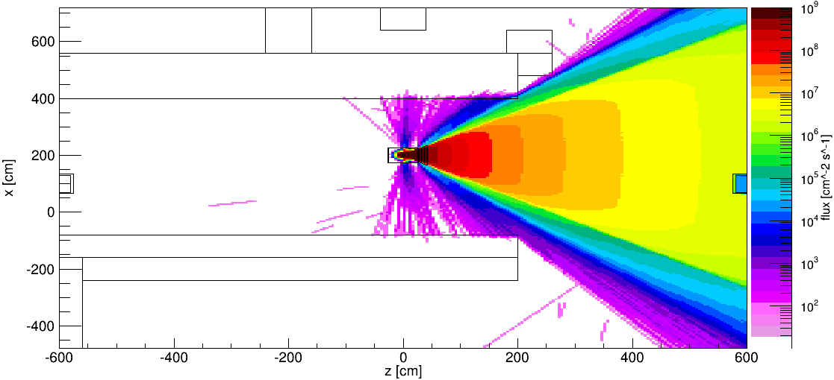
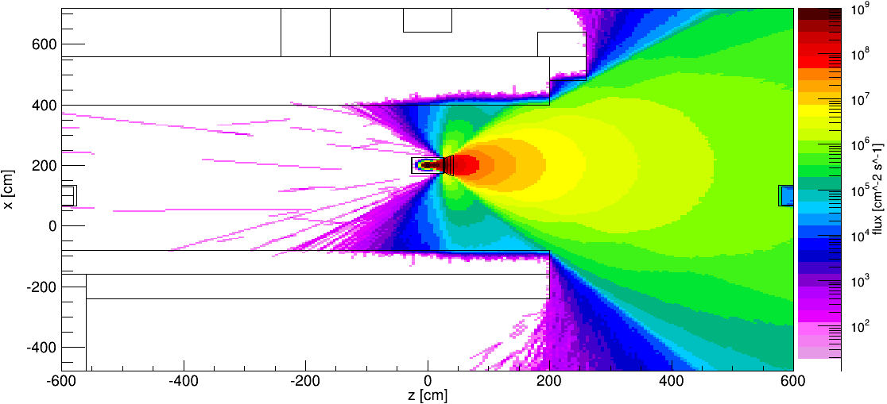
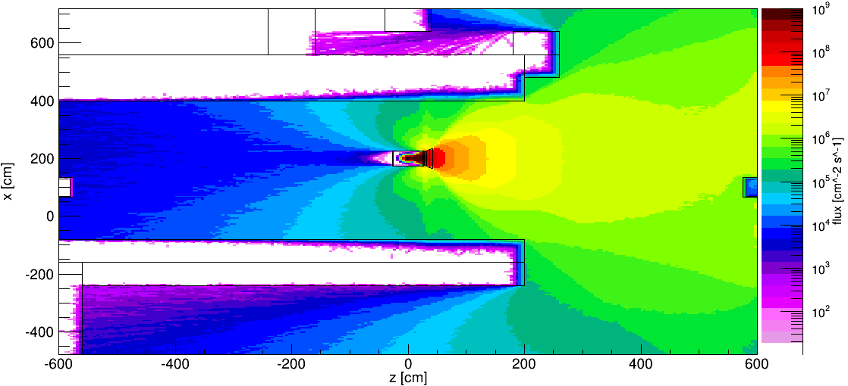
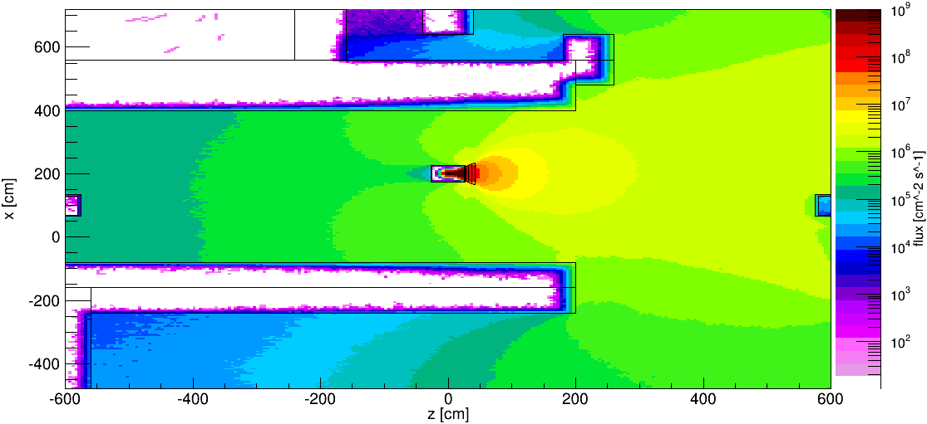
Unattenuated γ- flux at source height
E >= 600 keV
400 keV <= E < 600 keV
200 keV <= E < 400 keV
E < 200 keV

Slide 21
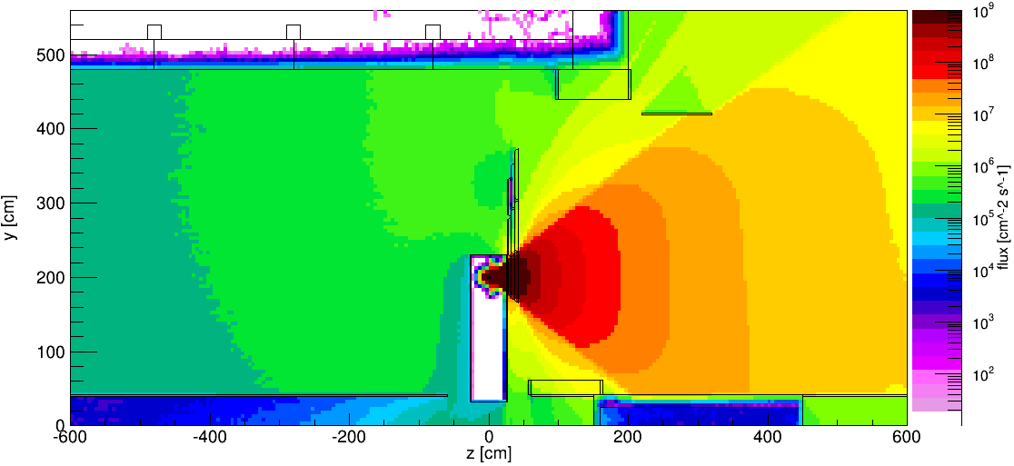
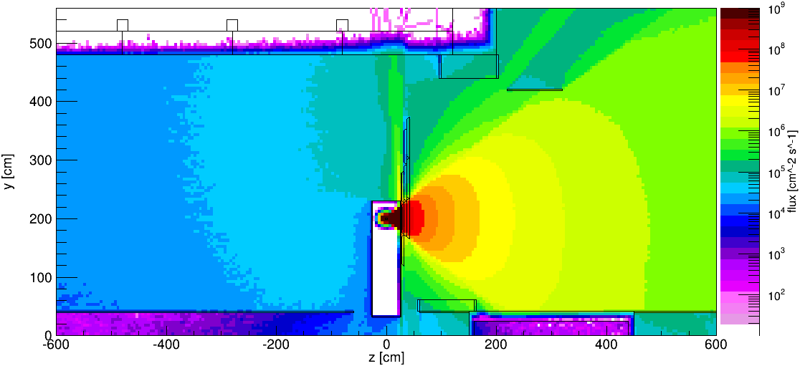
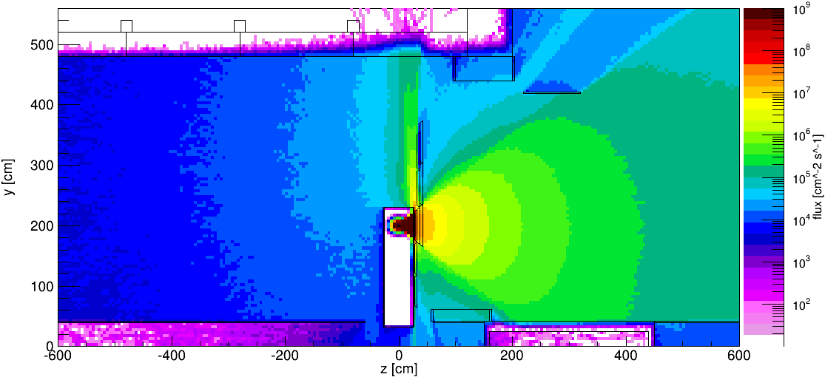
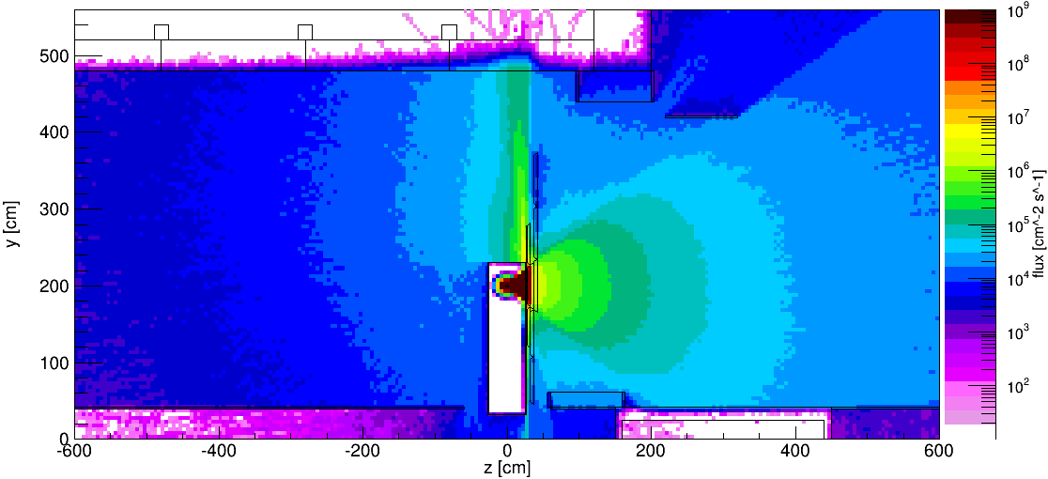
Attenuated totalγ- flux at source height
Unattenuated
Attenuation Factor 10
Attenuation Factor 100
Attenuation Factor 1000

Slide 22
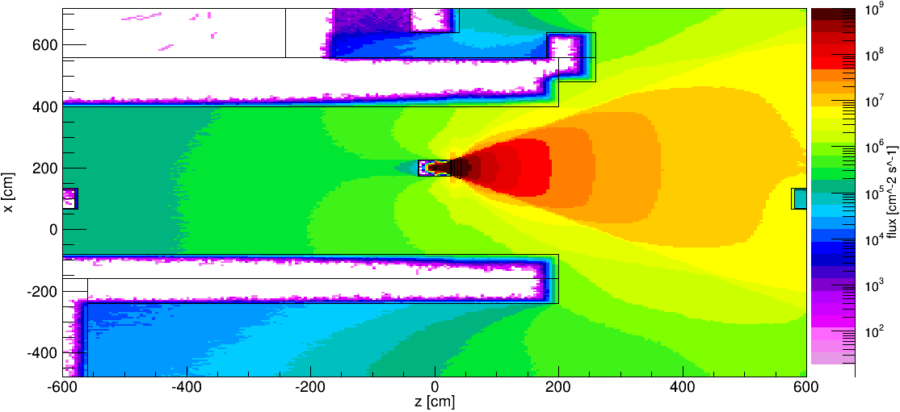
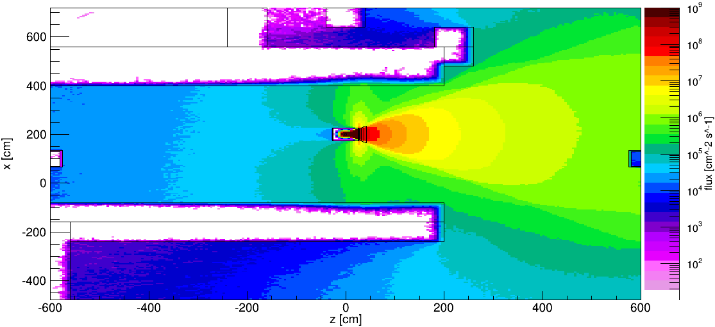
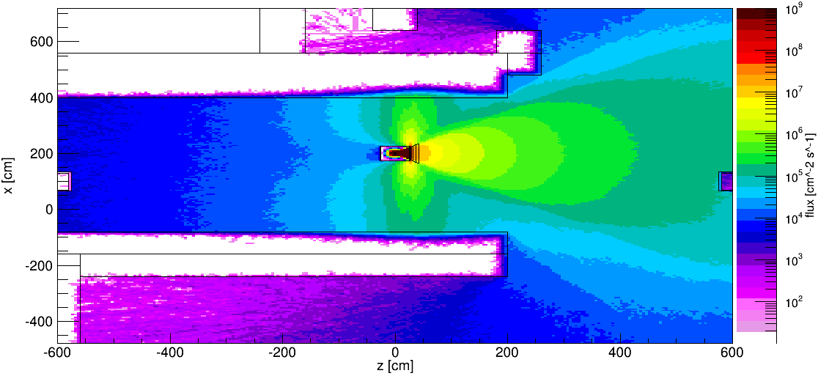
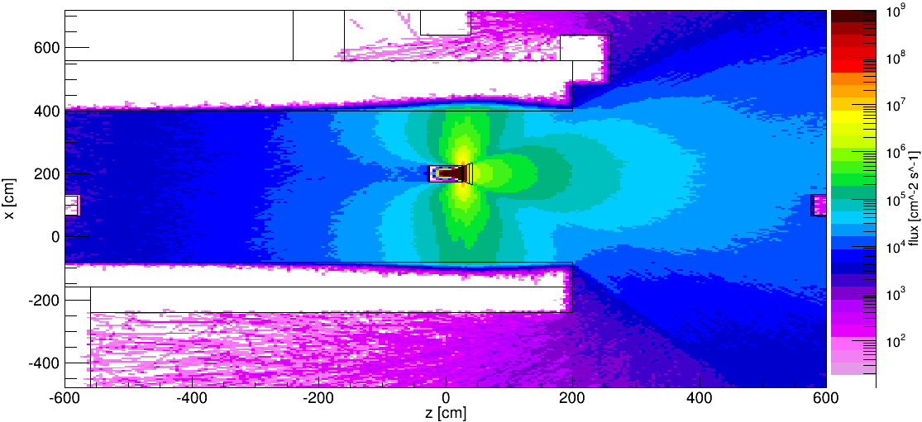
Attenuated totalγ- flux at source position
Unattenuated
Attenuation Factor 10
Attenuation Factor 100
Attenuation Factor 1000

Slide 23
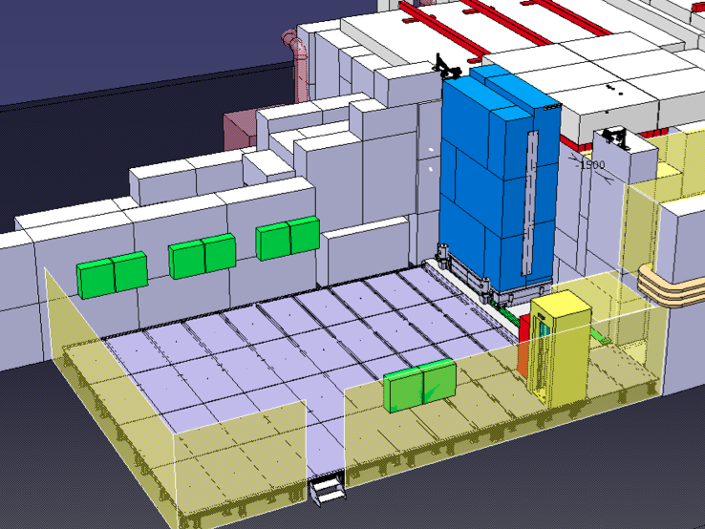
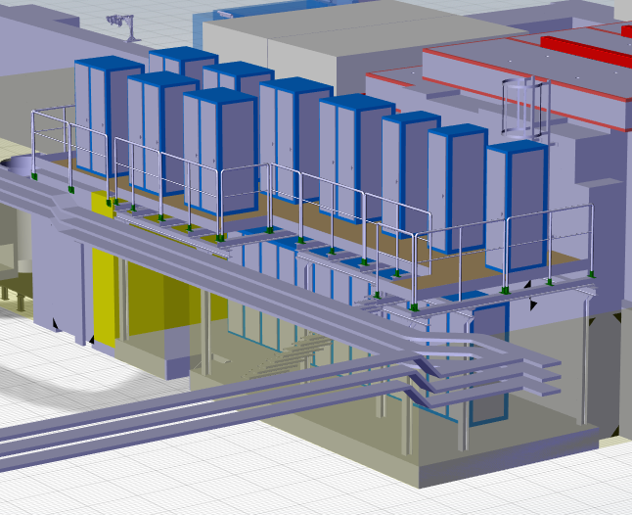
GIF++ Preparation & Service Zone
Large Preparation Zone (≈ 80m2), equipped with gas lines, electricity & network. Signal cables and HV/LV patch panels will be added during a first upgrade
Full size detectors can be set up and commissioned before moved to the radiation zone, already connected to the final DAQ
Ground floor: total of 17 electronic racks hosting the irradiator controls, DCS, user equipment, fire detection
Top Floor: 17 gas racks and distribution panels. 40 m2 net area

Slide 24
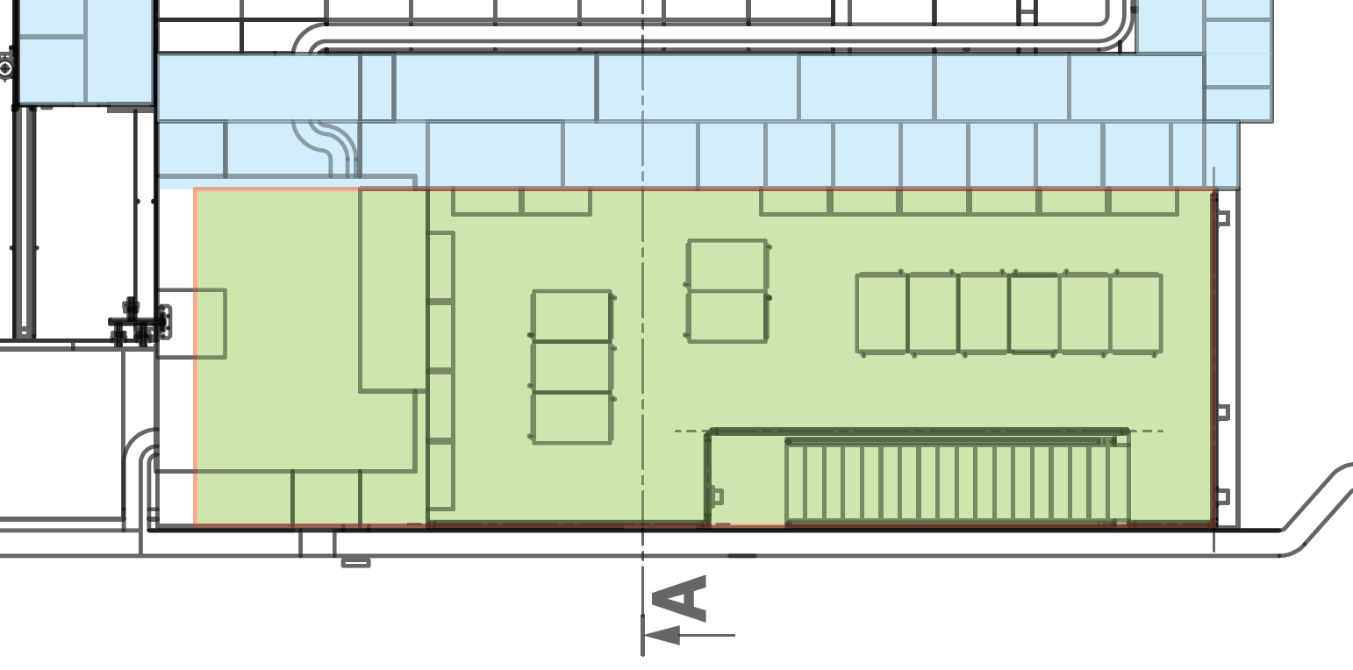
GIF++ Gas Mixing Zone
24
Gas supply panel
neutral gases
sup
sup
Gas supply panel
flammable gases
mix
sup
mix
mix
mix
sup
sup
mix
mix
mix
sup
sup
mix
mix
Mixture distribution
panels
RPC1
RPC2
Mix1
Mix2
Mix3
Spare
IR
Spare
CL1
CL2
CL3
mix
iC4H10, R134a, SF6
Detection iC4H10
Detection nC5H12
Detection CH4
Spare
TGC1
Ctrl
Anal
Spare
Spare
nC5H12, CH4, CO2
The mixing zone will contain 6 panels for non-flammable gas and 2 panels for flammable gas
4 panels for non-flammable gas and one panel for flammable gas will be equipped with 3-way valves to allow to supply also the preparation area
All pipes are stainless steel, cleaned at CERN following standard cleaning procedures for gas distribution systems

Slide 25
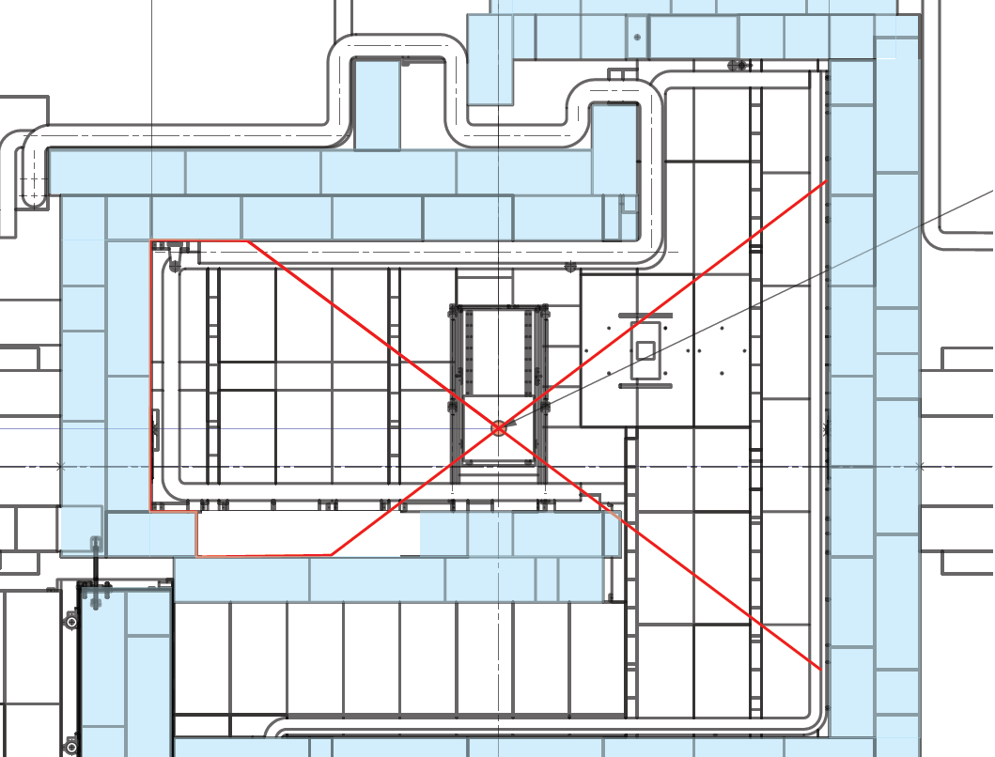
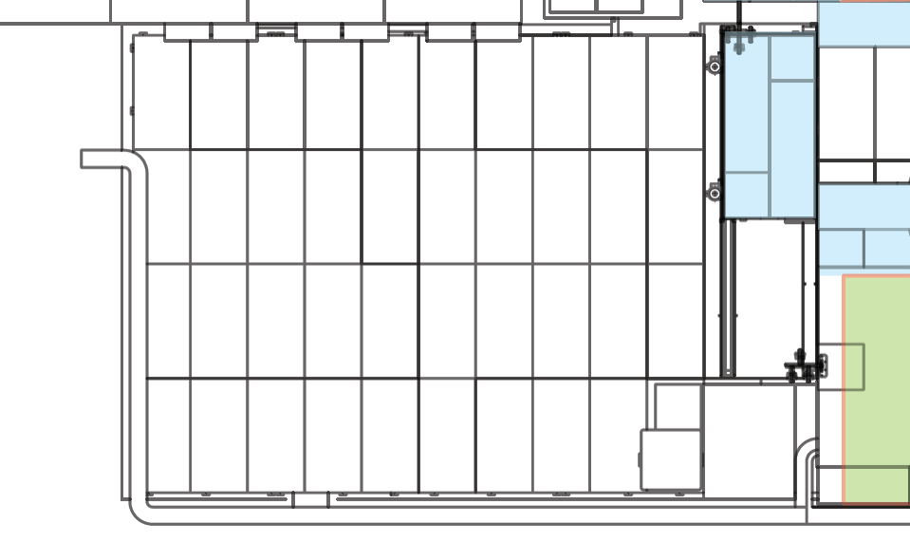
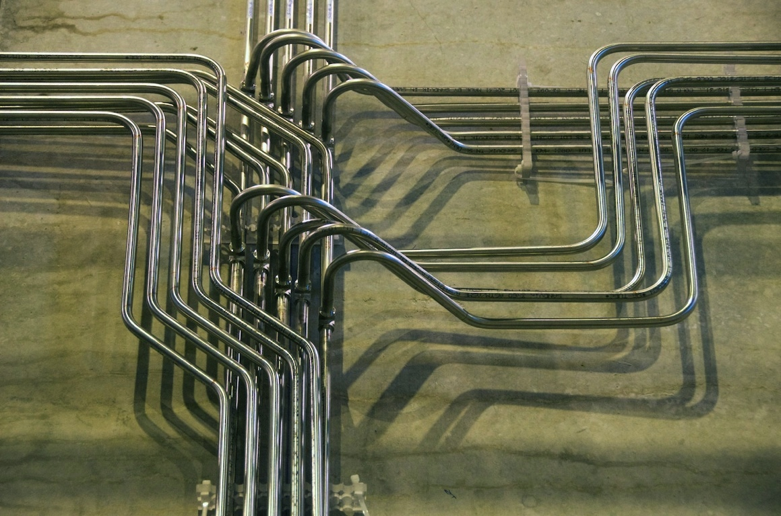
GIF++ Gas Panel Distribution
mix
mix
sup
mix
mix
iC4H10, nC5H12,
CH4, R134a, SF6
iC4H10, nC5H12
Preparation Area
Bunker Area
TGC – nC5H12
TGC – nC5H12
cabe trays to control room
iC4H10, nC5H12,
CH4, R134a, SF6
mix
Detection iC4H10
Detection nC5H12
Detection CH4
6 panels for non-flammable gas (blue) and 2 panels for flammable gas (red) in bunker, 4 panels for non-flammable gas (blue) and 1 panel for flammable gas (red) in preparation zone
In total, 96 pipes are connecting the gas mixing zone with the bunker

Slide 26
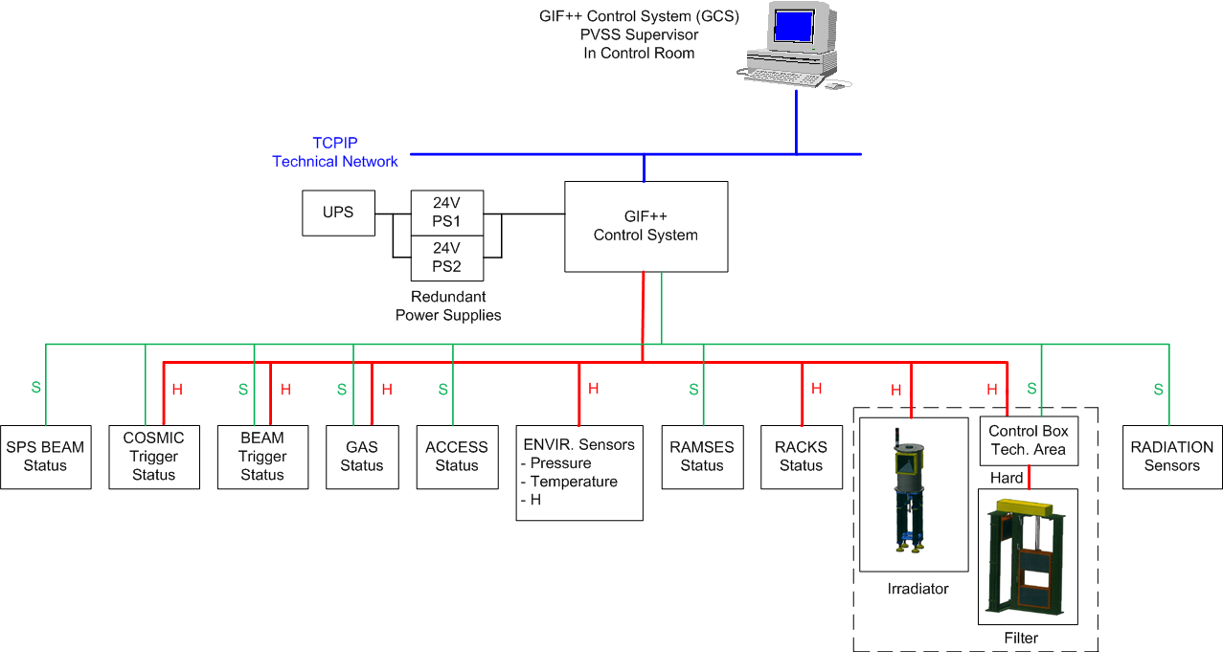
GIF++ Control System
Database
Database

Slide 27
Monitoring infrastructure

Slide 28

GIF++ User Infrastructure
WP-8.5.3: GIF++ User Infrastructure
  Bulgaria: INRNE
  Greece: NTUA, AUTh, Demokritos, NCUA
  Israel: Weizmann, Technion, Tel-Aviv U.
  Italy: INFN-Bari, -Bologna, -LNF, -Rome2
Deliverable: Infrastructure installed/commissioned 30/09/2014
  Beam tracker
  Cosmic tracker
  Gas + Environmental monitoring
  Radiation monitoring
  Detector Control System
  DAQ system

Slide 29
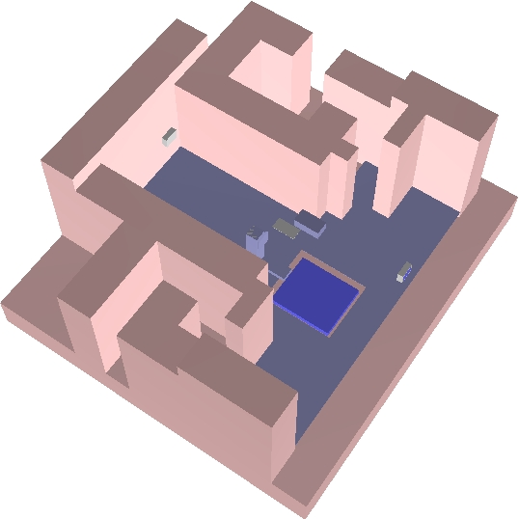
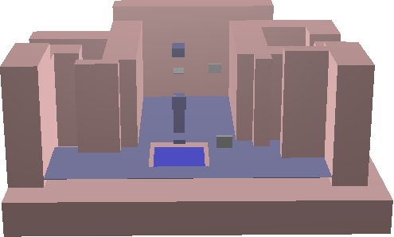
GIF++ User Infrastructure Geometry
RPC chambers surrounded by 4 cm of steel
Floor chamber also covered by 17 cm of steel
Beam trigger shielded by 5mm Tungsten rubber
Beam trigger
Lead shield for roof chamber
Irradiator with filter frame
roof chamber
Beam trigger
Finetracking chamber
floor chamber
Steel floor (2 cm)

Slide 30
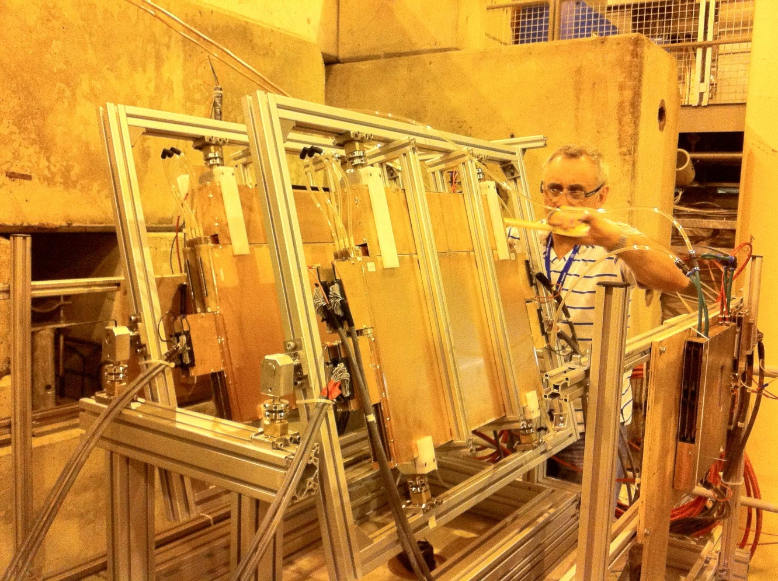
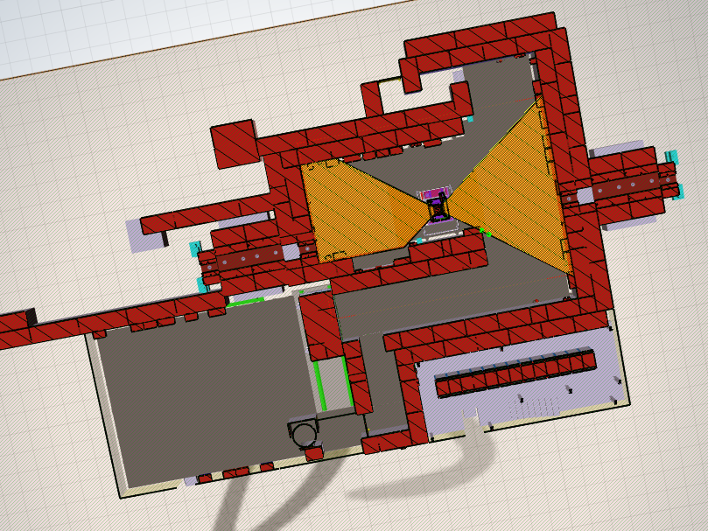
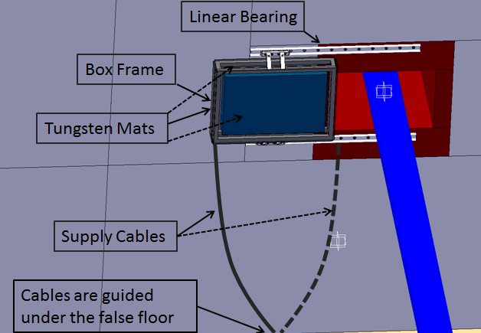
GIF++ Beam Tracker
Detectors
  Two Thin-Gap-Chamber (60cmx40cm) quad-ruplets with strips, wires and pads in each gap
  Test beam spatial resolution: 80μm
Electronics
  4 of 8 layers will be equipped with temporary front-end and readout electronics during 2014
  final electronics for all layers will be implemen-ted in 2015
Beam tracker
positions

Slide 31
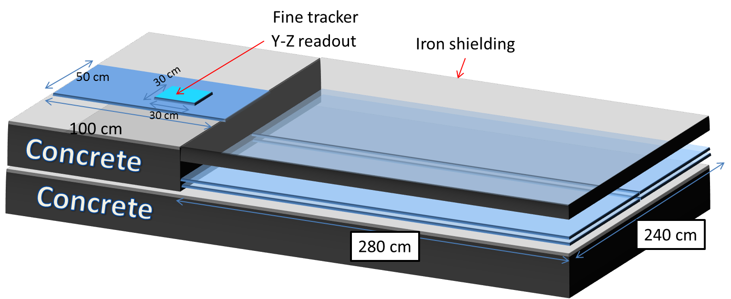
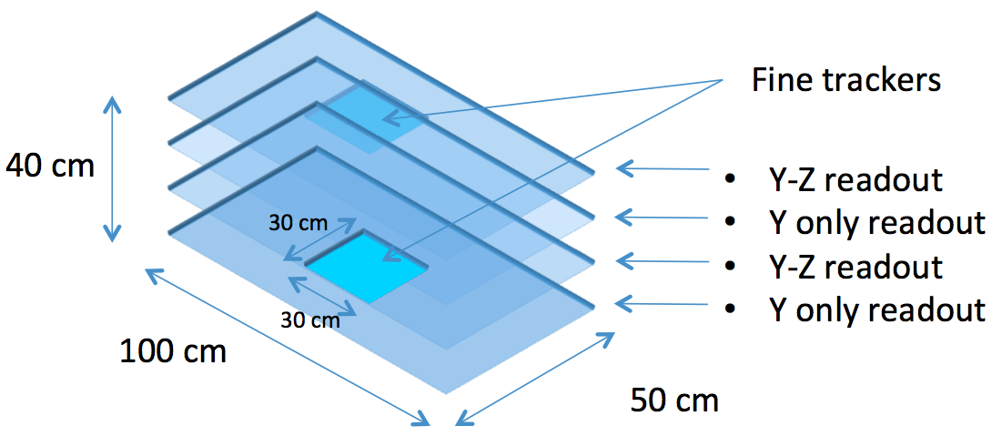
GIF++ Cosmic Tracker
Roof tracker
  4 independent Resistive Plate Chambers 1.0 x 0.5 m2
  readout strips 3 cm wide
  1 or 2 fine tracking RPC 30x30 cm2 with X-Y strips 1 cm wide
Floor tracker
  1.0 x 0.5 m2 chambers as for the roof
  1 fine tracking RPC chamber 30x30 cm2 as for the roof
Underground detector (confirm plane)
  Double layer RPC chambers 2.8 x 2.4 m2 with 4 cm strips in XY
floor tracker
roof tracker
confirm plane

Slide 32















GIF++ Detector Control System
Use PVSS/WinCC OA (as in LHC experiments)
CAEN Easy Power System [1 mainframe, 1 Power Generator, 1-2 crates + with HV and LV boards and 1 ADC A-3801 board for monitoring (128 channels), also for ENV and gas monitoring]
Mainframe and PC in proximity of the control room (radiation-free area) along with DAQ PCs and equipment
EASY crates and other equipment closer to detector area
Radiation, gas and environmental sensors to monitor atmosphere and gases: p, T, rH
Counting Room
AC/DC converter
48V
48V
OPC
…
…
Crate1
Crate2
Mainframe
Branch
Controllers
HV/LV Boards
Service Area
4
T, H sensor
PCMini 70 Michell
p sensor
TSA Gefran
CAEN
ADC 3801
Stainless steel housing
for use with F⁻

Slide 33

GIF++ DAQ System
Requirements
  Create a trigger from beam tracker (TGC) and/or cosmic tracker (RPC)
  Distribute the trigger to different Detectors Under Test (currently
  up to 5 DUTs)
  Synchronize the events from the
  TGC/RPC with the DUTs for
  tracking/efficiency purpose
TLU
Detector 1
Detector 2
Detector 3
Detector 4
TRIGGER DAQ:
RPC and/or TGC
Trigger
BUSY
DAQ 1
DAQ 2
DAQ 3
DAQ 4
xy timestamp
Event builder
Event builder
Event builder
Event builder
We provide trigger
We don’t expect busy
Event
Trigger x,y
Detector1 xy
Event
Trigger x,y
Detector2 xy
Event
Trigger x,y
Detector3 xy
Event
Trigger x,y
Detector4 xy
Implementation
  Based on a Trigger Logic Unit module provided by EUDET community (FP7: standardized test beam setup for high resolution detectors) and intensively used in test beams (DESY, CERN, FERMILAB)
  Unit provides trigger signal and trigger number to all detector DAQs
  Requires busy signal from detectors DAQs
  This module synchronizes the different DAQ systems
RJ45 output
Trigger detector inputs
Trigger output
Busy input
LEMO output

Slide 34
Project planning and responsibilities

Slide 35





GIF++ - A Joint Project

Slide 36
GIF++ - Responsibilities
Responsible for the EHN1 building and the installations inside, thus for the new of the GIF++
During planning and construction phase (project engineer)
  Compiles facility requirements and plans construction
  Builds the facility and provides the infrastructure for housing the irradiator and detectors
  Supplies general infrastructure
    Civil engineering components (shielding, false floor), control room
    Beam line elements and access system
    Electricity and gas distribution to the boundary limits of the service zone and the control room
During operations responsible for the H4 beam line (beam line physicist)
  Sets up muon beam as specified by the user
  Responsible for access system and operation of all beam line elements

Slide 37
GIF++ - Responsibilities
Responsible for all irradiation facilities and experimental areas at CERN
During planning and construction phase (manager irradiation facilities)
  Acts as interface to the users of the facility and collects their requirements
  Procures the irradiator and attenuators
  Develops the facility controls (GIF control System)
  Develops and installs the gas systems inside the facility
During operations responsible for the running of the facility and the user management (technical coordinator users)
  Helps users to install detector systems under test
  Irradiation time for users will be allocated via the SPS coordinator like other H4 beam time, one main user and up to five other parasitical users in parallel
  Responsible for space management inside the facilities
  Responsible for running of irradiator and attenuator systems

Slide 38
GIF++ Responsibilities
The responsibilities of the GIF++ user community (a very diversified group)
During planning and construction phase (AIDA, all users)
  Specifies requirements for the facility (GIF++ is a facility FOR the users)
  Provides the detector specific infrastructures within the framework of the FP7 AIDA project (beam trigger, cosmic trigger and tracker chambers, sensors, DAQ)
During operations various groups will test their equipment in GIF++
  ALICE, ATLAS, CMS, LHCb, COMPASS, NA62 experiments
  LHC Beam loss monitors
  RD-50 and RD-51 Collaborations
  Different CERN groups

Slide 39

GIF++ Webpage
https://cern.ch/gifpp

Slide 40



GIF++ - A Joint Project
https://edms.cern.ch - the CERN chess equivalent. It kind of works..
Question: Why are their two GIF++ folders?
Answers:
a: to confuse people
b: because it makes perfect
sense
c: because intra-departmental collaboration has its limits
(never let a person from another
department manage your
EDMS folder)

Slide 41


GIF++ Indico
https://indico.cern.ch

Slide 42


GIF++ Documents

Slide 43

Overall schedule: Still readable…

Slide 44

Construction schedule: less readable…
CE start
Jan. 2014
44
Functional specs
-July 2013
Design
-Dec. 2013
Infrastructure installation
March-July 2014
Irradiator delivery
Sep. 2014
Commissioning Sept.-Oct. 2014

Slide 45

GIF++ Construction Overview
Services area: June 2014

Slide 46

GIF++ Construction Overview
Bunker: June 2014
Beam
Irradiator
x
x

Slide 47

GIF++ Construction Overview
EHN1: June 2014

Slide 48
GIF++ Schedule
Late September : Arrival of new irradiator
(Start of dismantling of old facility in mid-September)
Early October: First part of commissioning: Irradiator & attenuator controls, access system, safety systems, gas system
16. October to 2. November : No access
(CMS-ECAL beam-time)
1-2. December: First dedicated beam time for GIF++ (Second part of commissioning: Trigger system, DAQ)
Early 2015 : User operation

Slide 49
Summary

Slide 50
GIF++ Highlights
GIF++ will be a unique place where high energy charged particle beams from H4 are combined with a 14 TBq 137 Cesium source
High energy Muon beam from T2 target available 6-8 weeks per year for GIF++ as main user, around 30% of the SPS operation time parasitical use of halo muon beam
The 100 m² GIF++ irradiation bunker has two independent irradiation zones, making it possible to test real size detectors of up to several m² as well as a broad range of smaller prototype detectors and electronic components

Slide 51
GIF++ Highlights
Both irradiation fields (±37°) equipped with independent attenuator systems that allow to tune the gamma flux individually (reduction between 1 and 46400)
Irradiator on both sides equipped with exchangeable angular correction filter
Fixed installed beam-trigger and cosmic-trigger
Central Control System
  Records environmental parameters, beam parameters, filter settings, gas
  Provides interlocks (e.g. for wrong gas mixtures)
Wide range of available gases (including custom gases), gas patch panels in bunker and service zone

Slide 52
GIF++ Summary
GIF++ well on track to be fully operational early next year !
Allocation of space and access to the inside of the bunker will be done via the IMPACT tool (impact.cern.ch). You can already start to fill in activity requests.
For staying informed, please subscribe to GIF-active-users e-group (e-groups.cern.ch)
For questions about radiation time, please contact
IMPACT-GIF-Coordination@cern.ch

Slide 53


