Slide 1
Phase 1 Design for LOKI at ESS: performance evaluation of suitable detector technologies Or how to build detectors for ESS
Kalliopi Kanaki
Andrew Jackson
Clara Lopez
Richard Hall-Wilton

Slide 2
Outline
Three neutron instruments approved by the ESS Steering Committee (STC) in 2013 for preliminary design phase 1:
NMX: Neutron Macromolecular Crystallography
Odin: Optical and Diffraction Imaging with Neutrons
LOKI: small angle neutron scattering (SANS)
Introduction to LOKI
Project phases until start of operations
Functional detector requirement analysis
Evaluation tools and preliminary results

Slide 3
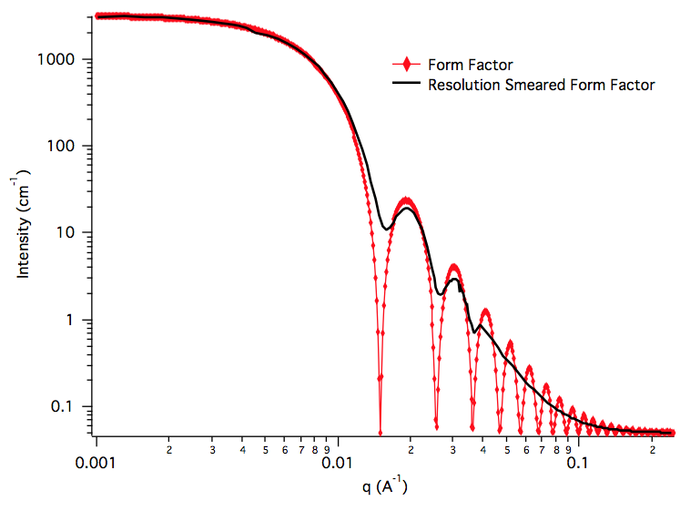
Small Angle Neutron Scattering with LOKI
Soft matter, biophysics and material studies
Emphasis on spatial and temporal heterogeneity
Spatial resolution down to nm scale
Sub-second time resolution
High neutron flux (10⁹ n/cm²/s on sample)
Broad λ band (2Å-12Å) and
wide-angle scattering
Wide Q range accessed
simultaneously (10⁻³- few Å⁻¹)

Slide 4
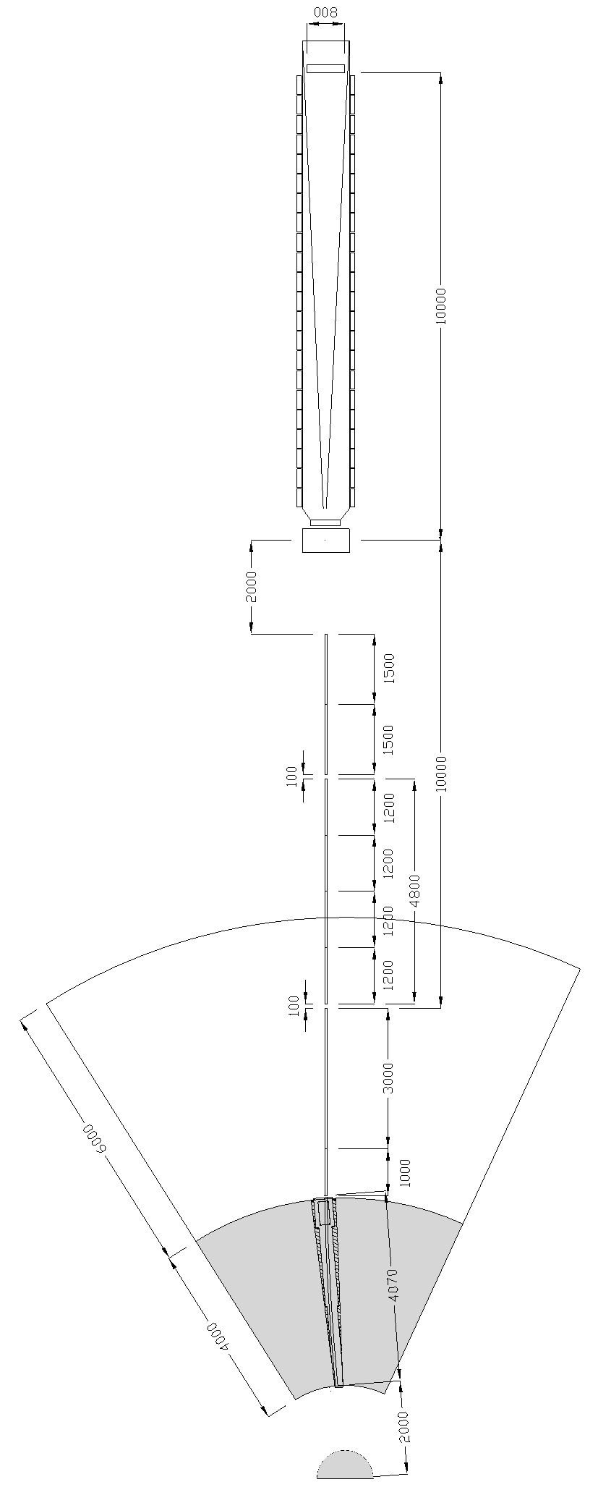
LOKI at a glance
Bender: r = 78 m
l = 4 m
Variable Opening Choppers
Collimation up to 10m
Guide 3 cm x 3 cm
Optional Focusing Optics
Detector: 10m

Slide 5
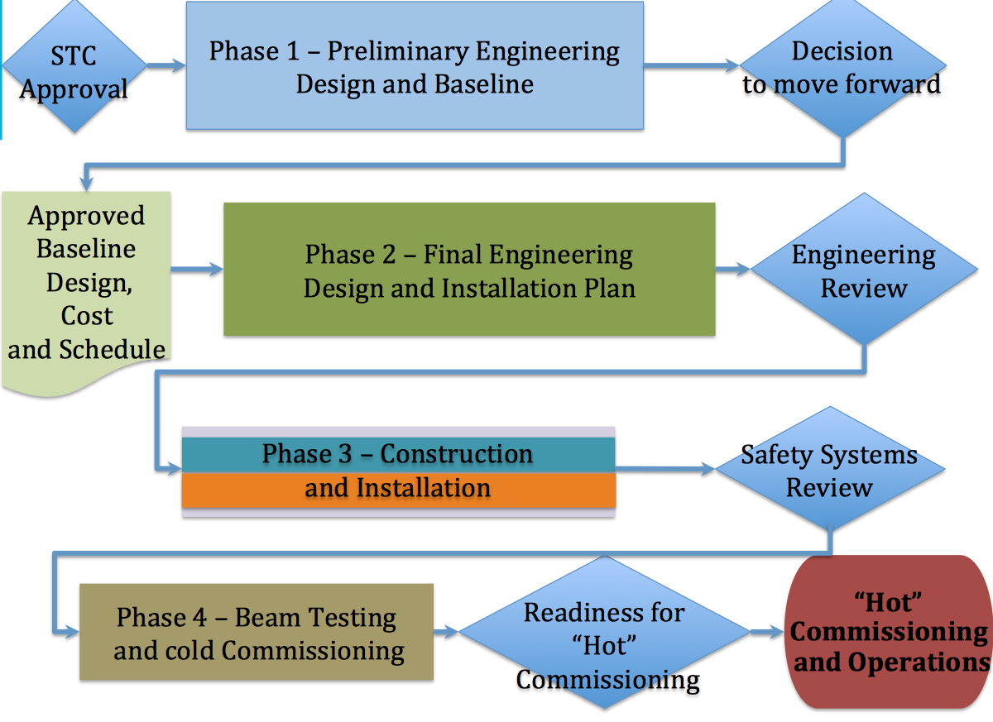
Approved Instrument Project Phases
LOKI
January 2014
Tollgate 2 decision
December 2014
December 2016
June 2019
December 2019

Slide 6
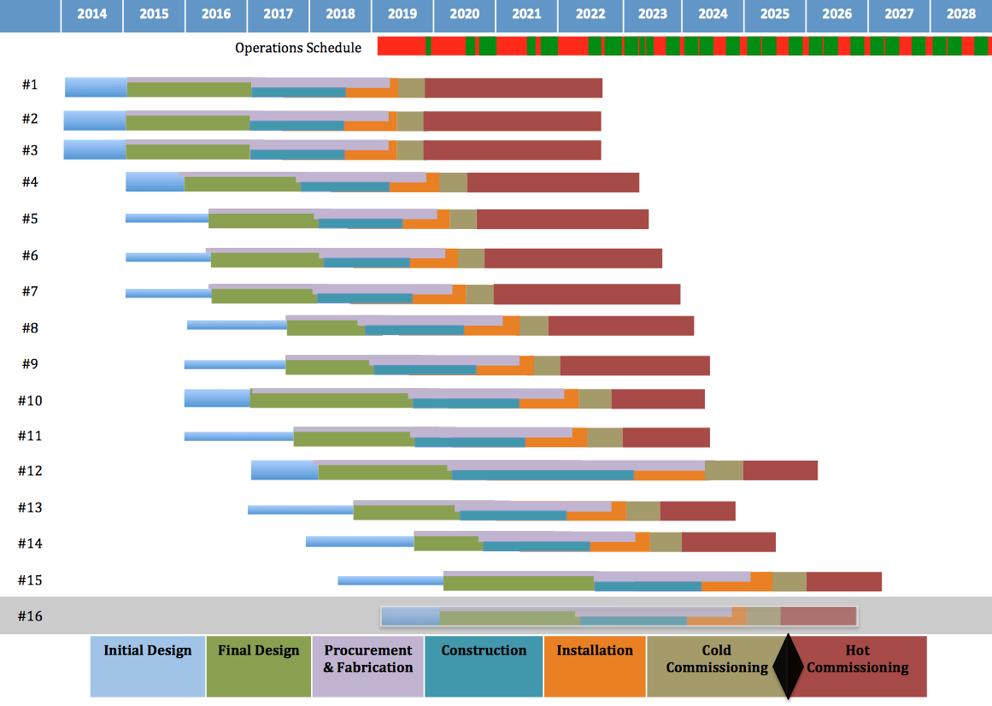
From Construction to Operations
14 proposals were evaluated in May
Recommendation of evaluated
instruments for entering phase 1 in
2015 will follow

Slide 7
Phase 1 Design Duties
Conceptual development of the instrument detectors
Performance evaluation
Geometry & technology selection to be fully pursued during final design phase 2
Schedule
In-kind plan for construction
Define envelopes in engineering drawings
Draft commissioning plan (cold & hot)
Budget estimate
Risk mitigation strategy
Interface identification (organizational & physical)

Slide 8
Functional requirements for LOKI detectors
Polar angle resolution
Wavelength resolution
Time of Flight resolution
Detection efficiency
Instantaneous rate capability
Stability
Background tolerance (intrinsic detector noise, natural components activity, cosmics, prompt pulse & secondaries escaping the guides - γ and fast neutrons - shielding, neighbouring instruments, sample-dependent background (incoherent, inelastic scattering))
Separate studies per detector technology, geometry and particle species

Slide 9
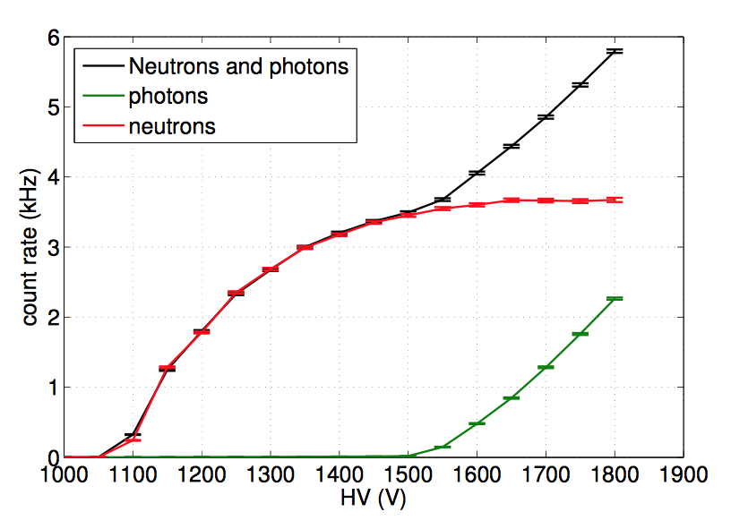
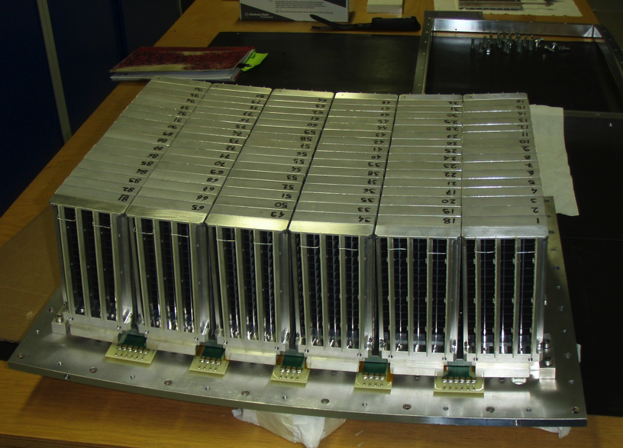
Studies on γ induced background (MultiGrid detector, ILL/ESS/Linköping collaboration)
neutron efficiency: analytically calculated,
simulated, measured
γ efficiency comparable to ³He
scattering understood
detector induced background understood
working on detector standards for reliable
comparisons
A. Khaplanov et al., JINST 8, P10025 (2013)

Slide 10
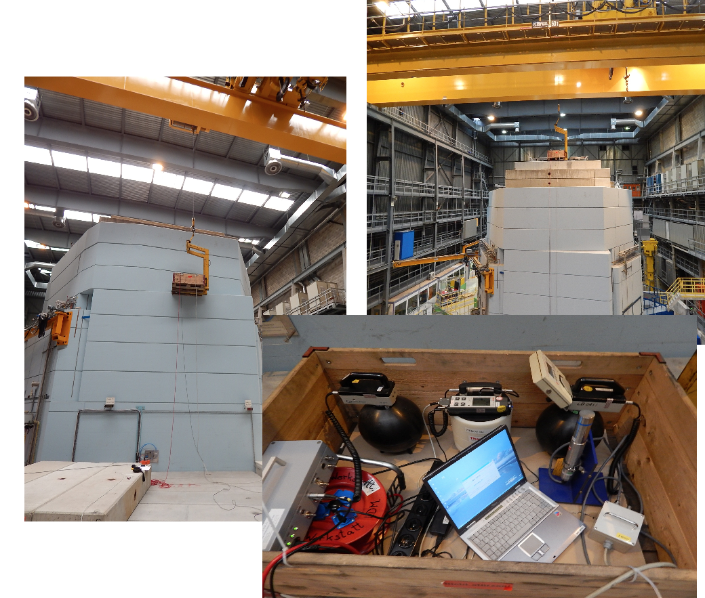
Collaborative background studies with PSI ESS Detector & Neutron Optics and Shielding groups
measurements at the SINQ target
paper in preparation
N. Cherkashyna et al.

Slide 11
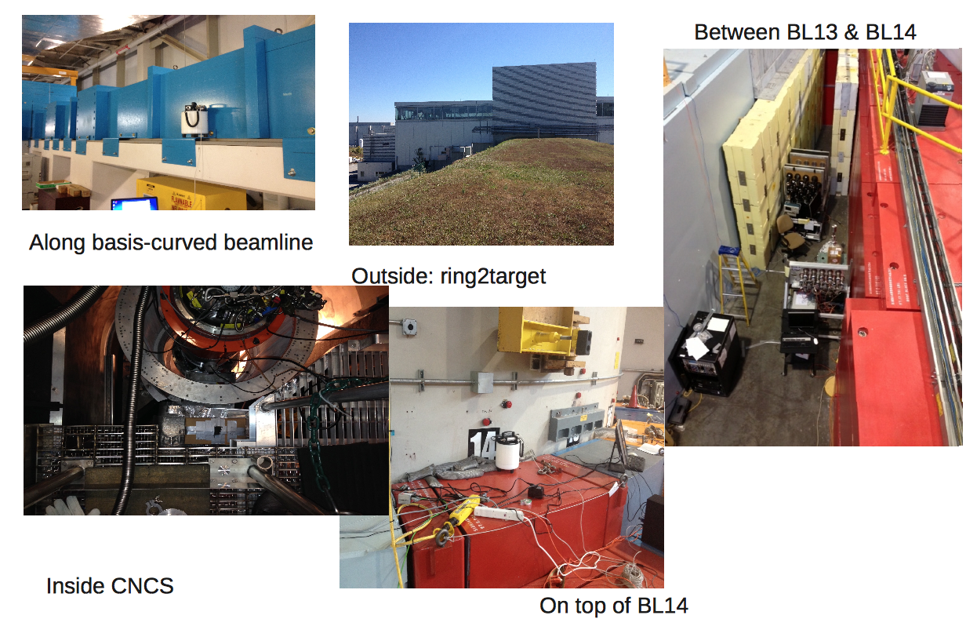
Collaborative background studies with SNS ESS Detector & Neutron Optics and Shielding groups
paper in preparation
D. DiJulio et al.

Slide 12
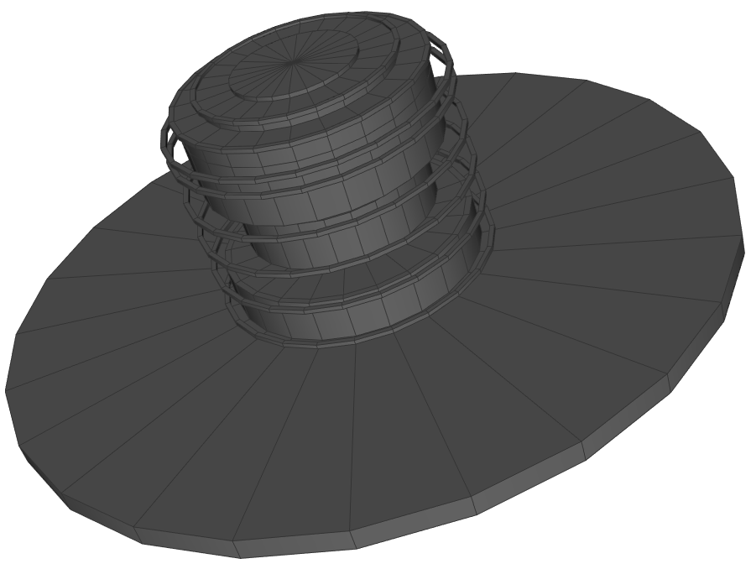
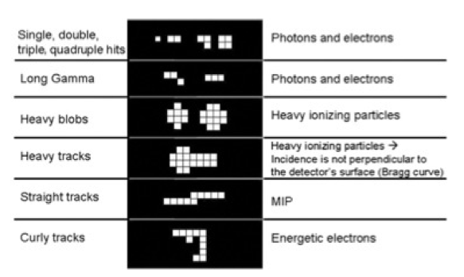
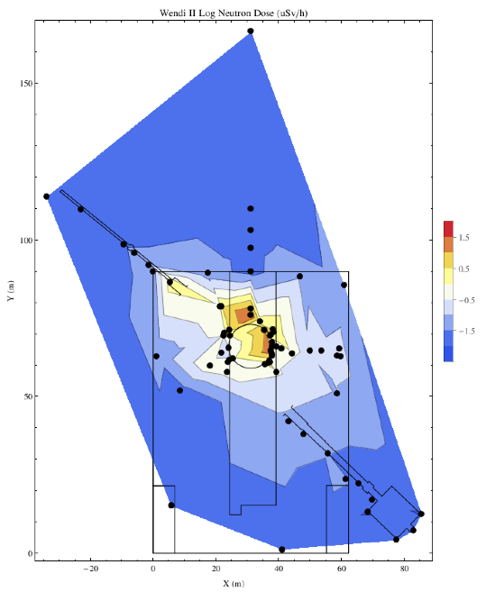
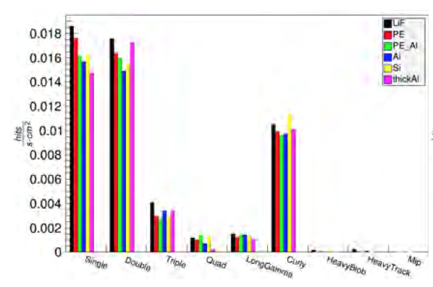
Measurements & Simulations
neutron dose map
around the SNS target
and POWGEN instrument
SINQ source G4 model
hit distributions in
Medipix detector
at SNS

Slide 13
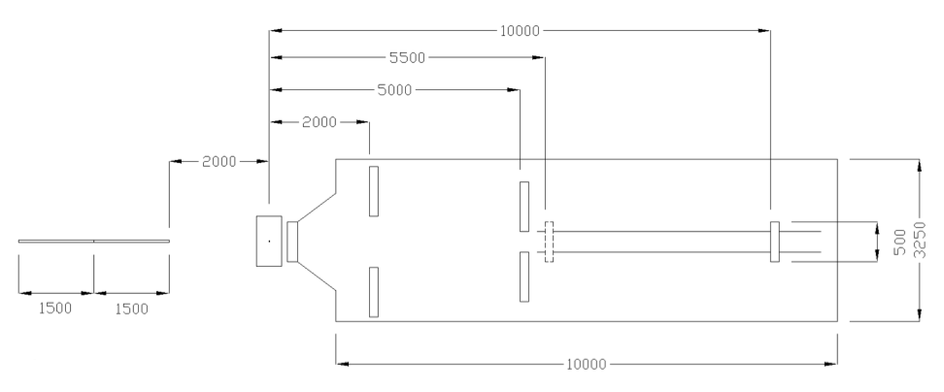
Possible LOKI detector geometries: window frame
possibility for sliding
outer frame: 3m x 3m, inner empty frame: 1m x 1m
outer frame: 2.4m x 2.4m, inner empty frame: 0.4m x 0.4m
0.5m x 0.5m

Slide 14
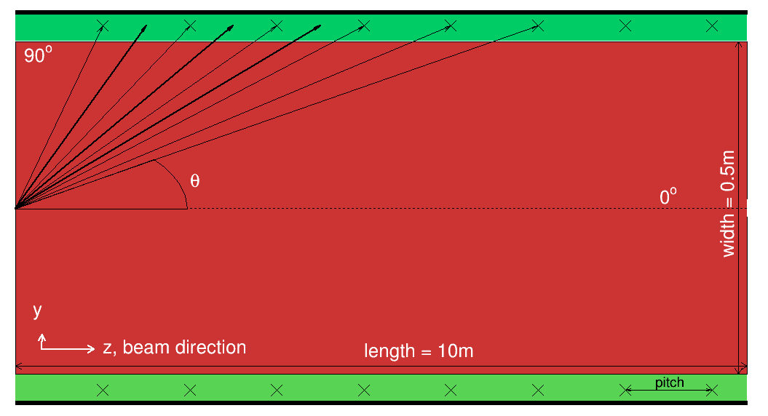
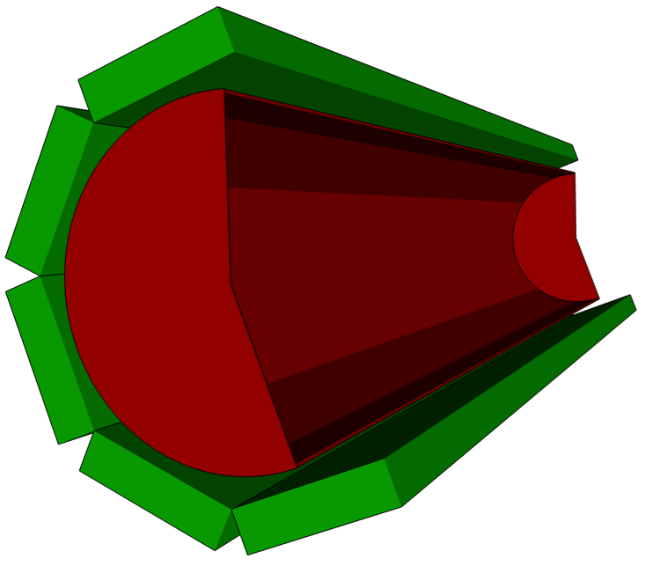
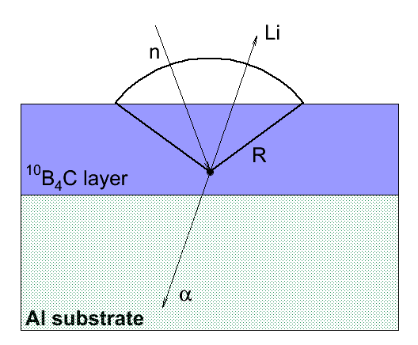
Possible LOKI detector geometries: ¹⁰B-lined barrel
detector banks
θ
vacuum tank
coating
sample
not-to-scale
¹⁰B₄C coating
K. Kanaki et al., J. Appl. Cryst. 46, 1031–1037 (2013)
2π solid angle coverage for efficient data taking
Length = 10 m, width = 0.5 m, ¹⁰B₄C layer thickness = 1 μm
Back-scattering detection mode with MWPC
Higher efficiency and resolution at forward angles
Detector and electronics outside the vacuum tank
Cheap, simple and easy to handle arrangement
Small size vacuum tank due to tube dimensions
Multi-parameter optimization
14

Slide 15
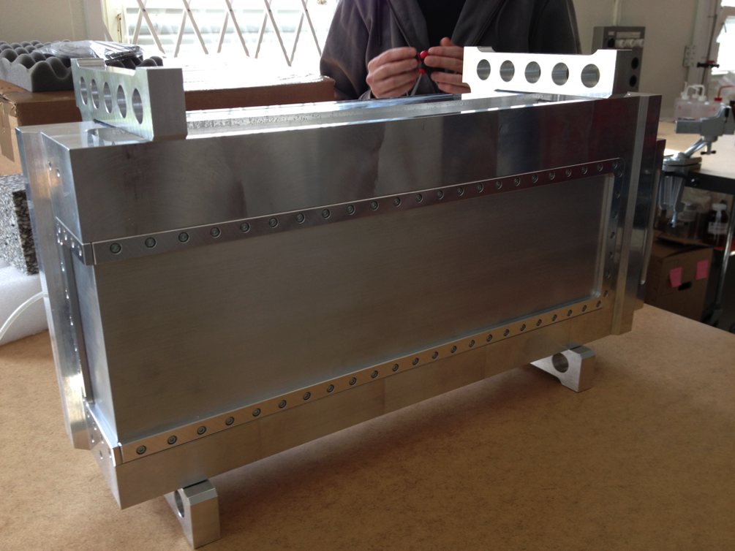
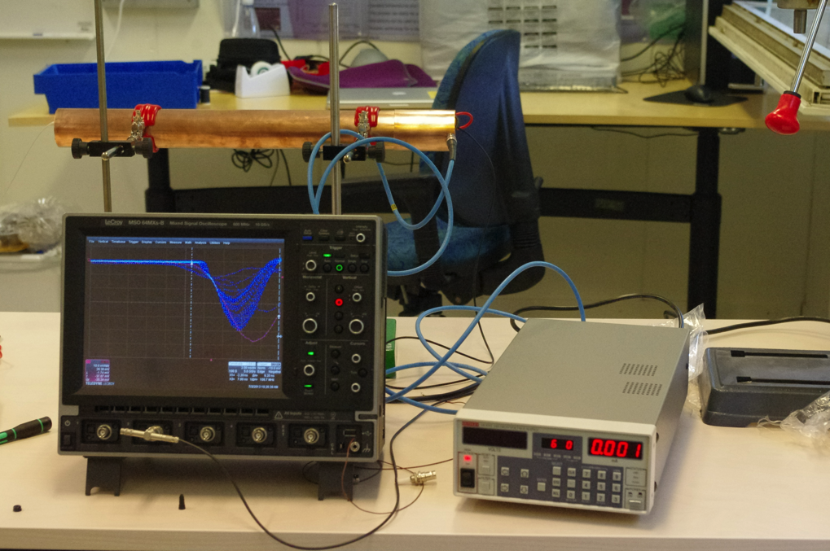
Evaluation Tools
Analytical calculations
McStas (MC): neutron ray-trace simulation package
Geant4 (MC): particle tracking and interactions
Garfield/Garfield++: ionization in gases, signal formation
Prototyping
R&D running in parallel
single cell counter
DENEX detector

Slide 16
Polar angle resolution (analytical) ¹⁰B-lined barrel
efficiency
Q resolution
Capture and ion escape included in the calculations
Back-scattering efficiency
Q resolution is detector-specific
K.Kanaki et al., J. Appl. Cryst. 46, 1031–1037 (2013)
F. Piscitelli and P. van Esch, JINST 8, P04020 (2013)
F. Piscitelli, Ph.D. thesis, University of Perugia (2013)

Slide 17
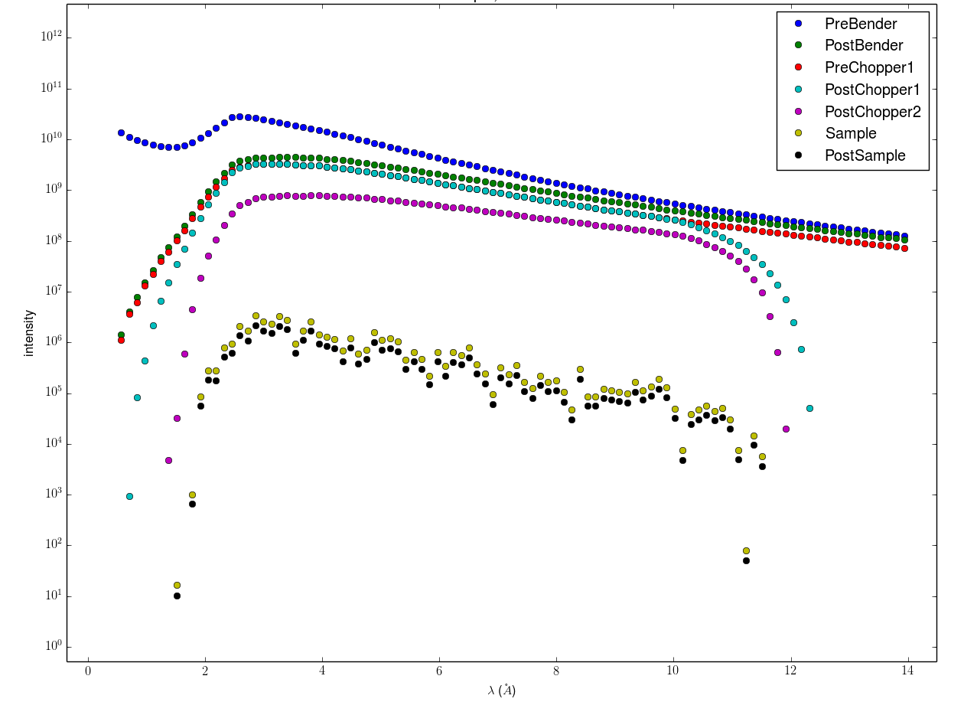
Pre- and post sample λ distribution (McStas) water sample, 2m collimation
n/s
λ (Å)

Slide 18
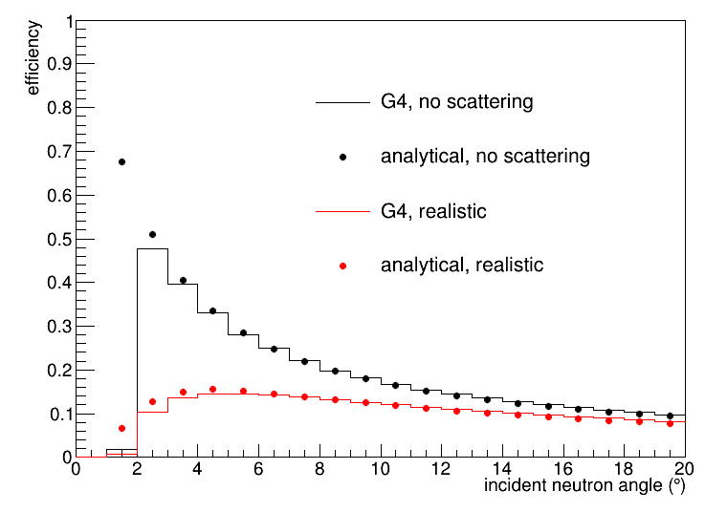
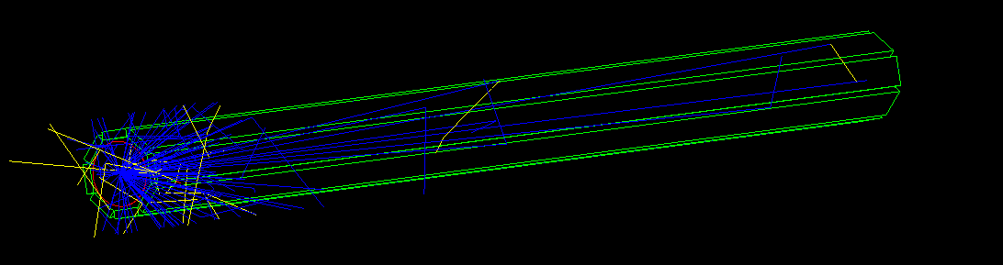
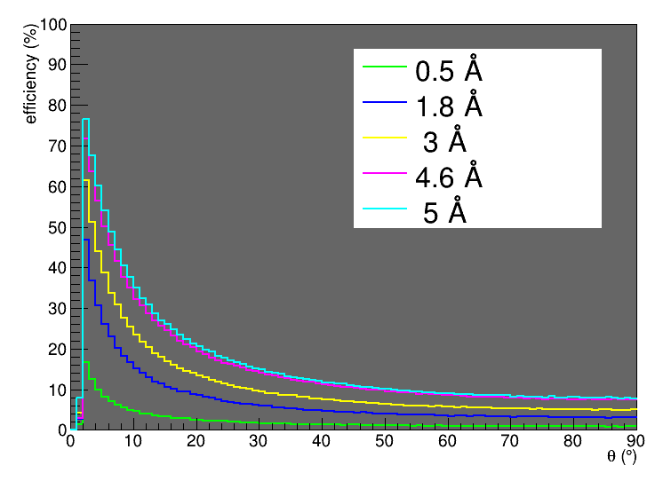
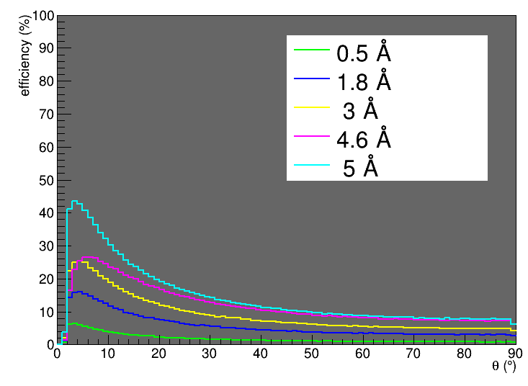
Efficiency & Scattering Studies (Geant4)
no scattering
with scattering

Slide 19
LOKI schedule for detector R&D and construction

Slide 20
Summary
LOKI entered conceptual design phase in 2014
Multiple front effort
analytical calculations
simulations
R&D
measurements in spallation facilities
evaluation for different detector geometries
Evaluation tools in place
Requirements collection process on-going
Performance of detector solutions on-going
Tollgate decision end of 2014 for technologies entering final design phase
Instrument construction at ESS is underway

