Slide 1

¹⁰B based thin films for next generation of neutron detectors using different deposition techniques
Mewlude Imam^{1,2}, Carina Höglund^{1,2}, Jens Birch¹,
Richard Hall-Wilton² , and Henrik Pedersen¹
¹Department of Physics, Chemistry and Biology Linköping University (LiU), Linköping, Sweden
²European Spallation Source (ESS) Lund, Sweden
Notes:
- Center the title
- ”for the next generation”

Slide 2
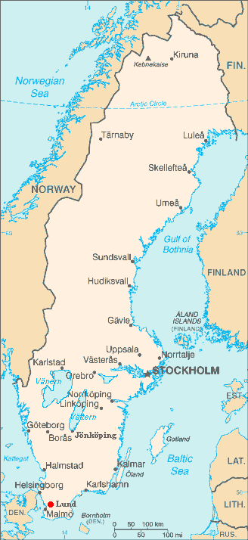

European Spallation Source (ESS)
ESS in Lund, Sweden - the world’s leading neutron source for the study of materials
Neutron detectors based on the isotope ¹⁰B instead of ³He
The first neutrons and 7 instruments will be produced in 2019, the full baseline suit of 22 instruments in 2025
Notes:
- For “the study of materials”

Slide 3
Neutron detection using ¹⁰B
¹⁰B has slightly less neutron absorption cross section compared to ³He
¹⁰B + n → ⁷Li + α + γ (94 %)
¹⁰B + n → ⁷Li + α (6 %)
^{nat}B contains 80 at.% ¹¹B 20 at.% ¹⁰B
CF₄ gas
⁷Li
¹⁰B
Substrate
α
Incident neutron

Slide 4
Boron containing thin film B₄C
Elemental B:
- Bad oxidation resistance
- Poor electrical conductivity
B₄C:
- Excellent wear resistance, thermally and chemically stable
- Better electrical conductivity
- Easy to deposit with DC magnetron sputtering

Slide 5
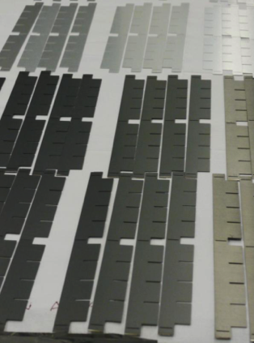
Demands on the thin films
Thickness > 1 µm
1- or 2-side coated substrates (neutron transparent)
Good adhesion and low stress
No demands on the crystallinity
High density
Minimal amount of impurities
Notes:
We want as High density as the bulk density. crystilline B4C is 2.52g/cm3

Slide 6
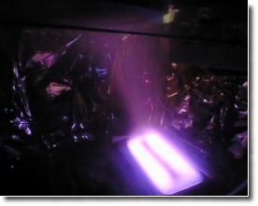
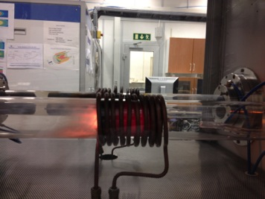
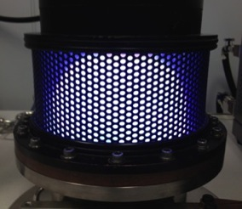
Deposition techniques in this project
DC magnetron sputtering
Thermally activated CVD
Plasma enhanced CVD
(PECVD)

Slide 7
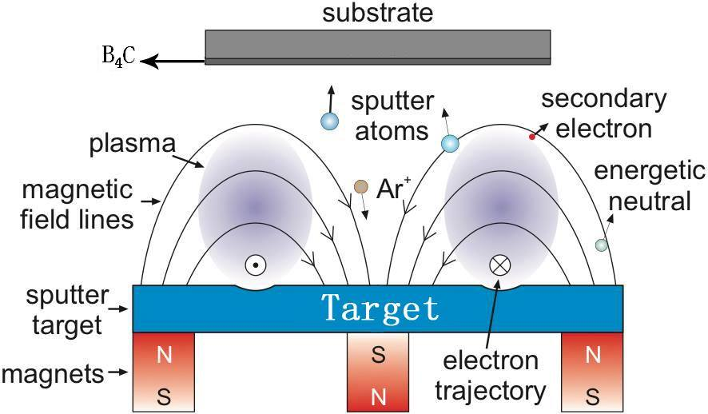
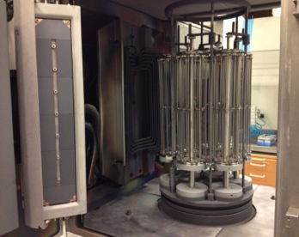
DC magnetron sputtering of ¹⁰B₄C (PVD)
LiU deposition system
Deposition in an industrial system, CemeCon CC800/9

Slide 8
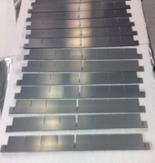
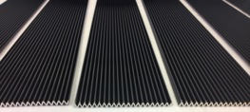
SEM cross sectional image
Required property | Result | OK?
Good adhesion | > 1 μm on Al, Si, Al₂O₃, etc | ☺
Low residual stress | 0.09 GPa at 1 μm ¹⁰B₄C | ☺
High density | 2.45 g/cm³, 97% of bulk* | ☺
High ¹⁰B content | 79.3 at.% of ¹⁰B | ☺
Low impurities | H +N + O only ~1 at.% | ☺
¹⁰B₄C
Si
1 μm
Film composition-ERDA
Patent SE 535 805 C2
C. Höglund et al., J. APPL. Phys. 111, 104908 (2012)
*O. Knotek et al. Surf. Coat. Tech. 1997, 91, 167
Coatings on Al blades
Coatings for different prototype

Slide 9
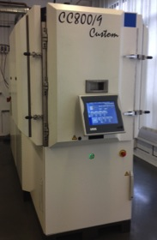
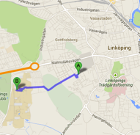
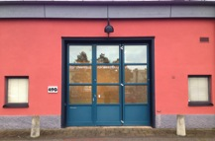
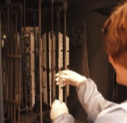
ESS coating facility in Linköping
9/2013: New deposition system ordered - Only for ¹⁰B₄C coating for neutron detectors - Covers needs of the ESS (6000 m²)
4/2014: FAT documents signed
23 June-2014 - delivery date
2014-2016: Up-scaling - 1000 m^{2/}year
LiU
”ESS”
Close collaboration with LiU:
Research & competence
- Sputtering, CVD, PECVD, …
Characterization -SEM, SIMS, XRD, ERDA,…
Upgraded LiU deposition system - Backup system
Staff:
1 engineer – 1 September start
1 technician (Q4, 2014)
Carina Höglund ~50%
8
Notes:
Factory acceptance test

Slide 10
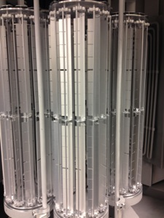
Demonstrator - IN5 segment
Mass production test!
Deadline September 2014
After this: Full scale detector!
Collaboration ESS – LiU – ILL
0.8 x 3 m² detector area
25 000 blades with ¹⁰B₄C, 103 m² in 45 days (up to 3.3 m²/day)
0.75, 1 and 1,5 μm ¹⁰B₄C coatings + 1 without coating
50% Ni-plated / 50% low-α Al
9
Notes:
30 υm Ni coating on Al blade
See Mathieu Ferraton's talk for more details
Natural Al contains U (uranium) and Th (thorium)

Slide 11
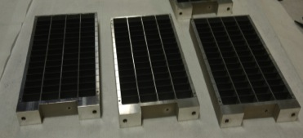
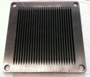
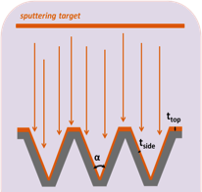
Deposition using CVD
Expected less stress in the films – less problems with adhesion
Not line of sight deposition –detector parts can be coated assembled, also allows for more complex detector geometries
It is possible to get different film stoichiometry, i.e., B_{x}C where x > 4
Notes:
Less stress in the film then sputtering.

Slide 12
Traditional B_{x}C CVD
Thermally activated CVD, 900-1300 °C Al melts at 660 ºC
Boron precursor BCl₃/BBr_{3,} produces HCl
Carbon precursor: Light hydrocarbons
typically CH₄ passive below 800 ºC
Any alternatives?
U. Jansson, J-O. Carlsson, Thin Solid Films 124 p. 101 (1985).
L. G. Vandenbulcke, Ind. Eng. Chem. Prod. Res. Dev. 24 p. 568 (1985).
U. Jansson et al.Thin Solid Films 172 p. 81 (1989).
H. Vincent et al. Carbon 34 p. 1041 (1996).
J. Berjonneau et al. J. Electrochem. Soc. 153 p. C795 (2006).
Y. Liu et al. Appl. Surf. Sci. 255 p. 5729 (2009).

Slide 13
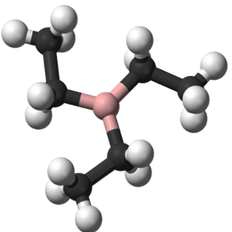
Alternative CVD route
H
Organoboranes, i.e. molecules with one or more B-C bonds:
Triethylborane (TEB) B(C₂H₃)₃
Trimethylborane (TMB) B(CH₃)₃
Tributyl borane (TBB) B(C₄H₉)₃
Very reactive – lower process temperature
Contain both B and C, no Cl
TEB reported to be the best choice for low temperature boron-carbon films *
Available as ¹⁰B enriched
B
C
TEB - TriEthylBoron
* J. S. Lewis et al. Mater. Lett. 27 p. 327 (1996)

Slide 14
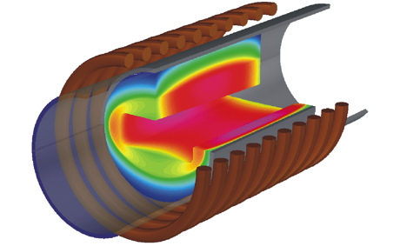

Thermally activated CVD
Growth parameters:
T = 400 – 600 °C
Pressure 50 mbar
RF Coil
Susceptor
Insulation
TEB
Carrier gas (H₂ or Ar)
Quartz tube

Slide 15
Deposited films
The films were found to be XRD amorphous, regardless of temperature and ambient
Deposition rate at 600 ºC: 0.4 µm/h in H₂ ambient, 1 µm/h in Ar
Films with thickness of 0.5-1 µm adhere well to both Al blades and single crystal Si (100) surface
H. Pedersen et al. Chem. Vapor Deposition 18 p. 221 (2012)
14

Slide 16
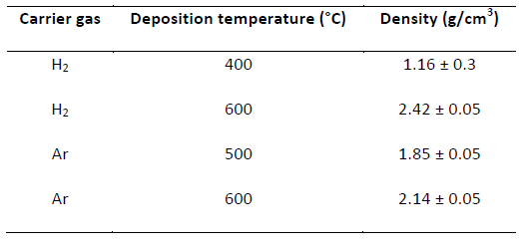
Elemental composition & density
Elastic Recoil Detection Analysis (ERDA)
Suggested chemical reaction mechanism:
In hydrogen ambient:
At low temperature TEB decomposed BH₃ and CH₄ -> high B/C
At high temperature TEB decomposed BH₃ and C₂H₄ -> lower B/C
In argon ambient:
TEB only decomposed to BH₃ and C₂H₄
Bulk density for crystalline B₄C: 2.52 g/cm³
O. Knotek et al. Surf. Coat. Tech. 1997, 91, 167
H. Pedersen et al. Chem. Vapor Deposition 18 p. 221 (2012)

Slide 17
Deposition at high T using thermal CVD
Si (100) substrate
Deposition temperature:
700-1200 ºC
Good adhesion & dense film
Deposition rate: 1.39 μm/h in hydrogen 955 nm/h in argon ambient at 700 ºC
Film density varies in 2.40 - 2.69 g/cm³
B_{x}C deposited at 800 °C in Ar

Slide 18
Elemental composition by ERDA
Precursor: B(C₂H₃)₃ (TEB)
Pressure: 50 mbar
Temperature: 700-1200 ºC
Carrier gases: H₂ & Ar
B/C = 4.5 at 700 ºC with 2.42 g/cm³
T > 1000 ºC, mainly deposited C in H₂ ambient
H < 0.3 at .%
Notes:
Different T in hydrogen and index peaks, check O, N from ERDA make sure if the impurity level is less than 0.1 at.%

Slide 19
Structural and mechanical properties
X-ray diffraction
Hardness (Nano-indentation)
T ≤ 1000 ºC, films are amorphous
> 1000 ºC graphite in H₂ ambient
Hardness 35 GPa and 33 GPa in Ar and H₂ ambient, respectively

Slide 20
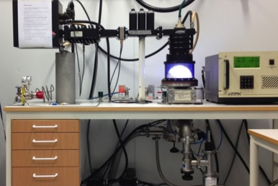
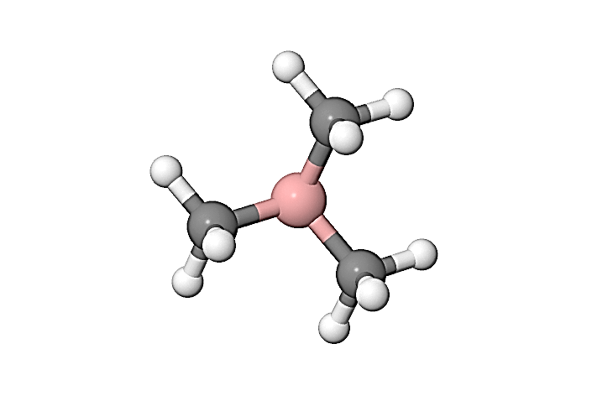
Plasma Enhanced CVD
Usually first choice for low temperature CVD
Growth parameters:
Pressure 0.2 mbar
No intentional heating
TMB
Ar carrier gas/plasma gas
¹⁰B enriched TMB is commercially available
Notes:
The reason why we used TMB,

Slide 21
Early results from PECVD
Highest Deposition rate ~300 nm/h
Smooth and dense films
Film density: 1.25 - 1.49 g/cm³
Notes:
Images white color numbers

Slide 22
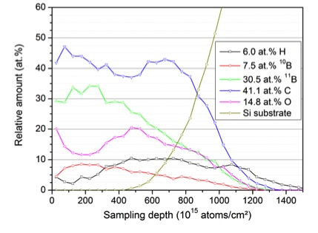
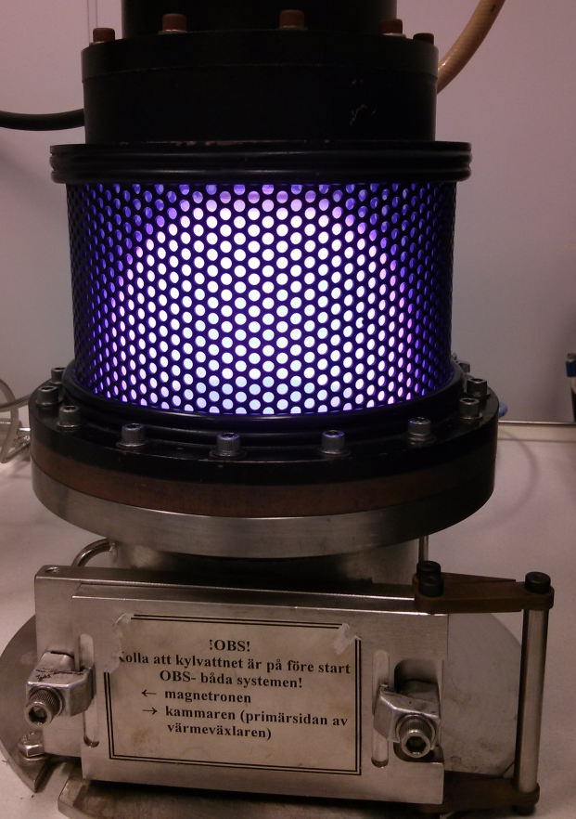
Film composition (ERDA)
Deposition parameter:
TMB 5 sccm
Ar 42 sccm
Power 2000 W
composition | Relative amount
B | 38 at. %
C | 41.1 at. %
H | 6.0 at. %
O | 14.8 at. %
B/C=1

Slide 23
Conclusions
¹⁰B containing thin film based detectors – an alternative to ³He detectors
¹⁰B₄C thin films deposited by PVD, up to 3.3 m²/day, dedicated machine will be around within a month
Thermal CVD process of B_{x}C using TEB shows:
B/C ~ 4.6, impurity level ~ 4 at.% at 600ºC
B/C= 4.3, impurity level ~ 0.1 at.% at 700 ºC
PECVD using TMB shows promising early results and is under development
Notes:
Think it again

Slide 24


Acknowledgements

Slide 25

Thank you for your attention!
Mewlude.imam@esss.se
yimma@ifm.liu.se

