Slide 1

A Neutron Source Facility for Energy Dependent Detector Characterization
julius.scherzinger@nuclear.lu.se
PhD student at
Lund University, Sweden
European Spallation Source

Slide 2
Overview
Low cost neutron irradiation facility for detector characterization
First results establishing viability of method:
blind irradiation using a mixed field
neutron “tagging”

Slide 3
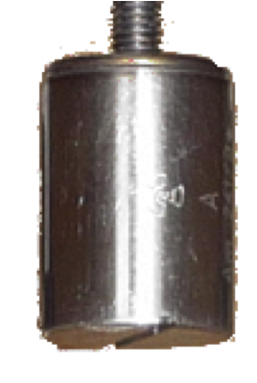
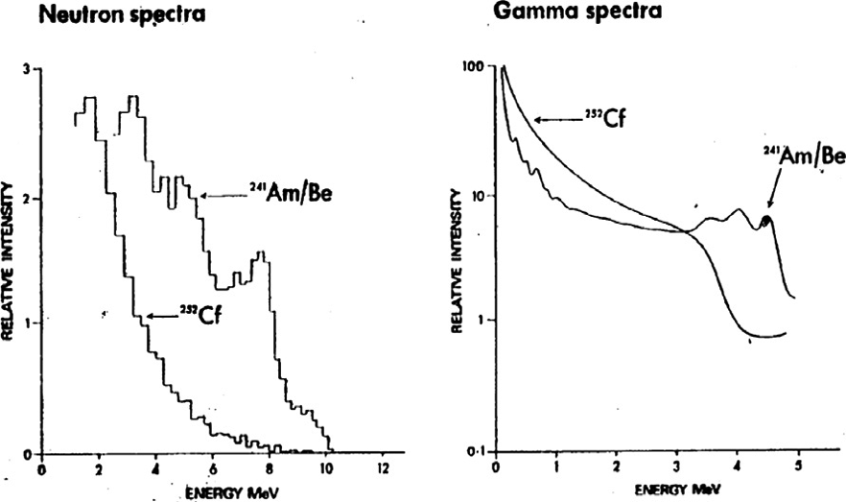
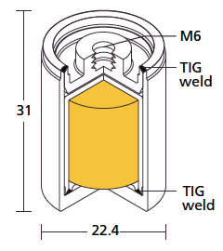
AmBe source

Slide 4
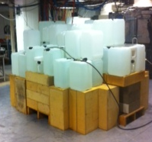

Slide 5
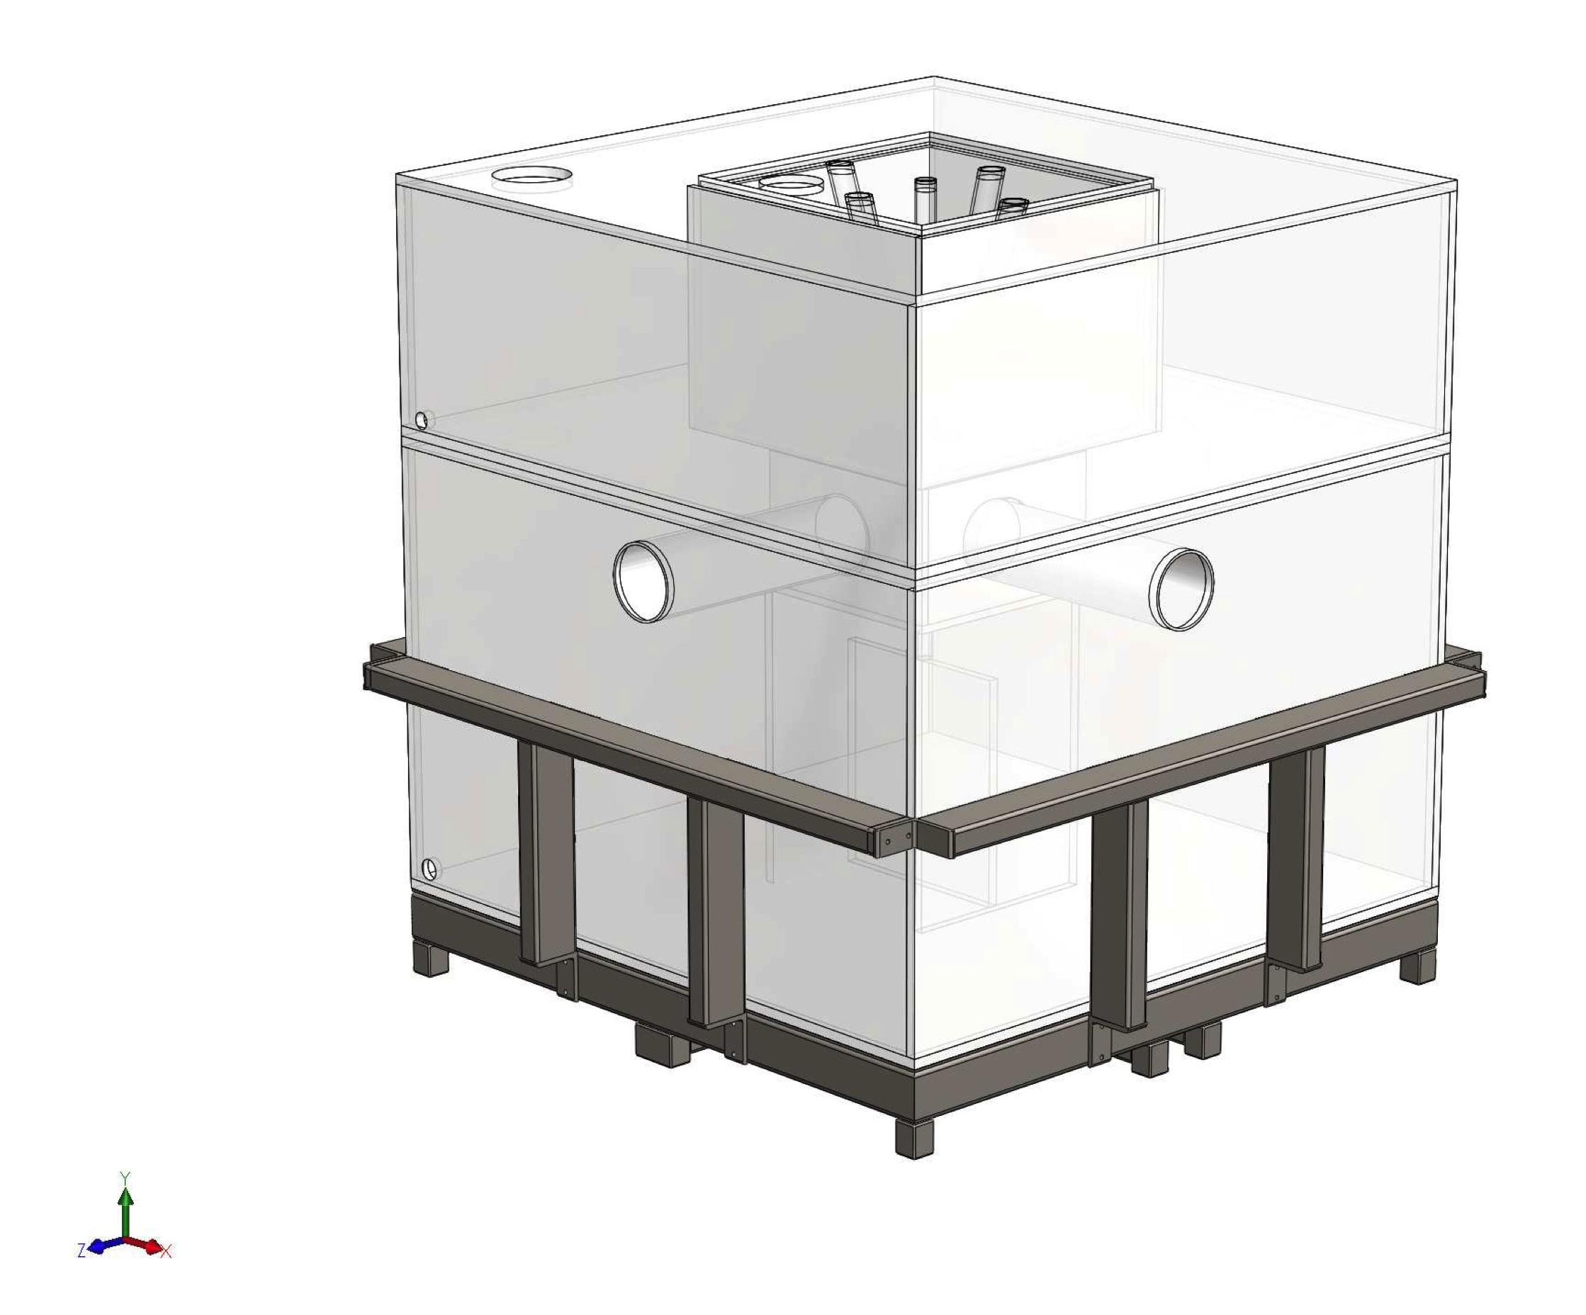

Slide 6
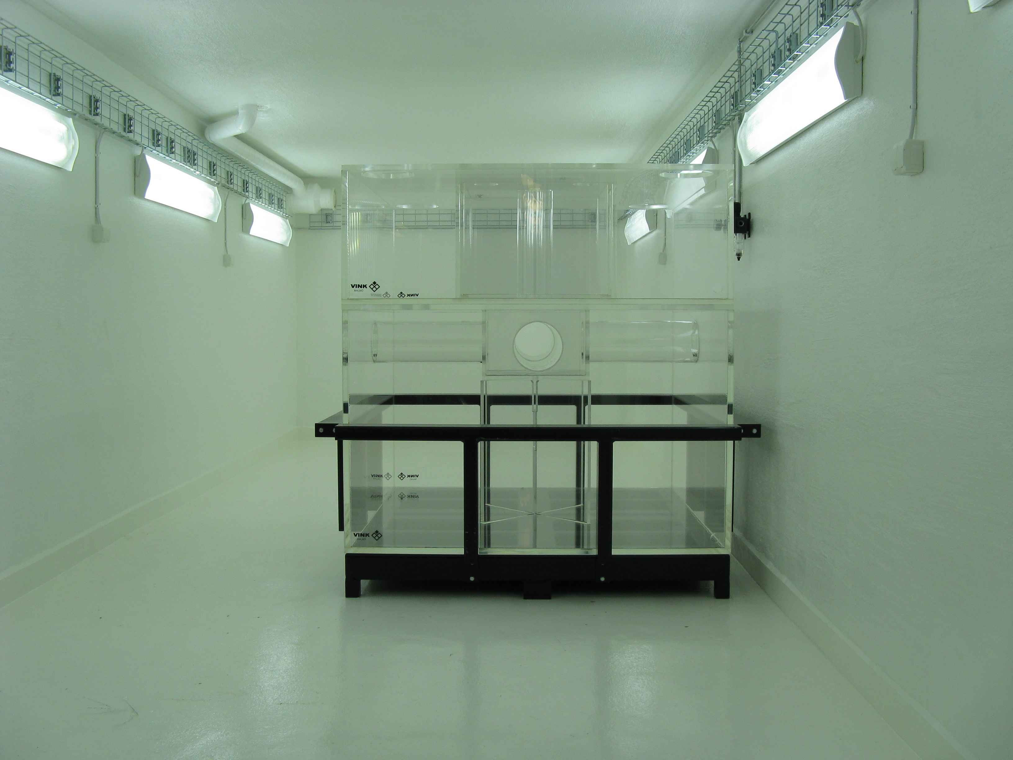

Slide 7
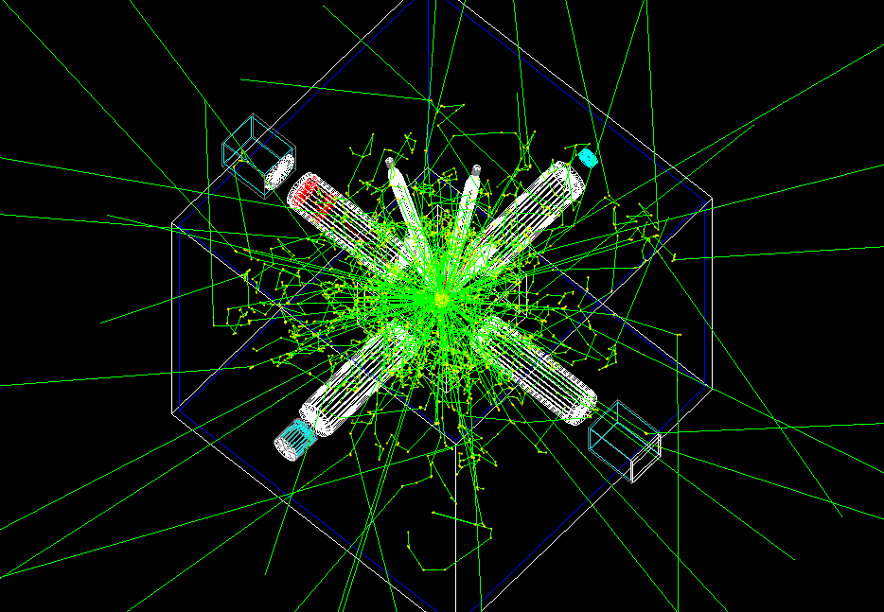
GEANT4 simulation, courtesy of J. Annand, University of Glasgow

Slide 8
Scintillator Properties
Mapping
Pulse Shape Discrimination (PSD)
Pulse Shape (PS)
Figure-of-Merit (FOM)
Proton Light Yield
Quenching (MeV_{ee}/MeV<1)
Non linearity

Slide 9
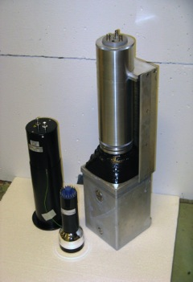
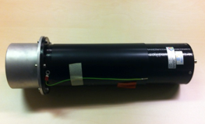
Scintillator
ET 9821 KB
3 inch
borosilicate glass
NE-213
Optical coupled
dry fitted
light guide
Aluminum Cell
10 cm X 7.5 cm
sandblasted and painted

Slide 10
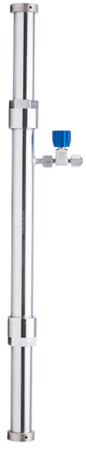
Scintillator
Hamamatsu R580
2 inch
borosilicate glass
⁴He
179 bar
Optical coupled
dry fitted
Active Volume
1.05 l
R. Jebali et al., "Response comparison between a 4He-based fast neutron detector and a NE-213 liquid scintillator reference cell ”, to be submitted to Nucl. Inst. and Meth. A

Slide 11
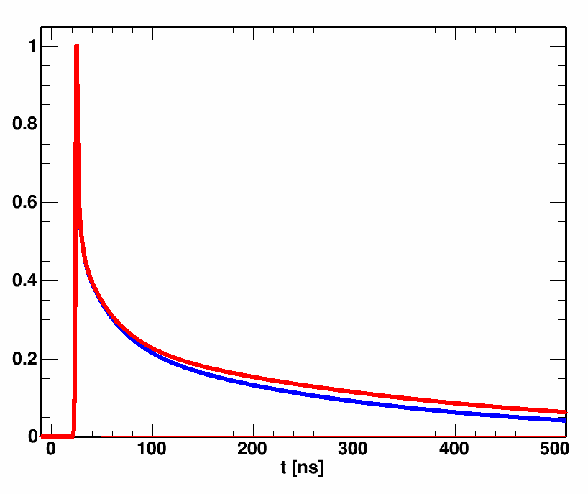
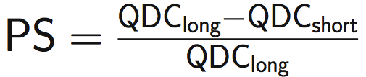
recoil proton (neutron)
recoil electron (γ)
Short Gate 60 ns
Long Gate 500 ns

Slide 12
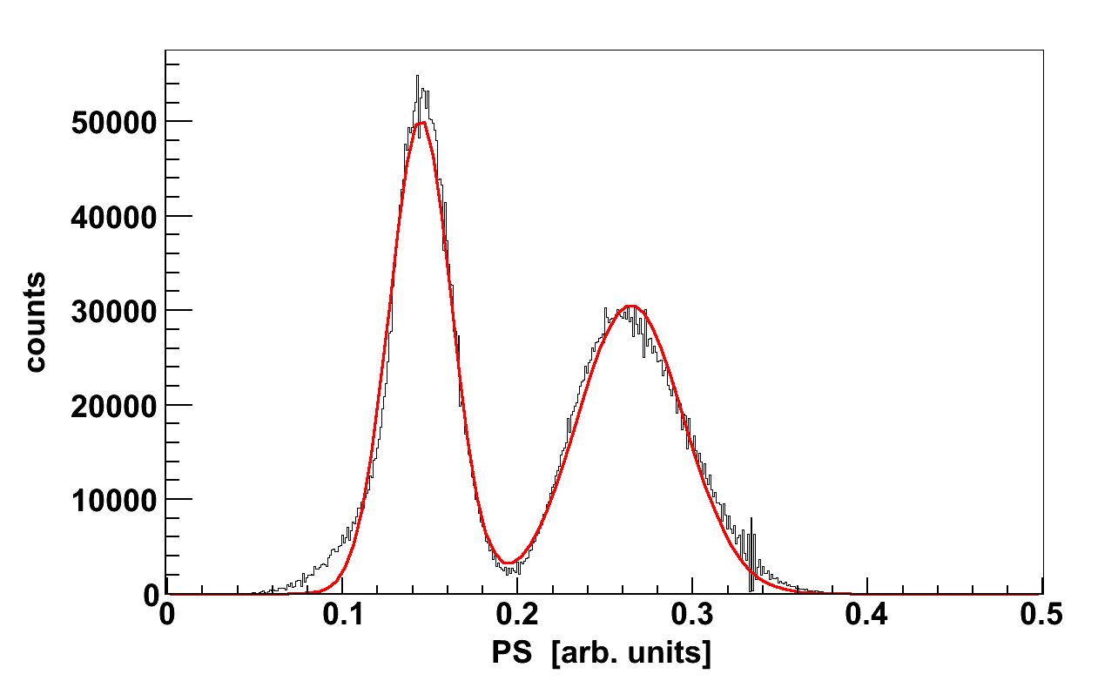
Integrated PS
Threshold 0.58 MeV_{ee}
FOM = Δm/(𝛅₁+𝛅₂)
γ
FOM = 1.03
Δm
neutrons
FWHM
𝛅₁
FWHM
𝛅₂

Slide 13
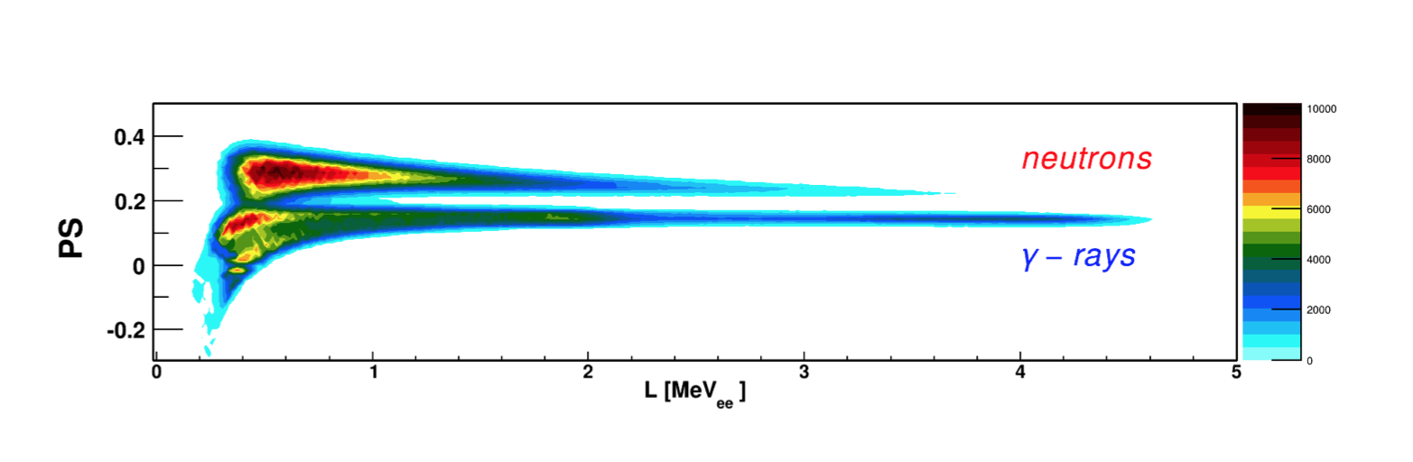
Integrated PS
Threshold 0.58 MeV_{ee}
FOM = Δm/(𝛅₁+𝛅₂)
γ
FOM = 1.03
Δm
neutrons
FWHM
𝛅₁
FWHM
𝛅₂

Slide 14
Integrated PS
Threshold 0.58 MeV_{ee}
FOM = Δm/(𝛅₁+𝛅₂)
γ
FOM = 1.03
Δm
neutrons
FWHM
𝛅₁
FWHM
𝛅₂

Slide 15
Integrated PS
Threshold 0.58 MeV_{ee}
FOM = Δm/(𝛅₁+𝛅₂)
γ
FOM = 1.03
Δm
neutrons
FWHM
𝛅₁
FWHM
𝛅₂

Slide 16
Integrated PS
Threshold 0.58 MeV_{ee}
FOM = Δm/(𝛅₁+𝛅₂)
γ
FOM = 1.03
Δm
neutrons
FWHM
𝛅₁
FWHM
𝛅₂

Slide 17
Integrated PS
Threshold 0.58 MeV_{ee}
FOM = Δm/(𝛅₁+𝛅₂)
γ
FOM = 1.03
Δm
neutrons
FWHM
𝛅₁
FWHM
𝛅₂

Slide 18
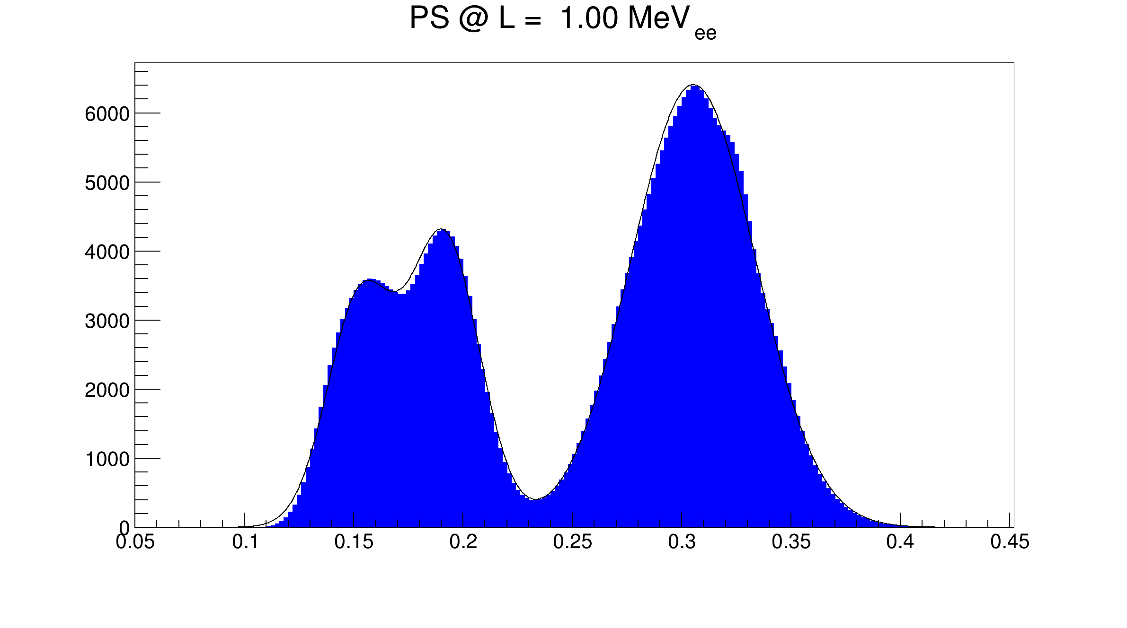
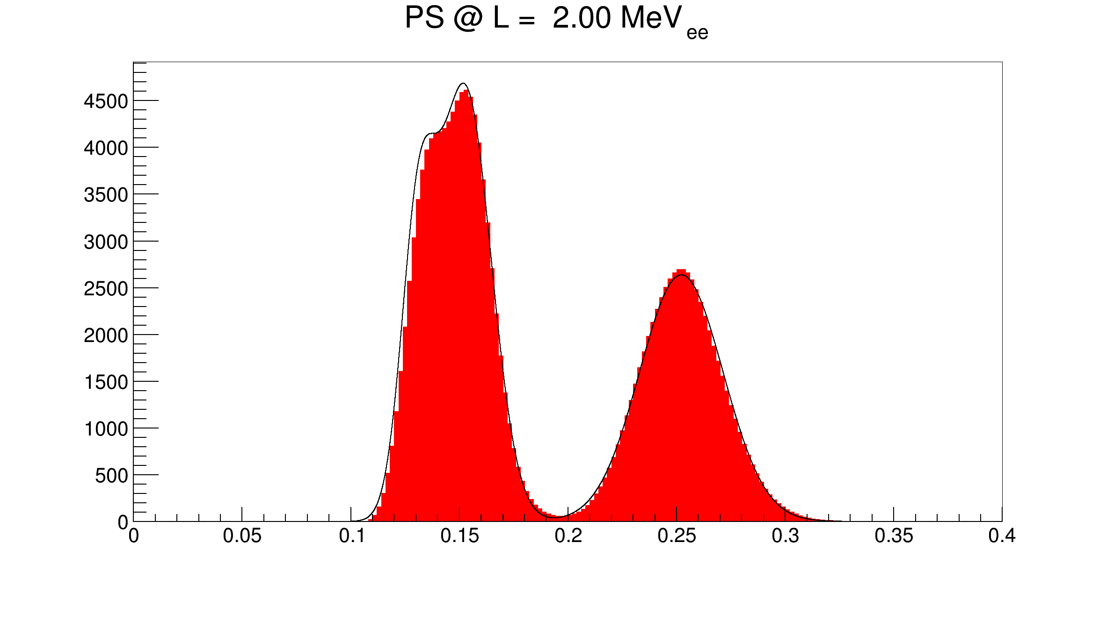
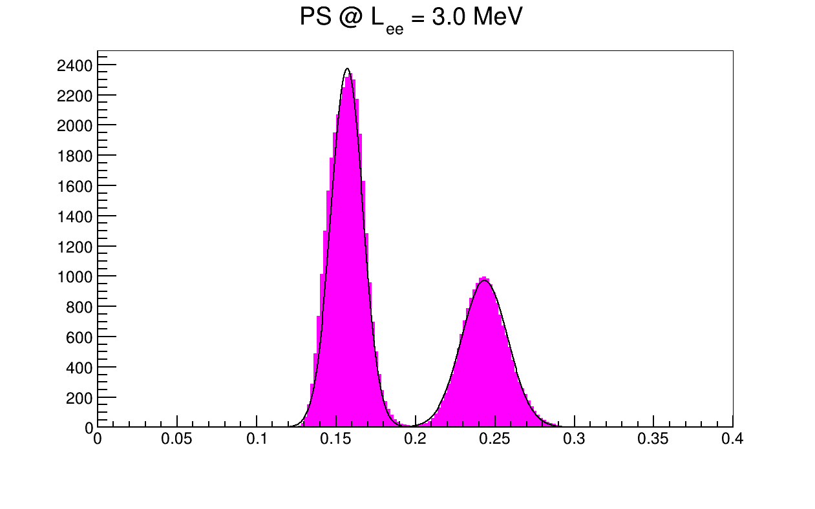
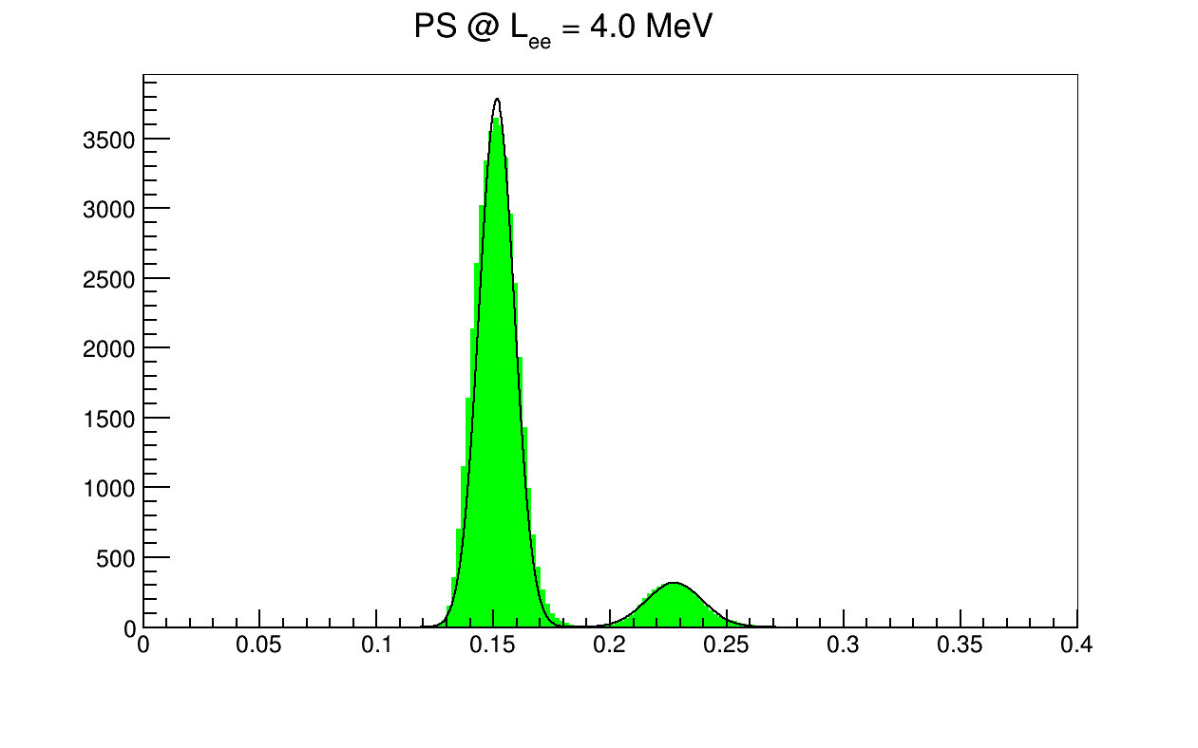
PS @ 1 MeV_{ee}
PS @ 2 MeV_{ee}
neutrons
neutrons
γ
γ
PS @ 3 MeV_{ee}
PS @ 4 MeV_{ee}
γ
neutrons
γ
neutrons

Slide 19
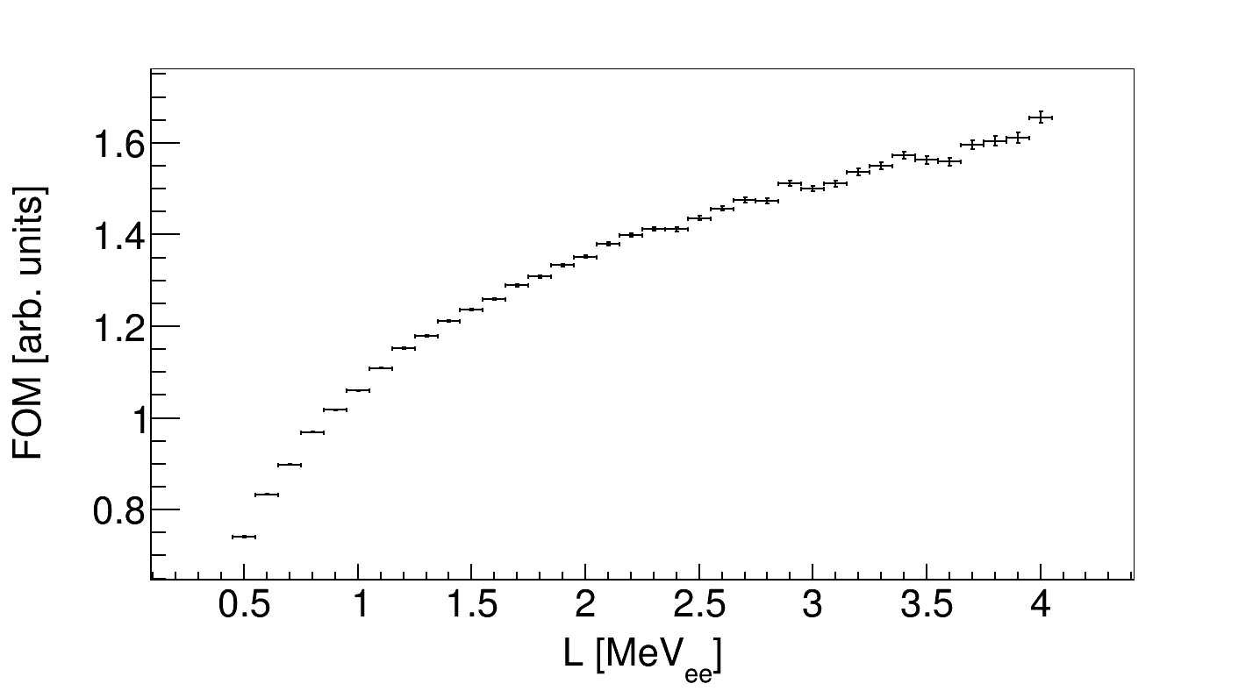
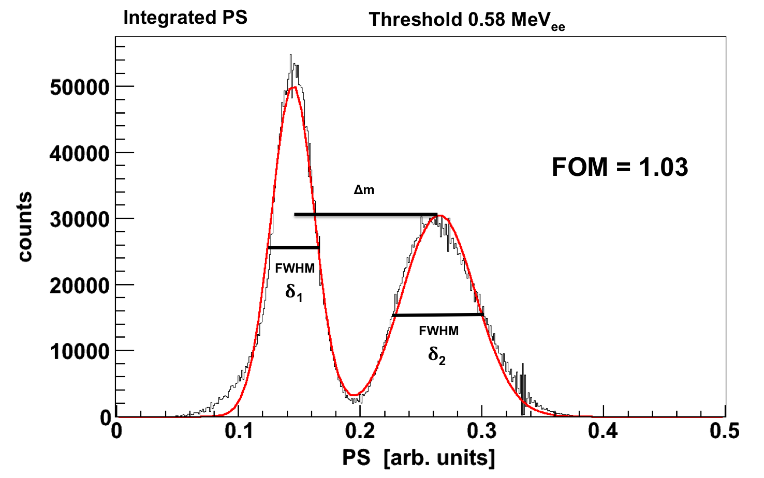
neutrons
γ

Slide 20
neutrons
γ

Slide 21
neutrons
γ

Slide 22
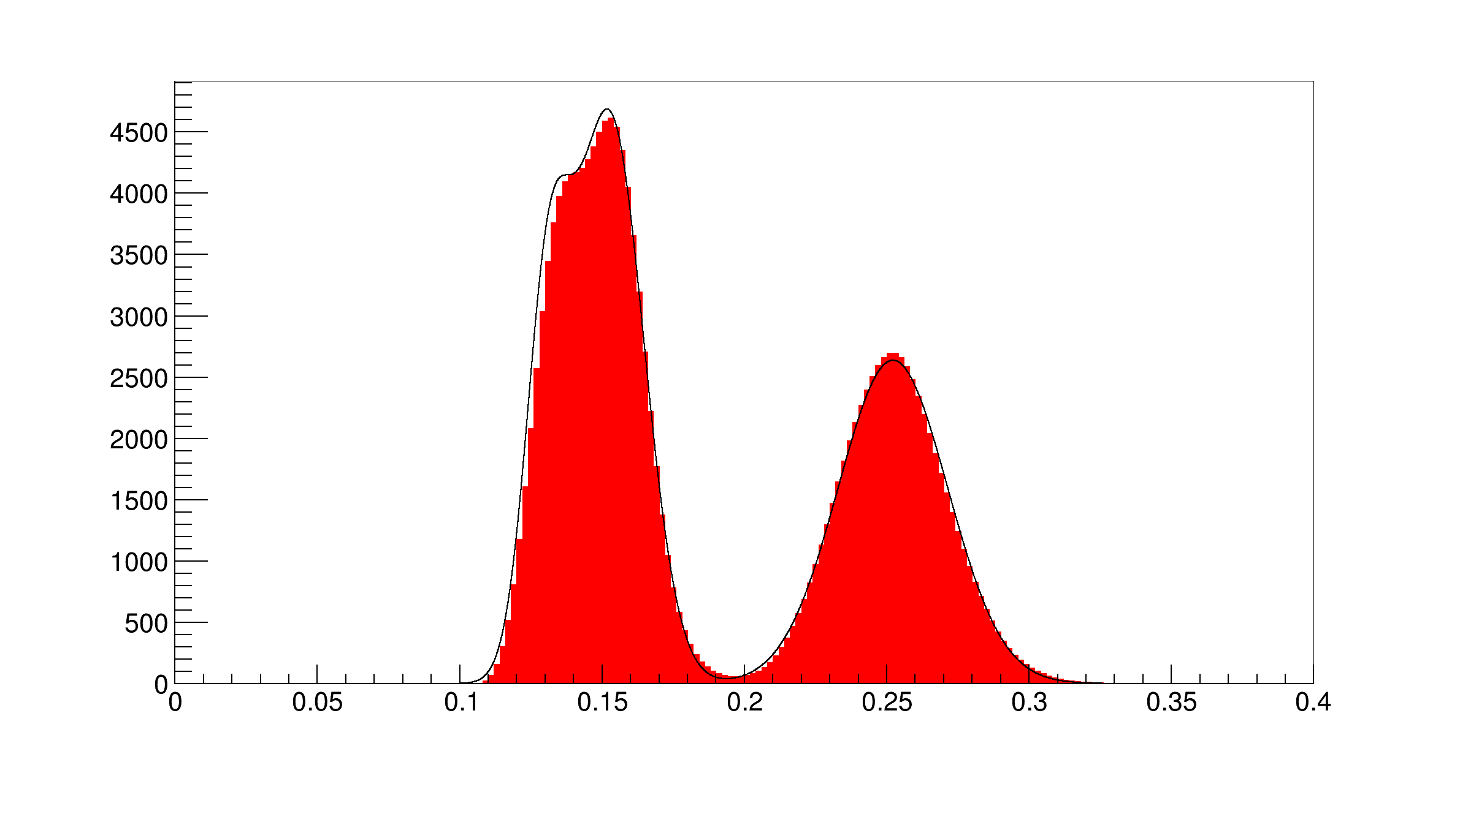
neutrons
γ

Slide 23
neutrons
γ

Slide 24
“Tagged” Neutrons
J. Scherzinger et al.,"A source-based fast-neutron facility for precision irradiations”,
arXiv:1405.2686[physics.ins-det] (2014), submitted to Nucl. Inst. and Meth. A

Slide 27
(4.43 MeV)
~60%

Slide 28
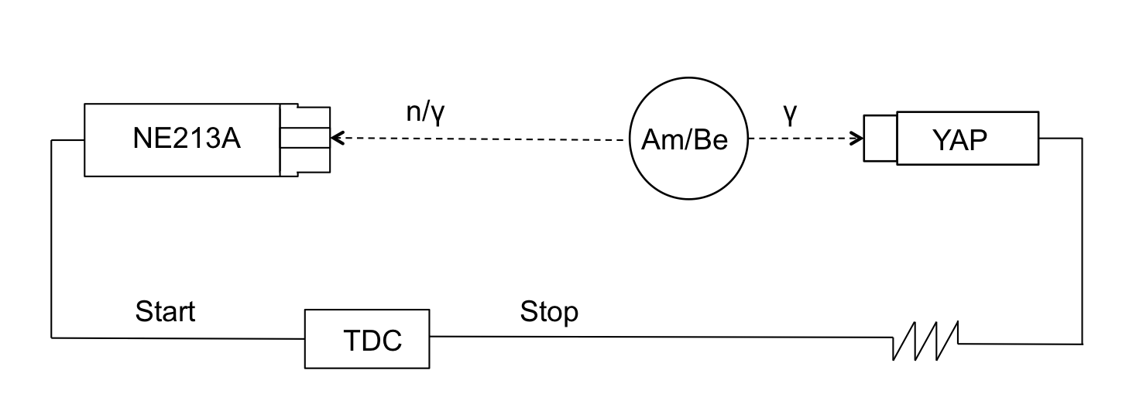
(4.43 MeV)
~60%

Slide 29
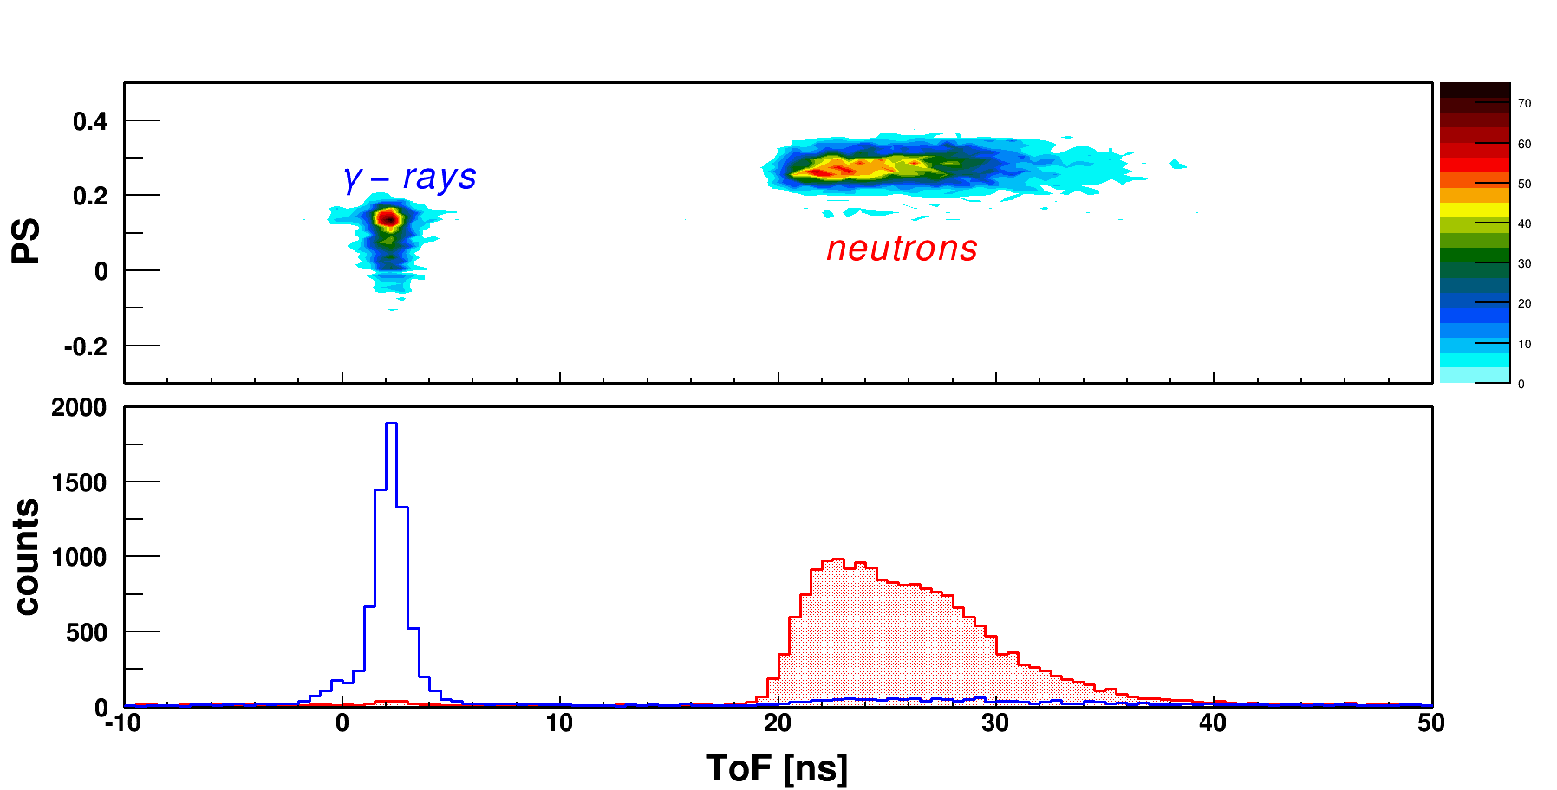

Slide 31
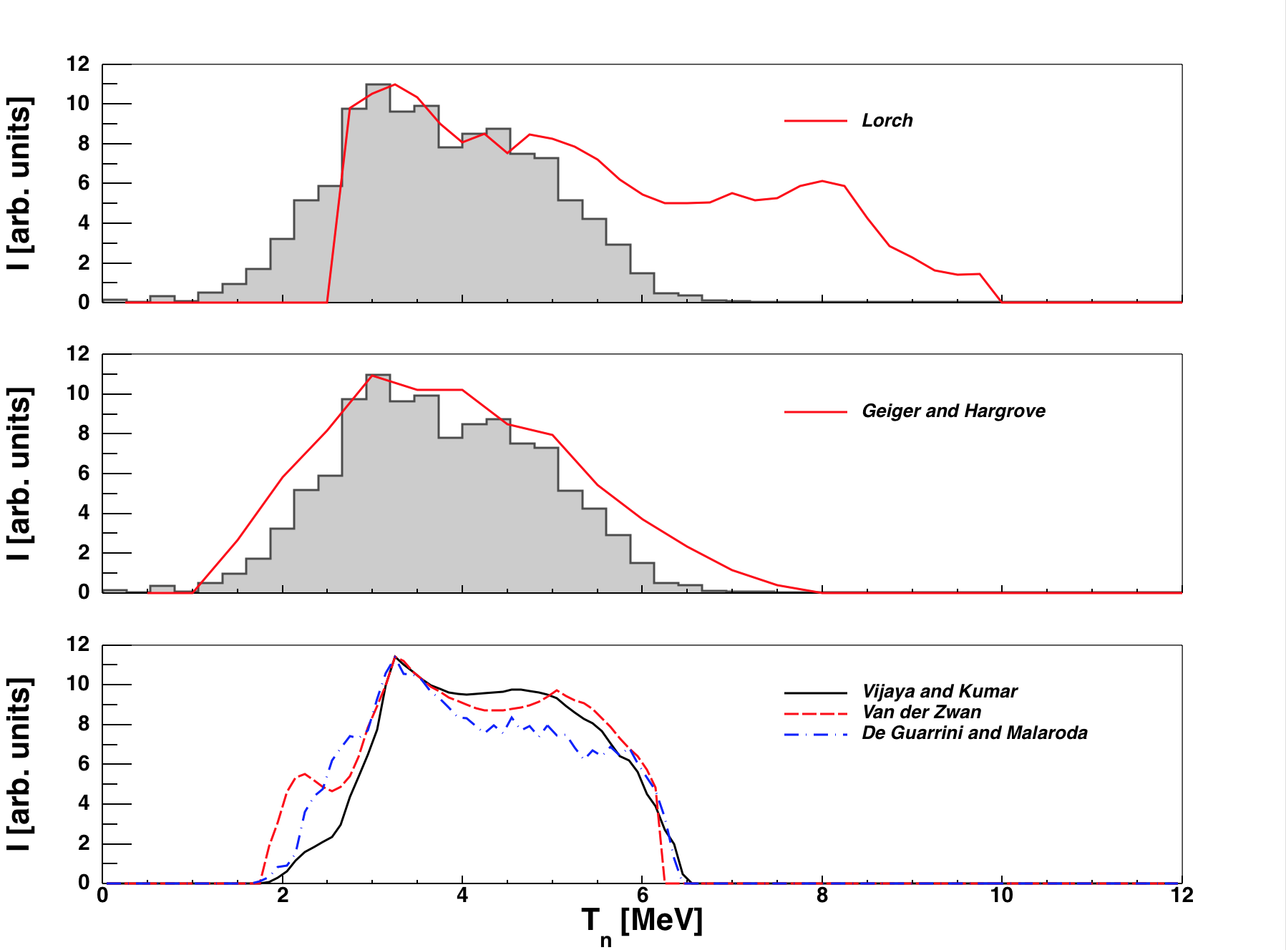
E.A. Lorch, Int. J. Appl. Radiat. Is. 24 (1973) 585.
This Work
K.W. Geiger, C.K. Hargrove Nucl. Phys. 53 (1964) 204.
Calculations
A.D. Vijaya, A. Kumar, Nucl. Instrum. and Meth. 111 (1973) 435.
L. Van der Zwan Can. J. Phys. 46 (1968) 1527.
F. De Guarrini, R. Malaroda Nucl. Instr. and Meth. 92 (1971) 277.

Slide 32
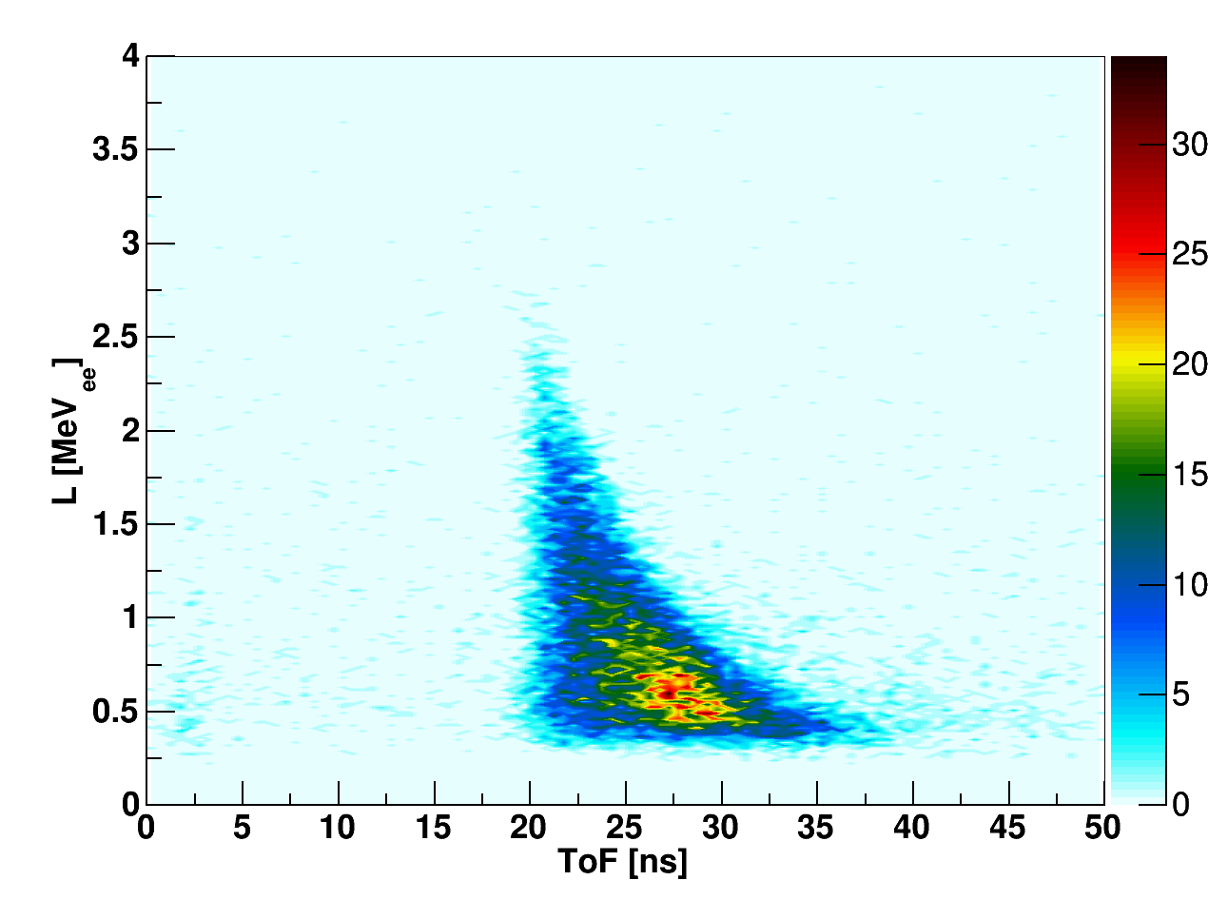
Proton Light Yield
Incident Neutrons

Slide 33
Proton Light Yield
4.8 MeV
Incident Neutrons

Slide 34
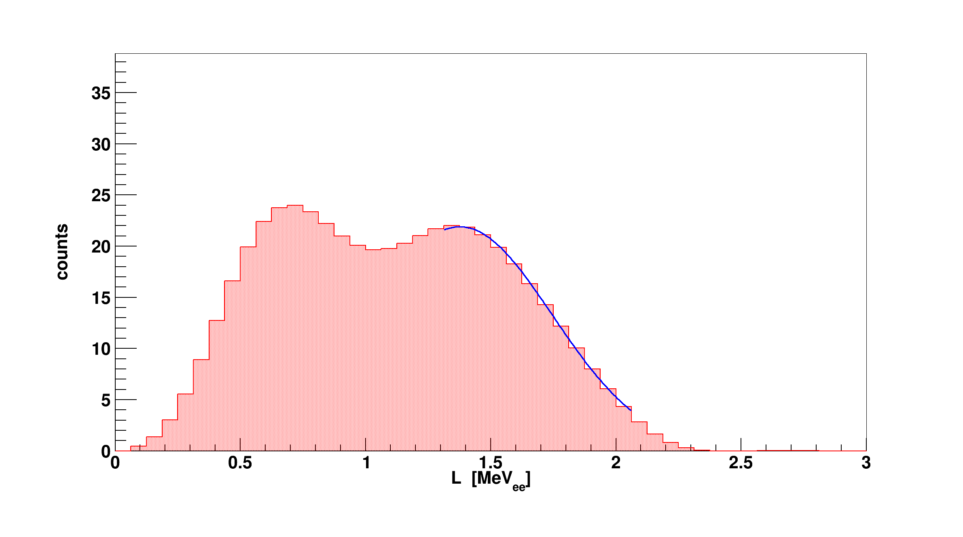
Threshold
Multi Scattering
L_{max}

Slide 35
This Work
A. Naqvi et al., Nucl. Inst. and Meth. A 353 (1994) 156–159.
N. Kornilov et al., Nucl. Inst. and Meth. A 599 (2009) 226–233.

Slide 36
Conclusion
Fast neutron detection
Blind irradiation behaves as expected
Neutron “tagging” technique promising
NE-213 characterization in good agreement with other groups

Slide 37
Conclusion
Fast neutron detection
Blind irradiation behaves as expected
Neutron “tagging” technique promising
NE-213 characterization in good agreement with other groups
“High” energy background studies

Slide 38
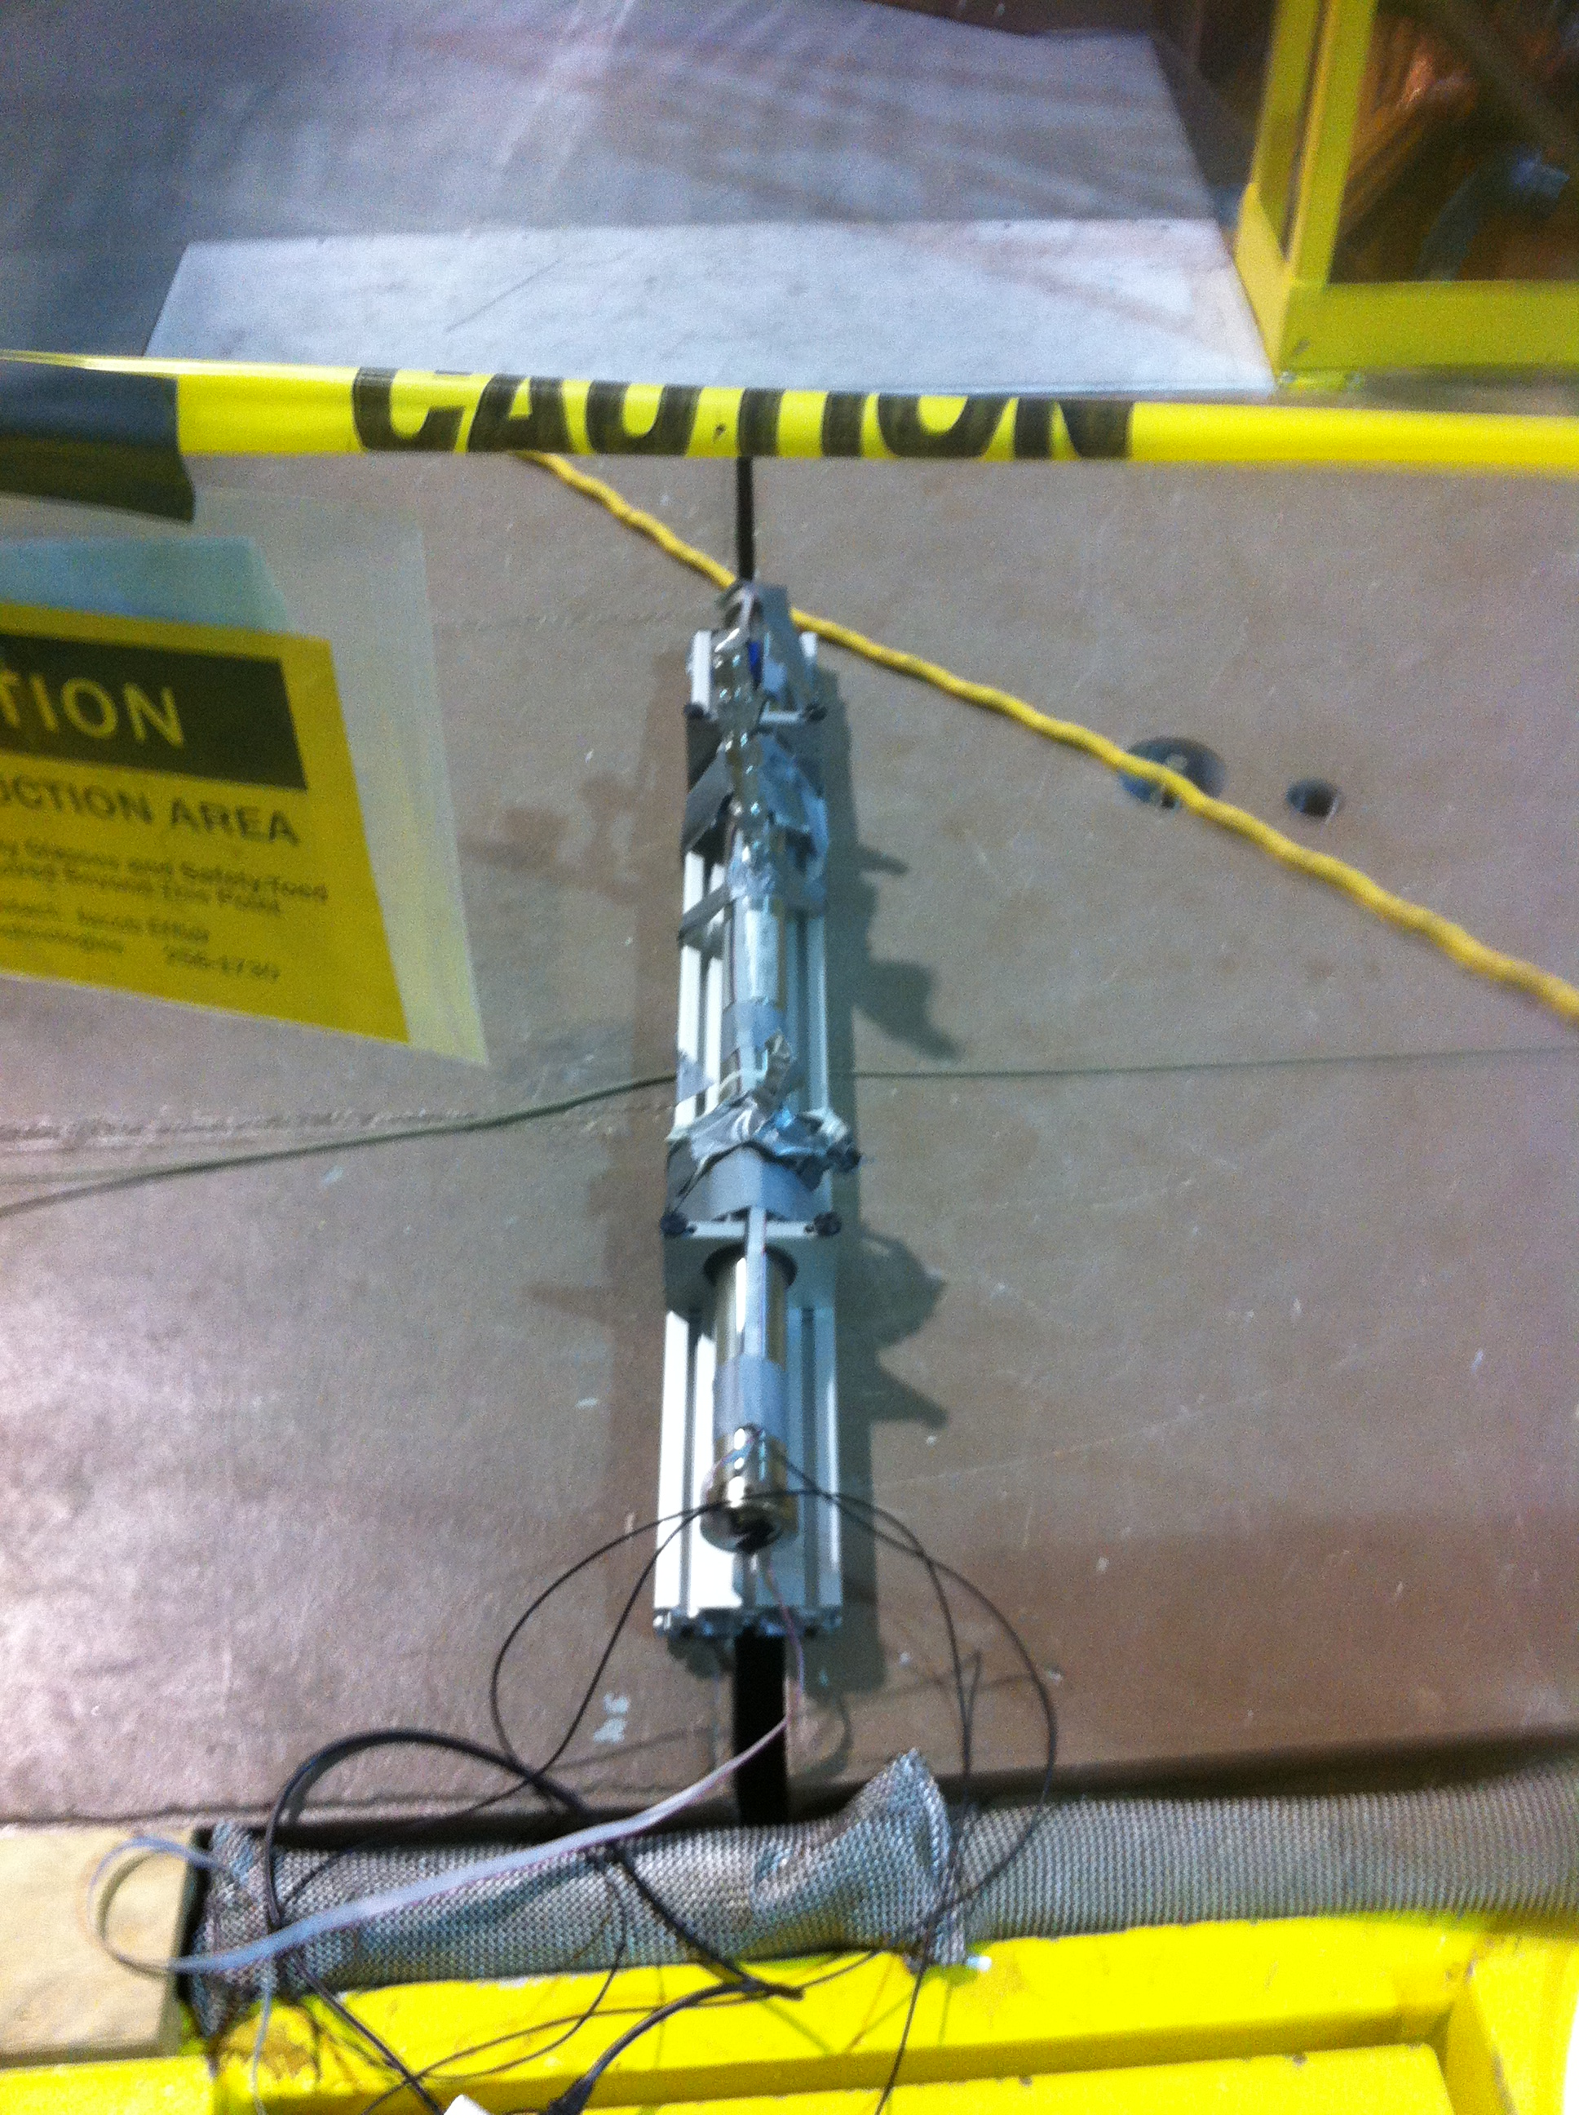
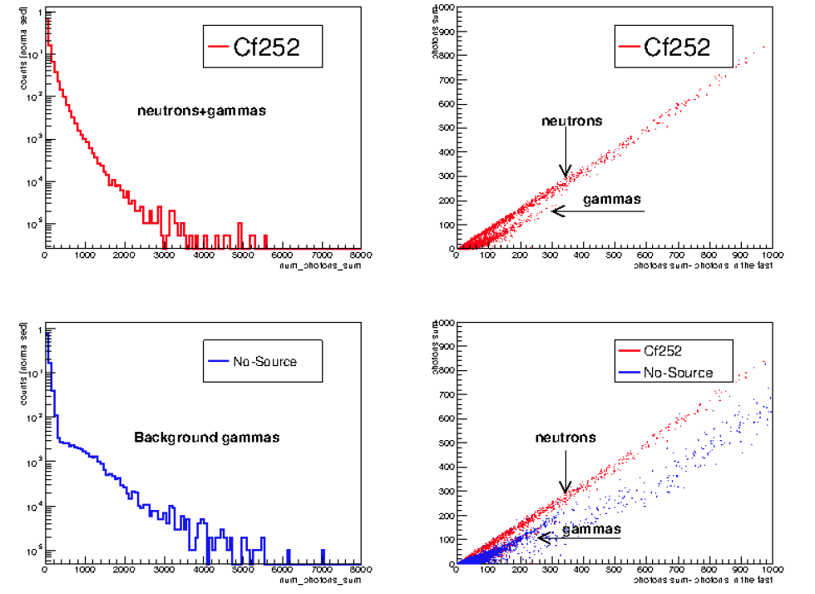
SNS “High” Energy Background

Slide 39
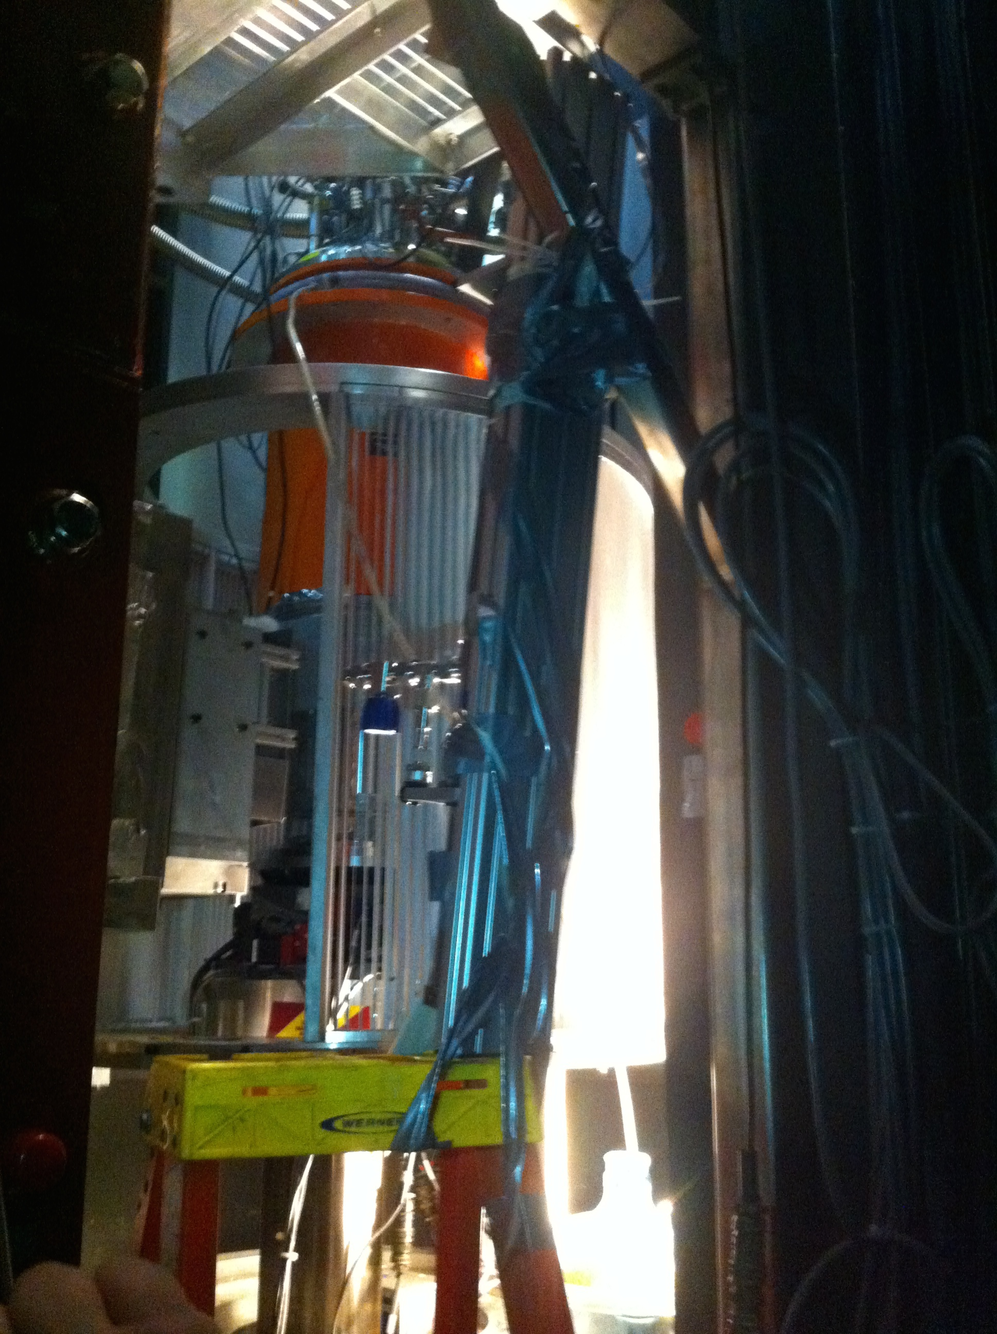
SNS “High” Energy Background

Slide 40
SNS “High” Energy Background
Preliminary

Slide 41
Outlook
Upgrading existing equipment
Flash ADC; to complement QDCs
Wide-Range TDC; 10 ms drift times
³He tube
Moderator/Shielding
Cd
PE

Slide 42
Outlook
Upgrading existing equipment
Flash ADC; to complement QDCs
Wide-Range TDC; 10 ms drift times
³He tube
Moderator/Shielding
Cd
PE
“Tagged” thermal neutrons

Slide 43



Thanks to
John Annand, Ramsey Jebali
Magnus Lundin, Anders Hansson, Håkan Svensson
Kalliopi Kanaki, Richard Hall-Wilton
Kevin Fissum

