Slide 1
¹⁰B-based detector with stacked macrostructured cathodes and resistive wire readout
Irina Stefanescu, Richard-Hall Wilton, Carina Höglund
ESS AB, Lund, Sweden
Ilario Defendi, Machiel Zee, Karl Zeitelhack
MLZ (FRM2), Garching, Germany
Jens Birch, Lars Hultman
IFM, Linköping University, Sweden
www.europeanspallationsource.se
03/06/14

Slide 2


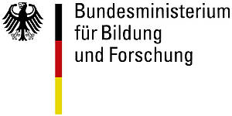

The working framework
International Collaboration for Neutron Detector Development
(ICND).
German In-Kind Contribution to the ESS Upgrade Phase (WP 2.3)
FP7 – NMI3-II (Task 21.2)
icnd.org
Main objective: development of alternative technologies to replace the ³He tubes in large-area detectors for neutron scattering applications.

Slide 3
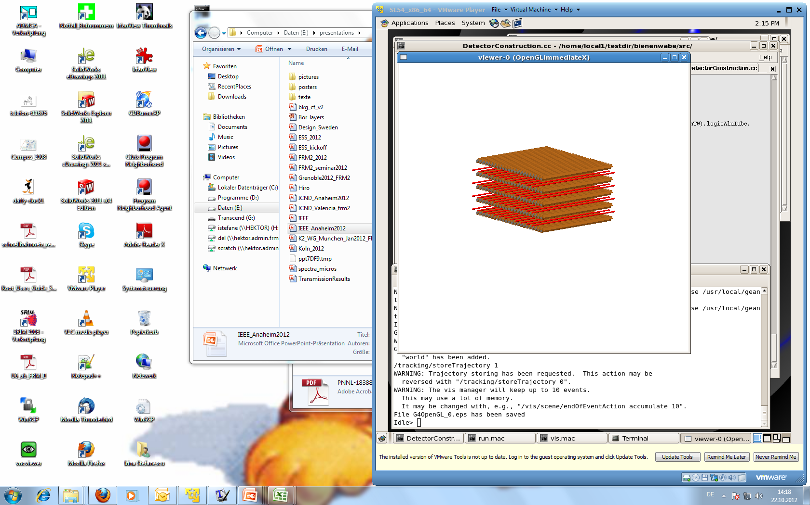
The detector concept
Concept exploits the increase of detection efficiency with angle
Stack of MWPCs with Boron-lined “macrostructured” cathodes
Sense wire planes
α=45°
λ=4.7 Å
ε～28%
x
22.5°
ε～12%
⁷Li(α)
α
n
∼mm
α
α(⁷Li)
d‘
ε_{absorption} ∼ d/sin(α)
n
ε_{absorption} ∼ d
3D regular pattern consisting of grooves that can be created in the substrate material by milling, extrusion, forming, etc.
¹⁰B
Al

Slide 4
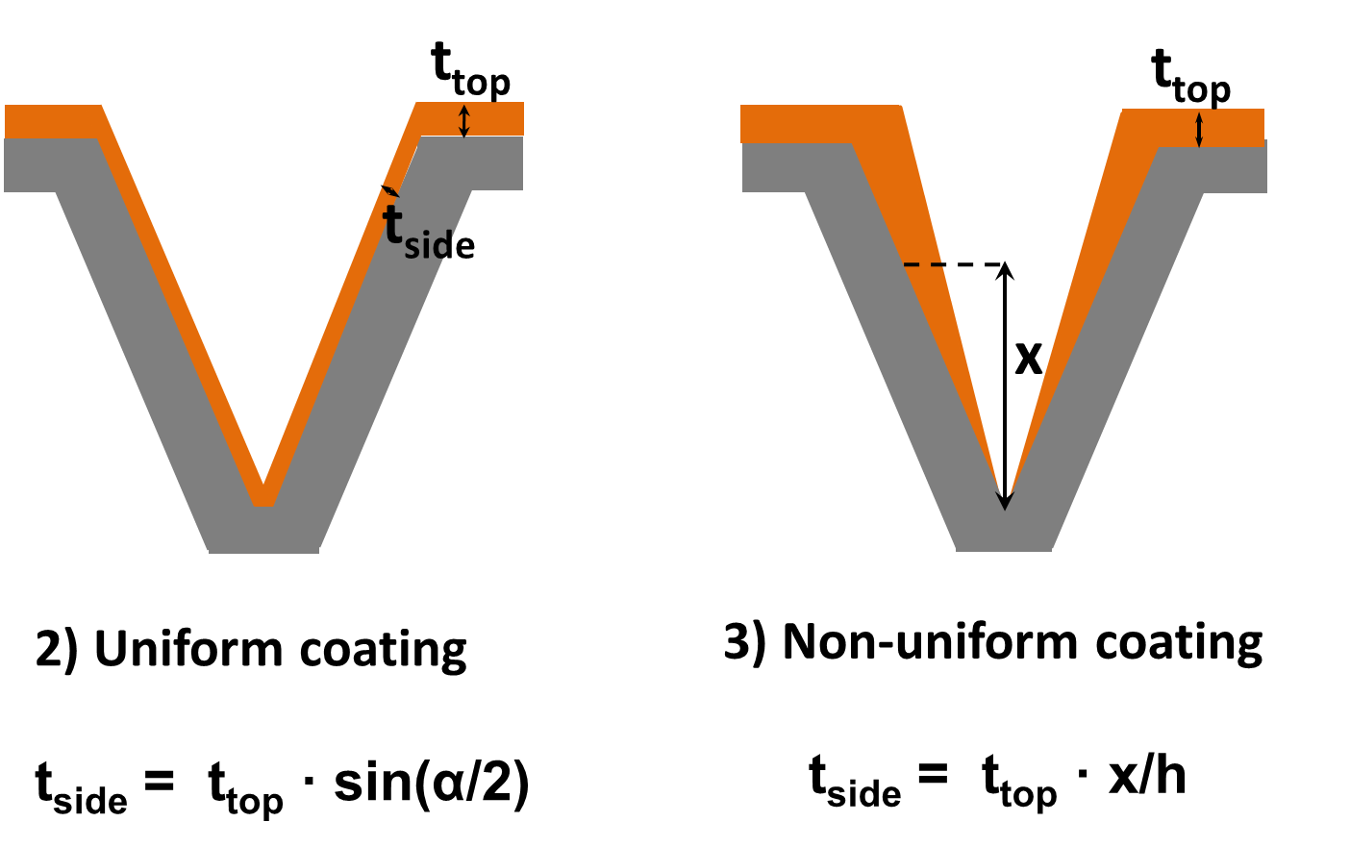
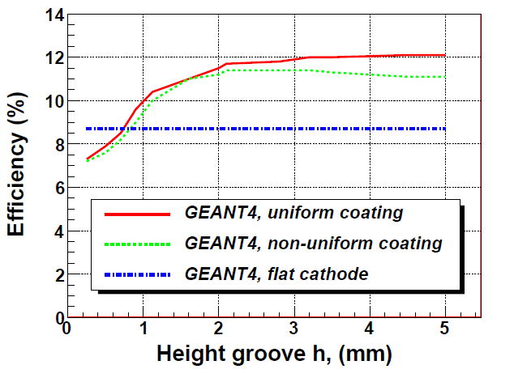
Model simulations
GEANT4 simulations
Optimal geometry of the groove to maximize the detection efficiency of the coated plate.
Effects of the conformality of the coating on the detection efficiency.
λ = 4.7 Å
t_{side} = t_{top} * sin(α/2)
α
(uniform coating, ideal)
h
t_{side} = t_{top} * (x/h)
I. Stefanescu et al., Nuclear Instruments and Methods in Physics Research A727 (2013) 109.
(coating non-uniform, realistic)

Slide 5
Model simulations
GARFIELD simulations
Electric field inside a MWPC with macrostructured cathodes.
Drift lines and times for electrons.
Drift time ≈700 ns (400 ns for flat cathodes)
A-C distance = 6.5 mm.
I. Stefanescu et al., Nuclear Instruments and Methods in Physics Research A727 (2013) 109.

Slide 6
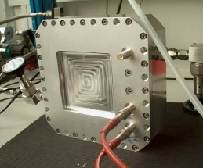
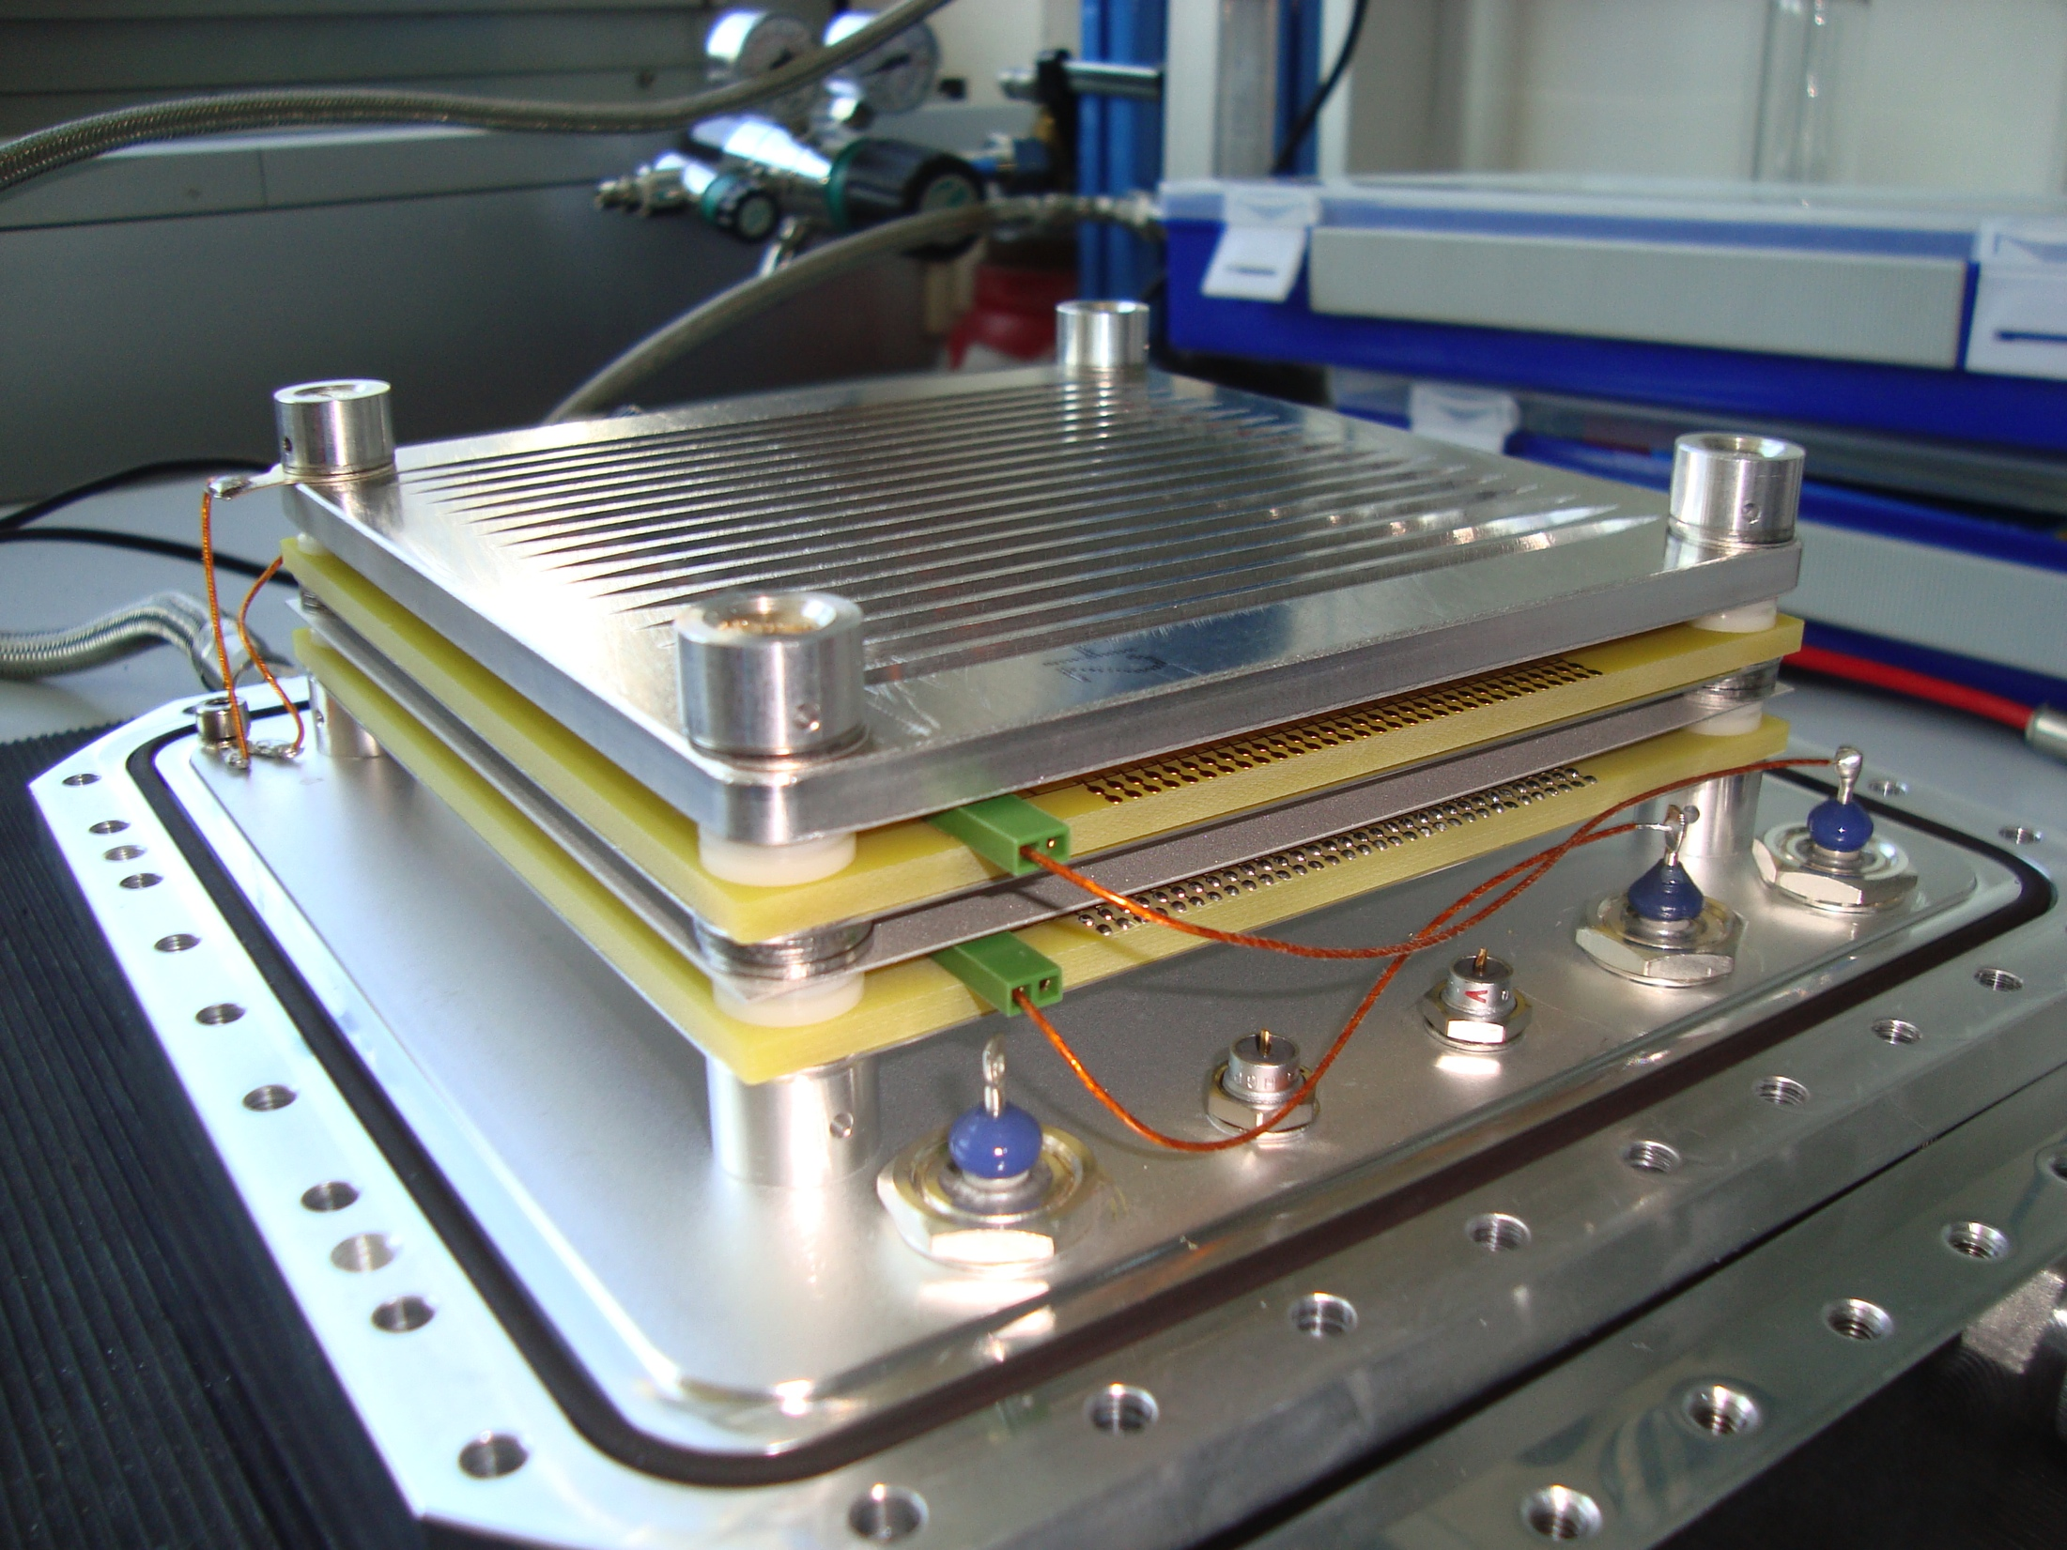
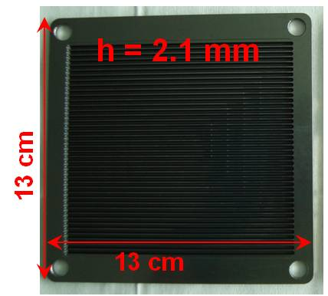
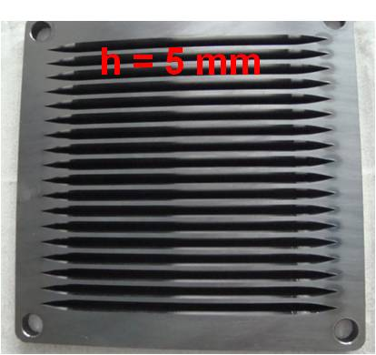
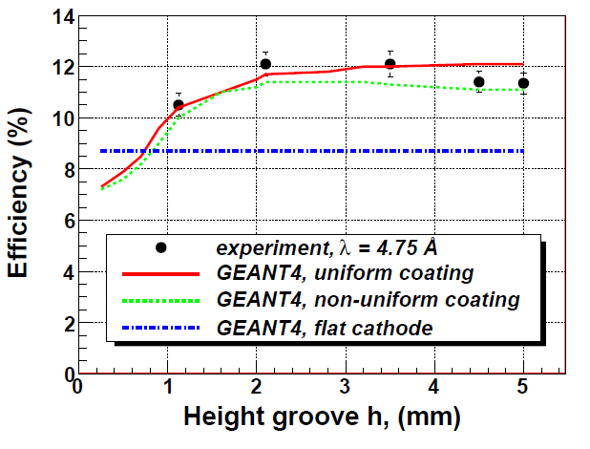
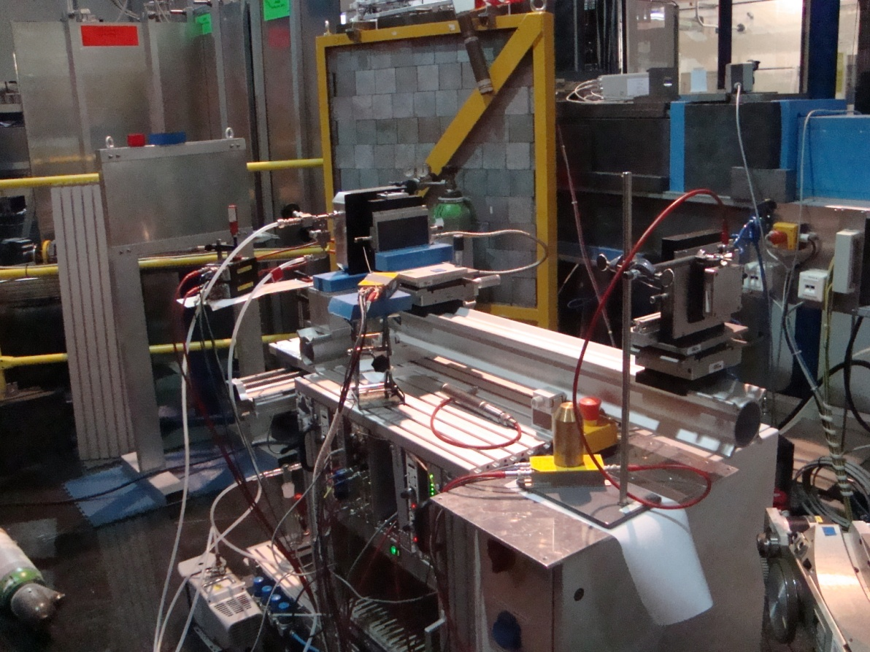
Proof-of-concept measurements
First proof-of-concept measurements with a small size test detector and grooved cathodes made by milling and coated by magnetron sputtering at the Univ. of Linköping, Sweden.
Test detector, 10 cm x 10 cm active area.
λ=4.7 Å
TREFF@FRM2
I. Stefanescu et al., Nuclear Instruments and Methods in Physics Research A727 (2013) 109.

Slide 7
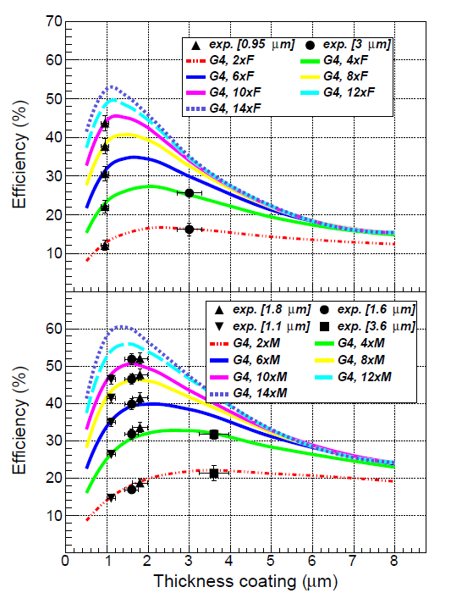
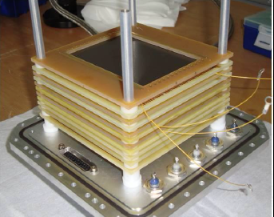
Efficiency of stacked MWPCs
A realistic detector must incorporate several Boron layers in order to be competitive with the He-3 tube.
λ = 4.7 Å
Flat
Detector stack used to test the efficiency of up to 5 MWPCs (10 Boron layers).
I. Stefanescu et al., JINST 8, P12003 (2013).
The larger efficiency obtained with the stack with macrostructured cathodes could be beneficial especially for instruments using thermal neutrons.
Macrostructured

Slide 8
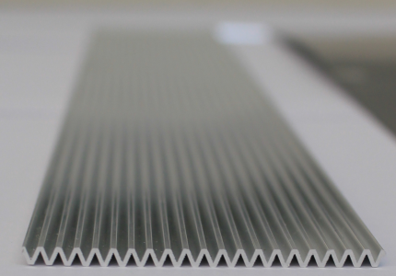
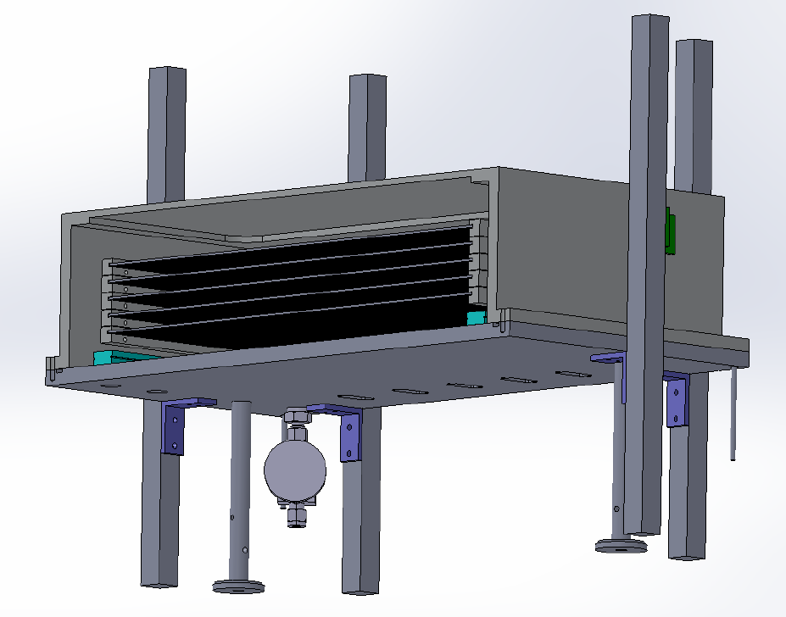
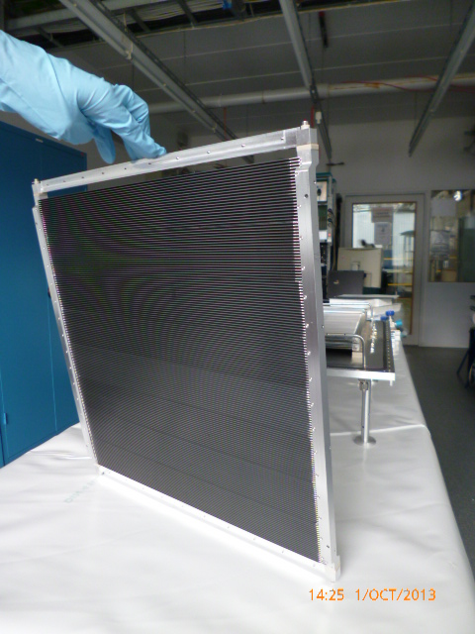
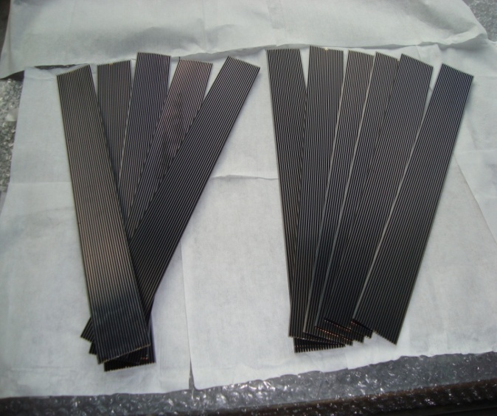
The ¹⁰B-demonstrator
Design by Ilario Defendi, FRM2
5 cm x 40 cm macrostructured plate fabricated by extrusion (MIFA, Holland).
n
40 cm x 40 cm active area
Incorporates a stack with 3 layers of macrostructured planes (2 MWPCs) each coated with 1.4 μm ¹⁰B₄C by magnetron sputtering.
Operated in a continuous flow of Ar/CO₂ gas.
Cathode panel, 40 cm x 40 cm (8 plates).
¹⁰B₄C-coated plates for the demonstrator (Univ. Linköping, Sweden).
Meant to answer questions concerning upscaling and procurement of the various components.

Slide 9
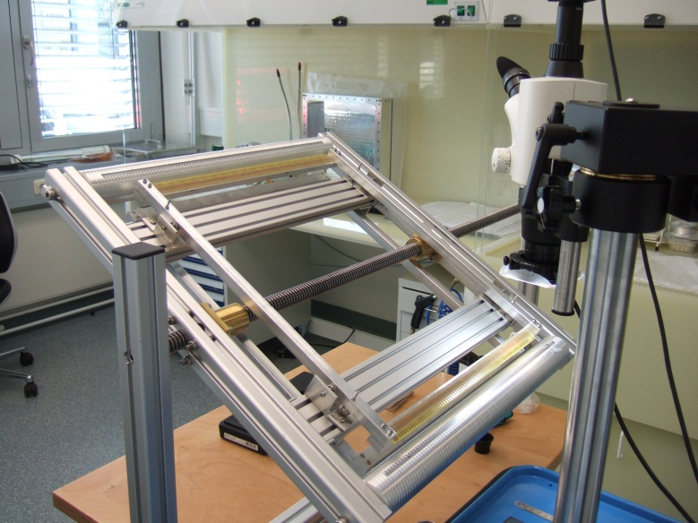
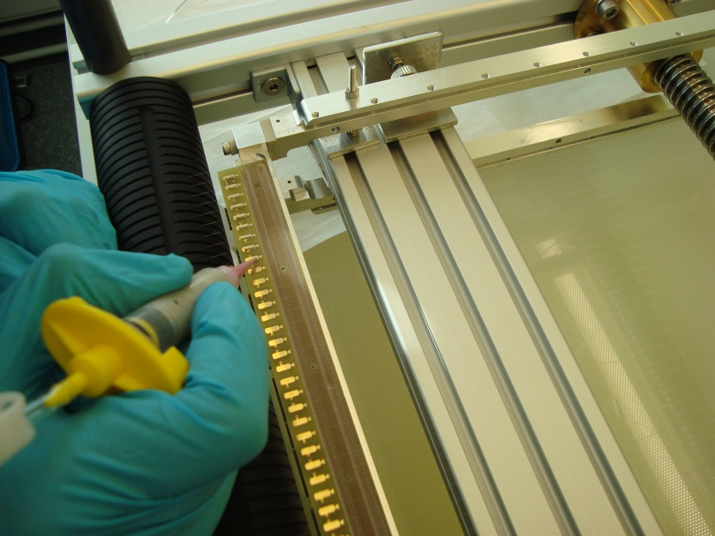
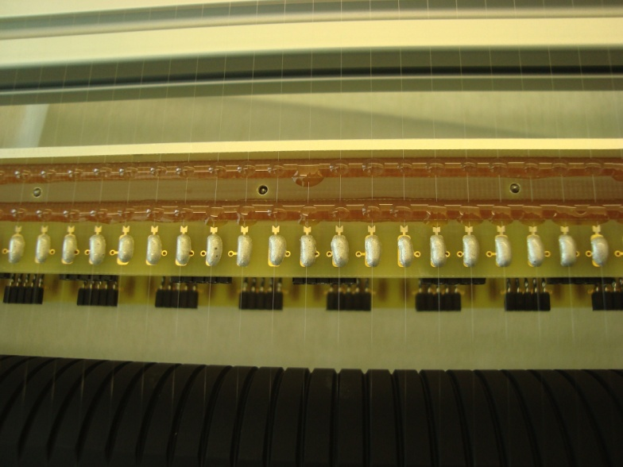
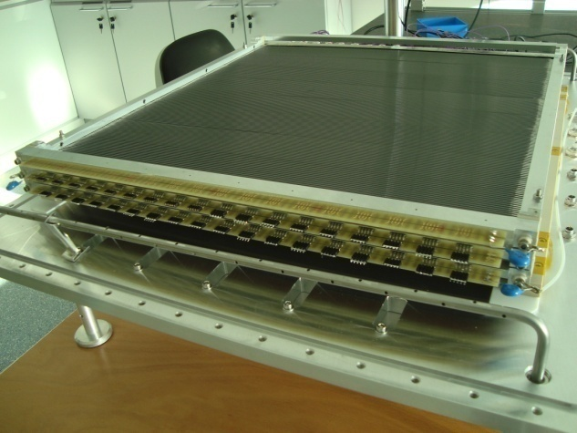
The ¹⁰B-demonstrator
Winding tool designed and built in house.
Gluing of anode wires
Stycast 1266
Stablohm 875 (resistive) wire Ø=17 μm
wire pitch = 5 mm
anode - cathode distance: 7 mm
72 wires/plane
each wire 40 cm long
resistance wire: ~3 kΩ
Conductive glue
Stack with 3 MWPCs with macrostructure cathodes and
resistive wires
Frame with resistive wires

Slide 10
Resistive wire readout concept
A
B
A
B
Concept*:
group the resistive wires in pairs by taking every other wire to create 2 independent, interleaved chains (4 preamp channels, Y-position).
connect all wires through a resistive chain (2 preamp channels, X-position).
Front-end boards, multichannel CSP and shapers delivered by Mesytec.
5 mm
*Thanks to R. Schneider, mesytec.com
A (Y-pos)
B (Y-pos)
Global Group
(X-pos)
Aimed position resolution: 5 mm x 5 mm.

Slide 11
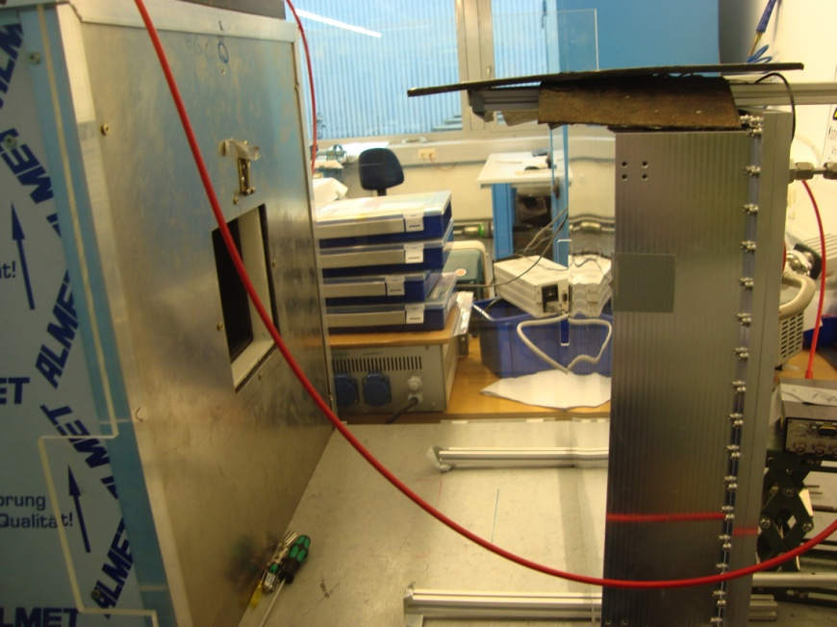
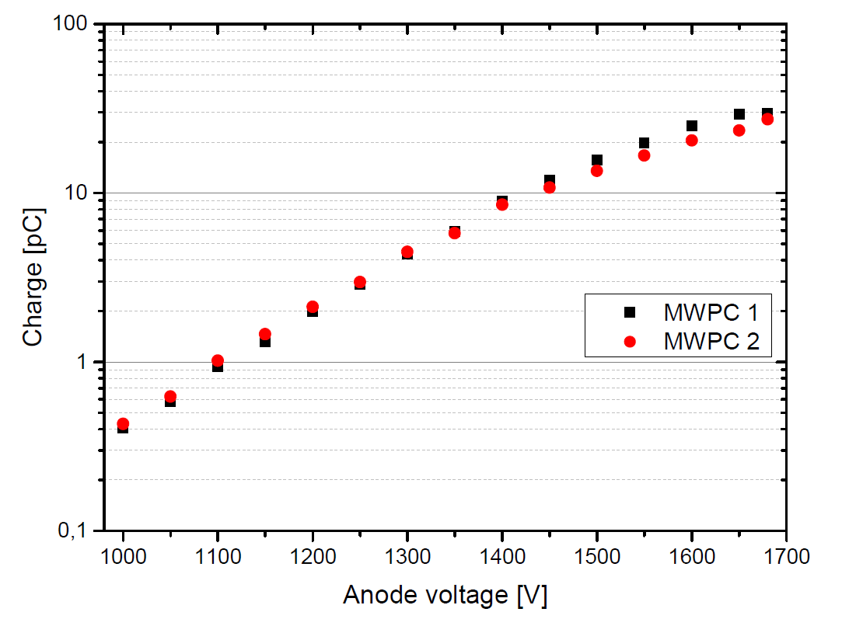
Performance tests with a ²⁵²Cf source: charge released in detector
Gas: 1 atm Ar-CO₂ 80/20
12 anode wires per counter grouped for readout
Readout with Mesytec CSPs (MPR-1), Silena amplifiers, and commercial MCA.
n + ¹⁰B → ⁷Li (0.84MeV) + α (1.47MeV) + γ (0.48MeV) (93%)
→ ⁷Li (1.02MeV) + a (1.78MeV) ( 7%)
Charge released by 1.47 MeV alpha
HV=1680 V

Slide 12
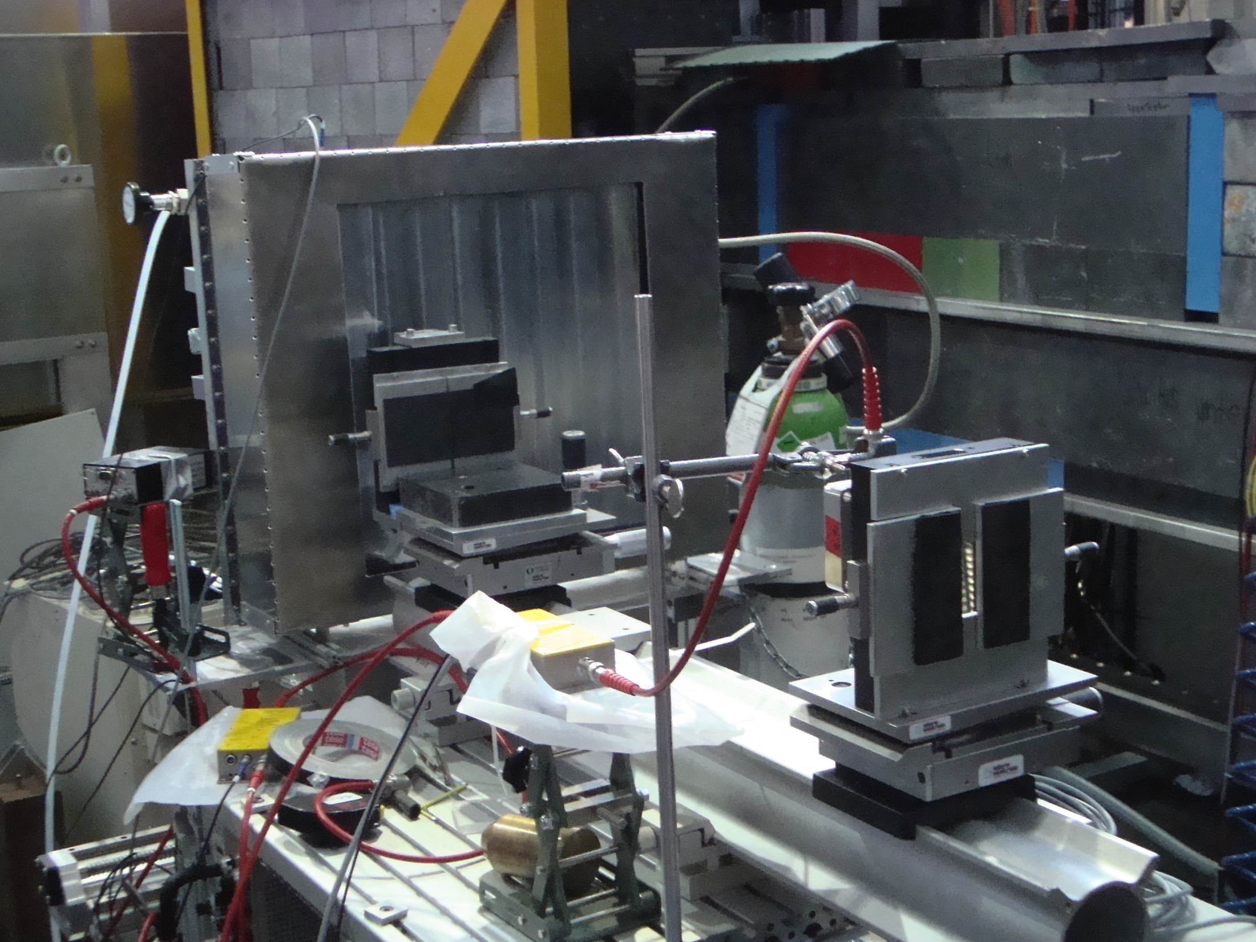
Performance tests with collimated beam: position resolution
4.7 Å collimated beam delivered by the TREFF instrument @FRM2. Detector placed on a XY moving table.
Group of 4 consecutive wires selected, 2 independent chains created by connecting each second wire (l_{chain} = 80 cm).
n beam
W2a
W2b
W1a
Photograph of the ¹⁰B-demonstrator during the in beam tests at TREFF@FRM2 (λ=4.7 Å).
Mesytec CSPs + CAMDA multichannel analyzer used to collect and analyze the signals at the ends of each chain.
Y_{pos} = W_{1(2)a}/(W_{1(2)a}+W_{1(2)b})
W_{1(2)a}, W_{1(2)b}: signals readout at the end of each chain
…
…
40 cm
40 cm

Slide 13
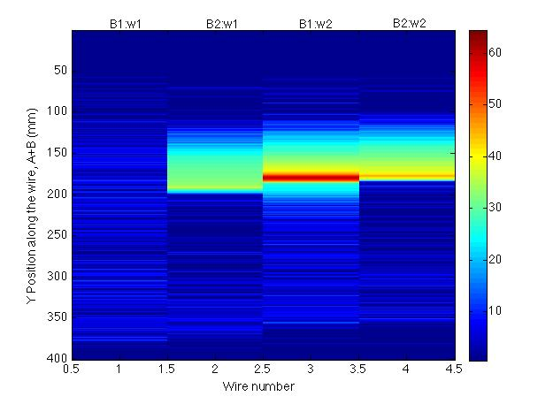
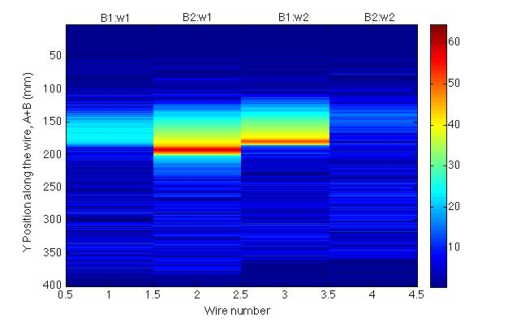
Position resolution: preliminary tests with the ¹⁰B demonstrator
W1a
W2a
W1b
W2b
Beam ⊥ wire W1b
W1a
W2a
W1b
W2b
Beam spot: 2 mm x 2 mm.
Charge distributed to maximum 2 wires, which belong to different chains.
Measured FHWM ~ 4 mm along the wire.
Beam between wires W2a and W1b

Slide 14
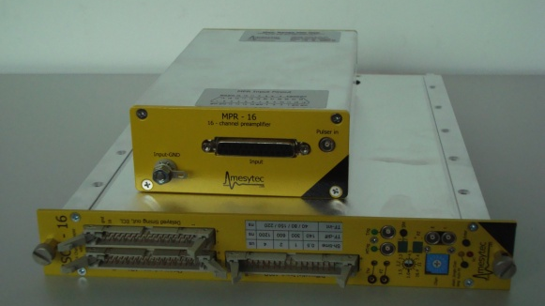
Coming soon….
Next week Mesytec will deliver the MWPC9 custom-designed frontend boards ➔ 6 output signal channels: Y-pos. group 0, Y-pos group 1, X-pos.
16-channel preamplifier (MPR-16) and shaper delivered earlier.
Final set-up ready to be assembled at FRM2.
Performance tests with the ²⁵²Cf source planned for July at FRM2.
In-beam tests at the TREFF instrument at FRM2 foreseen for the upcoming reactor cycle (starting in Fall ’14).
Mesytec front-end boards
Mesytec MPR-16 and shaper

Slide 15
Conclusions and outlook
We propose a concept for a neutron detector based on the ¹⁰B-converter, stacked MWPCs with macrostructured cathodes and resistive wire readout.
The concept was extensively studied in GEANT4 and GARFIELD calculations which were validated in a several experimental campaigns with a small area test detector.
Design and construction of a realistic size demonstrator with 2 MWPCs (3 cathodes layers and 2 anode wire plans) almost completed. Intense testing planned with a moderated fission source and collimated neutron beam.
The proposed detector could be an option for instruments that require large-area, moderate position resolution detectors.

Slide 16
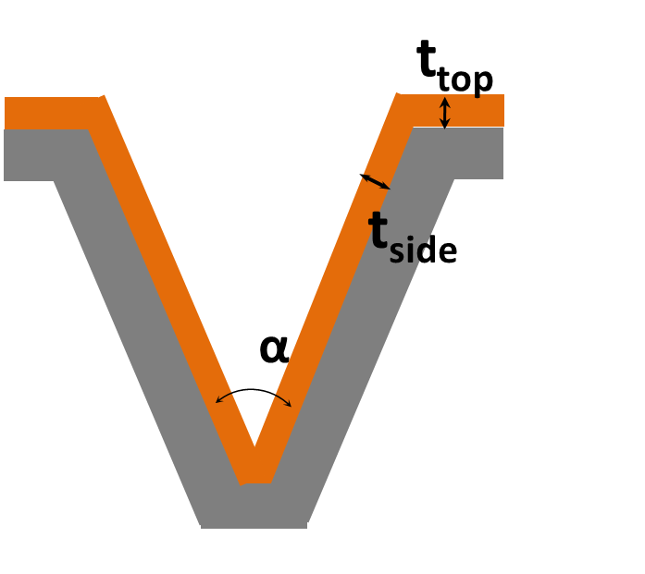
Model simulations
Possible scenarios for the conformality of the coating of a macrostructured plate
h
t_{side} = t_{top} * (x/h)
t_{side} = t_{top}
t_{side} = t_{top} * sin(α/2)
(forming after coating)
(coating after grooving, ideal)
(coating after grooving, realistic)

Slide 17
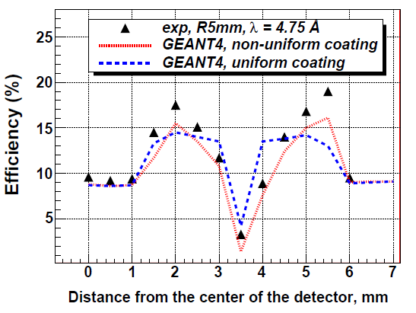
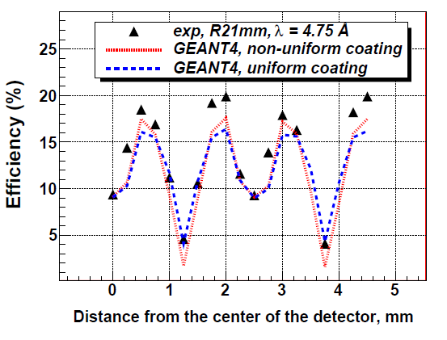
Model simulations
h = 5 mm
h = 2.1 mm

Slide 18
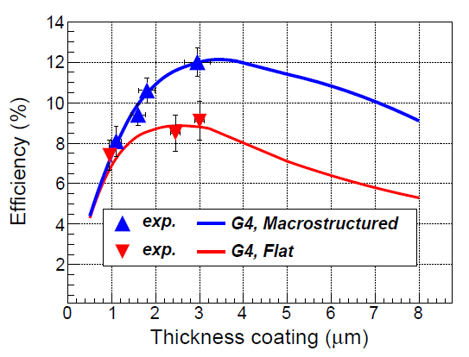
Model simulations
Calculations for 45° grooves, 2 mm deep) and λ = 4.7 Å
Results used in a general sense to understand trends in the performance of macrostructured cathodes.

Slide 19
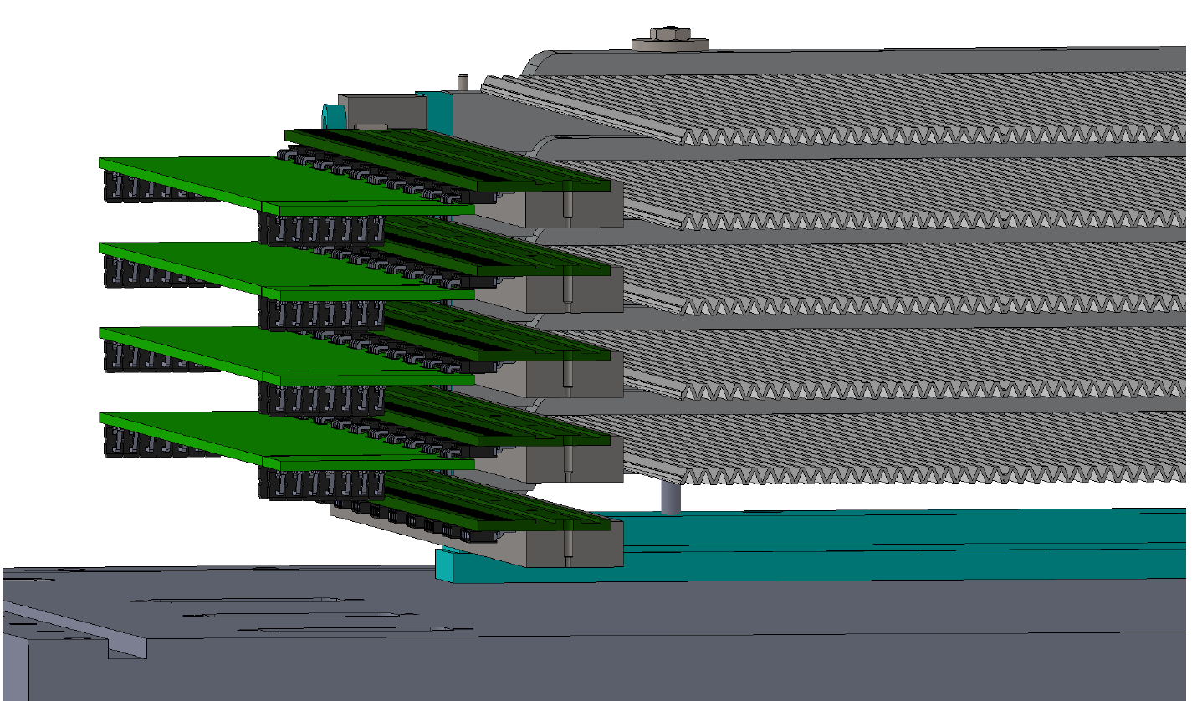
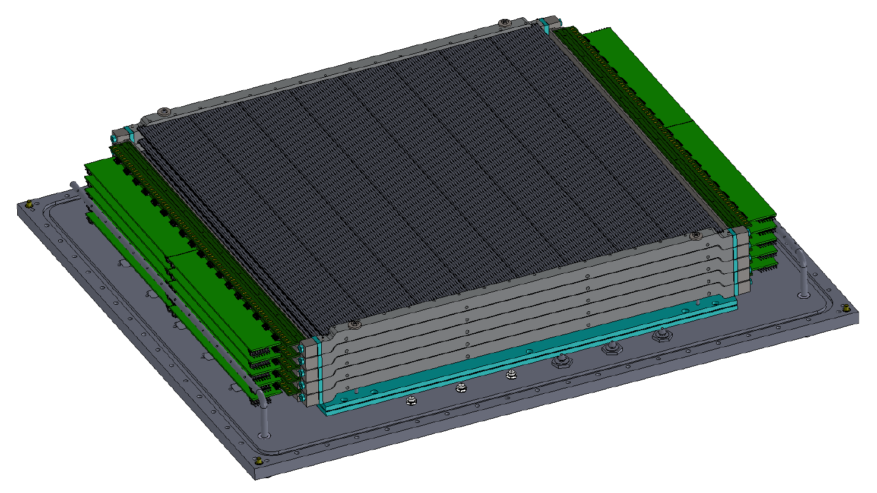
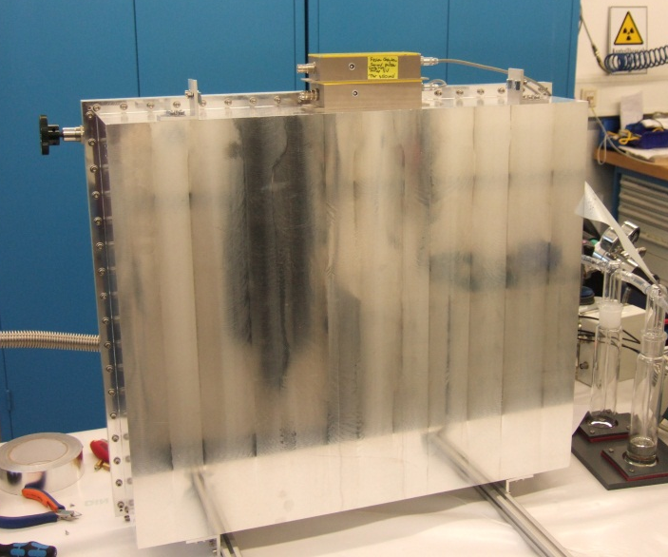
The ¹⁰B-demonstrator
Design by Ilario Defendi, FRM2
Stack with 3 MWPCs with macrostructure cathodes and
resistive wires
Demonstrator closed and ready to take data

