Slide 1
Completion of Water-Cooled Backup Study
Eric Pitcher
TAC-10
www.europeanspallationsource.se
November 5, 2014

Slide 2
Outline
Background
Geometry selected for evaluation
Neutronic performance
Thermal and stress analyses
Passive decay heat removal assessment
Operational issues
Concluding remarks

Slide 3
Background
ESS baseline is a helium-cooled rotating tungsten target
A backup water-cooled option has been evaluated as a hedge against unforeseen technical risks of the helium-cooled option
A Water Task Force, chaired by Peter Sievers, was formed to evaluate the water-cooled option, with expertise from ESS, ESS-Bilbao, FZJ, RAL, KIT, PSI, and McManamy Consulting

Slide 4
Design selected for evaluation: cross-flow cannelloni geometry à la PSI SINQ target
Zircaloy-clad tungsten with helium-filled gap
  Tungsten rod dimensions: 10 mm ø by 80 mm tall
  Clad thickness: 0.5 mm
Packing fractions: 61% W, 14% Zr, 25% D₂O
Target wheel segmentation into 33 sectors

Slide 5
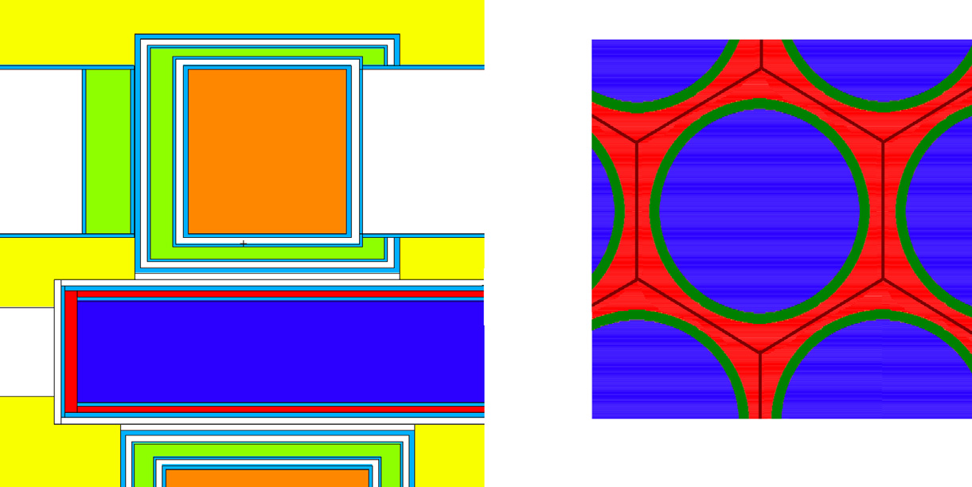
Neutronic performance
Cold source brightness of the water-cooled cannelloni geometry is 86% of that for the baseline helium-cooled geometry
Lower performance principally attributed to the lower tungsten volume fraction
Modelling detail
of cannelloni
→ neutrons
Proton beam →

Slide 6
Tungsten temperature depends on the thermal contact at the tungsten-zircaloy interface
The conductance between tungsten and zircaloy is weakly dependent on the contact pressure between 0.1 and 10 MPa
Concern about the residual stresses in the zircaloy tube
from press fitting motivates
a 10-µm gap filled with 1 bar
helium, for which the gap
conductance is 2·10⁴ W/m²·K
Sensitivity analysis shows the
peak tungsten temperature is
only weakly dependent on the
gap conductance so long as it
exceeds 10⁴ W/m²·K

Slide 7
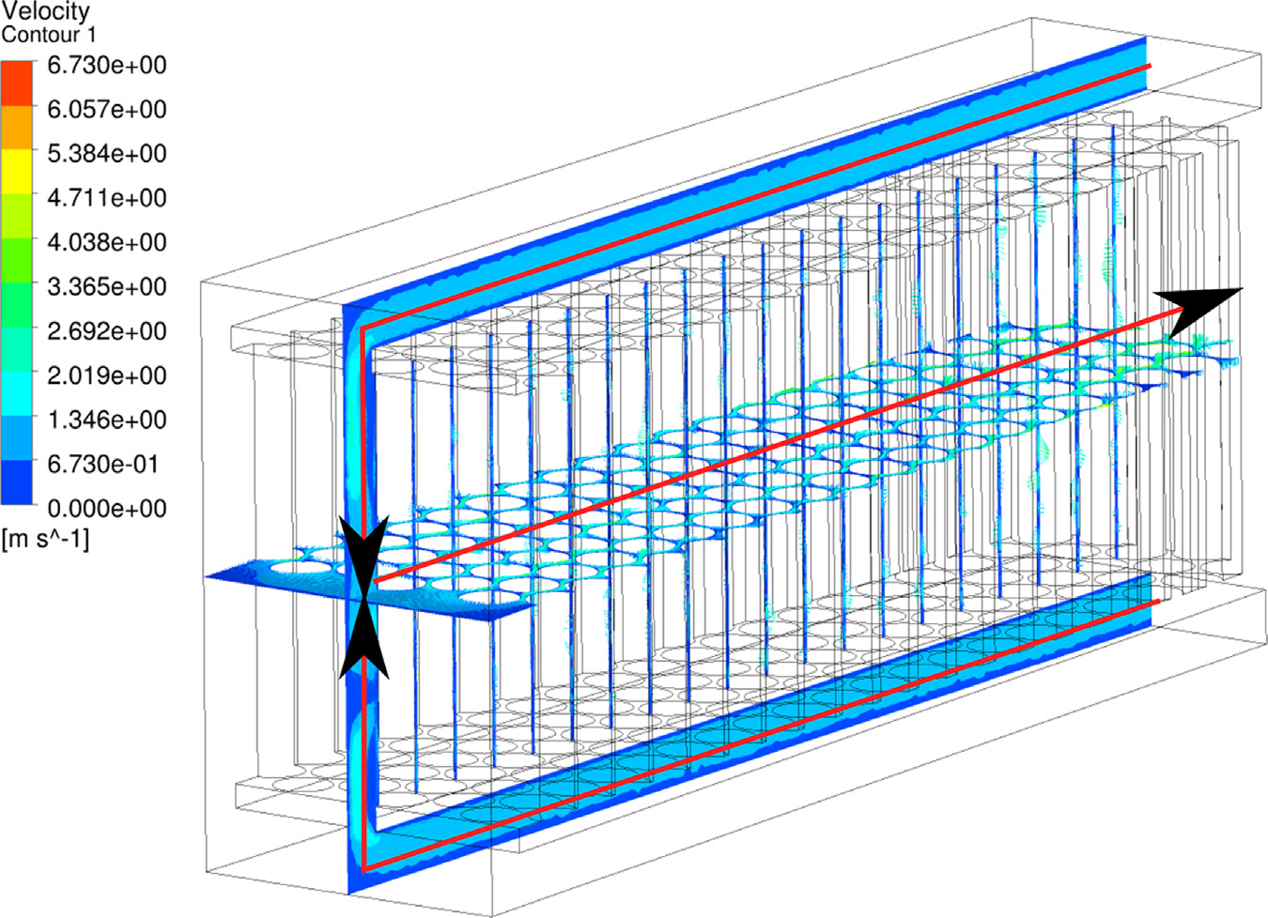
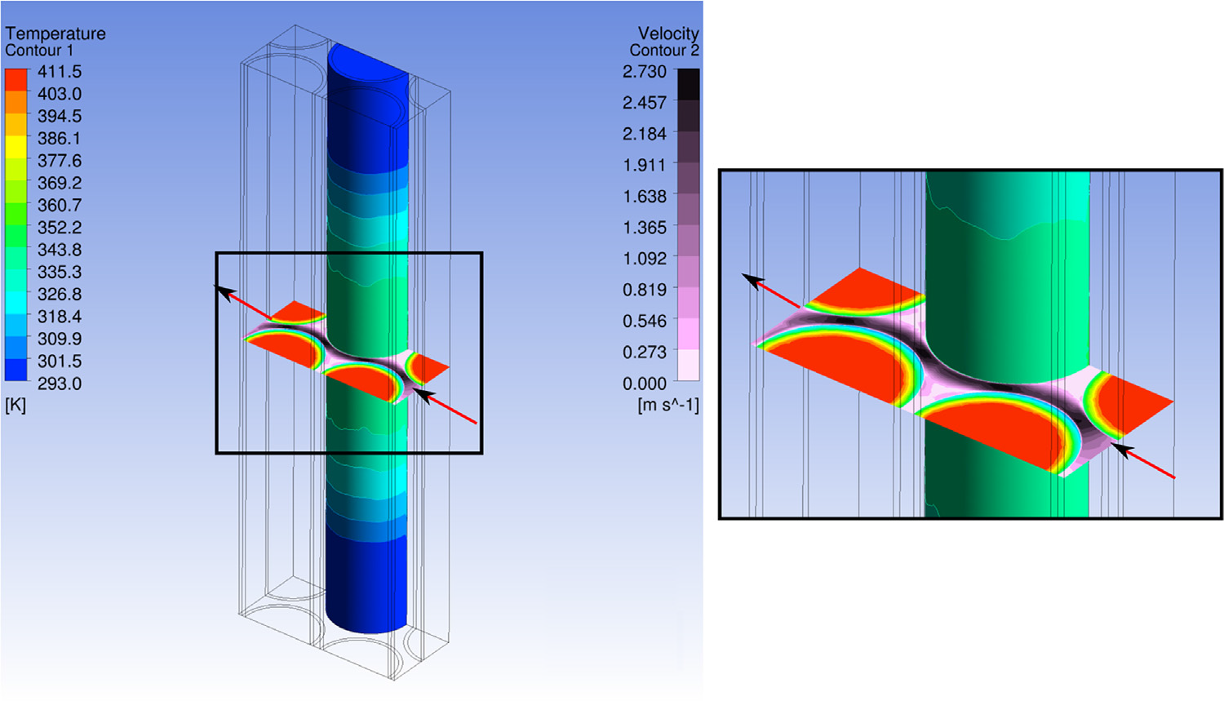
Transient CFD simulations under pulsed proton beam conditions
Post-pulse temperature on the zircaloy tube is <110°C, below the boiling point of water pressurized to ≥0.2 MPa
Quasi-steady state simulations show the maximum post-pulse von Mises stress is ~30 MPa in the zircaloy tube and <70 MPa in the tungsten core
Maximum stress in the
zircaloy tube is about half
of the zircaloy-4 fatigue limit
Peak stress in the tungsten
core is about 10% of the
yield stress

Slide 8
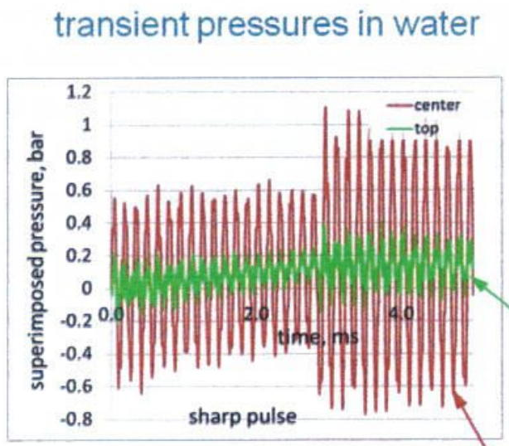
Transient pressure pulses in the water are not expected to be an issue
Power per pulse:
  ESS: 357 kJ in 2.86 ms
  SNS: 23 kJ in 0.7 µs
  LANSCE and ISIS: 3 kJ in <1 µs
Transient pressure pulses in the
water due to:
  Thermal expansion of the water from
  a 4 K temperature increase
  Thermal expansion of the cannelloni
Analysis of confined water volume gives rise to pressures >1 MPa
Unconfined water should greatly reduce pressure pulses

Slide 9
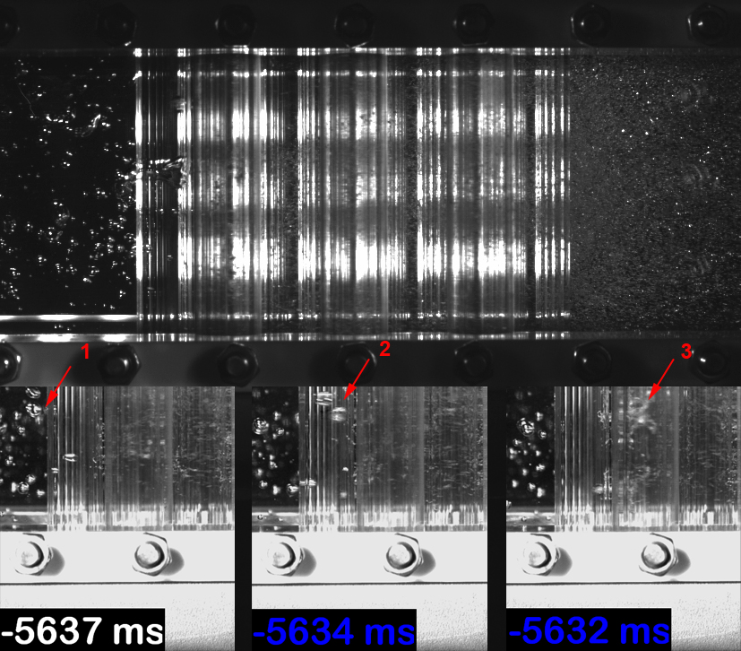
Experimental investigation of flow choking due to film boiling
Experimental set-up: glass tube immersed in water flow
Air or vapor bubbles introduced at the water inflow
Air bubbles: entrained in the water, no choking
Vapor bubbles: collapsed within 1 s
Conclusion: flow choking is not likely for cannelloni design

Slide 10
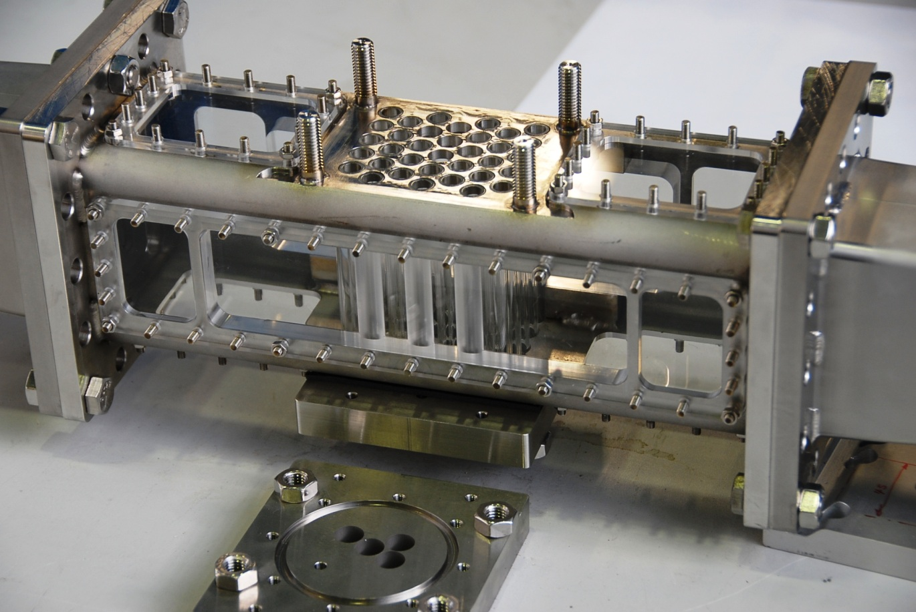
Experimental validation of flow and heat transfer

Slide 11
Passive decay heat removal is an important safety attribute for the target
Maintaining tungsten below 700°C during a loss-of-coolant accident (LOCA) confines the vast majority of radionuclides to the tungsten
ESS-Bilbao calculated decay heat data for the cannelloni geometry (45 kW at beam shutdown)
Decay heat removal analyses were performed based on 2-D axisymmetric models
Group | SS316 emissivity | Steel shielding emissivity | Initial W temperature (°C) | Initial steel shield temp (°C) | Gap composition in double-walled shroud | Time dependence of shield temperature | Maximum tungsten temperature (°C)
ESS-Bilbao | 0.66 |  | 25 | 25 | 20v% SS316 80v% water vapor | Actively cooled to 25°C | 400
McManamy Consulting | 0.6 | 0.4 | 100 | 50 | 100v% water vapor | No active cooling, serves as ultimate heat sink | 530

Slide 12
Calculations indicate that passive cooling is sufficient for decay heat removal
Sensitivity analyses performed by McManamy:
Ribs between walls are important conduction paths
Conclusion: Passive cooling of the decay heat is viable for the water-cooled backup
Impact of the moderator-reflector system on decay heat removal from the target not analyzed, but will be for the helium-cooled option
Case | SS316 emissivity | Steel shielding emissivity | Shroud interstitial gap (mm) | Shroud interstitial gap material composition | Gap between shroud & shielding (mm) | Maximum tungsten temp (°C)
1 | 0.66 | 0.4 | 5 | water vapor | 20 | 530
2 | 0.3 | 0.3 | 5 | water vapor | 20 | 635
3 | 0.66 | 0.66 | 5 | 20v% SS316 80v% water vapor | 20 | 380
4 | 0.1 | 0.3 | 5 | 20v% SS316 80v% water vapor | 15 | 607

Slide 13
Passive cooling is sufficient for removal of decay heat
It was previously thought that safety of the water-cooled option would be satisfied using active cooling
The results confirm that the margin with passive cooling can be not huge
Licensing would not be automatic, and actually licensing water would only work if helium is proved impractical beforehand (larger margins)
SSM condition for the start of construction is predicated on the successful realization of the helium-cooled tungsten target

Slide 14
Operational Issues
Scaling the water plant from existing spallation source facilities to ESS conditions should be straightforward
Assuming 10% of tungsten-produced tritium diffuses into the heavy water produces a concentration of ~7 GBq/kg per year of operation, which is <1% of the concentration levels found in heavy water fission reactors

Slide 15
Concluding Remarks
A water-cooled rotating tungsten target appears viable in terms of:
  Neutronics
  Thermal-hydraulics
  Mechanical design
  Safety
  Operations
The margin with passive cooling can be not huge
The water-cooled option will be retained as a viable backup to the baseline helium-cooled option

