Slide 1
Personnel Safety Systems
Stuart Birch
Senior Engineer, Personnel Safety Systems
www.europeanspallationsource.se
November 6th , 2014

Slide 2
Introduction
Personnel Safety Systems (PSS) Scope of work.
  Accelerator
  Target
  Neutron Instruments
ESS PSS Strategy
PSS Progress
Stuart Birch 6rd November2014.

Slide 3
Accelerator PSS Scope
Design, Manufacture, install and commission an IEC 61508 Personnel Safety System (PSS)
The PSS will control access into Accelerator tunnel radiological areas to protect personnel from hazards associated with the following but not limited to:
Ionizing radiation
Radio frequency
High voltage
Each component (magnets, solenoids, choppers, RFQ, DTL’s, Spokes Cavities. Elliptical Cavities etc.) will be assessed and all potential hazards identified
Hazard analysis will then determine whether the PSS shall protect against these hazards

Slide 4
Accelerator PSS Scope (continued)
Radiation Monitoring
All radiation monitors interfaced with the PSS (interlocked monitors) will be procured and installed by ICS/ PSS
Requirements for these monitors will be jointly developed by PSS and the “ESS Radiation Protection Organisation (RPO)”
The ESS RPO will be responsible for providing requirements related to measurement type, range, speed of response and accuracy
PSS team will ensure that the monitors are electrically compatible with the PSS and suitable for use in the system. The RPO will be responsible for determining the locations that require monitoring (and therefore the number of monitors required)
Notes:
----- Meeting Notes (22/10/14 15:52) -----
Currently I am talking to Lief Spannier about the radiation monitoring. (he starts at ESS in November)
ESS RPO be a group independent of accelerator, target & neutron instruments. ES& H
responsible for:
Radiation Training and authorisation.
Dosimetery
Stack monitoring
Boundary monitoring
Radiation monitoring and surveys (when machine turned on a full radiation survey will be required followed by continuous monitoring and testing)
Frisking stations
Etc.etc
Calibration of all monitors and hand held equipment.

Slide 5
Accelerator PSS Scope (continued)
Oxygen Deficiency Hazard (ODH).
Within the accelerator tunnel there is a potential for a large cryogen leak (helium) which would lead to oxygen deficiency within the tunnel
The PSS team will design, install and commission the ODH system
Test Stand.
There is an on site test stand planned to test each elliptical cavity before installation into the accelerator tunnel. A Personnel safety system will be required for this stand.
We will use this system as a prototype for the main systems.
The PSS team will design, install and commission the test stand PSS and we will use this system as a prototype for the main systems.
It is expected to have the following hazards:
ODH
Radio frequency
High voltage
Stuart Birch 3rd November 2014.

Slide 6
Target PSS Scope
Target PSS Scope.
The design, manufacture, installation and commissioning of the Target PSS systems to IEC61508
Initial thoughts area system that will cover Connection Cell, Utility vaults, Basement rooms and back rooms
The maintenance cell would be controlled by a separate system designed, manufactured, installed and commissioned by the PSS team
Radiation Monitoring System
Stuart Birch 3rd November 2014.

Slide 7
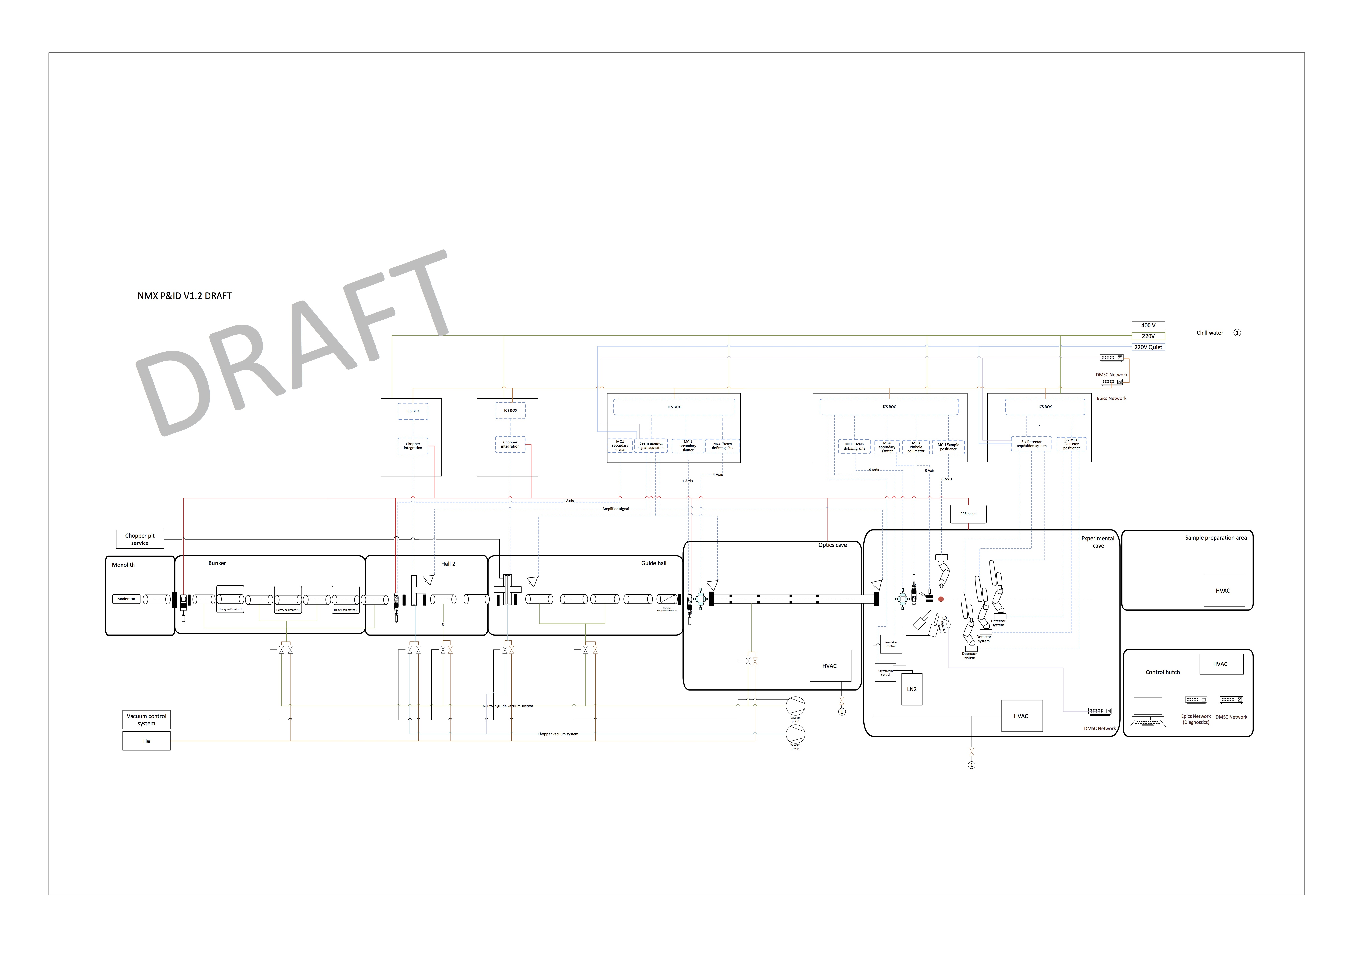
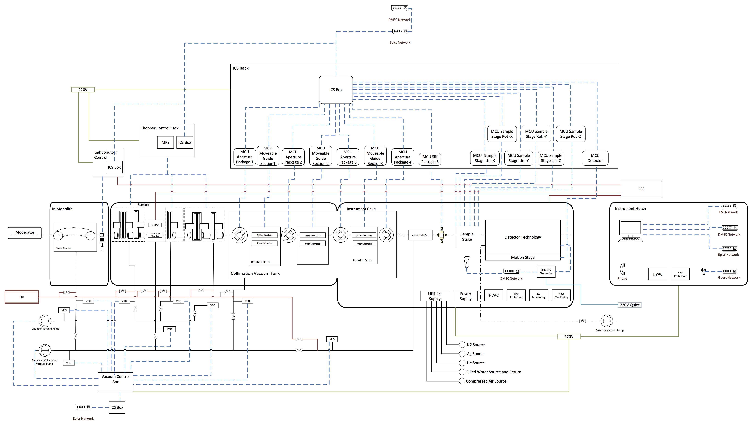
Neutron Instrument PSS Scope
Neutron Instrument PSS Scope
PSS for LOKI
PSS for ODIN
PSS for NMX
The design, manufacture, installation and commissioning of the first three neutron instrument PSS systems to IEC61508.
As new instruments start their design lifecycle start PSS design team will start the design lifecycle
I have scheduled this to start in early 2016
Stuart Birch 3rd November 2014.

Slide 8
Scope Summary
ICS PSS Scope Summary
1. Accelerator personnel safety system.
2. Accelerator oxygen depletion system.
3. Accelerator radiation monitoring system.
4. Accelerator Test stand personnel safety system.
5. Target personnel safety system.
6. Target radiation monitoring system.
7. Target maintenance cell personnel safety system.
8. Neutron Instrument (LOKI) personnel safety system.
9. Neutron Instrument (ODIN) personnel safety system.
10. Neutron Instrument (NMX) personnel safety system.
11. As the initial design of new neutron instruments begins a new personnel safety system will be required.
Stuart Birch 6rd November2014.

Slide 9
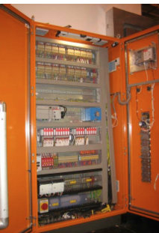

ESS PSS Strategy
The function of the ESS Personnel Safety System (PSS) is to prevent personnel remaining in or entering the Accelerator, Target or Neutron instruments when hazardous conditions exist.
This will be achieved by means of physical searches supervised by a safety controller, access controlled by mechanical interlocks and the facility to request an ESS trip or exit the associated areas in the event that a potentially hazardous situation arises.
Typical PSS Rack
The PSS is also governed by the Stral sakerhets myndigheten (SSM) (The Swedish Radiation Safety Authority) rules on ionizing radiation and will also operate within the ESS safety framework. The maximum tolerable risk level will be 10^-6. SSM H4 level.
Stuart Birch 6rd November2014.

Slide 10
ESS PSS Strategy
The ESS Personnel Safety System (PSS) will be designed, manufactured, installed and commissioned in accordance with IEC61508.
IEC 61508 is an international standard concerned with functional safety achieved by safety related systems that are primarily implemented in Electrical / Electronic and/or Programmable Electronic technologies (E/E/PE). The PSS is an example of this and falls within the scope of IEC 61508.
This standard provides an overall safety lifecycle structure for functional safety systems as detailed in figure 1.
Stuart Birch 6rd November2014.
Figure 1. IEC 61508 Safety lifecycle.

Slide 11
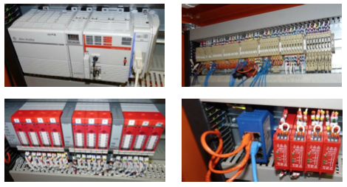
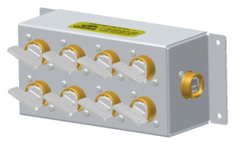

ESS PSS Strategy
My initial thoughts are PSS will consist of 3 major sub-systems:
Sub-System 1 - (Safety Controller + I/O):
A Safety Controller will monitor and control all safety related devices in, and associated with the ESS Accelerator.
Sub-System 2 - (Trapped Key Units):
A variety of trapped key devices will ensure that if hazardous conditions exist the gates which provide access into the PSS controlled area and any protective removable shielding cannot be unlocked and various key-controlled permits cannot be issued.
Sub-System 3 - (ESS Trip):
The system will provide a means for either authorised workers working in the tunnels or Sub-System 1 to request an ESS Trip at any time. A permit is to be continuously issued from the ESS PSS during normal operating conditions. Removing this permit constitutes requesting an ESS Trip. An ESS Trip will be requested if a Beam Off Button is pressed or the Safety Controller issues an ESS Trip signal.
Stuart Birch 6rd November2014.

Slide 12
PSS Progress
ESS Familiarisation - Accelerator, Target and Neutron Instruments.
Recruitment - IEC 61508 Electrical Engineer, IEC61508 PLC Engineer and
IEC61508 Super – Technician/Engineer. Hire by Q2 – 2015.
It is critical that positions are filled in early 2015 to meet PSS programme milestones
Scope – Awaiting confirmation.
IEC61508 Documentation “Concept” ready for peer review and approval.
PLC tender for framework agreement is complete and will go to OJEU in
mid-November
Accelerator PSS initial design started.
Stuart Birch 6rd November2014.

Slide 13
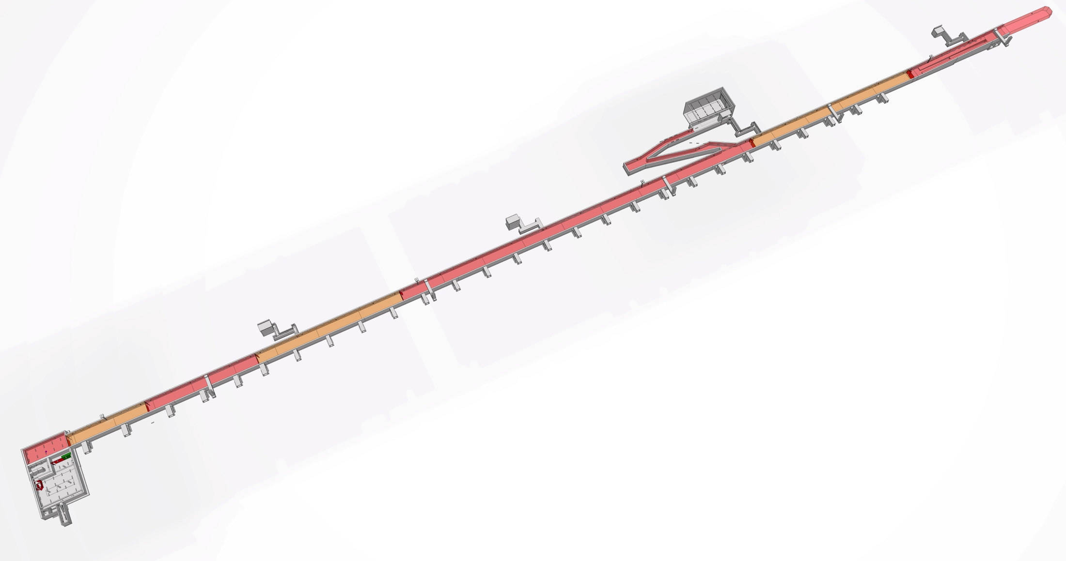
PSS Progress
Accelerator Tunnel
Entrance 2.
Obtained agreement for tunnel change to
add second entrance.
Entrance 1.
Stuart Birch 6rd November2014.

Slide 14
PSS Progress
Accelerator Tunnel
ZONE 7
ZONE 6
ZONE 5
ZONE 4
Zone 1 - Proton Source, LEBT, RFQ, MEBT.
Zone 2 - DTL’s
Zone 3 - Spokes Cavities
Zone 4 - Elliptical Cavities
Zone 5 - Elliptical Cavities
Zone 6 - HEBT
Zone 7 - A to T
ZONE 3
ZONE 2
ZONE 1
Gated fence between each zone.
Stuart Birch 6rd November2014.

Slide 15
PSS Progress
Typical safety PLC system.
Stuart Birch 6rd November2014.

Slide 16
PSS Progress
Radiation Monitoring System.
Initial concept design started.
There will be radiation monitors placed in appropriate positions throughout the Accelerator.
These devices will constantly monitor and record radiation levels and will trip the beam if excessive levels are measured. These will be at the cable and waveguide stubs in the Klystron Gallery and at entrances and exits.
Stuart Birch 6rd November2014.

Slide 17
PSS Progress
ODH System Design.
Initial concept design started.
Within the accelerator tunnel there is a potential for a large cryogen leak (helium) which would lead to oxygen deficiency within the tunnel.
This will be a separate safety system which will send a signal to the PSS. The PSS will then switch off beam, Lock entrances to avoid personnel entering into a hazardous area, activate alarms, lighting and start the tunnel smoke extraction system to remove the hazard.
Stuart Birch 6rd November2014.

Slide 18
Personnel Safety Systems
Questions?
Stuart Birch 6rd November2014.

