Slide 1


MTCA.4 RTM Carrier Board integration
Realization status and open tasks
Presenter: Aleksander Mielczarek, DMCS
Kacper Kłys, DMCS
2020-10-07, Łódź

Slide 2

MTCA.4 RTM Carrier Board Integration
Realization Status:
Removed projects from main ESSFFW repository and put them into two new repositories.
Updated LO RTM library and application in order to work with updated LO RTM CPLD firmware.
Corrected bug in driver, where two IOCTLs were given the same identifier.
Open Tasks:
Actually make the piezo driver firmware – which is not possible as we still do not have a framework- compliant BSP with working DDR3 from NCBJ.

Slide 3
IOC for Piezo Driver - Structure
e3-PiezoDriver
(e3-iocStats, e3-autosave, e3-recsync)
SensorConfiguration.db
AcutatorsConfiguration.db
DebugConfiguration.db
asyn driver
ics-pcd-lib
ics-xdriver-core
ics-xdriver-lib

Slide 4
IOC for Piezo Driver - Structure
Uses asyn driver based on API from Piezo Control device library (git submodules)
Made of three .db files, on for each mode and last for general settings
Working in one main thread in the infinite loop:
acquiring data
synchronising parameters changes
Attached all necessary e3 modules: autosave, iocStats, recsync

Slide 5
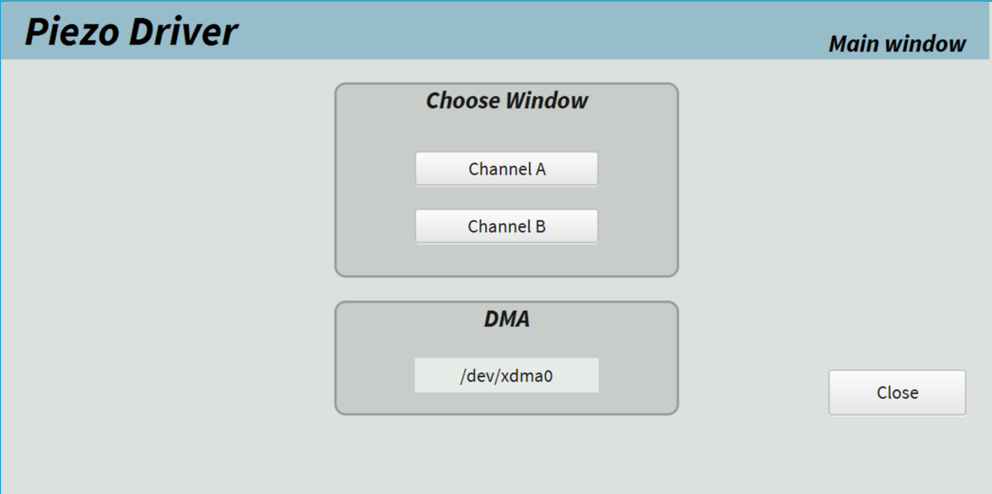
IOC for Piezo Driver - OPI
Composed of three windows:
Main panel
Channel A
Channel B

Slide 6
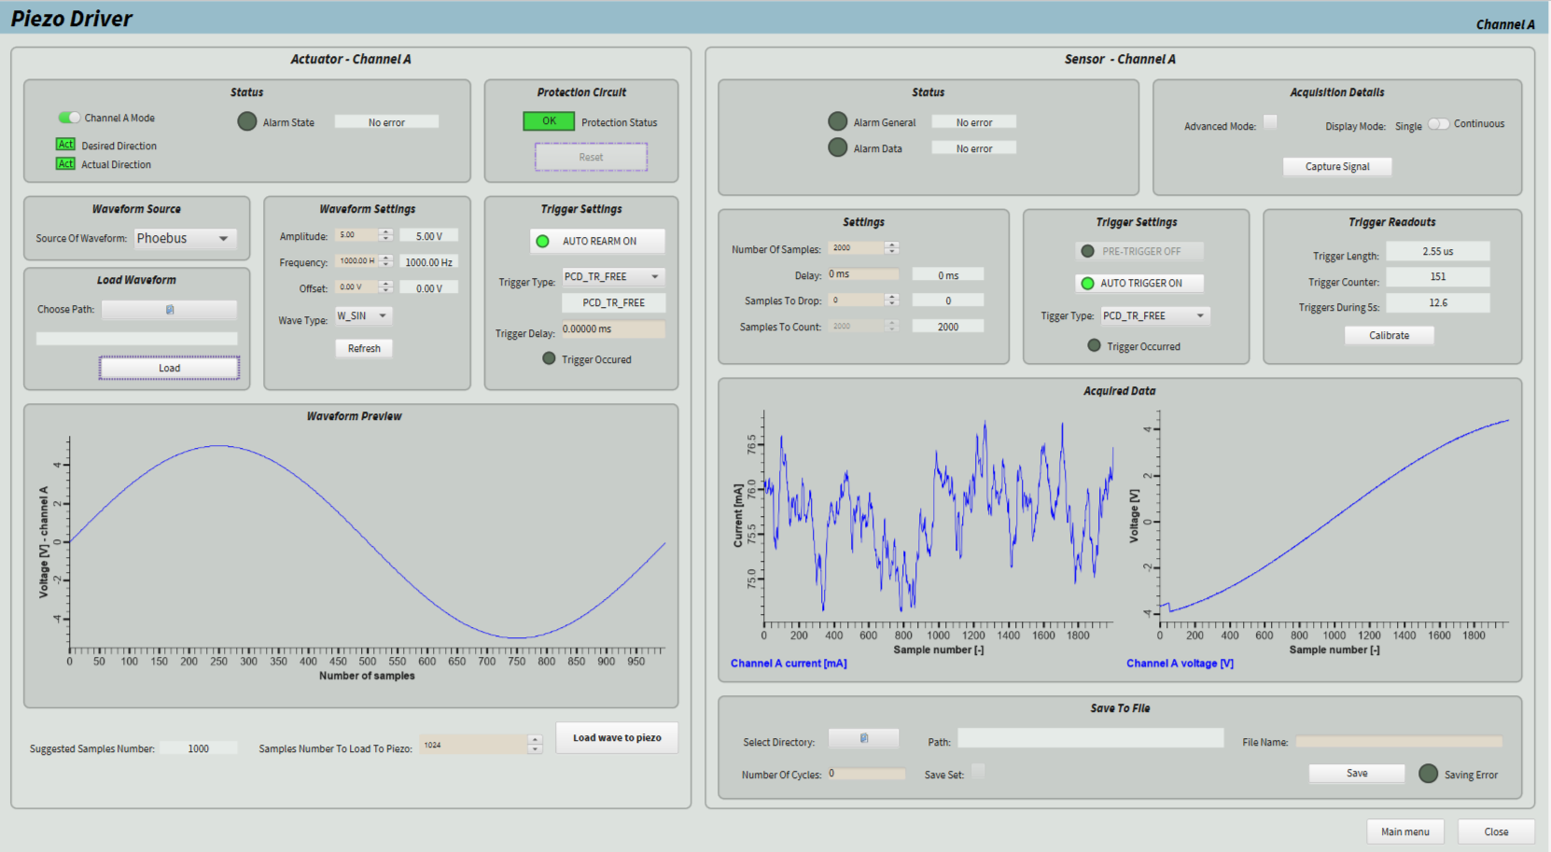
IOC for Piezo Driver - OPI
Preview of generated signal (from file or from OPI)
Data from ADCs (possible saving to file)
Trigger configuration (slope, delay etc.)

Slide 7
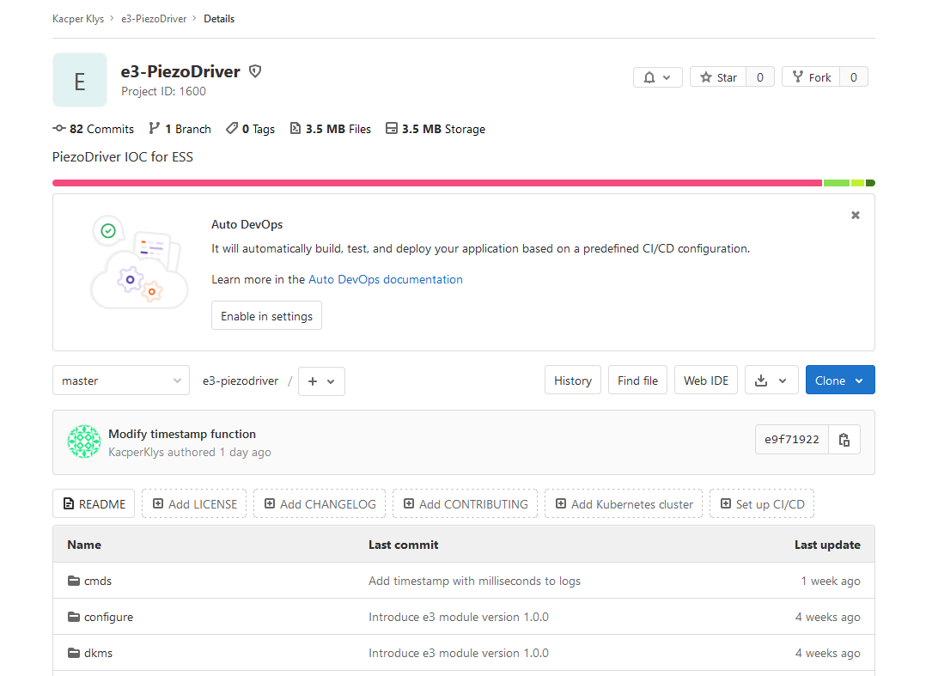
IOC for Piezo Driver - Links
Code on ESS gitlab: https://gitlab.esss.lu.se/kacperklys/e3-piezodriver

Slide 8
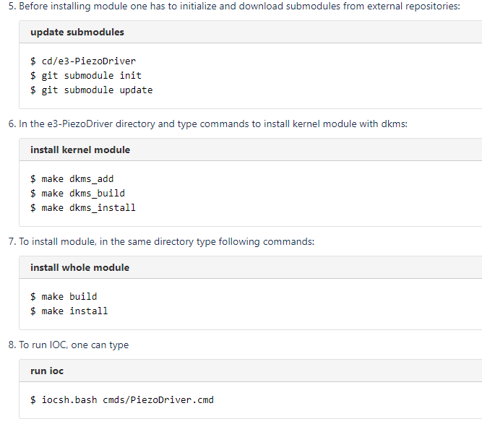
IOC for Piezo Driver - Links
Documentation on confluence (will be updated soon): https://confluence.esss.lu.se/display/HAR/Piezo-driver+integration+-+IOC
How to import .bob files
How to install e3 module
How to install kernel module

Slide 9

IOC for Piezo Driver – How it works?

Slide 10
IOC for LO - Structure
e3-LOdistribution
(e3-iocStats, e3-autosave, e3-recsync)
LOdistribution.db
asyn driver
ics-lo-lib
ics-xdriver-core
ics-xdriver-lib

Slide 11
IOC for LO - Structure
Uses asyn driver based on API from LO library (git submodules)
Made of one, main .db file
Working in one main thread in the infinite loop synchronising parameters changes
Attached all necessary e3 modules: autosave, iocStats, recsync

Slide 12
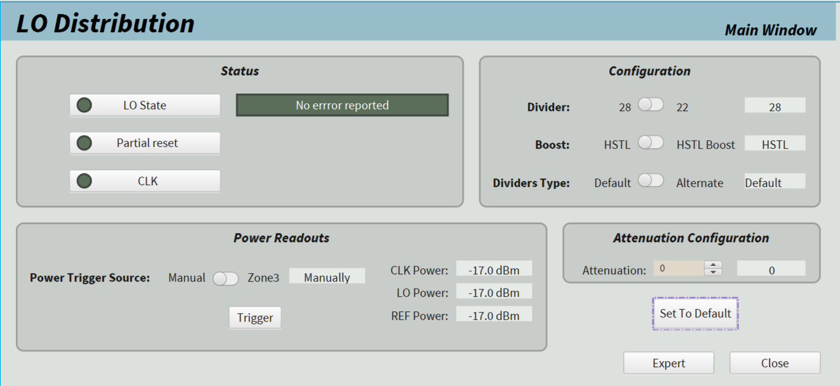
IOC for LO - OPI
Main window:
Enable CLK, LO
LO configuration (divider, boost, attenuation)
Power readouts in dbm

Slide 13
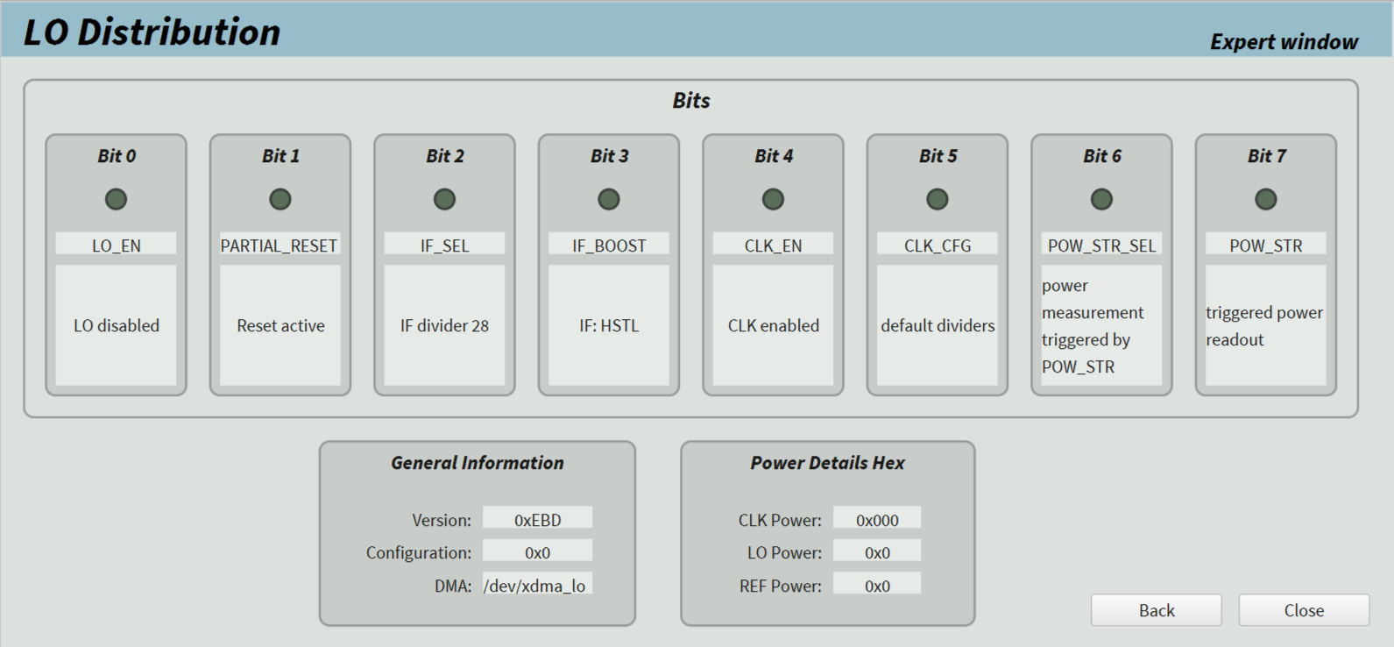
IOC for LO - OPI
Expert window:
Bit descriptions and statuses
Software version
Power readouts in hex

Slide 14
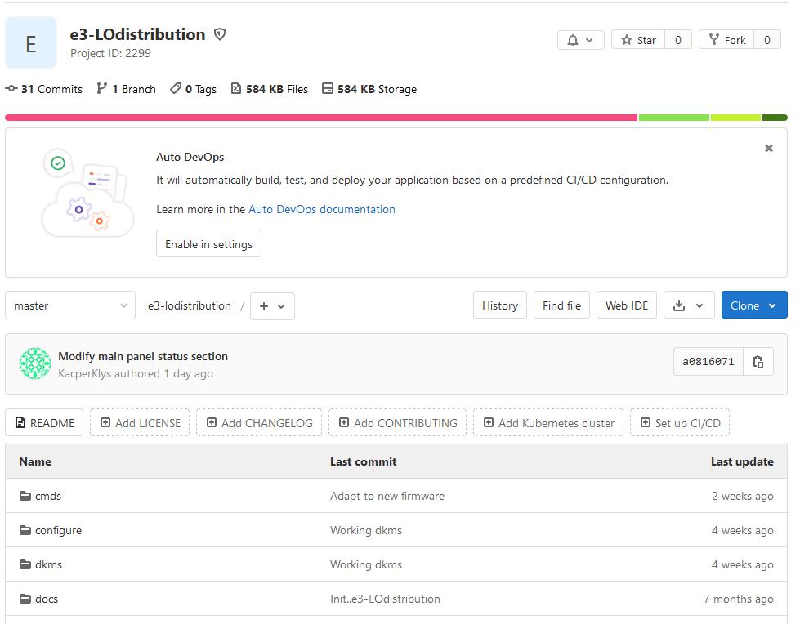
IOC for LO Links
Code on ESS gitlab: https://gitlab.esss.lu.se/kacperklys/e3-lodistribution

Slide 15
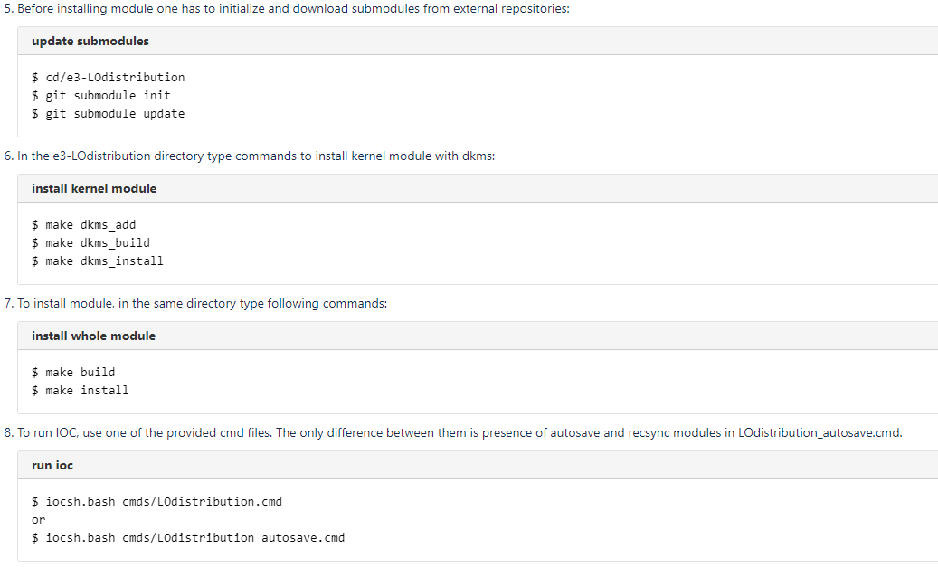
IOC for LO - Links
Documentation on confluence (will be updated soon): https://confluence.esss.lu.se/display/HAR/LO+distribution+-+IOC
How to import .bob files
How to install e3 module
How to install kernel module

Slide 16
IOC for LO – How it works?

