Slide 1
WU2 - nBLM Realization status and open tasks
dr inż. Grzegorz Jabłoński,
dr inż. Wojciech Jalmużna,
dr inż. Rafał Kiełbik
07.10.2020
Notes:
1

Slide 2
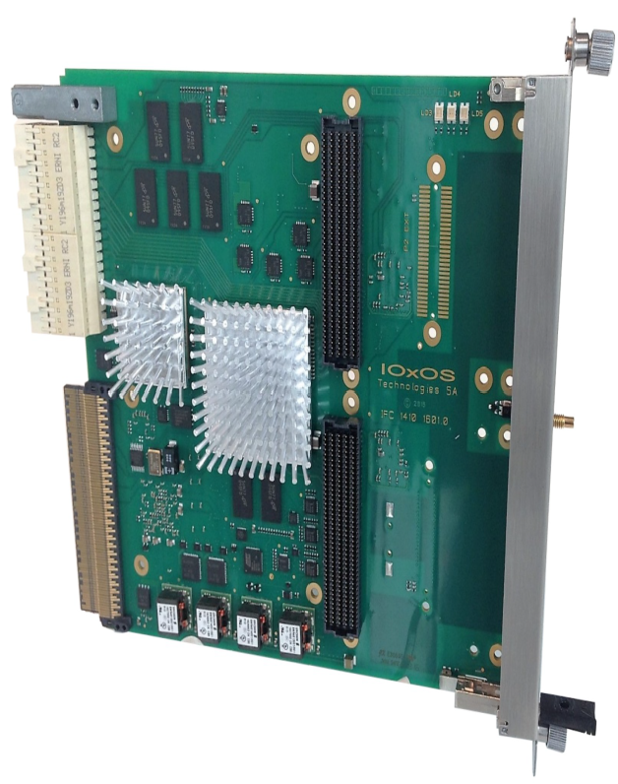
nBLM BEE hardware platform
IOxOS IFC_1410
FPGA Processing Unit
Xilinx Kintex UltraScale KU040 FPGA+1024MB dual channel DDR3L
Processor Unit
High-performance Freescale/NXP QorIQ T2081 processor
On-board 2GB DDR3L 1866 SDRAM
Powered by U-Boot/Linux and able to run EPICS-based applications
FMC Interfaces
Dual HPC VITA-57.1-compliant FMC slots
AMC Interface
Port 0: AMC.2-compliant gigabit Ethernet link with the processor
Ports 4 to 7: AMC.1-compliant PCI express x4 Gen3 link with the FPGA
Ports 12 to 15: point-to-point LVDS links with the FPGA
Ports 17 to 20: shared bus M-LVDS links with the FPGA
Notes:
2

Slide 3
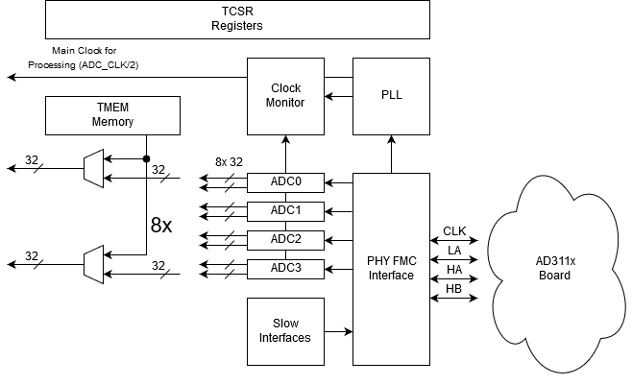
nBLM BEE hardware platform
AD3111
Eight (8) channels 16-bit/250Msps ADC
Sophisticated clock tree distribution
  TI LMK4906 (dual PLL)
  On-board ultra-low noise oscillator /VCXO
  External SSMC Clock reference
Notes:
3

Slide 4
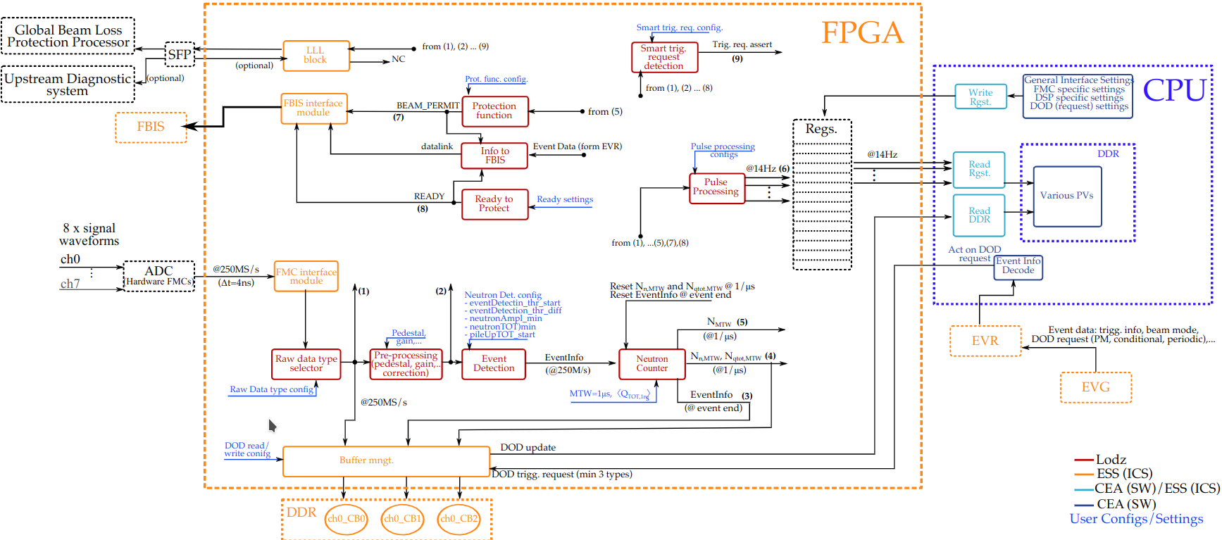
Implementation status
Periodic data is available via DDR

Slide 5
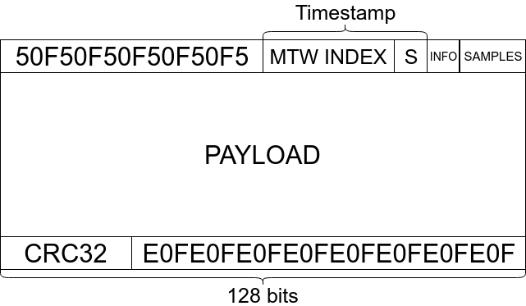
Frame layout
Start-of-frame pattern
Timestamp
  Serial number of the
  1-microsecond window
  Sample index within the window.
1 generic information byte
16-bit number of samples in the frame
Payload packed back-to-back on the bit level without any additional padding
32-bit CRC of all the previous words in the frame followed by the End-of-frame pattern.
MTW INDEX extended to 48 bits

Slide 6
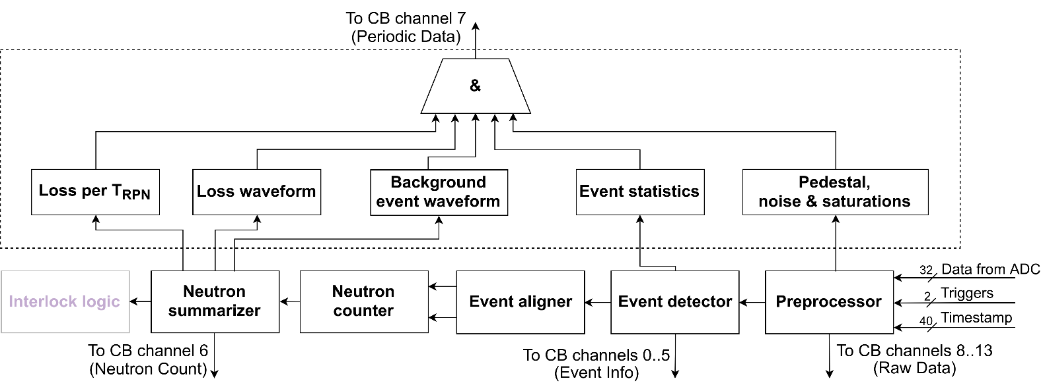
nBLM algorithms block diagram
Main flow – 5 pipelined processing blocks
Implemented in C++ with High Level Synthesis
Data in raw data, neutron summary and raw events channels timestamped by MTW number and sample number within MTW (unique within more than 1 hour 8 years, cycle-accurate)
Periodic data – timestamped in the same way, but not cycle-accurate
Notes:
6

Slide 7
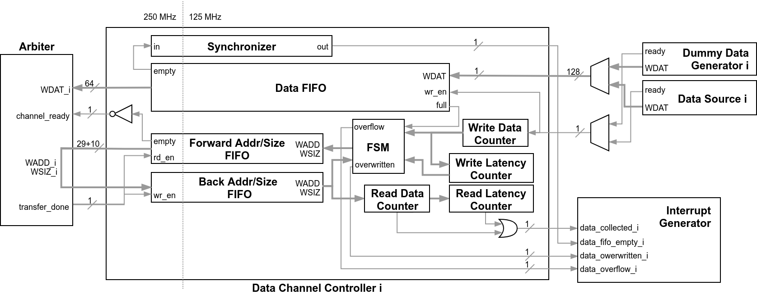
Updates since last meeting
48-bit MTW counter
The MTW counter has been extended to 48 bits, making it unique within 8 years period and simplifying timestamp management
TOSCA Turbo
Updated the firmware to use TOSCA Turbo
Simulation
Updated the system simulation to newest TOSCA.
Improved the HLS simulation
Test setup
Now two nBLM IFCs are available at DMCS
RTM support
Update of IFC firmware to properly handle RTM
IFC local CPU
Update to most recent u-boot and ESS Yocto linux
Notes:
7

Slide 8
Open tasks
ADC delay calibration
The ADC delay must be calibrated individually for each IFC board, otherwise ADCs do not always work
Firmware support for RTM
The protection functionality is not connected to RTM
Timing definition
The timing events received by EVR are not precisely defined
Notes:
8

Slide 9
Thank you for your attention
Notes:
9

