Slide 1
Project Management and Administrative Requirements
Adrameh Gaye
HighNESS Project Manager, ESS

Slide 2
Structure of the PPT
Reporting and project review(s)
Rules & procedures, incl. Financials
Governance

Slide 3
HighNESS Project Management: All you need to know!

Slide 4
Legal Agreements
Grant Agreement
Consortium Agreement

Slide 5
General Assembly
Main decision making body of the consortium
One representative on the project from each beneficiary
Convenes at least once a year for the duration of the project
Approval by `the General Assembly is needed for, inter alia: Major strategic decisions

Slide 6
Steering Board
Composed of all WP Leaders
Executive body responsible for the project on day-to-day working level
Meet regularly (once a month), in person or through VC

Slide 7
Review & Approval Procedures
Workflow of content deliverables and reports

Slide 8
Reporting to the European Commission
WHERE
WHAT
WHEN

Slide 9
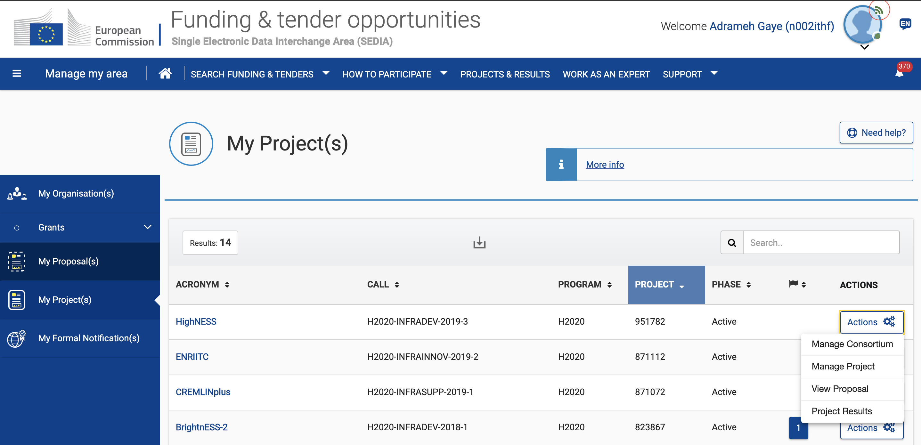
HighNESS on the Funding & Tenders Portal

Slide 10
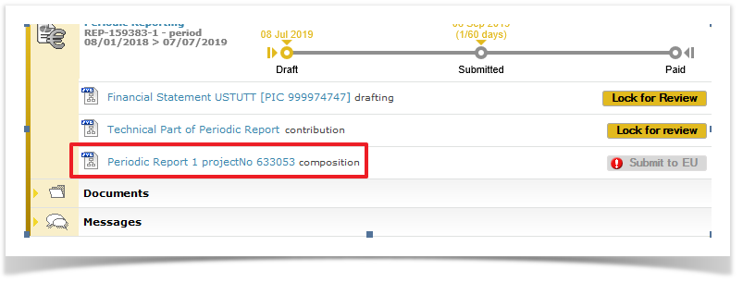
HighNESS on the Funding & Tenders Portal

Slide 11
Content Reporting
Deliverables & Milestones
Timing and conditions defined in Annex 1 of Grant Agreement
Periodic Technical Report containing:
An ‘explanation of the work carried out’ by the beneficiaries
An ‘overview of the progress’ towards the objectives of the action, including milestones and deliverables
An ‘executive summary’ for publication by the Commission
Answers to questionnaire on issues related to economic and societal impact

Slide 12
Financial Report
Each Periodic Financial Report must contain:
An ‘individual financial statement’ (Form C) from each beneficiary for the reporting period concerned:
Detailing the eligible costs for each budget category
Declaring all eligible costs, even if they exceed the amounts indicated in the estimated budget.
Each beneficiary must provide an ‘explanation of the use of resources’ including information on subcontracting and in-kind contributions provided by third parties for the reporting period.

Slide 13
Periodic Reports & Final Report
Reporting Period 1
01/10/2020 - 31/03/2022
Reporting period 2
01/04/2022 - 30/09/2023
Periodic reports consist of a technical and a financial report
An additional final report must be submitted with the last periodic report
All reports must be submitted within 60 days following the end of each reporting period

Slide 14
EC Financial Rules and Procedures
WHERE
WHAT
WHEN

Slide 15
Cost Categories & Eligibility criteria for actual costs
Personnel costs
Specific calculations apply
Hourly rate x Hours worked on the Action
Other Direct Costs
travel costs and related subsistence allowance
equipment (depreciation value) infrastructures and other assets
costs of other goods and services
Cost of subcontracting
Indirect Cost – Flat Rate 25%

Slide 16
Responsibilities
Each beneficiary is required to:
Inform the PC immediately of any circumstances likely to affect significantly or delay the implementation of the action
Submit to the PC in good time:
individual financial statements
the data needed to draw up the technical reports
ethics committee opinions and notifications for activities raising ethical issues
any other documents or information required under the Agreement,

Slide 17
Visibility of EU Funding
HighNESS is funded by the European Union Framework Programme for
Research and Innovation Horizon 2020, under grant agreement 951782

Slide 18
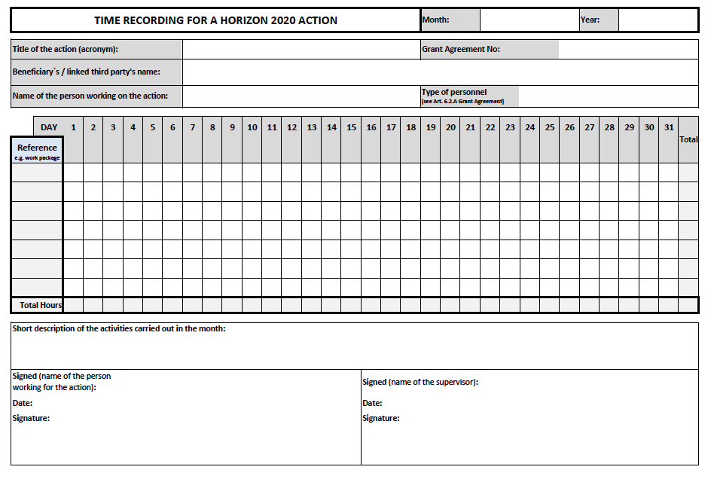
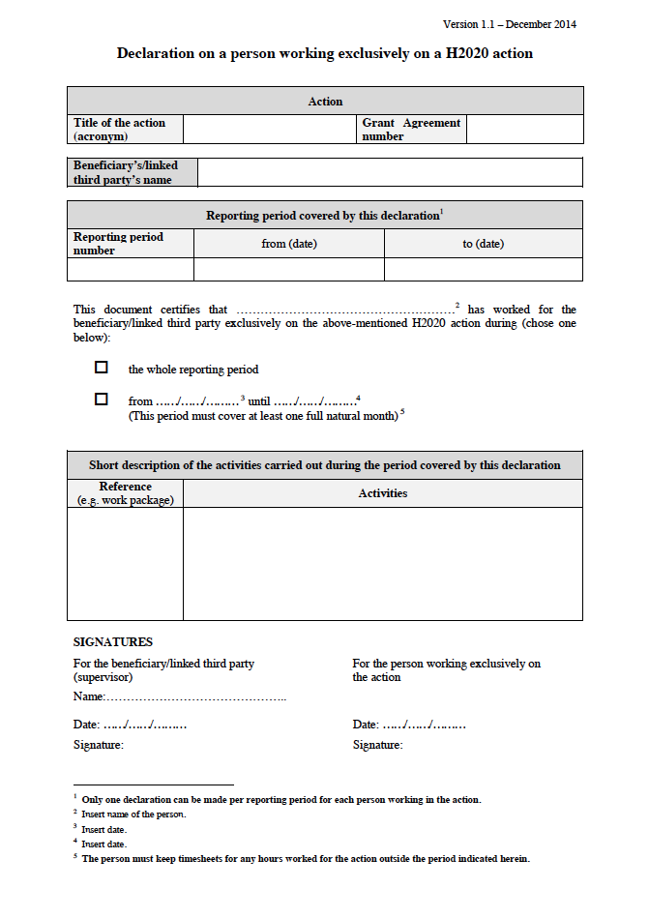
Record Keeping
Staff working part time on the action needs to keep signed time sheets in accordance with EC template (Vademecum Attachment 2)
Staff working full time on the action needs to sign ‘declaration on exclusive work for the action’ per reporting period. Now need WP number and description of Actions in this document .

Slide 19
Internal monitoring
Regular contact with each partner organisation, work closely with the persons responsible for the technical, financial and administrative delivery of their part of the activities and deliverables.
Via Google form, every six months, requesting inter alia:
Person Months
Costs
Justification of costs

Slide 20
Brand-new section for H2020 Audits
must be archived for 5 years after HighNESS finalisation
Record
keeping
Time sheets /‘declaration on exclusive work for the action’ for staff working on HighNESS Essential to archive file supporting evidence like: (electronic) agenda’s, travel documents and other project documents that underpin time sheet entries.
Record
keeping
Travel bookings and approvals in line with usual practices
Essential to archive original receipts, boarding passes, train tickets as well as conference/meeting agendas, minutes and participants lists for all events
Direct costs must comply with the applicable national law on public procurement. and in line with the beneficiaries’ internal procurement procedures and rules
Essential to archive relevant records of the claimed costs. procurement documentation, original invoices and additional receipts or documentation proving the necessity of the cost claim, such as signed participants lists for meeting costs.
Record
keeping

Slide 21
Payments
EC transfers funding to the HighNESS coordinator who distributes the funds among the consortium members.
The following payments are made to the Project Coordinator:
one pre-financing payment equivalent to the share in the estimated budget
one interim payment, on the basis of the request(s) for an interim payment
one payment of the balance, on the basis of the request for payment of the balance

Slide 22
No such thing as a Free Lunch
Adhere to reporting requirements
Eligible Costs related to the Action (Annex 1 GA)
Identifiable in Organisations Accounts
Supporting Documentation Archived
Keep HighNESS Coordination Team “in the loop”
It always seems impossible until it's done. _{Nelson Mandela}

