Slide 1

WP3:
Material characterization with neutrons
Experimental studies of novel material with promising properties for neutron moderation and diffuse reflection for Very Cold Neutrons (VCN)
Ultimate goal: strong enhancement of VCN fluxes in the wavelength tail of liquid-deuterium (LD₂) cold sources
→ a VCN source as a new tool for the community
Oliver Zimmer
HighNESS kick-off meeting; 26 October 2020

Slide 2
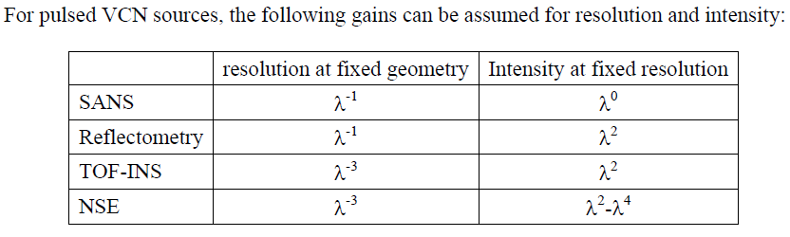
Very Cold Neutrons are useful for everyone:
Neutron scattering community:
From proceedings of workshop on application of a VCN source at Argonne, 2005
Particle physics community:
  Counting statistics improvements e.g. for
    neutron-antineutron oscillation experiment
    in-beam neutron EDM experiments

Slide 3
How to get cool neutrons?
 | λ (nm) | T_{n} (K)
thermal | 0.18 | 300
cold | 0.5 | 30-100
very cold | > 1.5 | < 4
ultra cold | > 50 | “0.002”
Moderation:
slowdown with many inelastic interactions
→ thermal equilibrium with cold medium
needs weakly absorbing cold medium with
good scattering cross sections
Moderation: compression
of full neutron spectrum

Slide 4
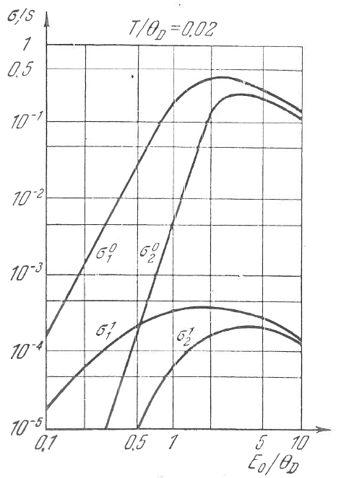
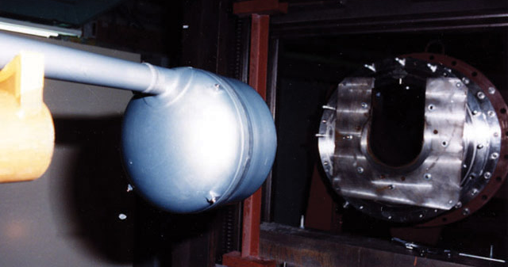
thermal → cold:
liquid H₂ and D₂ cold sources
(quasielastic scattering)
solid methane
(molecular rotations)
 | λ (nm) | T_{n} (K)
thermal | 0.18 | 300
cold | 0.5 | 30-100
very cold | > 1.5 | < 4
ultra cold | > 50 | “0.002”
thermal/cold → very cold?
phonons ?
kinematic restriction due to dispersion
T < T_{D} & E < k_{B}T_{D} : σ_{1-phonon-emission} ∝ E ⁻³
Gurevich and Tarasov,
Slow Neutrons

Slide 5
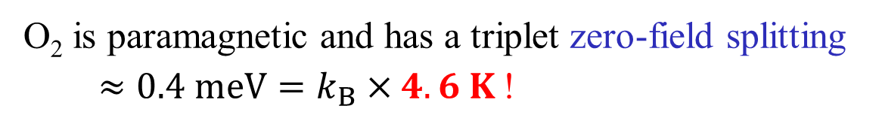
better use incoherent scattering by local modes
(1) molecular rotations
(2) librational (Einstein) modes of confined molecules
(3) weakly absorbing paramagnetic species:
O₂ is paramagnetic and has a triplet zero-field splitting
$≈0.4 meV=k_{B}×4.6 K$!
E_{m}
m = ±1
m = 0
…and it’s there without B-field !

Slide 6
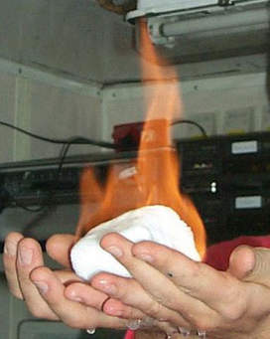
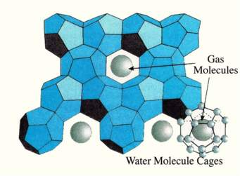
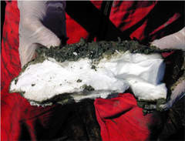
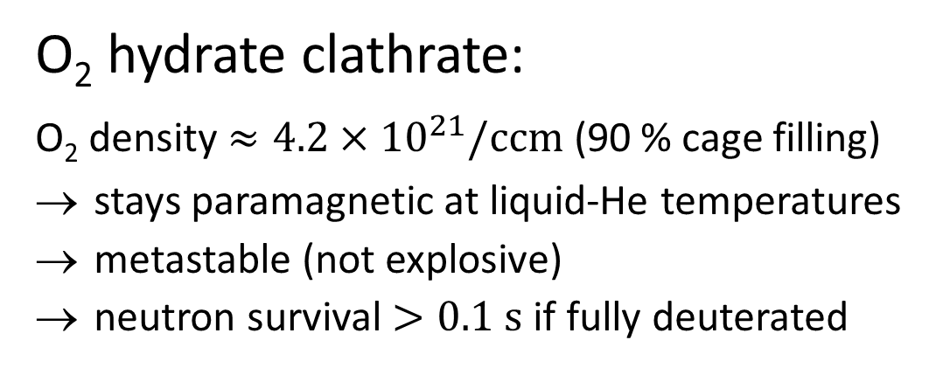
Solid oxygen is antiferromagnetic at low T (dispersion and dangerous)
O₂ hydrate clathrate:
O₂ density $≈4.2×{10}^{21}/ccm$ (90 % cage filling)
stays paramagnetic at liquid-He temperatures
metastable (not explosive)
neutron survival $>0.1 s$ if fully deuterated
Methane hydrate clathrate

Slide 7
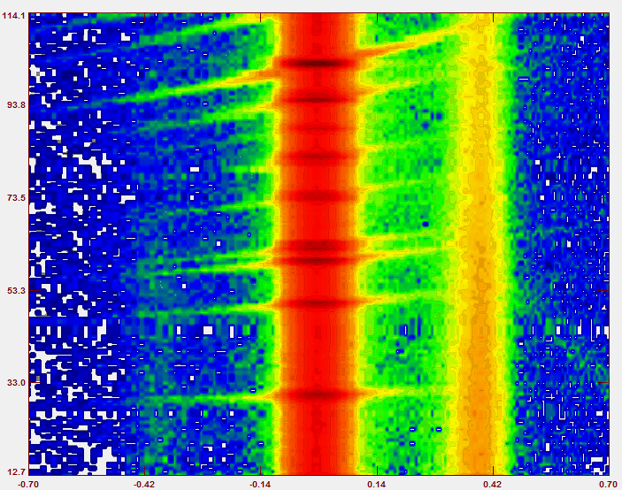
First experiments on O2 clathrate done at D20, IN4, IN6 and D7
(exp. Team: A. Falenty, T. Hansen, M. Koza, W. Kuhs, OZ)
Scattering angle
Energy transfer (meV)
→ shows dispersion-free excitation at 0.4 meV with magnetic form factor

Slide 8
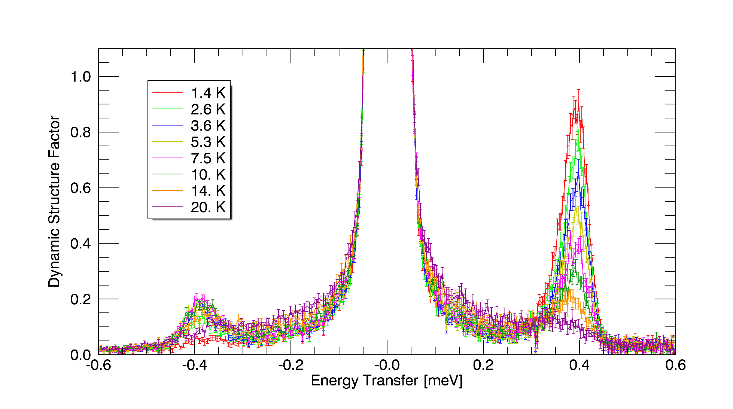
First experiments on O2 clathrate done at D20, IN4, IN6 and D7
(exp. Team: A. Falenty, T. Hansen, M. Koza, W. Kuhs, OZ)
Magnetic intensity seems in agreement with theoretical prediction

Slide 9
Neutron slowdown in medium at sufficiently low temperature,
e.g., k_{B}T < E * ≅ 4.6 K for zero-field splitting in molecular O₂:
see Phys. Rev. C 93, 035503 (2016) for analysis of slowdown in infinite medium

Slide 10
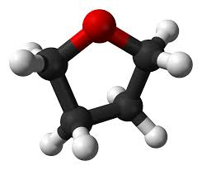
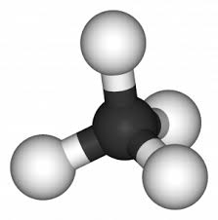

Slide 11
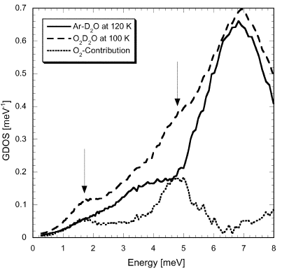
Einstein modes will help to short-circuit long paramagnetic cascades:
Chazallon, Itoh, Koza, Kuhs, Schober,
Chem. Phys. Phys. Chem. 4,
4809 (2002)
Binary clathrate with strong Einstein modes of THF-d and paramagnetic cooling by molecular O₂ might work best
Also: simpler moderator preparation than pure gas hydrate
Need absolute scattering strength S(q,ω) – main goal within HighNESS

Slide 12
Clathrate hydrates are also interesting neutron reflectors
 | Clathrate type I | Clathrate type II
structure | fcc, a = 1.2 nm | cubic, a = 1.71 nm
# H₂O per unit cell | 46 | 136
Cages per unit cell | 6 large + 2 small | 8 large + 16 small
Bragg cut-off wavelength | 2.4 nm | 2.0 nm
Guest molecules, e.g., | CH₄ | O₂ , C₄H₈O (THF)
Huge crystalline structures -> large Bragg cut-off, covering the whole cold-neutron λ-range
Large choice of weakly absorbing species
non-dangerous materials
Gas hydrates stable up to 140 Kelvin (O₂, CH₄)
THF-d clathrate stable below 7⁰ Celsius and simple to prepare – in-situ annealing possible!

Slide 13
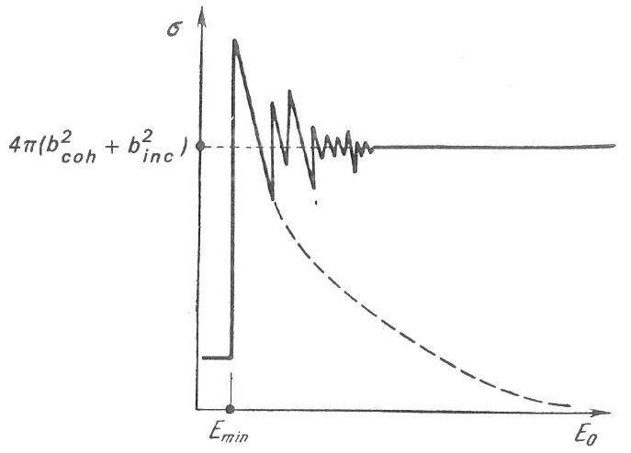
Albedo (diffusion theory)
Nanoparticles and clathrates cover VCN and CN complementary
but: MgH₂ might be best suited in high-radiation fields and limited space

Slide 14
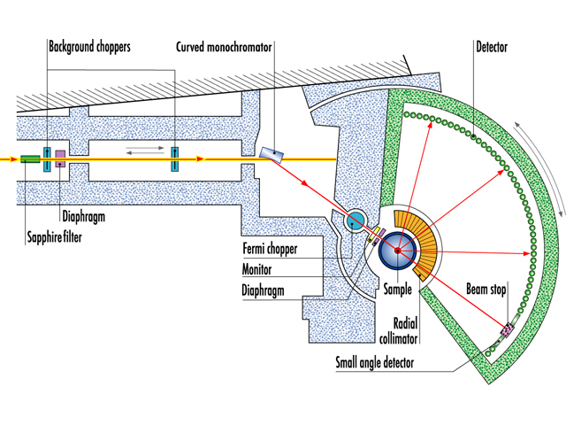
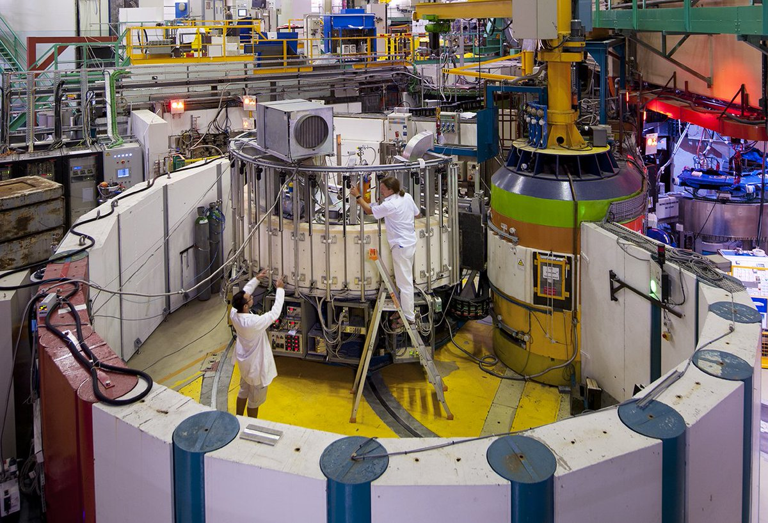
Experimental program for HighNESS uses ILL’s instrument suite,
notably:
Diffractometer D20
Time-of-Flight spectrometers IN5 and Panther

Slide 15
Milestones
Proposal to ILL for transmission measurements accepted by the subcommittee of the Scientific Council (M9) – proposal submitted
Proposal to ILL for measurement of S(q,ω) and complementary diffraction measurements for sample characterisation for clathrate hydrates accepted by the subcommittee (M12). Clathrate formation of 17D₂O:TDF already successfully tested at D20; first inelastic measurements foreseen at IN5 in spring 2021; proposal for complementary measurements at Panther (larger q,ω) submitted
Table of measured absolute values of S(q,ω) for clathrate hydrates (focus first on the stoichiometric inclusion compounds 17D₂O:TDF, 17H₂O:TDF, 17D₂O:THF, 17H₂O:THF), including all experimental corrections, provided to WP2, where the results of measurements are combined with computational work to describe the low-energy neutron transport through these materials (M24 or earlier)
Table of measured values of neutron transmission through clathrate hydrates, nano-diamonds and other materials provided to WP2 (M24 or earlier)
Deliverables
Devices: for prompt-gamma activation analysis on samples of interest for this project, and a generic low-background sample holder (M9)
Final publication of results of measurements (M36)
Postdoc selected and to start in January 2021, PhD student position still vacant

