Slide 1
HighNESS WP4 – Moderators design
Prepared by L. Zanini, A. Takibayev
26 October 2020 HighNESS kick-off meeting

Slide 2
Contents
Objectives
Tasks, Deliverables
Plan
People
First progress

Slide 3
WP4 objectives
WP4 will design the moderators for
cold, (~ 4-10 Å)
very cold ( ~ 10-40 Å)
ultra cold neutrons (> 500 Å)

Slide 4
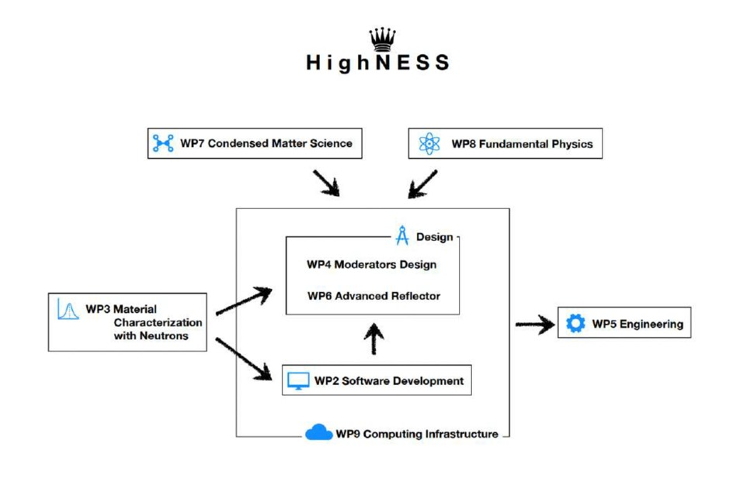
WP4 is central in the project with interfaces with all WPs

Slide 5
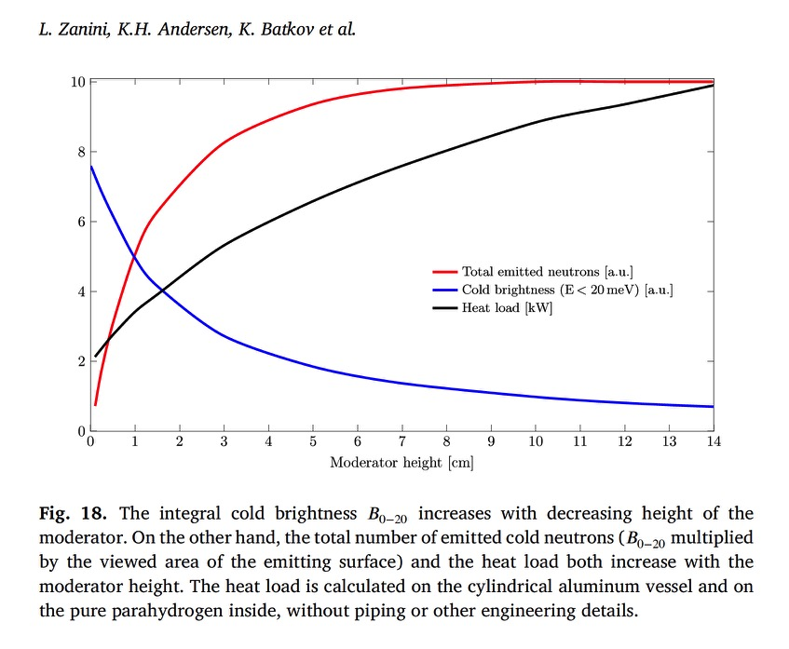
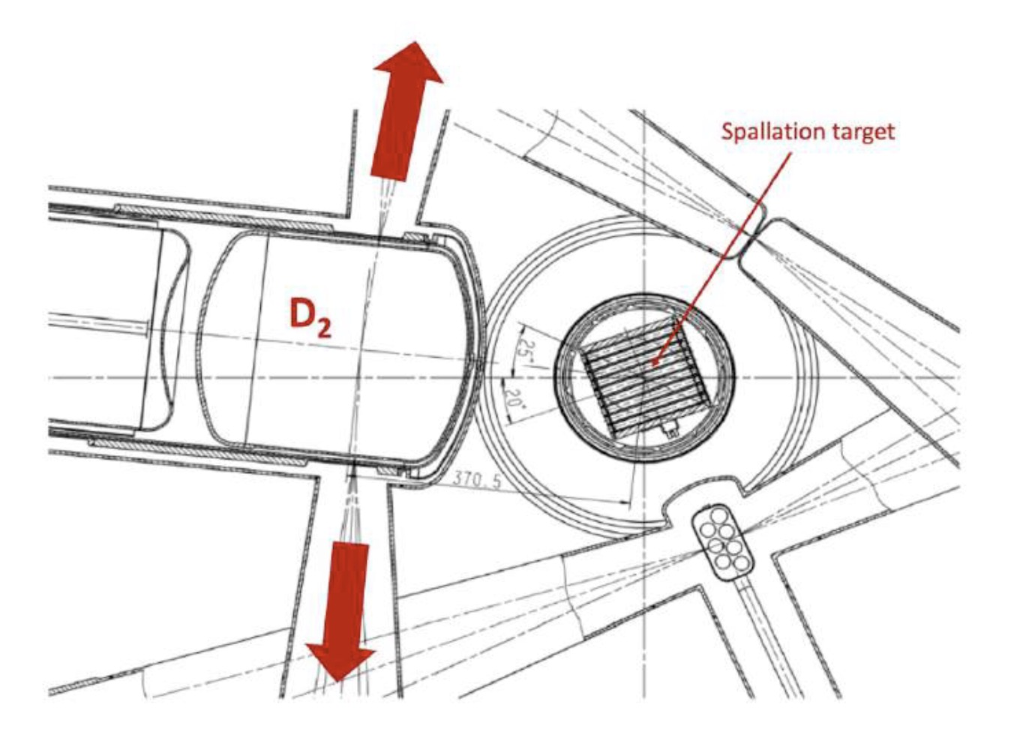
Cold moderator: why liquid deuterium?
To increase the intensity (total number of neutrons), parahydrogen is not viable
(3 cm moderator delivers 80% of the max intensity).
Maximum intensity achievable with parahydrogen
Intensity (a.u.)
Upper moderator
PSI-SINQ LD₂ moderator
Zanini et al NIM A 925 (2019) 33-52

Slide 6
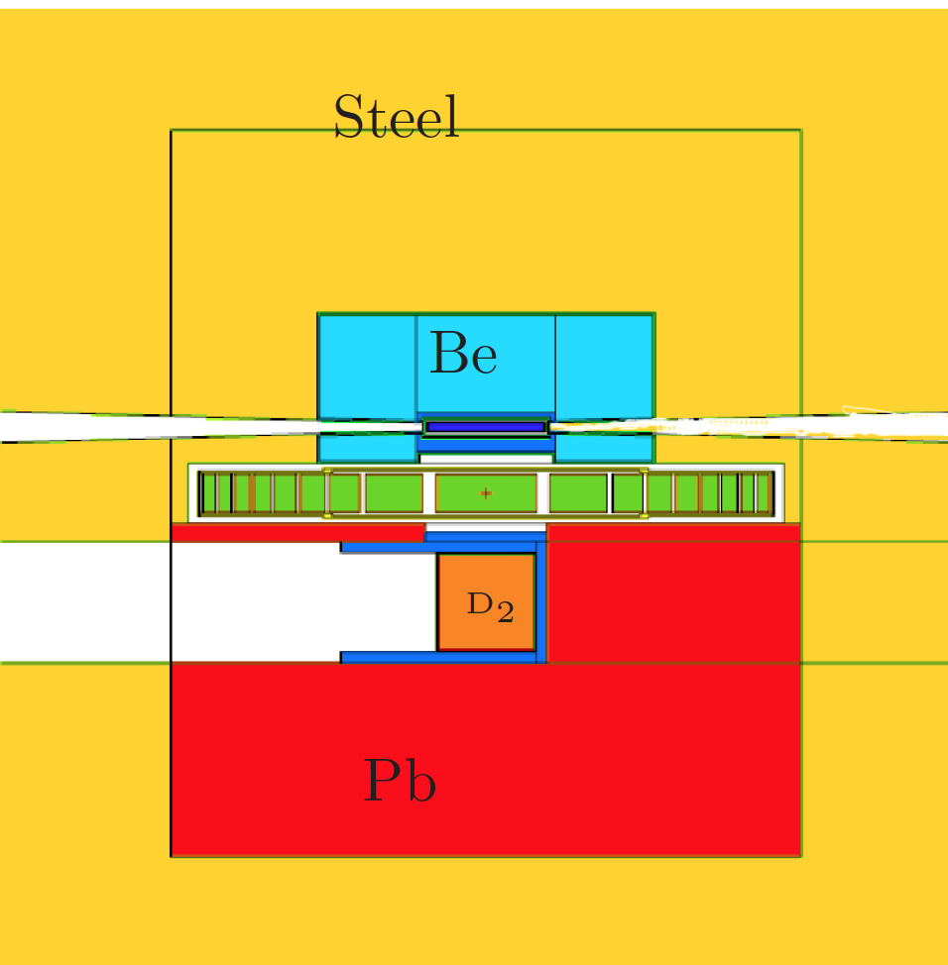
Cold moderator: why liquid deuterium?
~25
A much better way is to use voluminous D2 moderator (factor 3-4 more intense)
E. Klinkby et al.,https://arxiv.org/pdf/1401.6003.pdf
Intensity (a.u.)
Upper moderator
~20 cm LD₂

Slide 7
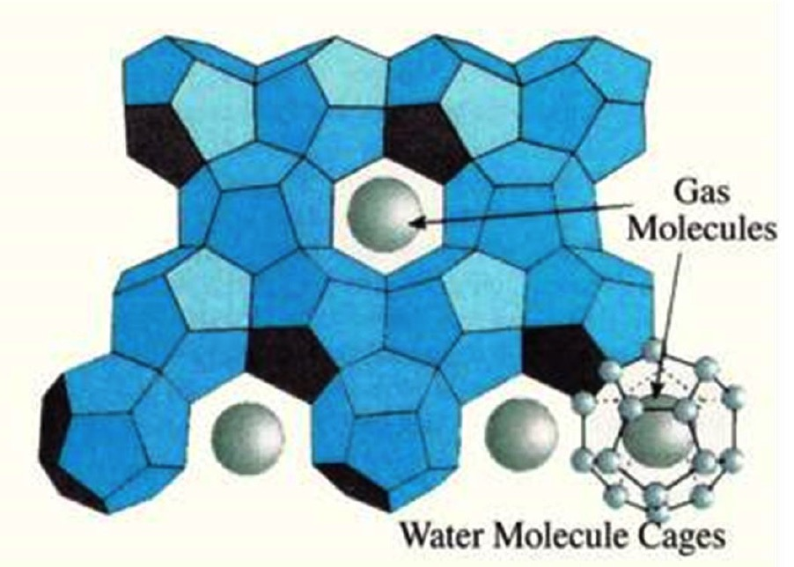
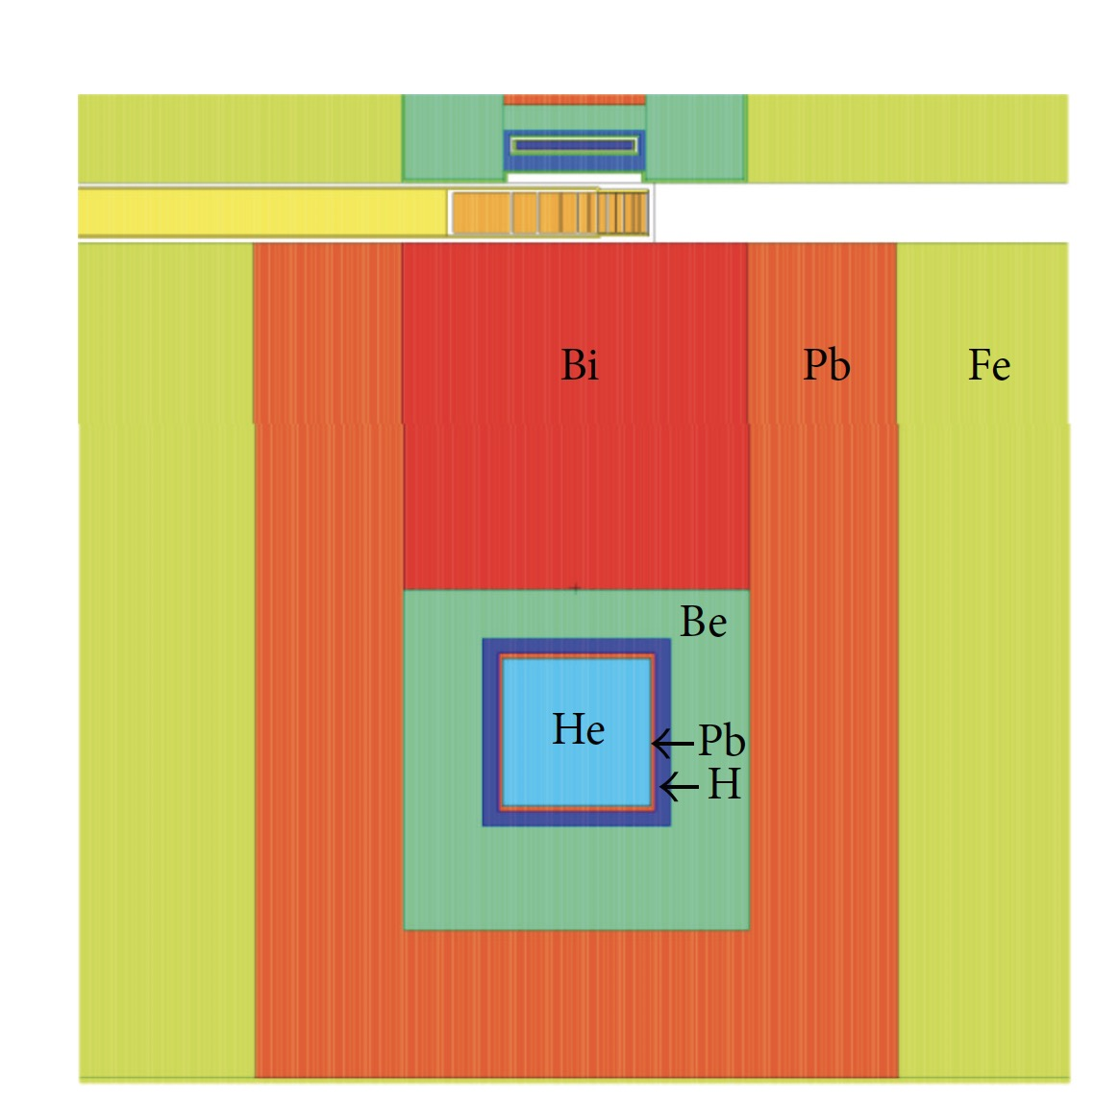
VCN and UCN
For increase of VCN there are two possibilities:
Enhancement of the cold tail of the LD2 via quasi-specular reflection from nanodiamonds or other reflectors (with WP6)
Development of a dedicated VCN moderator.
Study of candidate material, Cross section measurements (with WP2, WP3)
(M. Jamalipour)
Technology is UCN converters is known and used
Possibilities at ESS: in beam and in pile.
Both will be studied; one option will be selected and
engineering design will be performed for that option
Example of in-pile source
(Klinkby, 2014 https://doi.org/10.1155/2014/241639

Slide 8
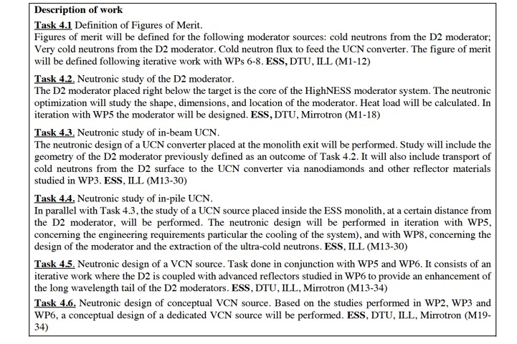
Tasks
Main source
UCN
VCN

Slide 9
The tasks are being splitted in subtasks that will be carried out by the single participants, with discussions and progress discussed in weekly meetings.
Example of subtasks in Tasks 4.2: D2 moderator design
some of them already started
Baseline MCNP model of D2 moderator within ESS TS monolith
Neutronic performance of baseline model for McStas model (for different vertical openings
McStas model based on MCPL (by WP6)
Model of NNBAR large beamport
Study of the effect of neutron scattering libraries for D2
Study of reentrant hole
Design of (conventional) reflector
Effect of openings in the reflector on the moderator performance
Effect of cold Be filter
Study of MgH2 around moderator
Study of HD composition in main moderator
Detailed maps of heat load
First engineering design of the moderator
Report on neutronic design of D2 moderator (deliverable)

Slide 10
Deliverables
D4.1. Baseline document with figure of merit to be used in the moderator design (written in conjunction with other WPs) (M12)
Contents of the report: FOM and other requirements like number of openings, geometrical constraints, heat removal, etc.
D4.2. Report on neutronic design of the D2 moderator (M18)
This report contains the design of the D2 moderator at mid-project. The final design will be delivered at M34 and will be the integrated design of all moderators.
D4.3. Report on neutronic design of in-beam UCN moderator (M30)
D4.4. Report on neutronic design of in-pile UCN moderator (M30)
Only either D4.3 or D4.4 will contain engineering design calculations (depending on the selected concept), while the other report will be on selection process between in-pile and in-beam options.
D4.5. Report on neutronic design of VCN source (M34)
This report contains the integrated design of VCN, D2 and UCN. For VCN, only nanodiamond extraction option will proceed to engineering design.

Slide 11
WP4 participants
ESS: L. Zanini, A. Takibayev, Z. Kokai, K. Ramic
ILL: O. Zimmer, 1 postdoc/student
DTU: E. Klinkby, N. Rizzi
Mirrotron: F. Mezei, 1 postdoc/student

Slide 12
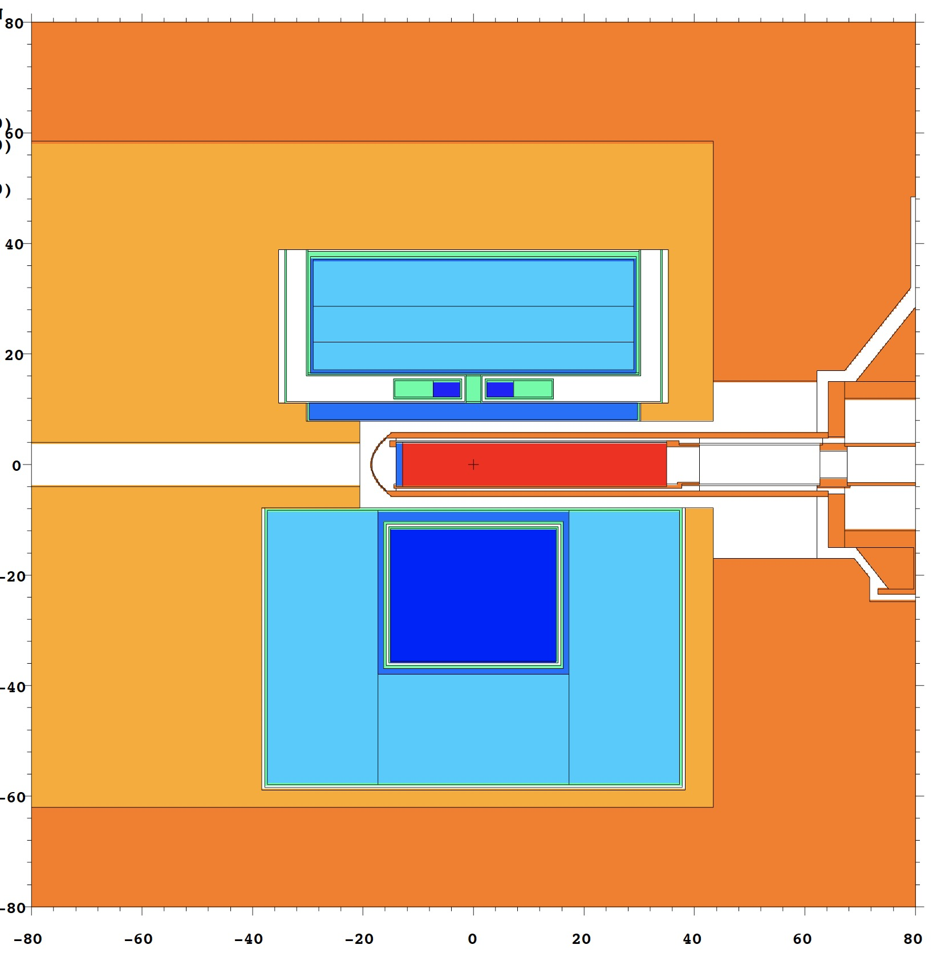
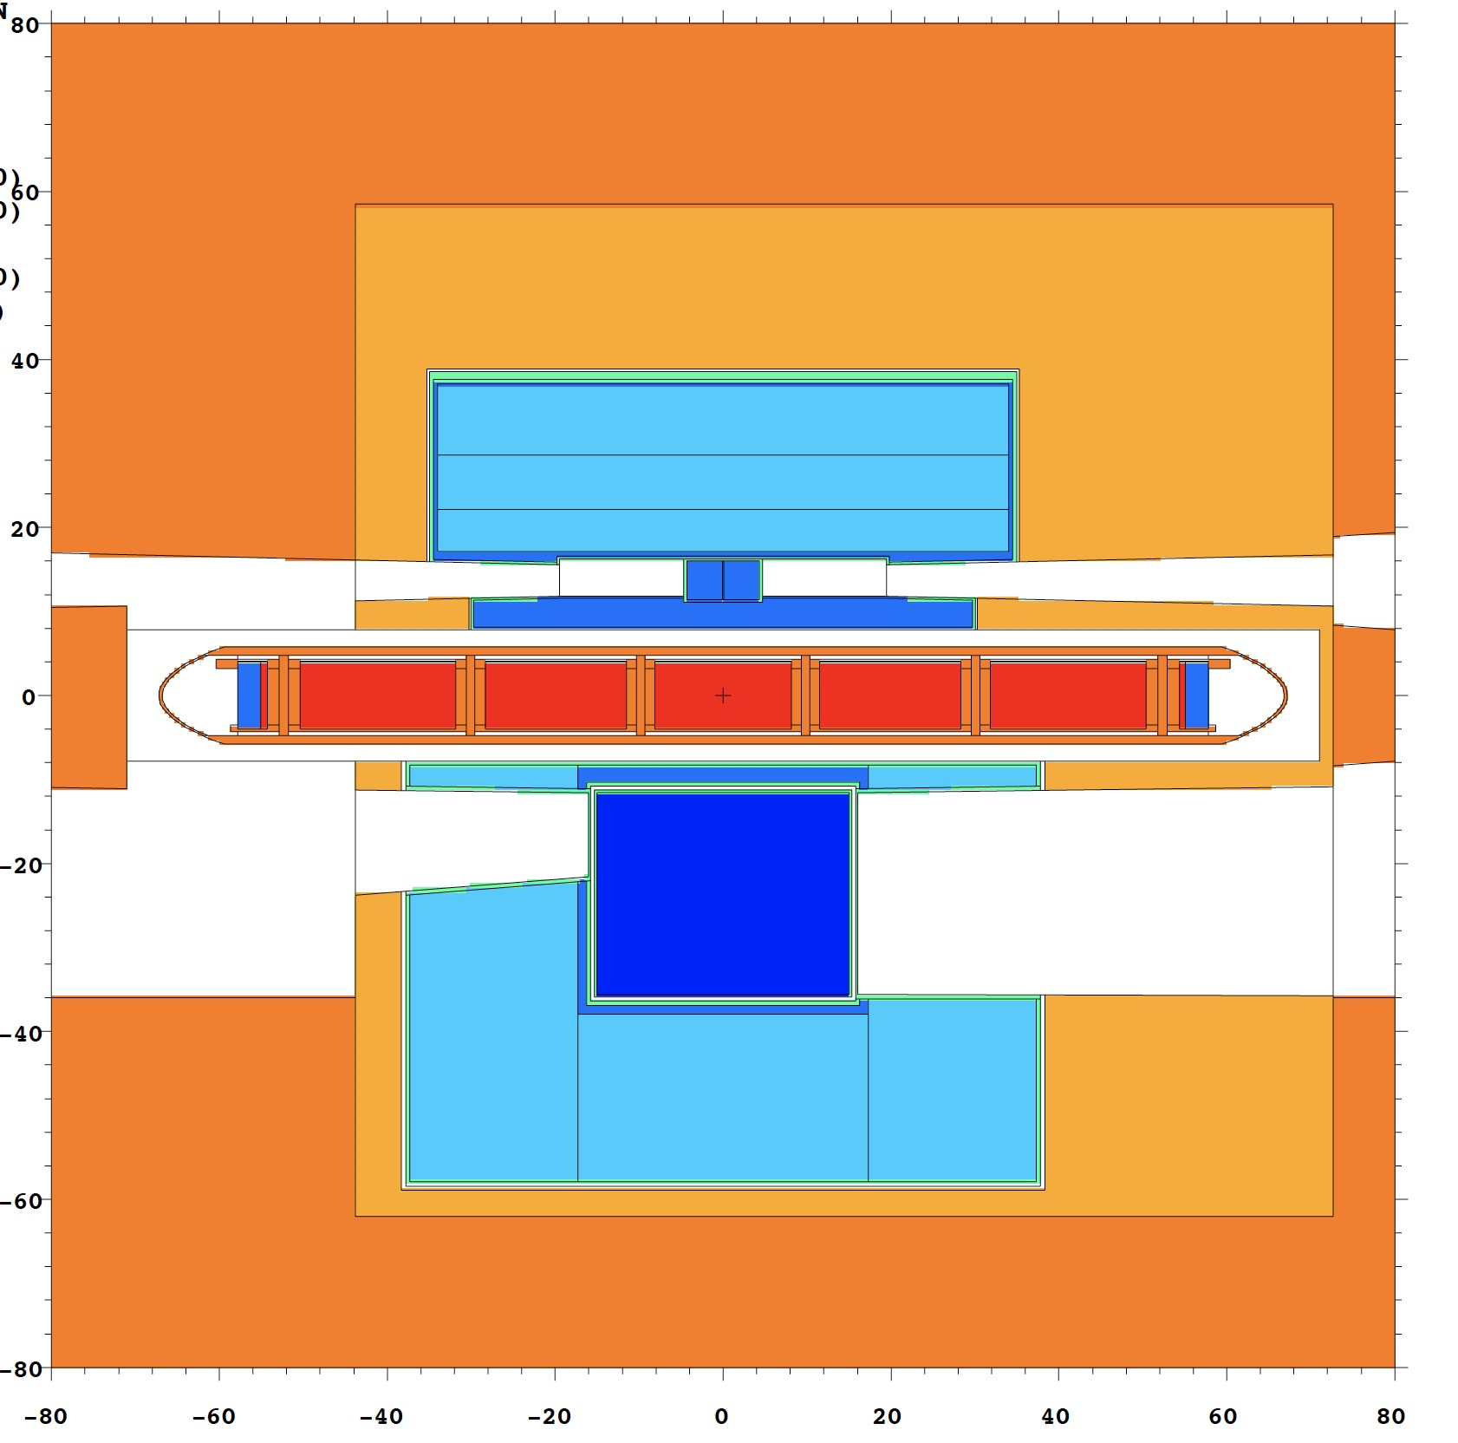
Recent progress (1): MCNP baseline model developed
target
D2
Be reflector
MCNP model fully parametrized to allow easy changes in the geometry for sensitivity studies and optimization.
Baseline dimensions and integrated heat load communicated to WP5
Calculations of intensity and McStas module in progress for first iteration with WP7

Slide 13
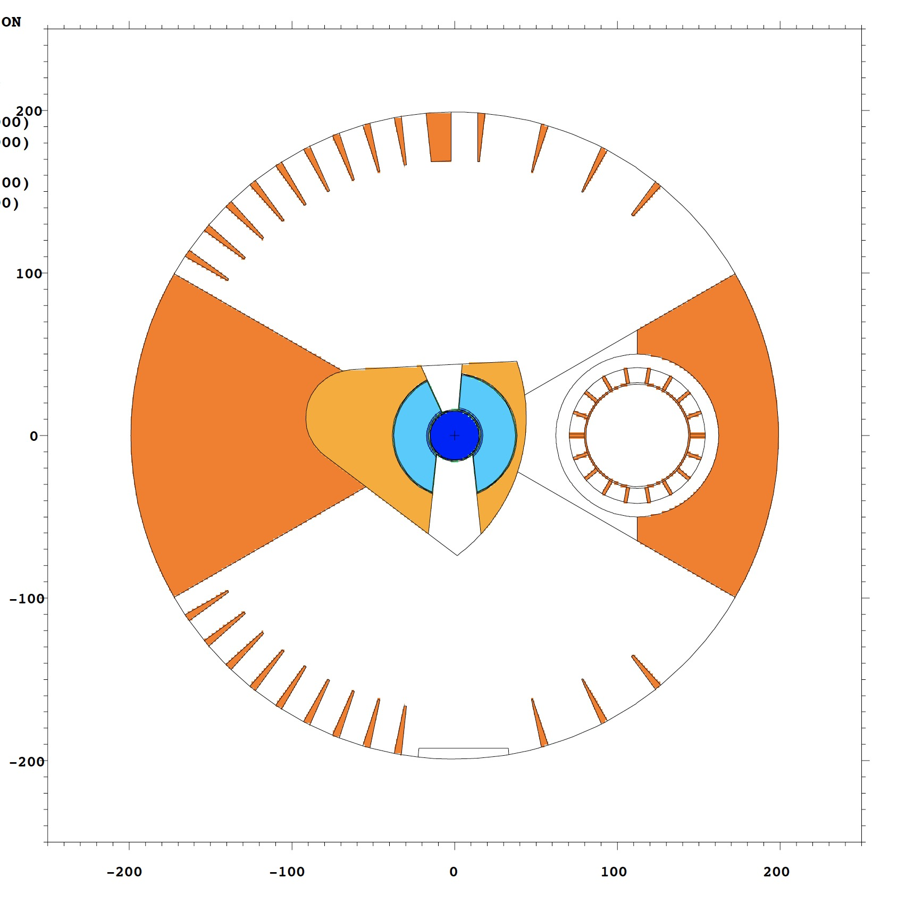
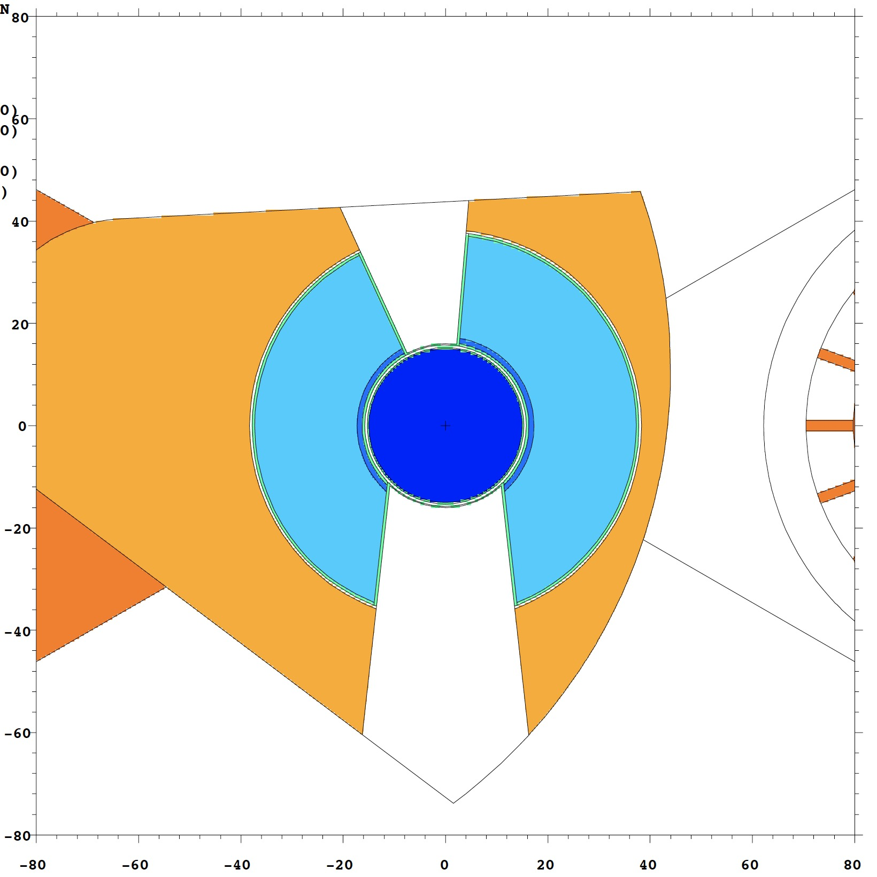
Recent progress (1): MCNP baseline model developed
2m
The space around the moderator/reflector plug is fixed and used for neutron beam extraction
The openings in the twister can be modified (number of openings, location, size)

Slide 14
Recent progress (2): interface work with other WPs, work started
Discussed thermal scattering library needs with WP2
Communicate to WP5 baseline dimensions of D2 moderator
Meeting with WP7 and ESS instrument scientists for possible instrument placement looking at lower moderator
Calculations ongoing for McStas module for WP7
Meeting with A. Serebrov (PNPI) to discuss ideas for UCN and possible locations at ESS
WP4 kick off meeting held. Started regular weekly meetings

Slide 15
Thank you
Any questions?

