Slide 1
WP 10: Dissemination and Outreach
HighNESS Kick-off Meeting
Ute Gunsenheimer & LENKA PETKOVA

Slide 2
WP10: Dissemination and outreach
Participants: ESS. Person Months: 6
Task 10.1
Internal Communication Platform
(M1-3)
Task 10.2
External Communication Platform
(M1-3)
Task 10.3
Organization of an International School on thermal neutron scattering kernel generation (M32-34)
Tasks
Form a knowledge database for all the researchers, experienced and inexperienced, of the grant consortium
Relay timely information about project activities and accomplishments to the public (website)
Increase project awareness and stimulate stakeholder participation (social media)
Teach attendees about the methods available to generate thermal neutron scattering kernels
Objectives
D10.1 Wiki Page
M3: December 2020
D10.2 Public Web Page and social media accounts
M3: December 2020
D10.3 International School on thermal neutron scattering kernel generation
M34: July 2023
Deliverables

Slide 3
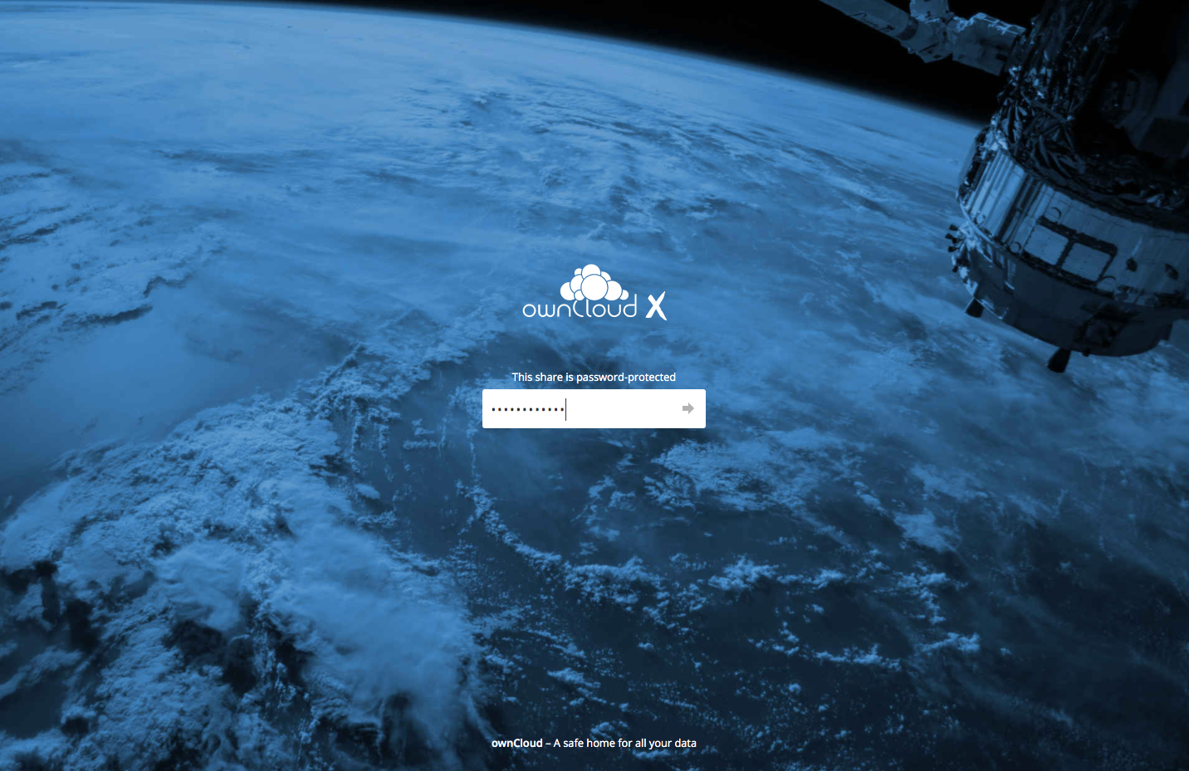
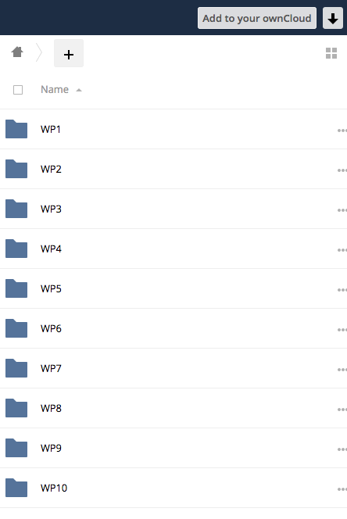
Task 10.1: Internal communication platform
OwnCloud: https://project.esss.dk/owncloud/index.php/s/uaRWkjUKnpGVNKK

Slide 4
Task 10.2: External communication platform
Project website structure
Home page
About
Project progress
News and events
Mission and objectives
Partners
Work Packages
Deliverables
Milestones
Cookies policy & privacy policy
Work Package 1
Work Package 2
Up to Work Package 10
Project branding and templates to download
Post 1
Post 2
Post 3
Contact
Post 4

Slide 5
Task 10.3: Organisation of an International School on thermal neutron scattering kernel generation
Where: Lund, Sweden
When: Months 32-34 (May-July 2023)
Length: Up to 1 week
Logistics and hosting: ESS
Technical content: All grant participants involved in generating and validating the thermal neutron scattering kernels for this conceptual design
Photo by Nathan Dumlao on Unsplash

Slide 6
Go to: www.menti.com
Use the code: 29 62 82 6

Slide 7
Mentimeter questions
What social media do you actively use for work-related purposes?
Twitter
LinkedIn
Slack
Facebook
None
How often do you use social media for work-related purposes?
Several times a day
Once a day
Every other day
Once a week
Sporadically
Never
What social media platform would be most useful for HighNESS?
Twitter
LinkedIn
Slack
Facebook
Have you ever logged in to HighNESS OwnCloud?
Yes
No
Do you plan to actively use HighNESS OwnCloud?
Yes
No
Describe the HighNESS project with one word. (Up to three entries per participant)

