Slide 1
Cryomodule / Valve box jumper connection
Presenter: Jarosław Fydrych (on behalf of the project team)
CDR for CM-VBox Jumper Connection, ESS, 2020-12-02

Slide 2
Outline
Introduction to CM/VBox jumper connection 1.1. CM/VBox interface 1.2. TS2 vacuum pump-down translation incident 1.3. Temporary solution (rigid sleeve)
Updated requirements for CM/VBox interface
Design of semi-flexible DN450 connection sleeve 3.1. TS2 configuration 3.2. Tunnel configuration
Stress and flexibility analysis
Open issues and next actions
Schedule and cost estimates

Slide 3
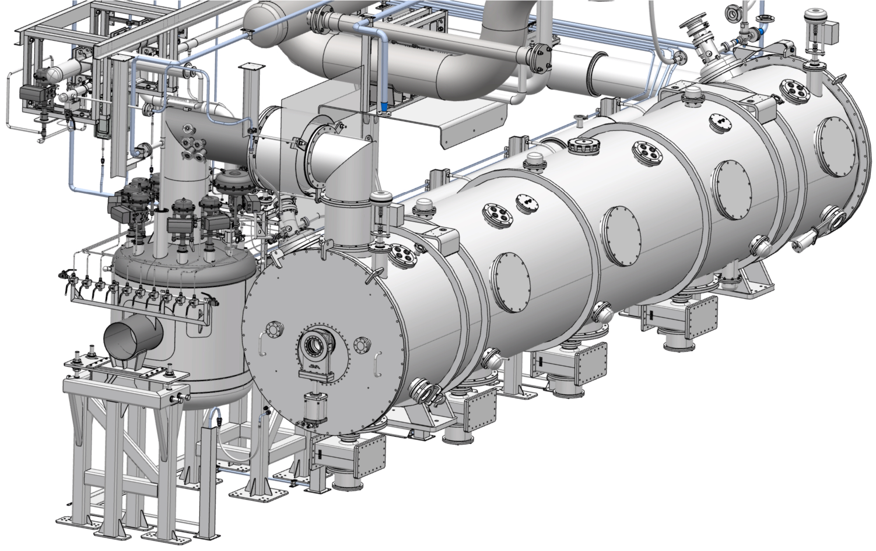
1. Introduction to CM/VBox jumper connection
CM-VBox interface virtual plane for vacuum jacket
1.1. CM/VBox interface
DN450 connection sleeve
Vbox Jumper Connection
Valve box
Cryomodule

Slide 4
1. Introduction to CM/VBox jumper connection
1.1. CM/VBox interface - Requirements
ESS-0054485 consists a list of 130 requirements for the CDS interfaces with other ACCSYS subsystems:
29 for interface with ACC.MBL.EMR
29 for interface with ACC.HBL.EMR
4 for interface with ACC.CNPW
13 for interface with ACC.VAC
45 for interface with ACC.CRYO.ACCP
10 for interface with SA

Slide 5
1. Introduction to CM/VBox jumper connection
1.1. CM/VBox interface – Requirements for ADJUSTABILITY
for interface with ACC.MBL.EMR
for interface with ACC.HBL.EMR

Slide 6
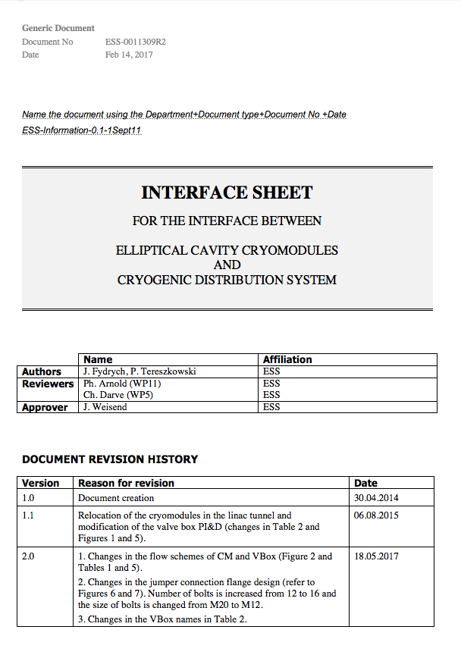
1. Introduction to CM/VBox jumper connection
1.1. CM/VBox interface – Requirements for MECHANICAL LOADS

Slide 7
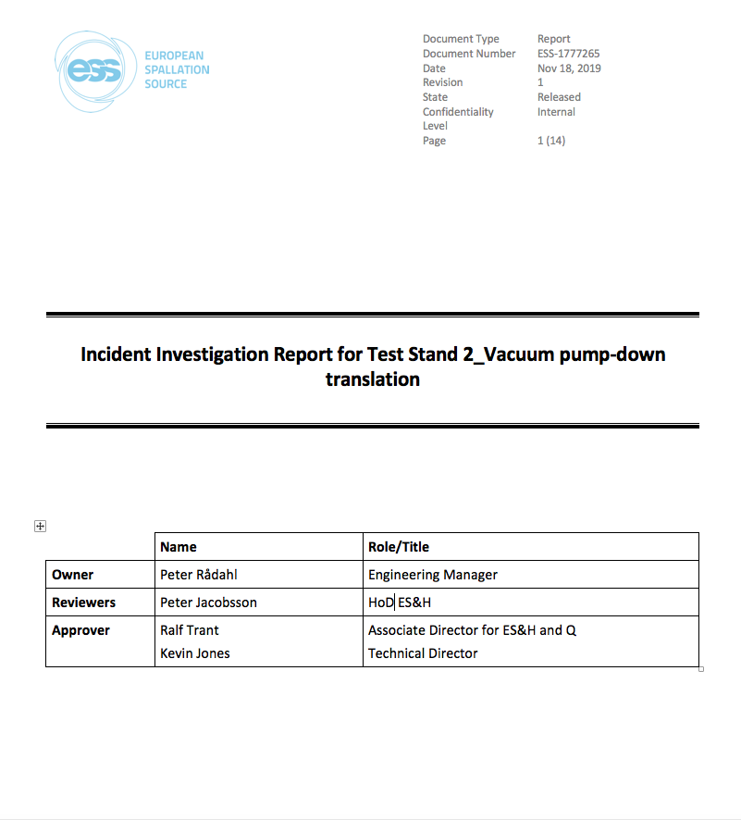
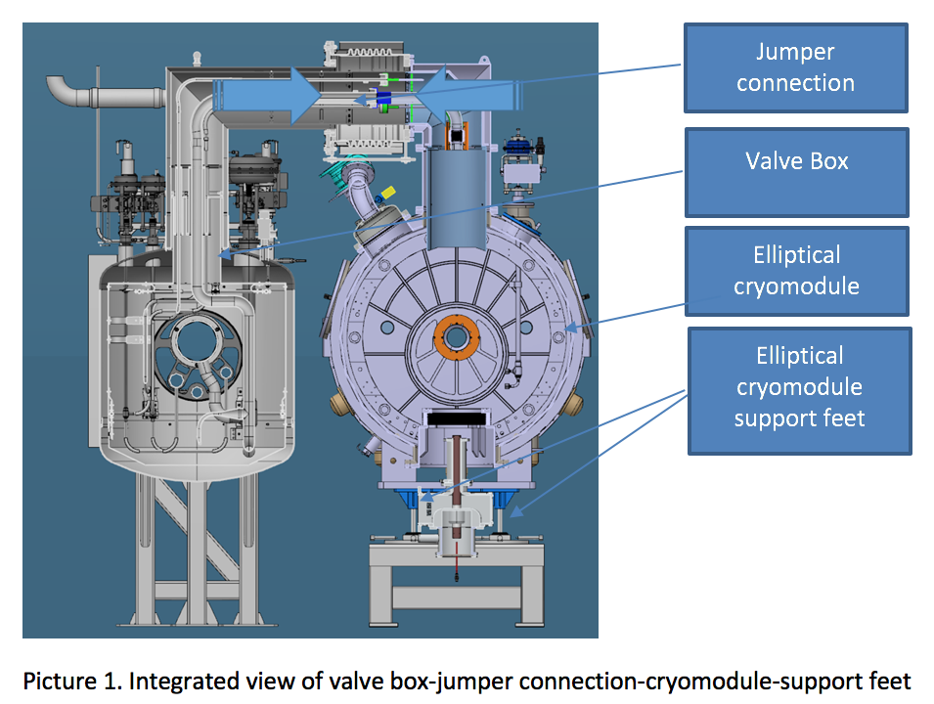
1. Introduction to CM/VBox jumper connection
1.2. TS2 vacuum pump-down translation incident

Slide 8
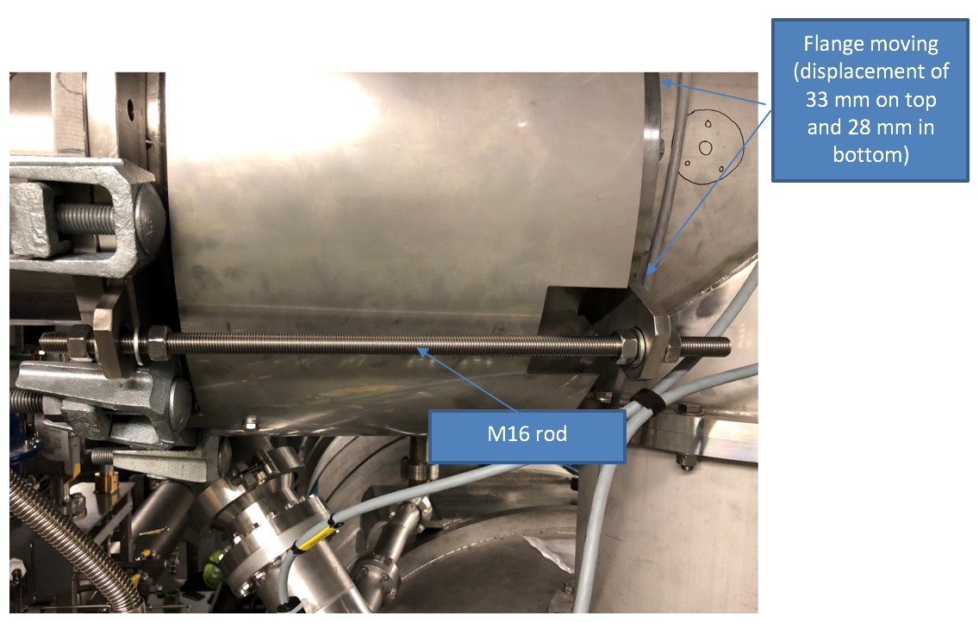
1. Introduction to CM/VBox jumper connection
1.2. TS2 vacuum pump-down translation incident

Slide 9
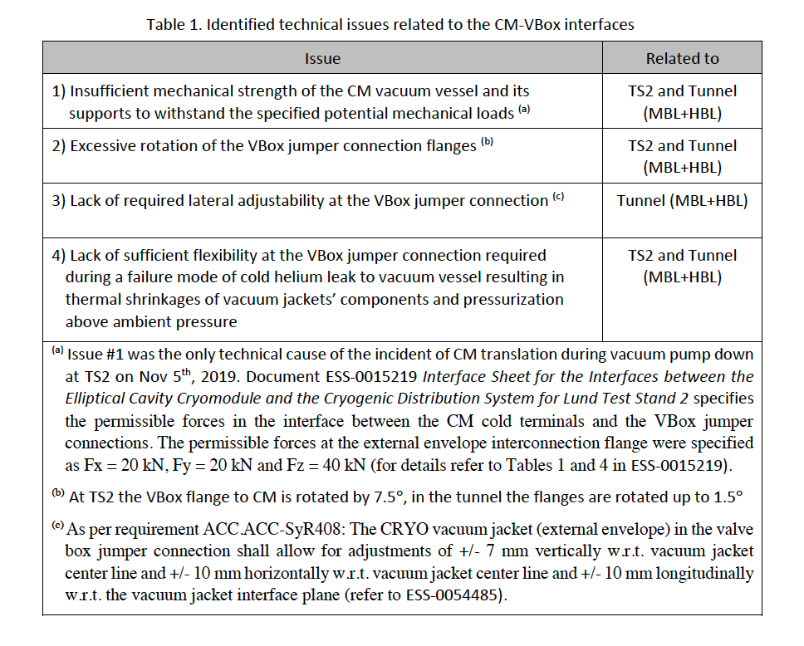
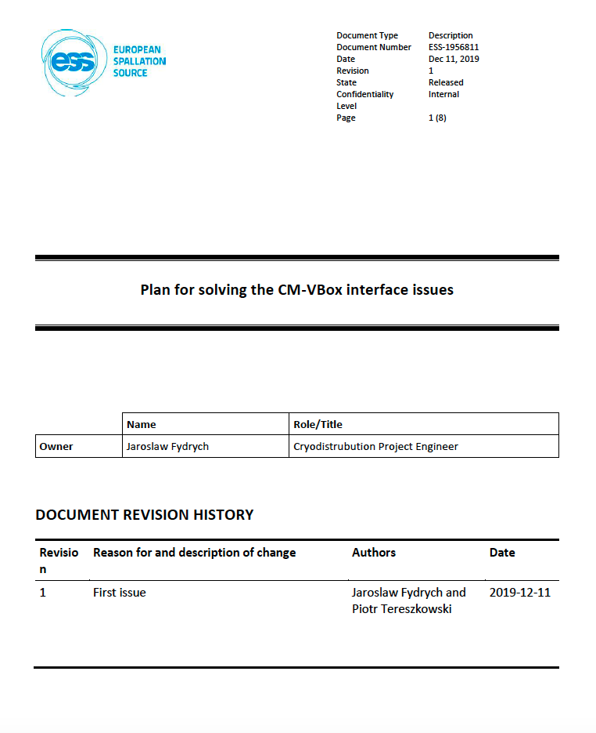
1. Introduction to CM/VBox jumper connection
1.2. TS2 vacuum pump-down translation incident

Slide 10
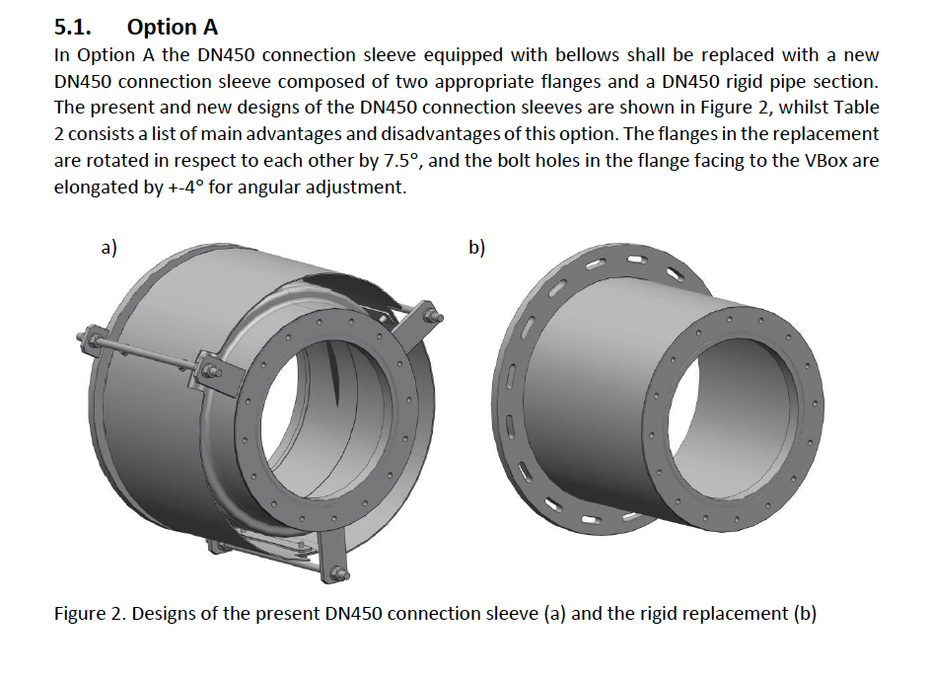
1. Introduction to CM/VBox jumper connection
1.2. TS2 vacuum pump-down translation incident

Slide 11
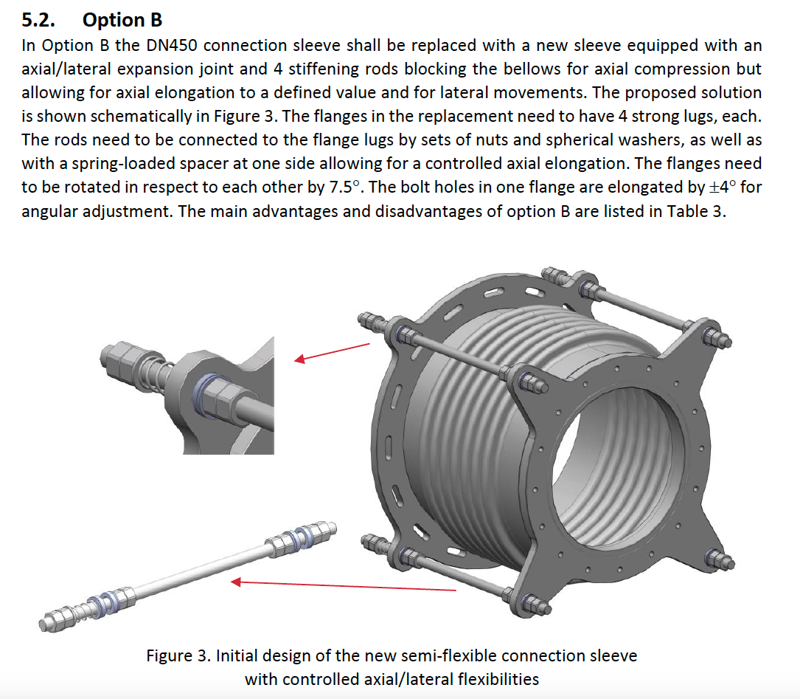
1. Introduction to CM/VBox jumper connection
1.2. TS2 vacuum pump-down translation incident

Slide 12
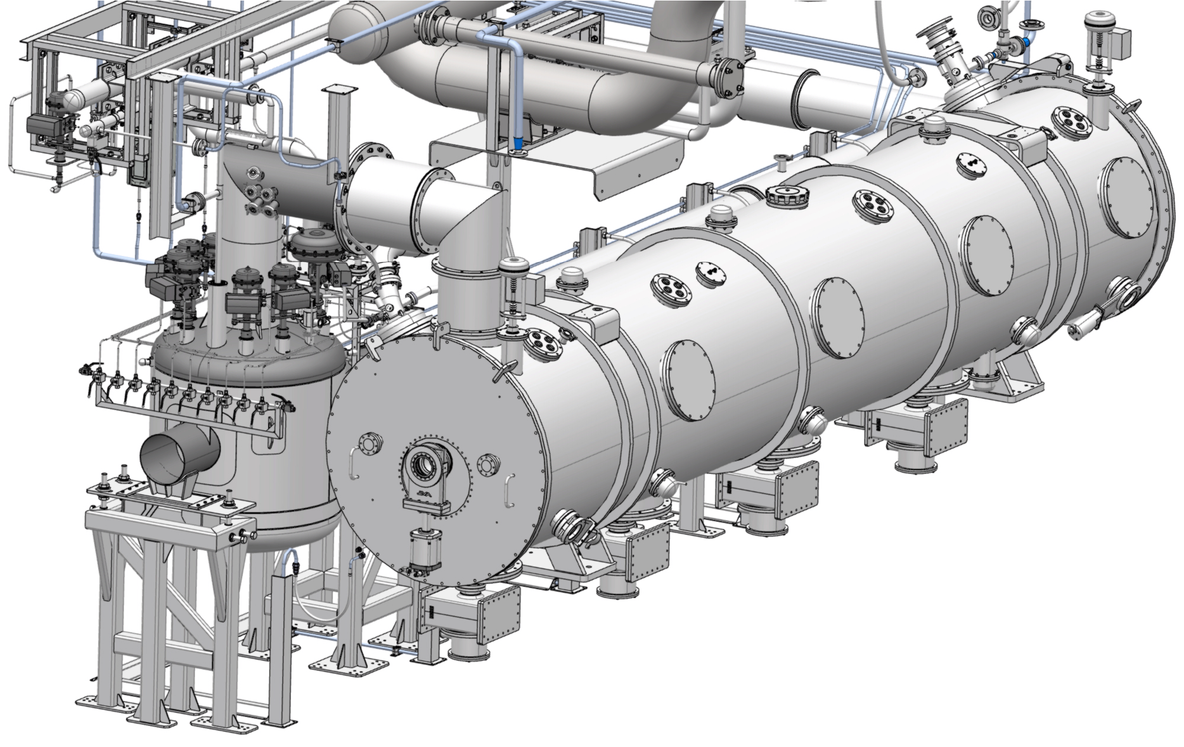
1. Introduction to CM/VBox jumper connection
1.3. TS2 temporary solution (Rigid sleeve)
New DN450 connection sleeve
with rigid pipe

Slide 13
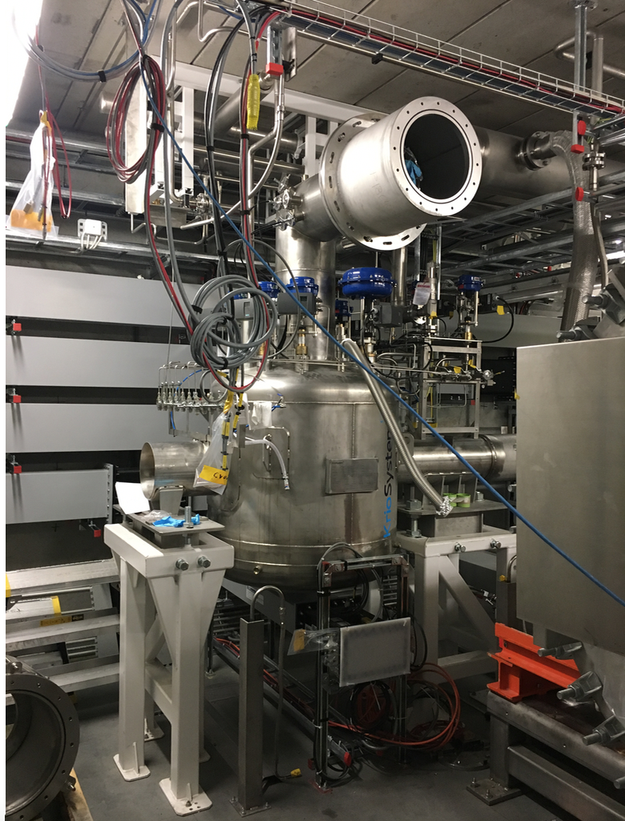
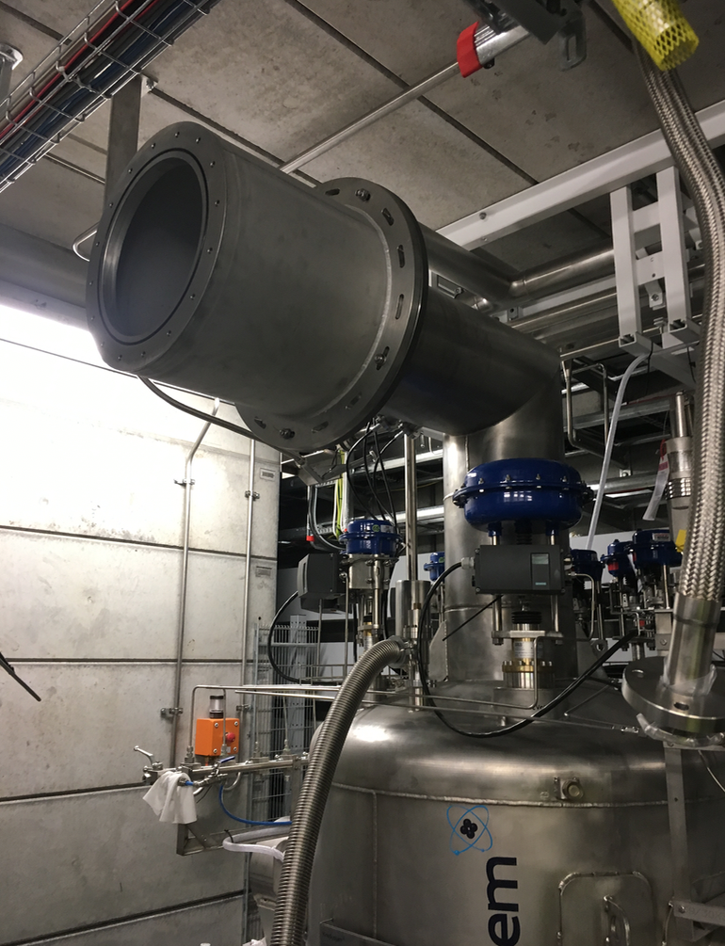
1. Introduction to CM/VBox jumper connection
1.3. TS2 temporary solution (Rigid sleeve)

Slide 14
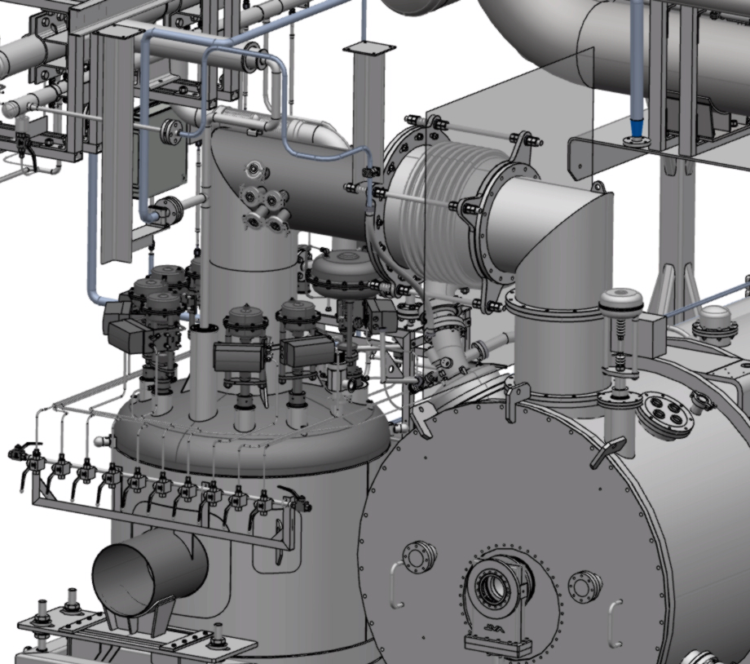
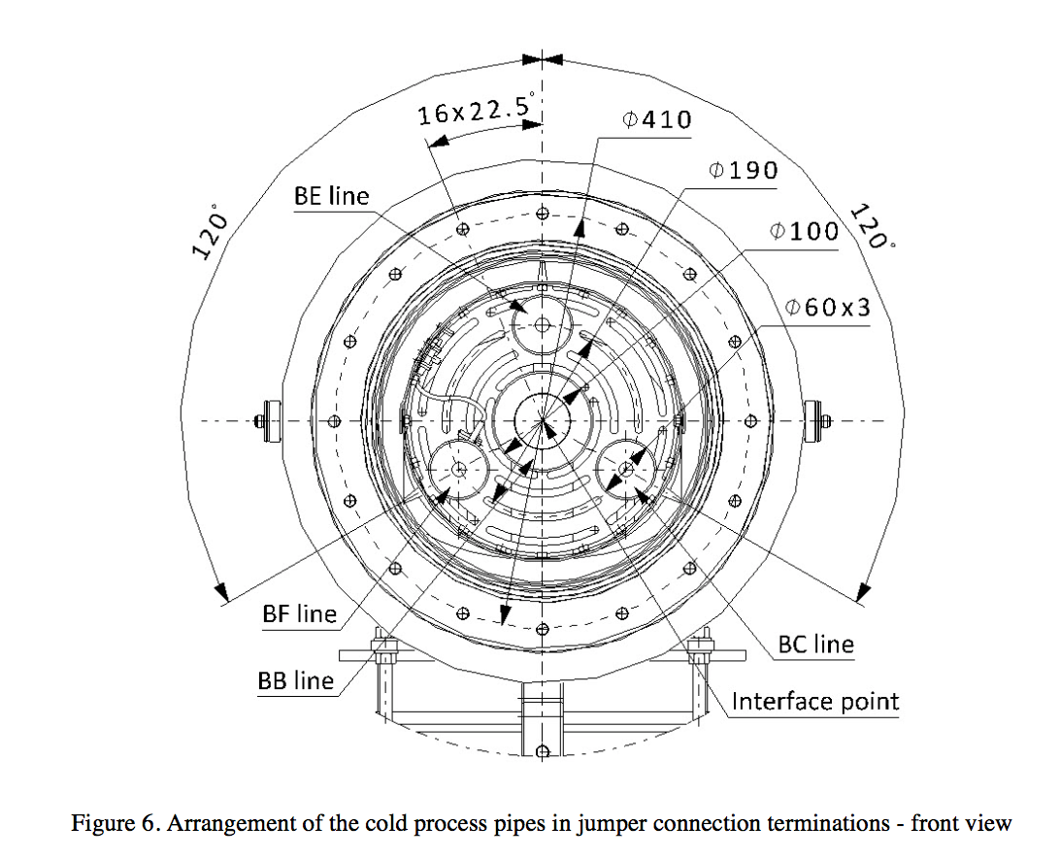
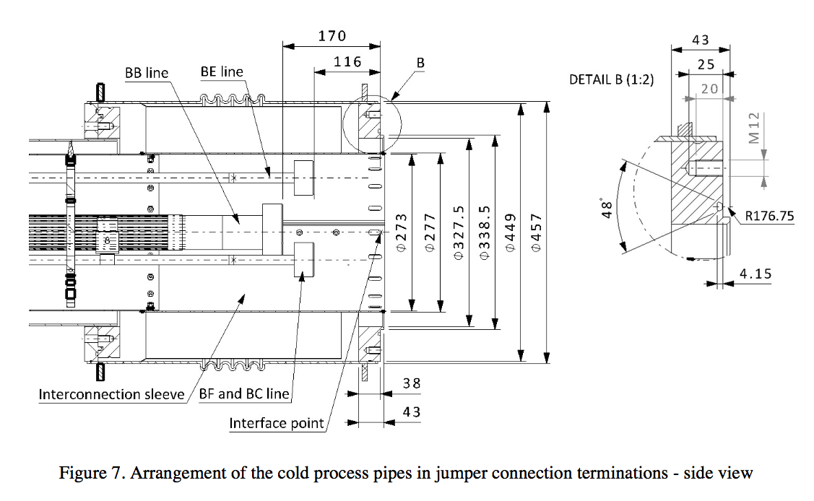
2. Updated requirements for CM/VBox interface
2.1. Requirements for ADJUSTABILITY
The CRYO vacuum jacket (external envelope) in the valve box jumper connection shall allow for adjustments of
a) +/- 10 mm longitudinally w.r.t. the vacuum jacket interface plane,
b) 10 mm radially w.r.t. vacuum jacket centre line, and
c) +/- 4 deg angularly w.r.t. nominal position of the M12 bolt holes shown in Figures 6 and 7 in Interface Sheets
ESS-0011309 (CDS-EL) and ESS-0015219 (CDS-LTS2)
14

Slide 15
2. Updated requirements for CM/VBox interface
2.2. Requirements for FLEXIBILITY (require during a failure mode)
The CRYO vacuum jacket (external envelope) in the valve box jumper connection shall allow for flexibility of
a) +0 mm/-4.05 mm longitudinally w.r.t. the vacuum jacket interface plane and
b) 2.35 mm radially w.r.t. vacuum jacket centre line
15

Slide 16
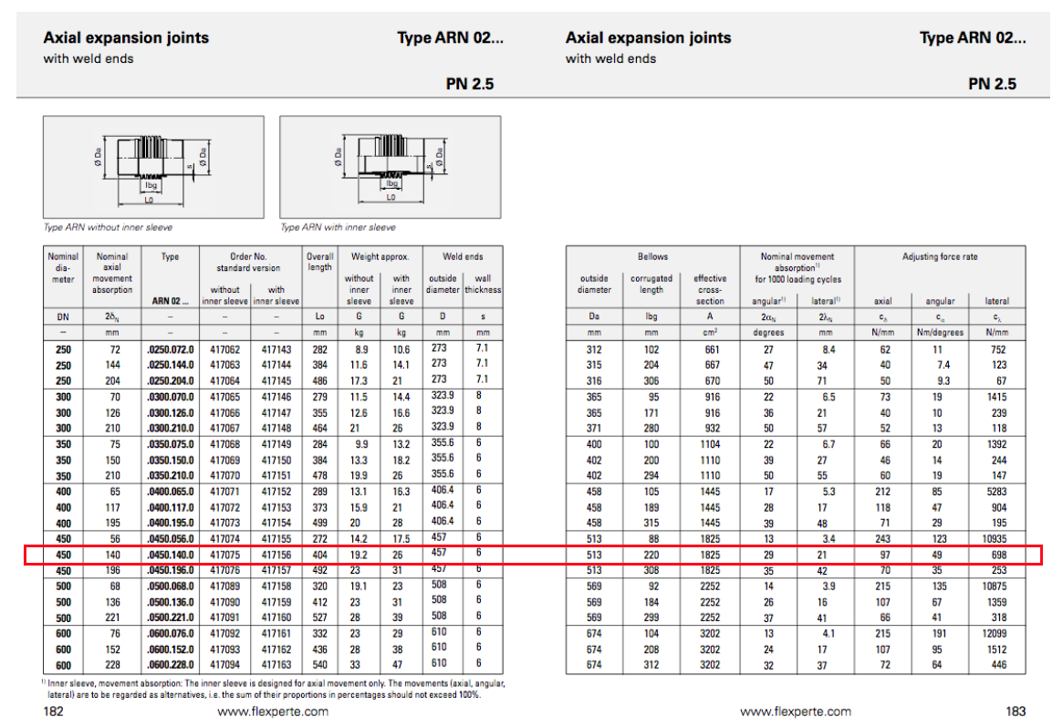
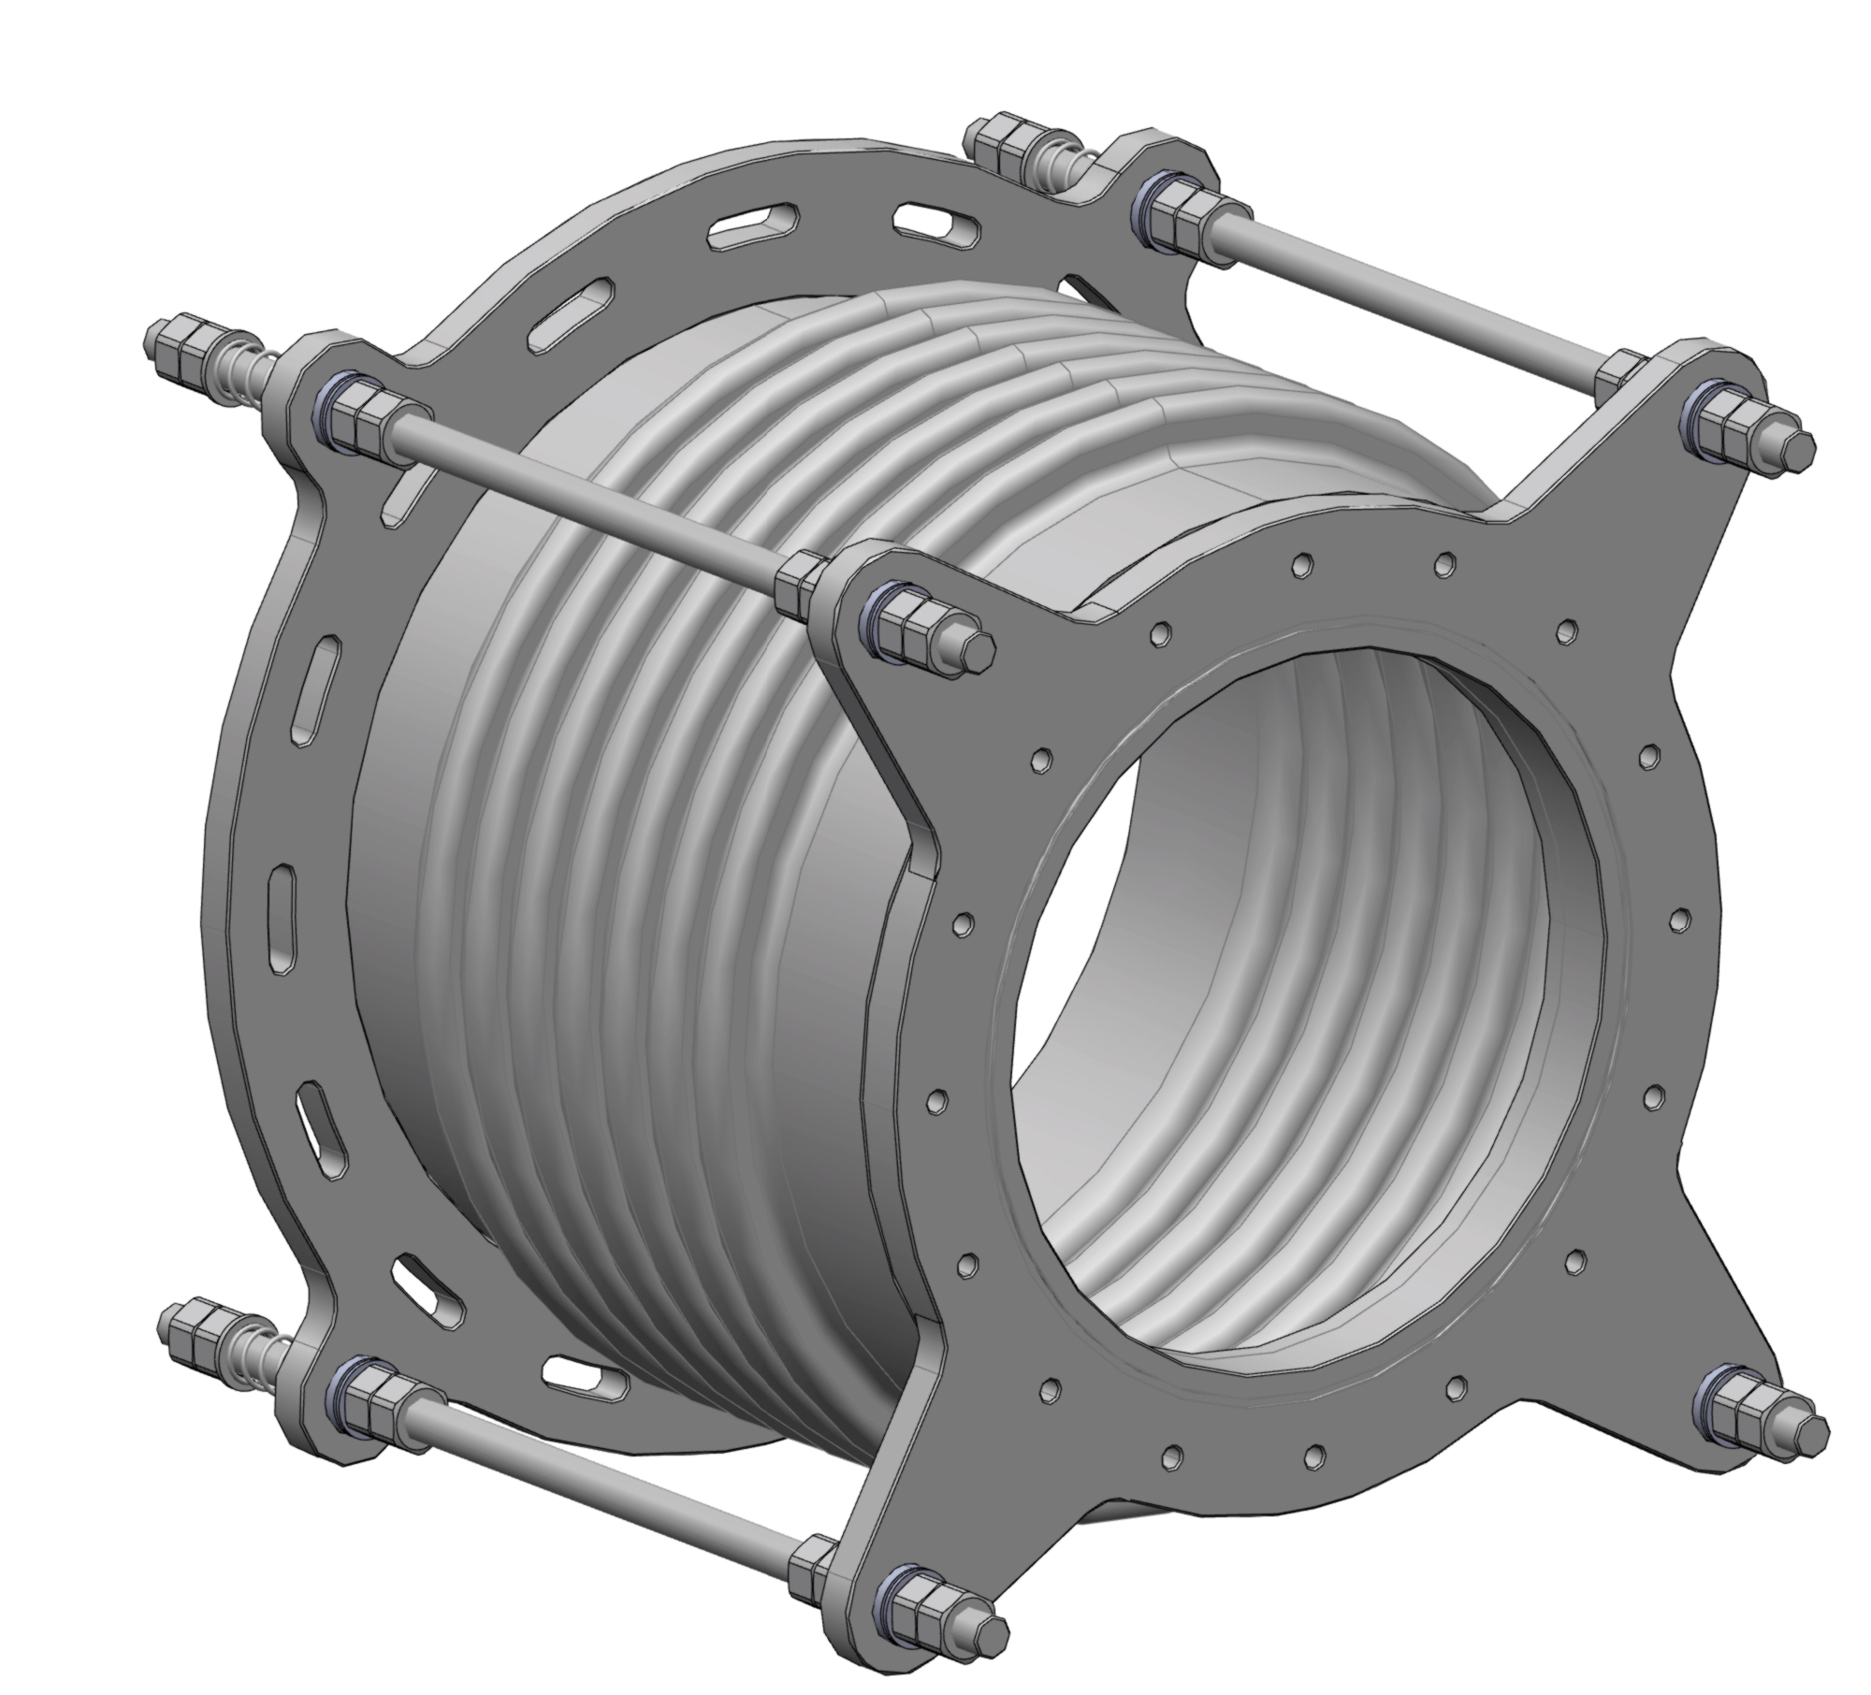
2. Updated requirements for CM/VBox interface
2.3. Requirements for PERMISSIBLE MECHANICAL LOADS
16

Slide 17
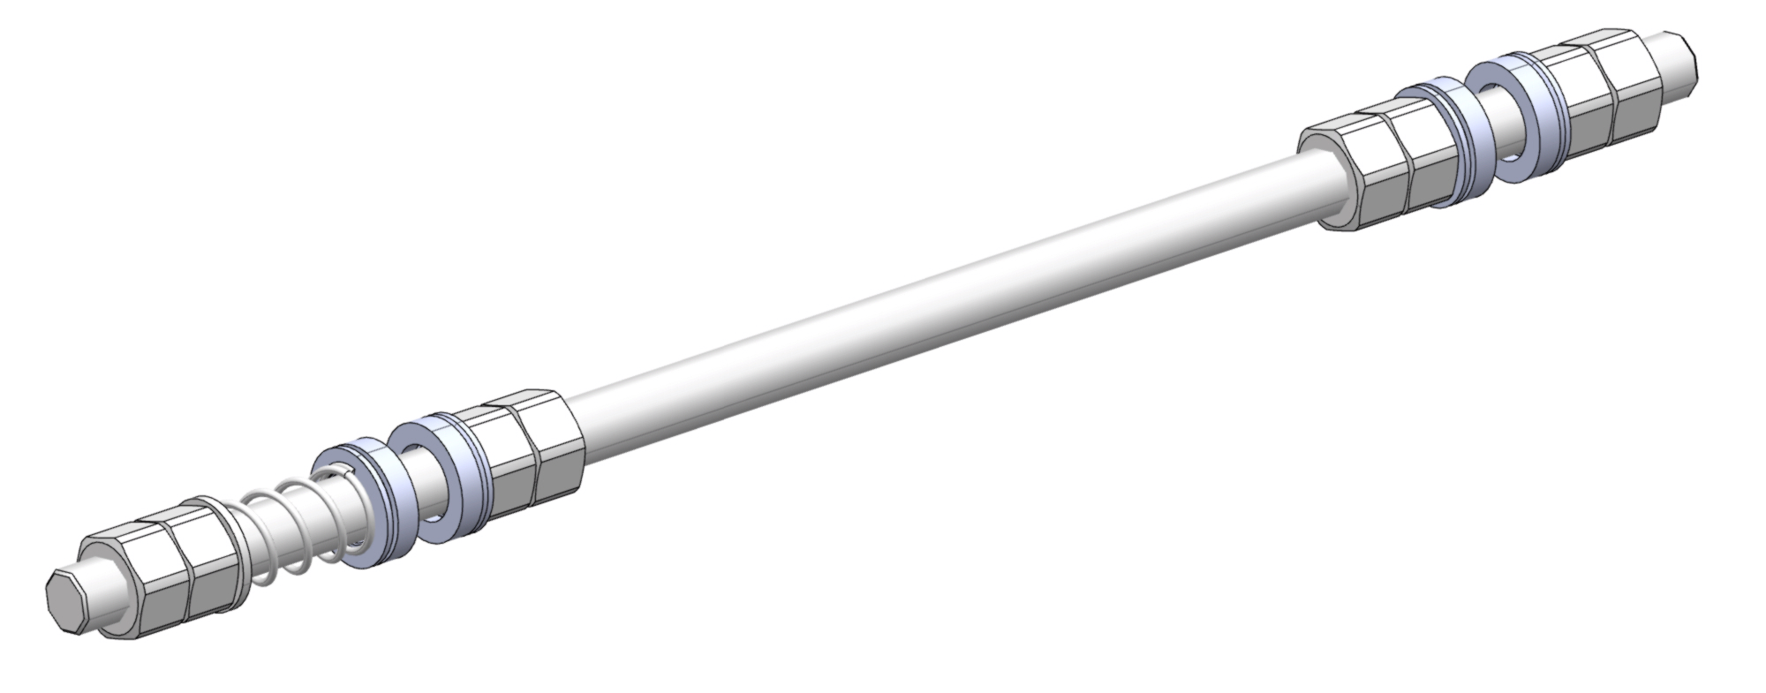
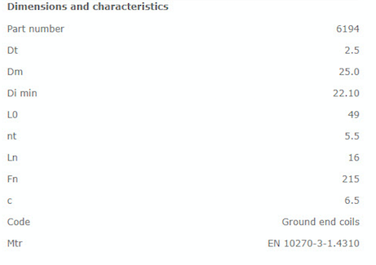
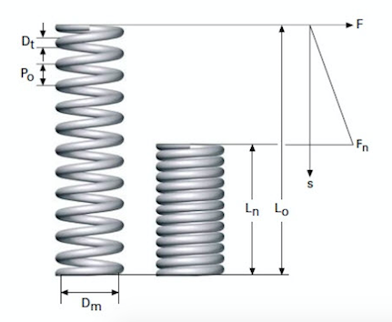
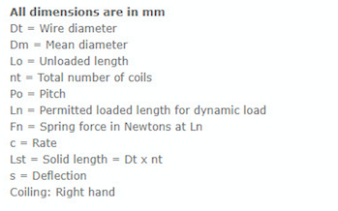
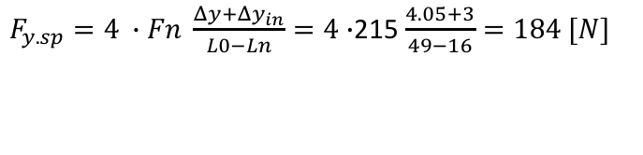
2. Updated requirements for CM/VBox interface
2.3. Requirements for PERMISSIBLE MECHANICAL LOADS
$F_{y.sp}=4 ∙Fn \frac{Δy+{Δy}_{in}}{L0−Ln}=4∙$215 $\frac{4.05+3}{49−16}=184 [N]$
17

Slide 18
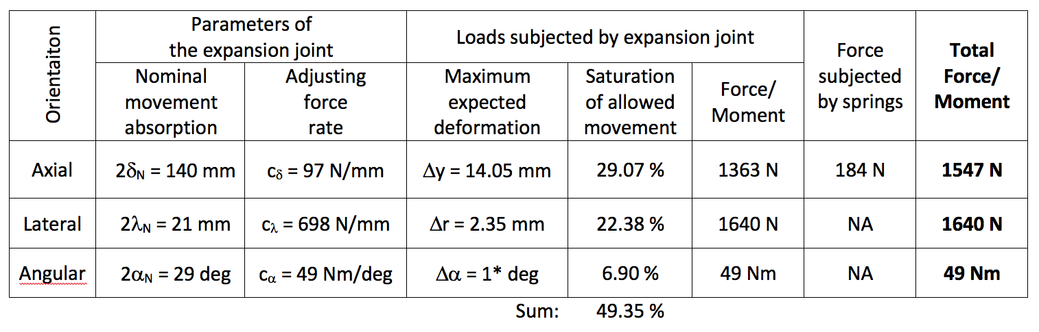
2. Updated requirements for CM/VBox interface
2.3. Requirements for PERMISSIBLE MECHANICAL LOADS
* - the angle of 1 deg may result in a linear horizontal displacement of 32 mm at the CM support pin.
18

Slide 19
2. Updated requirements for CM/VBox interface
2.3. Requirements for PERMISSIBLE MECHANICAL LOADS
At nominal conditions:
The DN450 connection sleeve of the CRYO vacuum jacket (external envelope) in the valve box jumper connection shall be equipped with supports designed to take a force generated by its flexible component (bellows). In case of axial expansion joint Witznemann ARN 02.0540.140.0 (417075) the force will be equal to 18.25 kN.
At failure mode conditions:
The vacuum jackets (external envelopes) of Elliptical Cryomodules and CDS-EL Valve Boxes shall be designed to take all mechanical loads generated by cool down of the jumper connection at a failure mode of cold helium discharge in the jumper connection. If the DN450 connection sleeve is equipped with axial expansion joint Witznemann ARM 02.0540.140.0 (417075) the forces may reach the following values:
Fy = +1547 N on Cryomodule and Fy = - 1547 N on Valve Box
Fz = ± 1640 N
Mx = Mz = 49 Nm
19

Slide 20
2. Updated requirements for CM/VBox interface
2.3. Requirements for PERMISSIBLE MECHANICAL LOADS (nominal conditions)
Data for numerical calculations:
z
x
y
This washer is subjected to a force of:
Fy = A_{ef} * p_{vac} * 0.25 * SF =
= 182500 mm2 * 0.1 MPa* 0.25 * 1.5 = 6844 N
z
y
x
This washer is fixed in y axis
20

Slide 21
2. Updated requirements for CM/VBox interface
2.3. Requirements for PERMISSIBLE MECHANICAL LOADS (failure mode conditions)
Data for numerical calculations:
z
x
Force/moment | Configuration for numerical analysis 0% of horizontal, 100% of axial, 100 % of vertical and 100% of angular max allowed displacements
Fx | 0 N
Fy | + 2320 N on CM (pulling) - 2320 N on Vbox (pulling)
Fz | ± 2460 N
Mx | ± 74 Nm
My | 0 Nm
Mz | ± 74 Nm
y
Safety factor of 1.5
+ inner pressure of 0.5 bar(g)
21

Slide 22
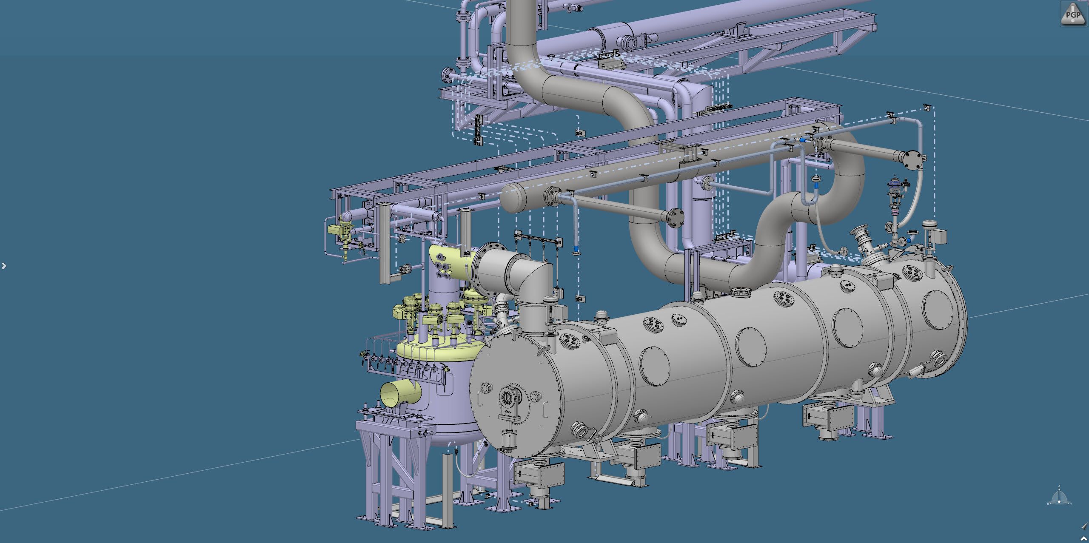
3. Design of semi-flexible DN450 connection sleeve
3.1. TS2 configuration
Current (temporary) state!
DN450 connection sleeve
with rigid pipe

Slide 23

3. Design of semi-flexible DN450 connection sleeve
3.1. TS2 configuration
Semi-flexible DN450 connection sleeve

Slide 24
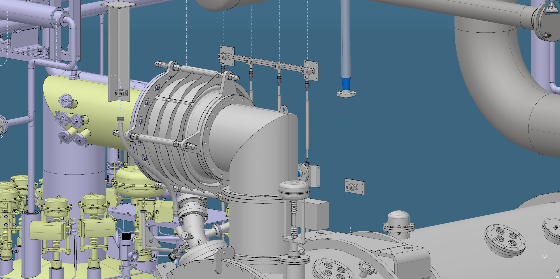
3. Design of semi-flexible DN450 connection sleeve
3.1. TS2 configuration

Slide 25
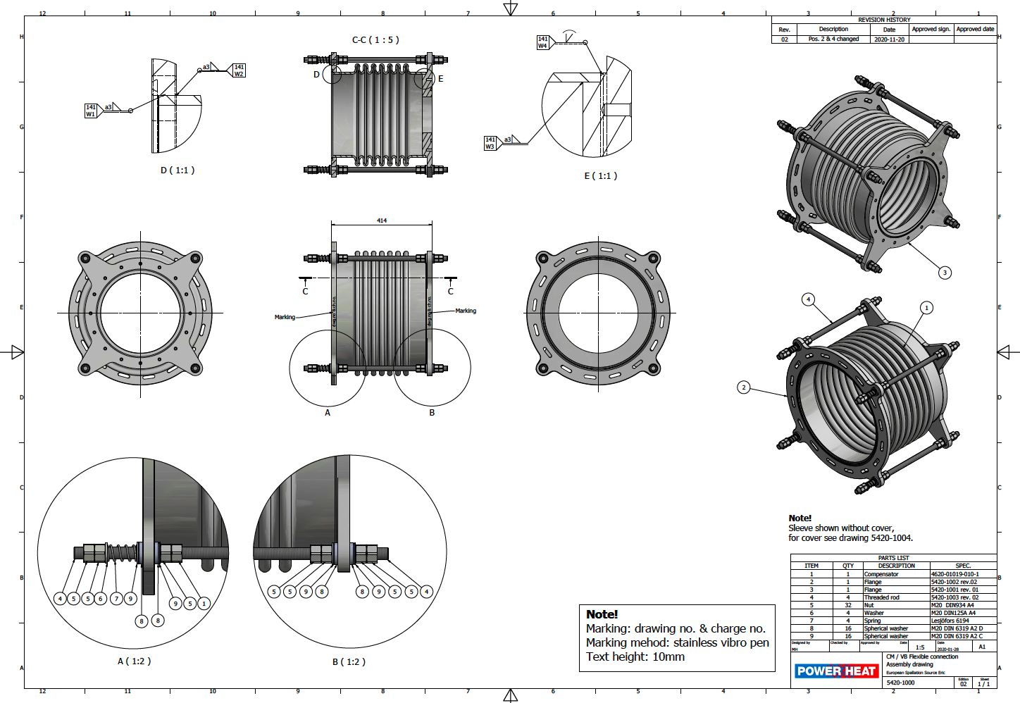
3. Design of semi-flexible DN450 connection sleeve
3.1. TS2 configuration

Slide 26
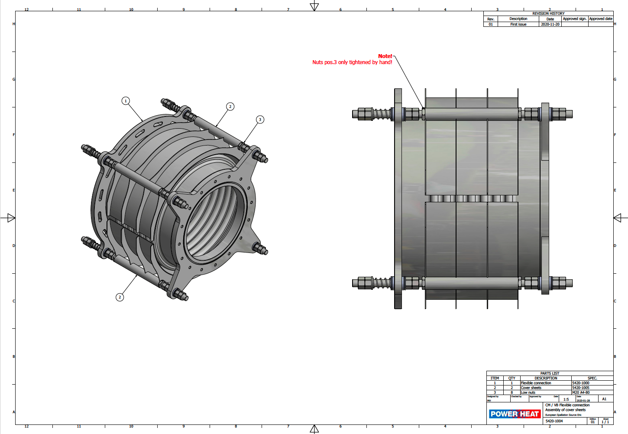
3. Design of semi-flexible DN450 connection sleeve
3.1. TS2 configuration

Slide 27
3. Design of semi-flexible DN450 connection sleeve
3.1. TS2 configuration

Slide 28
3. Design of semi-flexible DN450 connection sleeve
3.1. TS2 configuration

Slide 29
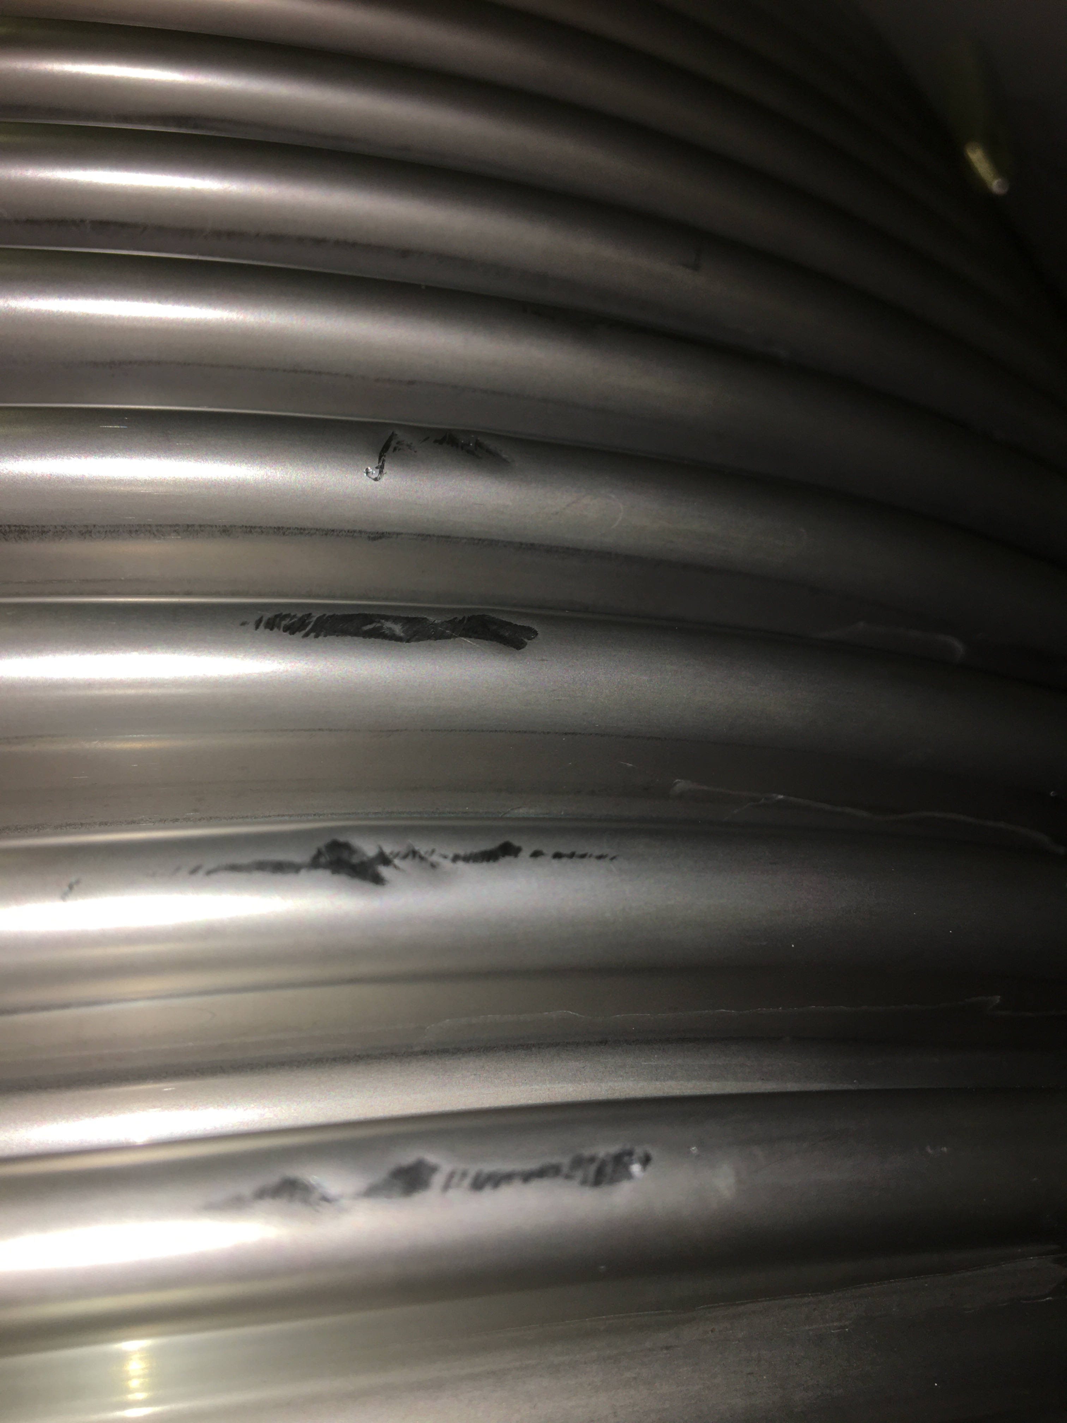
3. Design of semi-flexible DN450 connection sleeve
3.1. TS2 configuration
Bellows of the first sleeve were unfortunately dented and the sleeve did not pass the incoming inspection done by ESS Quality Officer.

Slide 30
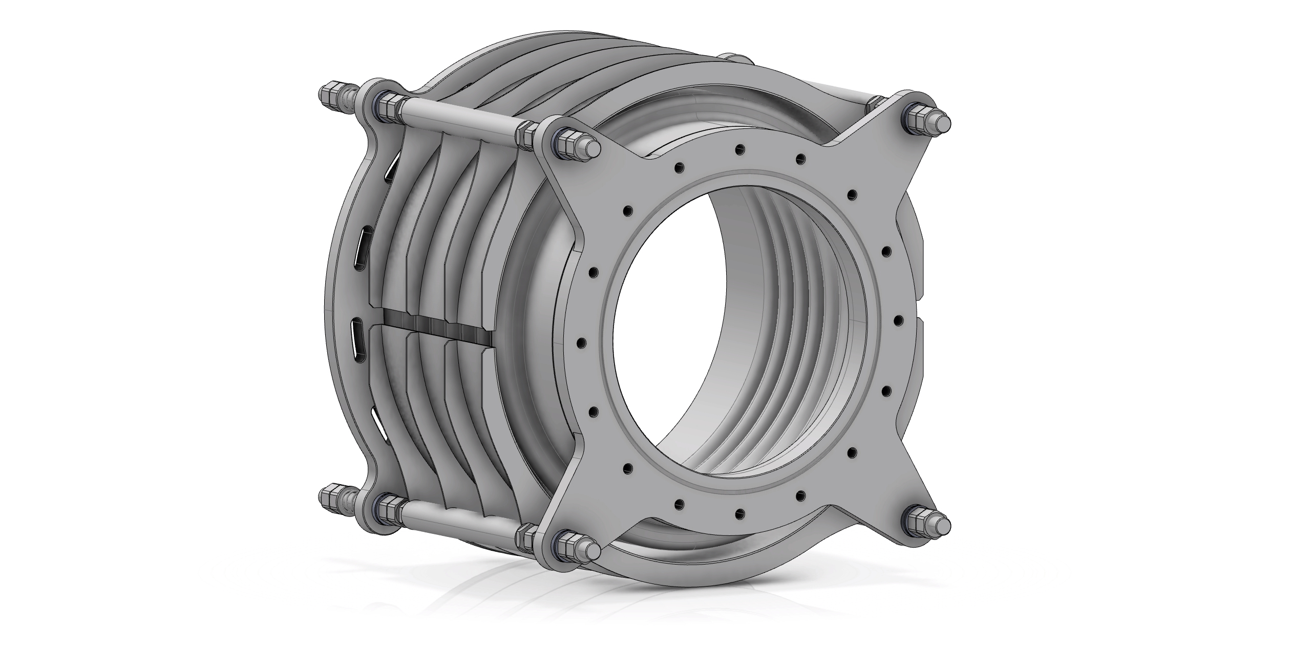
3. Design of semi-flexible DN450 connection sleeve
3.1. TS2 configuration
Unfortunately the bellows of the first sleeve was dented and did not pass the incoming inspection done by ESS Quality Officer.
Power Heat took responsibility for the damage and ordered new bellows and repaired the sleeve.
ESS decided to add special protective covers to avoid such damages in future.

Slide 31
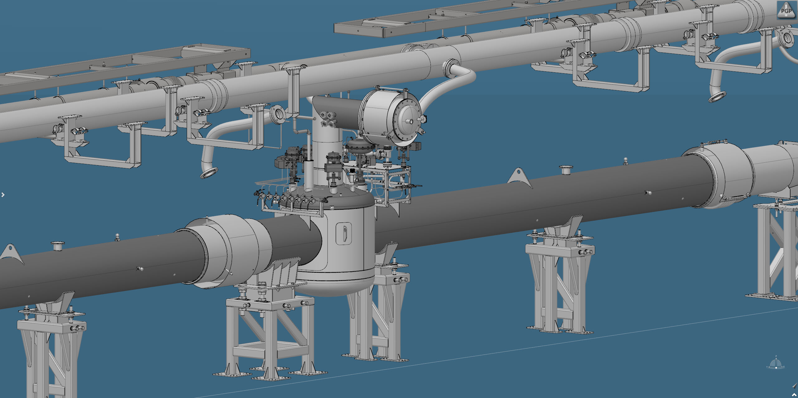
3. Design of semi-flexible DN450 connection sleeve
3.2. Tunnel configuration
Current state!
(with WUST sleeve and test box)

Slide 32
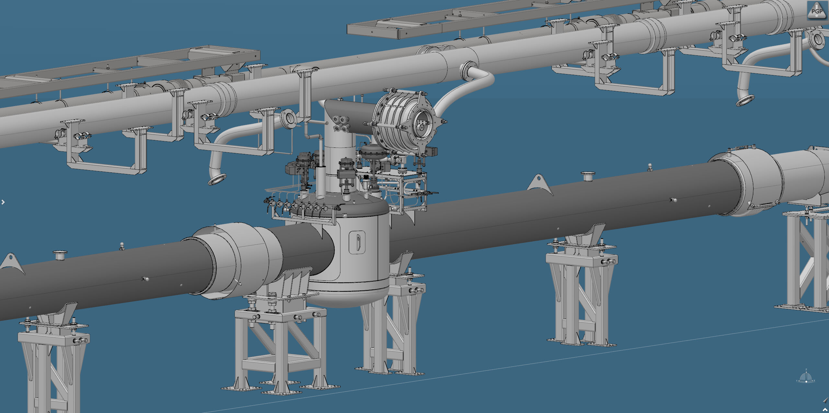
3. Design of semi-flexible DN450 connection sleeve
3.2. Tunnel configuration

Slide 33
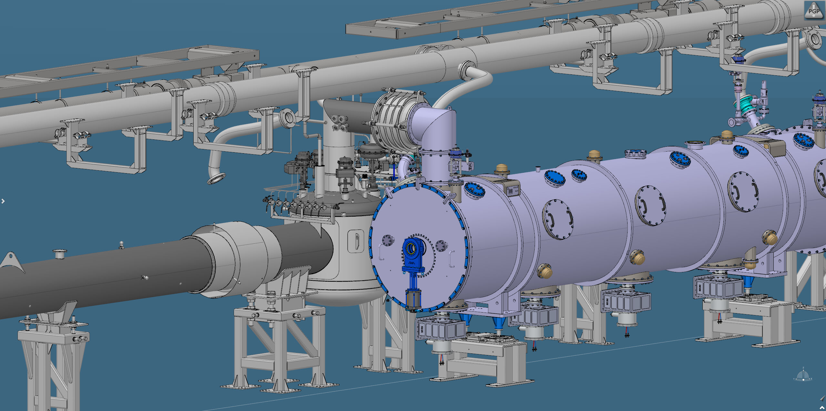
3. Design of semi-flexible DN450 connection sleeve
3.2. Tunnel configuration

Slide 34
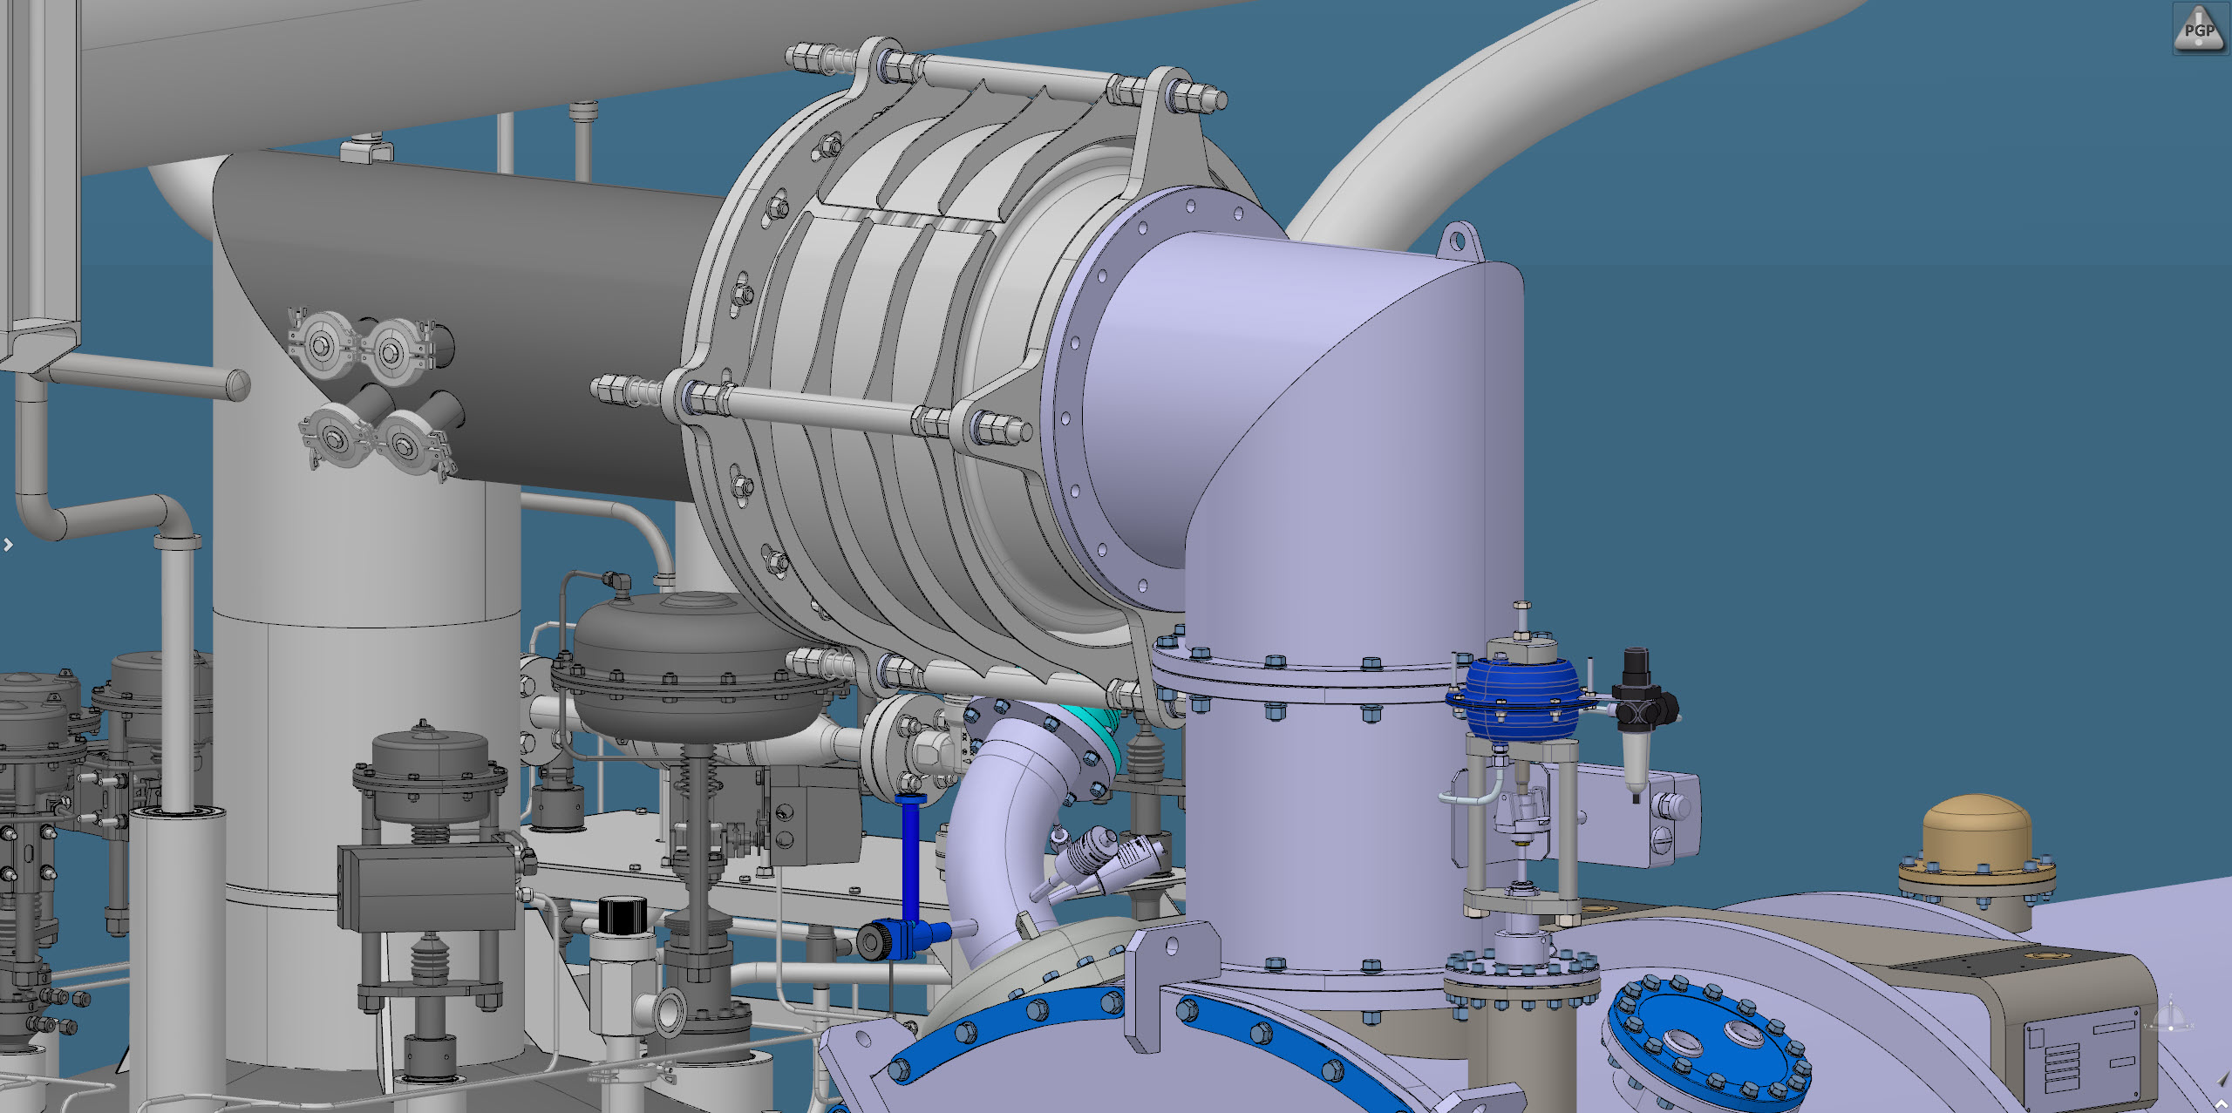
3. Design of semi-flexible DN450 connection sleeve
3.2. Tunnel configuration

Slide 35
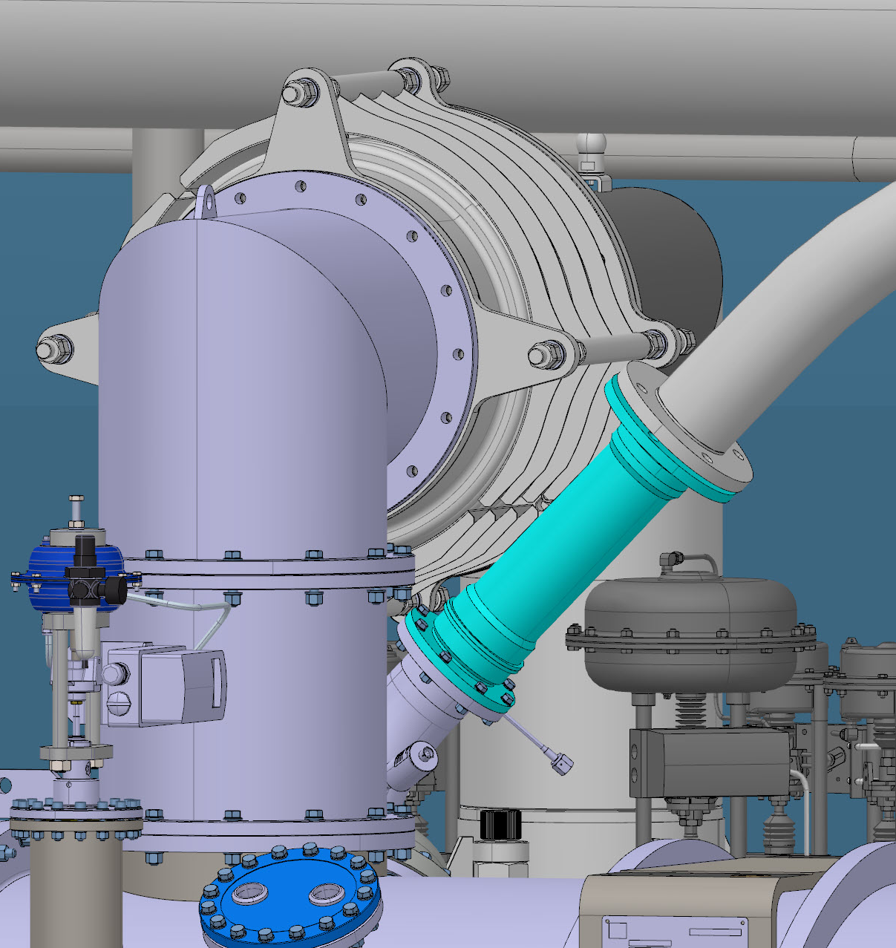
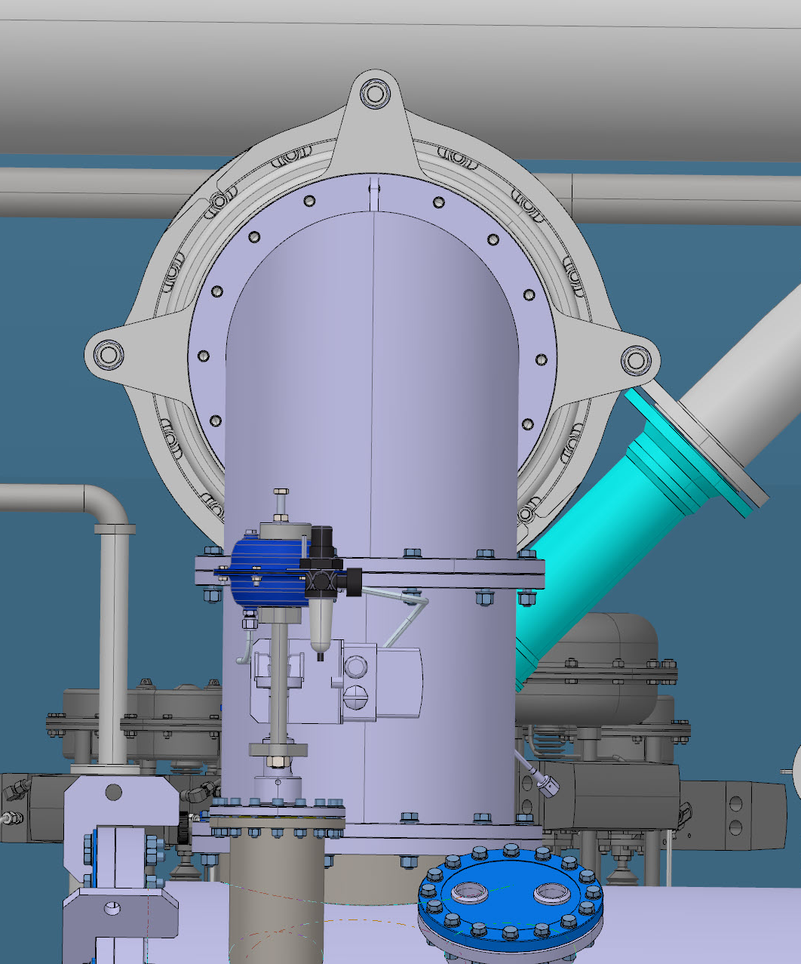
3. Design of semi-flexible DN450 connection sleeve
3.2. Tunnel configuration

Slide 36
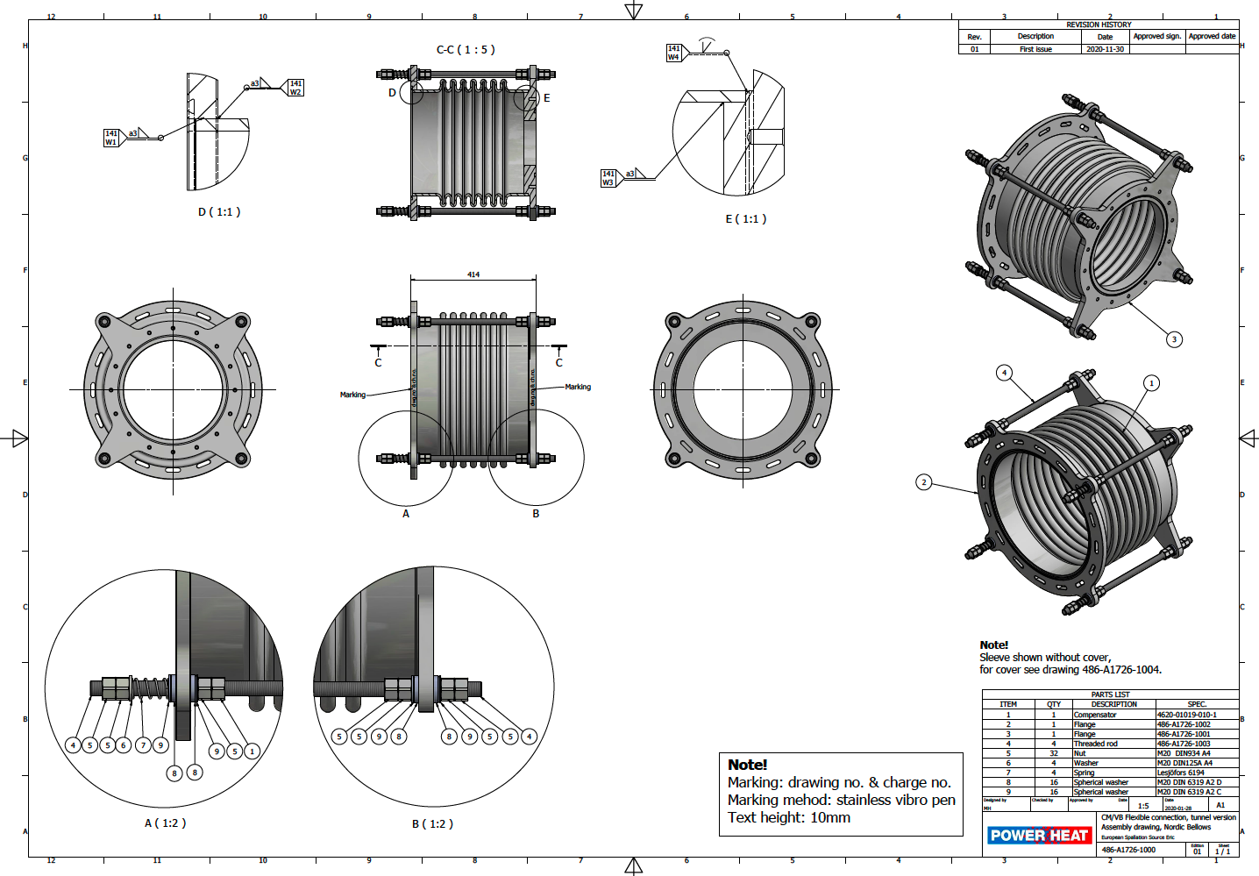
3. Design of semi-flexible DN450 connection sleeve
3.2. Tunnel configuration

Slide 37
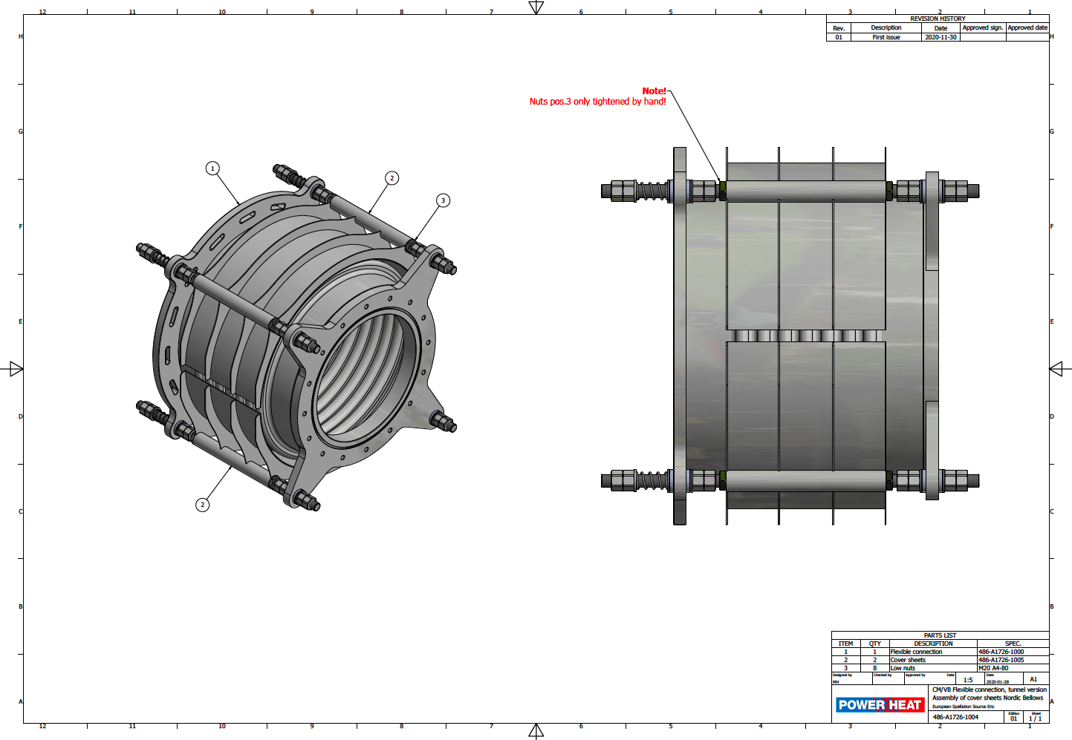
3. Design of semi-flexible DN450 connection sleeve
3.2. Tunnel configuration

Slide 38
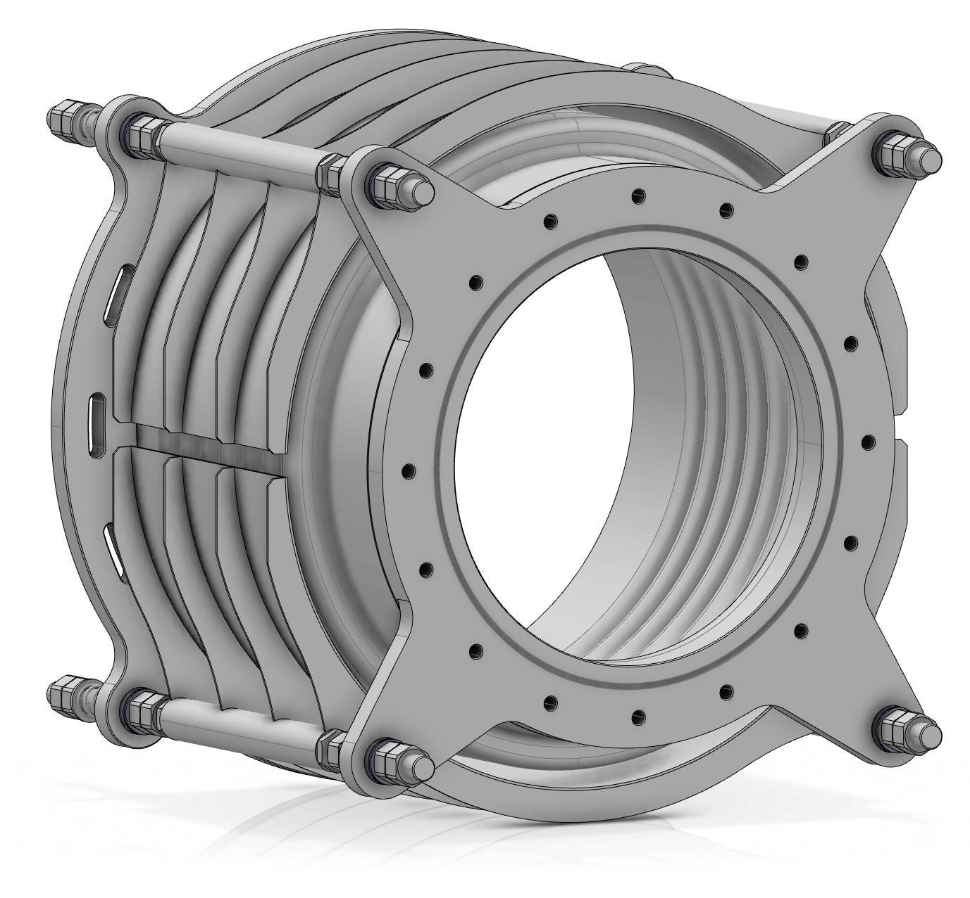
3. Design of semi-flexible DN450 connection sleeve
3.2. Tunnel versus TS2 configuration
Tunnel configuration
TS2 configuration
bean holes in the large flange are shifted
by -7.5 deg

Slide 39
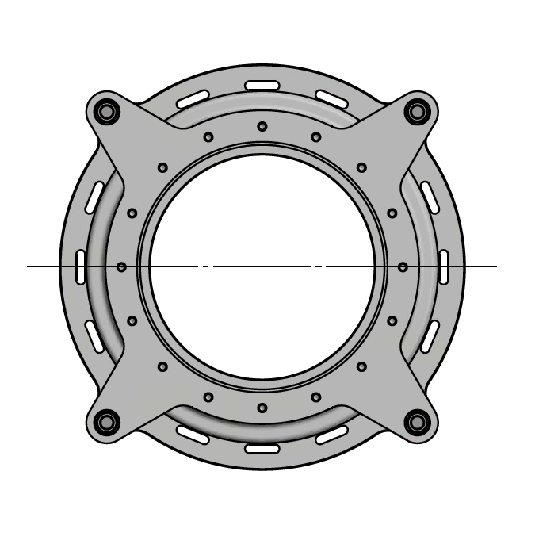
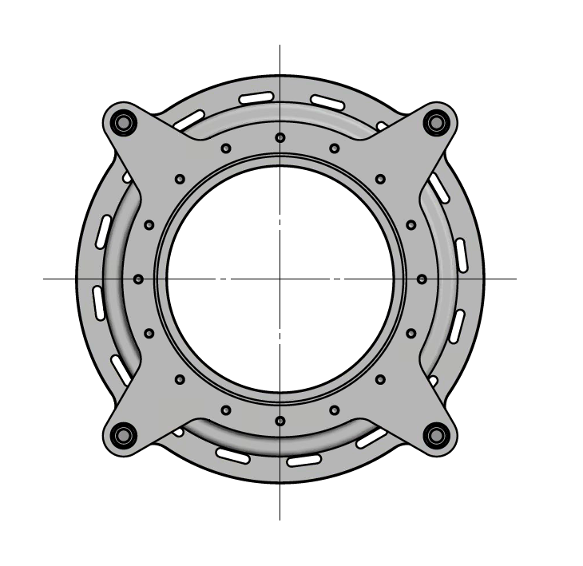
3. Design of semi-flexible DN450 connection sleeve
3.2. Tunnel versus TS2 configuration
Tunnel configuration
TS2 configuration
bean holes in the large flange are shifted
by -7.5 deg

Slide 40
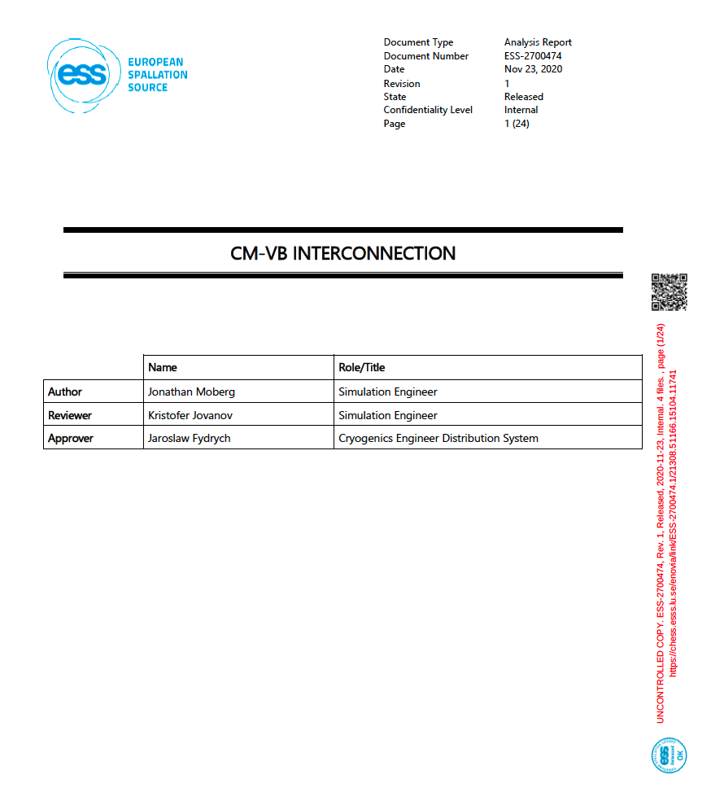
4. Stress and flexibility analysis for pipes and supports
4.1. Numerical model and loads

Slide 41
4. Stress and flexibility analysis for pipes and supports
4.1. Numerical calculation results
A2-70 has a tensile strength of at least 700 MPa and a yield strength (0.2%) of 450 MPa. With a material safety factor of 1.25, this results in a calculation yield strength of 311 MPa.

Slide 42
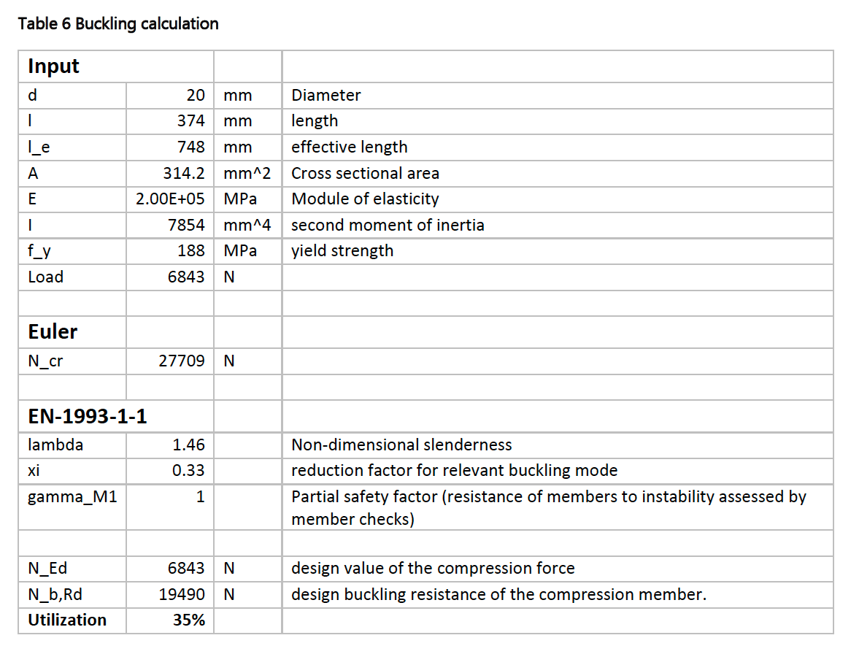
4. Stress and flexibility analysis for pipes and supports
4.1. Numerical calculation results
SS 1.4301 calculation yield strength: 187 MPa

Slide 43
5. Open issues and next actions
5.1. Installation of the sleeve in the tunnel and TS2
Lifting in a “crowded” space!
Total weight of 85.4 kg!

Slide 44
5. Open issues and next actions
5.1. Installation of the sleeve in the tunnel and TS2
Lifting in a “crowded” space, especially in TS2!
Total weight of 85.4 kg!

Slide 45
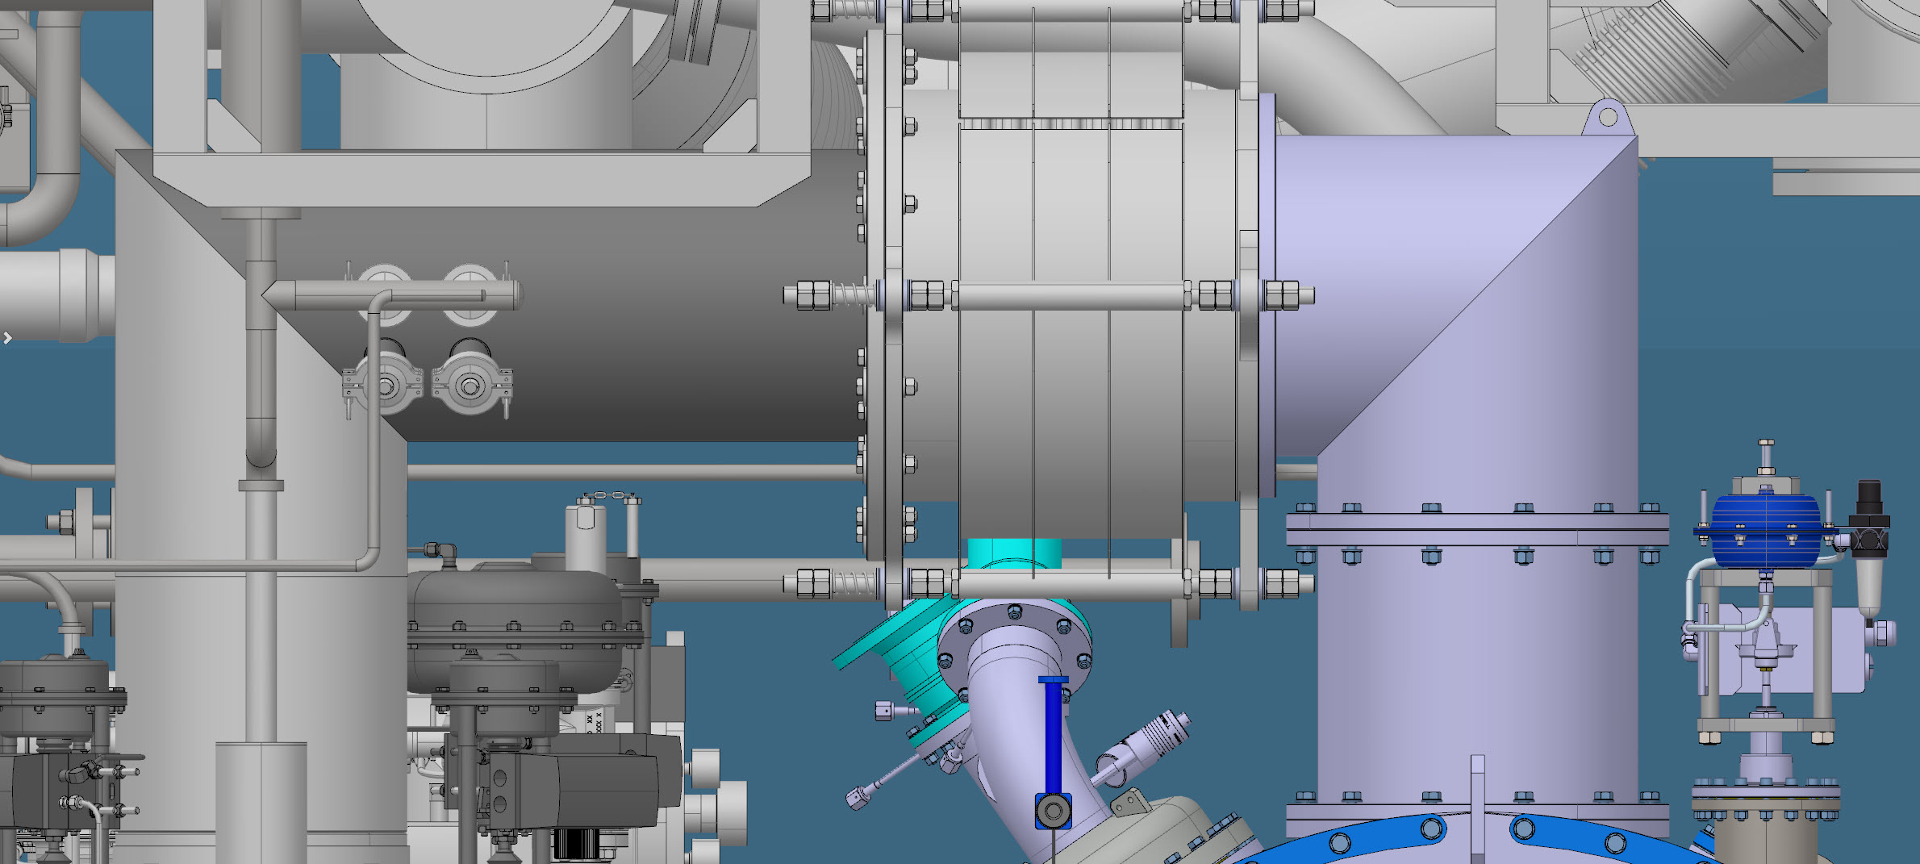
5. Open issues and next actions
5.2. Risk of denting the bellows from the inside

Slide 46
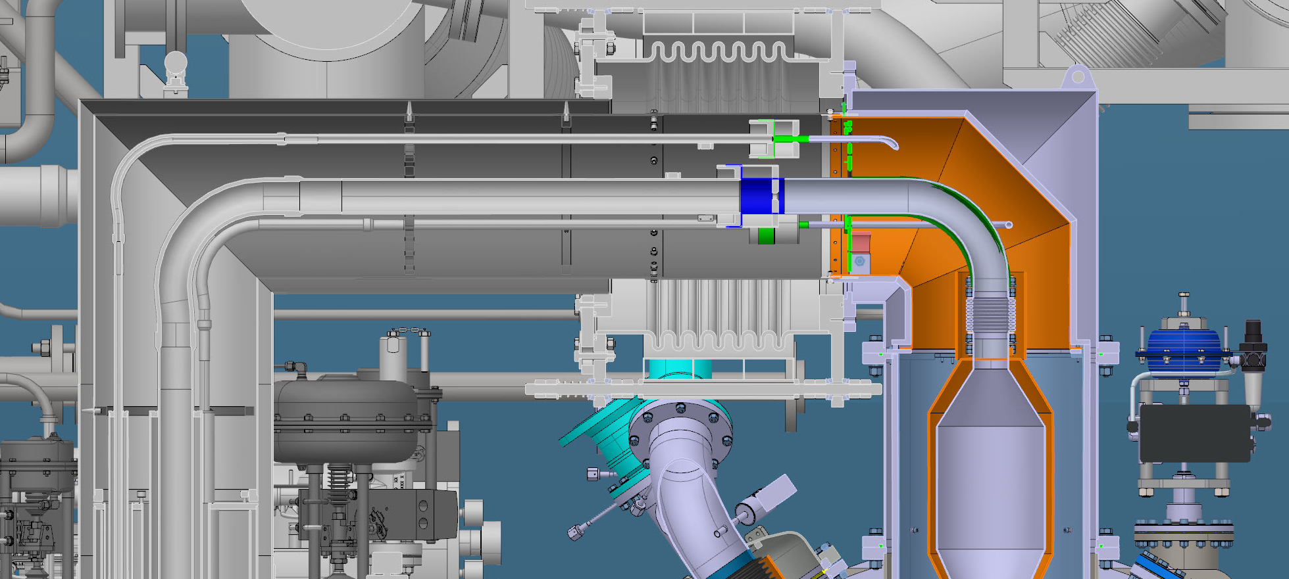
5. Open issues and next actions
5.2. Risk of denting the bellows from the inside
The bellows can be dented when its thin wall is placed/hit onto this flange (during opening/closing the interconnection)!

Slide 47
5. Open issues and next actions
5.3. Next actions
Developing installation methods for TS2 and tunnel configurations
Solving the issue of denting the sleeve from the inside
Preparing a procedure for verifying the sleeve adjustability at TS2
Testing the adjustability of the connection sleeve at TS2
Procurement of axial expansion joints
Manufacturing of connection sleeves
Quality receiving inspections and leak tightness verifications

Slide 48
6. Schedule and cost estimates
6.1. Schedule

Slide 49
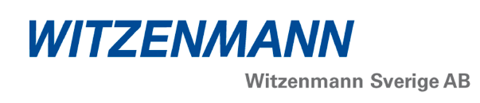
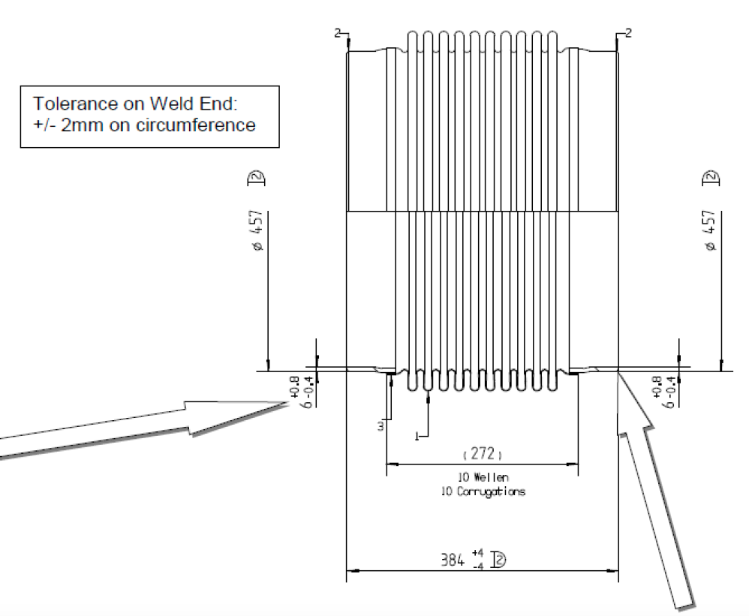
6. Schedule and cost estimates
6.2. Cost estimates

Slide 50
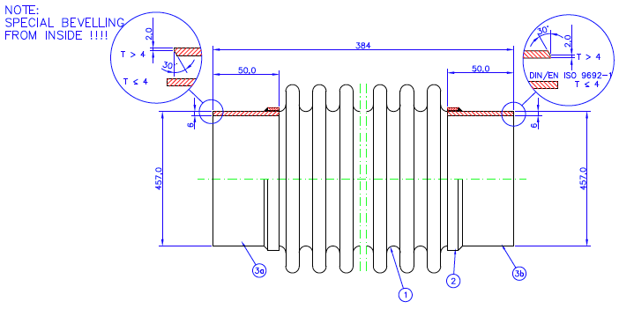
6. Schedule and cost estimates
6.2. Cost estimates

Slide 51
Thank you for your attention! Questions?

