Slide 1
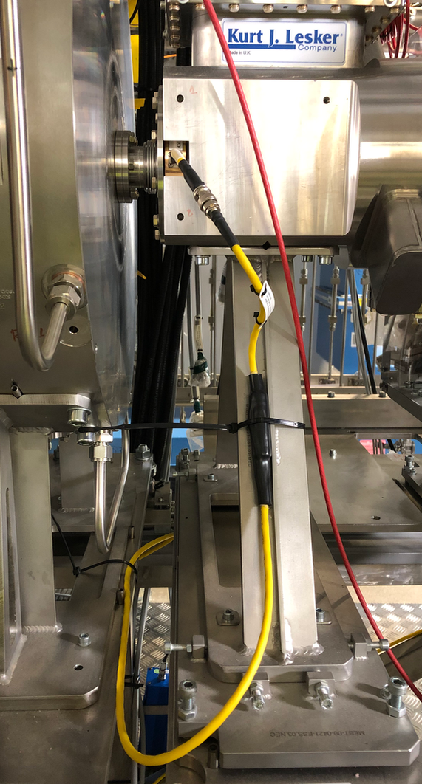
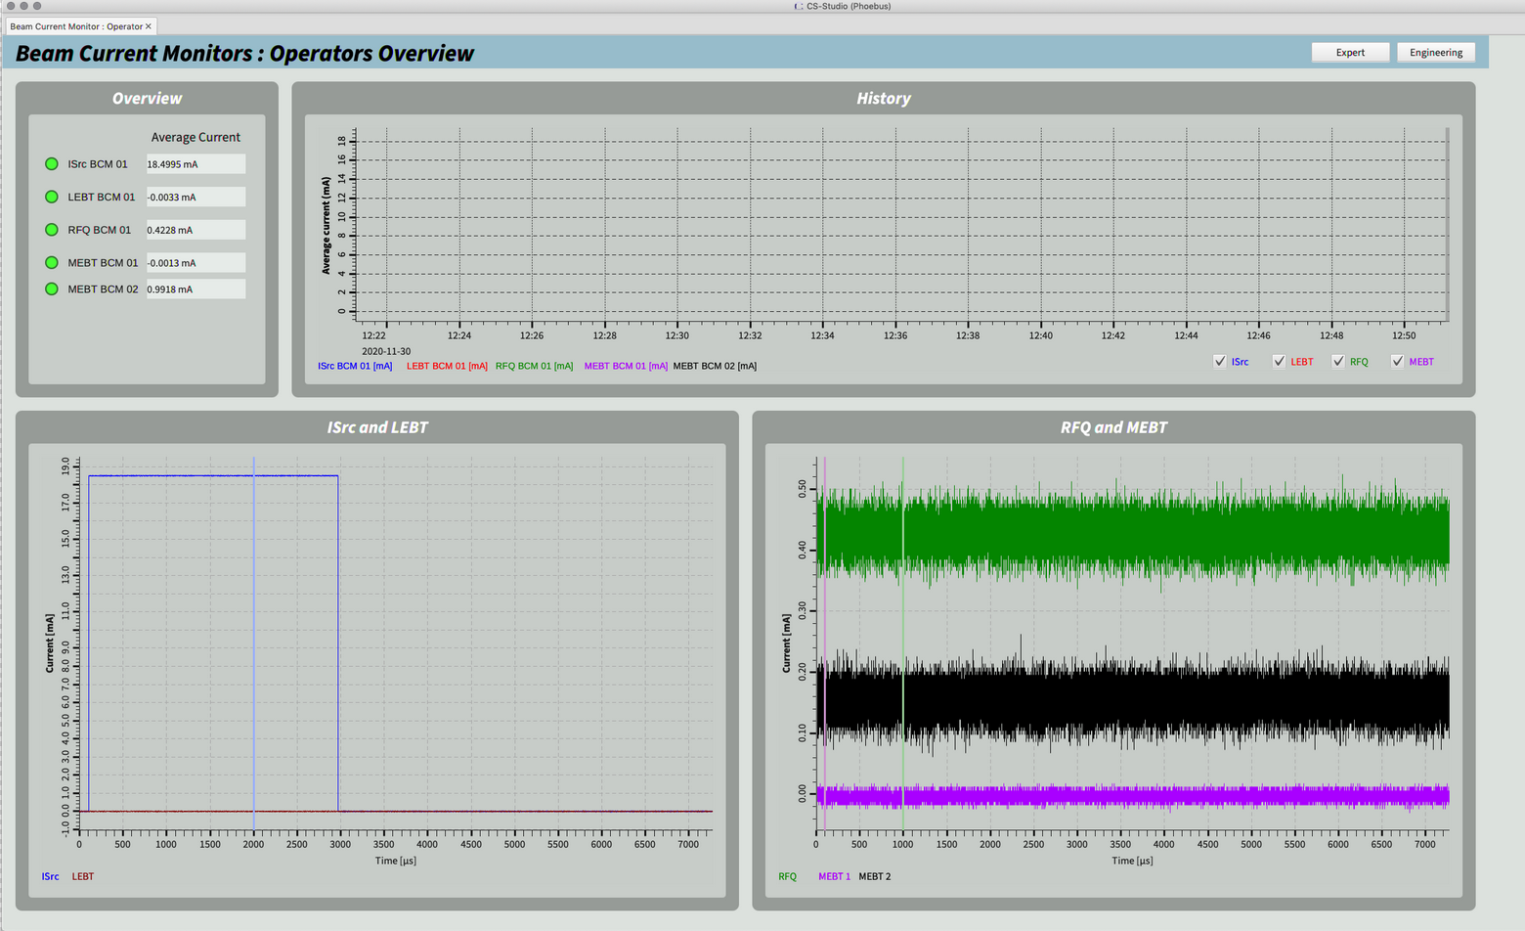
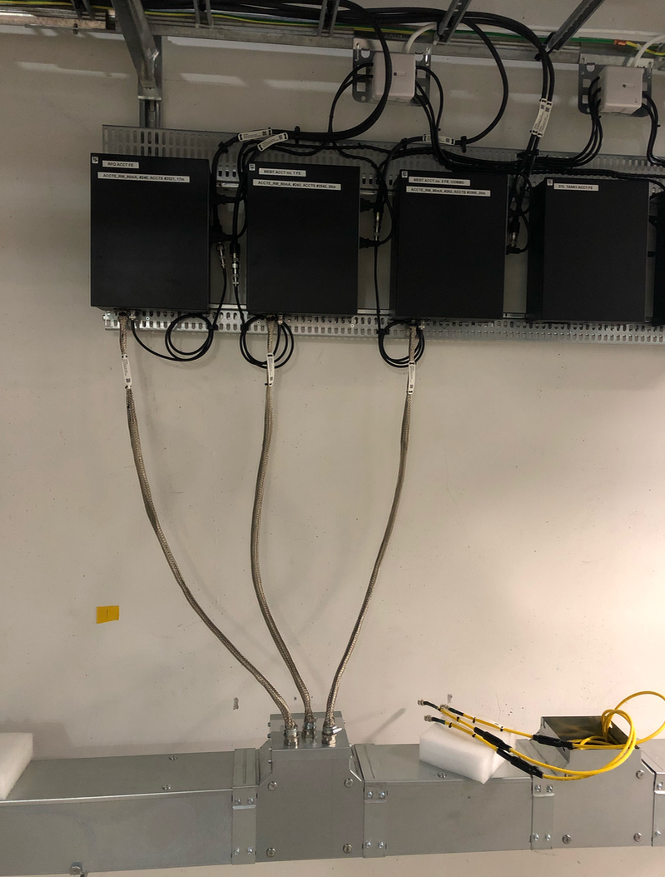
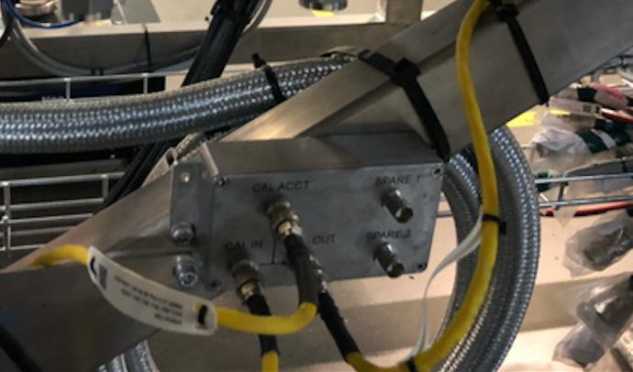
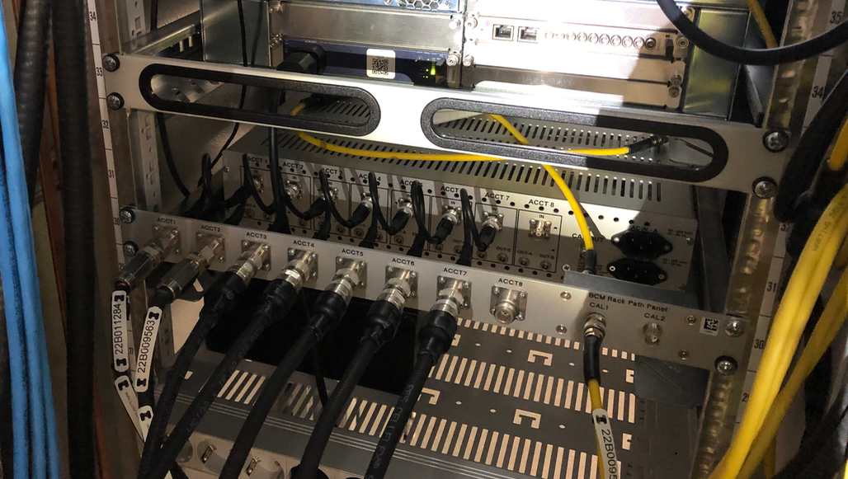
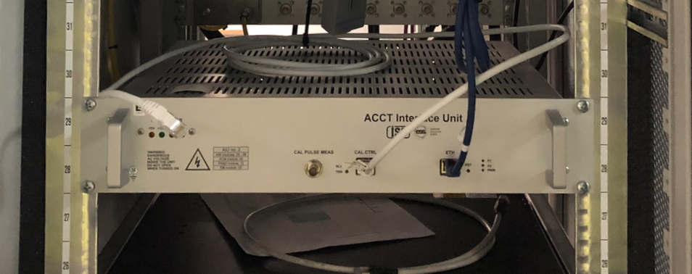
BCM works completed

Slide 2
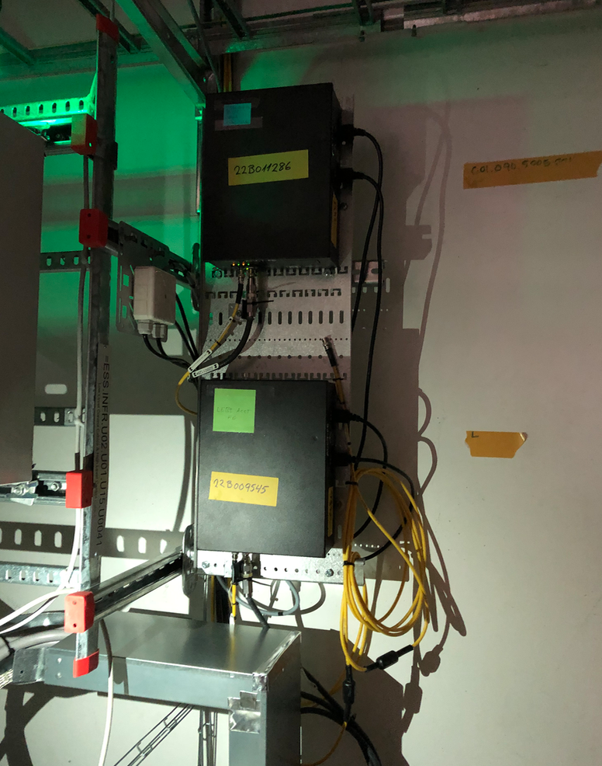
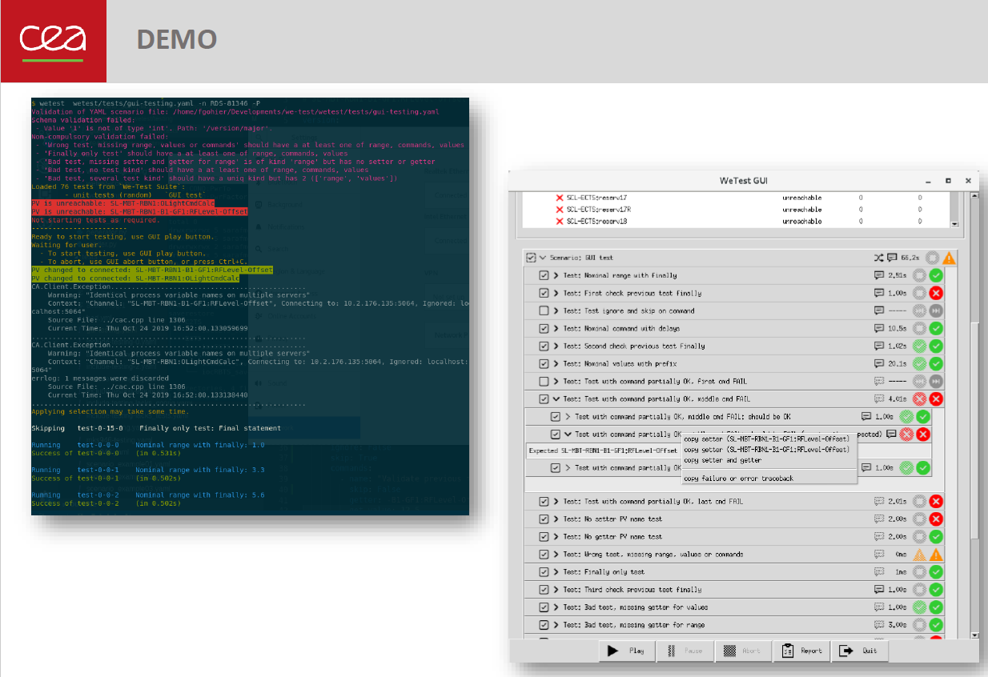
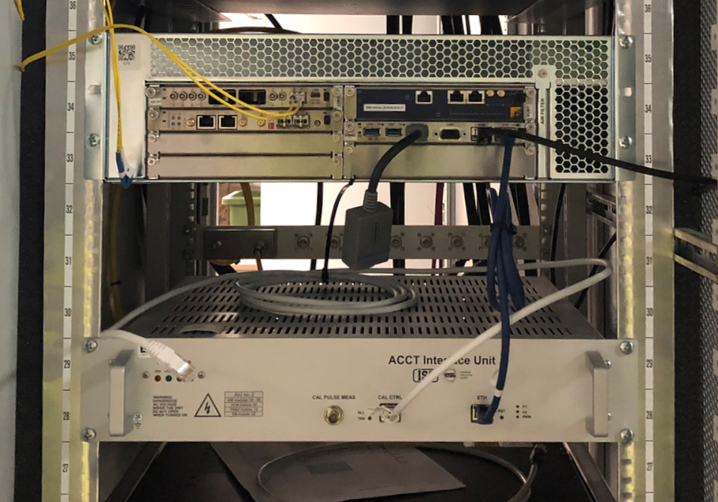
BCM works to be done + issues
LEBT ACCT (collimator) to be installed.
ISRC/LEBT ACCT FE units to be slightly displaced to relieve the pressure on the ACCT cable from the isolation transformer cable trunk.
uTCA crate in the FEB90 to be replaced.
BCM test and verification document ESS-0184393 being updated.
Test and verification (Wetest + manual) under progress.
Software:
Lab gateway issue: INFRA-2922
Time axis of the discrete channels on the BCM plots: ICSHWI-5669

