Slide 1
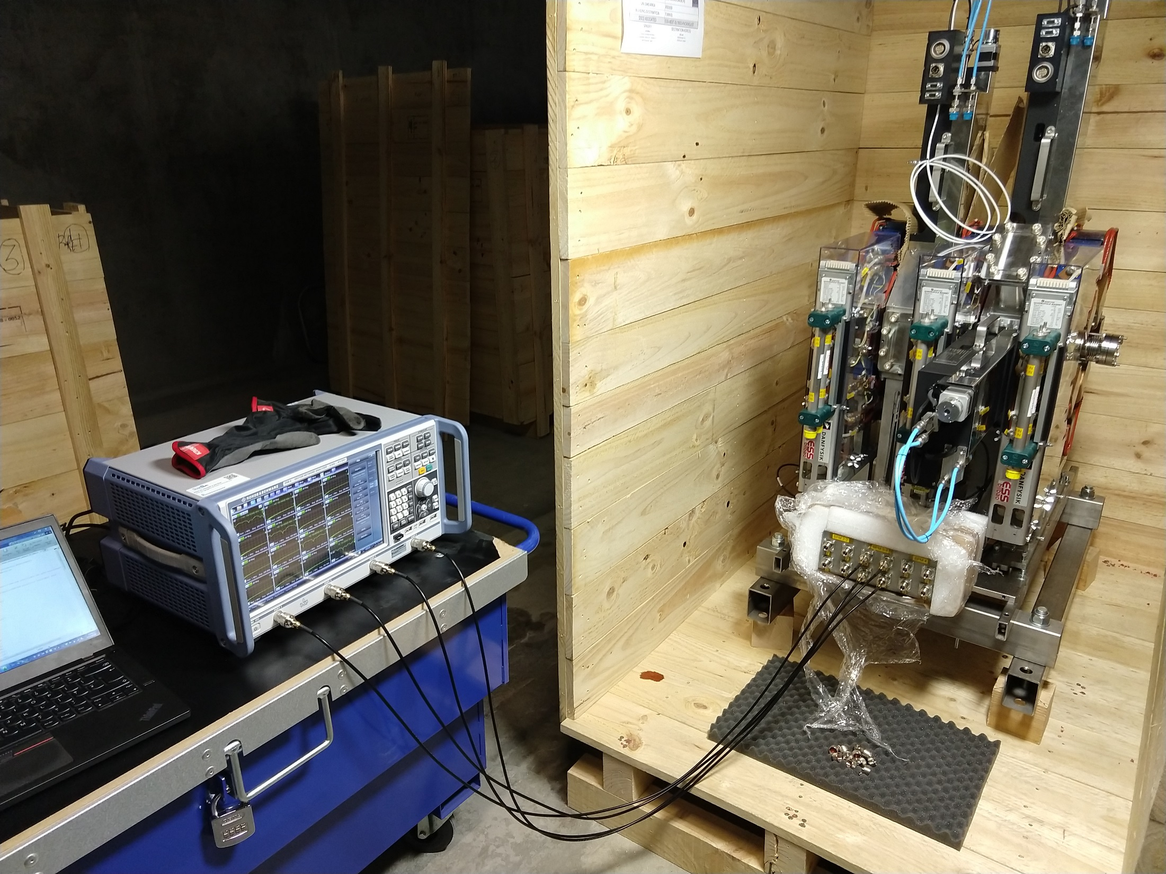
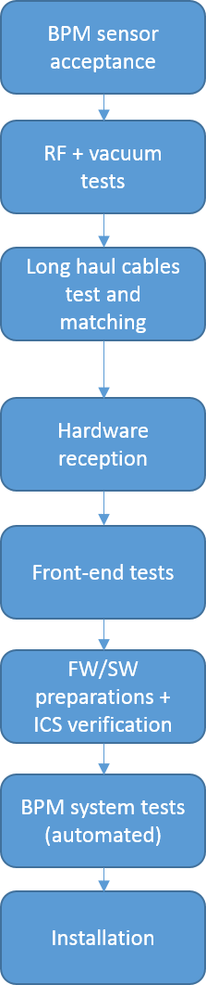
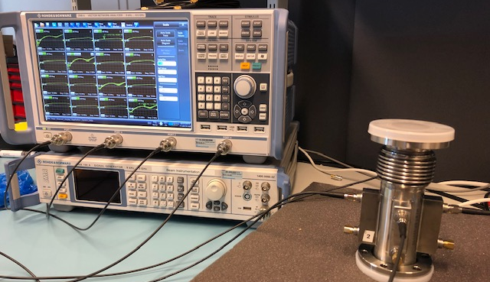
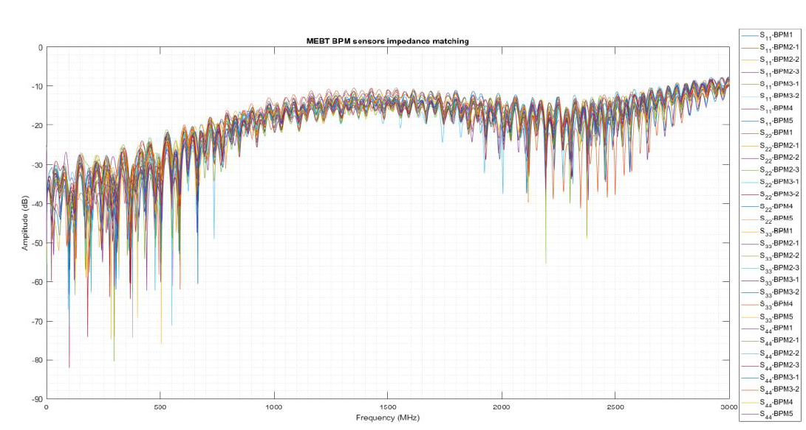
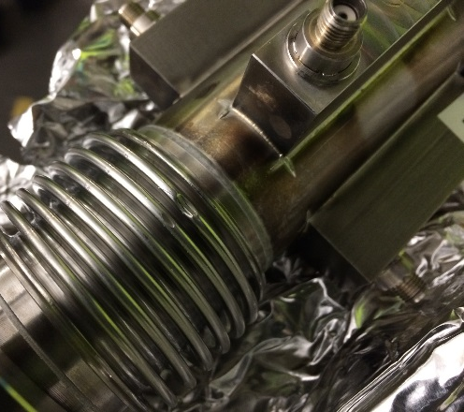
BPM installation workflow / status
Rafael Baron
1 damaged BPM during transportation from Bilbao to Lund → Already fixed in a local company and reinstalled in the machine: Already cleaned, RF tested and vacuum checked
System installed / production tested for:
All BPM’s tested and one was rejected in the workflow
S-parameters tests: reflection coefficients and crosstalk
Electrical vs mechanical center misalignment measurements
Wire tests performed (not full mapping)
MEBT BPM’s tested in Bilbao + on-site

Slide 2
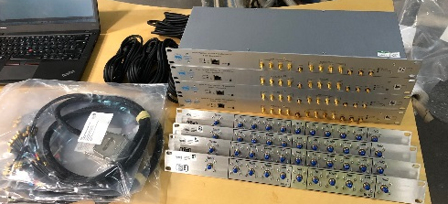
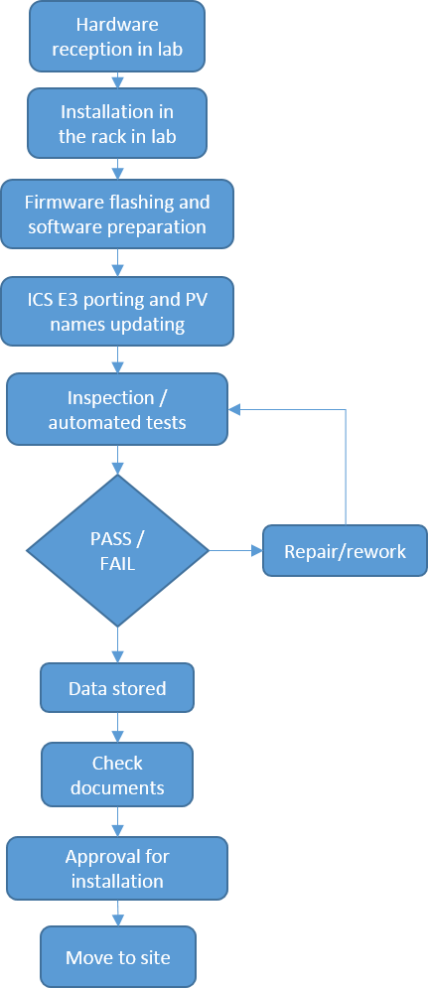
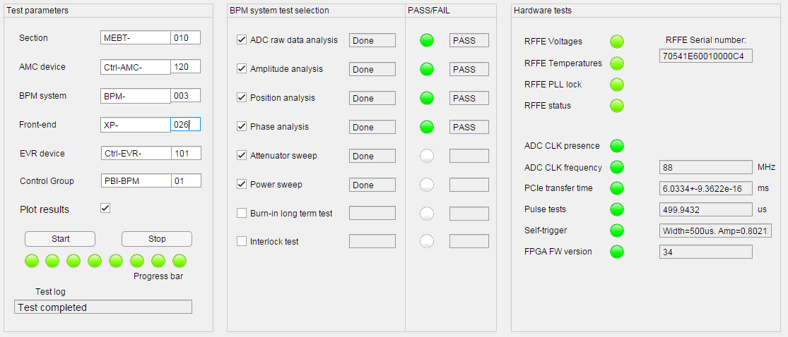
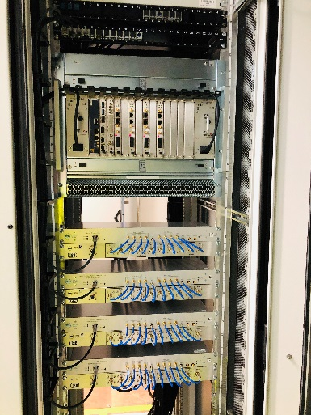
BPM electronics installation workflow
BPM system testing
System installed / production tested for:
BPM sensor tests (S-parameters, center measurements)
Long haul cables measured and phase matched
MicroTCA.4 crates tests (voltages, versions, power, etc)
Voltages, power consumption, etc
Temperatures
PLL lock / spectrum
ADC clock / spectrum
PCIe transfer time
Pulsed tests (check EVR and its outputs)
EVR backplane trigger / Self trigger
Check firmware version
SNR, SFDR for given input
Amplitude (time/frequency domain)
Phases (time, spectrum and integrated RMS noise)
Positions (offset, spectrum and integrated RMS noise)
Attenuators sweep (gain sweep)
Input power sweep for 3 ms and 5 us pulses

Slide 3
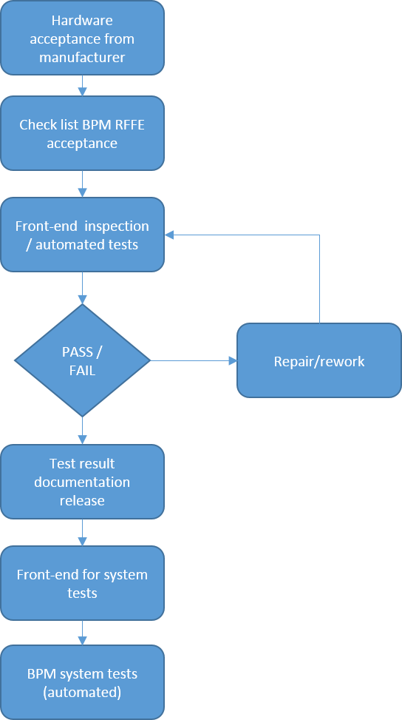
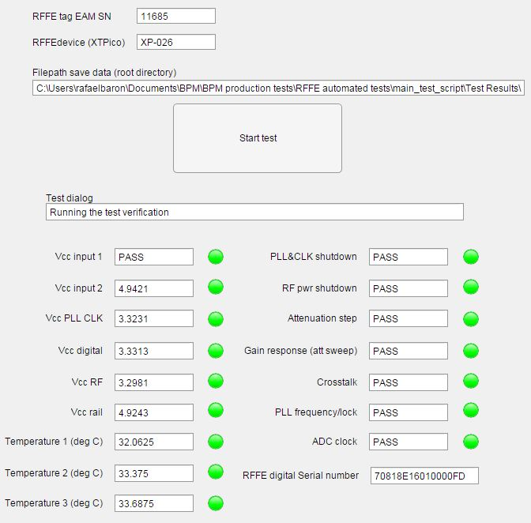
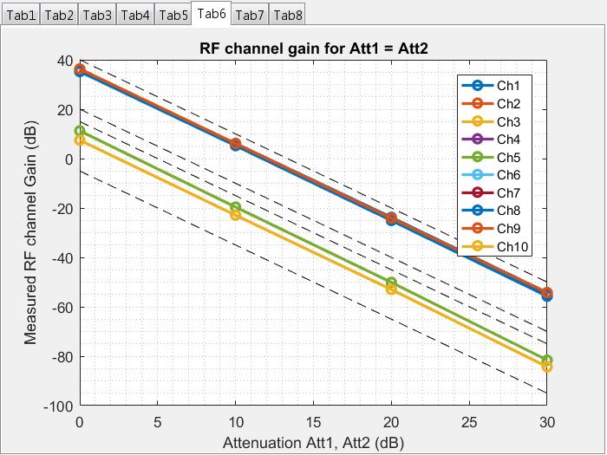
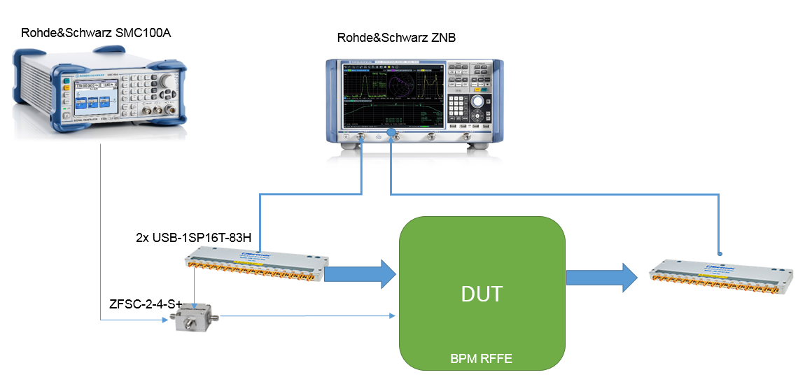
BPM electronics installation workflow
RF Front-end tests
Tested for (given a specific input signal):
Voltages
Power consumption
Temperatures
Shutdown circuits
PLL lock / spectrum
ADC clock / spectrum
RF crosstalk
Attenuation step
Gain sweep
Serial numbers

Slide 4
MEBT BPM installation status
Component | Status | Responsible | Test | Comments
Beamline sensor | Installed | PBI | Tested | S-parametersMatching performed
Short cables | Installed | PBI | Tested
Patch panel tunnel | Installed | PBI | Tested
Cable support | In production | PBI | Not tested | Delay due to ESS workshop closed. We outsourced the production.
Long haul cables | Installed | PBI / INFRA | Tested | Phase matching completed, not connected
Patch panel rack | Installed | PBI | Tested
Short patch cables | Installed | PBI | Tested
Front-end | Installed | PBI | Tested
Front-end -> RTM cables | Installed | PBI | Tested
RTM | Installed | PBI | Tested
AMC | Installed | PBI | Tested
MicroTCA.4 crate | Installed | PBI / ICS | Tested
FPGA firmware | Installed | PBI | Tested
IOC / Engineering OPI | Installed | PBI | Tested
Rack power | Not ready | PBI | ?
Timing system | Installed | ICS | Not tested
Network | Installed | ICS | Not tested | Additional ethernet ports installed in the rack
Phase reference line | In progress | RF | Not tested | Initial tests in progress at the RF group
Documentation | In progress | PBI

