Slide 1
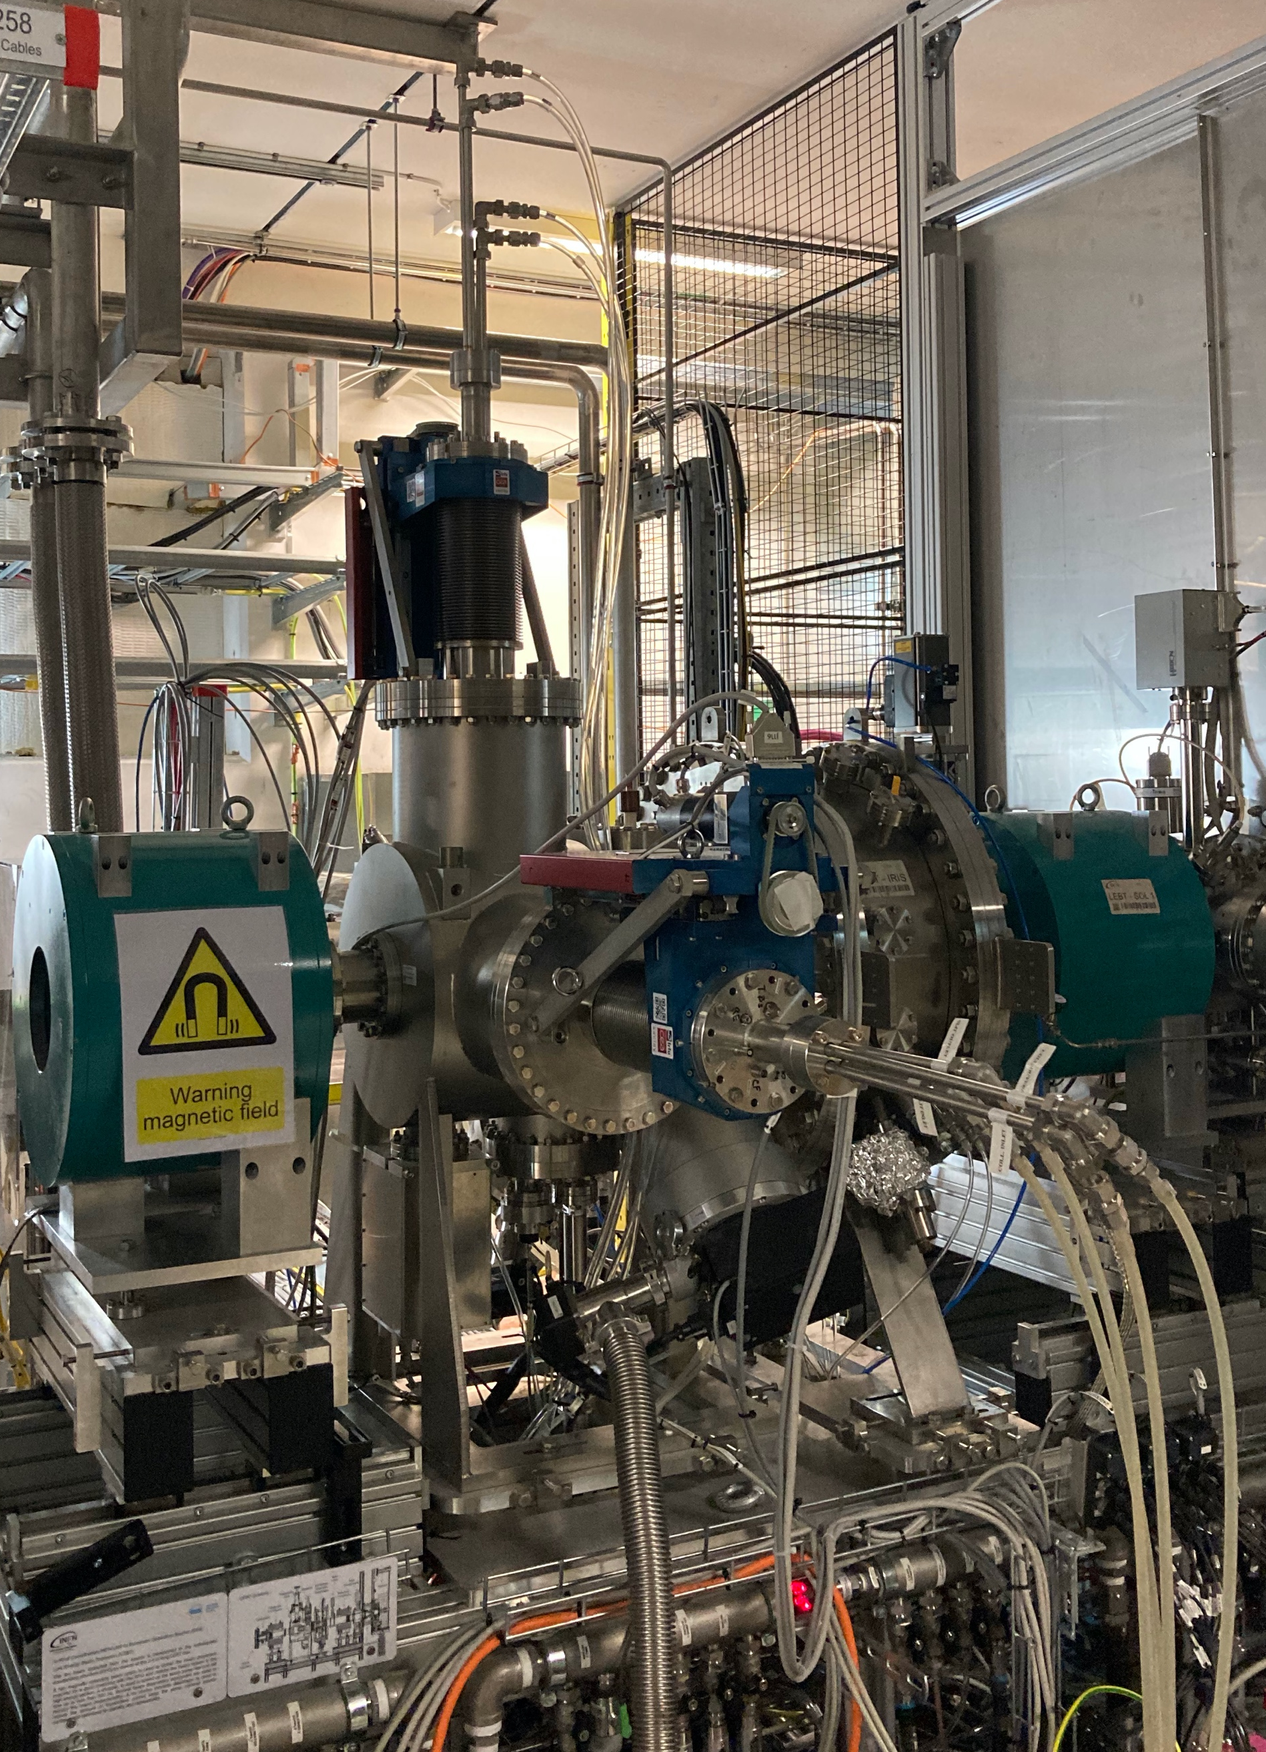
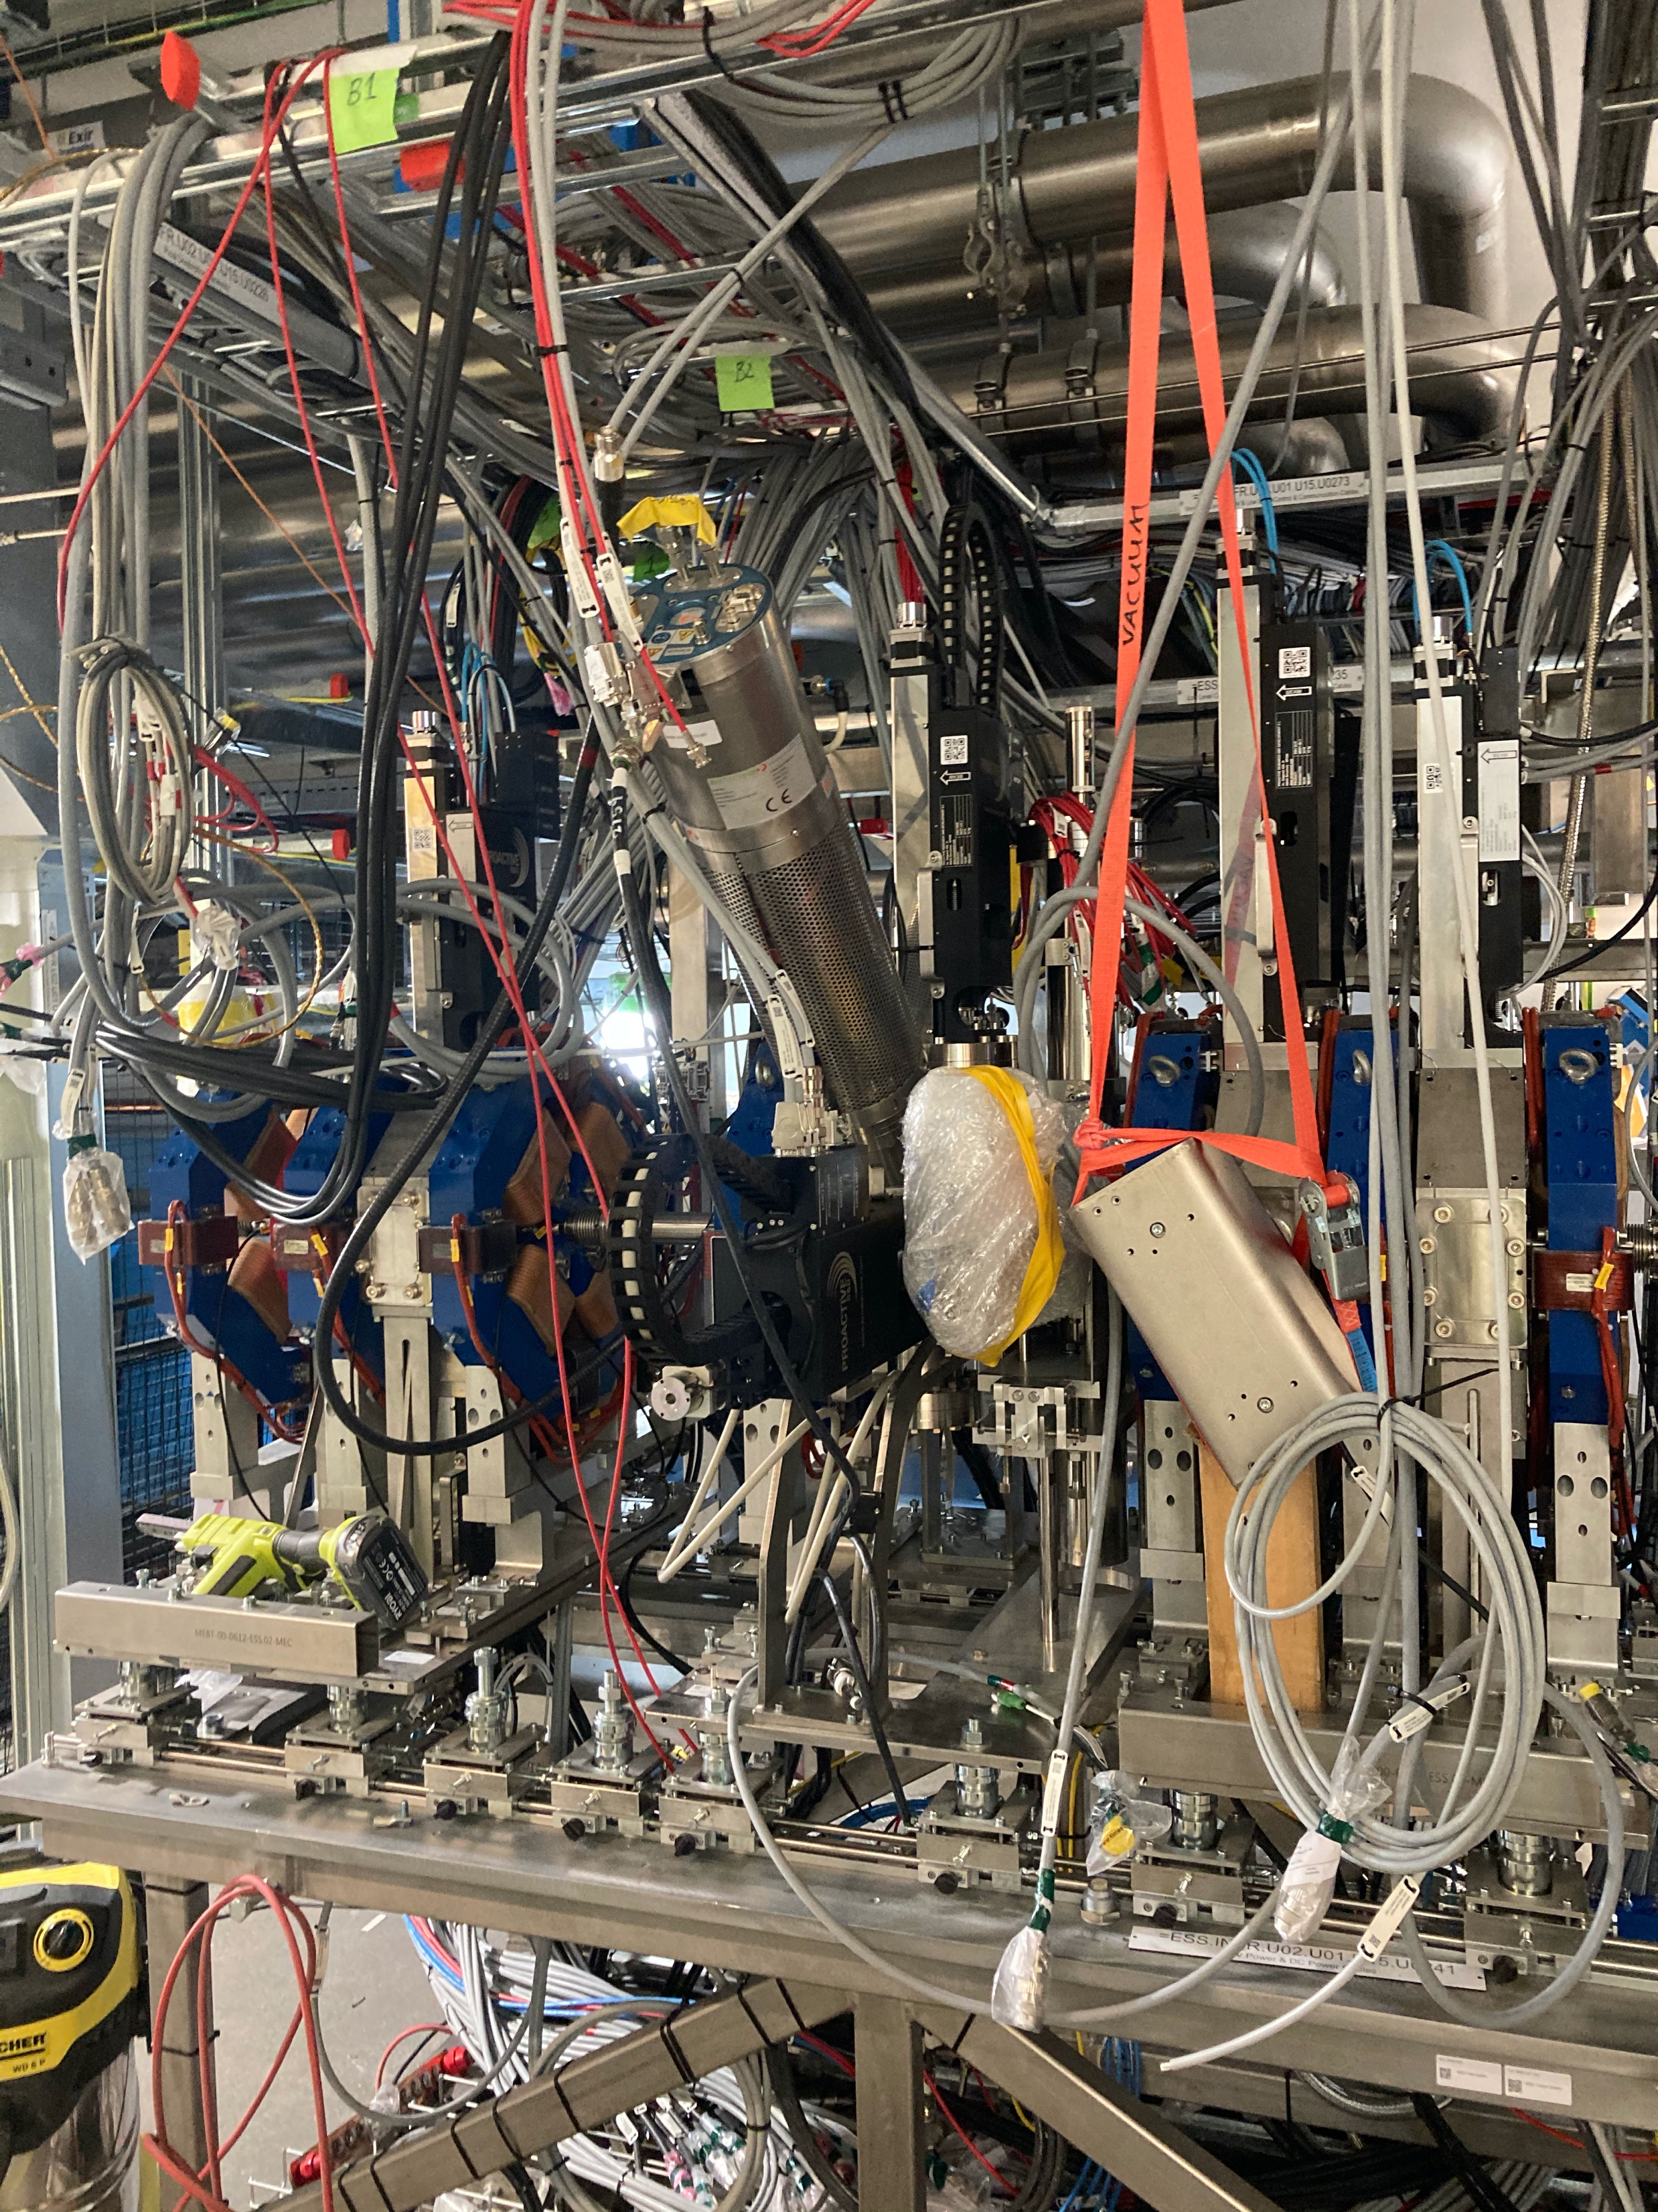
LEBT MEBT Insertable devices HW status
LEBT FC
MEBT FC
WS
EMU AS
EMU SG
SC
BSM
Notes:
No details, no software, no rack power as covered in Slava’s talk

Slide 2
LEBT MEBT Insertable devices HW status
LEBT FC
MEBT FC
WS
EMU AS
EMU SG
SC
BSM
Beam line:
Beam line HW installation: fully installed
Cabling machine side: completed
MPS modifications: completed
Water flow & temperature: not connected
Collision protection: not implemented
Control racks:
ECAT crate installed
HVPS installed
mTCA ready for installation
Internal cabling partially completed
Testing:
Motion testing without beam: partially completed
Verification plan released

Slide 3
LEBT MEBT Insertable devices HW status
MEBT FC
MEBT FC
WS
EMU AS
EMU SG
SC
BSM
Beam line:
Beam line HW installation: fully installed
Cabling machine side: completed
MPS modifications: completed
Water flow & temperature: not connected
Control racks:
ECAT crate: tests ongoing (NAMUR sensors)
HVPS: installed
mTCA: ready for installation
Internal cabling: partially completed
Testing:
Motion testing without beam: not started
Verification plan released

Slide 4
LEBT MEBT Insertable devices HW status
WS
MEBT FC
WS
EMU AS
EMU SG
SC
BSM
Beam line:
Beam line HW installation: WS 2 &3 complete – WS1 in repair
Cabling machine side: completed
AFE: Installed
MPS modifications: completed
Collision protection: not implemented
Control racks:
ECAT crate: LAB tests ongoing
AFE + BE: installed
mTCA: not started
Internal cabling: partially completed
Testing:
Motion testing without beam: not started
Verification plan in review

Slide 5
LEBT MEBT Insertable devices HW status
EMU AS
MEBT FC
WS
EMU AS
EMU SG
SC
BSM
Beam line:
Beam line HW installation: completed – Front End to Update
Cabling machine side: not completed
MPS modifications: completed
Collision protection: not implemented
Water flow & temperature: not connected
Control racks:
“special case”: in same state as in 2018.
System update plan: PBIEMUAS-19
Testing:
not started
Verification plan in review

Slide 6
LEBT MEBT Insertable devices HW status
EMU SG
MEBT FC
WS
EMU AS
EMU SG
SC
BSM
Beam line:
Beam line HW installation: Actuators complete – FE to install
Cabling machine side: partially completed
MPS modifications: completed
Collision protection: not implemented
Water flow & temperature: not connected
Control racks:
not started
Testing:
Motion testing without beam: not started
Verification plan released
Notes:
LEBT FC: Beam Line Hardware installed. MPS modification done.
EMU SG: all actuators installed. All MPS modification done.
BSM: instrument tested in the PBI lab last year by our Russian colleages. Installed on MEBT

Slide 7
LEBT MEBT Insertable devices HW status
SC
MEBT FC
WS
EMU AS
EMU SG
SC
BSM
Beam line:
Beam line HW installation: completed
Cabling machine side: partially completed
MPS modifications: completed
Collision protection: not implemented
Water flow & temperature: not connected
Control racks:
not started
Testing:
Motion testing without beam: not started
Verification plan to update
Notes:
LEBT FC: Beam Line Hardware installed. MPS modification done.
EMU SG: all actuators installed. All MPS modification done.
BSM: instrument tested in the PBI lab last year by our Russian colleages. Installed on MEBT

Slide 8
LEBT MEBT Insertable devices HW status
BSM
MEBT FC
WS
EMU AS
EMU SG
SC
BSM
Beam line:
Beam line HW installation: installed
Cabling machine side: partially completed
MPS modifications: ongoing
Water flow & temperature: not connected
Collision protection: not implemented
Control racks:
“special case”: fully tested installed in test rack. Deployment in FEB rack by IK team.
Testing:
Motion testing without beam: partially completed
Verification plan to write from Sergei’s notes
Notes:
BSM: instrument tested in the PBI lab last year by our Russian colleages. Installed on MEBT

