Slide 1
Powering
Viatcheslav Grishin (ESS)
BI-half day 2020

Slide 2
The Electrical Safety organizational structure at ESS and at AD
Category/roles of personnel in terms of electrical safety:
EOL’s;
ESL’s;
Skilled person;
Instructed person;
instructed person: person adequately advised by skilled persons to enable him or her to avoid dangers which electricity may create
EOL ESS
(Owen Buchan)
skilled person: person with relevant education, knowledge and experience to enable him or her to analyze risks and to avoid hazards which electricity could create
EOL - The nominated person in control of an Electrical Installation : is the person who has the task of being directly responsible for the whole electrical installation as assigned
EOL TARGET
(??)
EOL ICS
(??)
EOL NSS
(??)
EOL AD^{(*)}
(Carlos Martins)
ESL - The nominated person in control of a work activity: is the person who has the task of being directly responsible for electrical works as assigned
ESL AD-WP3-6^{(*)}
(Emmanouil Trachanas)
ESL AD-WP7^{(*)}
(Slava Grishin)
ESL AD-WP8^{(*)}
(Morten Jensen)
ESL AD-WP12^{(*)}
(?)
ESL AD-WP17^{(*)}
(Göran Göransson)
Authorized persons
Henrique, Edvard, Clement
Authorized persons
Authorized persons
Authorized persons
^{(*)} – valid for the Normal Conducting Linac (NCL) only
BCM and FC - power ON

Slide 3
The sequence for energising the racks
Self Inspection report : Edvard, Clement, Henrique and approved by Slava
Quality inspection of the rack - Quality report : Stefan Arvidsson
RAMS , Work request and Energisation request : System Leaders and Slava
In 2020: Carlos and Owen to give their green light for energisation
Racks to be powered in Feb90:
BPM
Motion Control
NPM
DPL

Slide 4
Self Inspection report
Protection against direct contact
 | Item | Compliance ^{(NOTE 1)} | Comments ^{(NOTE 3)}
1 | Insulation of live parts
2 | Barriers
3 | Enclosures
B. Equipment
 | Equipment | Selection ^{(NOTE 2)} | Erection ^{(NOTE 1)} | Comments ^{(NOTE 3)}
1 | Cables
2 | Wiring accessories
3 | Conduits
4 | Trunking
5 | Distribution equipment
6 | Protective devices

Slide 5
Self Inspection report
C. Identification
 | Item | Presence | Correct Location | Correct Wording | Comments ^{(NOTE 3)}
1 | Labelling of protective devices, switches and terminals
2 | Warning notices
3 | Danger notices
4 | Identification of conductors
5 | Isolation devices
6 | Switching devices
7 | Diagrams and schedules
Test protocol
 | Enter type of test that has been performed | Protocol No:
1 | >>Continuity Test<<
2 | >>Insulation Test<<
3
4
5

Slide 6
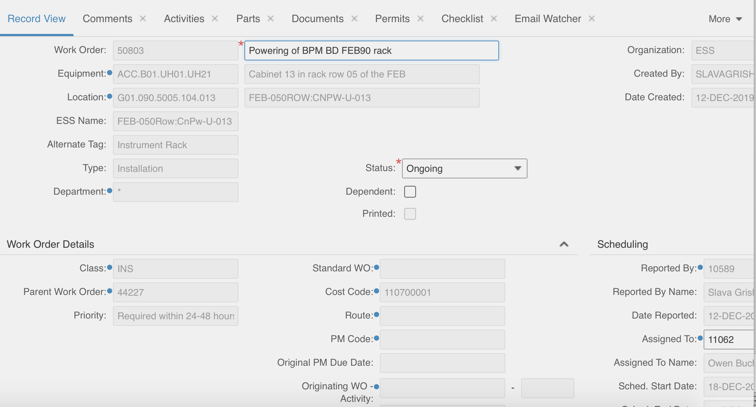
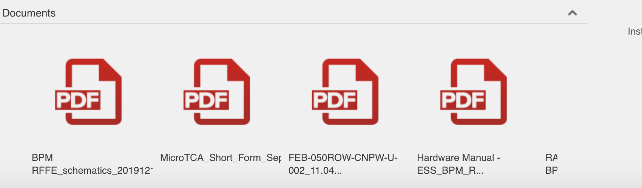
Work Order50803Powering of BPM BD FEB90 rack

Slide 7
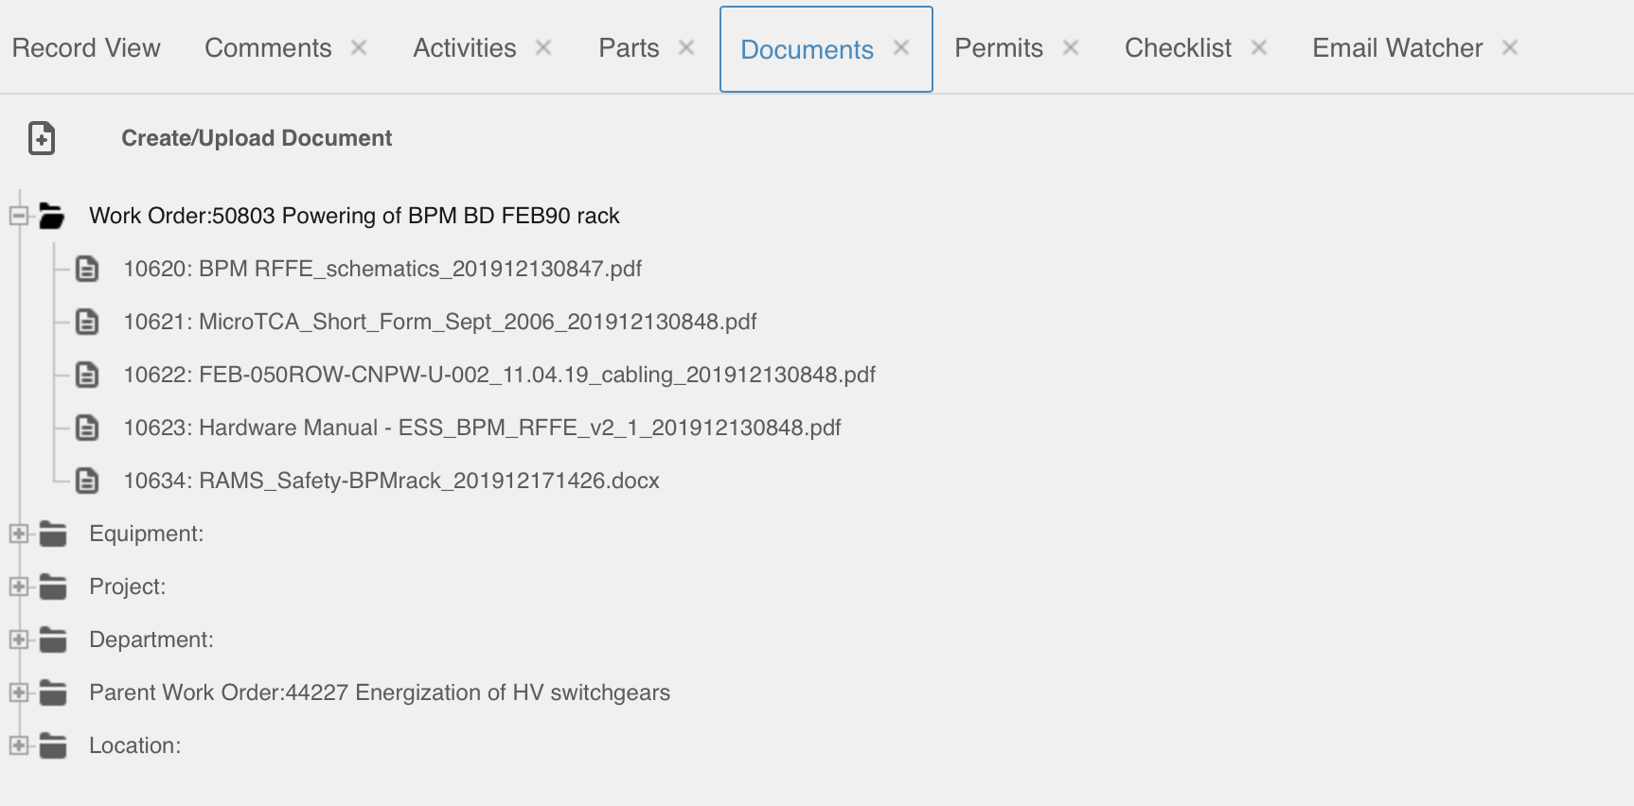
Work Order50803Powering of BPM BD FEB90 rack

