Slide 1
Campus BI Lab
Edvard Bergman
Lab manager
www.europeanspallationsource.se
2 December, 2020

Slide 2
BI Lab area
Requested: 400 sq. m.
Temporary lab: 347 sq. m.
Permanent lab B02: 280 sq. m.

Slide 3
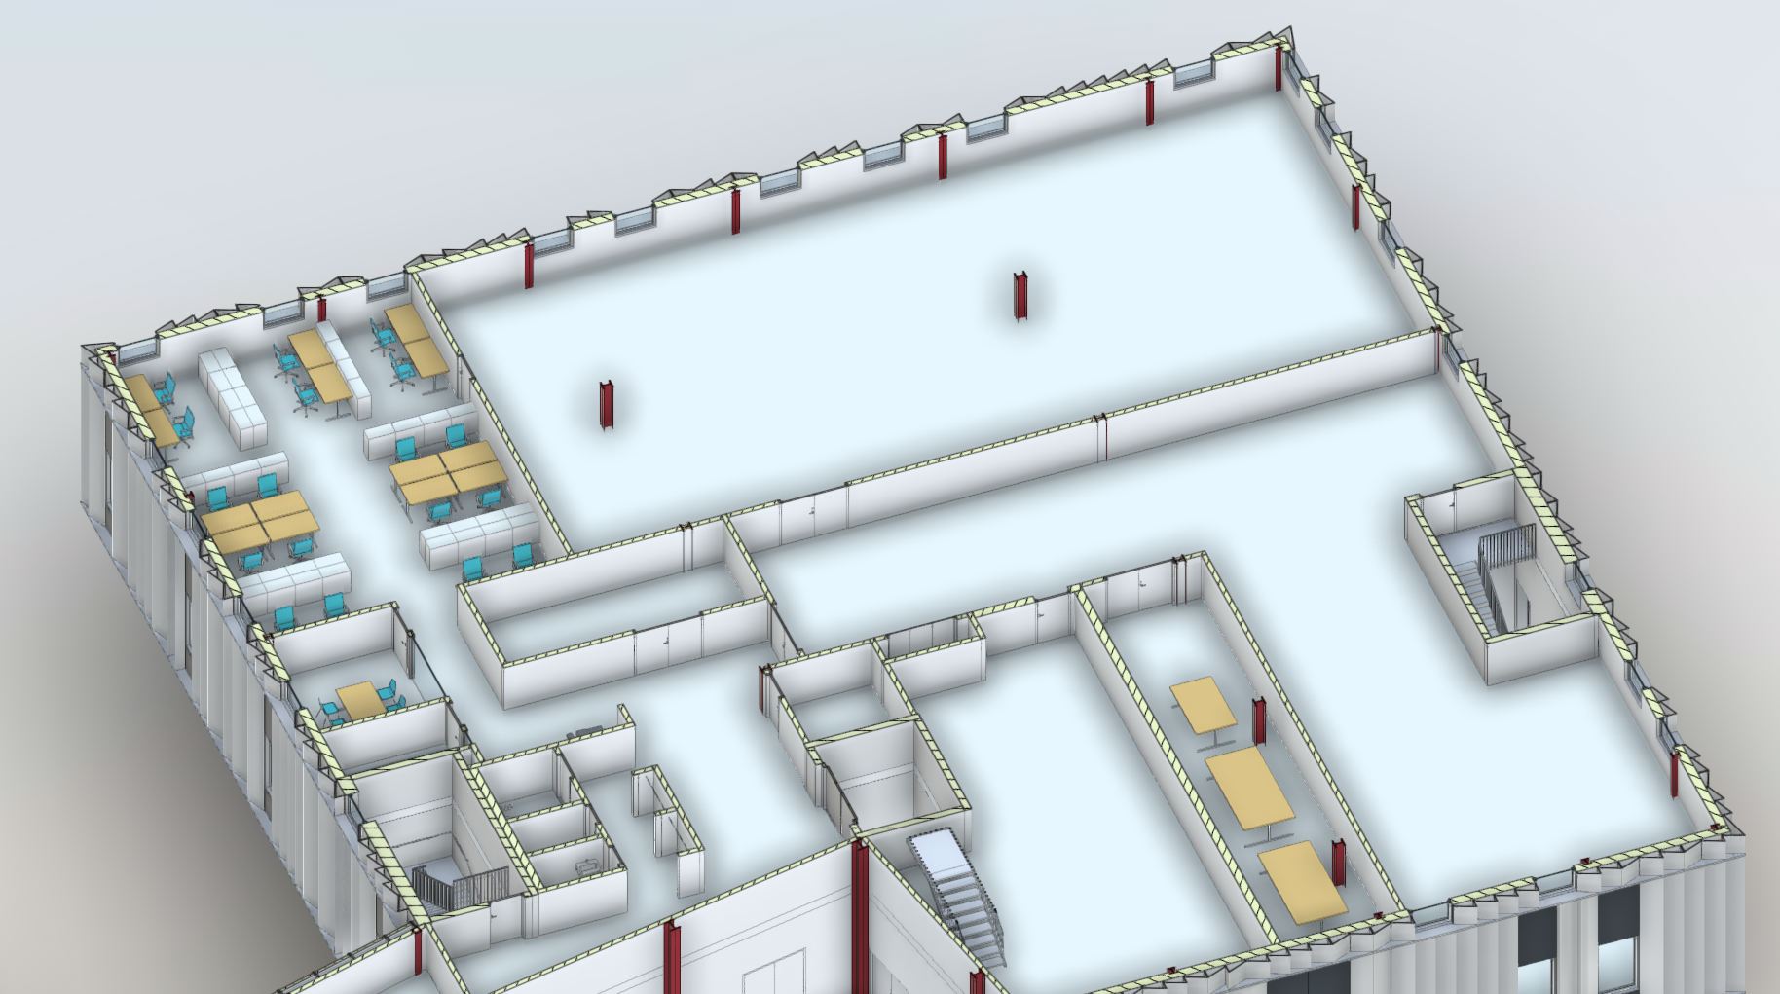
Campus BI LAB B02 area.

Slide 4
B02 Lab area.

Slide 5
Cable tray plan

Slide 6
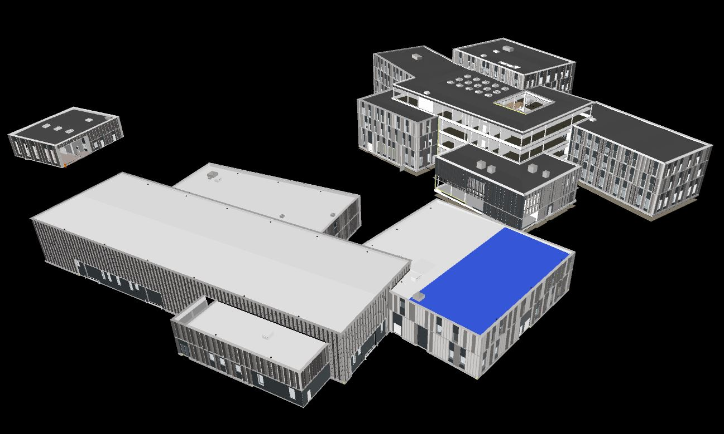
Campus B02

Slide 7
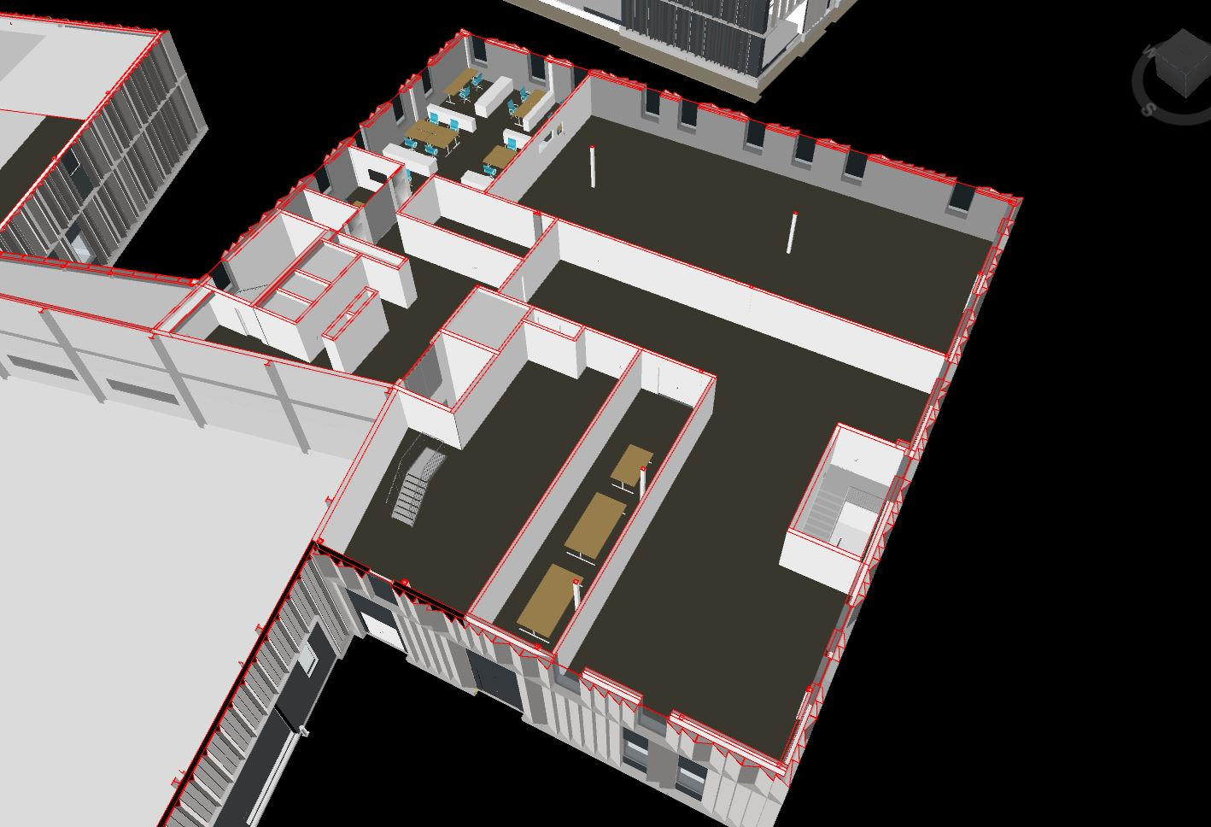
B02 BI LAB

