Slide 1
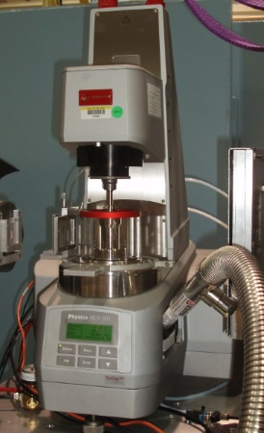
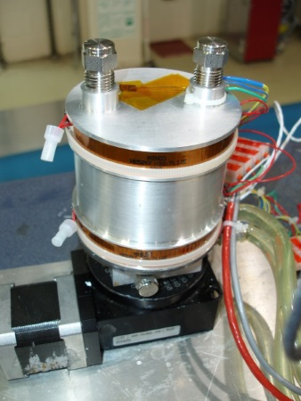
Sample Environment
Sample Environment List Established and WU developed
Loki Specific (in baseline)
Sample Changer ambient >= 50 samples
Sample Changer -20C < T < 150C >= 50 samples
Flow cell with HPLC pumps
Rotating sample holders for sedimenting samples
Quartz (hellma) cells
SANS Specific – shared with SKADI (not in baseline)
Humidity Chamber
Rheometer
Couette Shear cell
Plate-plate shear cell
2T electromagnet
1T electromagnet
2D low-field magnet (coils)

Slide 2
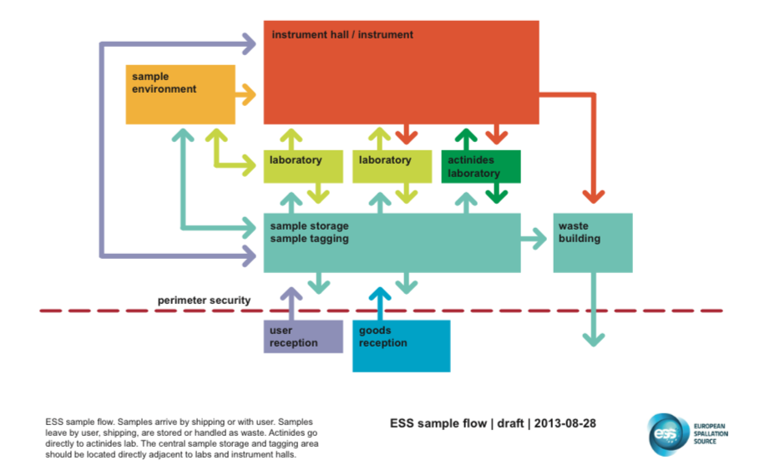
Sample Handling
Wide variety of samples on SANS
Masses in 100 mg to 10 g range
Containment and handling of each sample based on assessement during proposal review
ESS Procedures will be followed once developed

Slide 3
Data analysis software for SANS
SASView is the preferred data analysis software
Widely used and supported by many facilities (SNS, NIST, ISIS, ILL, ESS)
Andrew Jackson is on SASView management board
Requirement and design document completed end of 2015
Software completed and tested 6 months before Cold Commissioning.
First requirement document drafted already – high level requirements
Automated and real-time data analysis requirement determines where major effort will be spent:
Modularizing SASView and making interoperable
API and Scriptable Command Line Interface
Sufficiently fast routines for real-time data analysis

