Slide 1
Tollgate 2 Review
LoKI SANS Instrument
December 12 2014
Instrument Team
Andrew Jackson
Clara Lopez
www.europeanspallationsource.se
2014

Slide 2
LoKI Overview
Instrument, Budget and Schedule
Instrument Team
Andrew Jackson
Clara Lopez
www.europeanspallationsource.se
2014

Slide 3





The LoKI Team
Lead Instrument Scientist
Andrew Jackson
Lead Instrument Engineer
Clara Lopez
Scientific Partners
Prof. Adrian Rennie, Uppsala University
Prof. Lise Arleth, Copenhagen University
Dr. Joachim Kohlbrecher and Dr. Gergely Nagy, PSI
Kalliopi Kanaki, Scott Kolya (Detectors)
Erik Nilsson, Robin Petterson (Choppers)
Carolin Zendler (Optics)
Natalyiia Cherkashyna (Shielding)
Anders Sandström (Motion Control)
Torben Nielsen (Software)
Anders Petterson (Sample Environment)
Peter Ladd, Marcelo Ferreira (Vacuum)
Stuart Birch (PSS)
Stewart Pullen,Hanna Wacklin

Slide 4
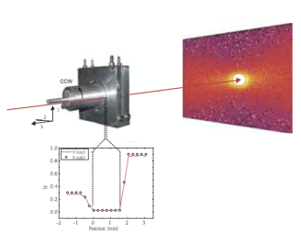
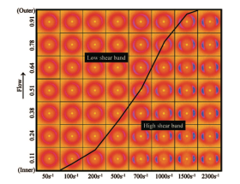
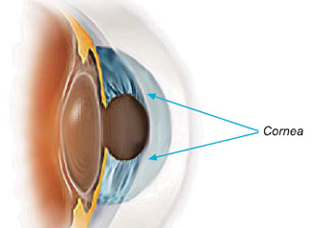
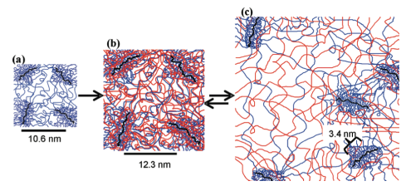
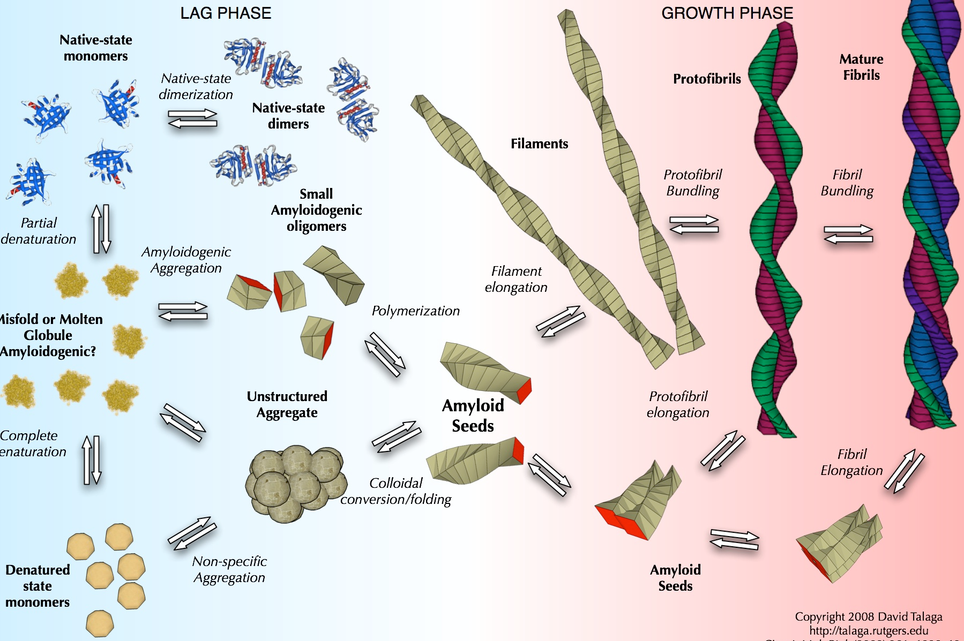
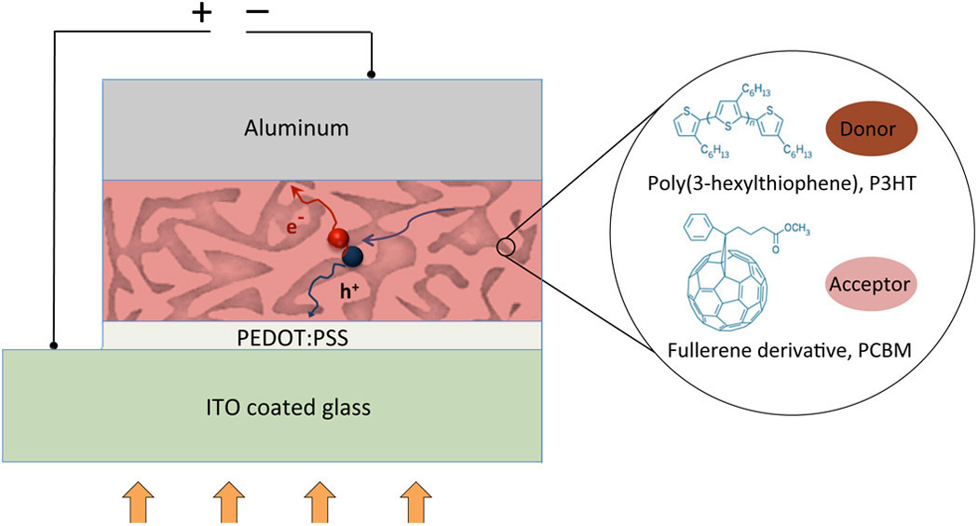
Science Case
The flow of complex fluids through complex geometries is relevant to many industrical processes. There is a need to understand structural effects of flow both for practical purposes and to compare with fluid flow models.
FLOW
Shear Banding in CTAB wormlike micelles providing confirmation of rheological model. (Helgeson et al. (2009) J. Rheol 53, 727)
KINETICS
Gel structure forms over multiple length scales. Kinetics of gelation can be rapid needing sub-second time resolution. Neutrons provide the structure of each component in the presence of the other.
Swelling of a double network hydrogel designed for use as a cornea replacement. (Frank Group, Stanford)
MULTI
SCALE
Amyloid fibril formation and growth is a multi-length scale problem and to understand methods of formation and inhibition the structural evolution must be observed.
Organic Solar Cells promise to provide cheap and accessible solar energy. The lifespan and efficiency of the devices depends on the nano-structure polymer mixture. Understanding the structural evolution under operation guides development of new devices.
DEVICES
BIOLOGY
Membrane proteins are key drug targets and cannot easily be crystallised for study by macromolecular crystallography. Examining such proteins in their native environment is vital to understanding their function.

Slide 5
Requirements

Slide 6
Requirements
A broad Q range, high flux SANS instrument for soft matter, bio-science and materials science
Science Based Goals
Rapid data collection / short counting times to enable kinetics
Probe broad size range to examine hierarchical structures
Small sample volumes for scanning, biological and complex samples
Integrated flexible sample environment for non-equilibrium studies
Integration of complementary techniques experimentally and in data analysis
Simplicity of operation to allow users to focus on science
Technological Goals
Broad simultaneous Q range with Q_{max}/Q_{min} = 1000
Good Q resolution over the whole Q range
High flux making best use of ESS source
Single pulse scattering measurements
Optimized use of new detector technologies
High-level Scientific Requirements for the Instrument
The instrument shall allow data to be collected to a Q_{min} of < 0.001 Å⁻¹.
The instrument shall allow data to be collected to a Q_{max} of > 2 Å⁻¹.
The instrument shall allow data to be collected simultaneously over a continuous Q range with Q_{max}/Q_{min} > 1000.
The instrument shall match the size of the neutron beam to the size of the sample.
The instrument should allow the Q resolution (dQ/Q) to be optimised for the experiment.
The instrument should be capable of providing a Q resolution < 10% dQ/Q over the whole Q range.
The instrument should allow data collection from samples < 8 mm³ volume
The instrument should maximise the signal-to-background (S/B) ratio of the small angle scattering.

Slide 7
Key Components and Technical Developments

Slide 8
LoKI layout
Collimators changers and aperture systems 2m, 3 m, 3m
Monolith insert (first bender) and light shutter
Chopper Pit 1
Chopper Pit 2
Gold Foil
Sample positioning
Detectors tank
Second bender
Secondary shutter
Chopper Pit 3
Gold Foil
0
2
6
7.5
9.7
10.3
11
12.5
20.5
22.5
38
L1_{max} = 10m
L2_{max} = 10m
Repetition rate = 14Hz or 7Hz
δλ_{max} = 10Å at 14Hz
Max flux on sample ~1x10⁹ n/cm²/s
2x line-of-sight closure

Slide 9
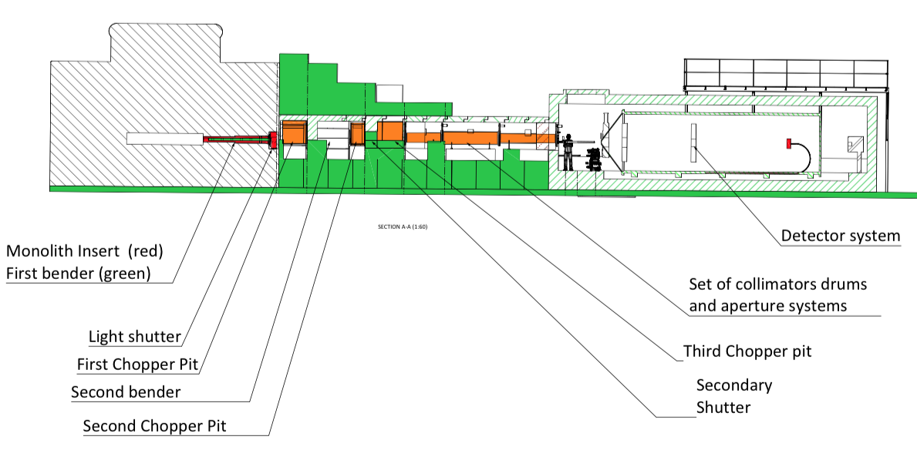
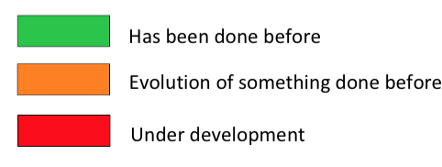
LoKI Layout – Technical Risk Rating

Slide 10
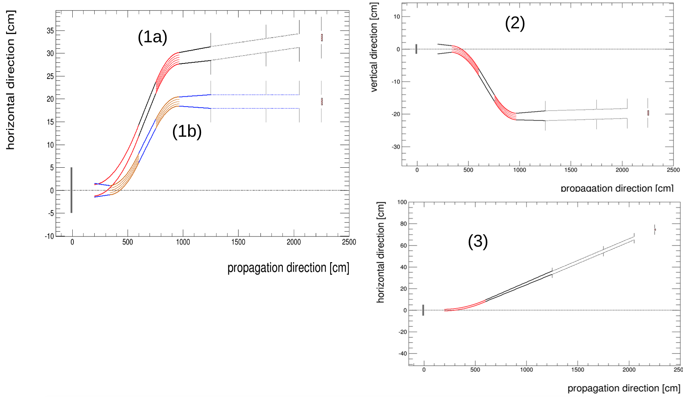
Key Components - Optics
Optics TAP advised that we should take 2x line-of-sight as our baseline and use integrated optics/shielding simulations next year to see if we can relax that requirement
3 options considered :
horizontal 2x LOS, vertical 2x LOS and horizontal 1x LOS (proposal)

Slide 11
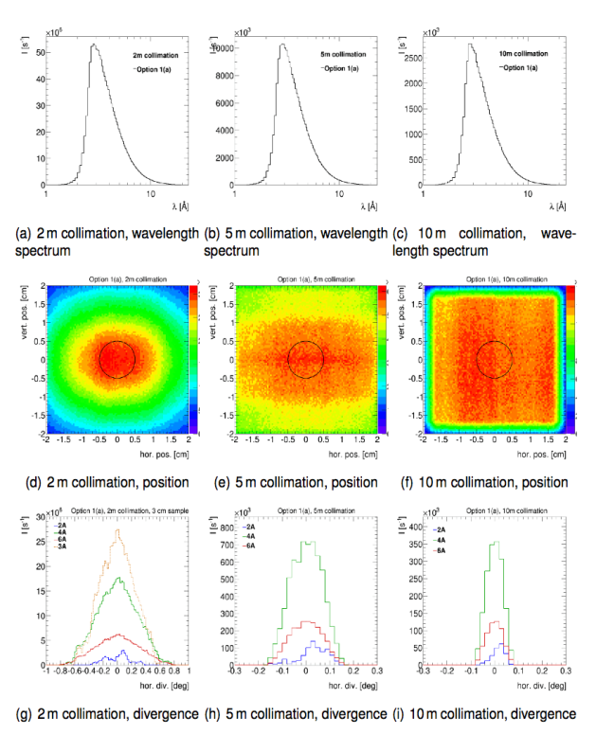
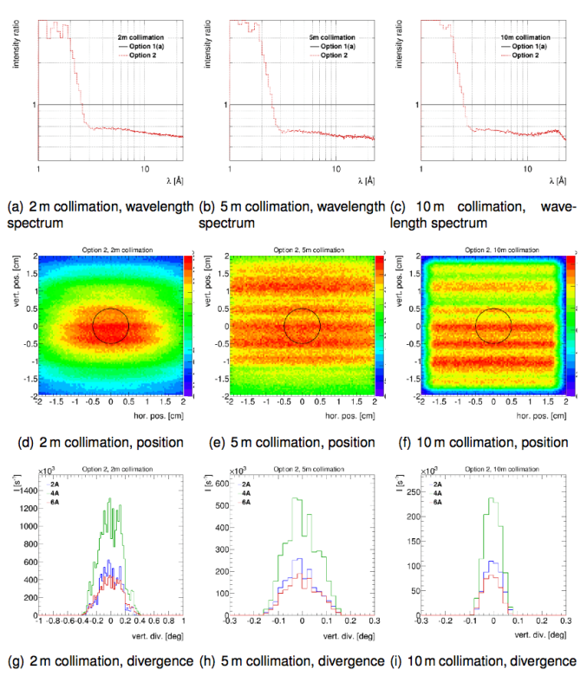
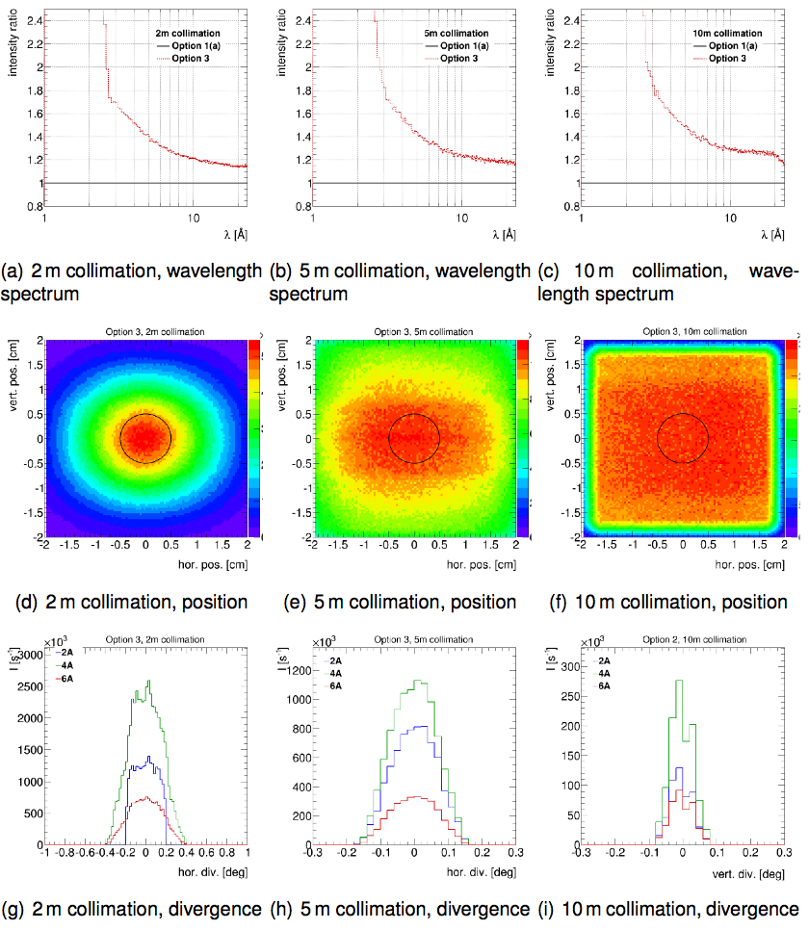
Key Components - Optics
Optics TAP advised that we should take 2x line-of-sight as our baseline and use integrated optics/shielding simulations next year to see if we can relax that requirement
Option 1 (a) & (b)
Horizontal s-bender
2x LOS
Option 2
Vertical s-bender
2x LOS
Option 3
Horizontally curved
1x LOS
Notes:
Optimised for 3A with 2 – 22A band

Slide 12
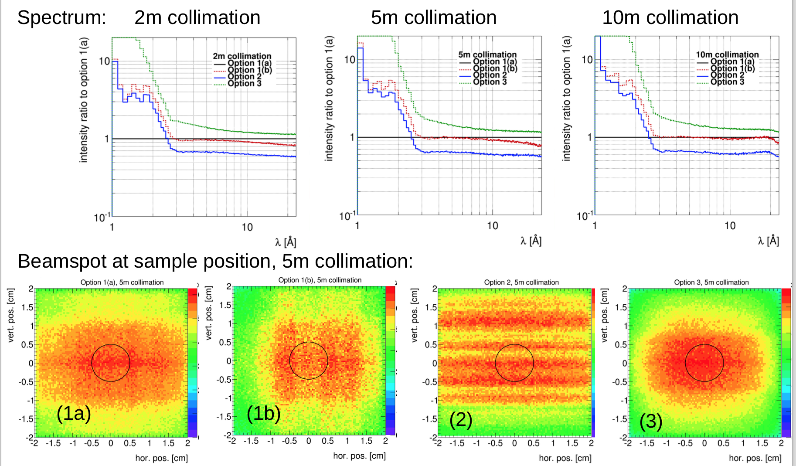
Key Components - Optics

Slide 13
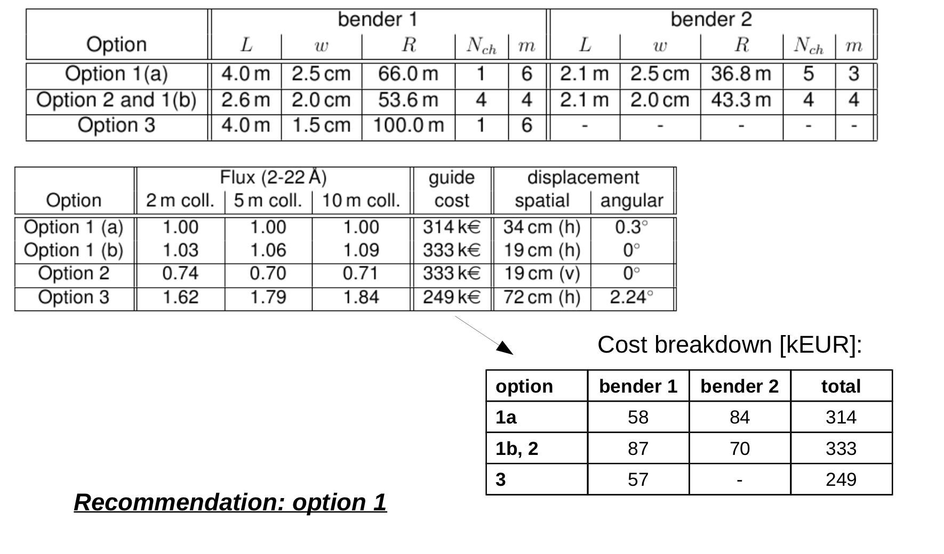
Key Components - Optics

Slide 14
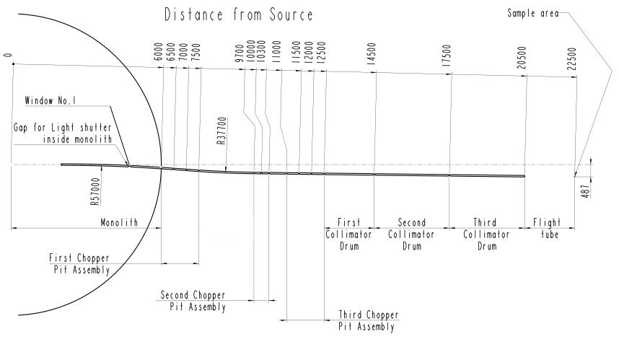
Key Components - Optics
Chopper gaps simulations
Collimation sections
Line of sight
Guide windows
Coating
  Straight guide sections use m=2 super mirror coating
  In the collimation sections m=0 absorbing “guide” sections
  Section from 2.5x3 to 3x3 cm²
Notes:
Chopper gaps: are short enough and far enough from the sample position that no significant performance decrease in either flux or beam homogeneity is expected.
The choppers facilitate a maximum guide dimension of 3x3 cm2
Constraint is the space between the chopper pits 1 and 2, limits the length of a possible curved guide or bender to 2.1 m
Collimation sections: the collimation starts at 12.5, with 3 collimation changers (2, 3, 3) that will create fours gaps at 12.5, 14.5, and 17.5. The beam ends at 20.5 m 2 meters before the sample posiitoning.
The last 8 m of guide have to be changeable between a supermirror coated actual guide and an absorbing section.
Line of sight: Line of sight to the source should be avoided twice: at 6 m and 9.7 m from the source. Non bends in the chopper pits. First bender 4 m and second bender 2.1 m
Guide windows: Choppers with common vacuum reduce the number of windows, it will be need just at 6 m and at the sample position. Those windows have not
been included in the simulation so far
Coating: Benders the bended surface has a different coat, but the other 3 are supermirror coat

Slide 15
Key Components - Choppers
Variable opening double disc choppers at 6.5 m and 11.5 m
Operate at 14 Hz or 7 Hz
Wavelength Band @ 14 Hz
2 Å – 11 Å
3 Å – 10 Å full pulse

Slide 16
Key Components - Choppers
Variable opening double disc choppers at 6.5 m and 11.5 m
Operate at 14 Hz or 7 Hz
Wavelength Band @ 7 Hz
2 Å – 19.5 Å
3 Å – 18.5 Å full pulse

Slide 17
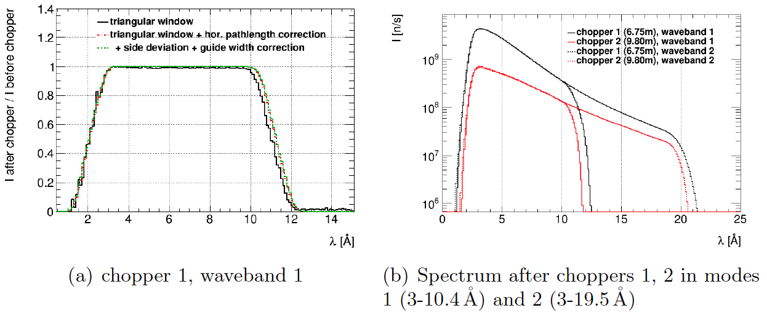
Key Components - Choppers
Variable opening double disc choppers at 6.5 m and 11.5 m
Operate at 14 Hz or 7 Hz

Slide 18
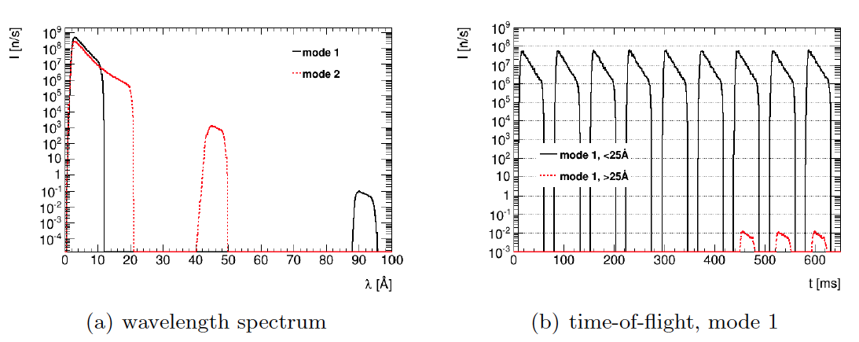
Frame Overlap Contamination
Simulations to assess issue of long-wavelength frame overlap
Worst case is 10⁻⁵ contamination at 7Hz

Slide 19
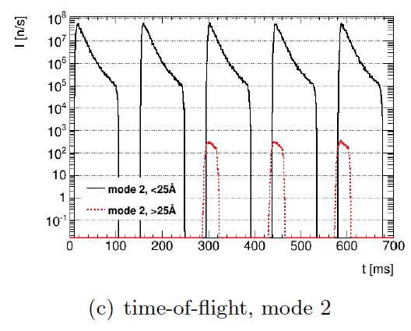
Frame Overlap Contamination
Simulations to assess issue of long-wavelength frame overlap
Worst case is 10⁻⁵ contamination at 7Hz

Slide 20
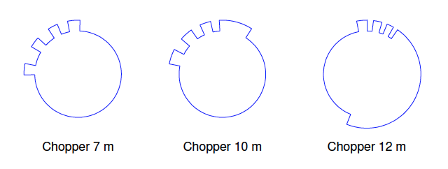
Optional– Resolution Choppers
Choppers at 7m, 10m and 12m.
3x, 2x and 1x source frequency
Provide short pulses for short wavelengths to improve resolution
Can be thought of as enhanced flux at a given resolution compared with not using short wavelength bins in data processing
42 Hz 28 Hz 14 Hz
Notes:
Wavelengths and Pulse Widths for unshaded minimum pulse lengths
Min L | MaxL | Pulse Width
3.0 | 3.351348 | 1.0044
4.1291712 | 4.4350416 | 0.76492
5.2994304 | 5.3963712 | 1.11384
6.4869552 | 10.0 | 2.12764
Wavelengths and Pulse Widths for penumbra included pulse lengths
Min L | MaxL | Pulse Width
2.0562 | 3.6828 | 2.86
3.415632 | 4.917726 | 2.86
4.59327 | 6.001578 | 2.86
5.784834 | 10.9438 | 2.86

Slide 21
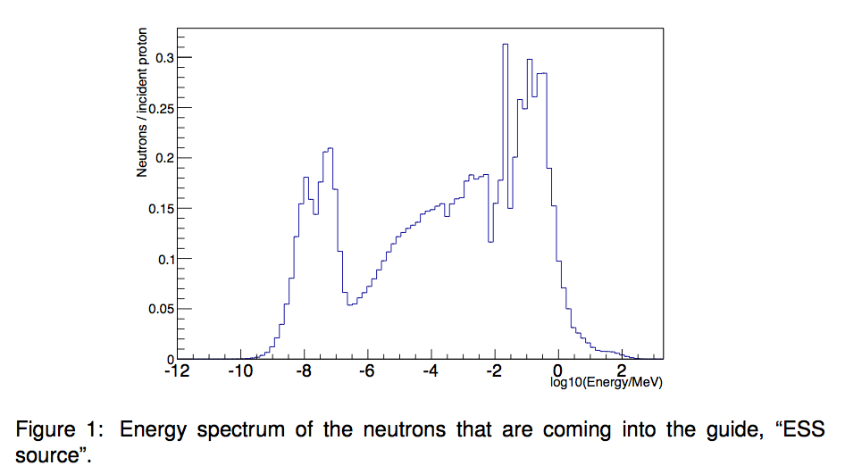
Key Components – Shielding
Simulation tools: Geant4
The energy spectrum shown is full energy spectrum. In the simulations of LoKI shielding concept only high-energy part of the spectrum was used, i.e. neutrons with energy equal to and above 1 eV

Slide 22
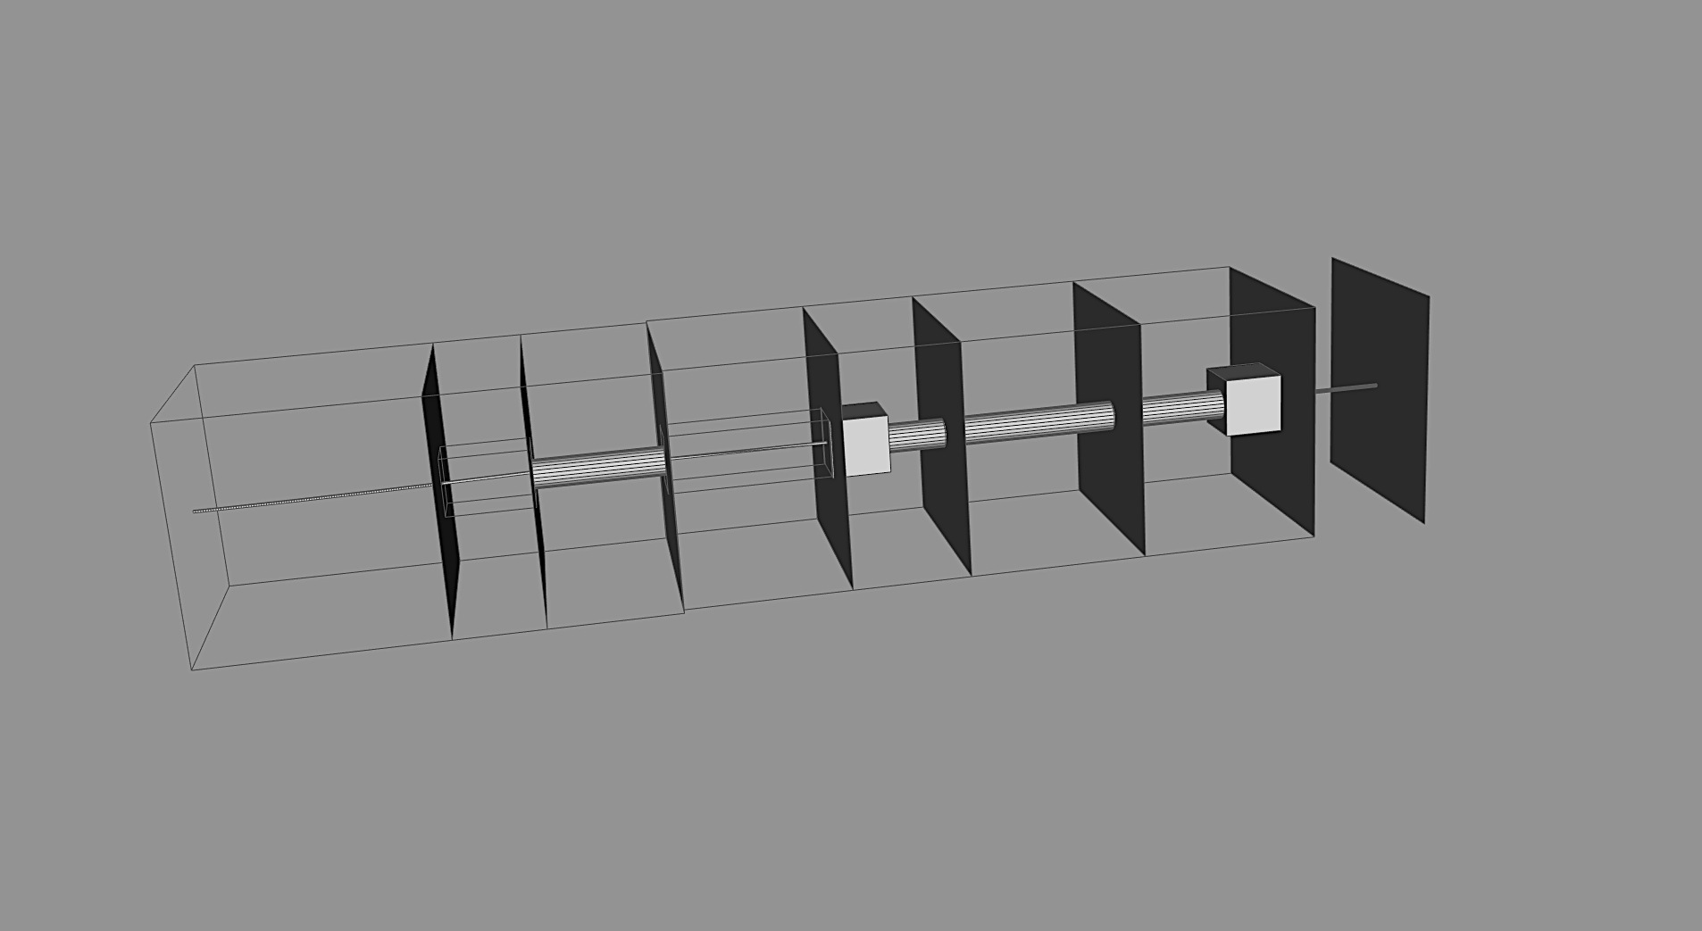
Key Components - Shielding
GEANT4 geometry viewer and computing framework developed by Detector Group

Slide 23
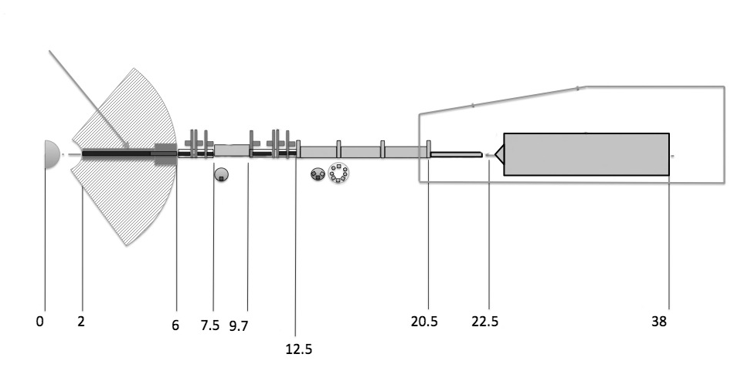
Key Components - Shielding
World = 5m x 5m x 45m
ESS source (from target),
size of source: 3.5cm x 12 cm
only fast part of the spectrum
Collimator blocks 1m x 1m x 1m, copper
D = 4m x 4m x 0.1mm
D1
D2
D3
D4
D5
D6
D7
D8
Cave and detector are not present in the model
“Empty” spaces around the guides for choppers, 80 cm x100cm
Ordinary concrete
4m x 4m
Choppers and apertures are nor present in the model
Block of iron,
4m x 4m x 4m

Slide 24
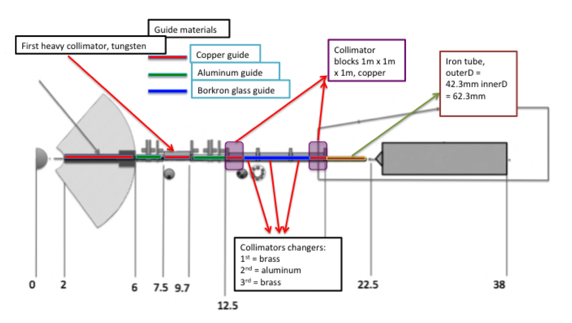
Key Components - Shielding
Layout of Instrument LoKI for materials
Notes:
background signal at the sample position instrument cave and detector tank are not present, as well as some details like choppers and apertures.

Slide 25
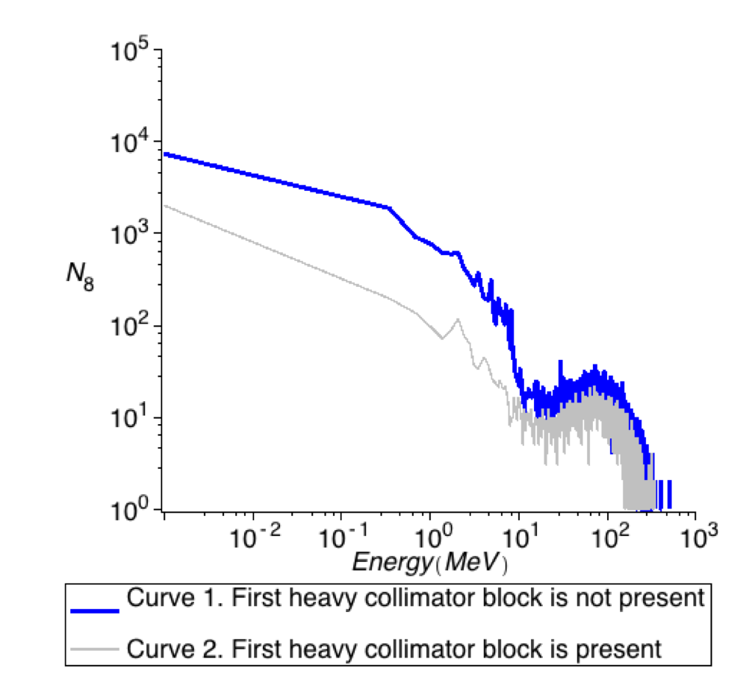
Key Components - Shielding
Heavy collimators vs no heavy collimators
Neutron spectrum at the sample position
Between D2 and D3 heavy collimator block is placed. It is a tungsten cylinder diameter of which is 50 cm and it’s thickness equals to 2.2 m.
Background at sample position with heavy collimator:
2.4 x 10-5 n/m^2/s
Notes:
As it is demonstrated on the figure 5 first heavy collimator reduces background at
the sample position by 1 order of magnitude in the energy range below 10 MeV, and
by factor of 5 in the energy range from 10 MeV to 100 MeV

Slide 26
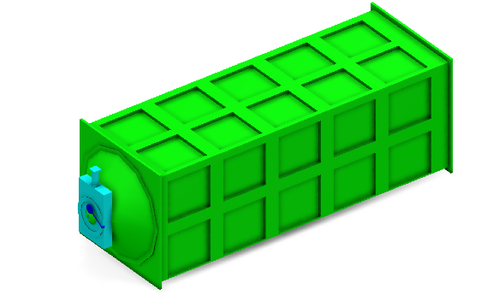
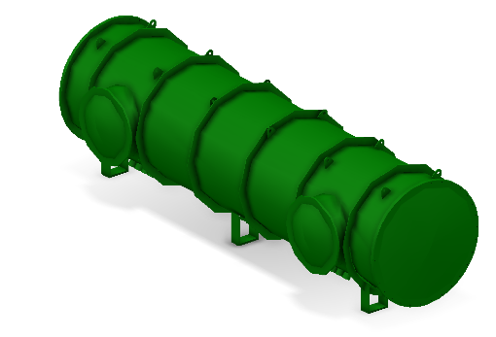
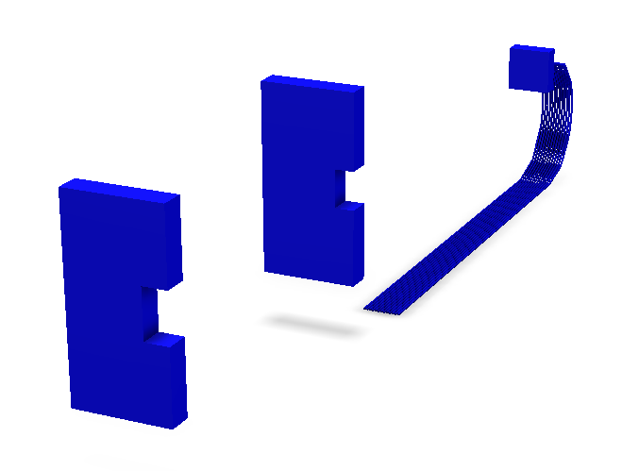
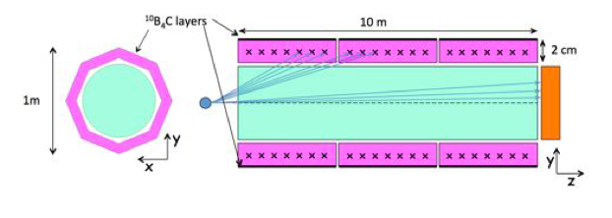
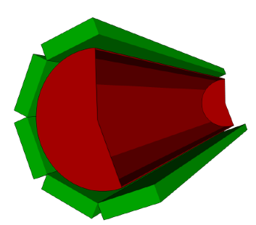
Key Components - Detectors
Option 1:
Half-size window-frame using 10B is LoKI baseline as recommended by the STAP: 1mx2m First panel 1.4 from sample, second panel 1mx2m installed 5 m from sample, 0.5mx0.5mvariable5.5 – 10m from sample
Alternative option: The barrel geometry
In this case the detector banks are arranged around a cylinder, the diameter can be reduced without loss of performance, the vacuum tank becomes smaller.

Slide 27
Key Components - Detectors
Detector resolution: Front panel – 15 mm / Second panel – 8 mm / Rear panel – 3 mm
Final geometry and resolution to be determined during Phase 2

Slide 28
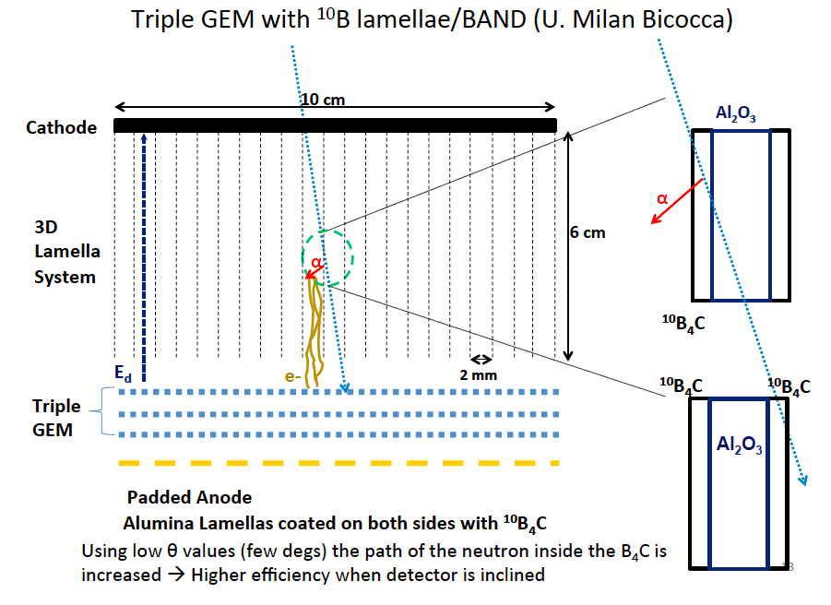
Key Components - Detectors

Slide 29
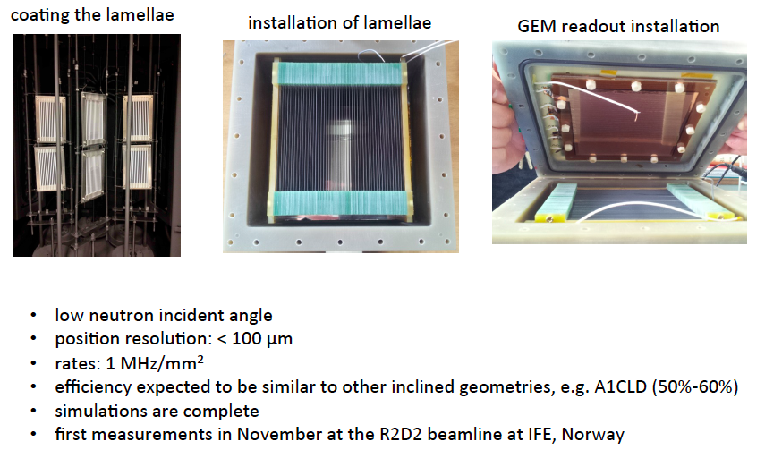
Key Components - Detectors

Slide 30
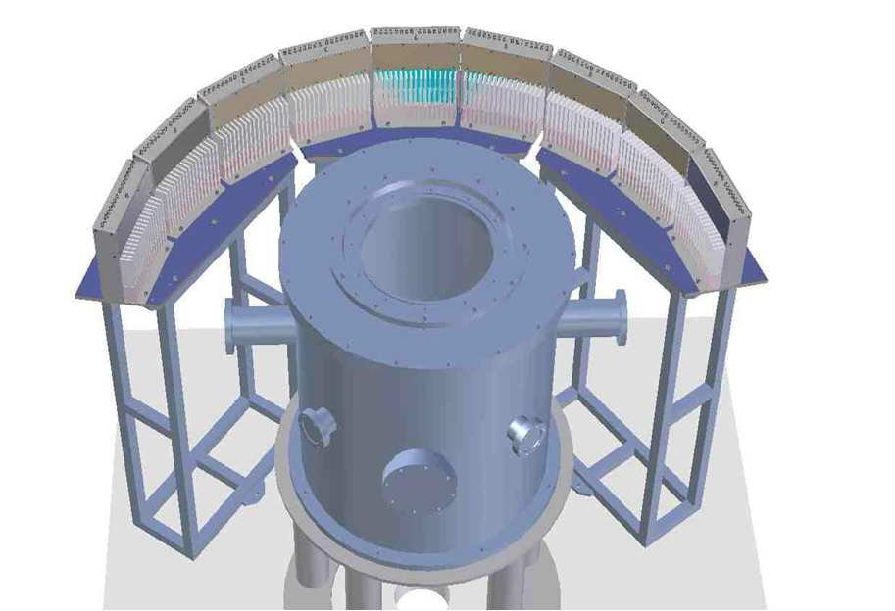
Key Components - Detectors
Comparison with INES ³He tubes at 90°
Start of demonstrator tests
1
λ = [ 0.17 , 3.2 ] Å
2
GEM
INES sample position
3
Transmitted neutron beam
1
³He
Incident neutron beam
2
3
GEM position
30

Slide 31
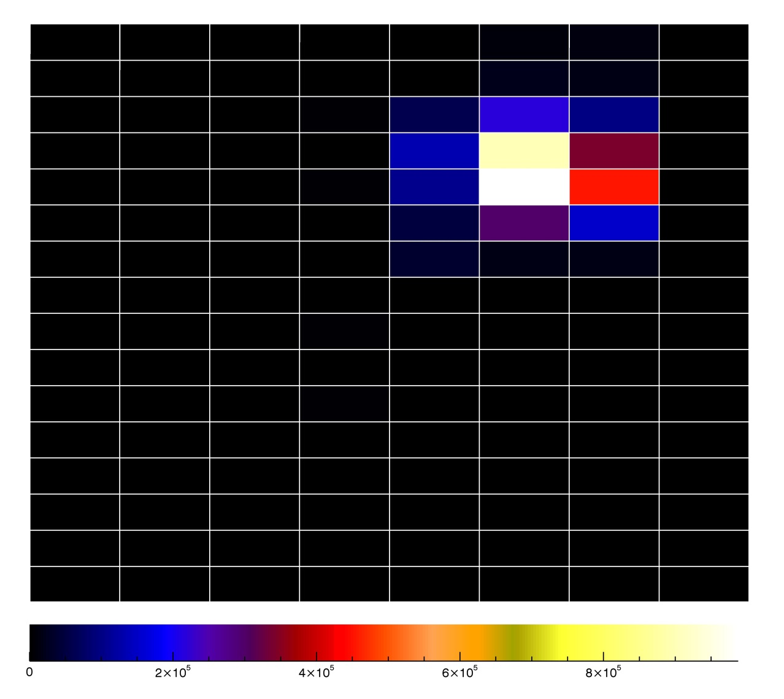
Key Components - Detectors
Beam Profile
E_{d} = 230 V/cm
E_{t1}=E_{t2}= 3 kV/cm;
E_{i} = 5 kV/cm
Mixture Ar/CO₂ 70%/30% 230 cc/min
Angle = 7 degrees
VGEM = 980 V
6 mm
12 mm
Preliminary raw data from 2 weeks ago, analysis not yet done
ε_{GEM} = 18.27 % at E_{n} = 34.5 meV, (1.54 Å), as expected from simulation
We expect to have ε_{GEM} = 21.5 % at E_{n} = 25 meV (1.8 Å)
Future design will have greater efficiency
31

Slide 32
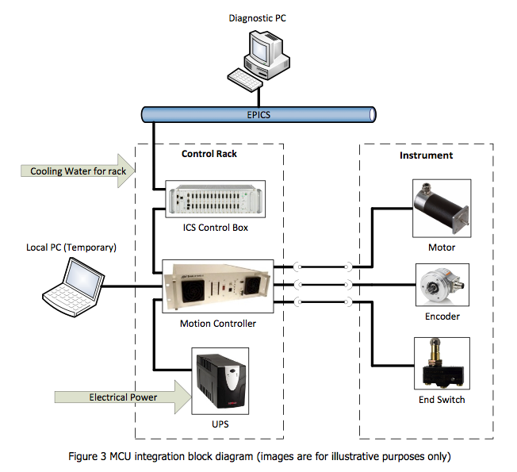
Key Components – Motion Control
Instrument Control & Automation work unit from LoKI
Every instrument will have the need of different solution to control the motion of various components. (called axis, rotation or linear).
MCA will deliver a MCU integrated in a rack
Custom changes or prototyping
Electrical schematic drawings and manuals
Support to mechanical design team in components selection
Factory Acceptance testes
Commissioning activities:
  Rack MCU and cables commissioning
  MCA will be responsible together with ICS, will integrate the parameters to EPICS network and all required movements can be performed from an EPICS terminal
List of preferred components and procedures
MCA is primary interface to ICS for controls

Slide 33
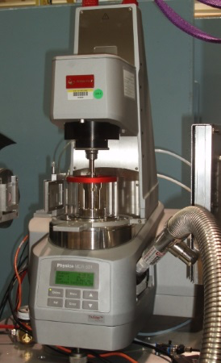
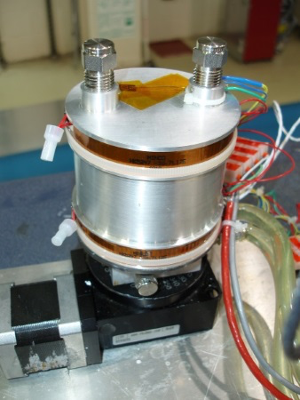
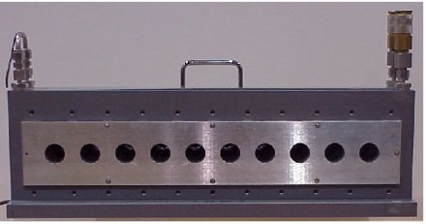
Key Components – Sample Environment
Sample Environment List Established and WU developed
Loki Specific (in baseline)
  Sample Changer ambient >= 50 samples
  Sample Changer -20C < T < 150C >= 50 samples
  Flow cell with HPLC pumps
  Rotating sample holders for sedimenting samples
  Quartz (hellma) cells
SANS Specific – shared with SKADI (not in baseline)
  Humidity Chamber
  Rheometer
  Couette Shear cell
  Plate-plate shear cell
  2T electromagnet
  1T electromagnet
  2D low-field magnet (coils)

Slide 34
Key Components - Software
Phase-2
Detailed Design
Phase-3
Procurement, Construction & Installation
Phase-4
Cold Commissioning
Phase-5
Hot Commissioning
LOKI project
Tollgate 2
Tollgate 3
Tollgate 4
Tollgate 5
2015 | 2016 | 2017 | 2018 | 2019 | 2020 | 2021
CORE Experiment control FW
Bug fixing & Ongoing development
EC.core1
EC.core2
EC.core4
EC.core5
EC.iteration3
DMSC core
development projects
CORE Reduction FW inc VATES Vis
Bug fixing & Ongoing development
LRV.core1
LRV.core3
LRV.core4
EC.Loki1
EC.Loki2
EC.Loki3
EC.Loki4
LOKI Pre operations requirements Spec and cost
LOKI EC specific work
DMSC instrument specific development
Live Reduction SANS development and SANS data analysis (Data analysis group)
LOKI cold Comms
Testing and debug
LOKI Hot Comms
Development of future requirements
LRV.Loki1
LRV.Loki2
LRV.Loki3
LRV.Loki4

Slide 35
Schedule for SANS data analysis software
2014
2015
2016
2017
2018
2019
2020
Hot Commissioning
Reqs.
Dsgn
Iterative Developm.
SANS Core
6 months float
Reqs.
Dsgn
Iterative Develop.
Testing
Int. Tst
LoKI

Slide 36
Data analysis software for SANS
SASView is the preferred data analysis software
  Widely used and supported by many facilities (SNS, NIST, ISIS, ILL, ESS)
  Andrew Jackson is on SASView management board
Requirement and design document completed end of 2015
Software completed and tested 6 months before Cold Commissioning.
First requirement document drafted already – high level requirements
Automated and real-time data analysis requirement determines where major effort will be spent:
  Modularizing SASView and making interoperable
  API and Scriptable Command Line Interface
  Sufficiently fast routines for real-time data analysis

Slide 37
Instrument Layout and Overview

Slide 38
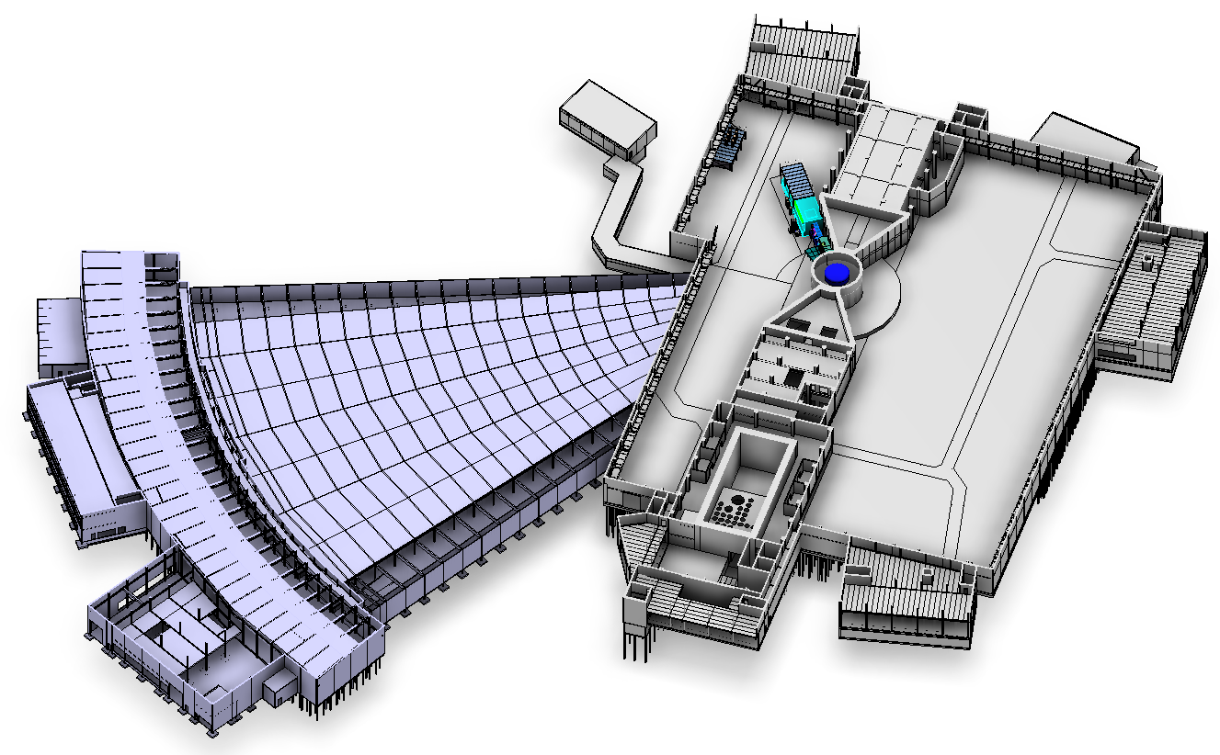
LoKI – Hall two
Floor 2.5 m below Target centerline
Non-magnetic floor
Monolith - bunker: 30 ton/m²
Instrument hall: 20 ton/m²
Guide hall: 20 ton/m²
Notes:
Hall allocation for LoKI instrument in ESS Plant layout, Hall 2, beam allocation TBD, details for the floors access and temporally parking places and people access
Checking external interfaces, floors, doors, crane access, positioning

Slide 39
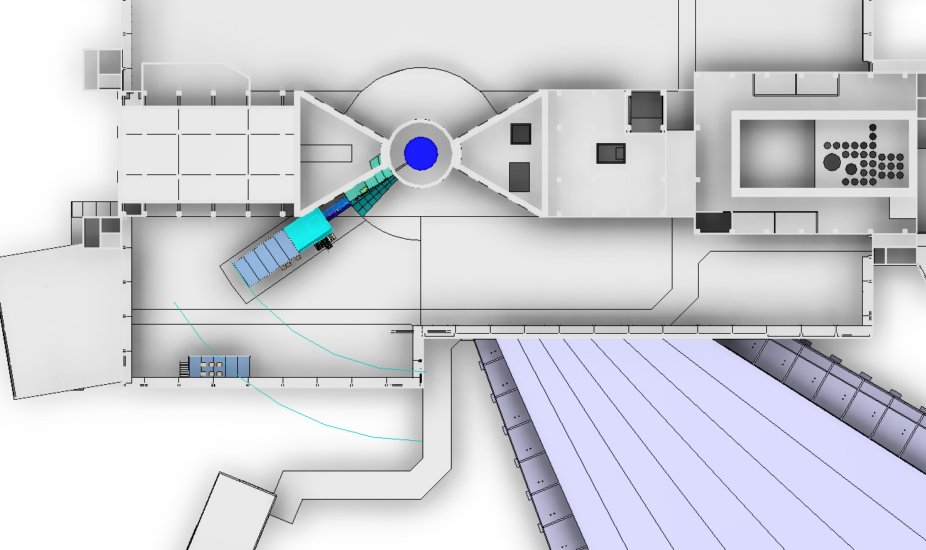
LoKI – Hall two
Notes:
Position for the hutch is flexible. It will be fixed together with the beam allocation, and one time the position is defined is easier to draw the routing for pipes, services and utilities from the gallery to the instrument and to the different components

Slide 40
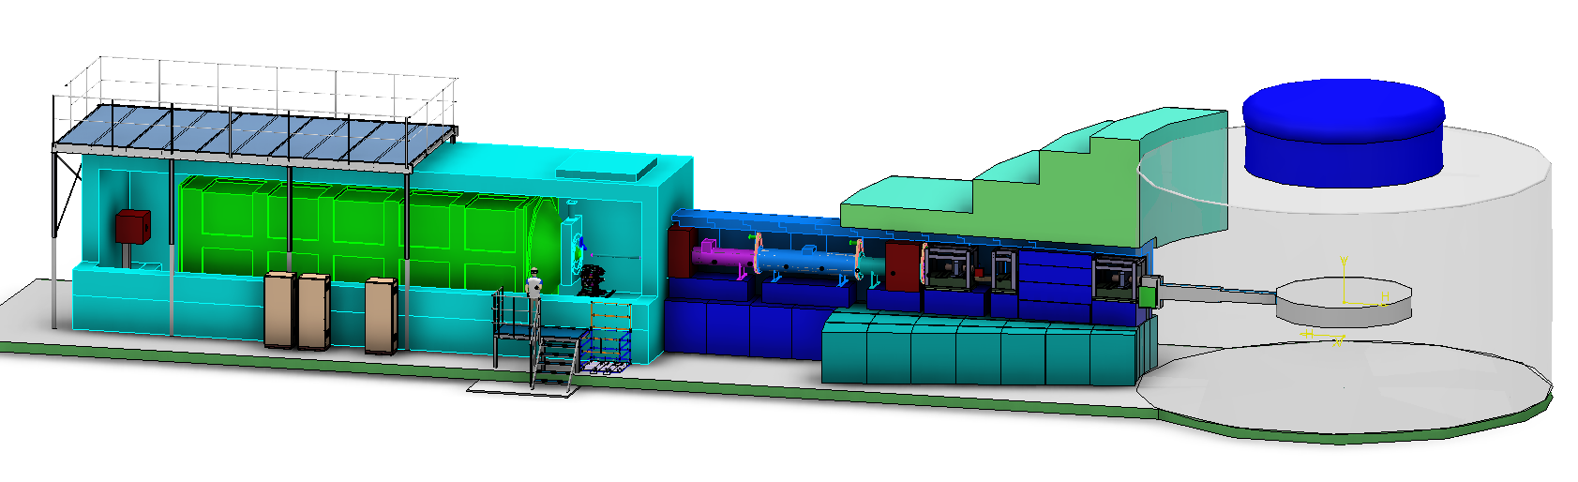
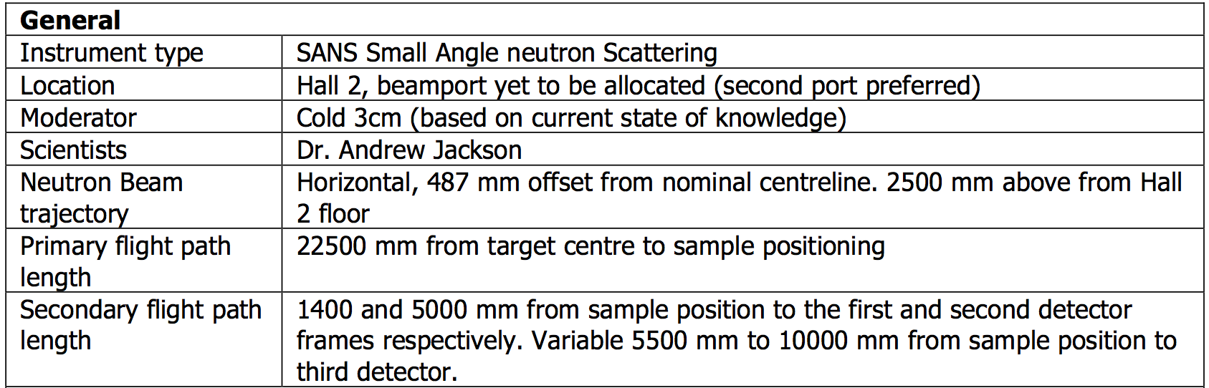
Overview LoKI
Notes:
This sketch illustrate the mayor components of loki and the position with reference to the monolith, the bunker and the floor in the hall 2, we will describe the instrument from source to the end, for the mayor components, giving a general description for the technical solutions that the team has made until now. Marking the references

Slide 41
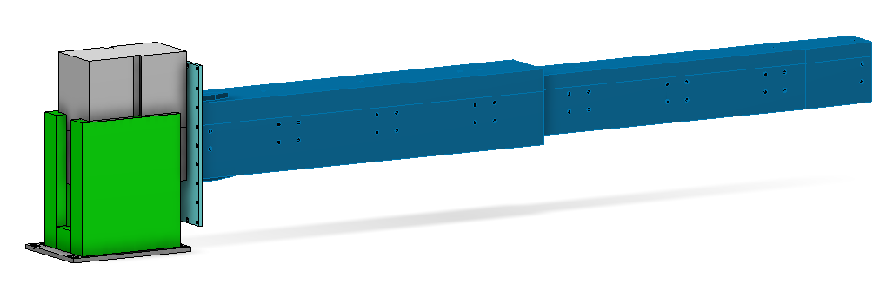
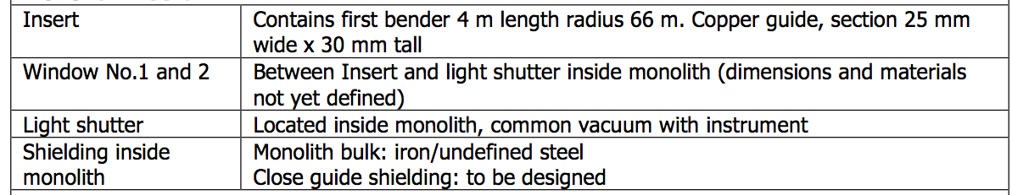
Overview LoKI
Notes:
The first element we will find is the extraction system, conformed by the monolith insert and the light shutter. This is a previous design from Target group who is the team responsible for the extraction. Insert, light shutter and extraction tool. Location for the first bender

Slide 42
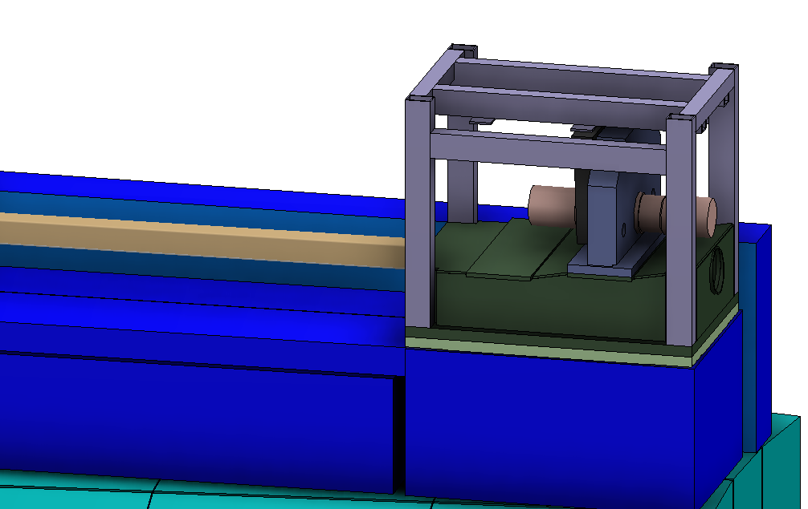
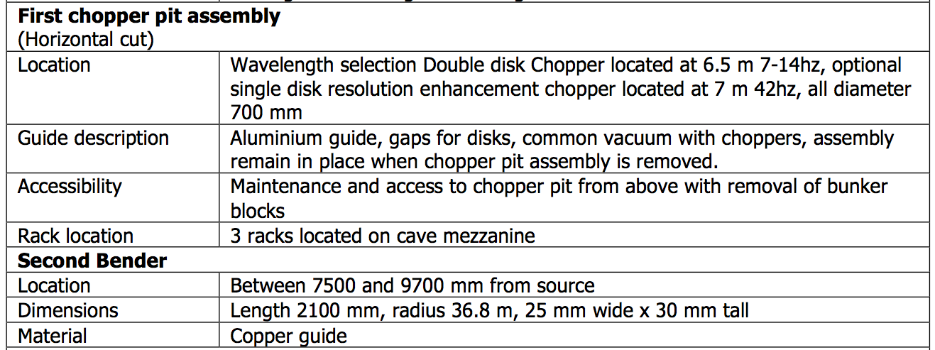
Overview LoKI
Notes:
Beam monitor: in every pit assembly (1 and 3) a beam monitor installed. This is part of the instrument scope of work. They will be used during commissioning and
operation of the instrument. The cabling for the beam monitors can be done through the chopper umbilical.
Common Vacuum: no neutron windows, separating the chopper units to the guides. The enclosure is split horizontally between the guide opening and the rest of the chopper. When
you extract the chopper units the bottom support, containing all optics components, will be left in the pit.
Horizontal or vertical inclination: any case for the guide has implications on the chopper system. It has been considered for the case of need have an angle.
Design:
Choppers system engineering performance and functionality requirements for the instrument.
• Technical specifications and guidelines
• Manufacture, integration and operation of the chopper system.
• Validation of performance and functionality, including measurement campaigns, computer simulation and the manufacture and testing of physical prototypes.
Procurement
• procurement decisions and procedures of the chopper system, components and associate parts
• technical documentation, for the procurements and acceptance testing of components and systems.
• technical specifications, verification and validation plans, test,
and installation & operation manuals.
• Technical discussion with suppliers prior to order placement and during production.
• The selection and validation of potential equipment suppliers.

Slide 43
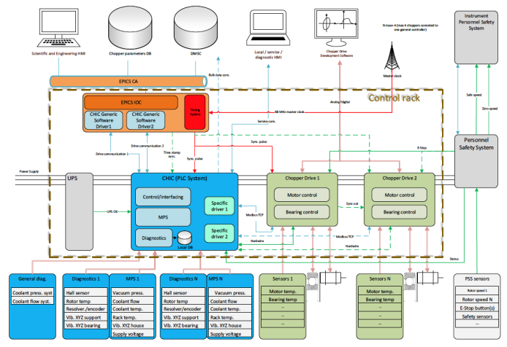
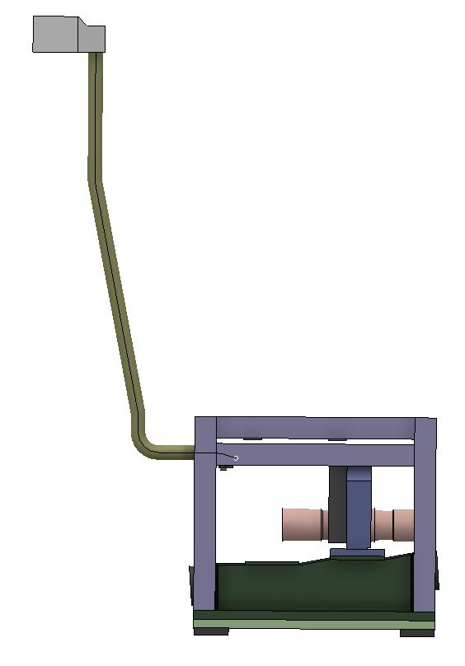
Overview LoKI
Final documents
Deliverables list:
  Pit assembly 1 (double disk chopper)
  Pit assembly 2
  Pit assembly 3 (double disk chopper)
  Control system
  Support system
Technical solution
  Horizontal cut and Common vacuum
  Option for horizontal or vertical inclination
  Pit assembly concept
  Beam monitors
  Control system
  Vacuum pressure 10^-3 mbar.
Functional and Non functional requirements
Planning documents
Budget document
Interface documents
Design
Procurement
Installation
Commissioning
Notes:
Pit assemblies: Chopper assembly, chopper pit, connection to chopper pit head box and chopper pit box
Control System: three chopper standard control racks, with chopper drives, the power electronics, the ICS interface and the CHIC. Cabling from the pit head box to the chopper racks
Design:
Choppers system engineering performance and functionality requirements for the instrument.
• Technical specifications and guidelines
• Manufacture, integration and operation of the chopper system.
• Validation of performance and functionality, including measurement campaigns, computer simulation and the manufacture and testing of physical prototypes.
Procurement
• procurement decisions and procedures of the chopper system, components and associate parts
• technical documentation, for the procurements and acceptance testing of components and systems.
• technical specifications, verification and validation plans, test,
and installation & operation manuals.
• Technical discussion with suppliers prior to order placement and during production.
• The selection and validation of potential equipment suppliers.

Slide 44
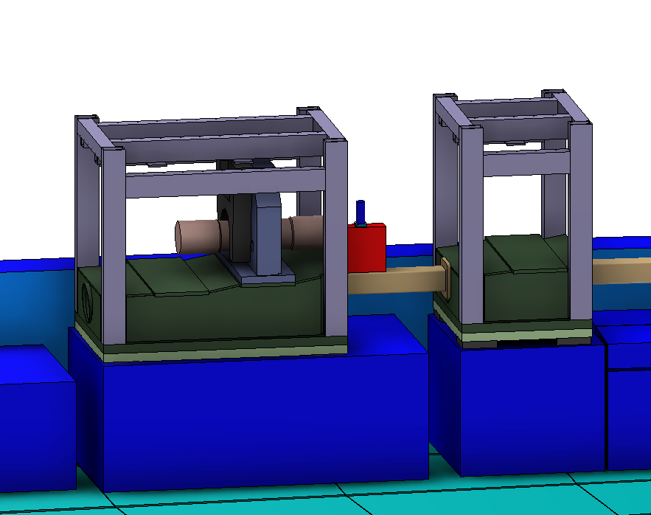
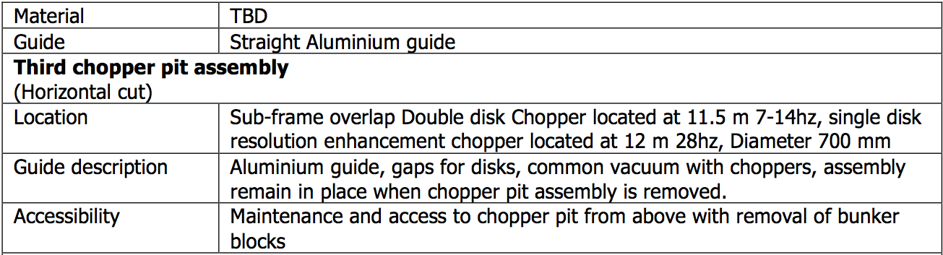
Overview LoKI
Notes:
2 Pit assembly: Single disk resolution enhancement 10 m
3 Pit assembly: Double disc sub frame overlap and simple disc resolution improvement 11.5 and 12
Beam monitor: in every pit assembly (1 and 3) a beam monitor installed. This is part of the instrument scope of work. They will be used during commissioning and
operation of the instrument. The cabling for the beam monitors can be done through the chopper umbilical.
Design:
Choppers system engineering performance and functionality requirements for the instrument.
• Technical specifications and guidelines
• Manufacture, integration and operation of the chopper system.
• Validation of performance and functionality, including measurement campaigns, computer simulation and the manufacture and testing of physical prototypes.
Procurement
• procurement decisions and procedures of the chopper system, components and associate parts
• technical documentation, for the procurements and acceptance testing of components and systems.
• technical specifications, verification and validation plans, test,
and installation & operation manuals.
• Technical discussion with suppliers prior to order placement and during production.
• The selection and validation of potential equipment suppliers.

Slide 45
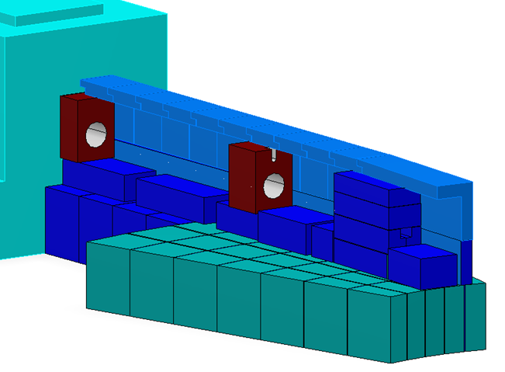

Overview LoKI
Notes:
Mass load calculation
Tight shielding according to the envelope of every instrument after detail design
Design of removable shielding thinking in extraction insert tool,
Choppers pit assembly
Utility and power supplies: cabling, chilled water, piping: vacuum, pressure air (valves)
Adaptation for cables trays and routing of utilities,
Assembly drawings
Adaptation of pss design
Interfaces with Bunker and every component installation ( alignment)

Slide 46



Overview LoKI
Notes:
The aperture collimation system is part of the beam geometry conditioning system and provides a system of interchangeable
apertures to vary divergence of the neutron beam via beam defining apertures placed within the guide collimation system

Slide 47


Overview LoKI
Notes:
Weight cylinder 1 in brass 3.4 Length 2000 diameter 500
Weight cylinder 2 in Al diameter 700 2.1 ton Length 3000
Weight cylinder 3 in brass diameter 500 5.1 ton Length 3000
Different diameter for second cylinder to prevent streaming of fast neutrons along
the gap between the drum and the vacuum vessel and rollers and supports inside the rotating mass.

Slide 48





Slide 49



Overview LoKI
Notes:
building houses the sample exposure system and the scattering characterisation
system and acts to provide structural support and radiation shielding. The radiation shielding
acts both, to protect personnel outside the cave from radiation within and to protect the
scattering characterisation system from radiation coming from outside.
the shielding component is designed to meet ESS radiation protection standards
and the background standards defined in the LoKI requirements documents
Flight tube
Beam monitor and sample alignment laser
The sample positioning
The detector system assembly, including the provision for electronics,
vacuum valve,
Vacuum equipment installations
foundation to vessel vacuum tank.
The beam stop
Sample environment control box
Storage space for tools and light equipment needed to daily operations.
Rails system for equipment mounting
Utility distributions: Power supply, gases, chilled water, compressed air
support infrastructures: Power supply, Network , Lighting, Ventilation, Fire Protection, Local crane, intercom system, Cable Trays

Slide 50



Overview LoKI
Notes:
purposes;
the fist is to support and align with high precision the sample
second is to provide a set of physical and chemical conditions to the sample (magnetic fields, temperature, pressure positive and negative, etc).
The possibility to supply the total set up to give response to a
ll the different requirements from the user is complex and expensive, a standard set of equipment giving the versatility
for most of the experiments is the first solution for the instrument, and additional a standard
interchangeability for equipment must be design in the way the demand can be supplied
sharing equipment in the facility by a group of instruments

Slide 51


Overview LoKI

Slide 52


Overview LoKI
Notes:
The
control hutch is the cabin or space where the user can have access to the data from the
current experiment; it contains the terminals of the LoKI control.

Slide 53
Schedule

Slide 54
Schedule – Phases and Milestones
TG2
TG3
TG4
TG5
2014 |  | 2015 |  | 2016 |  | 2017 |  | 2018 |  | 2019
Phase 1
 |  | 02 Project Management
 |  | 03 Design
 |  |  | 04 Procurement and Fabrication
 |  |  |  |  |  |  | 05 Installation
 |  |  |  |  |  |  |  | 06 Cold Commissioning
2014 |  | 2015 |  | 2016 |  | 2017 |  | 2018 |  | 2019
Detector Geometry Decision
Detectors Installed
Early Procurement Choppers
Choppers Installed
Early Procurement Optics
Shielding Procurement
Optics Installed

Slide 55
Budget, Staging & In-Kind

Slide 56
Budget – Initial Scope
Half detector coverage
Option to install resolution enhancing choppers
Basic suite of SE to enable partner experiments
12.1 M€
 | Cost | Work | FTE
01 Shielding | €1 098 909 | 5480 | 3.04
02 Neutron Optics | €798 603 | 4167 | 2.31
03 Choppers | €876 230 | 6904 | 3.84
04 Sample Environment | €370 508 | 3603 | 2.00
05 Detector and Beam Monitors | €4 198 620 | 30158 | 16.75
06 Data Acquisition and Analysis | €0 | 0 | 0.00
07 Motion Control and Automation | €330 912 | 4187 | 2.33
08 Instrument Specific Technical Equipment | €3 556 533 | 27441 | 15.25
09 Instrument Infrastructure | €796 810 | 3380 | 1.88
10 Vacuum | €0 | 0 | 0.00
11 PSS | €114 640 | 800 | 0.44
Total | €12 141 765 | 86121 | 47.84
Spend Profile

Slide 57
Staging : Initial to Full Scope
The additional fit out of the remaining detector coverage, as foreseen in the full scope, would cost approximately 1.5 M€ on the assumption that while detectors would be cheaper by then, there would be additional manpower costs for restarting work. This could be paid for from a combination of operations budget and/or external grants.
Adding the resolution choppers would cost around 400 k€ and is something that we could envisage obtaining from external funding.
Sample environment would be paid for from an on-going programme using a combination of operations funds, external grants and collaborations with users.

Slide 58
In-Kind
Key partner : ESS Bilbao
  Labour : 2nd engineer and drafting support
  Mechanical components:
    Detector vacuum vessel
    Collimation and Aperture changers
Key Partner : Italy
  Detectors : 90% of hardware in-kind

