Slide 1
Interfaces, Engineering and Standards

Slide 2
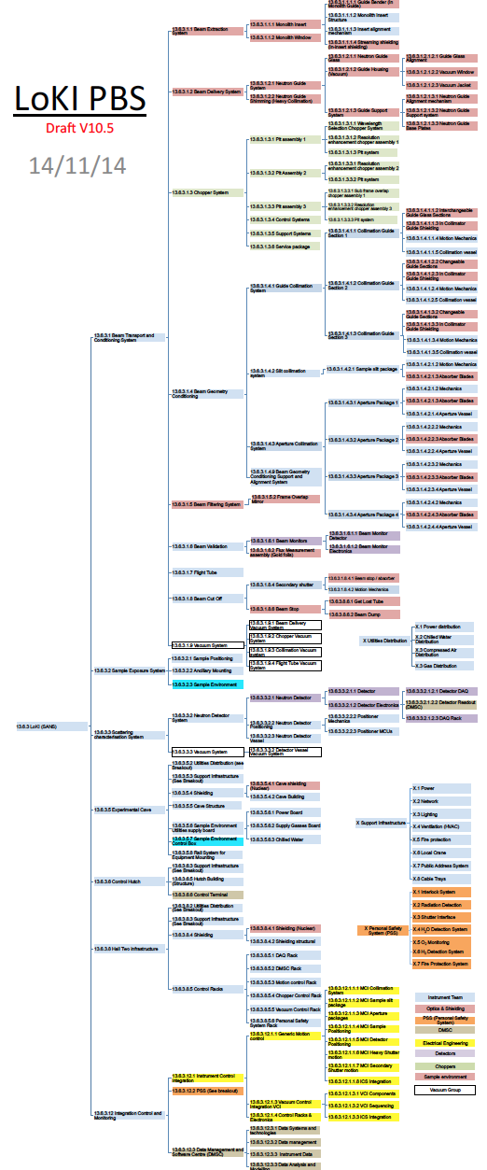
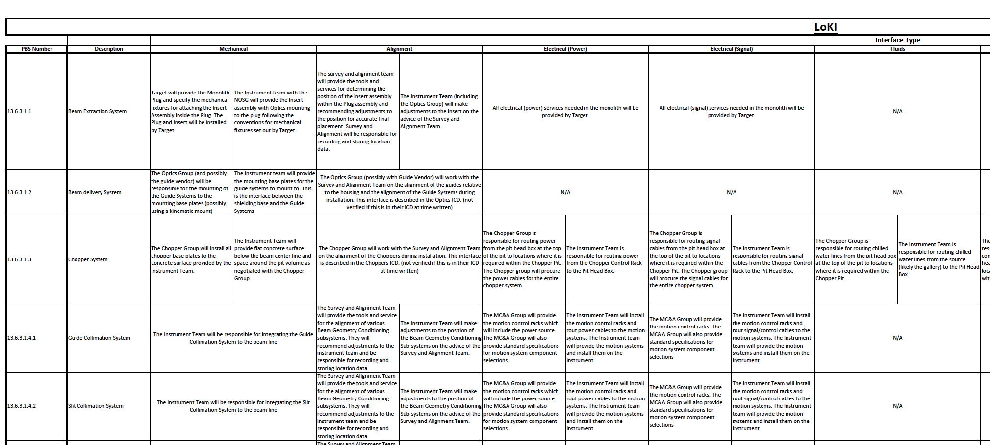
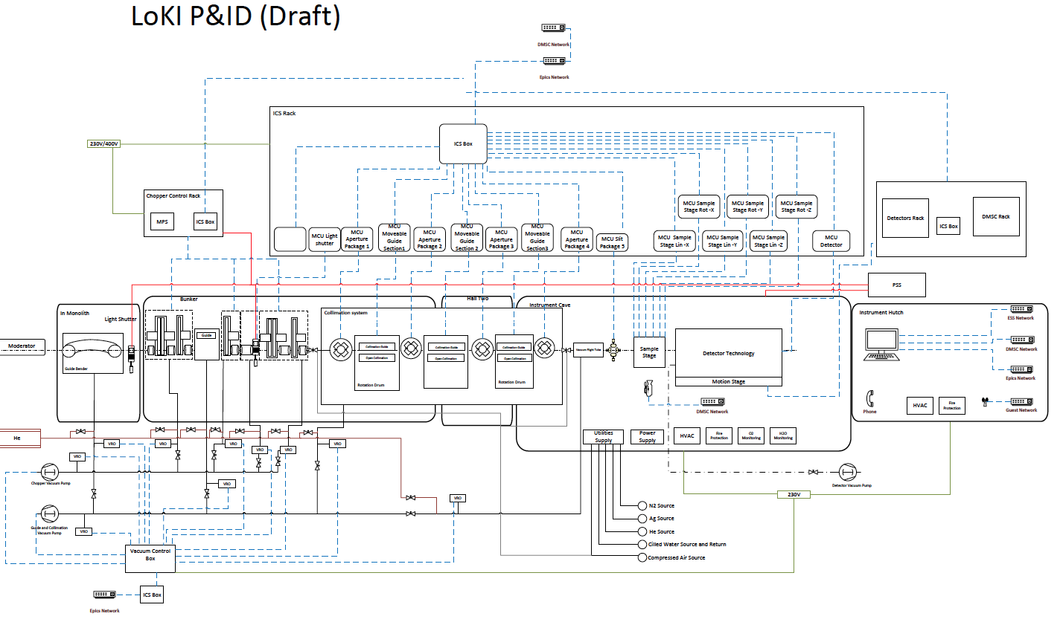
Interfaces LoKI
Interface document description for deliverables
Elements: PBS number, Deliverable description, Type interface: mechanical, alignment, electrical power or signal, fluids, gases, vacuum, PSS, software
CAD Interface management ESS-0000717
Interface matrix

Slide 3
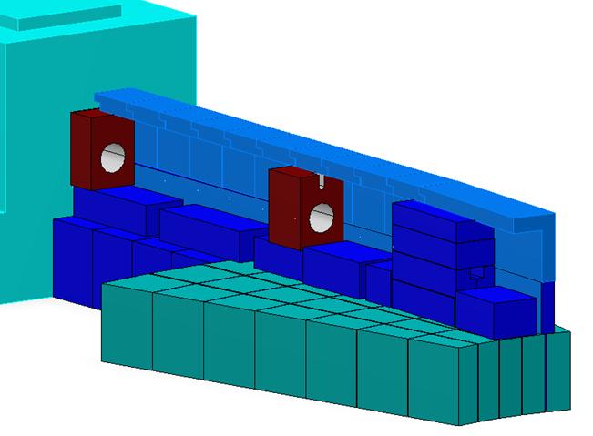
Interfaces LoKI
Example:
PBS number: 13.6.3.8.4.2
Deliverable description: Shielding Structural hall 2
Type interface:
Mechanical
Alignment
Electrical power
Electrical signal
Fluids
Vacuum connections
Gasses
PSS
Software
Notes:
The Survey and Alignment Team will provide the tools and service for the positioning of the shielding components. They will recommend adjustments to the instrument tea be responsible for recording and storing location data
Mechanical: Integration by Instrument team: nuclear requirements (radiation flows), bunker dimensioning, mass loads, space restrictions, tight shielding to components dimensioning
Alignment: Support from SAG for tools and positioning (storing data location), Instrument team will do the positioning according to their recommendations
Electrical power/signal, Fluids, vacuum connections and Gasses: Instrument team is responsible for procurement, routing paths and installation of cable trays, piping gasses and chilled water from the source to every component for the instrument in hall 2
PSS: PSS Group responsible for hardware needs design and instrument team will adapt shielding to integrate the system designed.
Software: N/A
Integration: routing pipes, cabling and supports. Installation assembly drawings. Availability of crane and storage.

Slide 4
Engineering LoKI
Design process and control ESS-0002411
DESIGN PROCESS
1 Statutory and Regulatory Requirements
2 Safety Requirements
3 Concept, Basic and Detailed design
4 Documentation Requirements
Engineering Design Specification
Engineering Drawing
5. Design Control
6. Design Changes
Instrument
Commissioning
Requirements
Validation plan
System design
System testing
Integration and verification
Decomposition and definition
Components design
Component Testing
Manufacturing
Notes:
5.1 The codes, standards and practices used for dimensioning the product,
5.2 Safety Requirements
requires a safety assessment, ESS Health and Safety team
should carry out the assessment/review early enough in the design
5.3 Concept, basic and detailed design
transfer of conceptual requirements into an Engineering
Design Specification (EDS). then detailed design. Engineering, engineering
specifications, procurement documentation, manufacturing and manufacturing verification
instructions.
Manufacturing verification procedures and
methodologies are prepared. These should cover acceptance verification that will be
performed at the supplier’s/manufacturing facilities, Factory Acceptance Tests (FAT) and Site
Acceptance Tests (SAT).
5.4 Documentation Requirements
5.4.1 Engineering Design Specification: Functional Requirements, Interface Control Document
Design Description (System Design Description) Calculations, sketches,
5.4.2 Engineering Drawing
6. DESIGN CONTROL
Performing design reviews at various stages of the design process ensures formal design
control.
7. DESIGN CHANGES
A formal Engineering Change Request (ECR) is required to initiate a revision of a design
when that design has already been released for procurement/production.

Slide 5
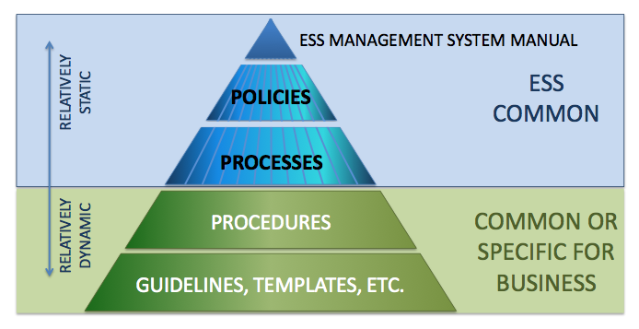
Technical standards ESS
ESS Management System Manual ESS-0008201
ISO 9000-2005, Quality Management Systems - Vocabulary.
ISO 9001-2008, Quality Management Systems - Requirements
ISO 9004-2000, Quality Management Systems - Guidelines for performance Improvements
ISO 14001-2004, Environmental management systems
Notes:
A policy tells that we have an intention to achieve something
A process tells what we do within a concerned area.
A procedure tells how we do within a concerned area
A guideline is a statement by which to determine a course of action
A template is a predefined document structure to be reused over and over again.
Environmental survey (PROJECT INVESTIGATION, with aspects that ess must fulfil within environment ESS-0001136 rev 2 FINAL

Slide 6
Standards ESS
ESS Management System Manual ESS-0008201
1 - General Requirements for ESSMS
2 - Management Commitment
3 - Resource Management
4 - Product Realization
5 - Emergency Preparedness and Response
6 - Measurement, Analysis and Improvement
ESS-00000126 Quality management policy
ESS-00001516 Recommendation Standards and Norms Environment, Safety & Health:
ESS-0000004 ESS General Safety Objective
ESS-0019190 ESS Policy for safety, health and security
ESS-0008351 Hands on maintenance conditions
ESS-0003520 ESS Radiation Protection Strategies for Employees
ESS-0001786 Radiation zoning
ESS-0005388 ESS Environment, Safety & Health (ESH) Plan
ESS-0000058 ESS Environmental Objectives
ESS-00001136 Environmental Survey
ESS-00008309 ESS event categories
ESS-00004020 Waste management Plan for the ESS facility
ESS-00003144/5 ESS Preliminary waste management plan
ESS-00003740 Transport of radwaste from ESS
ESS-00016468 ESS rule for identification and classification of safety important components
ESS-0002411 Mechanical engineering design procedure
ESS-0001879 Change control process
ESS-0002639 Checklist specifying design steps
ESS-0002955 Engineering drawing standards Manual
ESS-0018828 Official permit from SSM (the Swedish Radiation Safety Authority) regarding construction of ESS
ESS-0002908 Systems engineering management plan
IEC 61508 International Electro technical Commission Functional safety of electrical/electronic/ programmable electronic safety-related systems
Notes:
1. General requirements:
General requirements:, documentation, language, control de documents, control of records,
2. Management commitment: , Stakeholder focus, Policies, Planning: Environmental aspects, legal aspects. Objectives, targets and programmes, responsibility and authority, management representative, internal and external communication, management review,
3. Resource management: Provision of resources, Human resources, Competence, awareness and training, infrastructure, work environment
4- Product realization : . Due to the complexity and size of the facility ESS AB has chosen to apply the Systems Engineering approach to manage these challenges.
Planning of product realization
Stakeholder-related processes
Review of requirements related to the product
Stakeholder communication
Design and Development
Purchasing and In Kind contributions
Production and Service Provision: control of operations, validation, identification and traceability
5 - EMERGENCY PREPAREDNESS AND RESPONSE
6 - MEASUREMENT, ANALYSIS AND IMPROVEMENT
Monitoring and measurement, Internal audits, Monitoring and measurement of product, Control of monitoring and measuring equipment, Control of Nonconformity, Analysis and improvement

Slide 7
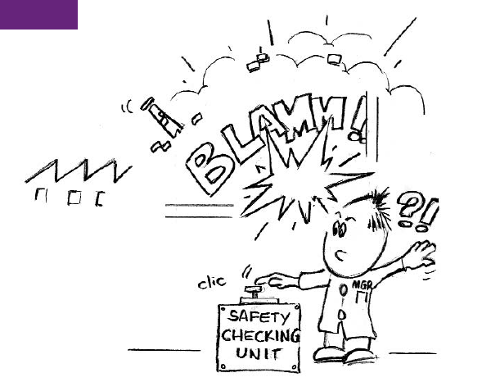
Personnel Safety System(PSS)
13.6.3.12.2 PSS Deliverable
Interlock System
Radiation Detection
Shutter Interface
H₂ O Detection System
O₂ Monitoring
H₂ Detection System
Fire Protection System
Primary focus:
Worker safety and environment
Individual set up for every instrument
Appropriate search routines for controlled areas
Lock doors to controlled areas
Notes:
The PSS is an independent system built on. It manages access to restricted areas and surveys radiation levels. It prevents people to get a radiation dose higher than the limits given by the law.
Interlock systems for restricted areas
I E C 6 15 0 8, Functional safety of electrical/ electronic/programmable electronic safety-related systems

