Slide 1
Budget Breakdowns

Slide 2
LoKI – Labour Costs
 | Cost | Work (hrs) | Work (FTE)
Admin Assistant | €57 840.00 | 1 446 | 0.8
Admin Officer | €115 020.00 | 2 396.23 | 1.3
Consultant C1 | €57 120.00 | 840 | 0.5
Craftsman | €234 624.00 | 4 888 | 2.7
Engineer | €1 297 056.00 | 21 617.60 | 12.0
Junior Engineer | €370 330.00 | 7 715.20 | 4.3
Scientist | €992 284.00 | 16 538.07 | 9.2
Senior Engineer | €848 847.00 | 11 023.98 | 6.1
Senior Scientist | €17 710.00 | 230 | 0.1
Technician | €932 435.00 | 19 425.72 | 10.8
Total | €4 923 266.00 | 86 121 | 47.8

Slide 3
LoKI –Non-Labour Costs
 | Cost
Fixed Costs | €350 000.00
Chopper Costs | €511 000.00
MCA Costs | €84 000.00
Travel Costs | €50 000.00
Detector Costs | €2 546 000.00
Optics Costs | €402 000.00
Shielding Costs | €305 000.00
PSS Costs | €60 000.00
SE Costs | €155 000.00
Minor Equipment Costs < 50k | €575 500.00
Equipment Costs > 50k | €730 000.00
Major Equipment Costs > 200k | €1 450 000.00
Total | €7 218 500.00

Slide 4
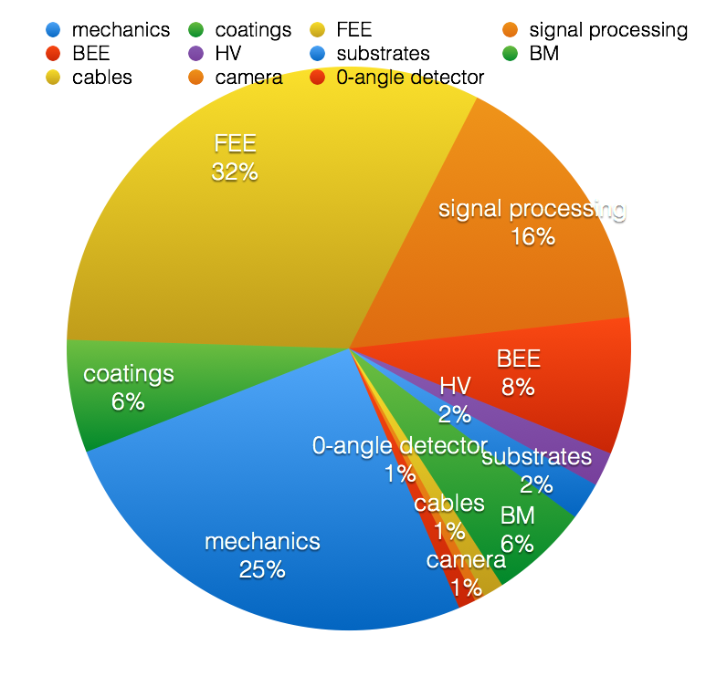
Detectors
 | Labour | Non-labour
Front Panel | €502 618 | €162 250
Middle Panel | €502 618 | €794 000
Rear Panel | €510 318 | €554 000
Beam Monitors | €93 600 | €159 000

Slide 5
Choppers

Slide 6
Instrument Team
 | Labour | Non-Labour | Total
13.6.3.0 LoKI Integration | 932974 | 100000 | 1032974
13.6.3.1.4.1 Guide Collimation System | 291709 | 150000 | 441709
13.6.3.1.4.2 Slit Collimation System | 6912 | 10000 | 16912
13.6.3.1.4.3 Aperture Collimation System | 72705 | 120000 | 192705
13.6.3.1.4.9 Beam Geometry Conditioning Support and Alignment System | 22677 | 30000 | 52677
13.6.3.1.7 Flight Tube | 8026 | 30000 | 38026
13.6.3.1.8.4 Secondary Shutter | 14087 | 30000 | 44087
13.6.3.2 Sample Exposure System | 31455 | 185000 | 216455
13.6.3.3.2 Neutron Detector System | 39494 | 800000 | 839494
13.6.3.5 Experimental Cave | 359945 | 958000 | 1317945
13.6.3.6 Control Hutch | 50000 | 76500 | 126500
13.6.3.8 Hall Two Infrastructure | 314038 | 469000 | 783038

