Slide 1
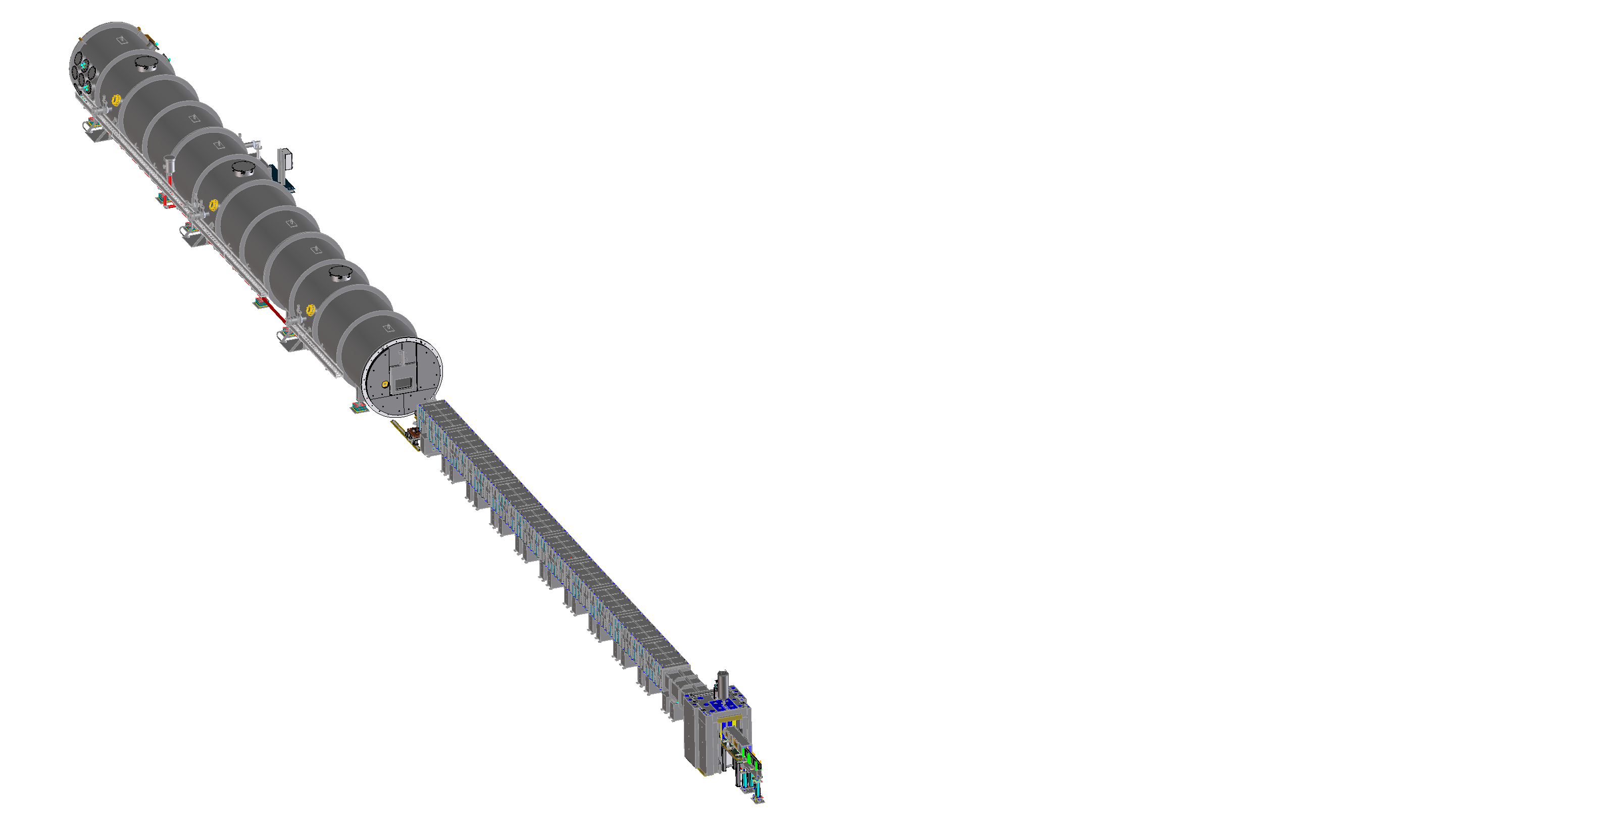
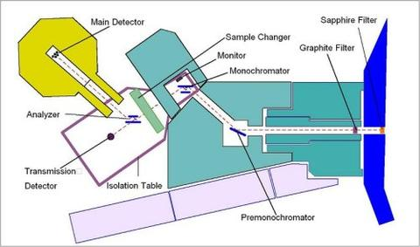
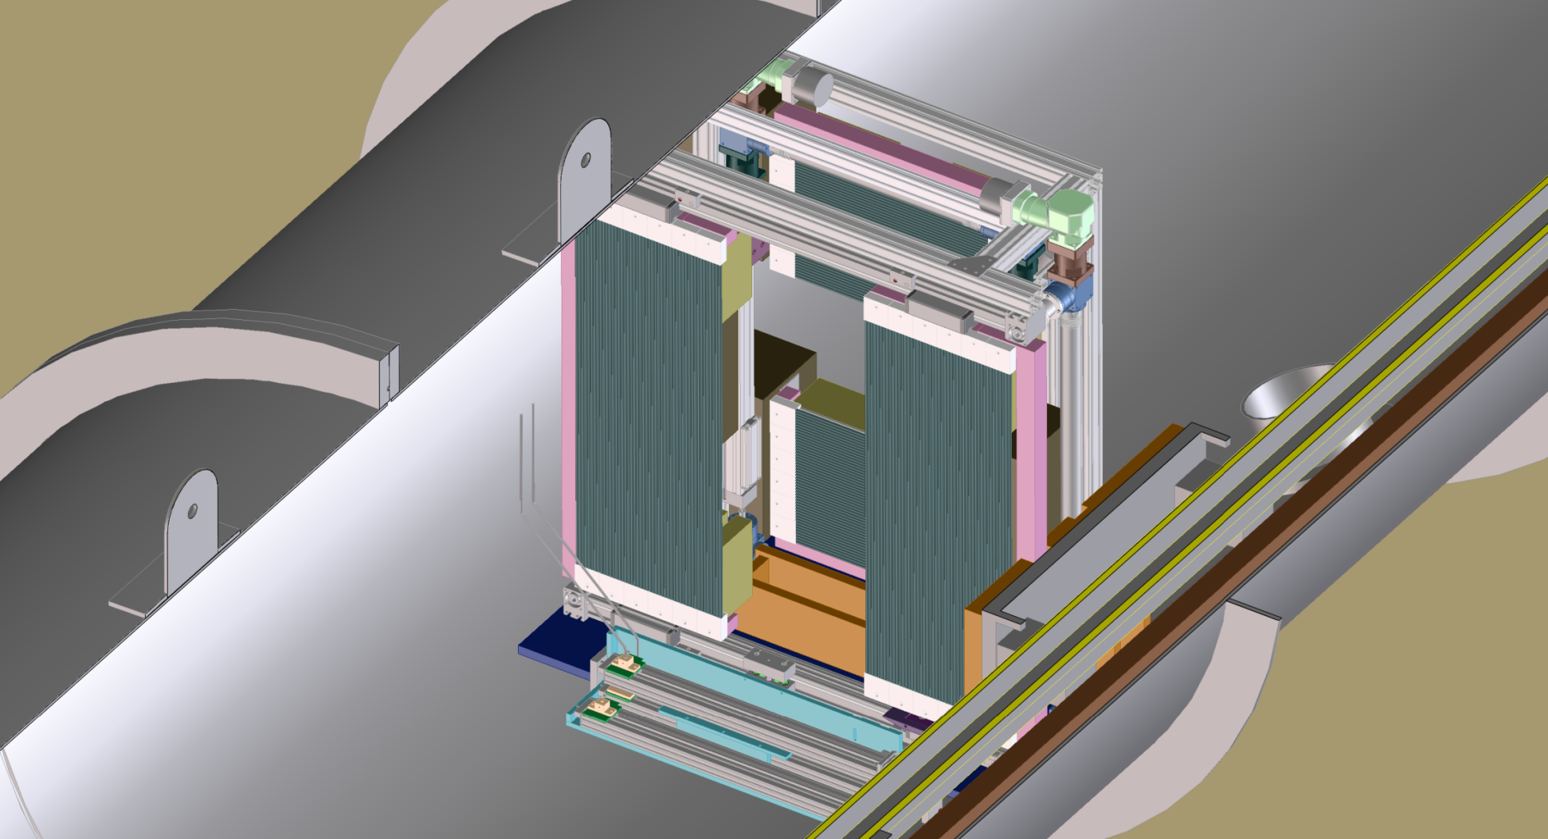
Narrow Slit Smearing on
Bonse Hart & vSANS at NIST
March 26th, 2021
John Barker
NIST Center for Neutron Research
Gaithersburg, Maryland
Notes:
Fig. 1
Very Small Neutron Scattering Instrument

Slide 2
Rectangular Slit Smearing: two slit case
Detector
Column
Simplifying assumptions:
Uniform source flux
Uniform detector efficiency
All rectangular: Source, Sample & Detector
Sample slit located at sample
“0D” Detector slit or column of 2D Detector
2D Weighting Function = “Source” * “Sample” * “Detector Element”
P(x,y) = P_{W}(x) P_{L}(y) = “Beam Profile” * “Detector Element”
{ Section along width P_{W}(x) & length P_{L}(y) }
Sample
Beam
Source
2D Detector
For Kratky Camera and more general cases:
Hendricks & Schmidt (1967). Acta Physica Austriaca 26, 97-121

Slide 3
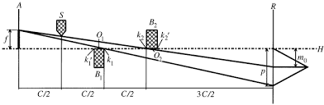
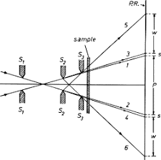
More Complicated Cases
Kratky
Camera
Three Slit
Camera
Same as two slit case, third slit
Does not define beam.
Sample is not at 2nd slit.

Slide 4
Convolution of source and sample slits
Source Slit size: X₁ x Y₁ L₁ → source to sample distance
Sample Slit size: X₂ x Y₂ L₂ → sample to detector distance
Detector size: X_{D} x Y_{D}
Beam Profile→ Trapezoidal
Width: ΔX_{U} = | X₁ L₂/L₁ – X₂ (L₁ + L₂) /L₁ |
ΔX_{L} = X₁ L₂/L₁ + X₂ (L₁ + L₂) /L₁
Height: ΔY_{U} = | Y₁ L₂/L₁ – Y₂ (L₁ + L₂) /L₁ |
ΔY_{L} = Y₁ L₂/L₁ + Y₂ (L₁ + L₂) /L₁
Projected slit sizes:
Source Sample Detector
L₂/L₁
(L₁+L₂)/L₁
ΔX_{U}
ΔY_{U}
ΔX_{L}
ΔY_{L}

Slide 5
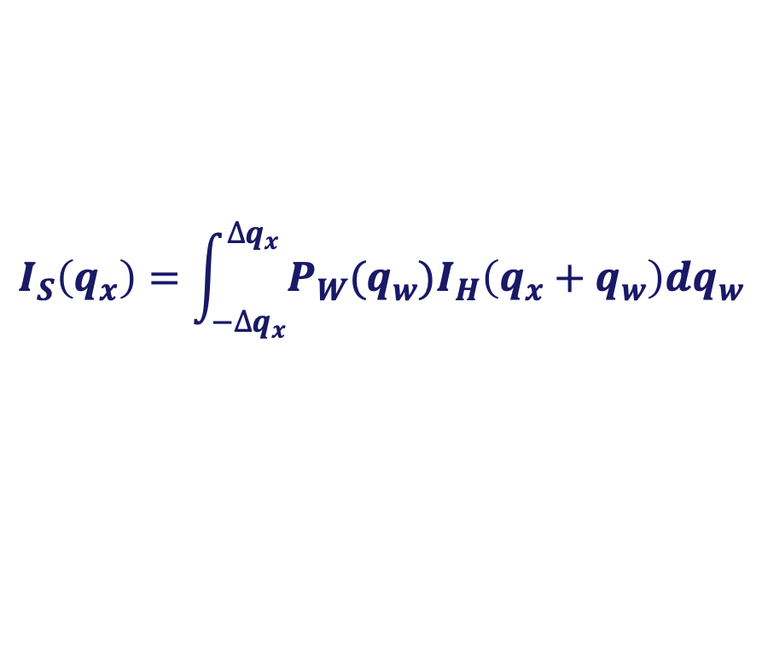
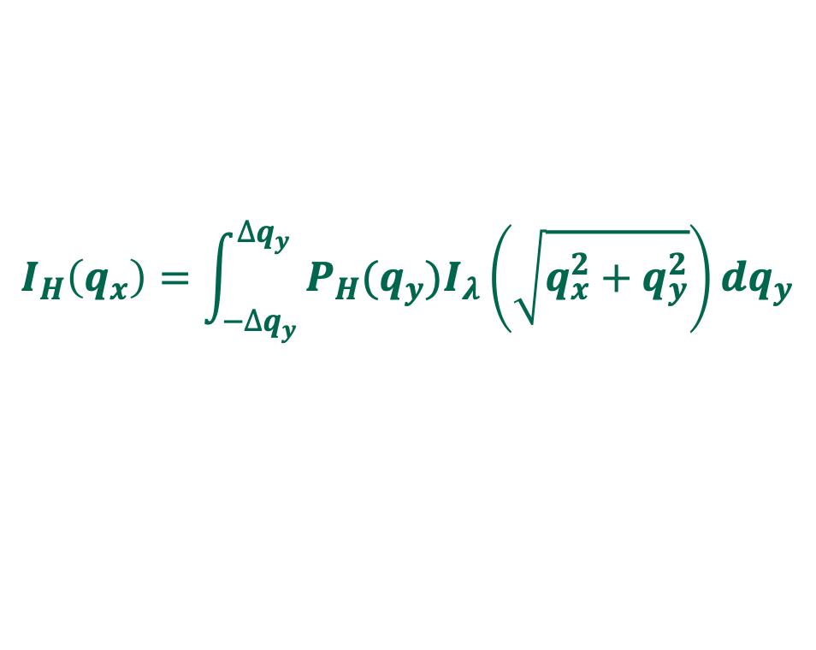
$$I_{H}\left(q_{x}\right)=\int_{{−∆q}_{y}}^{{∆q}_{y}}{P_{H}(q_{y})I_{λ}\left(\sqrt{q_{x}^{2}+q_{y}^{2}}\right)dq_{y}}$$
Weighting
Function
q_{y}
q_{x}
$$I_{S}\left(q_{x}\right)=\int_{−∆q_{x}}^{∆q_{x}}{P_{W}(q_{w})I_{H}\left(q_{x}+q_{w}\right)dq_{w}}$$

Slide 6
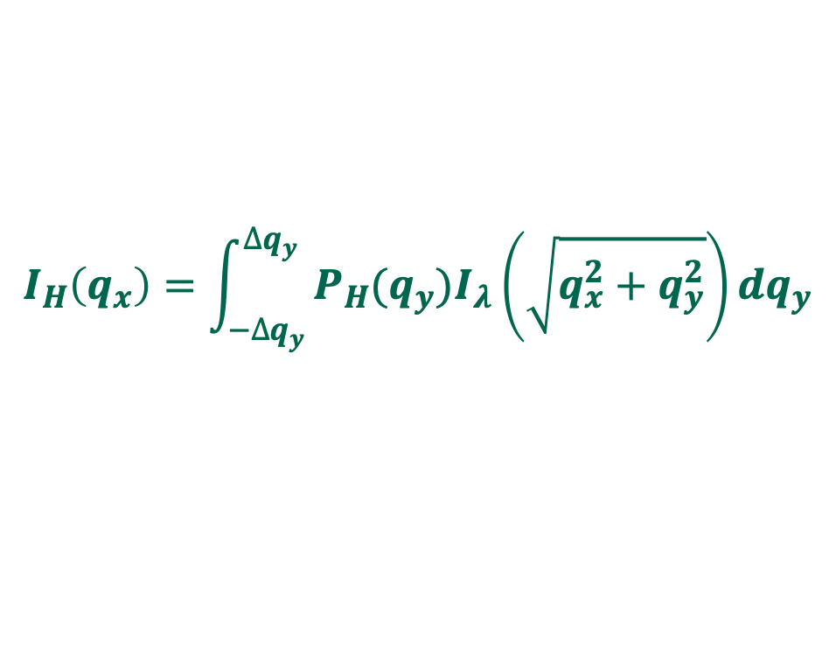
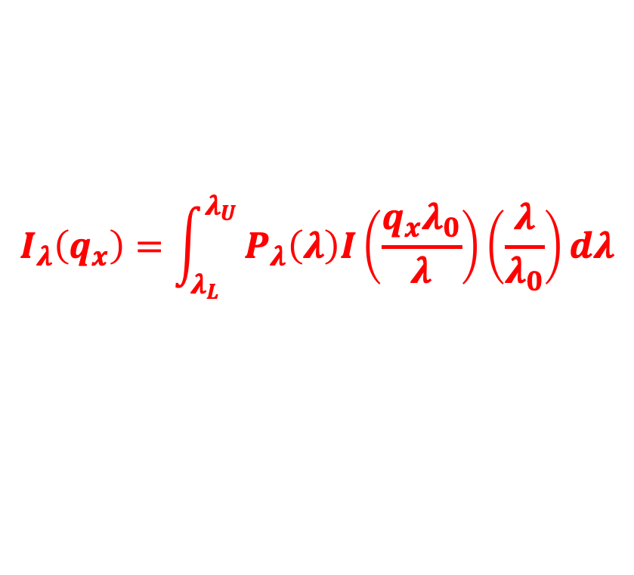
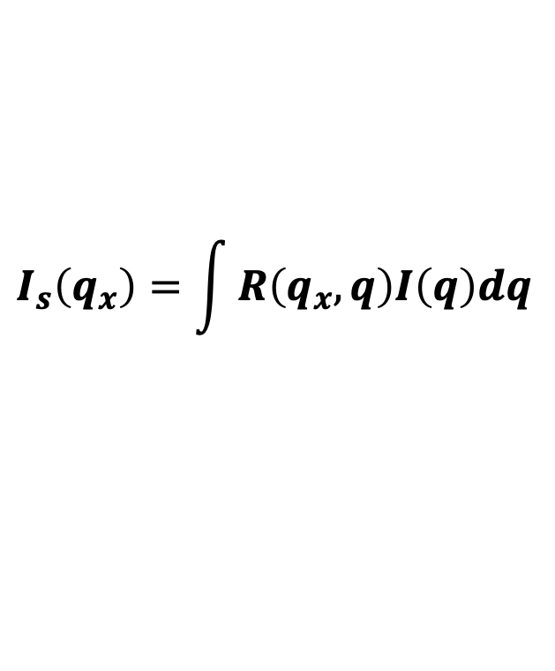
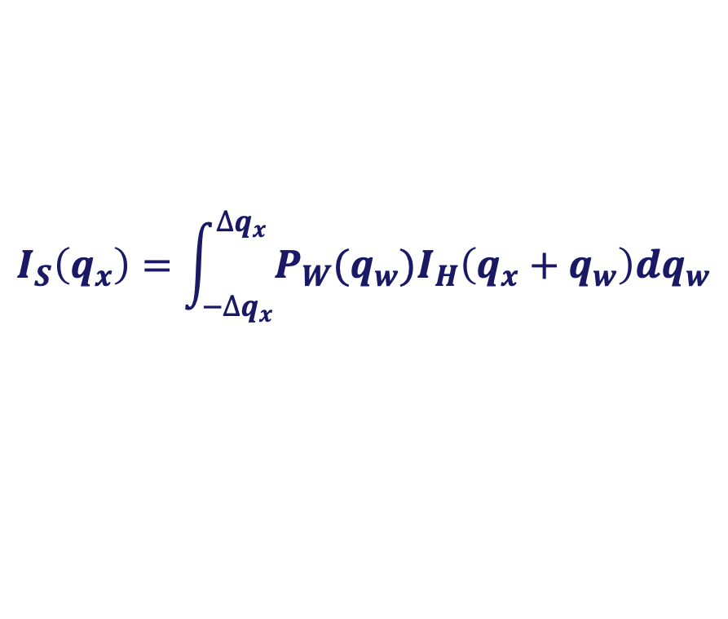
Smear sequentially: 1) wavelength, 2) height & 3) width
$$I_{λ}\left(q_{x}\right)=\int_{λ_{L}}^{λ_{U}}{P_{λ}\left(λ\right)I\left(\frac{q_{x}λ_{0}}{λ}\right)\left(\frac{λ}{λ_{0}}\right)dλ}$$
{ Wavelength }
$$I_{H}\left(q_{x}\right)=\int_{{−∆q}_{y}}^{{∆q}_{y}}{P_{H}(q_{y})I_{λ}\left(\sqrt{q_{x}^{2}+q_{y}^{2}}\right)dq_{y}}$$
{ Slit-Height }
$$I_{S}\left(q_{x}\right)=\int_{−∆q_{x}}^{∆q_{x}}{P_{W}(q_{w})I_{H}\left(q_{x}+q_{w}\right)dq_{w}}$$
{ Slit-Width }
Can also Combine into single “2D” Resolution Function
$$I_{s}\left(q_{x}\right)=\int{R\left(q_{x},q\right)I\left(q\right)dq}$$

Slide 7
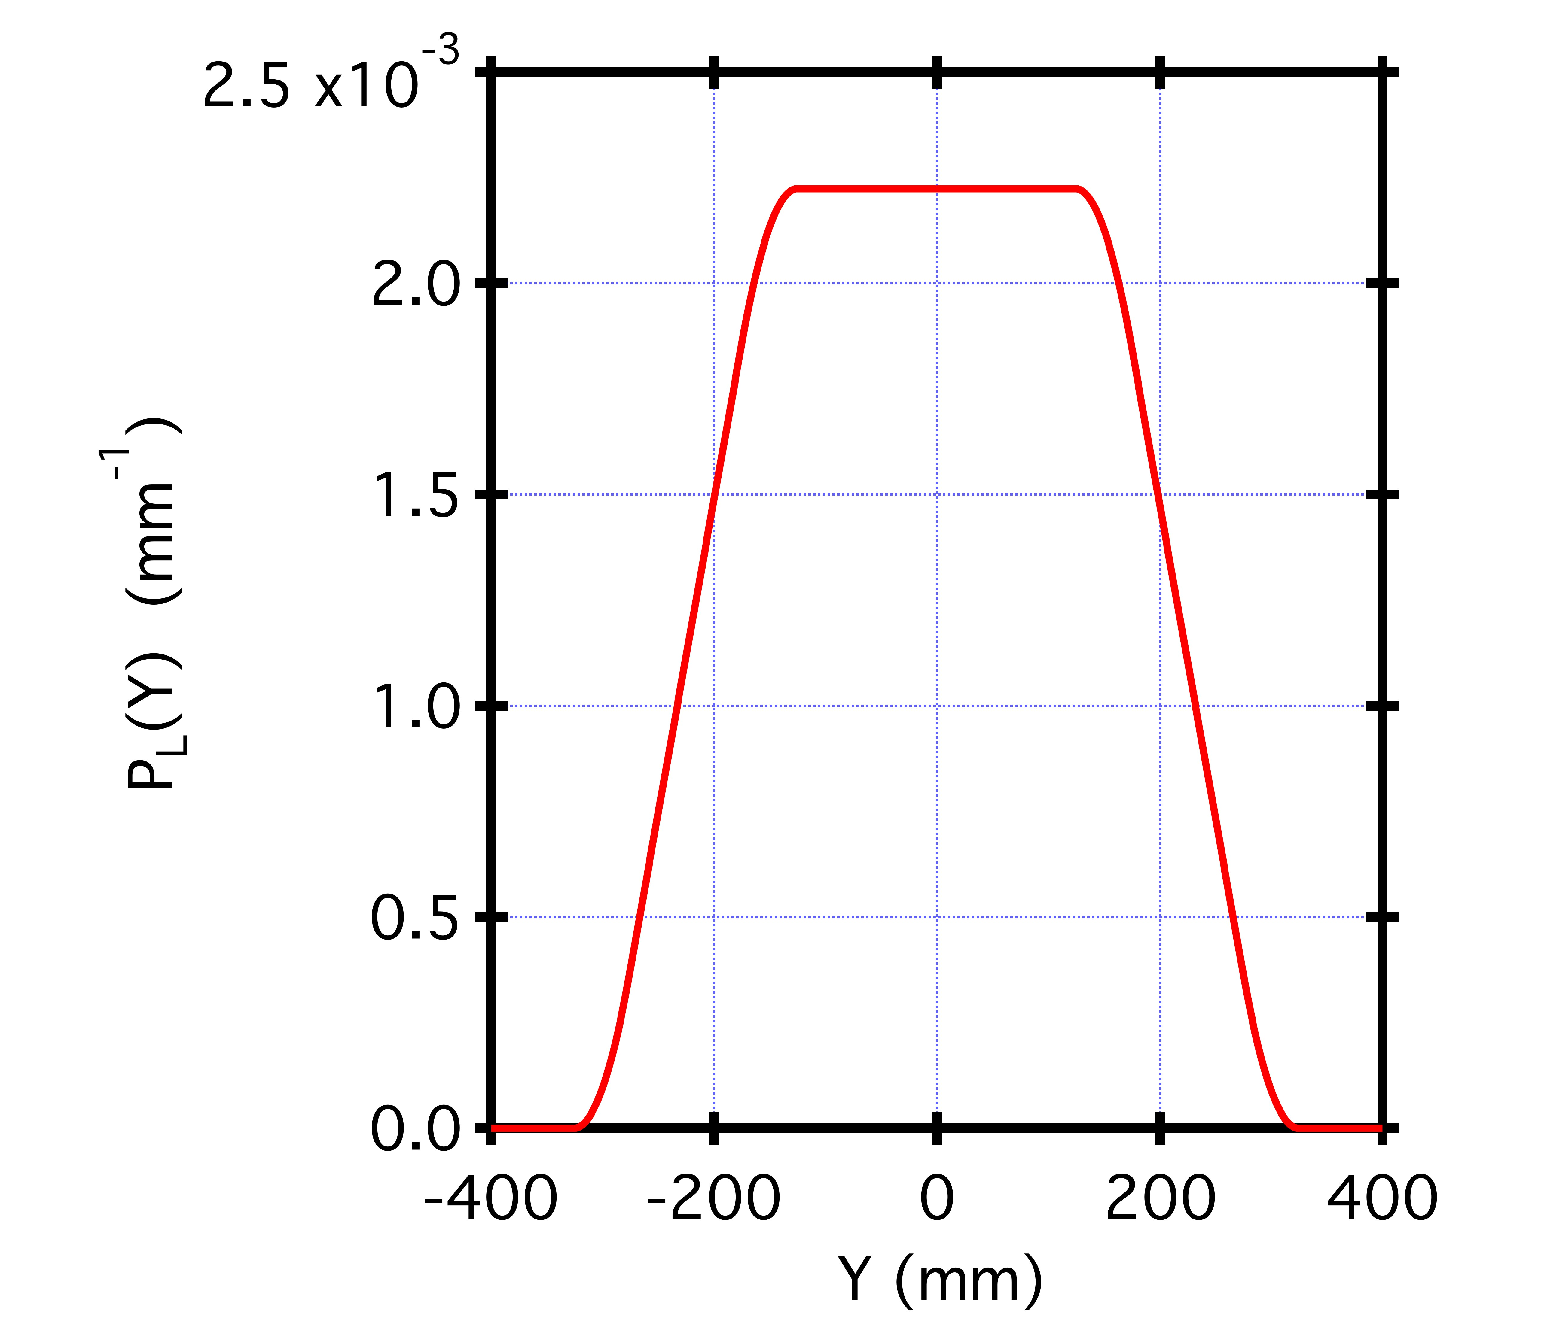
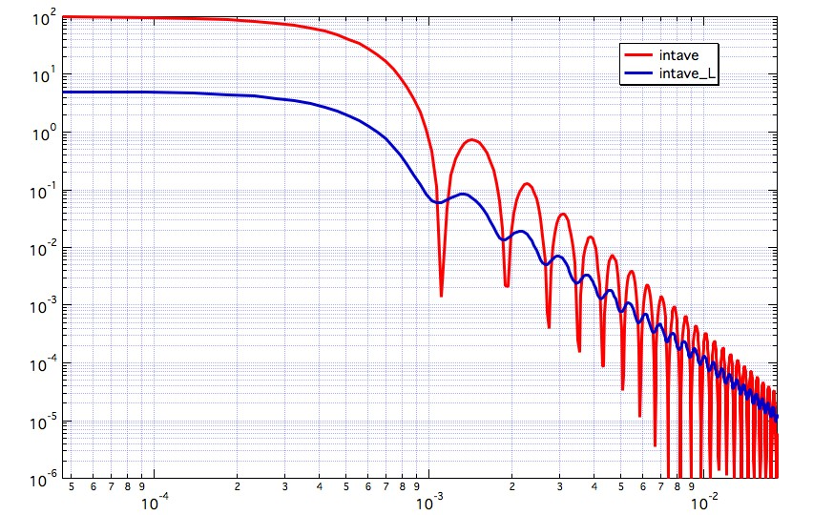
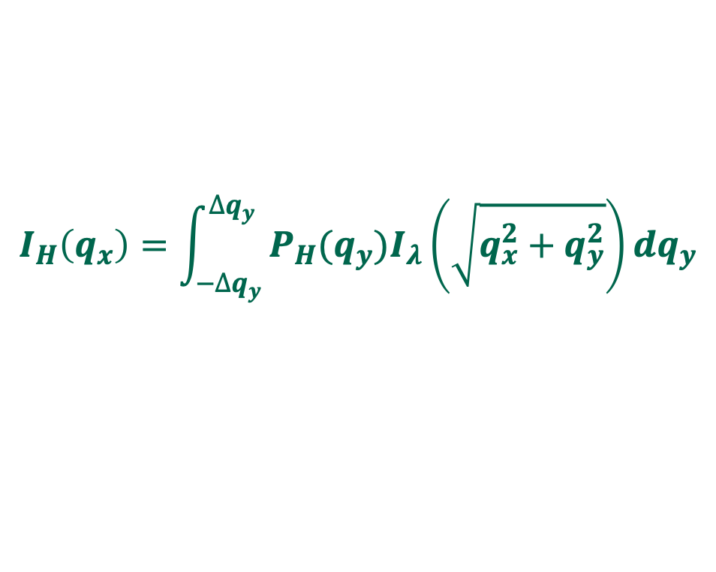
Slit Height Function
VSANS Narrow slits Option
Source: 150 mm x 2.5 mm L₁ = L₂ = 24 m
Sample: 25 mm x 1.25 mm width ≈ Height / 100
Detector: 450 mm x 0.3 mm → see graph →
$$I_{H}\left(q_{x}\right)=\int_{{−∆q}_{y}}^{{∆q}_{y}}{P_{H}(q_{y})I_{λ}\left(\sqrt{q_{x}^{2}+q_{y}^{2}}\right)dq_{y}}$$
Spherical Particles:
5,000 Å radius
{ ignoring wavelength smearing }
Slit Smeared

Slide 8
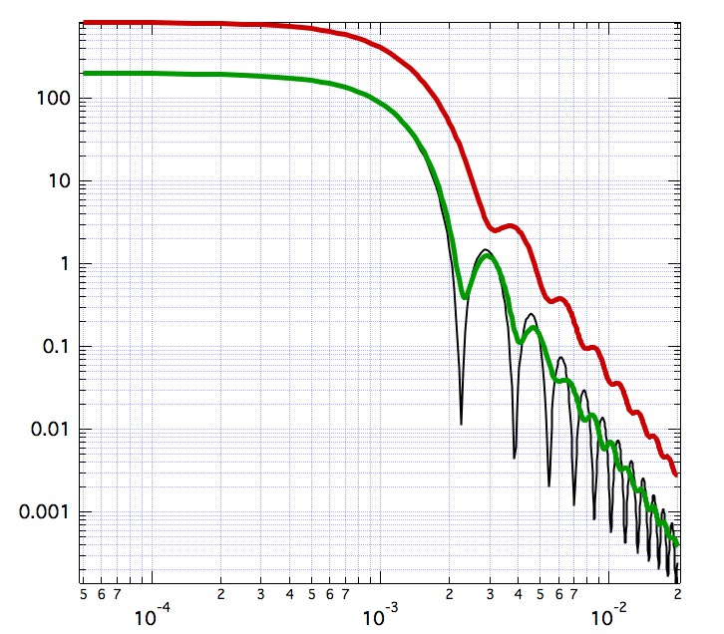
“White Beam Option”
• Beryllium filter cuts λ < 4 Å
• Cut-off Mirror cuts λ > 8 Å
Gain of factor 5 but with
Additional smearing …
NVS Δλ/λ = 12.5%
“White Beam”
4 Å ≤ λ ≤ 8 Å
Graphite
Monochromator
Δλ/λ = 2 %

Slide 10
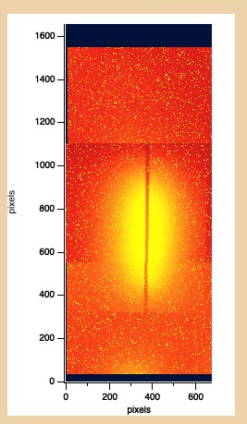
Scattering from Teflon
Beamstop: 6 mm x 300 mm
Detector: 150 mm x 450 mm
Raw CCD image
{ Read bias and speckles not
Removed }

Slide 11
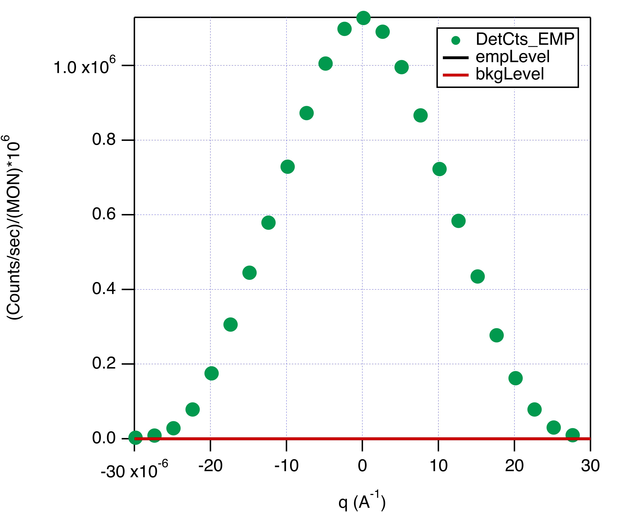
Neutron Bonse-Hart Calculation (USANS Instrument)
Wavelength Spread Δ_{ƛ}/ƛ = 6% { Ignore wavelength smearing…}
Width ≈ Height / 5,000 { Ignore width smearing … }
P_{H}(q_{y}) = 1/Δq_{y} for -Δq_{y} ≤ q_{y} ≤ Δq_{y} … Δq_{y} = 0.117 Å⁻¹
{ Detector dominates shape → “Box” }
Width Function → Rocking curve
2.5x10⁻⁵ Å⁻¹

Slide 12
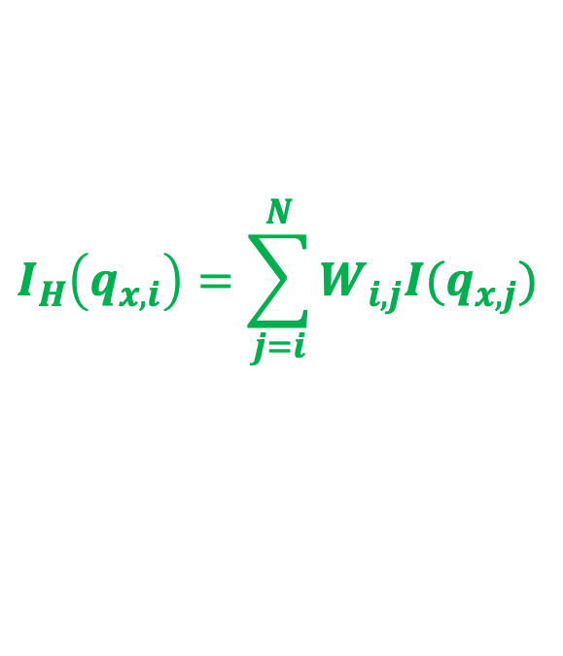
Weighting Array Approximation: W(i,j), 1 ≤ i or j ≤ N
Evaluate slit height integral only at experimental q_{x,i}
Use linear interpolation between q_{x,i}
To cover q-range beyond last data point: q > q_{i,N}
a) Use power law approximation: I(q) = aq^{-m}
b) Leave as numerical integral
$$I_{H}\left(q_{x,i}\right)=\sum_{j=i}^{N}{W_{i,j}I(q_{x,j})}$$
x x x x x x x x x x x x x
0 x x x x x x x x x x x x
0 0 x x x x x x x x x x x
0 0 0 x x x x x x x x x x
0 0 0 0 x x x x x x x x x
0 0 0 0 0 x x x x x x x x
0 0 0 0 0 0 x x x x x x x
0 0 0 0 0 0 0 x x x x x x
0 0 0 0 0 0 0 0 x x x x x
0 0 0 0 0 0 0 0 0 x x x x
0 0 0 0 0 0 0 0 0 0 x x x
0 0 0 0 0 0 0 0 0 0 0 x x
0 0 0 0 0 0 0 0 0 0 0 0 x

Slide 13
Conclusions:
Narrow rectangular slit data smeared in three steps:
i) wavelength ii) height and iii) width
2) Meta Data Needed for Smearing Calculations:
i) Slit, detector and path length dimensions
ii) P_{ƛ}(ƛ) Table for wavelength distribution
iii) P_{H}(q_{y}) Table for height function
iv) P_{W}(q_{x}) Table for width function

