Slide 1
Introduction to ESS
Dr. Sara ghatnekar Nilsson, work package manager, monolith systems, target division

Slide 2
Agenda
1 ESS Basics
2 Deliverables and Charge for the Committee

Slide 3
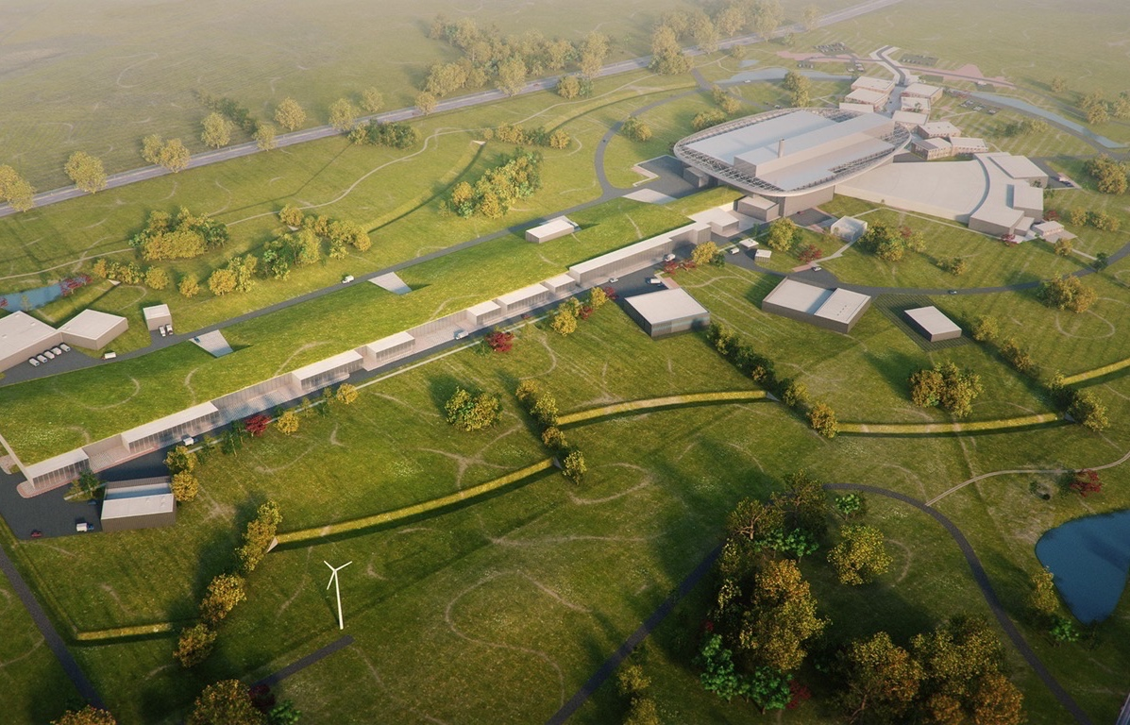
ESS Basics
High Power Accelerator:
Energy: 2 GeV
Rep. Rate: 14 Hz
Current: 62.5 mA
Pulse length: 2.86 ms
Target Station:
He-gas cooled rotating W-target
Average power: 5 MW
Pulse power: 125 MW
Neutron beam ports: 42
16 Instruments in Construction budget
Committed to deliver 22 instruments by 2028
Proton Source
Environmental goal (“Sustainability”)
Energy responsible
Renewable energy
Recyclable heat

Slide 4
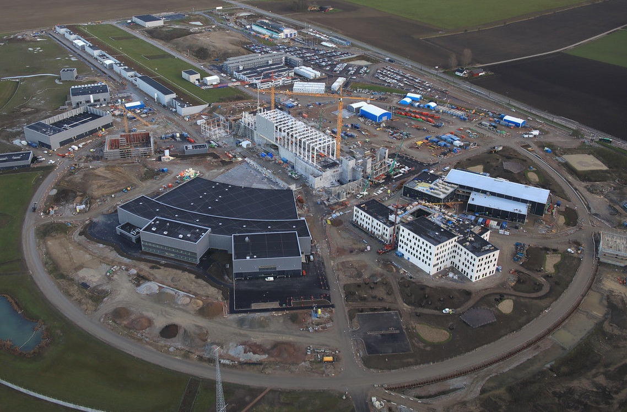
ESS Basics
Photo 2020
Photo 2021
Accelerator tunnel
Target area
Instrument hall
West sector

Slide 5
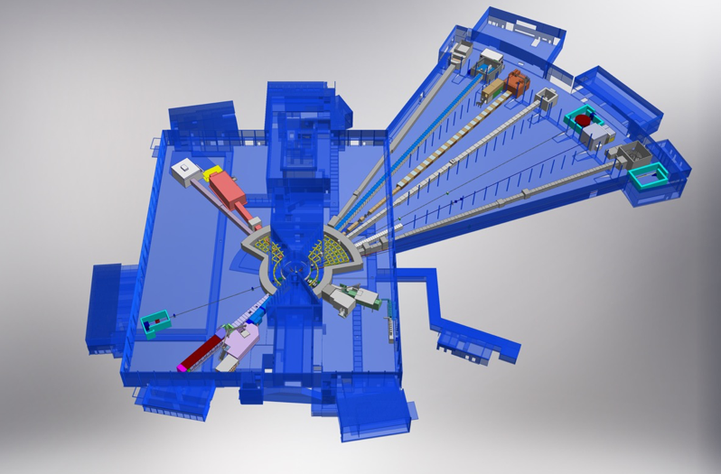

ESS Basics, Target and Instruments
Monolith
BEER
NMX
Instrument hall
West sector
C-SPEC
BIFROST
MIRACLES
MAGIC
ODIN
Neutron beam guides
T-REX
DREAM
HEIMDAL
LoKI
VESPA
FREIA
Instrument hall
North sector
SKADI
ESTIA
Accelerator tunnel
ESS Instrument Layout

Slide 6
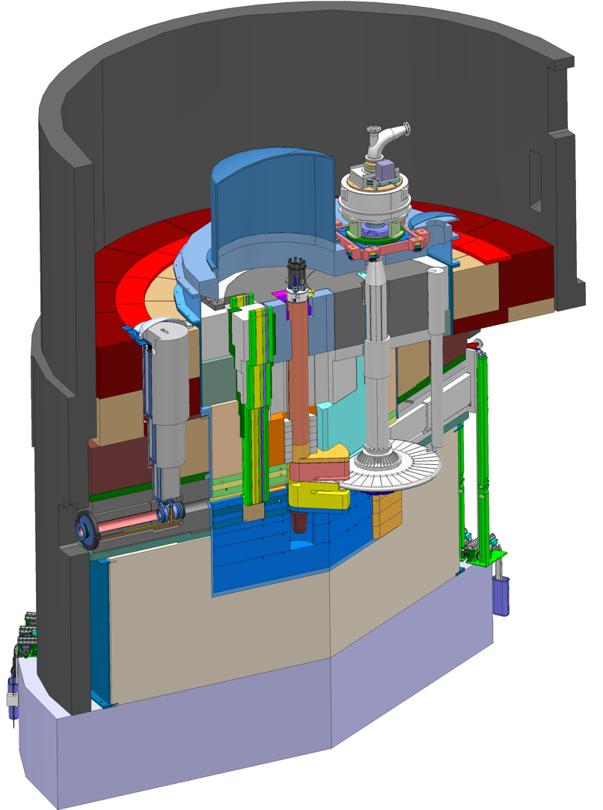
ESS Basics, Monolith Vessel and Port Tubes
Monolith Vessel
Moderator and Reflector
Proton Beam Instrumentation Plug
Monolith Vessel
Neutron beams to sample stations.
PBW Vessel
Neutron Beam Port Tube
Proton
beam
Target Wheel
Target Monitoring Plug
Proton
Beam Window
ESS-Beam Instrumentation
Proton beam
nn-bar
Port tubes

Slide 7

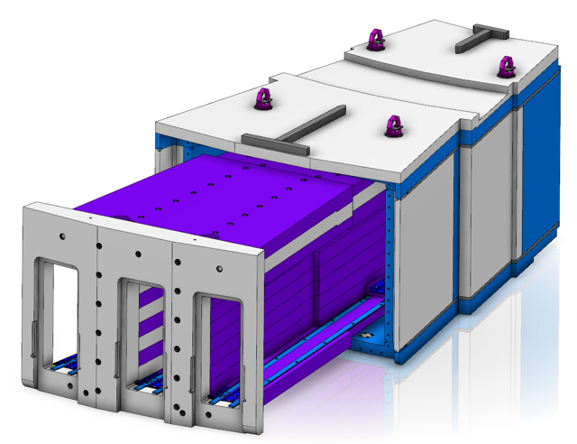
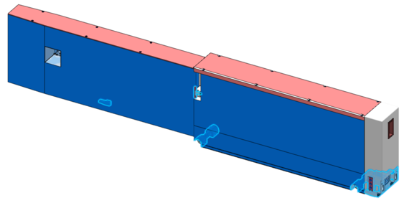
Function of Neutron Beam Port Tubes and nn-bar
Neutron beams to sample stations.
nn-bar frame
Proton
beam
Plug
nn-bar adapter holding 3 tubes
Plug
Neutron beam port tube
Test Beam Line (camera obscura) in the middle.
Neutron beam insert carrying the optics
Neutron beam

Slide 8

ESS Basics, Monolith Vessel and Port Tubes
Manufacturer Vessel: AVS and Cadinox
In-Kind from ESS-Bilbao
Method: Submerged arc-weld and TIG weld towards vacuum side
Facts: Diameter≈6m, H:6m, W:40 tons
Manufacturer tubes and nn-bar: Ensa and Asturfeito
ESS-managed contract
Method: Laser weld
Facts tubes at Vessel side:
L:2.7m, H:0.7m, Width:0.2m
W:1.2 tons
Facts nn-bar:
L: 2.7m, H:0.9m, Width:1m
W:11 tons (frame) + 18 tons (adapter)

Slide 9
2
Deliverables and charge for the committee

Slide 10
Deliverables for this CDR
Regarding ESS ERIC Requirements
1) Interface and functional requirements described in the relevant interface control documents
and the system requirement documents (including the tolerance budget), and the related functional drawings;
2) Requirements coming from the Applicable Law, including but not limited to: European Directives, relevant standards, and Notified Body.
3) Reminder on the choice of the welded solution against other design variants for the connection between port tubes and monolith vessel.
Regarding ESS Bilbao Activities
4) Global procedure and installation scheme, including port tube installation sequence and alignment strategy, and fastening method
5) Project schedule
6) Update of the Safety Analysis Report
7) Results and analysis from the welding on the two prototypes at ENSA
8) Preparation: bevel preparation, WPS (Welding procedure specification), PQR (Procedure Qualification Records), production coupons, protection gas
9) Execution: welding process order and realisation scheme
10) Verification and validation plan, including inspection plan
11) Estimation of the deformations produced during the welding process, and of the compliance with tolerance budget
12) Detailed Risk Analysis

Slide 11
Committee Charge
Global project questions
1) Is the plan complete, consistent, and in line with the scope of the TIK 4.5 rev.2?
2) Have risks been properly identified, analysed, and appropriately addressed?
3) Are the mitigations well defined in case of major Non-Conformity?
4) Are the quality assurance and quality control activities properly planned?
5) Does the design satisfy all functional, performance and safety requirements?
Specific technical questions
1) Is the welding process specification sufficiently defined and documented in order to
provide a sufficient technical basis to start the preparation of the on-site welding?
2) Are the estimations on welds deformation and vessel shrinkage realistic?
3) Is the way to proceed in order to minimize deformations satisfactory?
4) Are the residual stresses in the welds a concern, is the configuration too constrained?
5) Are the defined non-destructive inspections considered enough to ensure the quality of
the welding?

Slide 12
Finish presentation

